Slide 1



PSI SMACC1 quench protection
Emmanuele Ravaioli (CERN)
D. Araujo (PSI), B. Auchmann (PSI), A. Verweij (CERN), M. Wozniak (CERN)
PSI SMACC1 Design Review
2025.01.13

Slide 2
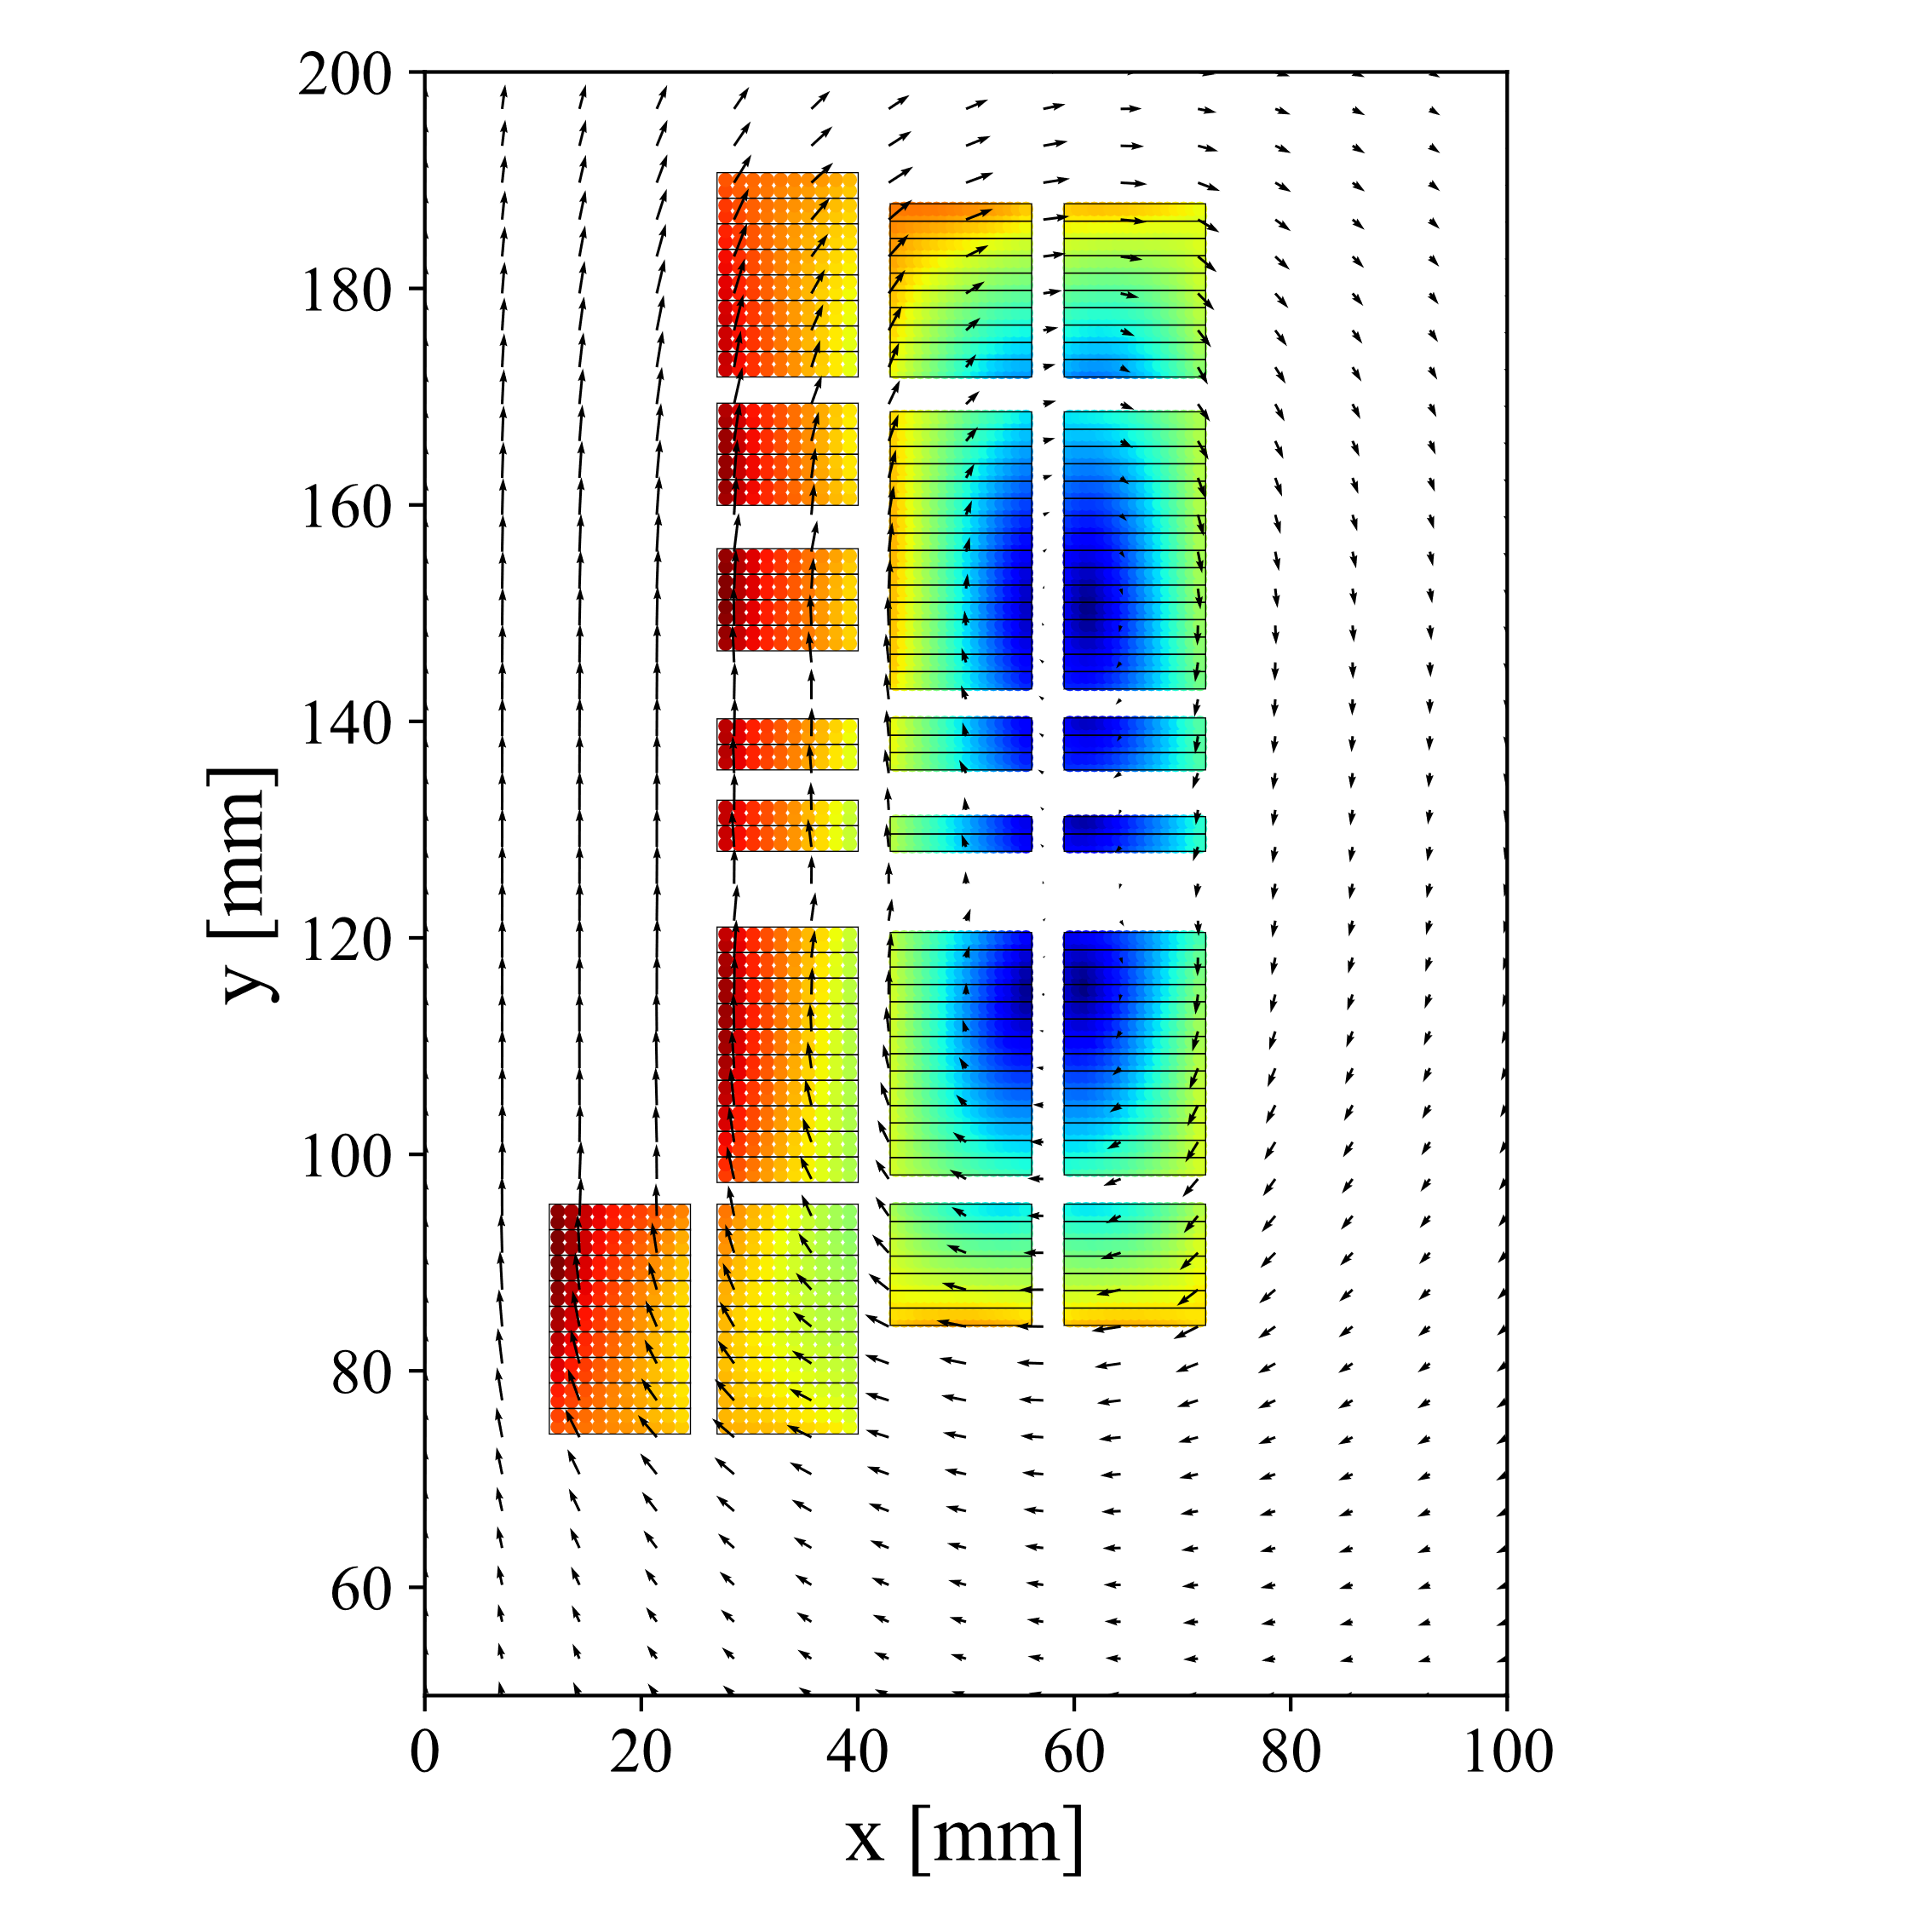
SMACC magnet by Douglas Araujo at PSI
First demonstrator will be built at PSI
12 T bore field with >20% margin at T=1.9 K
Circular bore with 50 mm diameter
250 mm intra-beam distance
Utilizing two already-existing Nb₃Sn cables
I_{nom}= 12.9 kA → 12.0 T
14.1 kA → 13.0 T
15.3 kA → 14.0 T
I_{SS}= 16.8 kA → 15.2 T
No flexibility in the choice of conductor grading
Quench protection is much more challenging
(one conductor heats up twice more quickly!)

Slide 3
Quench protection targets and constraints
Hot-spot temperature T_{hot}<350 K
Peak voltage to ground U_{g}<1 kV
If CLIQ is used,
CLIQ unit current I_{C}<5 kA

Slide 4
Analyzed quench protection options
ACTIVELY
EXTRACT ENERGY
Energy extraction system
ACTIVELY
SPREAD ENERGY
Active heating system
Energy extraction with constant resistor
Energy extraction with varistor
CLIQ
(Coupling-Loss Induced Quench system)
Energy Extraction + CLIQ

Slide 5
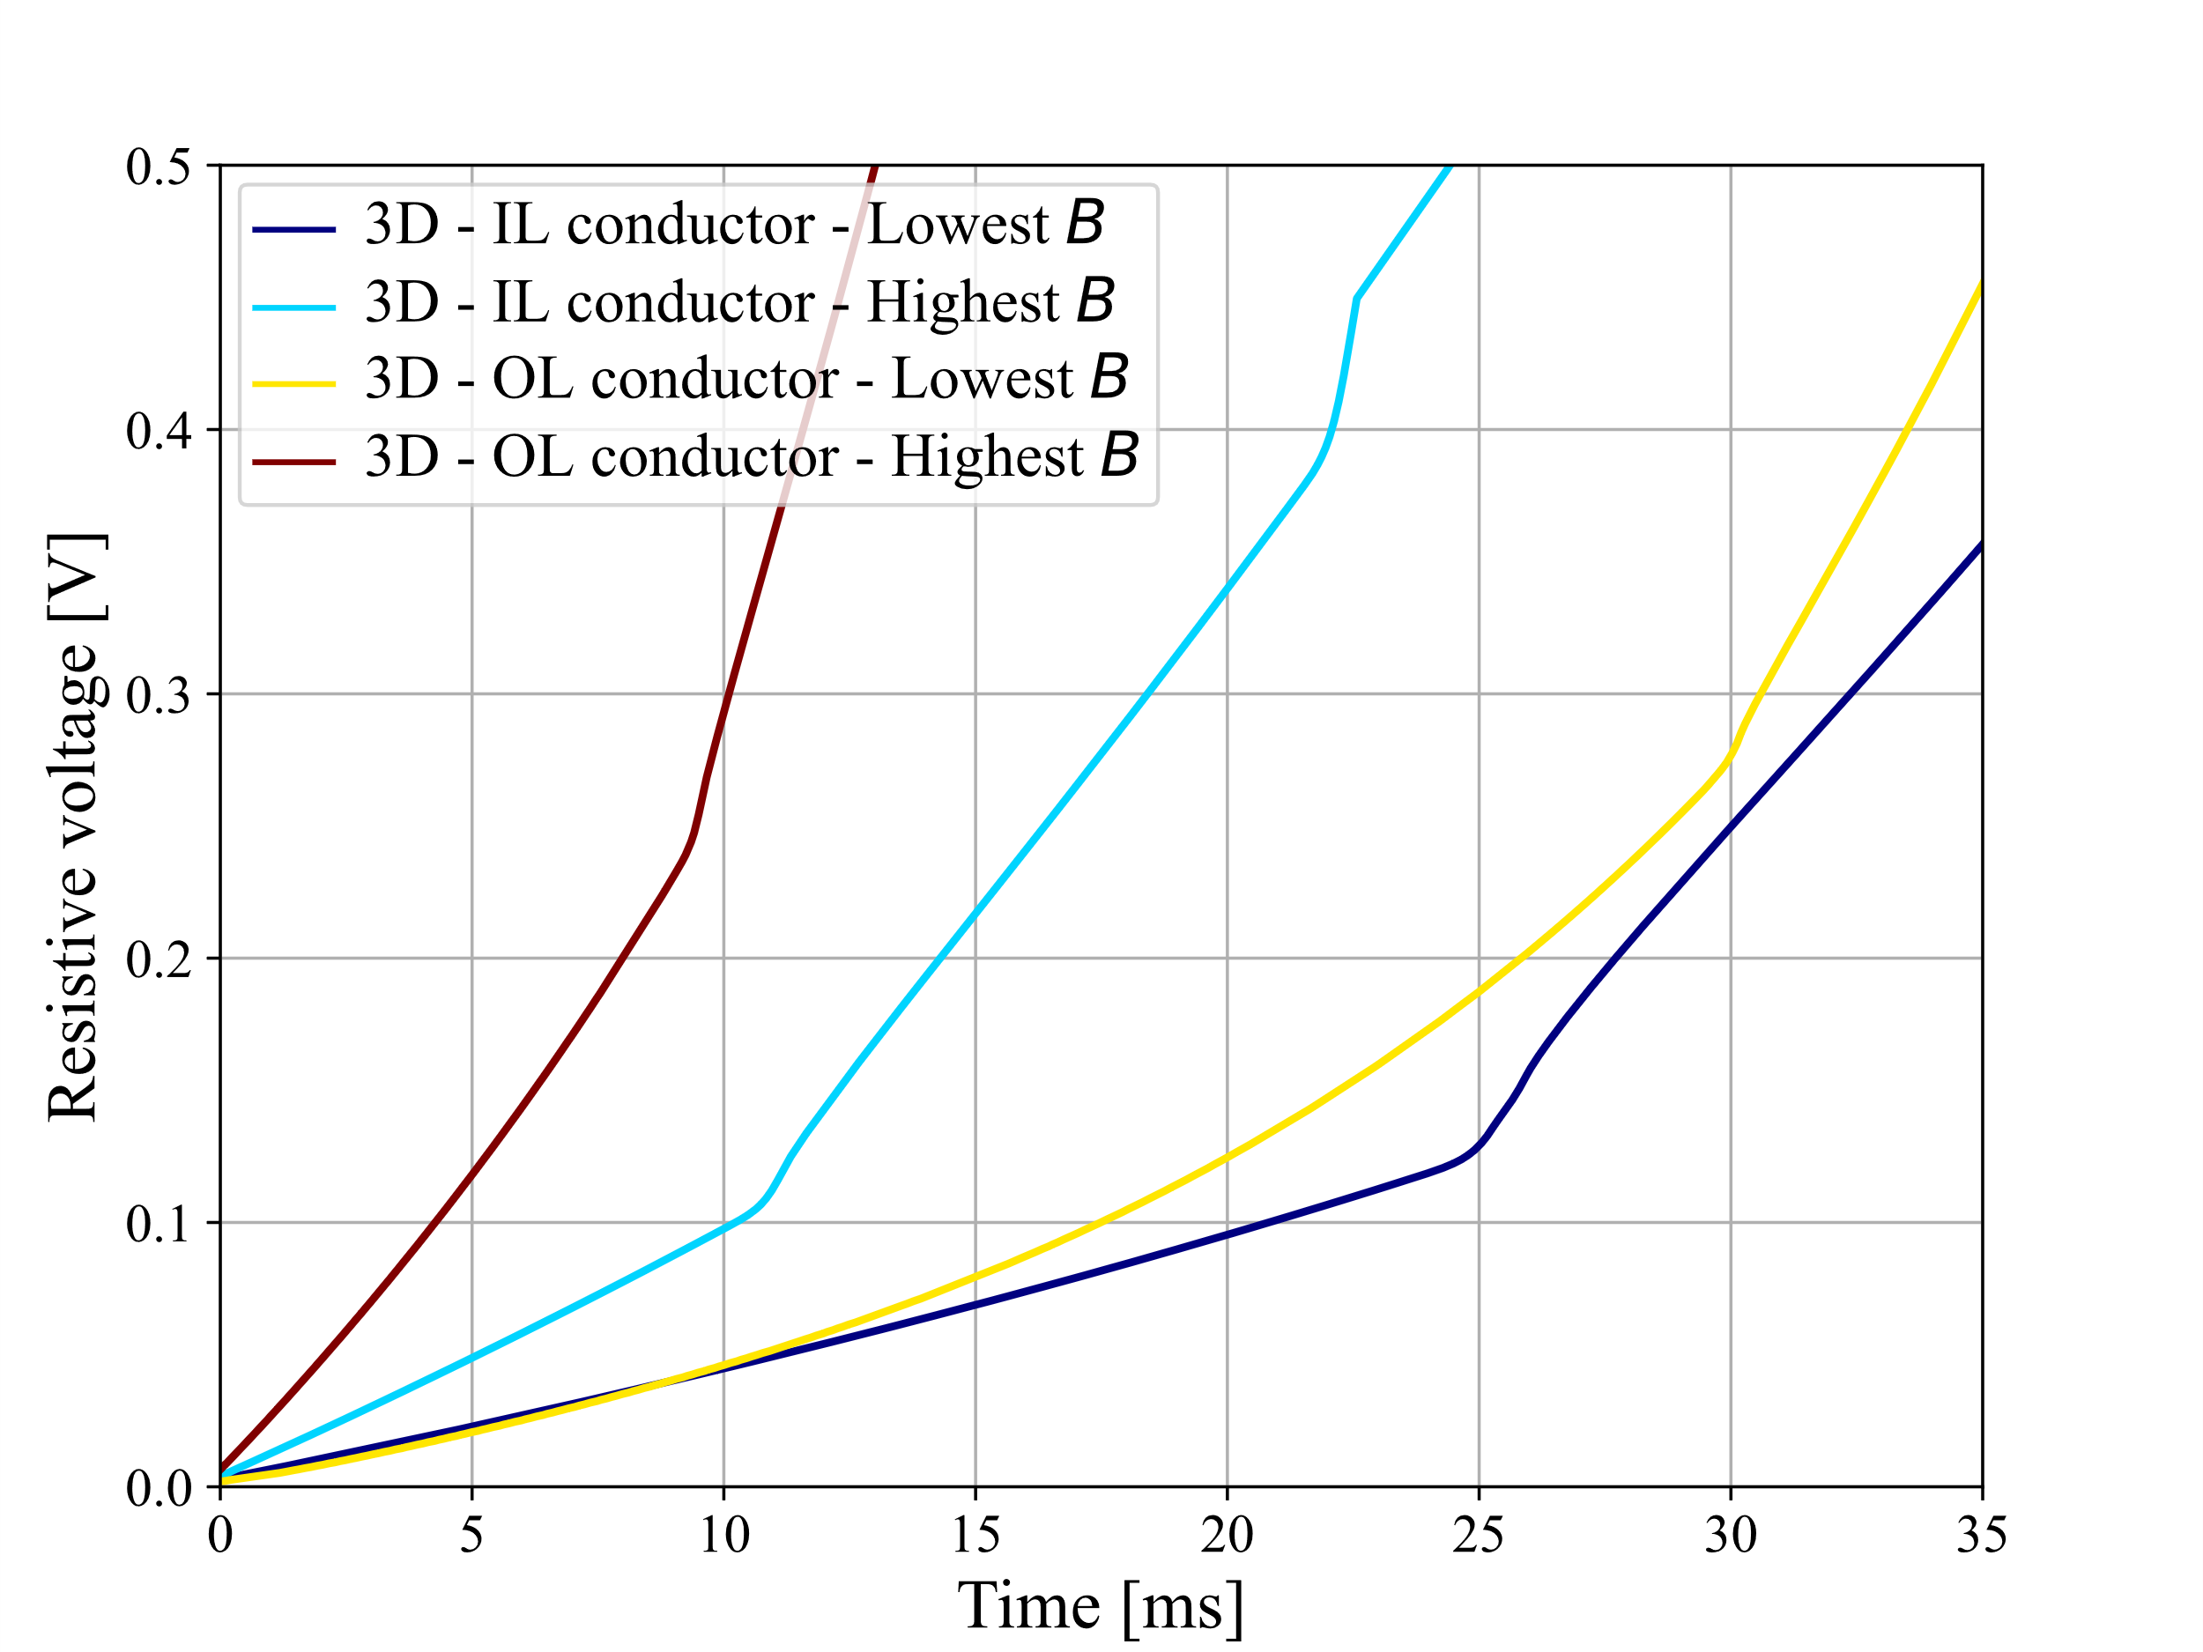


Quench detection based on differential voltage monitoring
Resistive voltage build-up simulated
for different quench locations
Detection threshold of 100 mV is reached in 4.3 ms after quench in a high-field turn
(that is the worst case for protection here)
4.3 ms
LEDET

Slide 6
Total reaction time t_{R}
Quench detection time
Validation time
Triggering time
Total reaction time
t_{R}
+
+
=
4.3 ms
for a quench in the worst-case turn
5 ms
assumption based on experience with similar magnets
3.2 ms
for energy extraction mechanical switch
12.5 ms
for energy extraction
≈
0.2 ms
for CLIQ unit
9.5 ms
for CLIQ
Of course these values are not general, but they are valid for the test facility where the tests will be performed

Slide 7
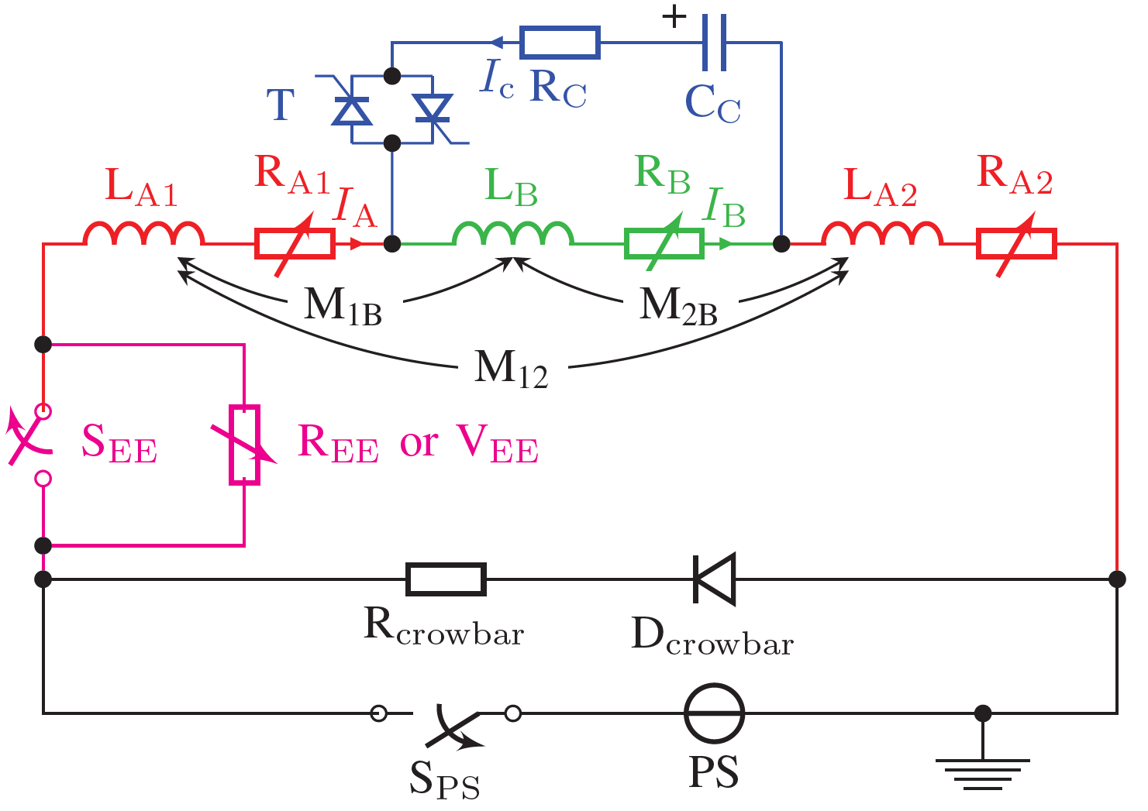
Quench protection options
CLIQ
(Coupling-Loss Induced Quench system)
EE
(Energy extraction)

Slide 8
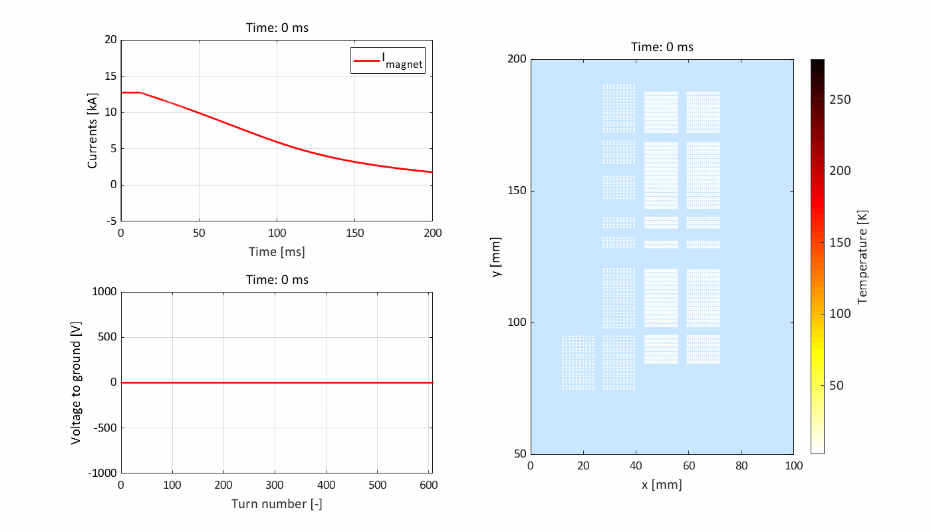
Quench protection with 1 kV energy extraction with constant resistor
hot-spot (highest field location in the outer layers)
The presence of quench-back influences significantly the transient
Reduction of differential inductance
Quench-back (coil resistance increase due to transient losses)
LEDET

Slide 9
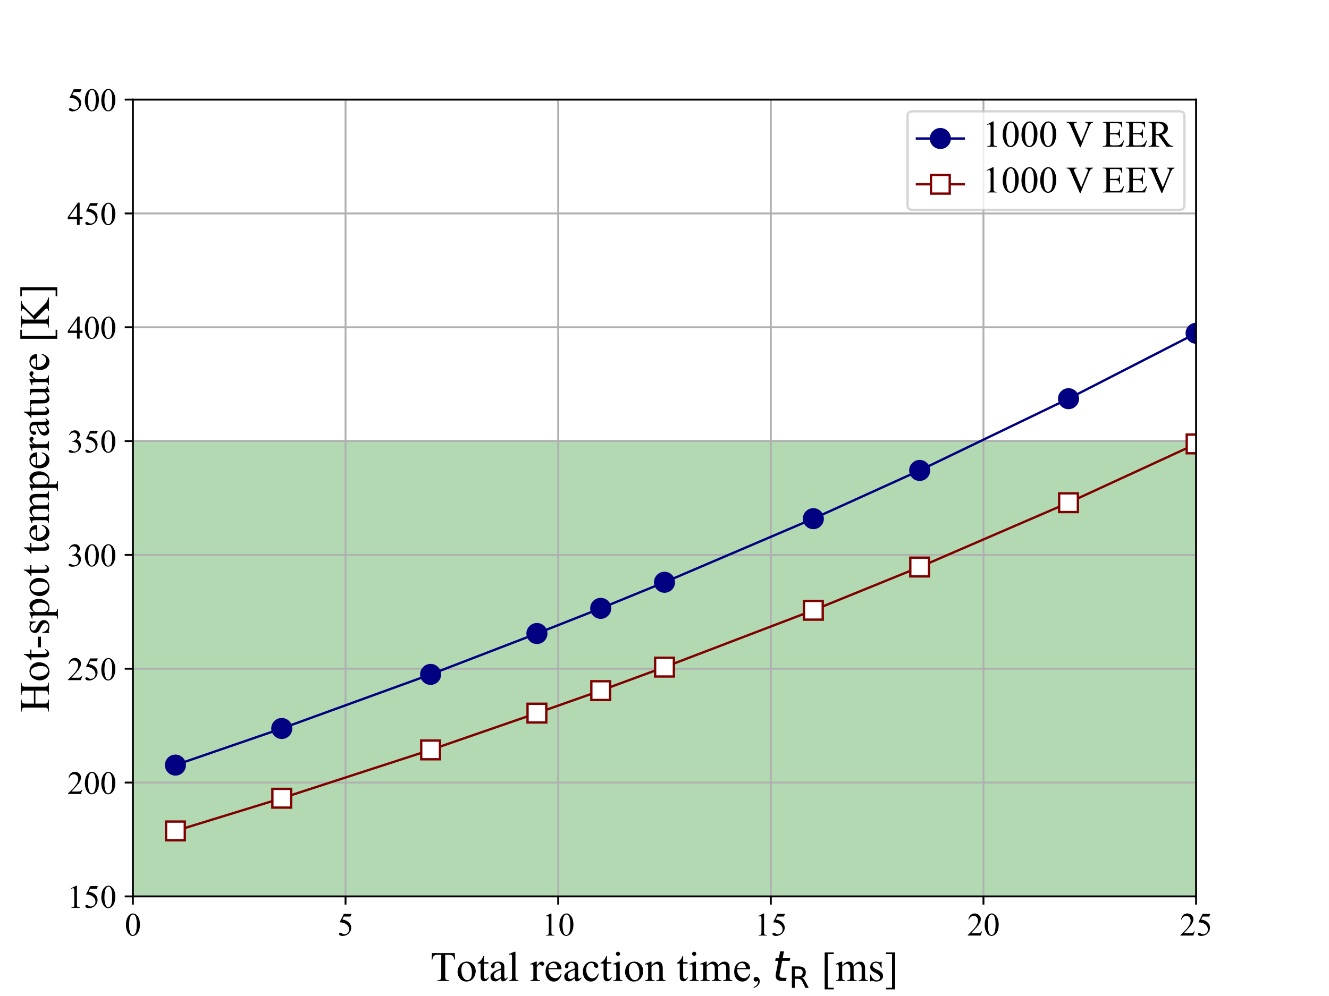
Hot-spot temperature as a function of total reaction time
Varistor (EEV) improves quench protection (30-50 K temperature reduction)
Quench protection possible (T_{hot}<350 K)
if t_{R}<20 ms (for EER) or t_{R}<25 ms (for EEV)
Estimated total reaction time t_{R}=12.5 ms, which leaves a good margin at I_{nom}
LEDET

Slide 10
Quench protection summary at I_{nom} – EER and EEV
Quench protection | T_hot [K] | Peak U_ground [V] | Peak I_CLIQ [kA]
1000 V EER | 288 | 1000 | 0.0
1000 V EEV | 257 | 966 | 0.0
LEDET

Slide 11
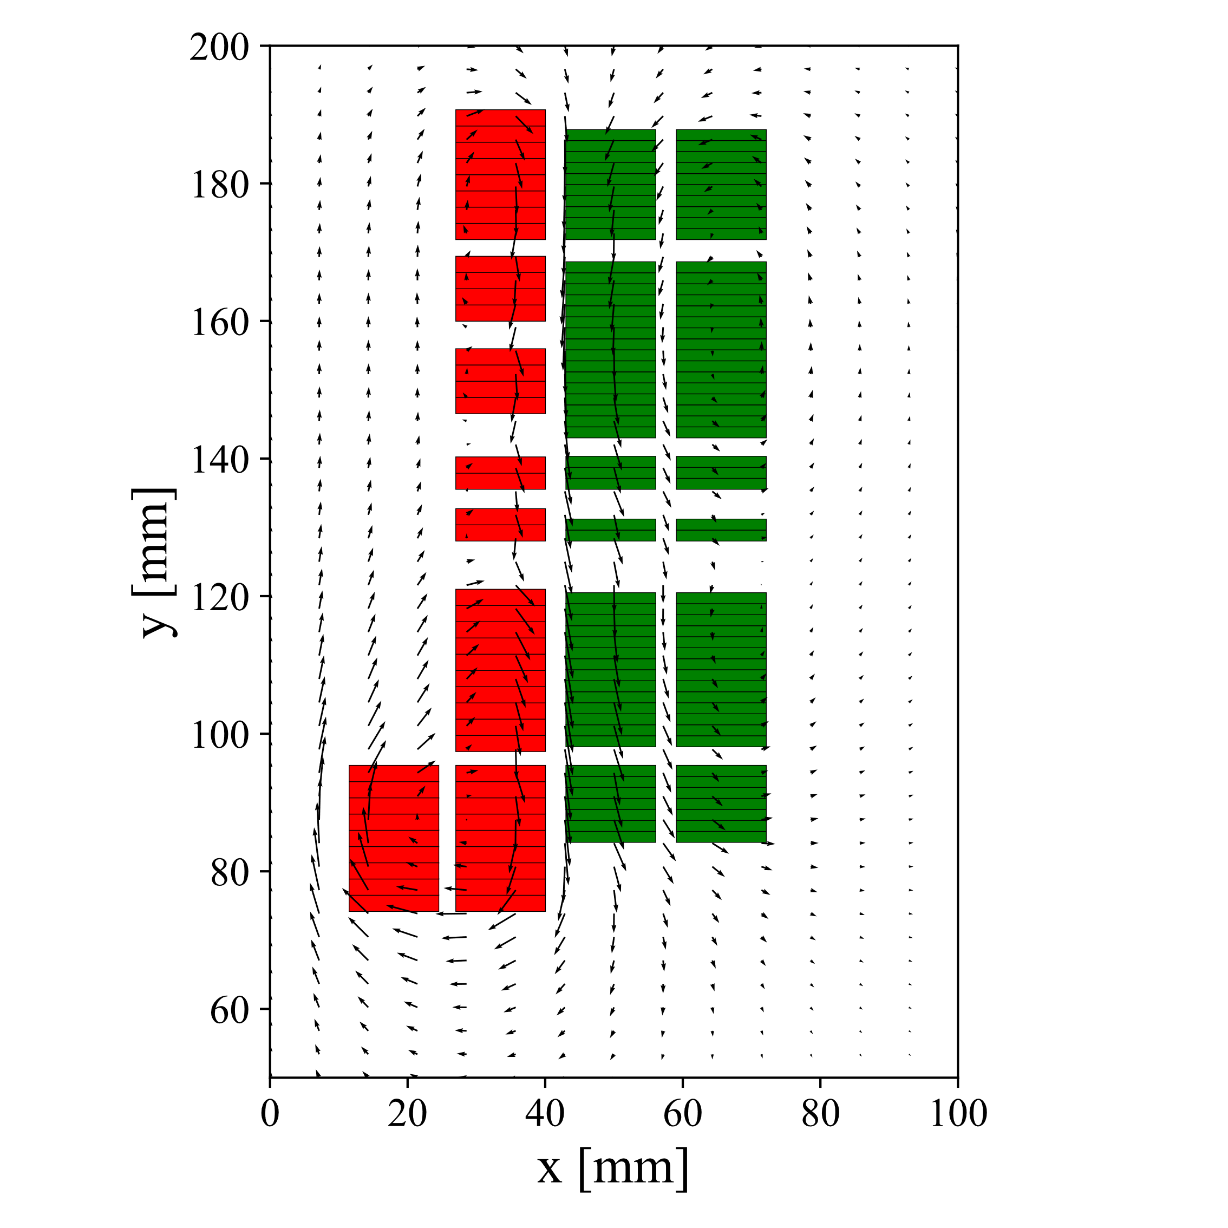
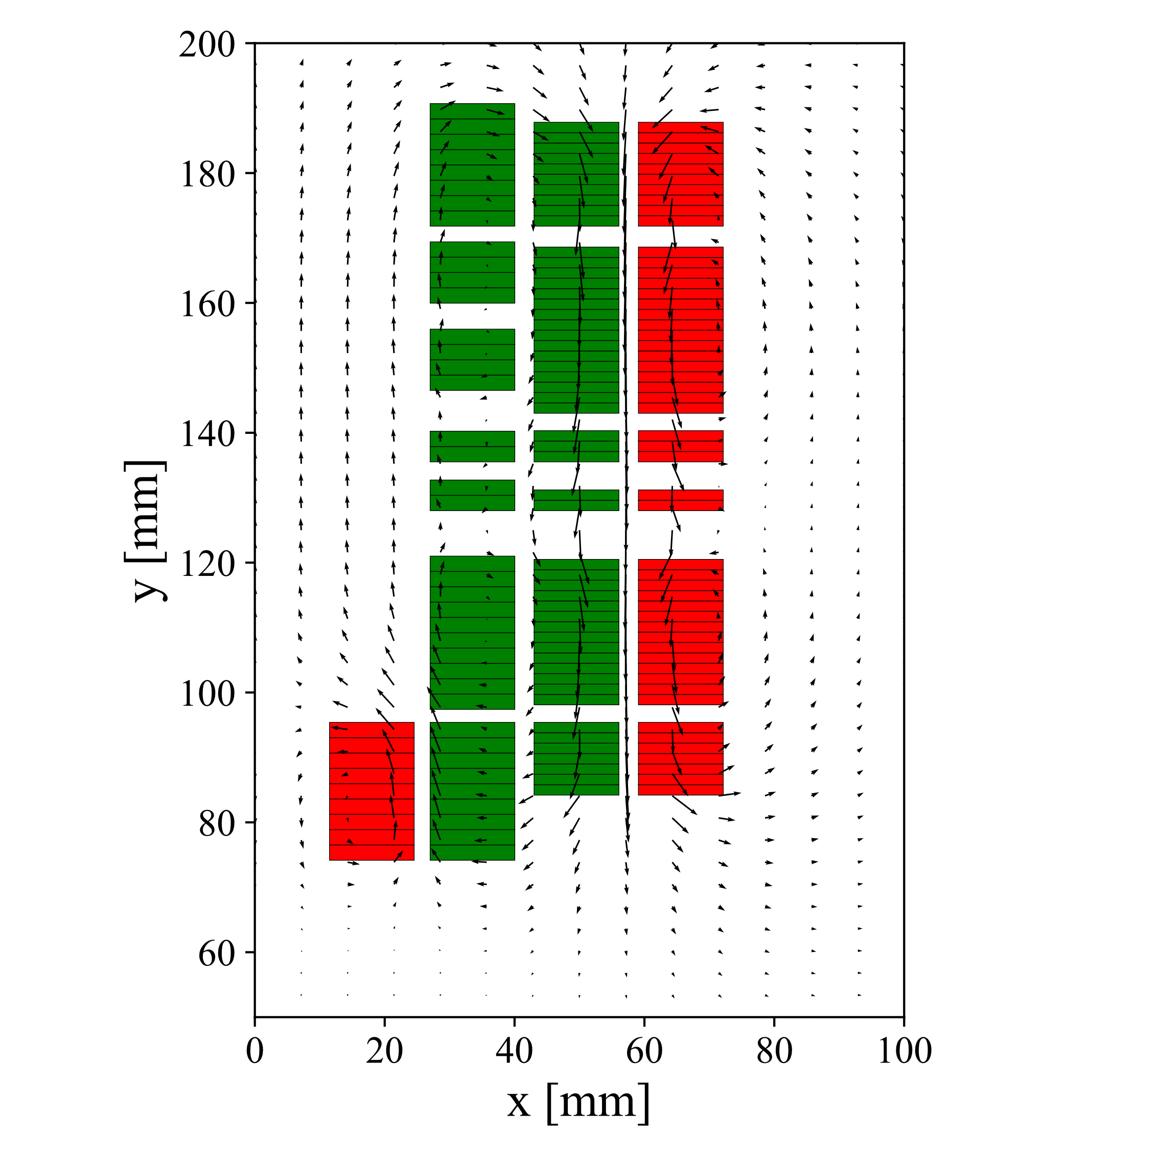
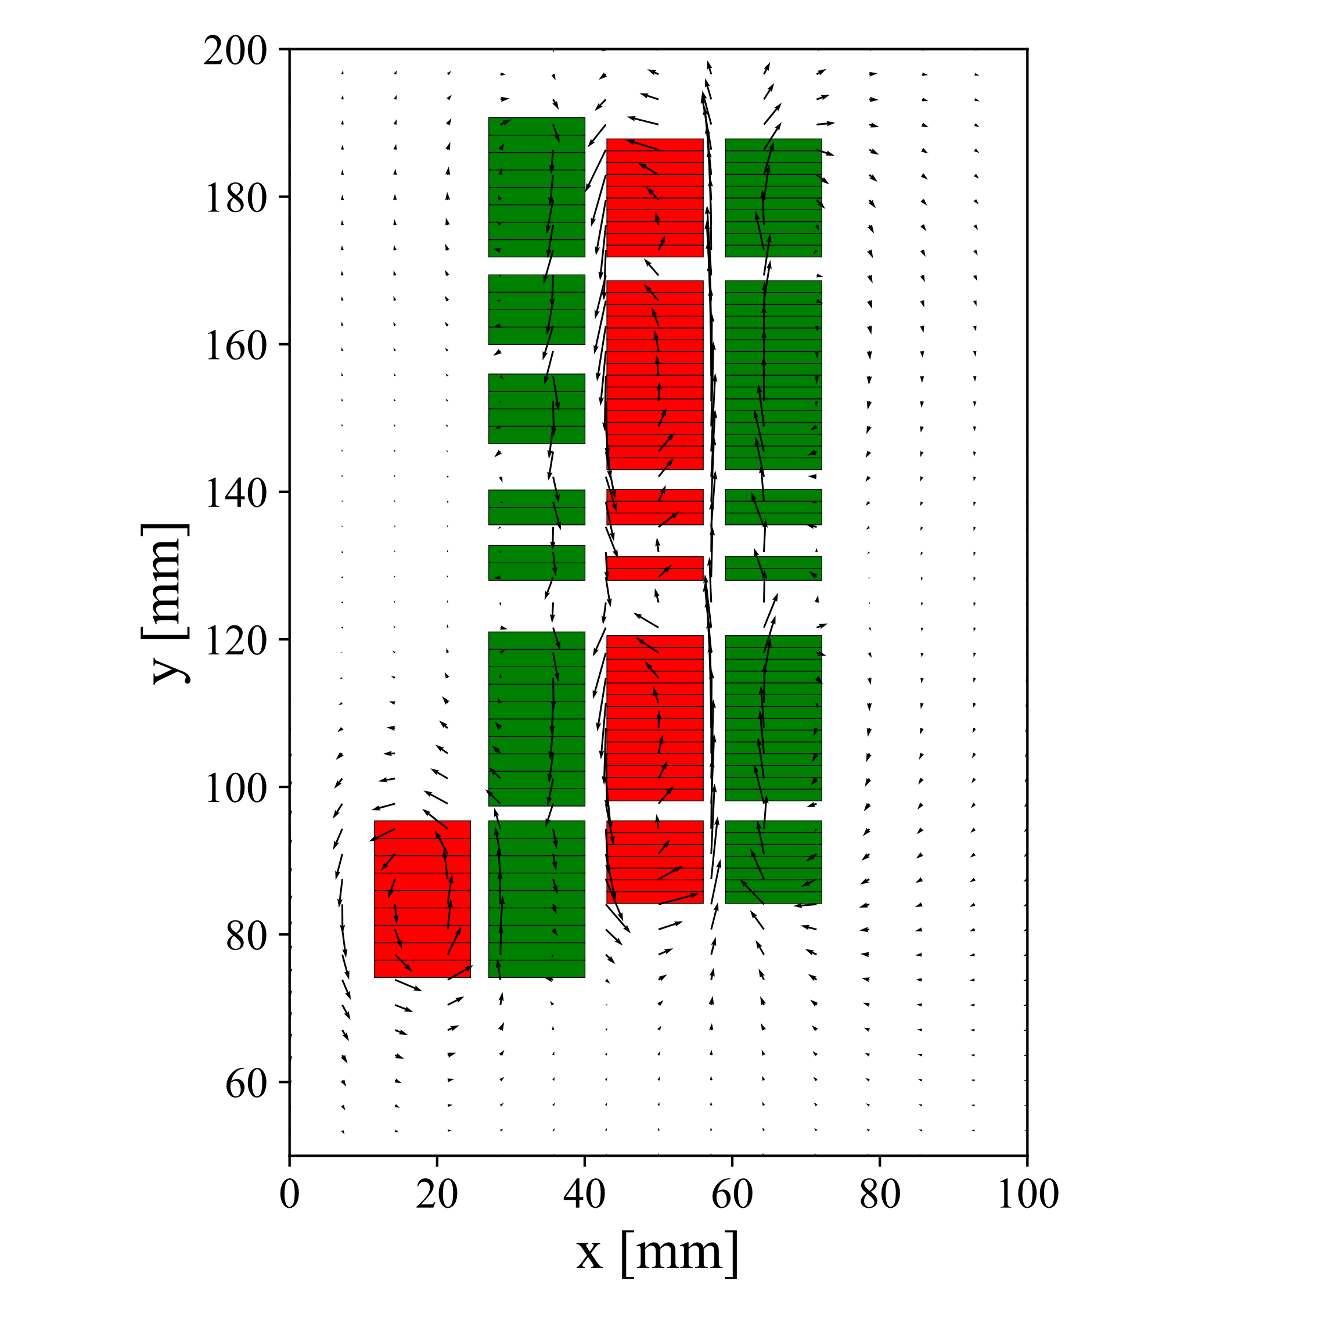
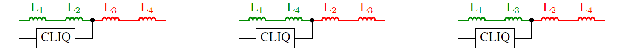
Electrical connections of CLIQ configurations
CLIQ-C1
CLIQ-C2
CLIQ-C3

Slide 12
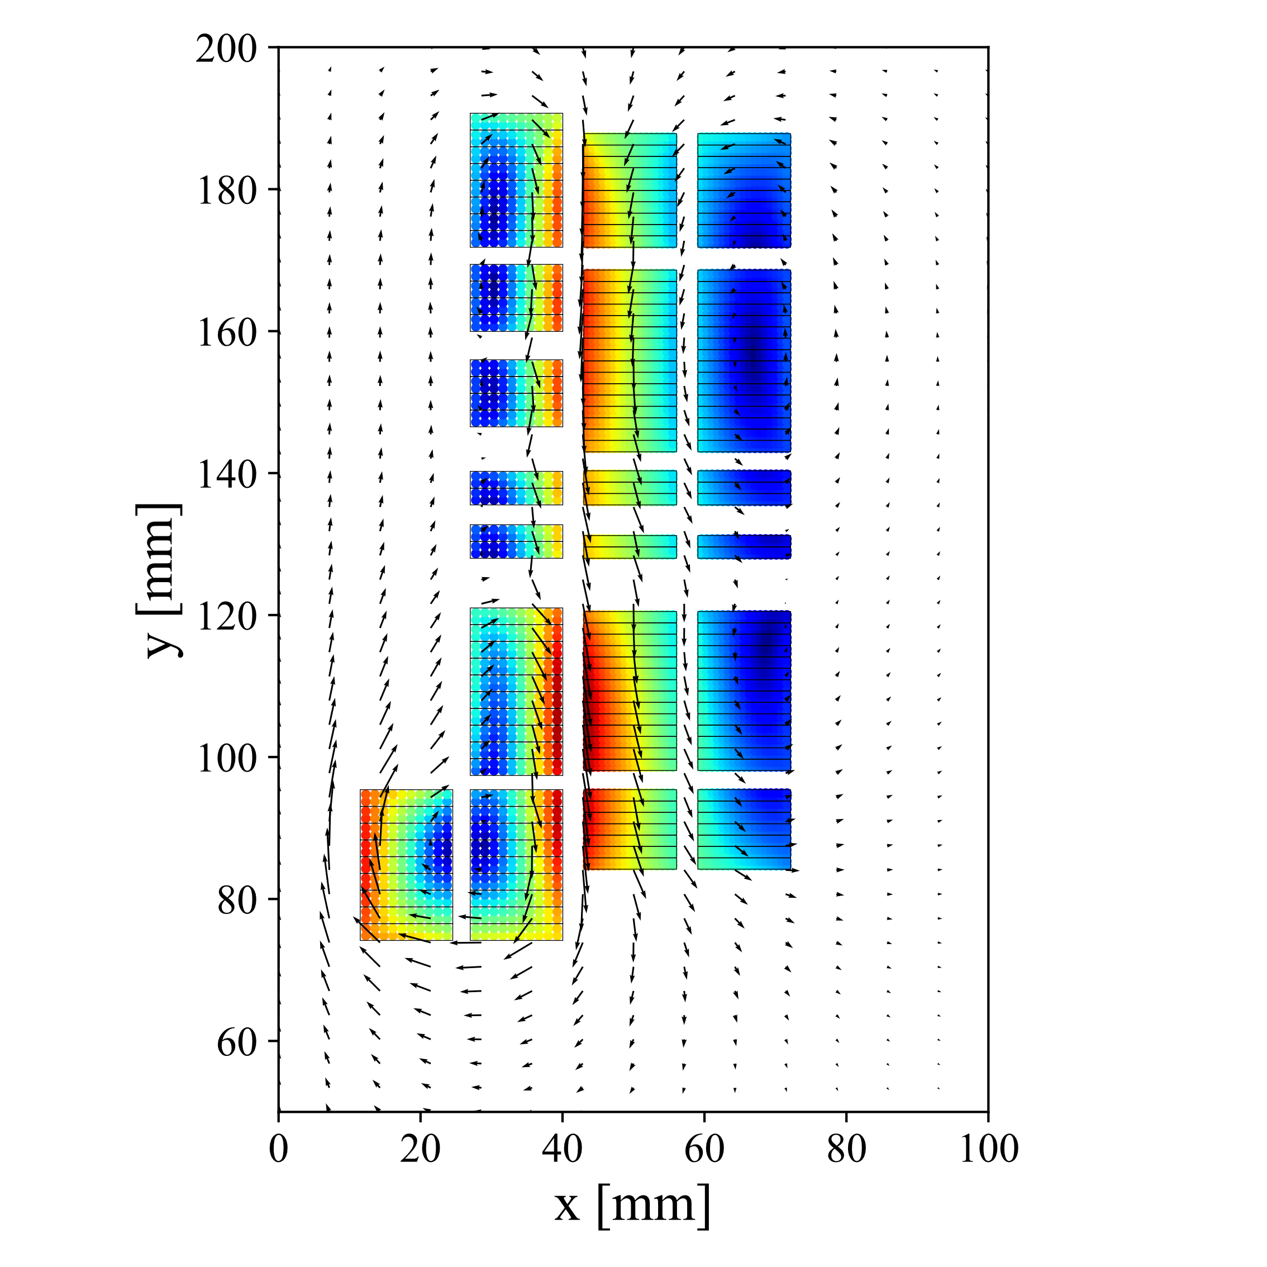
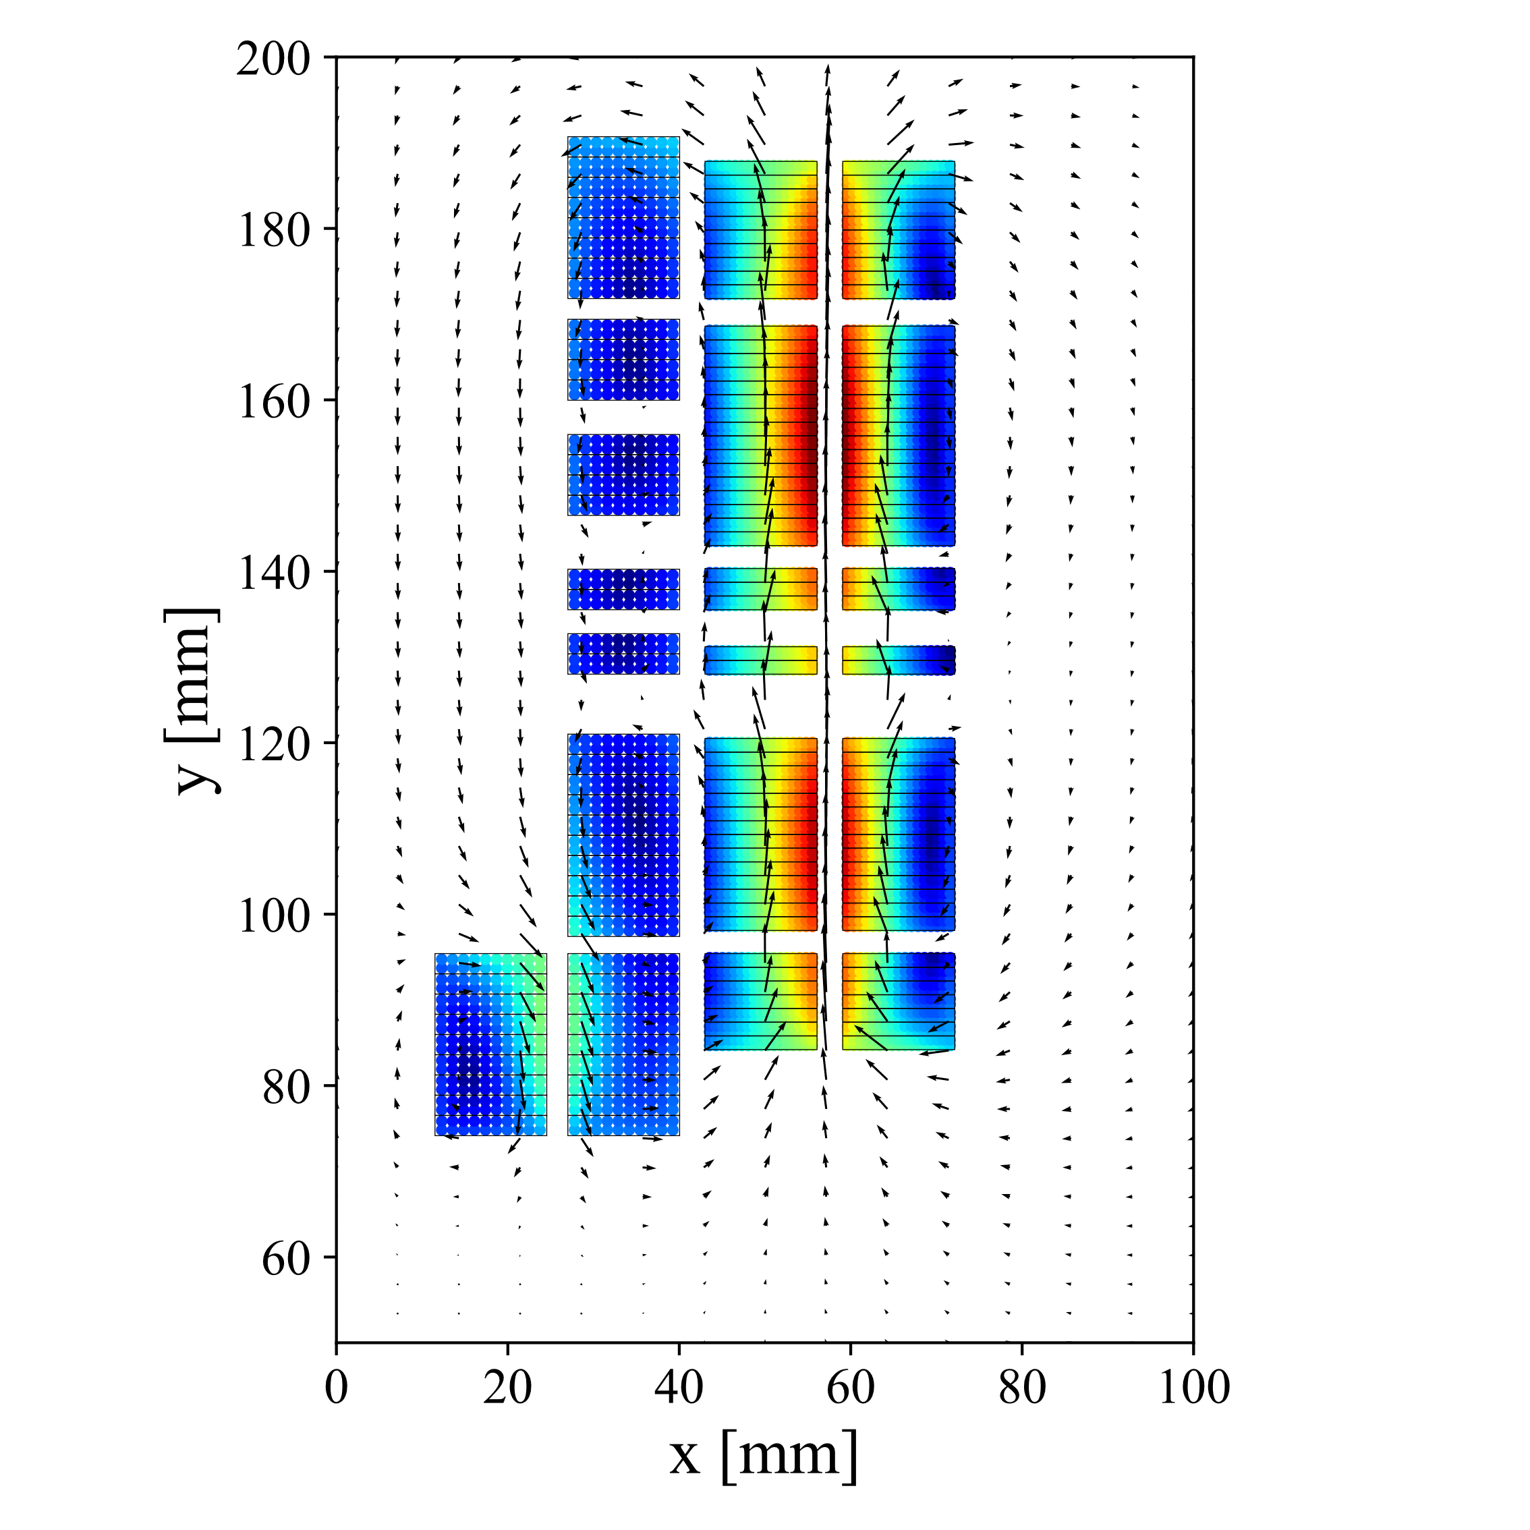
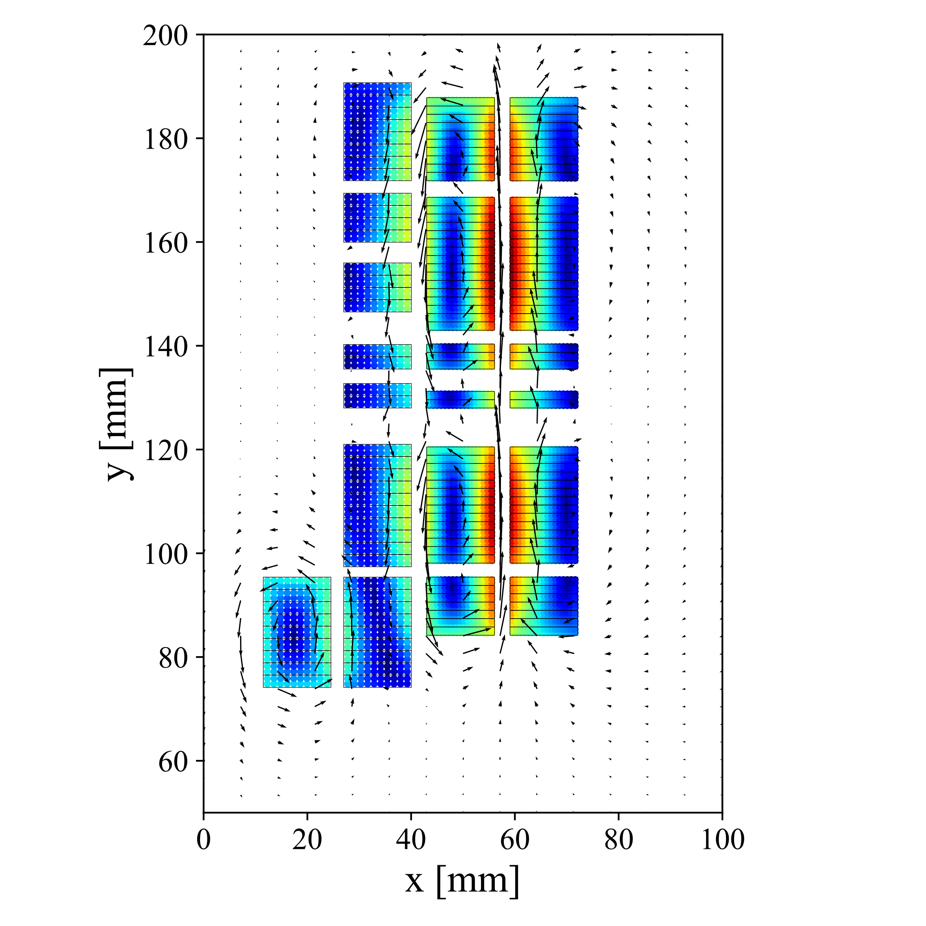
CLIQ optimization
CLIQ-C1
CLIQ-C2
CLIQ-C3
CLIQ PERFORMANCE CAN BE GREATLY ENHANCED BY SELECTING THE OPTIMUM CONFIGURATION

Slide 13
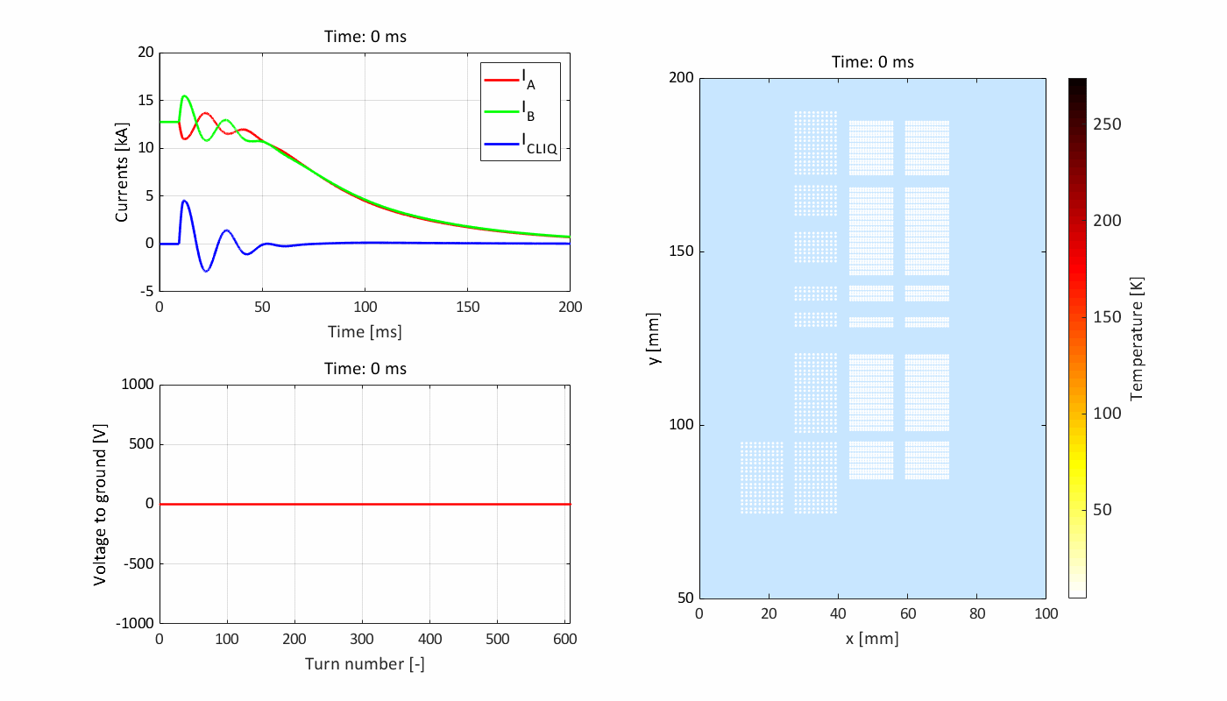
Quench protection with 50 mF, 300 V CLIQ-C3 system
hot-spot (highest field location in the outer layers)
Very fast quench
(most turns quenched in <5 ms)
Hot-spot temperature ~280 K
Peak voltage to ground ~150 V
LEDET

Slide 14
Quench protection summary at I_{nom} – CLIQ
Quench protection | T_hot [K] | Peak U_ground [V] | Peak I_CLIQ [kA]
1000 V EER | 288 | 1000 | 0.0
1000 V EEV | 257 | 966 | 0.0
500 V CLIQ C-1 | 293 | 250 | 4.7
400 V CLIQ C-2 | 277 | 195 | 4.4
300 V CLIQ C-3 | 279 | 151 | 4.5
LEDET

Slide 15
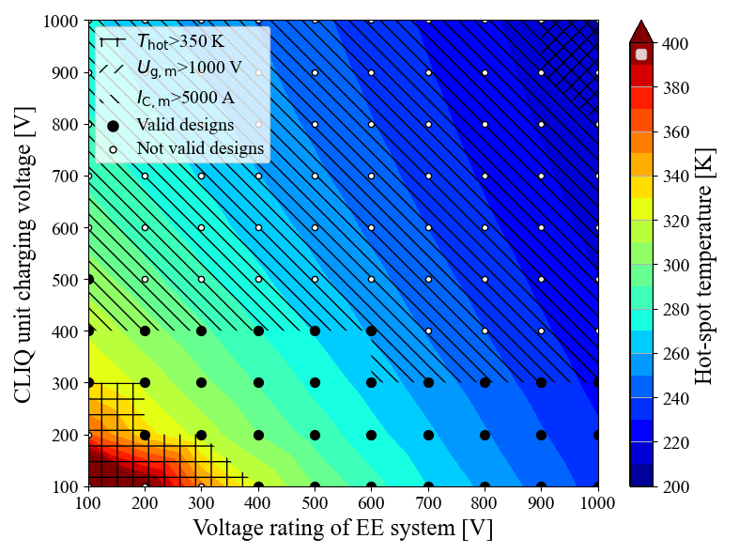
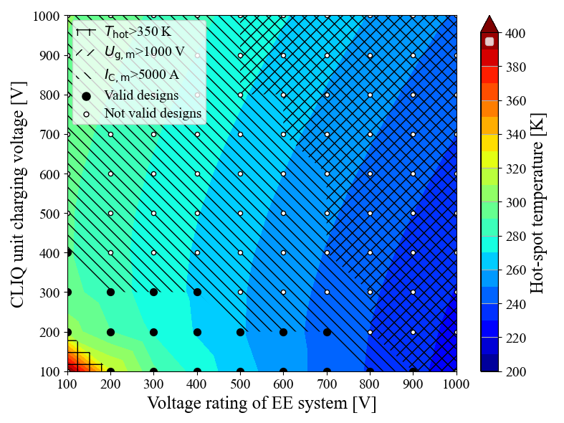
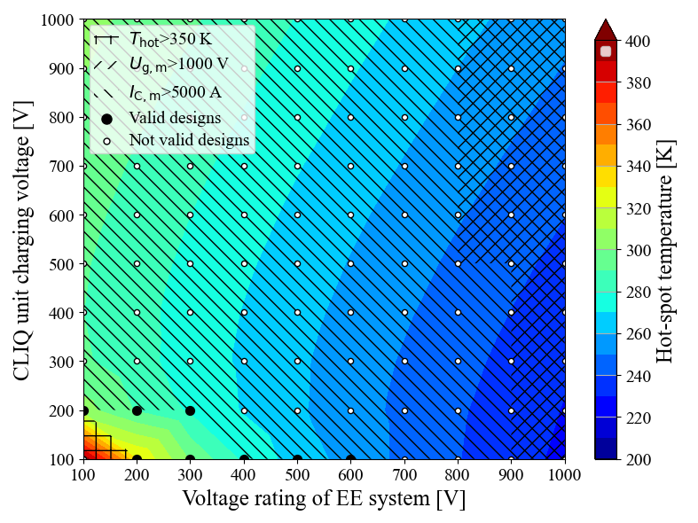
Energy extraction + CLIQ optimization
EE + CLIQ-C1
EE + CLIQ-C2
EE + CLIQ-C3
Parametric study to identify the combinations of CLIQ configuration, CLIQ charging voltage, and EE voltage rating that satisfy all requirements in terms of hot-spot temperature
(T_{hot}<350 K), peak voltage to ground (U_{g,m}<1000 V), and peak CLIQ current (I_{C,m}<5 kA)
Recommandation: CLIQ “Configuration 1”, 300 V CLIQ + 1 kV EE
Low hot-spot temperature. Redundancy. Wider, more flexible parameter space.
LEDET

Slide 16
Quench protection summary at I_{nom} – EER+CLIQ and EEV+CLIQ
Quench protection | T_hot [K] | Peak U_ground [V] | Peak I_CLIQ [kA]
1000 V EER | 288 | 1000 | 0.0
1000 V EEV | 257 | 966 | 0.0
500 V CLIQ C-1 | 293 | 250 | 4.7
400 V CLIQ C-2 | 277 | 195 | 4.4
300 V CLIQ C-3 | 279 | 151 | 4.5
1000 V EER + 300 V CLIQ C-1 | 227 | 1000 | 4.8
900 V EER + 100 V CLIQ C-2 | 232 | 958 | 4.6
600 V EER + 100 V CLIQ C-3 | 256 | 614 | 4.7
1000 V EEV + 200 V CLIQ C-1 | 206 | 1000 | 4.1
900 V EEV + 100 V CLIQ C-2 | 216 | 959 | 5.0
600 V EEV + 100 V CLIQ C-3 | 244 | 607 | 4.9
There is some flexibility since several options can protect the magnet
LEDET

Slide 17
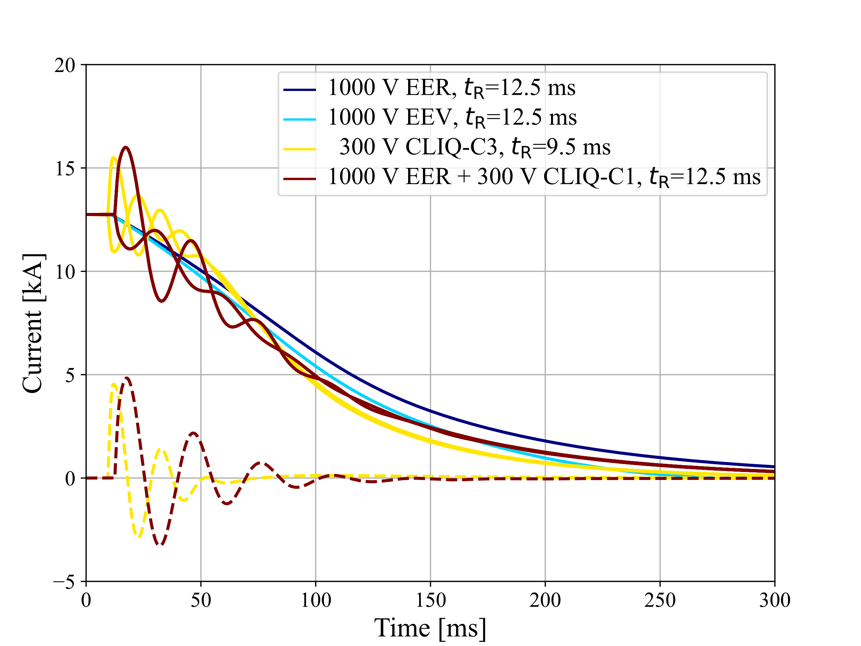
Currents versus time for the different quench protection options
All options can protect the magnet if the total reaction time is <24 ms
CLIQ charged to low-medium voltage achieves sufficiently low temperature
with 4-5 times lower voltage to ground
Energy extraction plus CLIQ achieves the lowest hot-spot temperature overall
There is some flexibility since several options can protect the magnet
LEDET

Slide 18
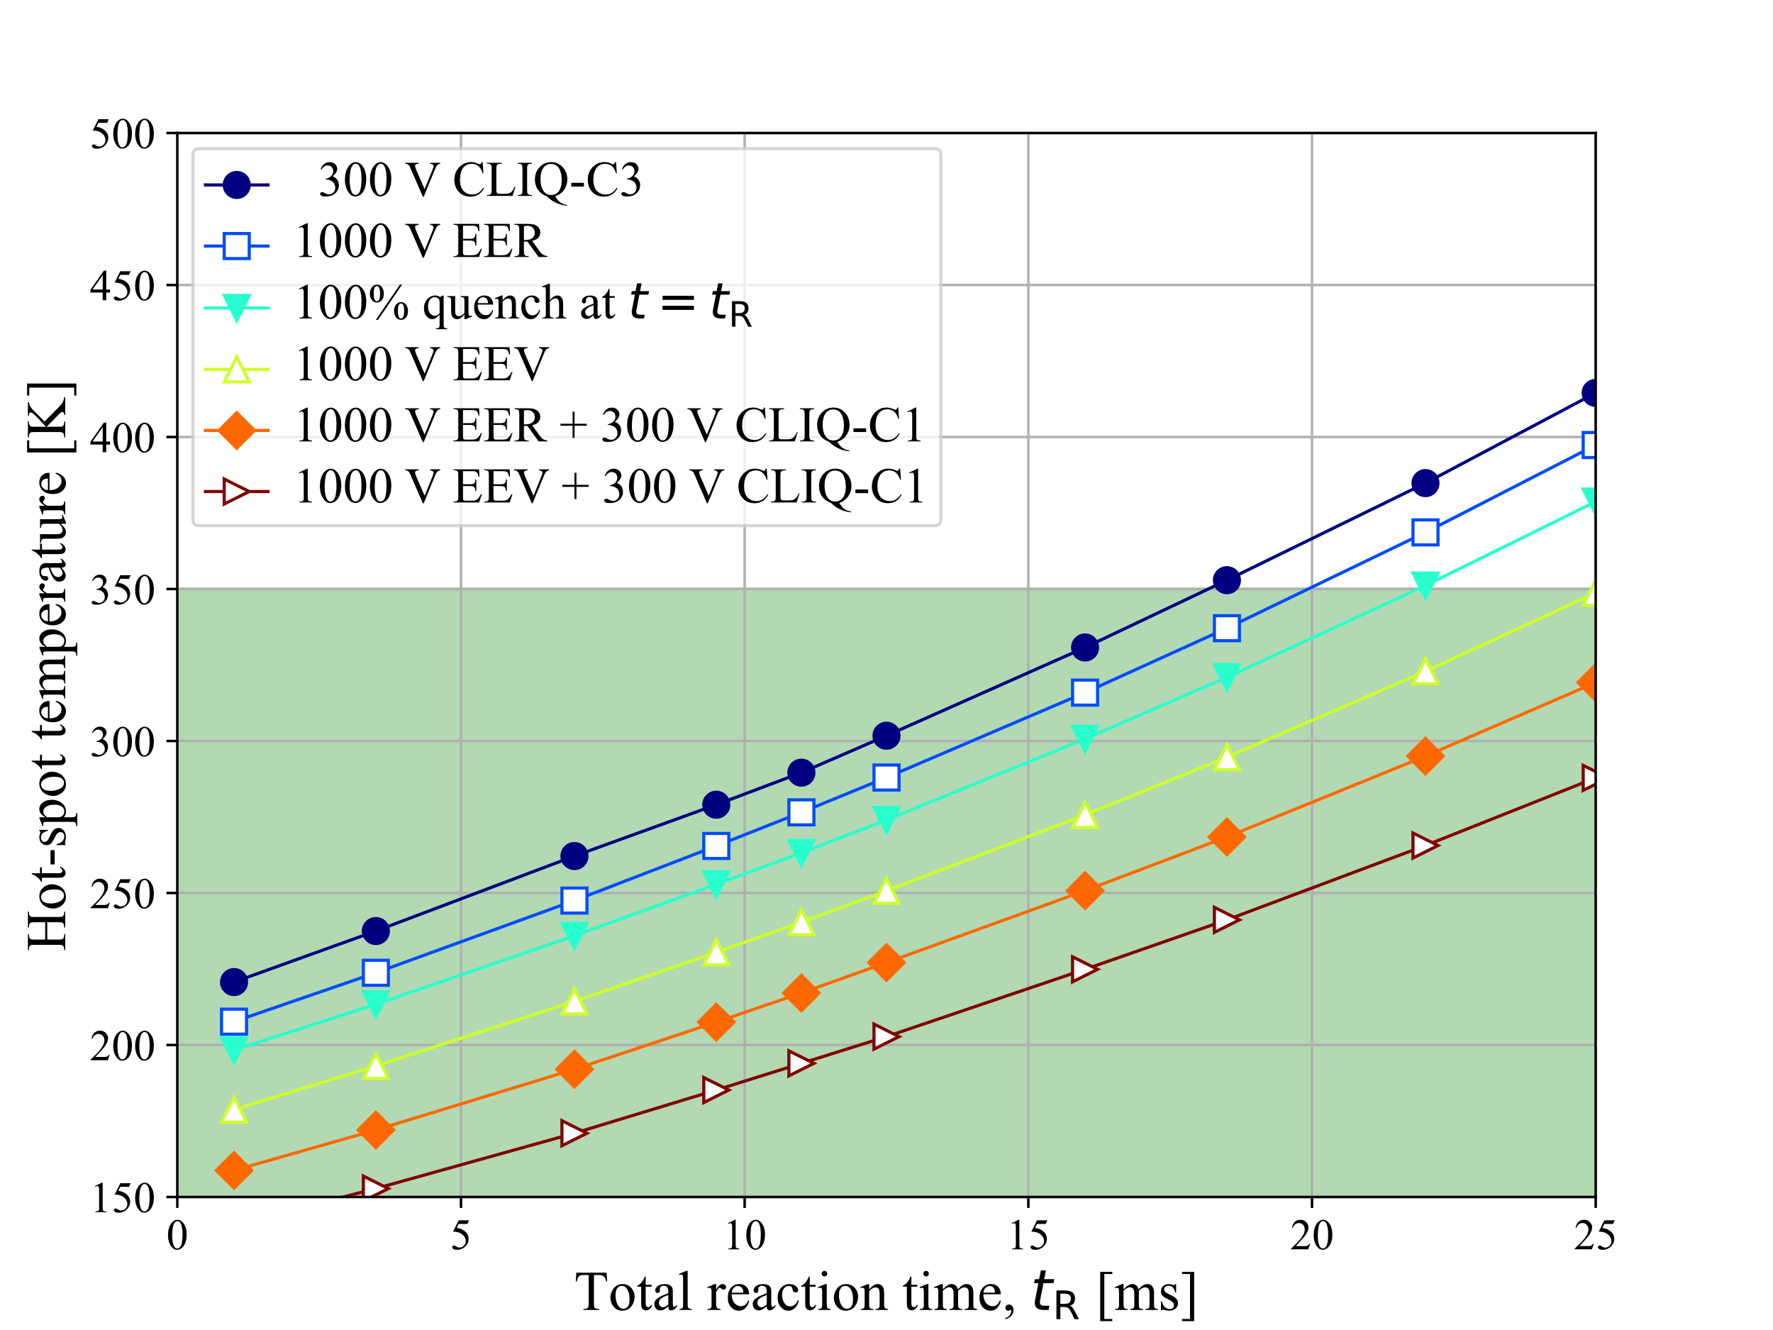
Hot-spot temperature as a function of total reaction time
All options can protect the magnet if the total reaction time is <24 ms
CLIQ charged to low-medium voltage achieves sufficiently low temperature
with 4-5 times lower voltage to ground
Energy extraction plus CLIQ achieves the lowest hot-spot temperature overall
Recommandation: CLIQ “Configuration 1”, 300 V CLIQ + 1 kV EE
LEDET

Slide 19
Selection of the quench protection strategy
 | EER | EEV | CLIQ | EER+CLIQ | EEV+CLIQ
Lower T_hot
Lower U_ground
Simpler
More redundant
Protection at 12 T
Protection at short sample
Protection equipment available
Green=Good. Yellow=Fair. Red=Bad.
Recommandation: CLIQ “Configuration 1”, 300 V CLIQ + 1 kV EE
LEDET

Slide 20
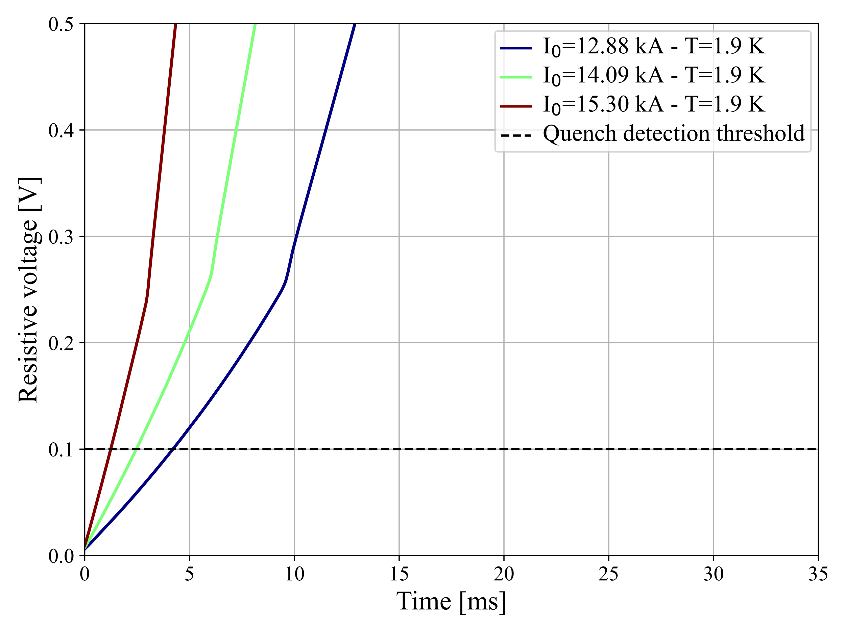
Quench detection at higher currents
Resistive voltage build-up simulated
after quench in a high-field turn
Detection threshold of 100 mV is reached in 4.3 ms at 12.9 kA (12 T)
in 2.5 ms at 14.1 kA (13 T)
in 1.2 ms at 15.3 kA (14 T)
4.3 ms → 1.2 ms
LEDET

Slide 21
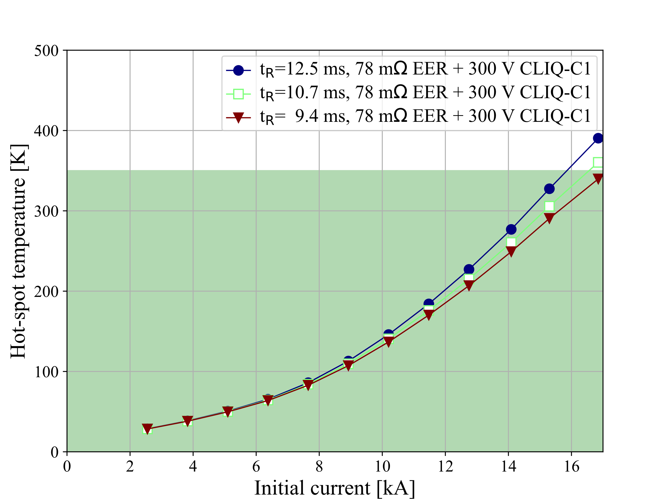
Hot-spot temperature as a function of initial current, EER+CLIQ-C1
Up to nominal current (12.75 kA, i.e. 12 T), with R_{EE}=78 mΩ, i.e. U_{EE}=1 kV at nominal,
the quench protection is comfortable.
At higher currents, R_{EE} needs to be reduced to maintain U_{EE}≤1 kV
SS
14 T
13 T
12 T
LEDET

Slide 22
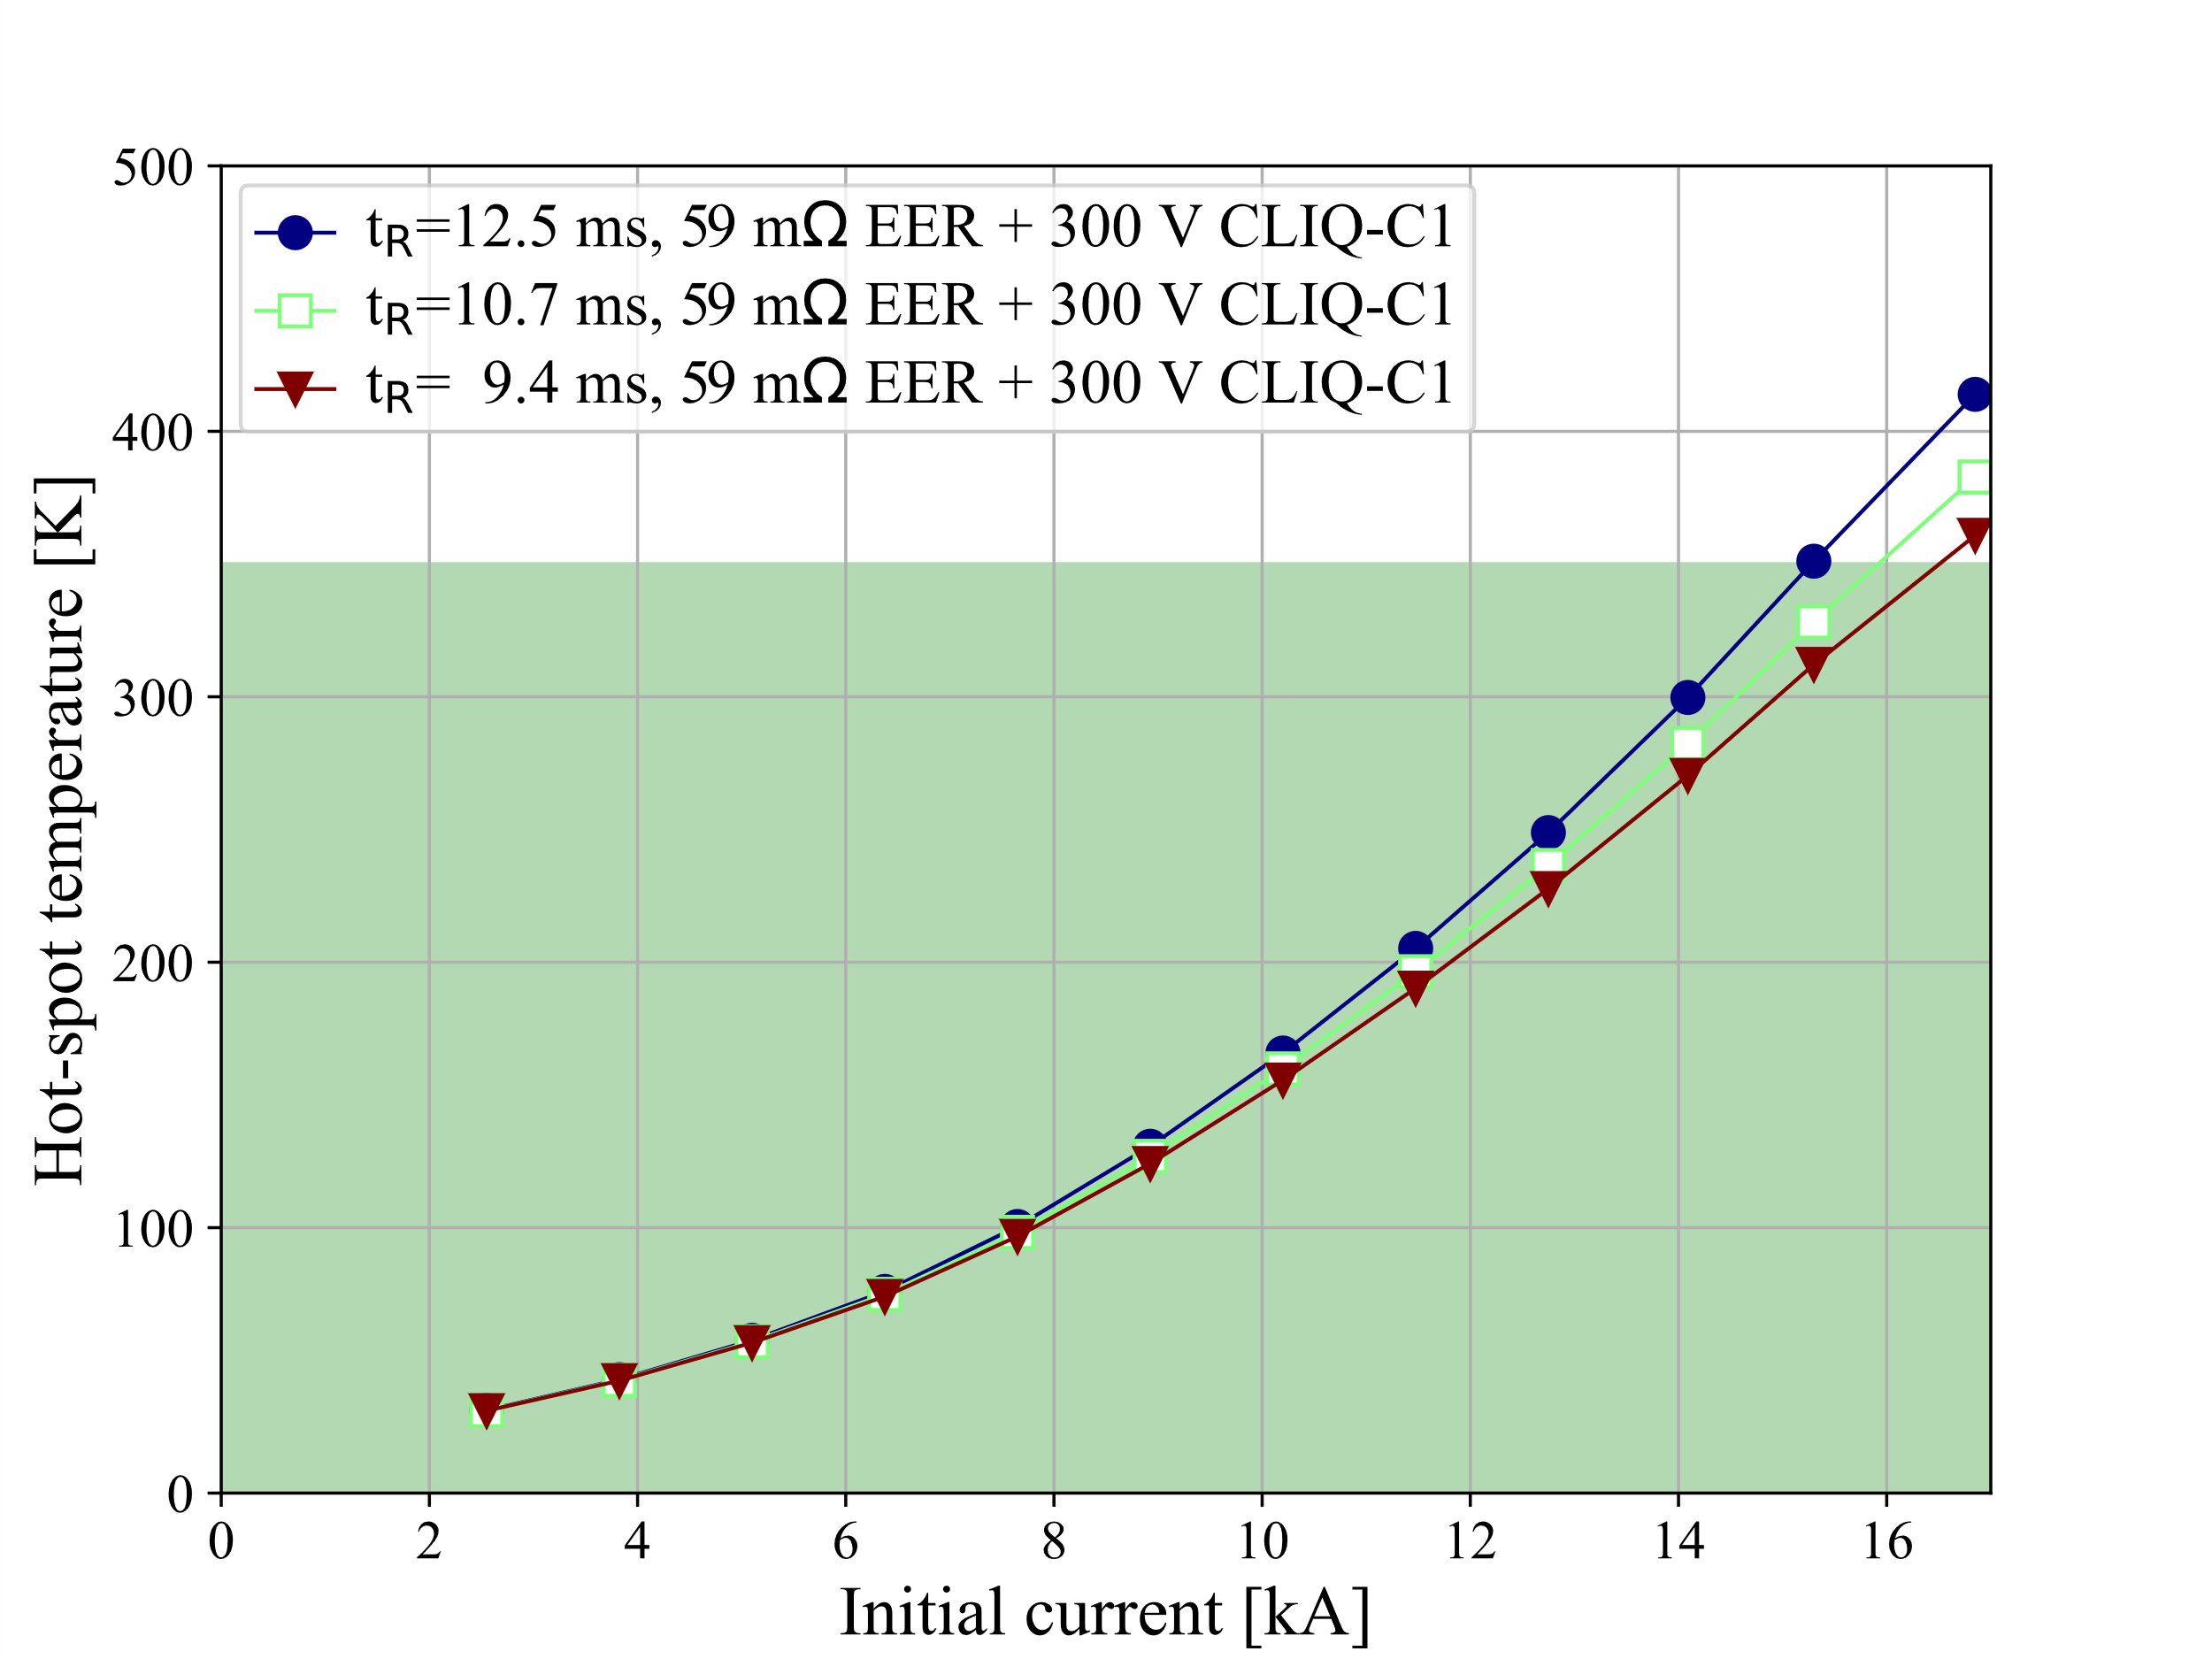
Hot-spot temperature as a function of initial current, EER+CLIQ-C1
Up to nominal current (12.75 kA, i.e. 12 T), with R_{EE}=78 mΩ, i.e. U_{EE}=1 kV at nominal,
the quench protection is comfortable.
At higher currents, with lower R_{EE}=59 mΩ,
i.e. U_{EE}=1 kV at short-sample (I_{SS}=16.85 kA),
the quench protection is at the limit.
SS
14 T
13 T
12 T
LEDET

Slide 23
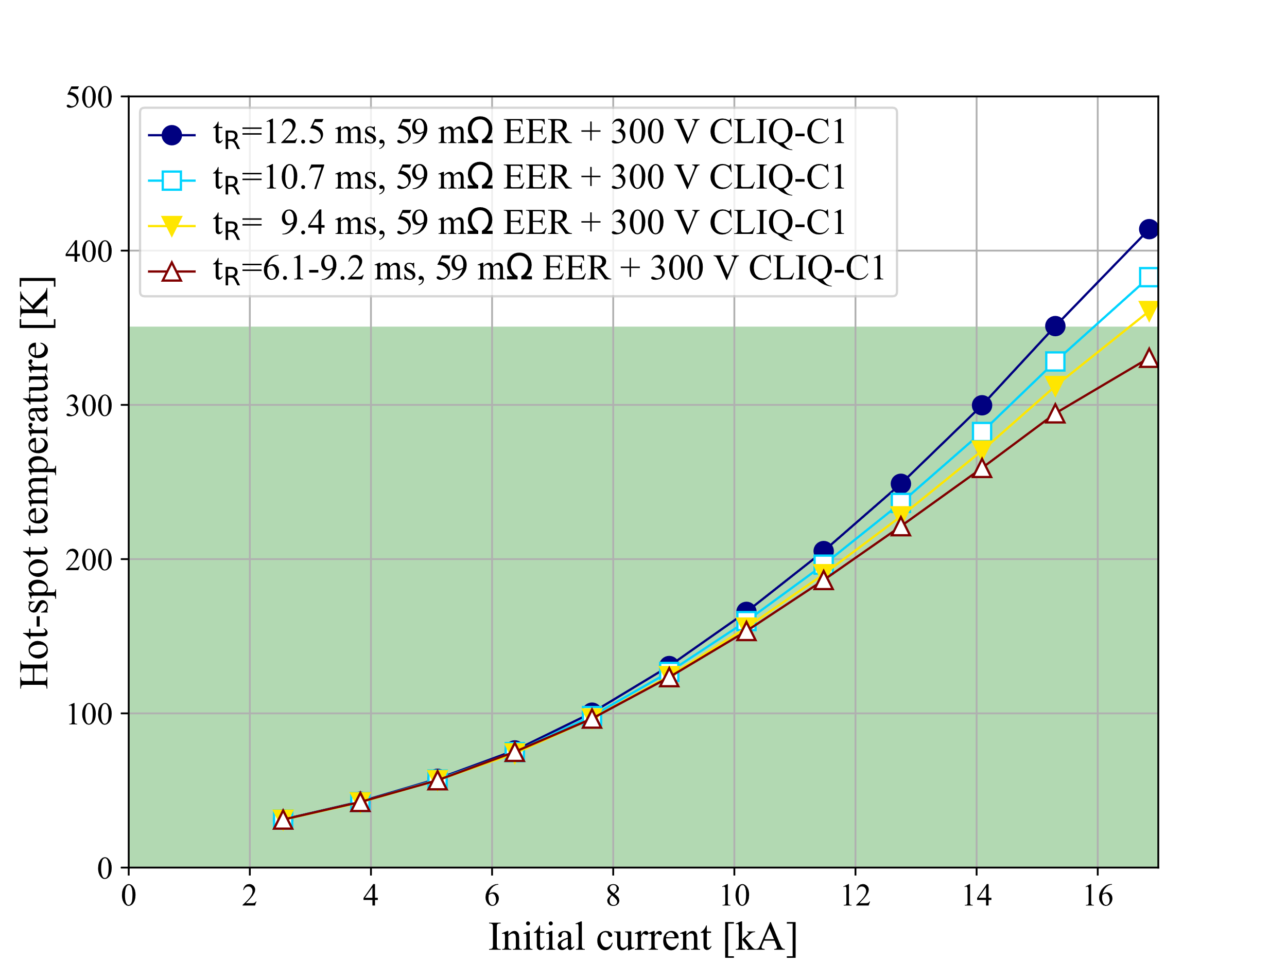
Hot-spot temperature as a function of initial current, EER+CLIQ-C1
Up to nominal current (12.75 kA, i.e. 12 T), with R_{EE}=78 mΩ, i.e. U_{EE}=1 kV at nominal,
the quench protection is comfortable.
At higher currents, with lower R_{EE}=59 mΩ,
i.e. U_{EE}=1 kV at short-sample (I_{SS}=16.85 kA),
the quench protection is at the limit.
SS
14 T
13 T
In the previous simulations, EER and CLIQ are triggered simultaneously.
In reality, CLIQ is triggered in 0.1 ms while EER is triggered in 3.2 ms.
Quench protection is possible up to I_{SS}
12 T
LEDET

Slide 24

Conclusion
Quench protection of 12 T common-coil SMACC magnet (PSI)
Five quench protection strategies are analyzed and compared
Energy extraction with constant resistor Energy extraction with constant resistor + CLIQ
Energy extraction with varistor Energy extraction with varistor + CLIQ
CLIQ
Optimized CLIQ connection configuration, CLIQ voltage, EE voltage rating
Recommandation: CLIQ “Configuration 1”, 300 V CLIQ + 1 kV EE
→Low hot-spot temperature. Redundancy. Readily available equipment.

Slide 25
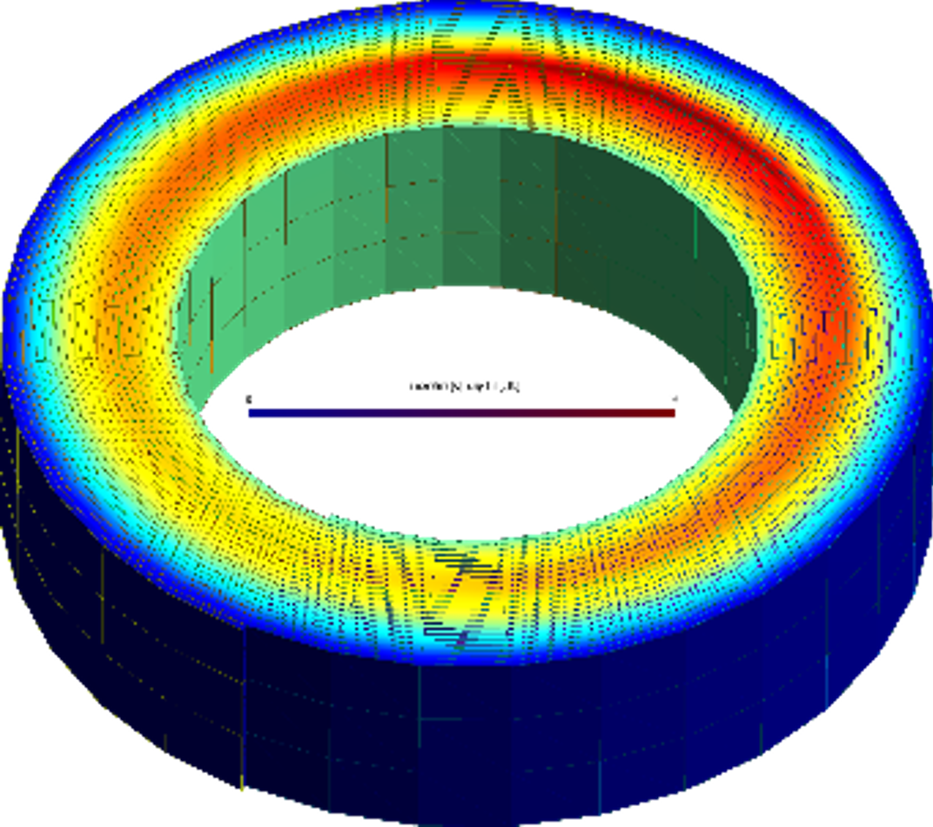
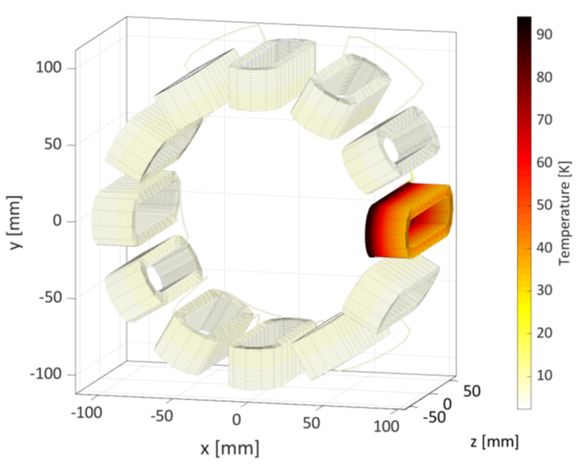
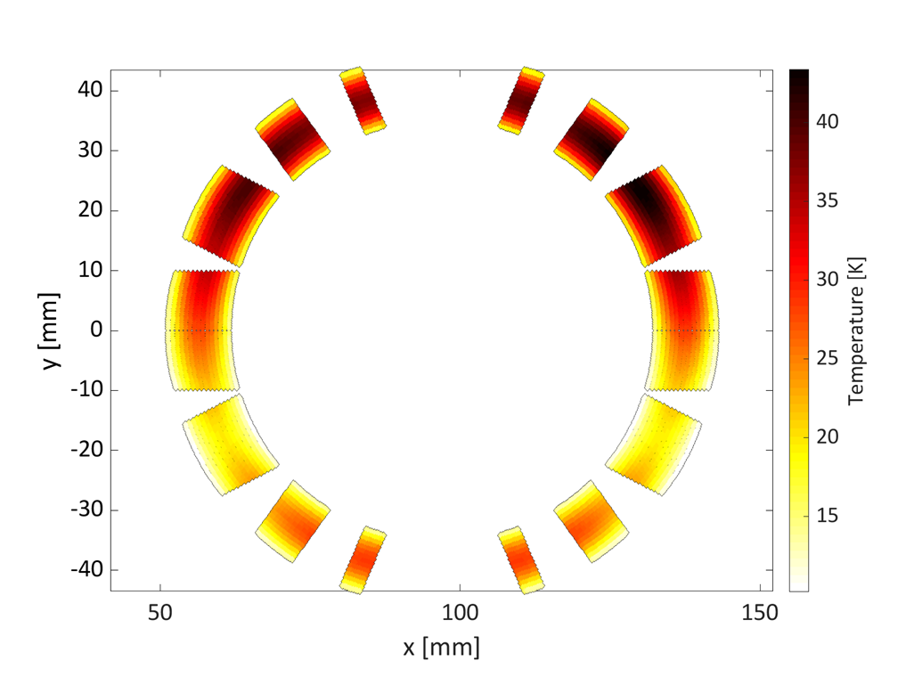
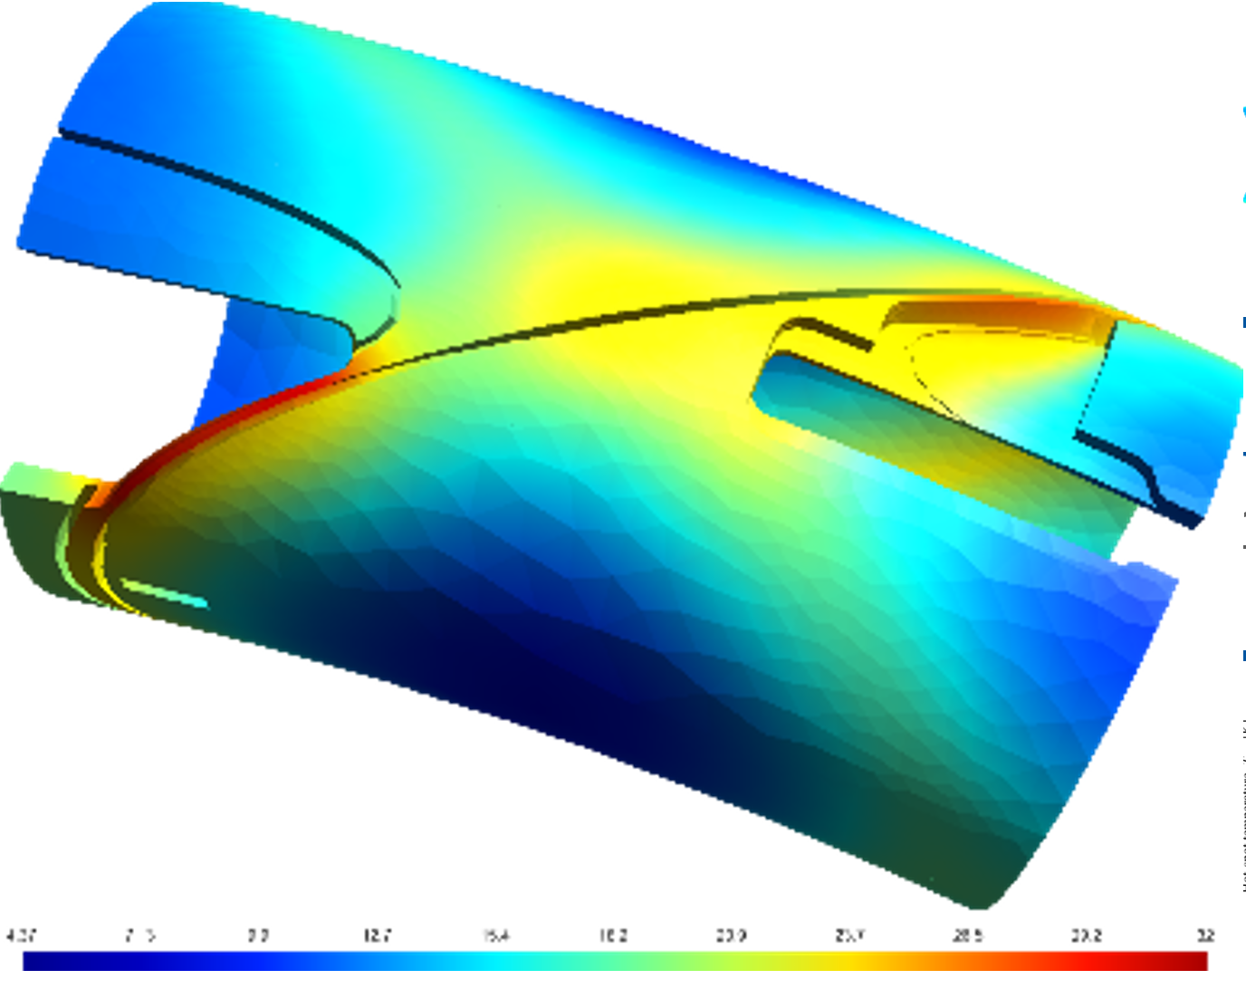
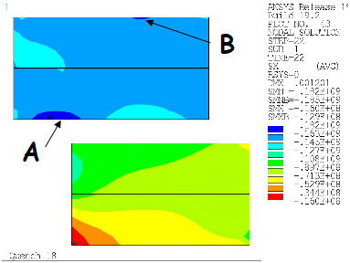
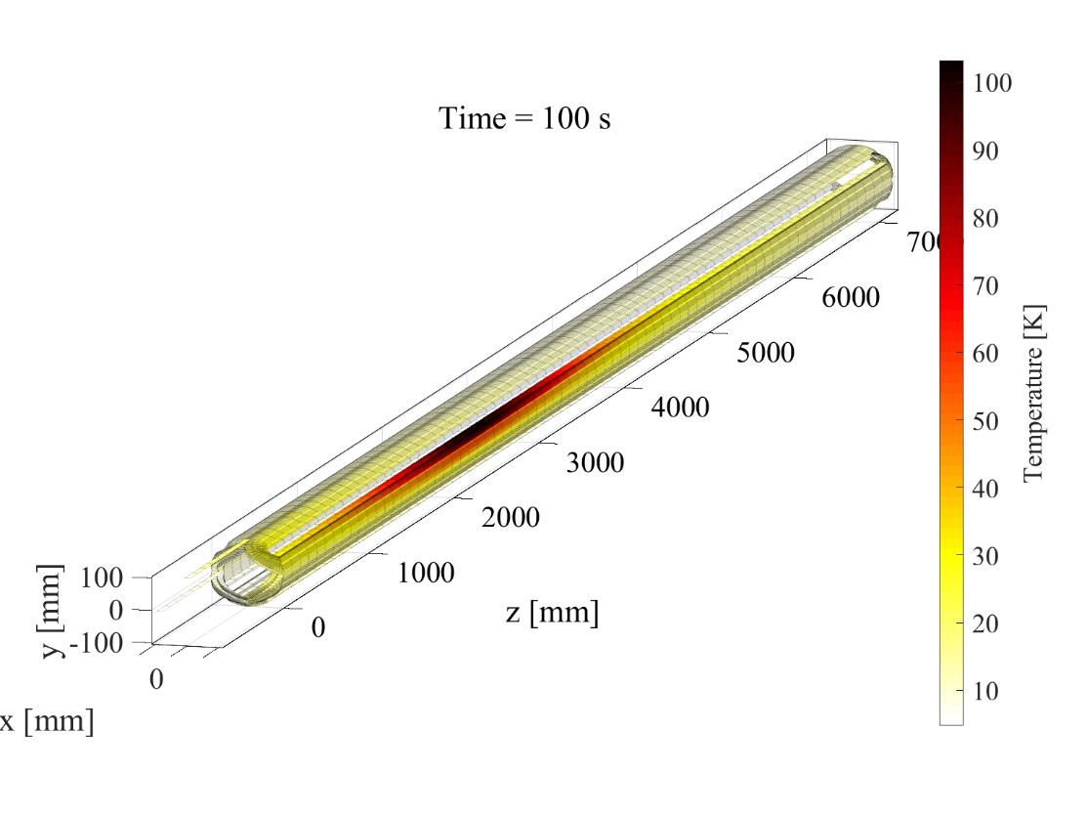
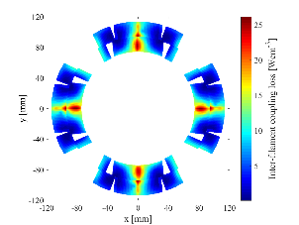
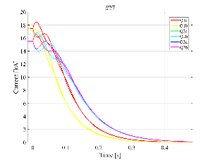



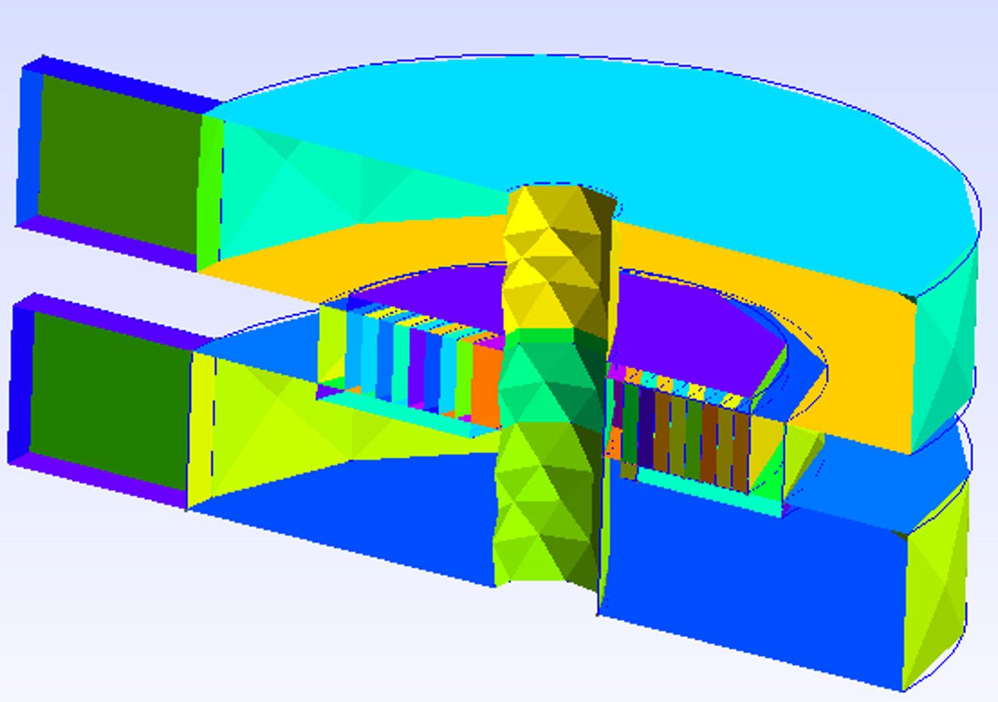
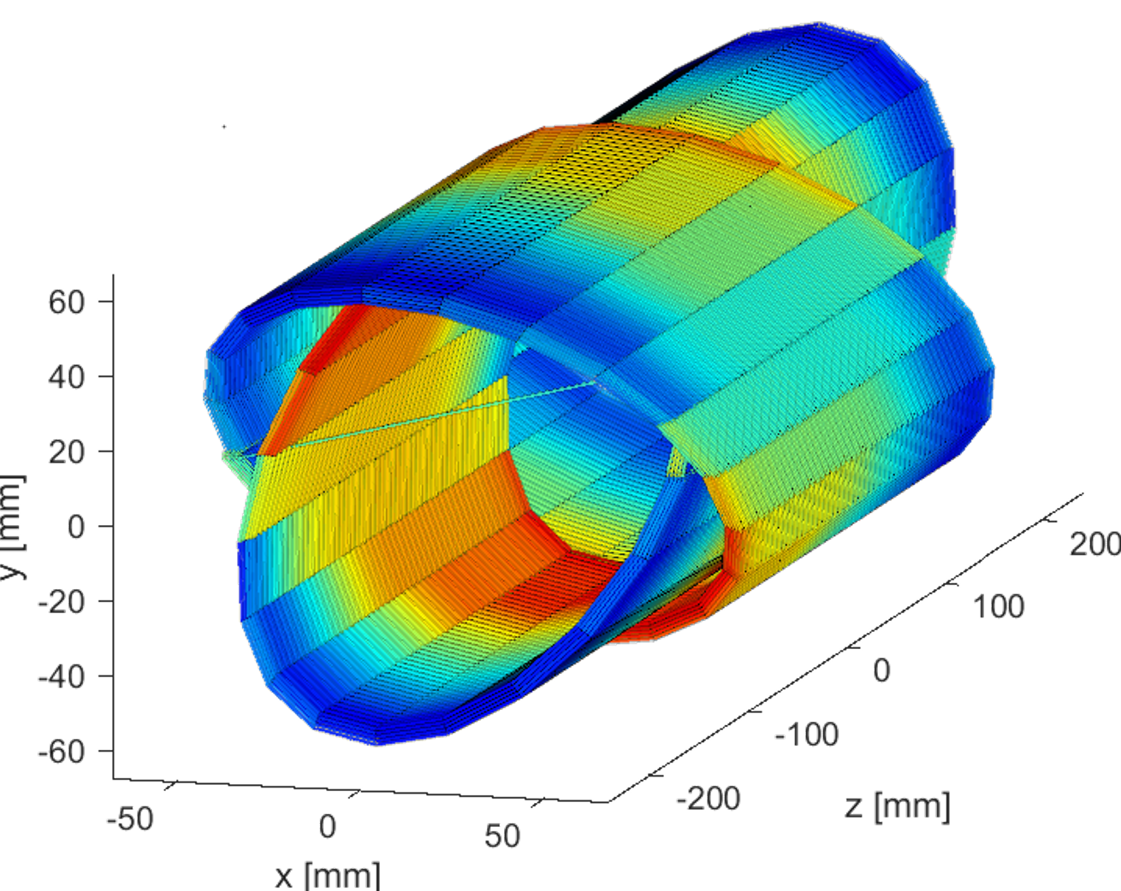
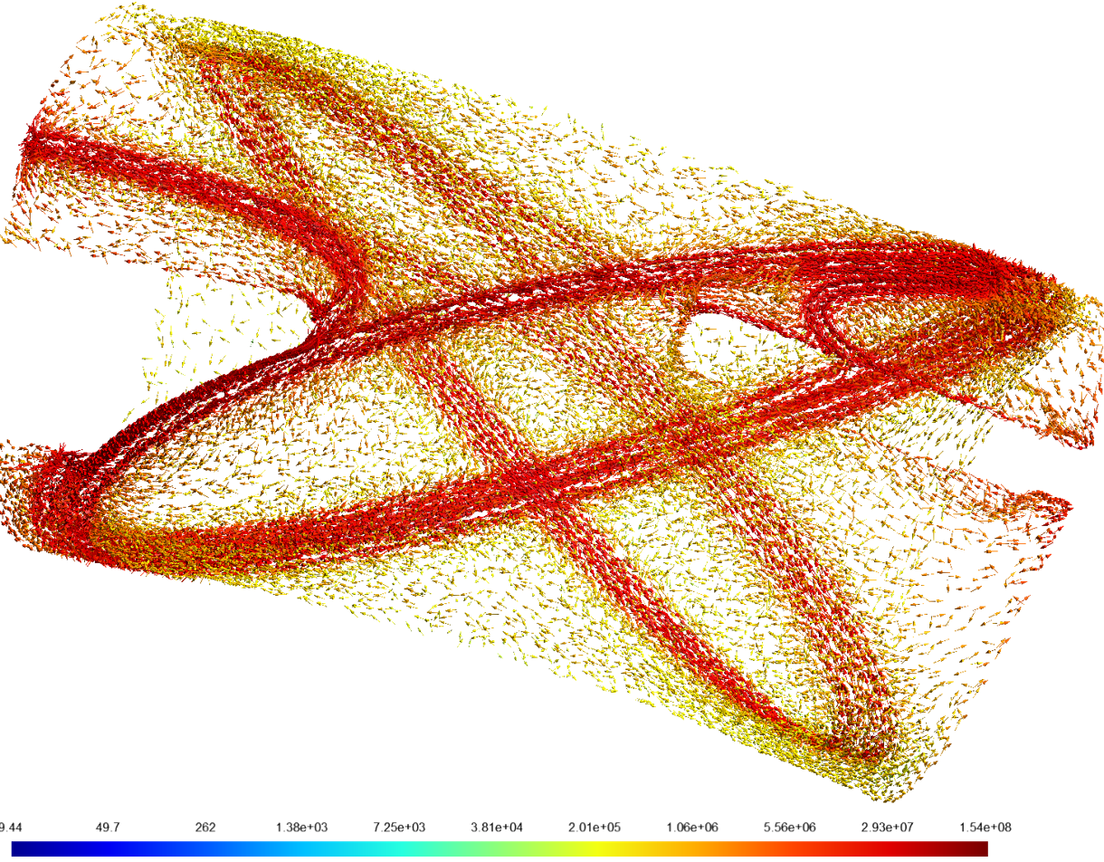
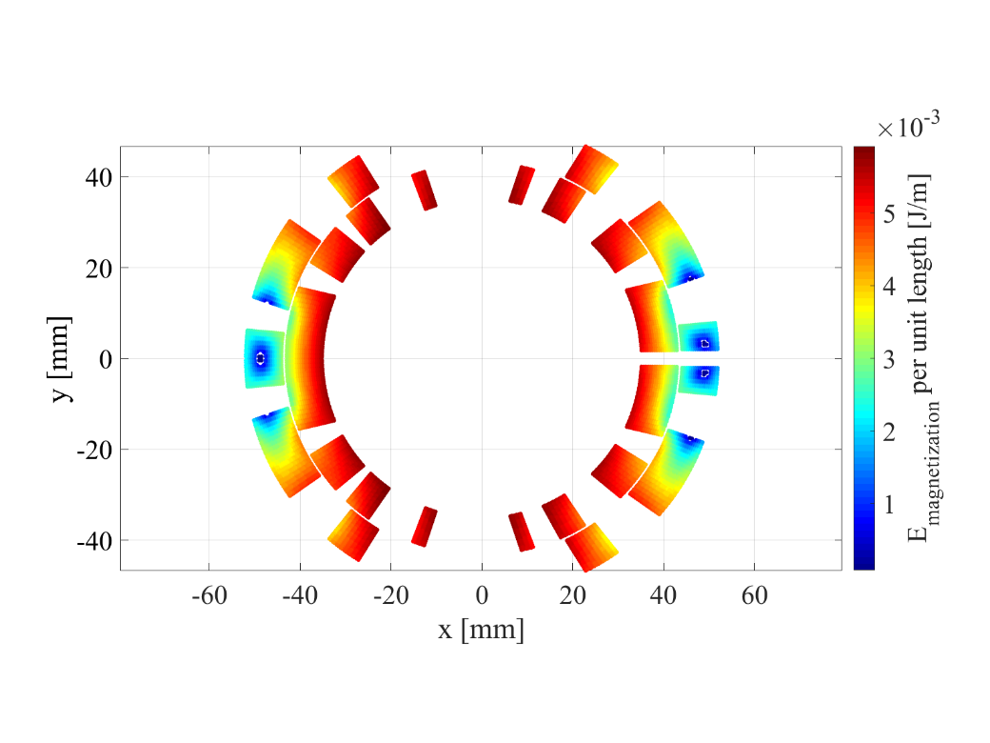
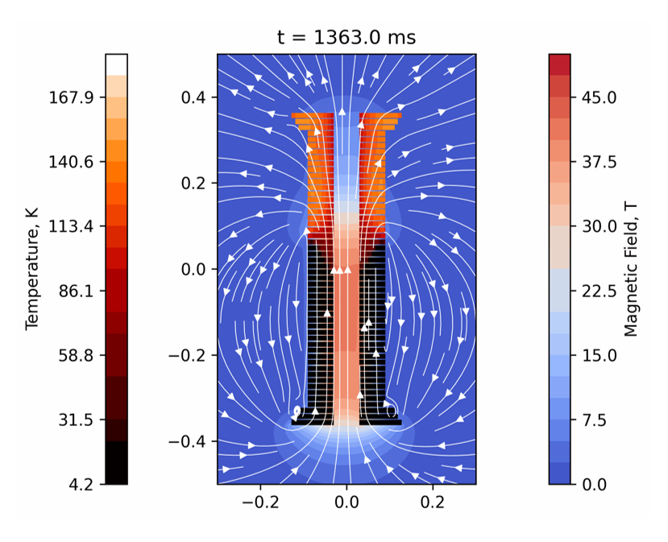
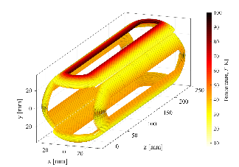
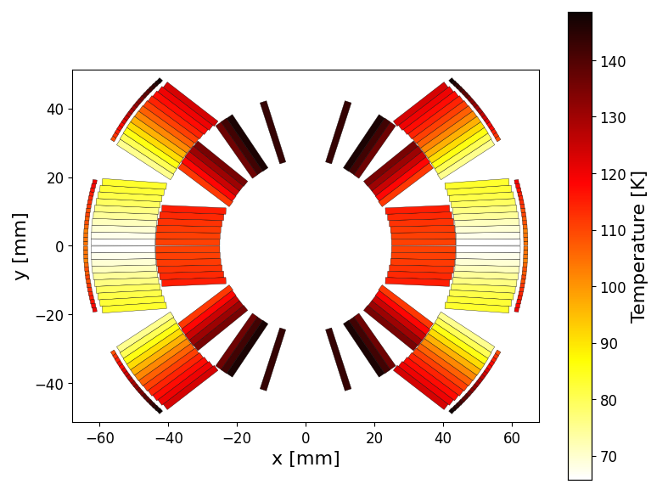
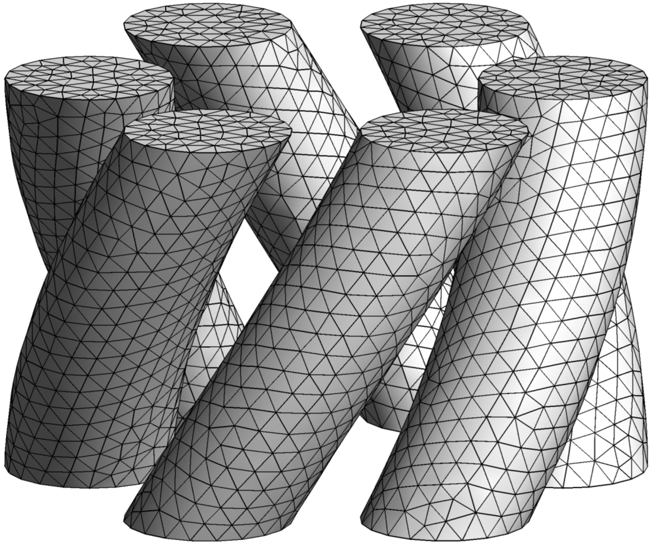
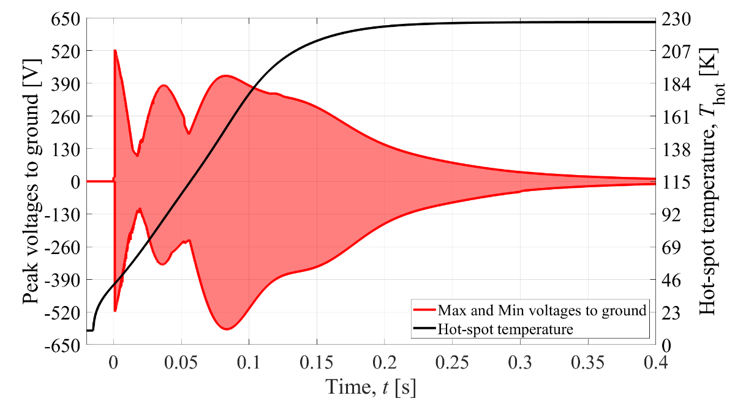
All simulations presented today were performed with LEDET,
a program that is part of the STEAM framework developed at CERN
All STEAM programs are available free of charge for the community
Interested? Visit us → https://espace.cern.ch/steam or Contact us → steam-team@cern.ch
For a general introduction on STEAM:
https://indico.cern.ch/event/1161448/
LEDET

Slide 26
Annex

Slide 27
New common-coil concept by Douglas Araujo at PSI
with acknowledgment to a similar design proposed in LBNL, which did not focus on field quality [S. Gurlay et al., 1995]
Common-Coil
SMACC Common-Coil

Slide 28
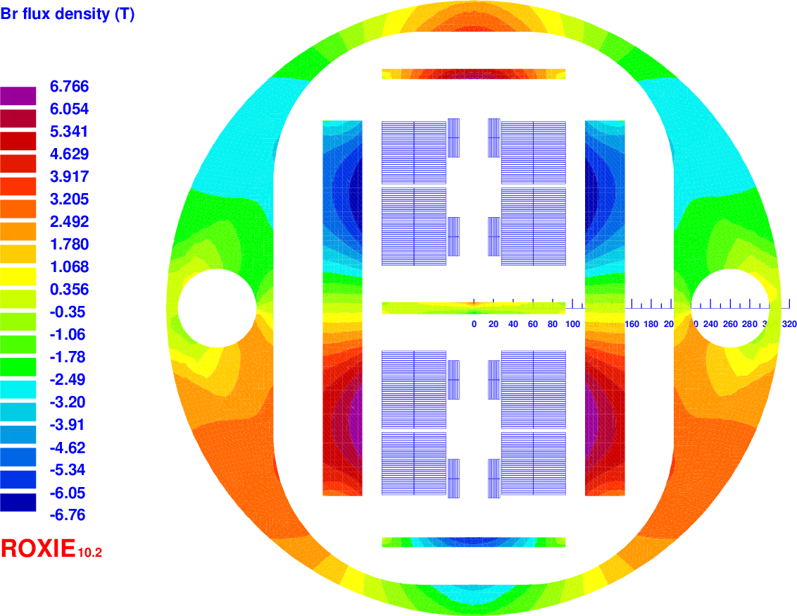
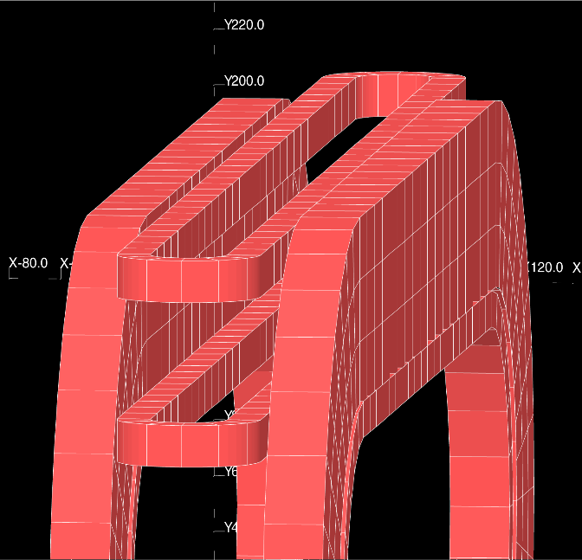
Asymmetric common-coil by GL. Sabbi and E. Ravaioli (LBNL)
Magnet cross-section
4 cm thick Al shell
Top-bottom coil asymmetry
3D end layout
Pressured bladders and load keys for preload
623 mm yoke OD
From FCC Week 2017

Slide 29
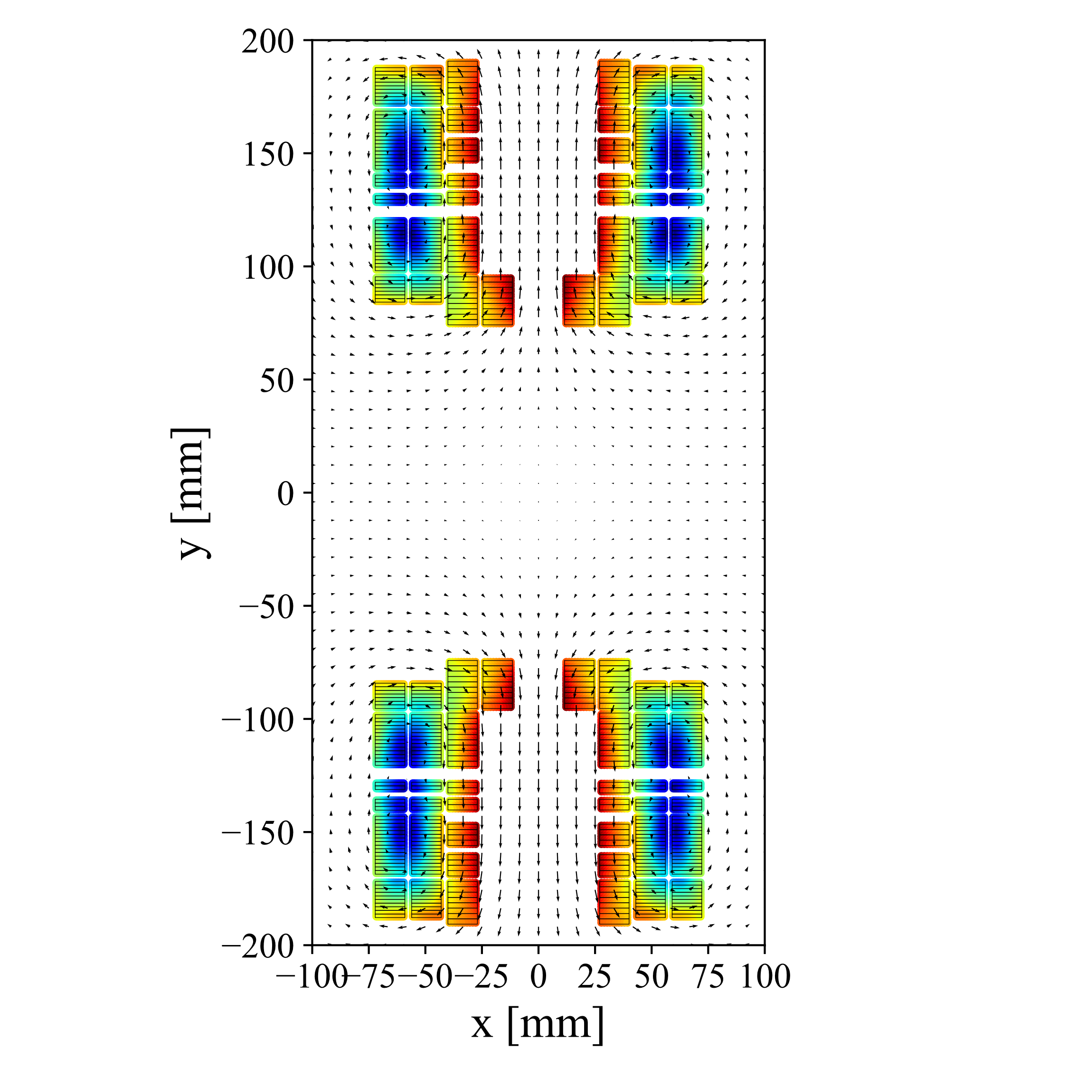
SMACC magnet by Douglas Araujo at PSI
SMACC
Stress-Managed
Asymmetric
Common-Coil
No racetrack coils around the pole
Large bending radius for all turns
Congratulations to Douglas!
This is a major development
for the common-coil technology!

Slide 30
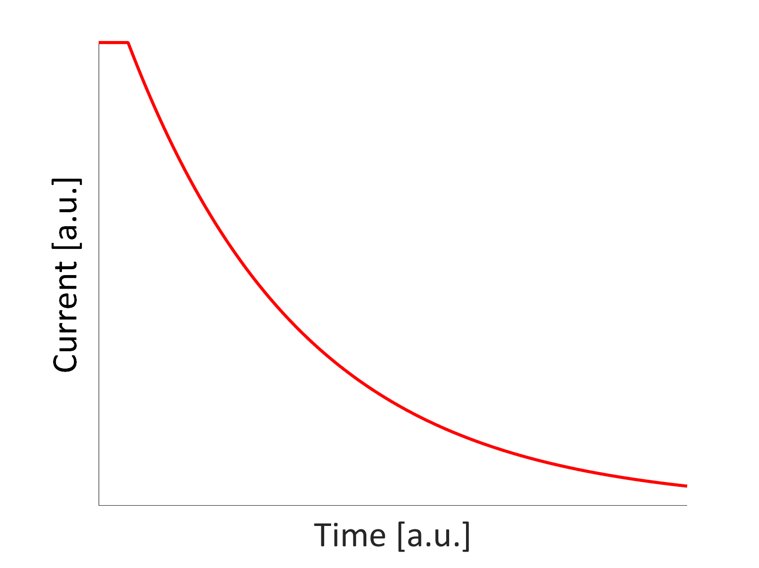
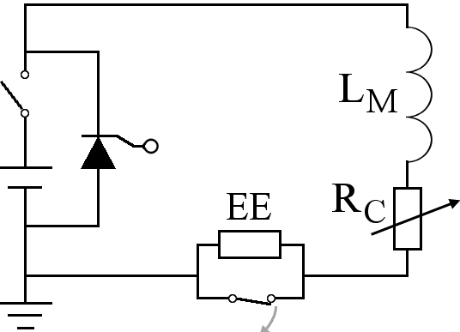
Energy extraction system (EE)
Advantages
Straightforward design and implementation
Extracts energy from the cryostat
Disadvantages
Can be large and expensive for high current magnets
Impractically high voltage needed for high current density magnets
Can’t be applied to a chain of high-field magnets
Note: EE of LHC main dipole circuits doesn’t protect magnets

Slide 31
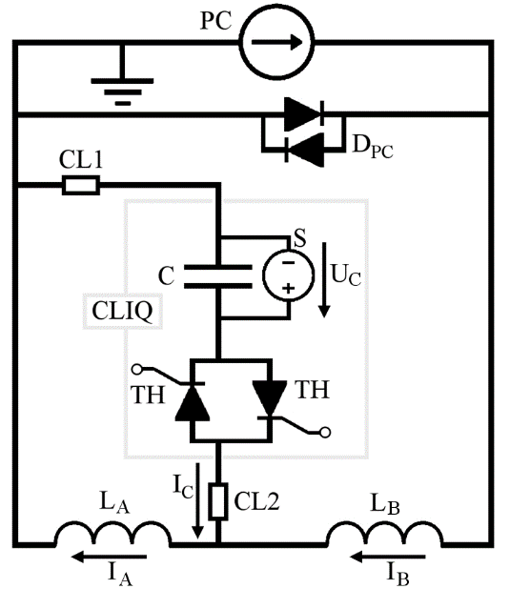
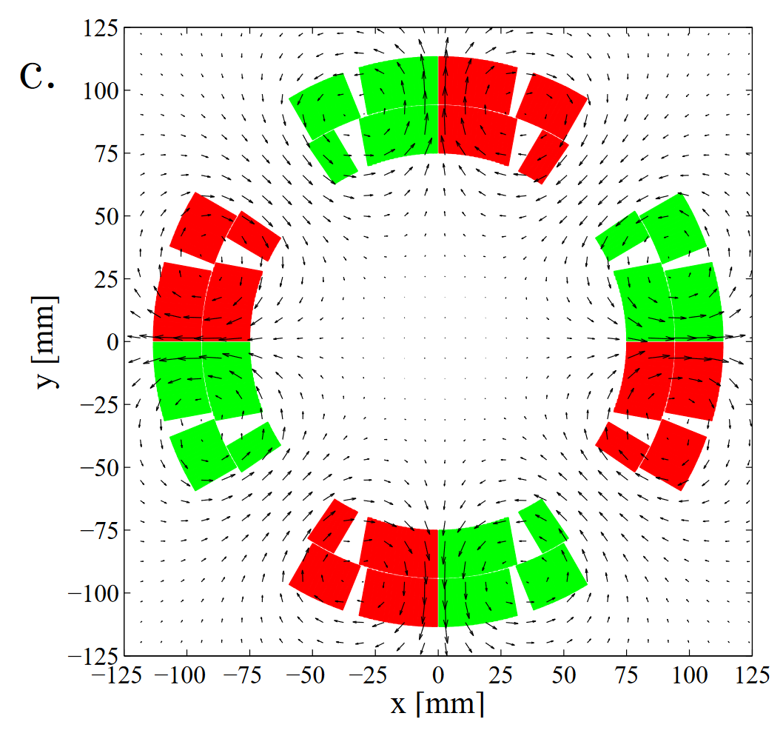
Coupling-Loss Induced Quench (CLIQ)
Current change
Field change
Transient losses
Temperature increase
Coil SC→resistive
Magnet energy discharged
Reduced hot-spot temperature
Advantages
Fast and effective heat deposition
Heat deposited simultaneously in most of the coil volume
Electrically robust system
Disadvantages
Direct electrical connection to the magnet circuit
Challenging to make it redundant
Additional asymmetric forces on the magnet coils

Slide 32

Interaction between CLIQ and energy extraction (EE) system
EE
Discussion
Is it possible/recommended to test and EE system together?
positive polarity → Superposition of voltage across CLIQ and across EE causes higher voltage to ground
negative polarity → Subtraction of voltage across CLIQ and across EE reduces CLIQ performance

Slide 33
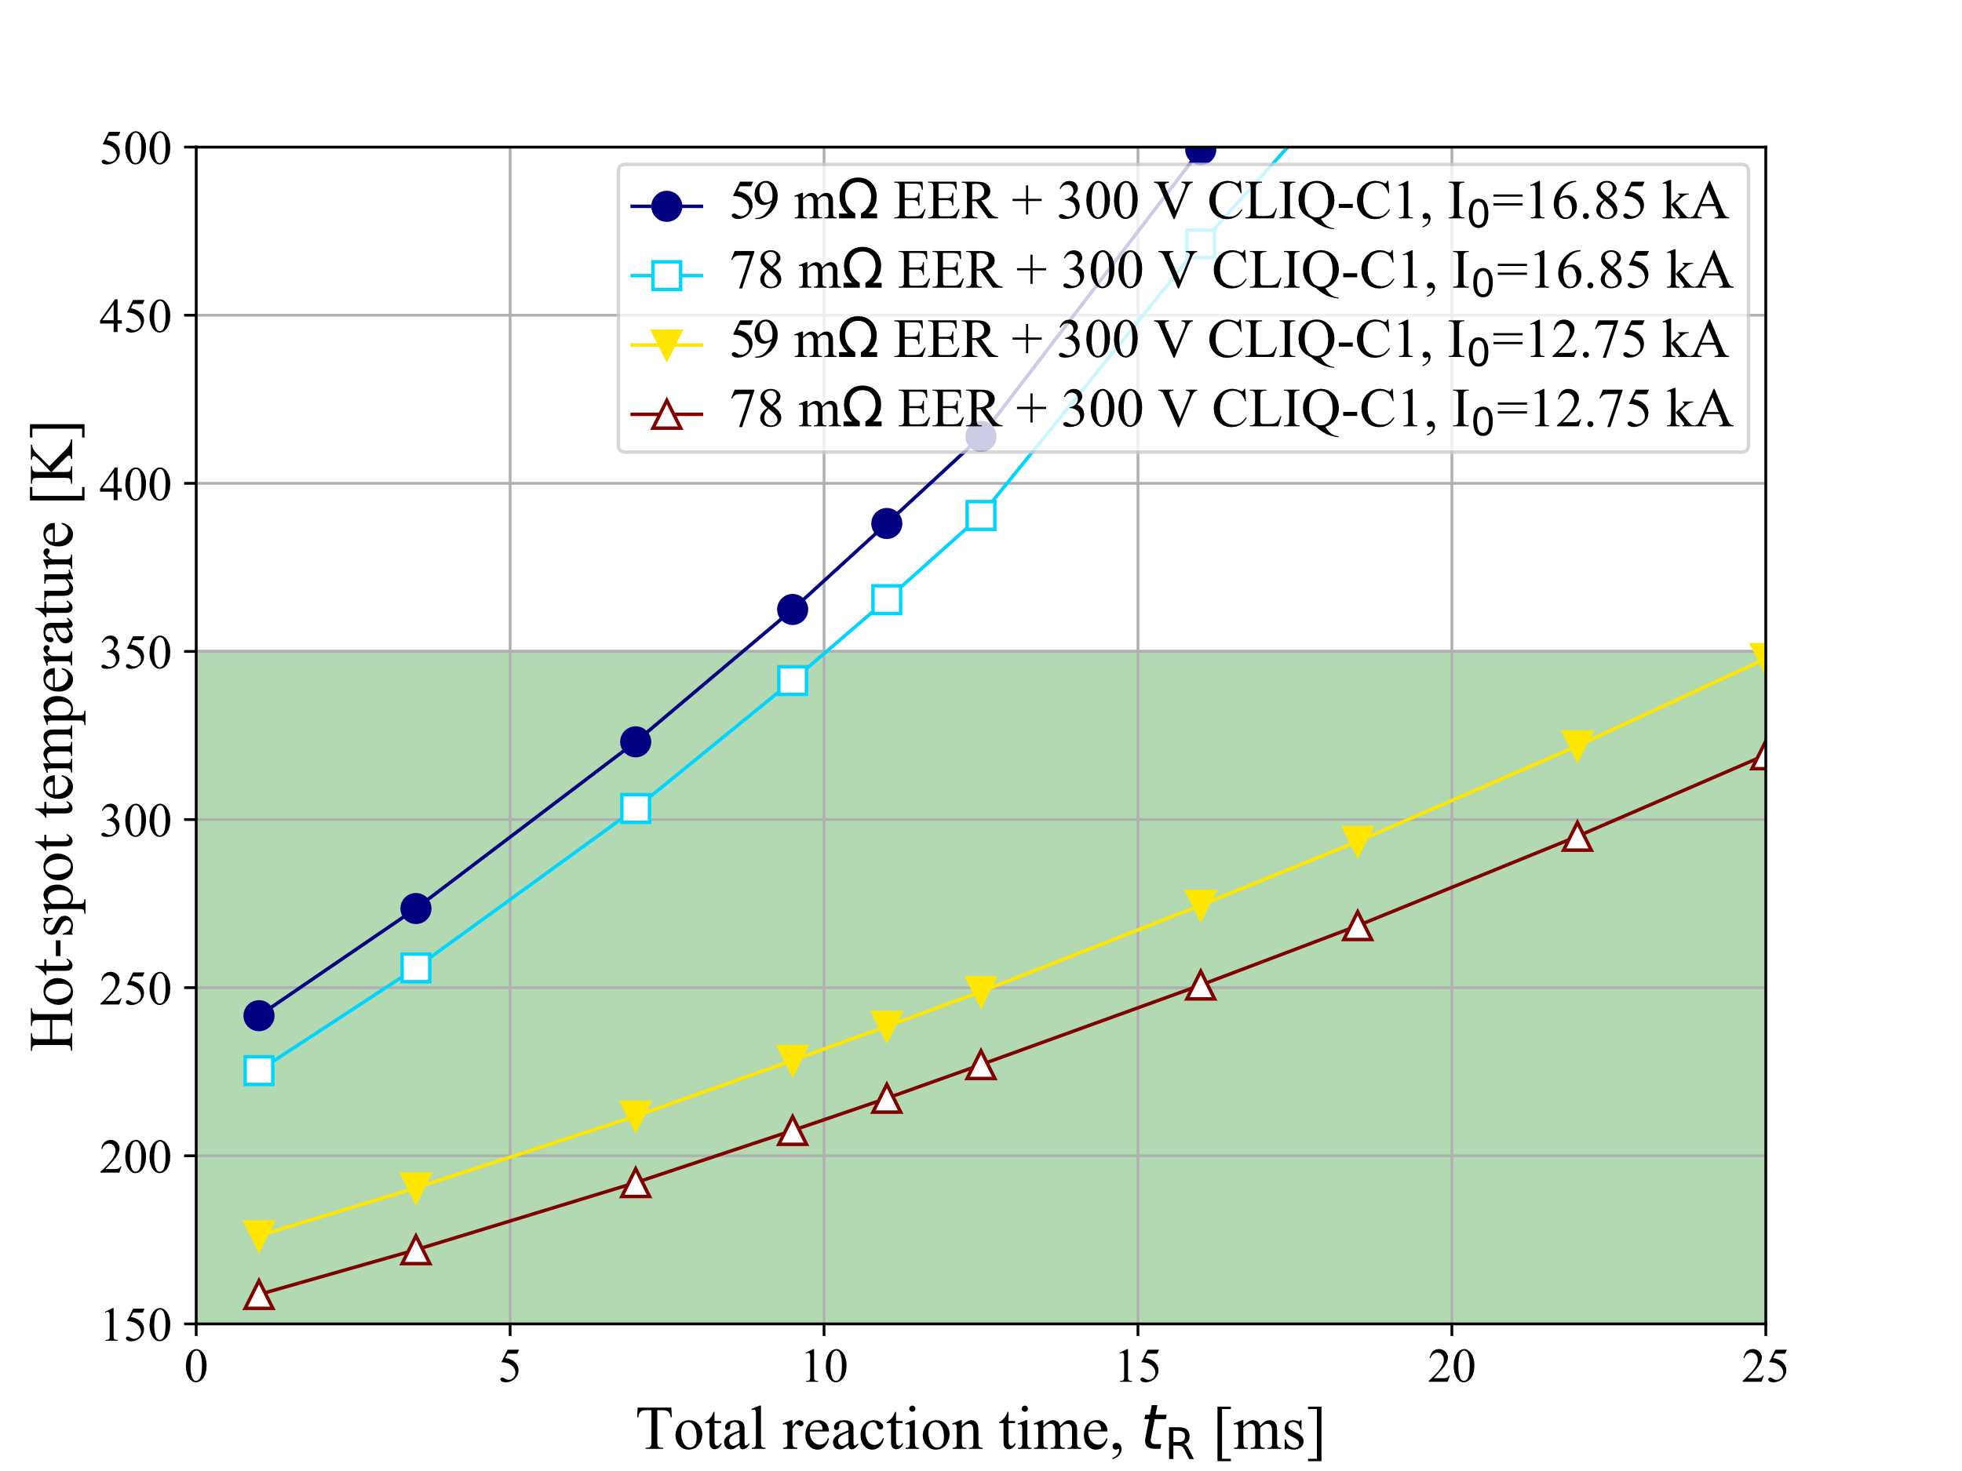
Hot-spot temperature as a function of total reaction time, EER+CLIQ-C1
At nominal current, the quench protection has significant margin even for R_{EE}=59 mΩ, i.e. U_{EE}=1 kV at short-sample current
At short-sample current (16.85 kA),
T_{hot}<350 K for t_{R}<9 ms,
which is quite tight but not out of reach:
0.5 ms detection time +
5.0 ms validation time +
3.2 ms triggering time =
8.7 ms total reaction time
LEDET

Slide 34
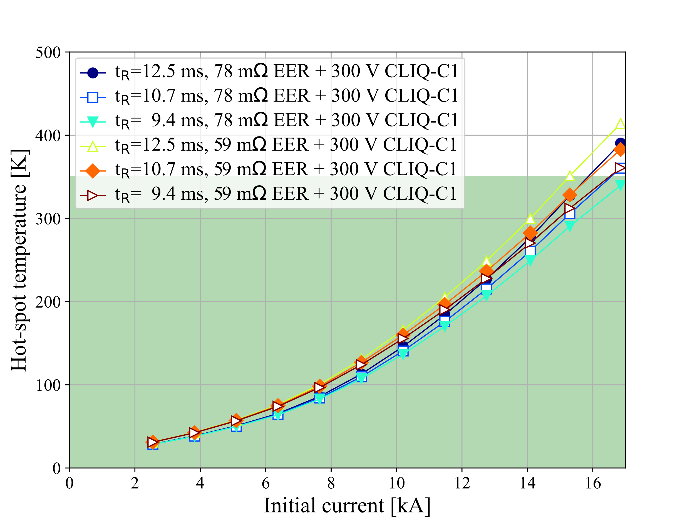
Hot-spot temperature as a function of initial current, EER+CLIQ-C1
Up to nominal current (12.75 kA, i.e. 12 T), with R_{EE}=78 mΩ, i.e. U_{EE}=1 kV at nominal,
the quench protection is comfortable.
At higher currents, with lower R_{EE}=59 mΩ,
i.e. U_{EE}=1 kV at short-sample (I_{SS}=16.85 kA),
the quench protection is at the limit.
SS
14 T
13 T
12 T
LEDET

Slide 35
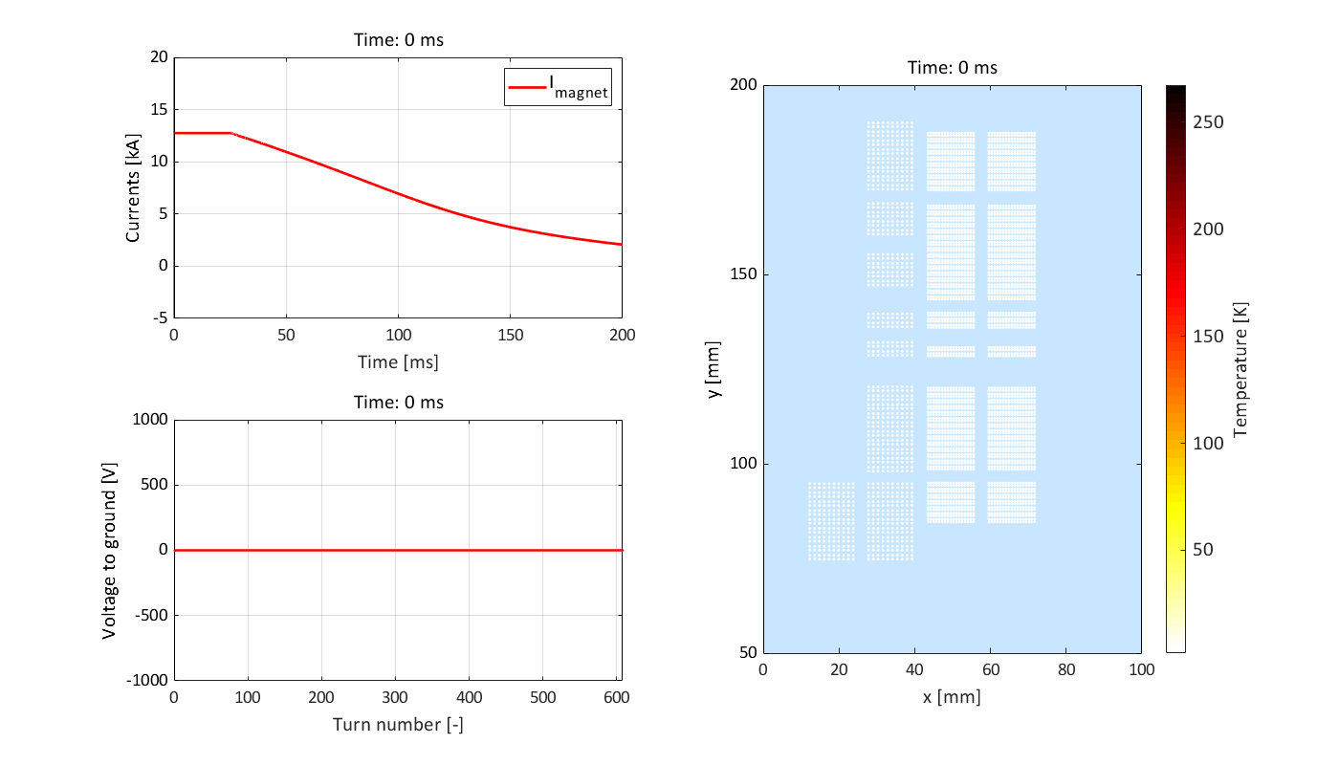
Quench protection with 1 kV energy extraction with constant resistor
hot-spot (lowest field location in the outer layers)
The presence of quench-back influences significantly the transient
Reduction of differential inductance
Quench-back (coil resistance increase due to transient losses)
LEDET

