Slide 1
Splicing Methods and Trials
This work was performed under the auspices of and with support from the Swiss Accelerator Research and Technology (CHART) program.
A.Stampfli, (Courtesy D. M. Araujo, M. Duda, T.Michlmayr, A.Brem, C.Müller, H.Rodrigues)
Villigen PSI, 14 Januar 2025
Notes:
A.Stampfli, (Courtesy D. M. Araujo, M. Duda, T.Michlmayr, A.Brem, C.Müller)

Slide 2
Agenda
SubMCC1 Splices
Splice V1 NbTi – HTS
Splice V2 Nb₃Sn –HTS
Splice V3 HTS - HTS
Conclusion
PSI Center for Accelerator Science and Engineering A.Stampfli, (Courtesy D. M. Araujo, M. Duda, T.Michlmayr, A.Brem, C.Müller, H.Rodrigues)

Slide 3
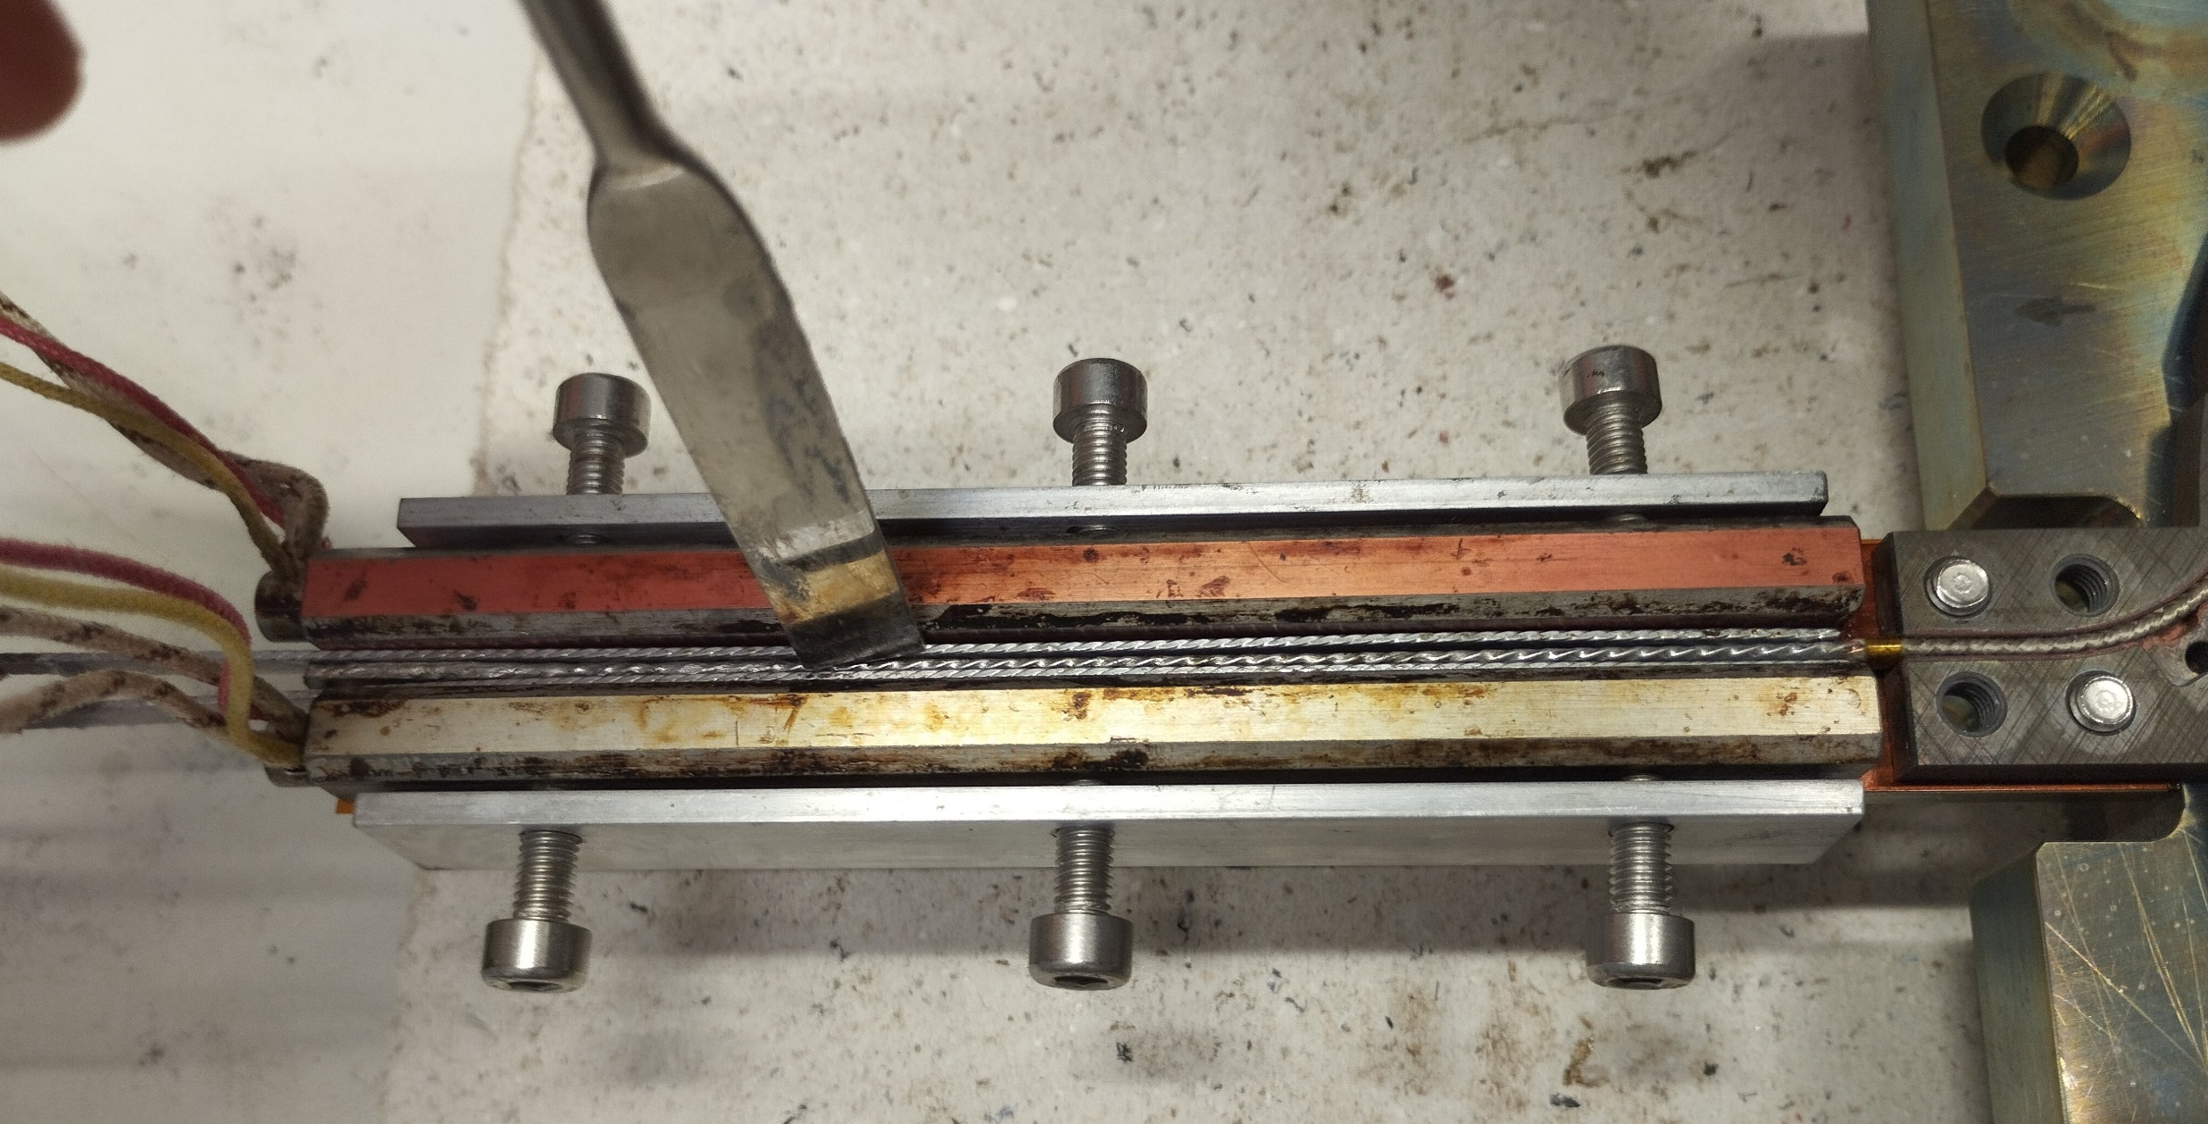
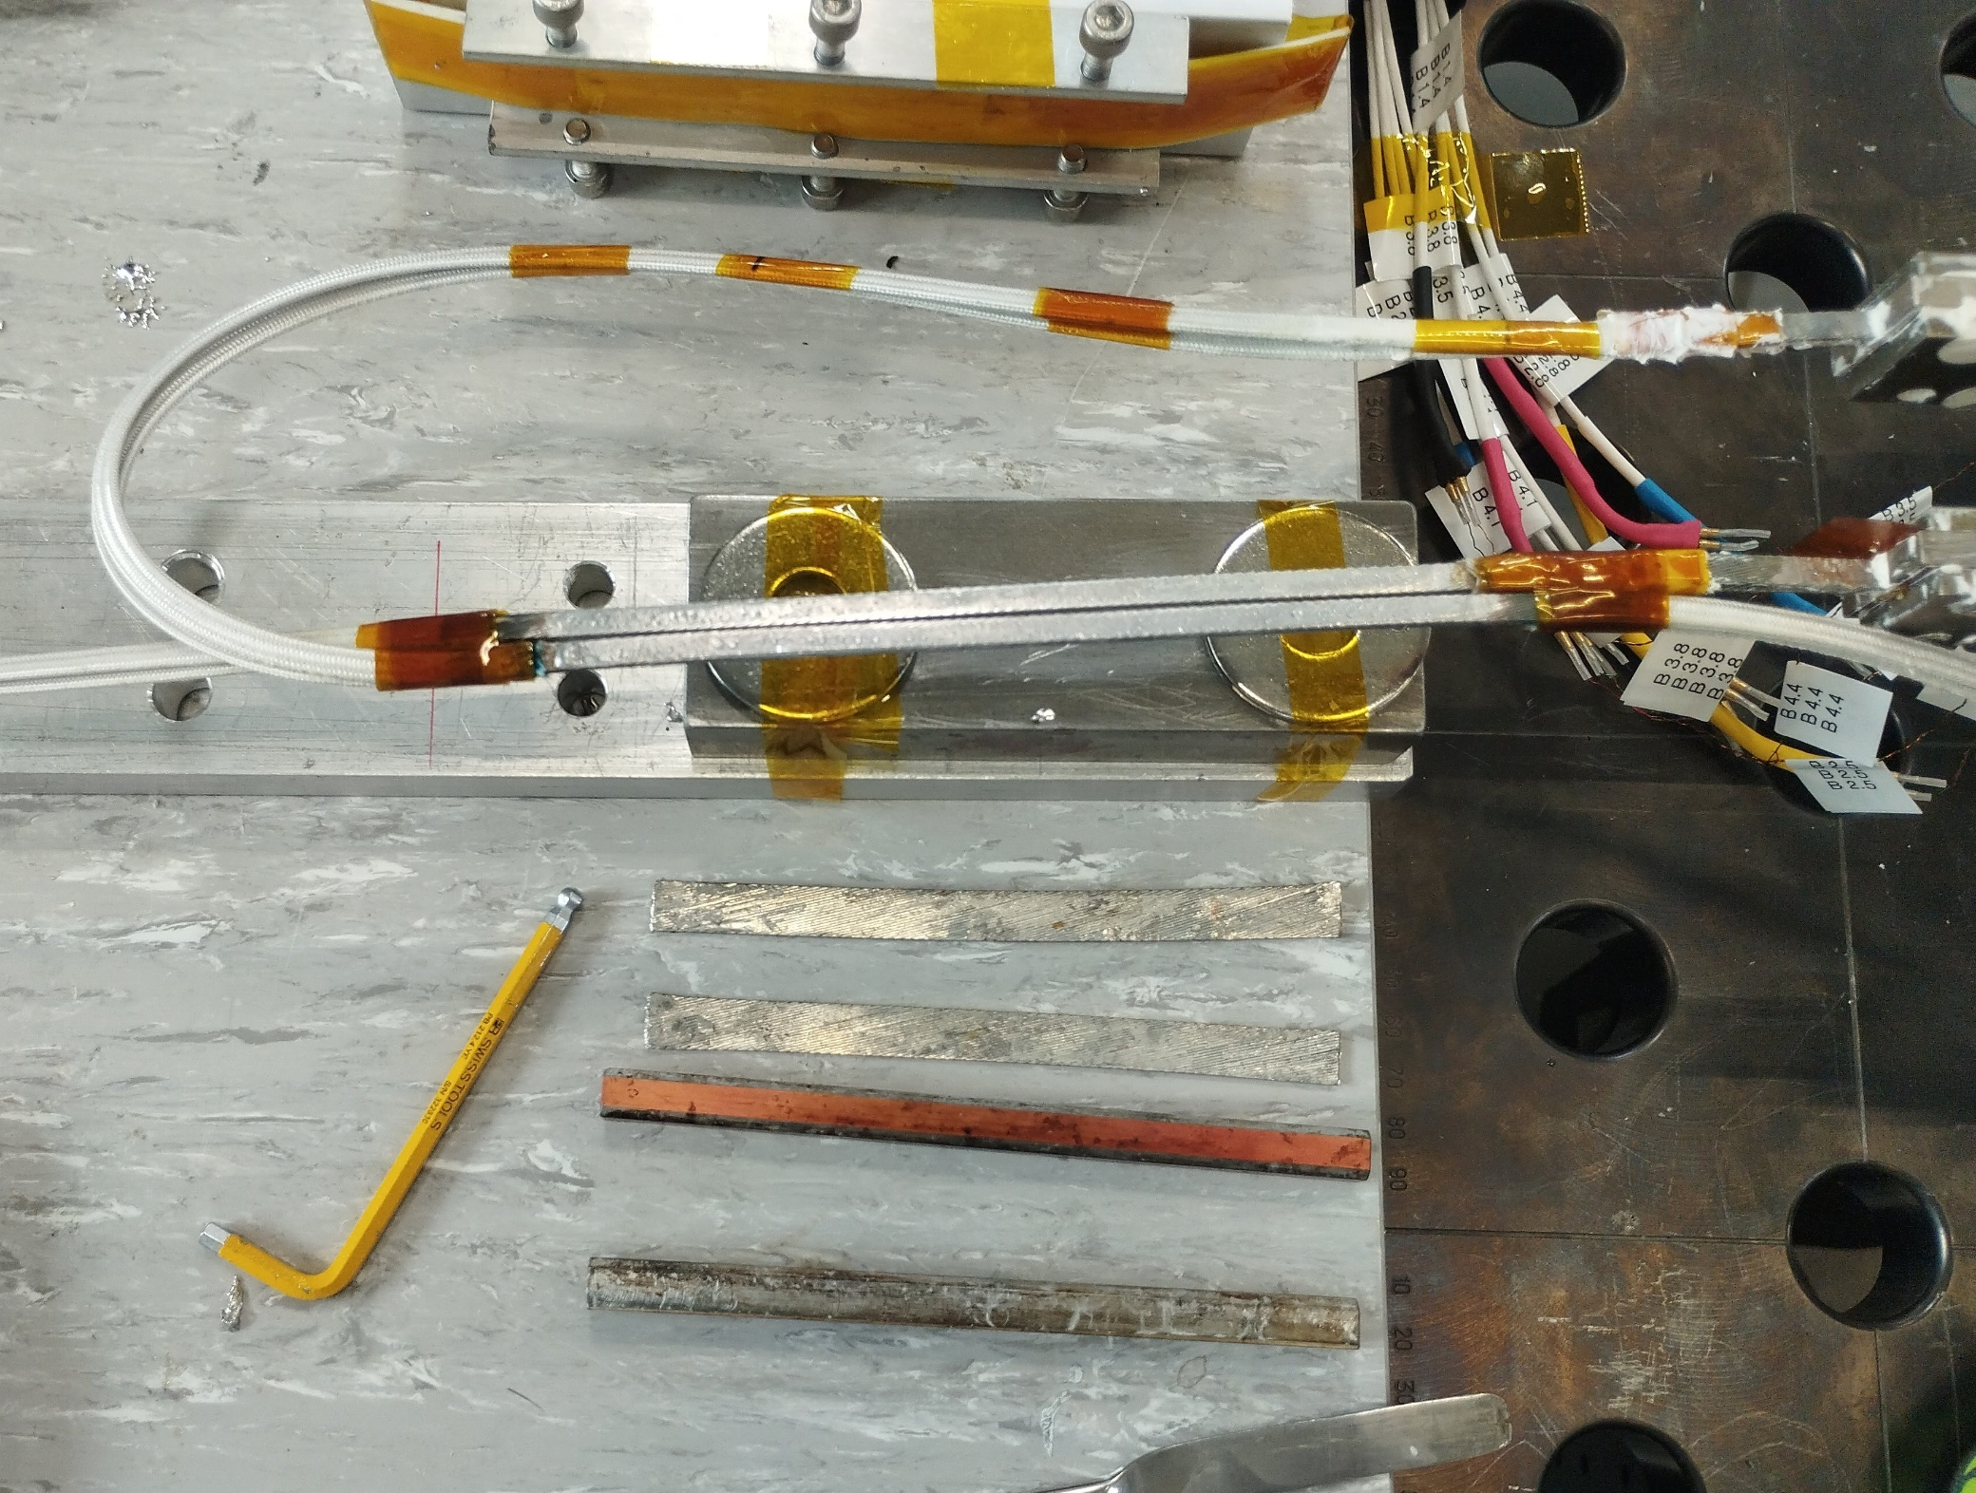
SubMCC1 outer Splice
Lead Splice
2 NbTi Cables pretinned
Soldered by Tooling
Same procedure
PSI Center for Accelerator Science and Engineering A.Stampfli, (Courtesy T.Michlmayr)

Slide 4
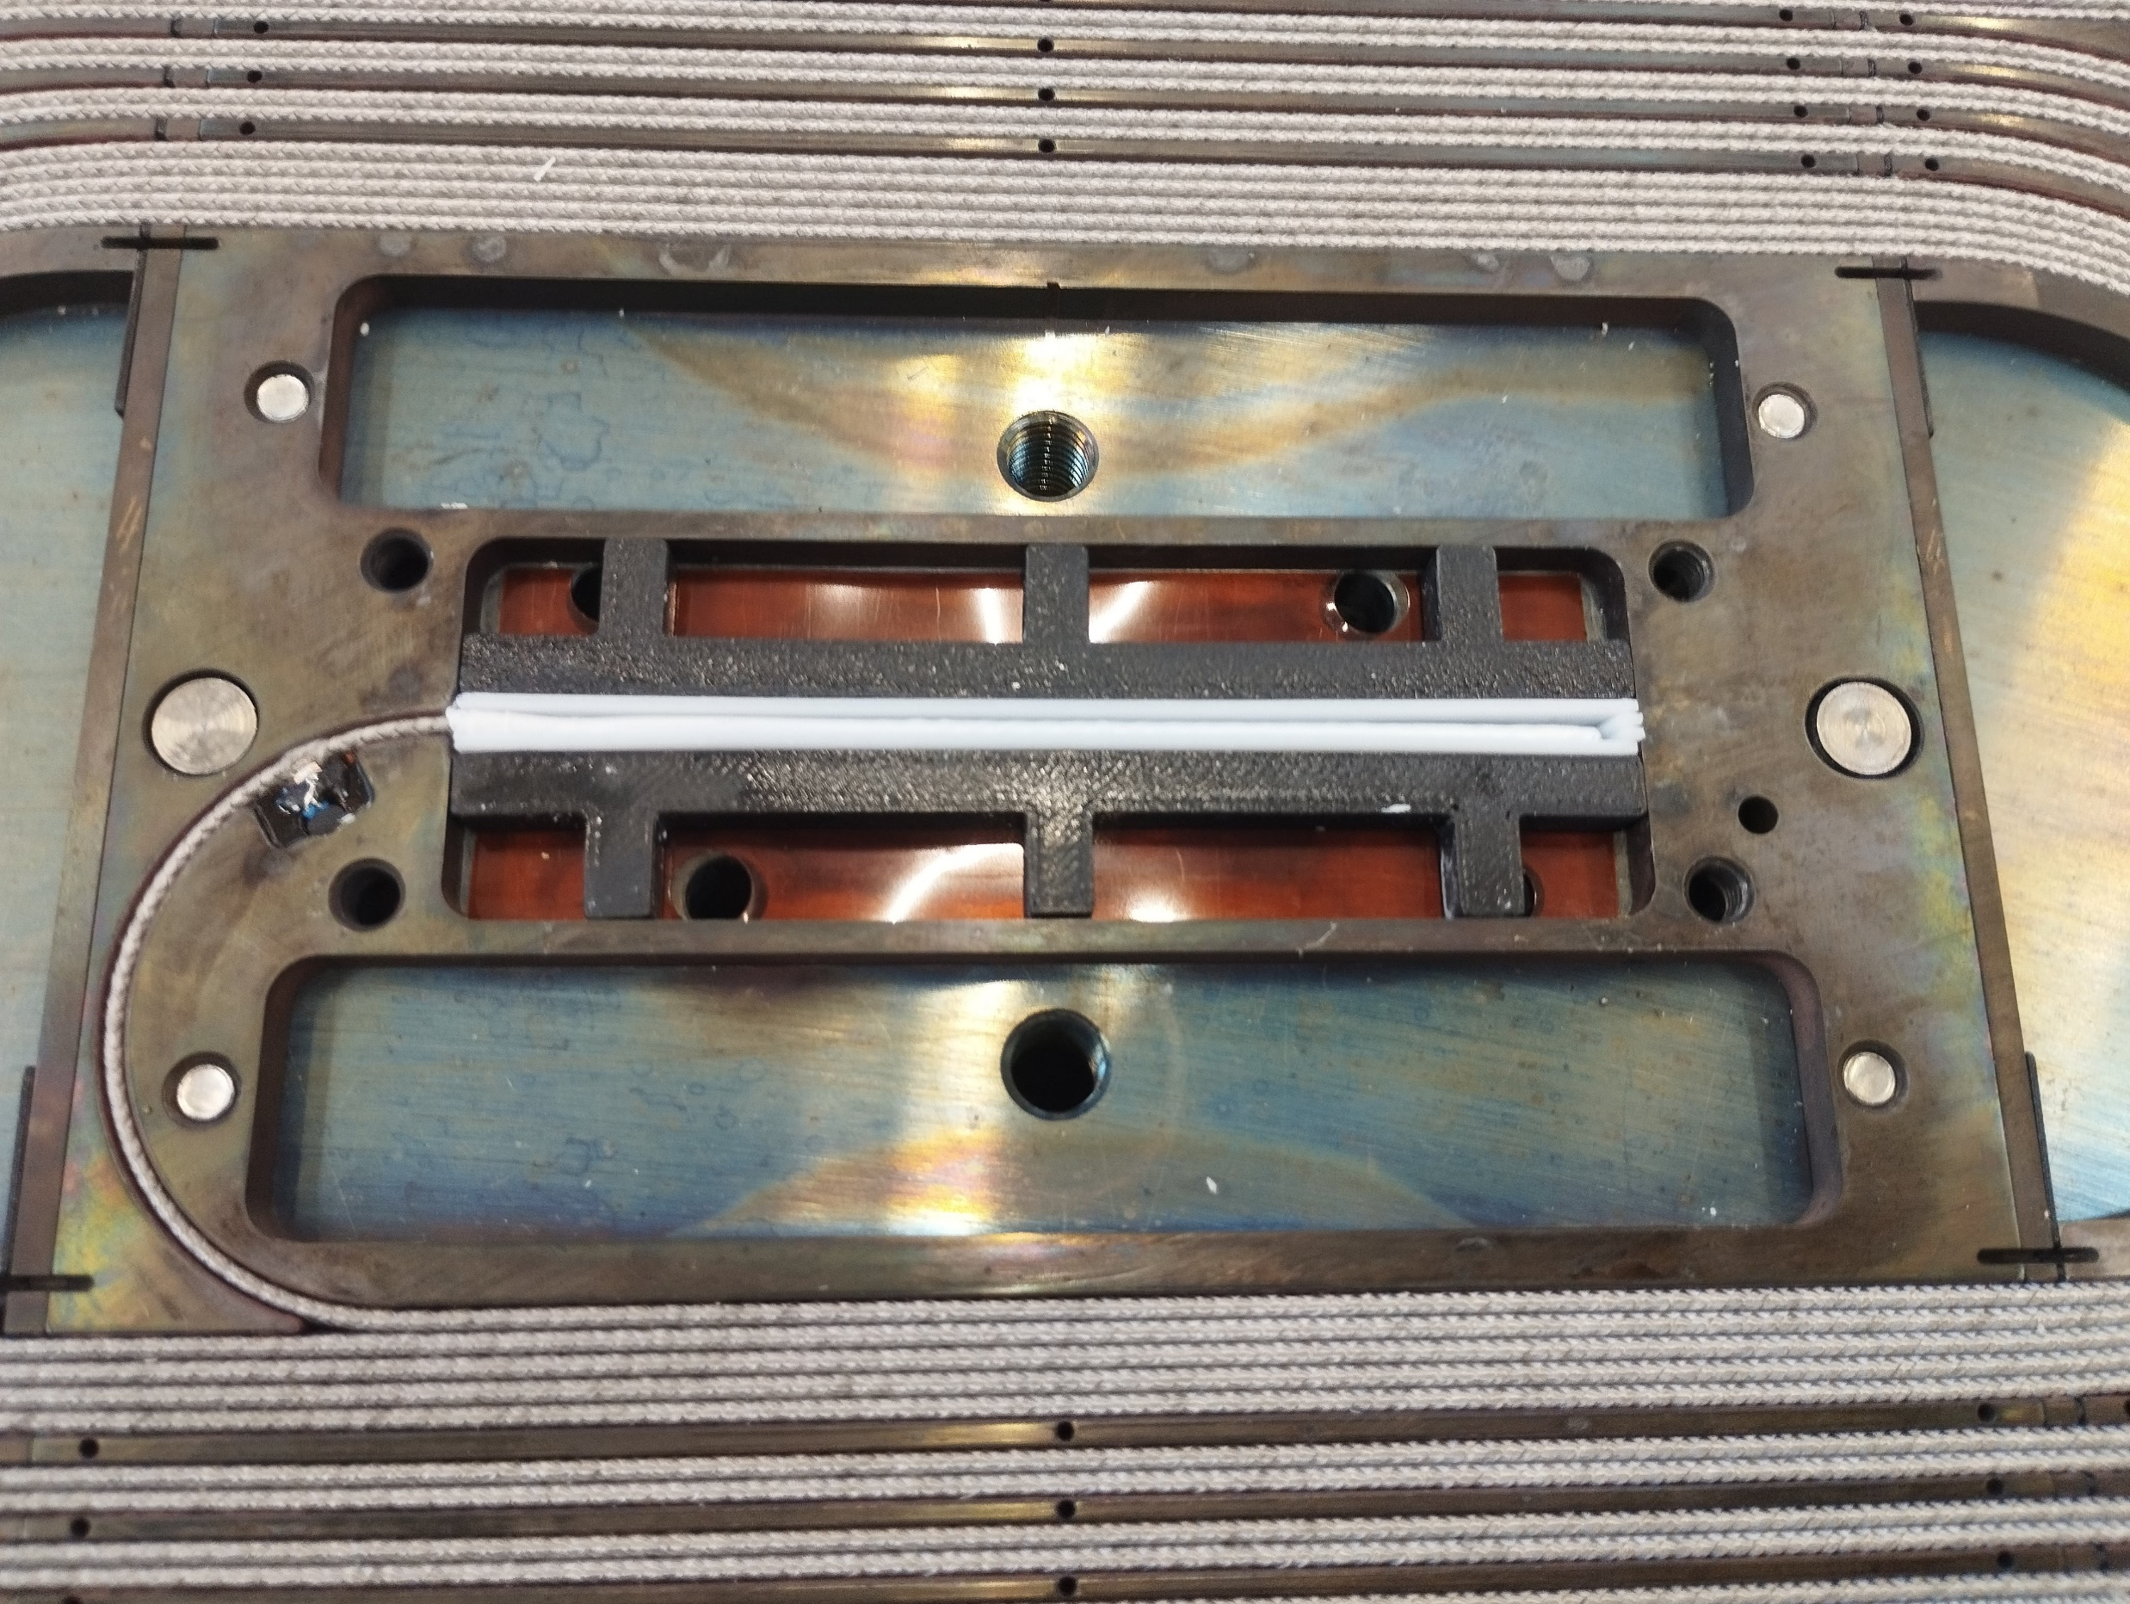
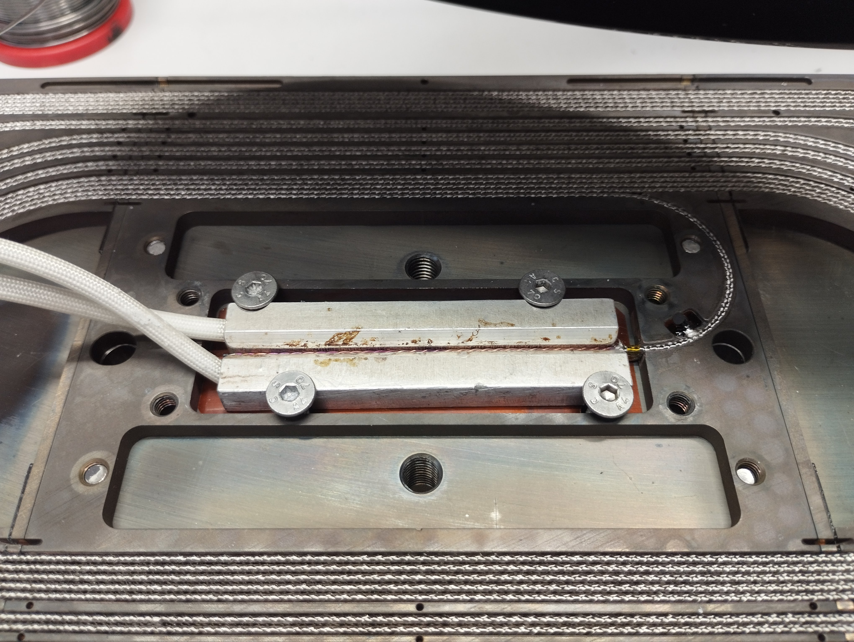
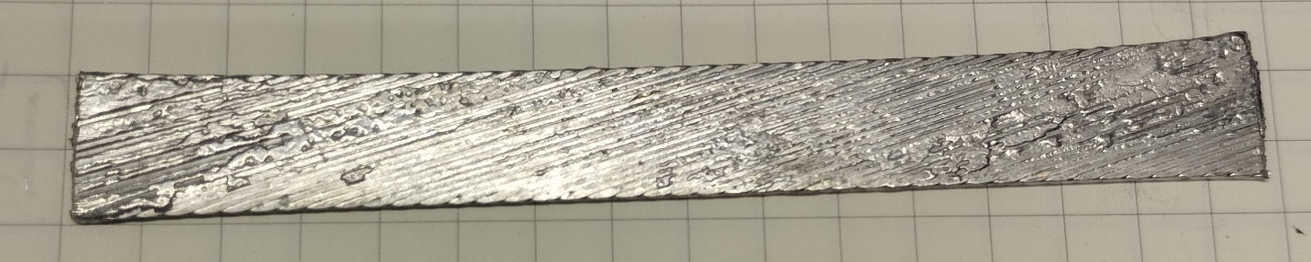
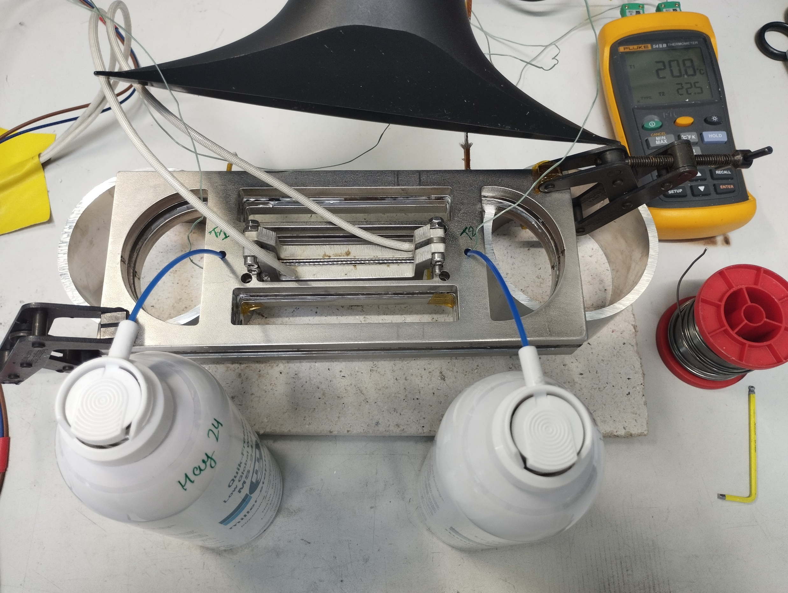
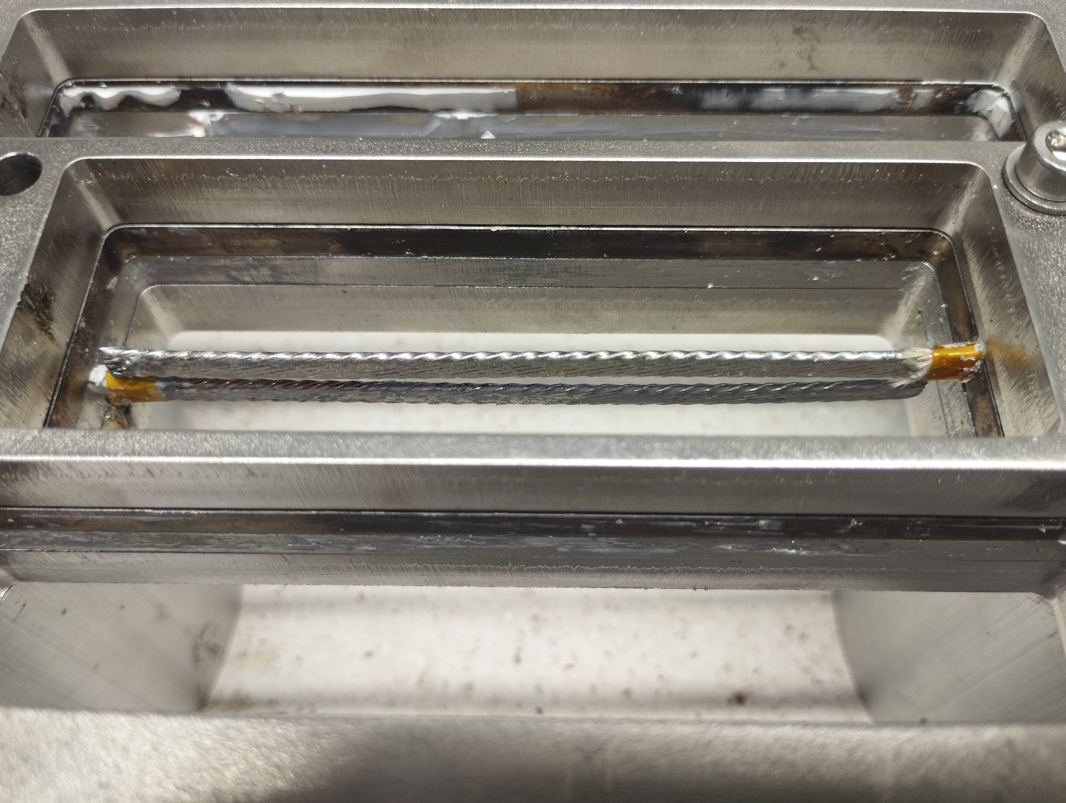
SubSMCC1 inner Splice
<= Pretinning with Tooling
Protection before Impegration=>
Teflon Tape
<= Trial to demonstrate Wachs will not melt
Soldered after Impegration=>
With 2 pretinned NbTi Cables
from each side, Cooling Spray and Temperature Measurement
PSI Center for Accelerator Science and Engineering A.Stampfli, (Courtesy T.Michlmayr, A.Brem)
Notes:
For SMACC it is not that delicate, because of bigger dimentions

Slide 5
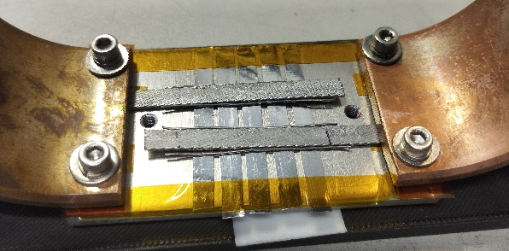
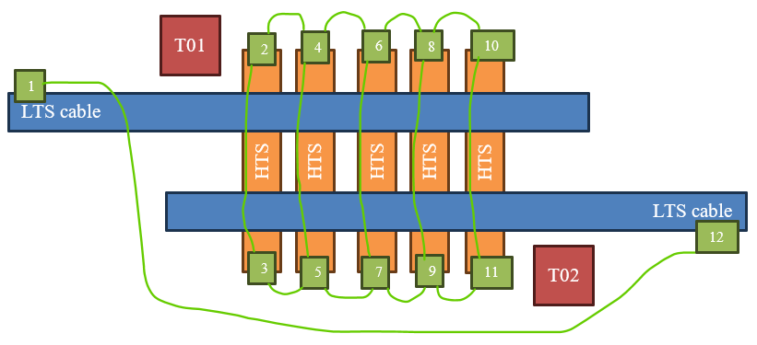
Splice V1
Why HTS Splices?
HTS Subscales planned
Possibility for SMACC1
Setup
4mm NbTi
5x 4mm pretinned HTS low grade tape
soldered with SnPb @195°C at heatingplate
12 positions for voltage taps
14 voltage measurement pairs
2 cernox temperature sensors
PSI Center for Accelerator Science and Engineering A.Stampfli, (Courtesy D. M. Araujo)
Notes:
Test setup for SMACC
Goal to find out how many tapes are needed
How small the soldering resistance will be

Slide 6
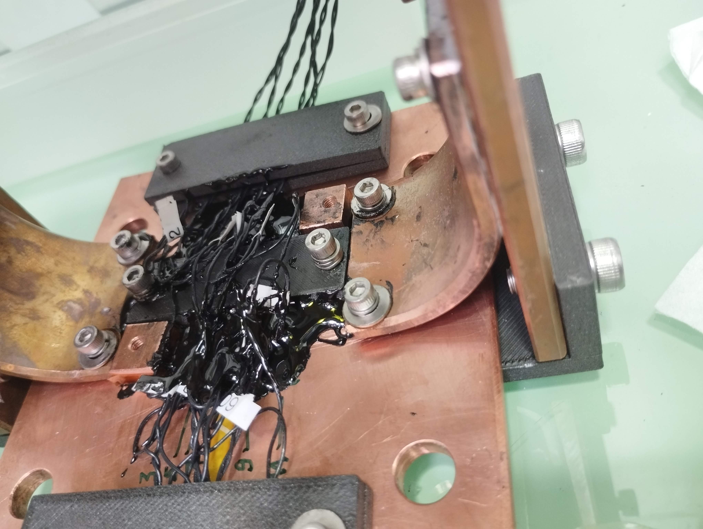
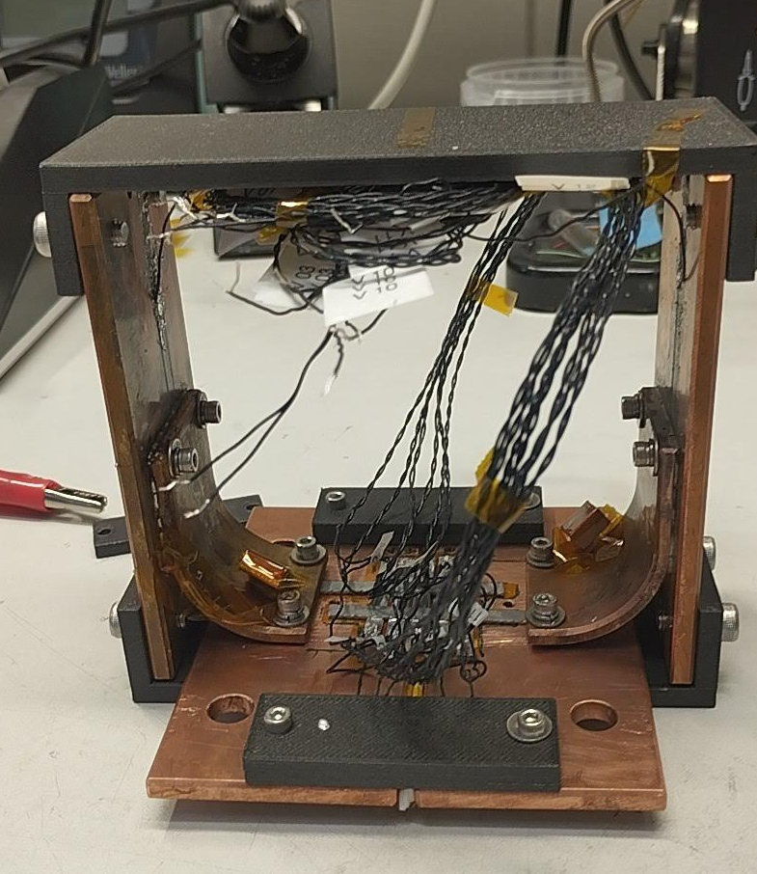
Splice V1
= insulated from each other
= soldered
PSI Center for Accelerator Science and Engineering A.Stampfli
Notes:
The ground plate consists of two pieces which are insulated from each other
And splice is insulated with kapton tape and stycast from ground plate

Slide 7
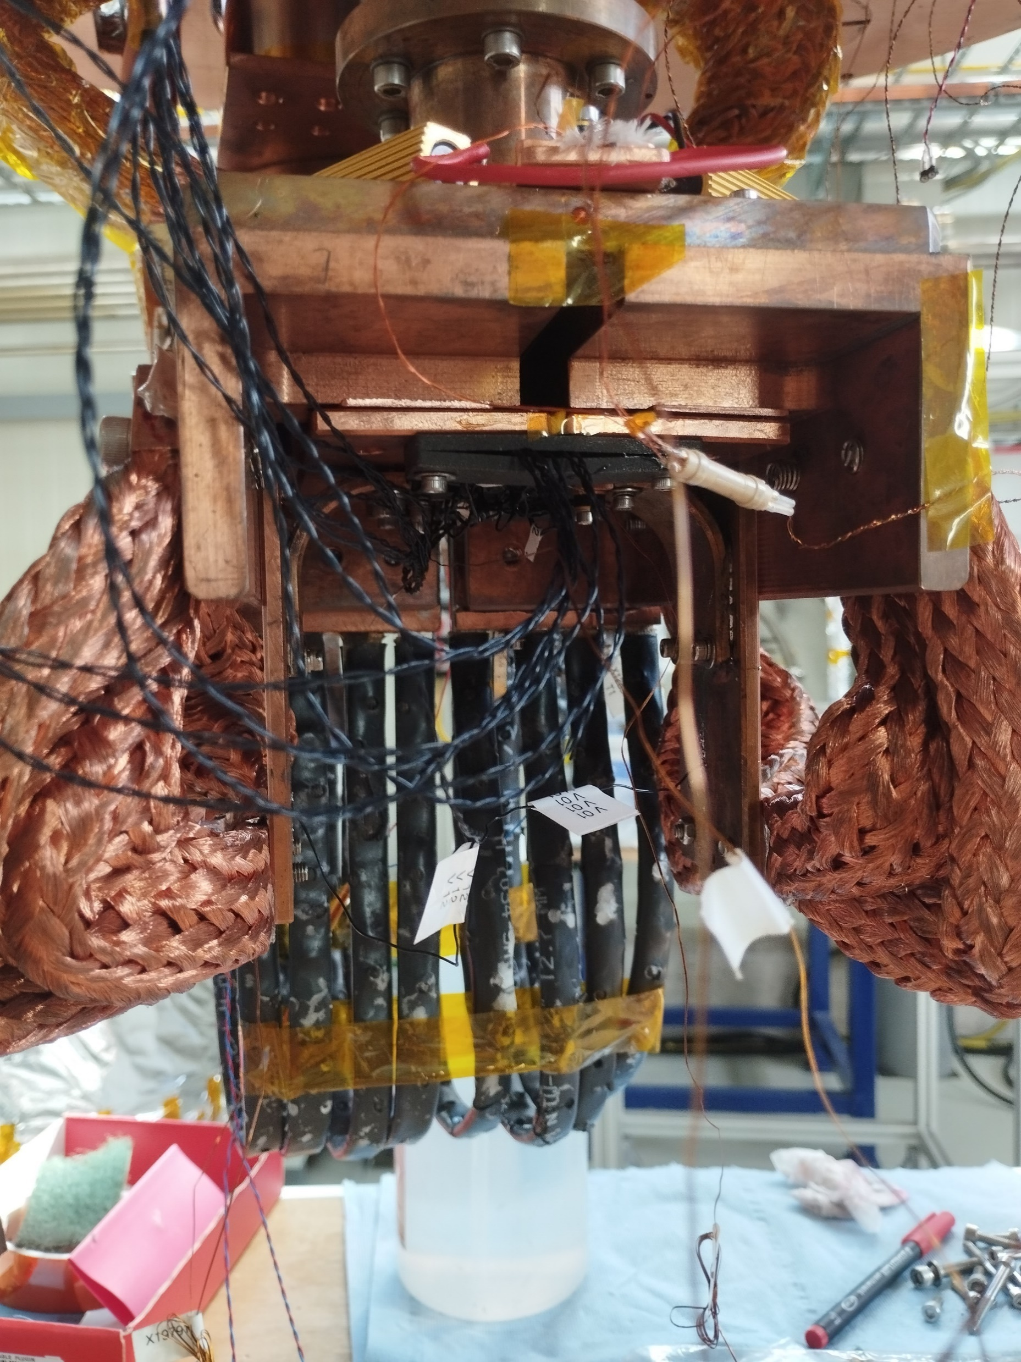
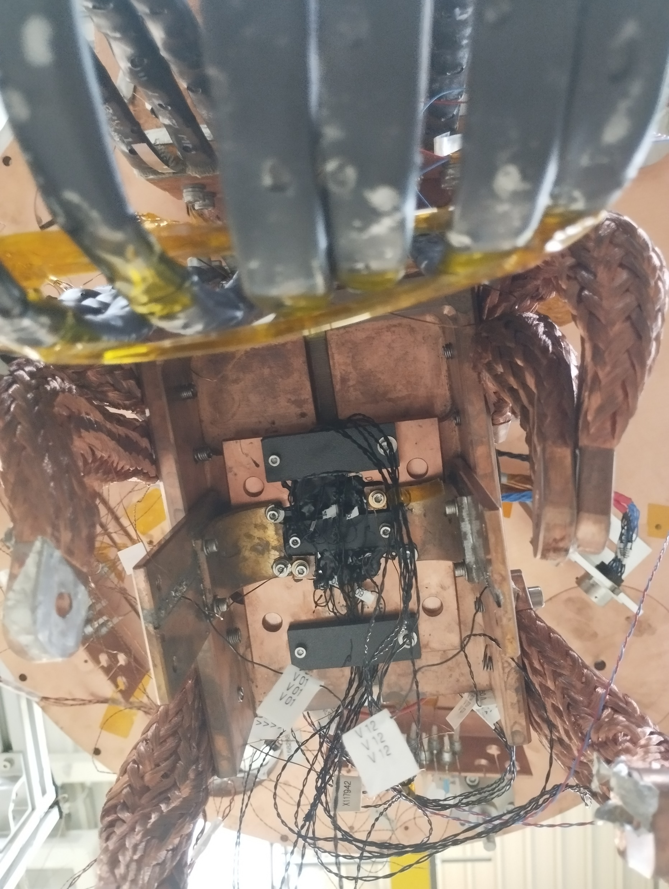
Splice V1
Integration into cryostat
Current leads from left and right
Bad thermal conductivity to the top, because of gap of 2mm
=> could only reach 6-8K
Notes:
Tried to fill the gap with additional 2mm cooper plates and heating paste

Slide 8
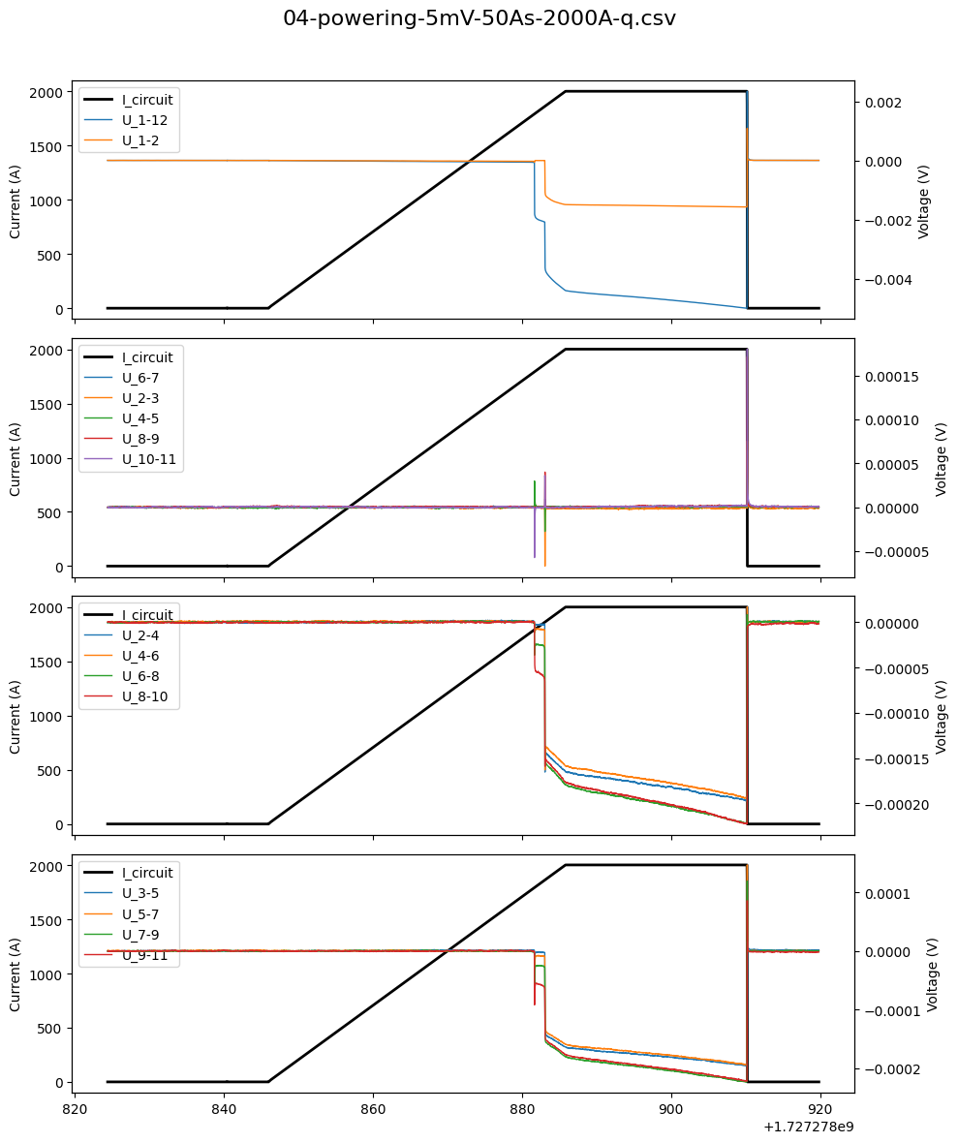

Splice V1
Tests & Results
Tried to reach 2kA with different ramp rates (10As -100As, steps of 10As)
5mV Treshhold for Quench protection
2 Quench like events at 1600 – 1900 A @ T1 = 9K, T2 = 11.5K
Total Resistance before = 30nΩ, after Quench Event = 2µΩ
$$R_{1Joint }=75 nΩ$$
Timestamp [s]
Notes:
No matter which ramp rate we always observed quench like events
2uOhm could come from small non superconductictive LTS section which are only around 1 cm per side, all the rest is suported by a lot of cooper, because the cable was soldered to the bending holder

Slide 9
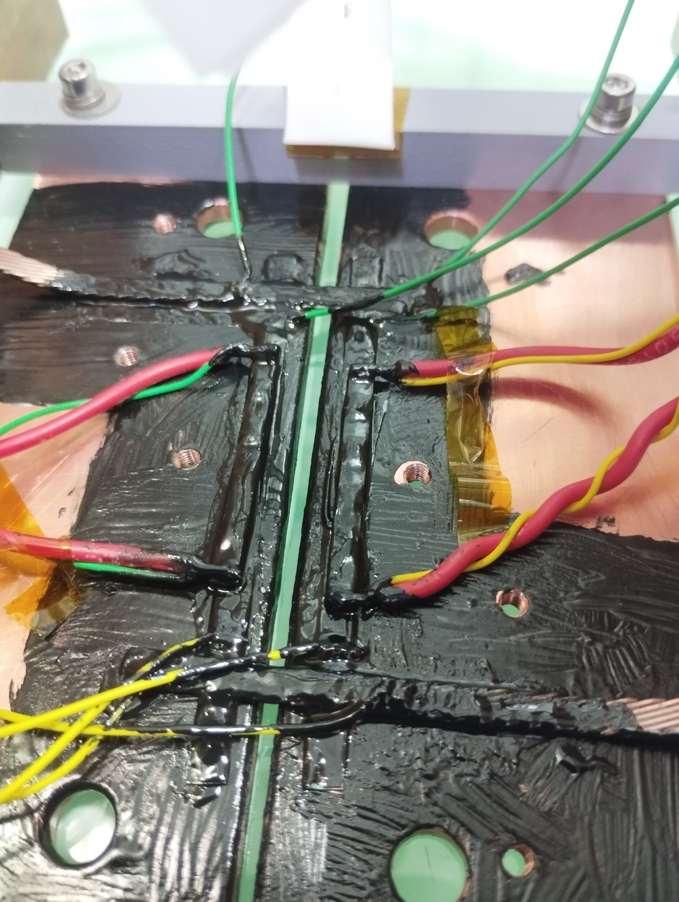
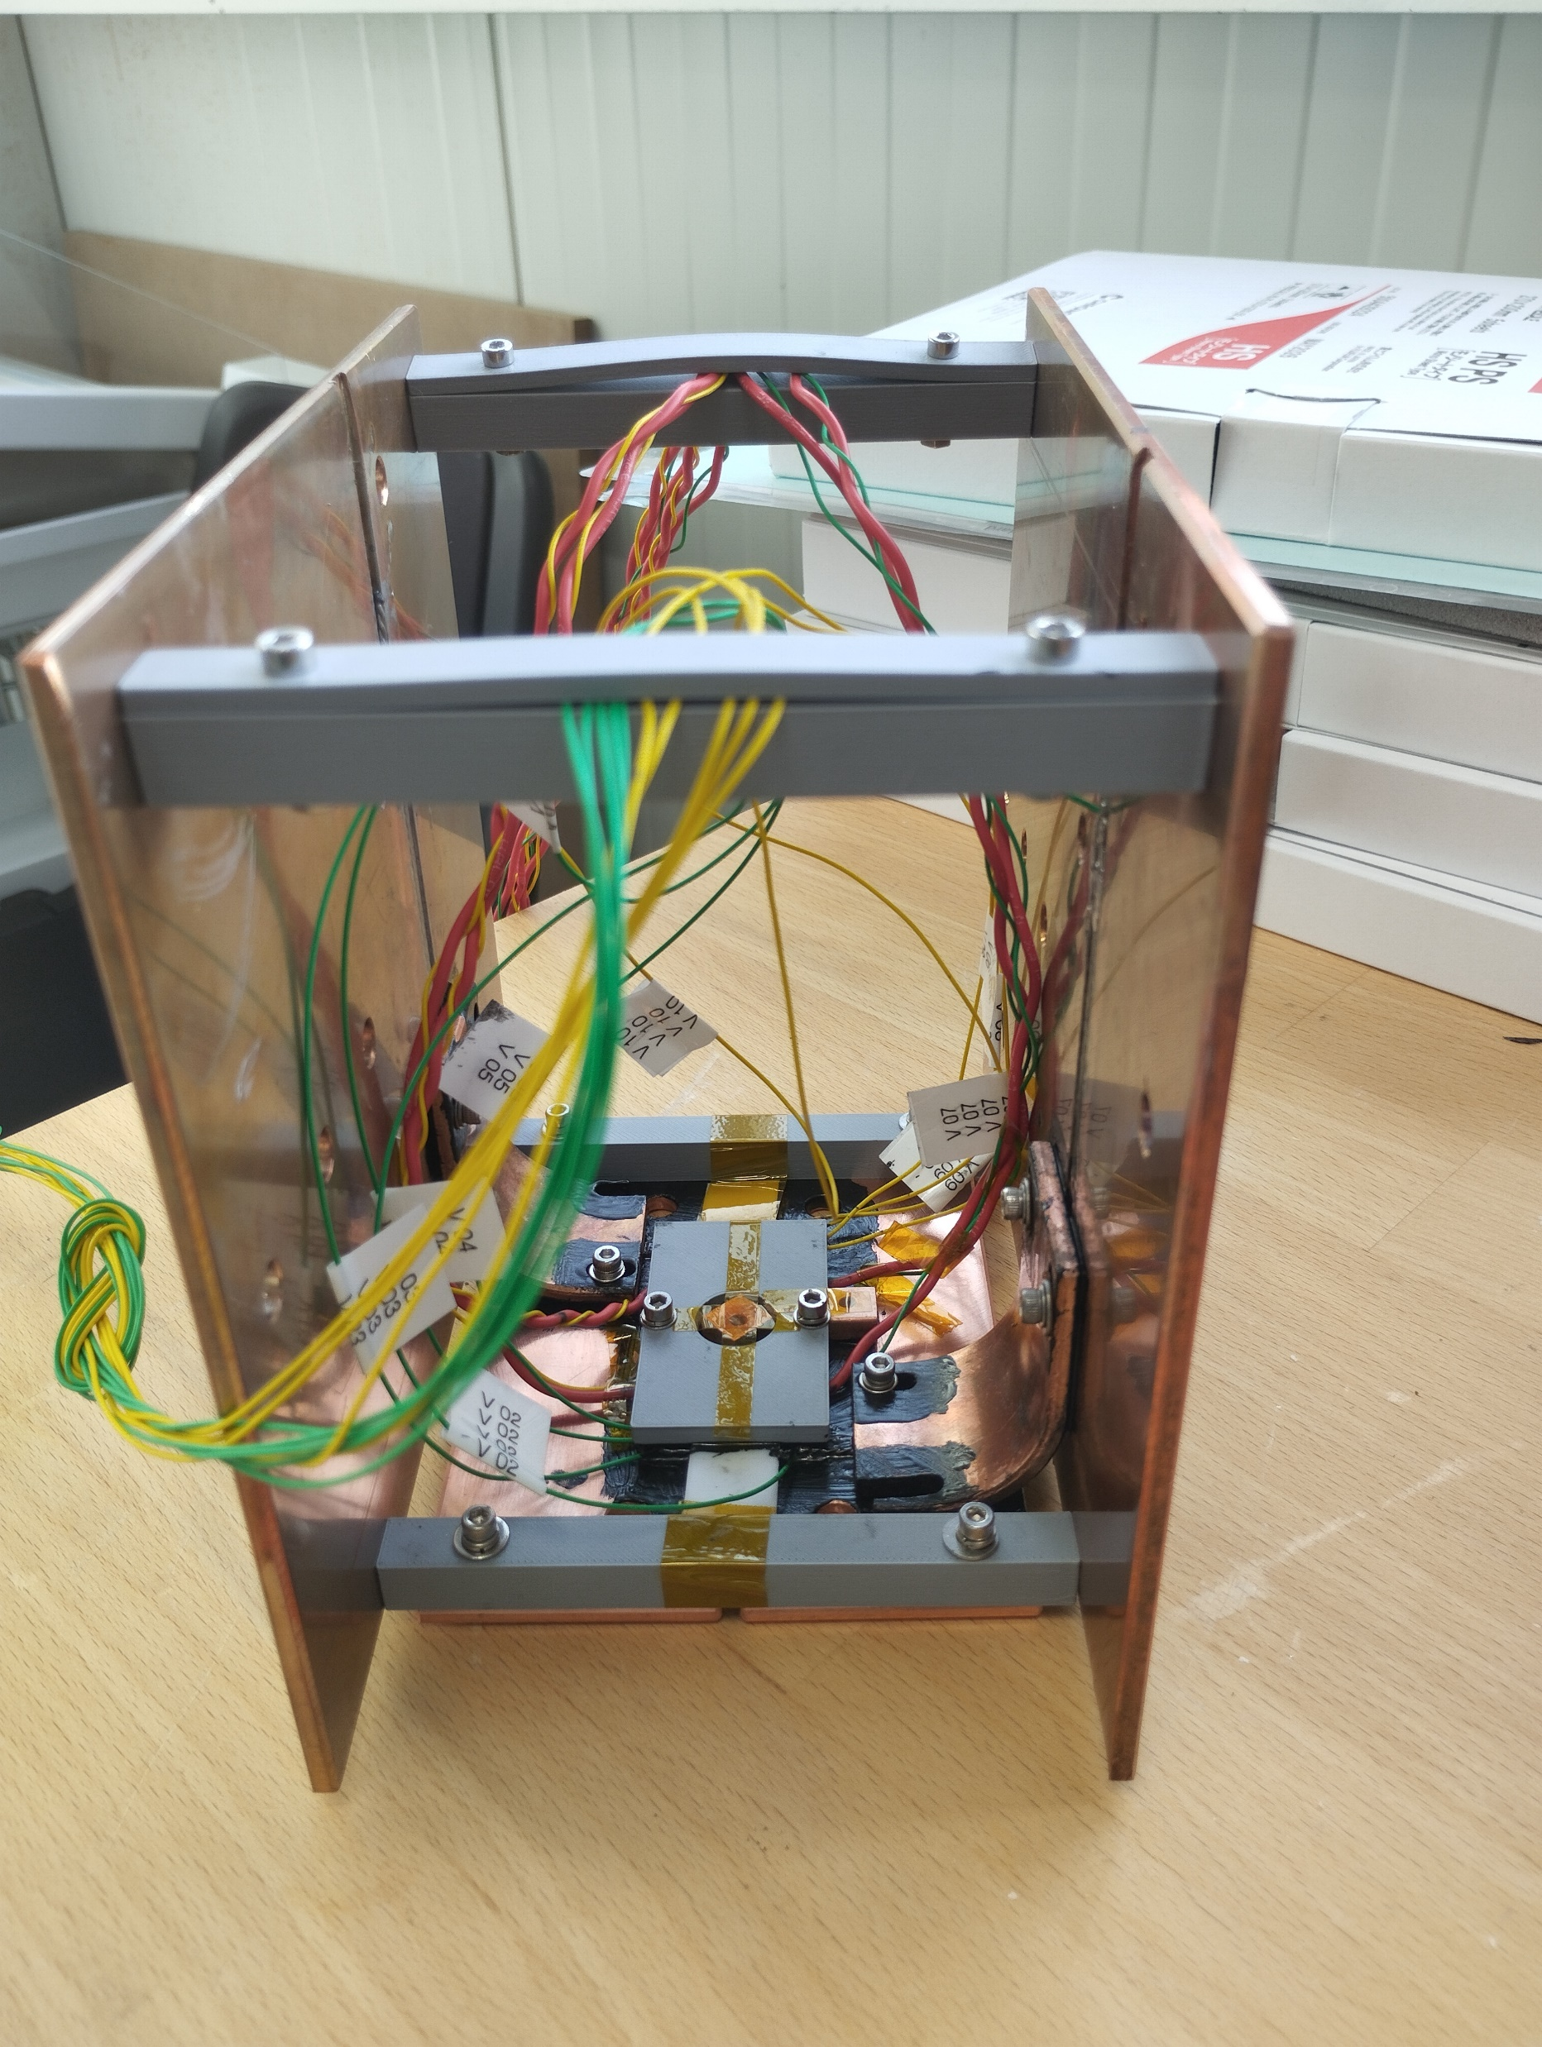
Splice V2 Nb₃Sn –HTS
Improvements
Reacted Nb₃Sn
Only 2 HTS tapes
Insulated only with stycast
Insulated from bended cooper part with stycast
Better thermal conductivity to top side
Heaters on each tape, to try to force all current to all tape
PSI Center for Accelerator Science and Engineering A.Stampfli, (Courtesy D. M. Araujo, M. Duda)

Slide 10
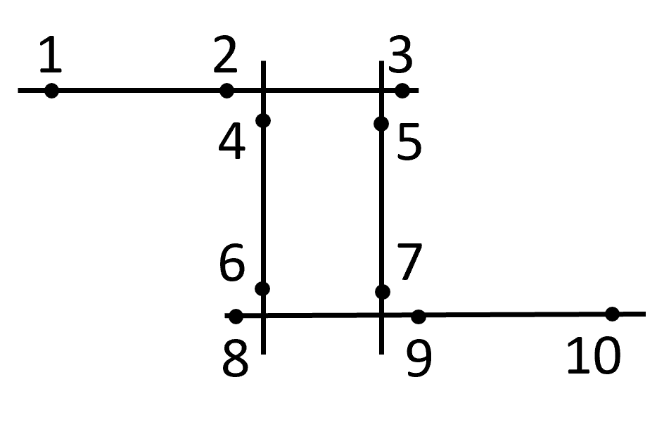
Splice V2 Nb₃Sn –HTS
Setup
bent r=25mm
HTS
1
2
3
LTS 1
-
4
5
Voltage Pairs:
LTS 1: V1-2; V2-3; V1-3
LTS 2: V8-9; V9-10; V8-9
HTS: V4-6; V5-7
R_1Joint: V2-4; V3-5; V6-8; V7-9;
Ts
Tc
Heater
Heater
HTS
HTS
6
7
+
8
9
10
LTS 2

Slide 11
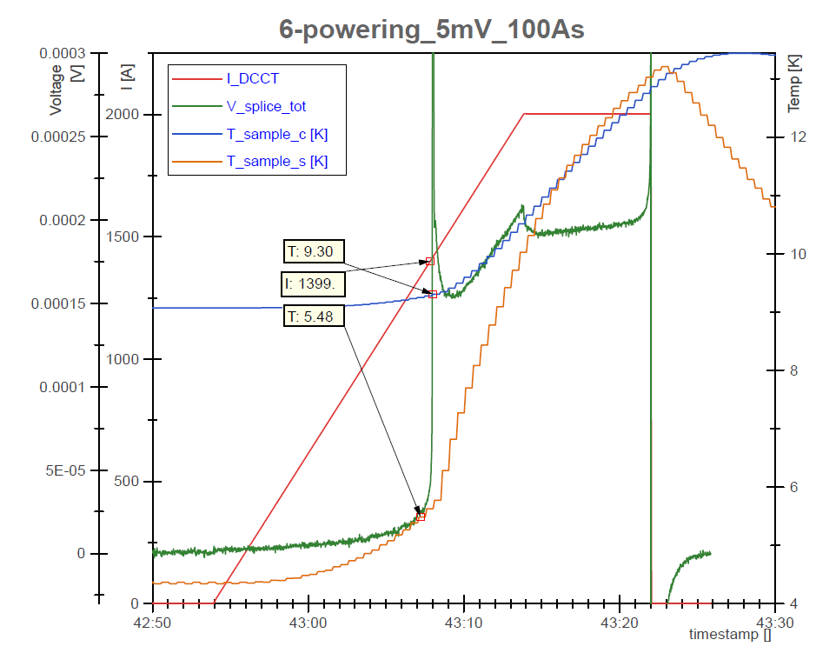
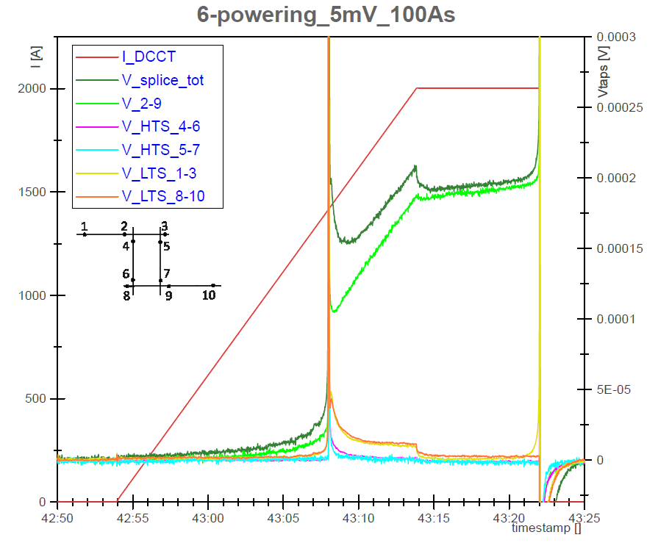
Splice V2 Nb₃Sn –HTS
Test & Results
Tried to reach 2kA with different ramp rates (10As, 50As, 100As, 200As)
PSI Center for Accelerator Science and Engineering A.Stampfli, (Courtesy M. Duda)

Slide 12
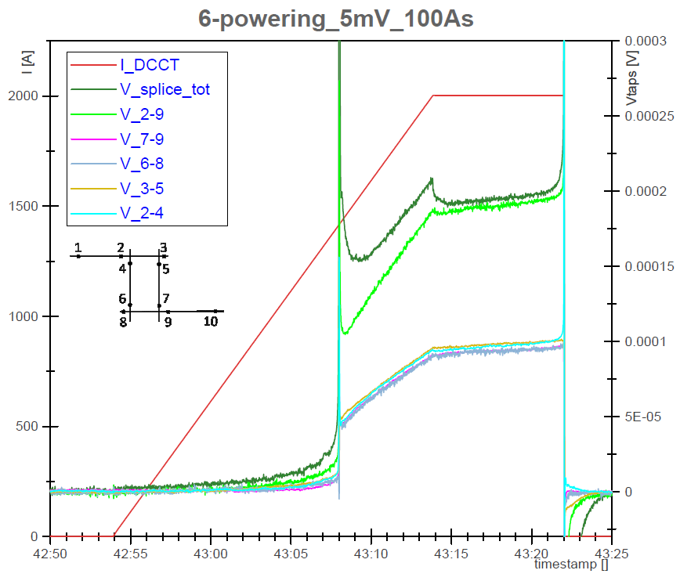
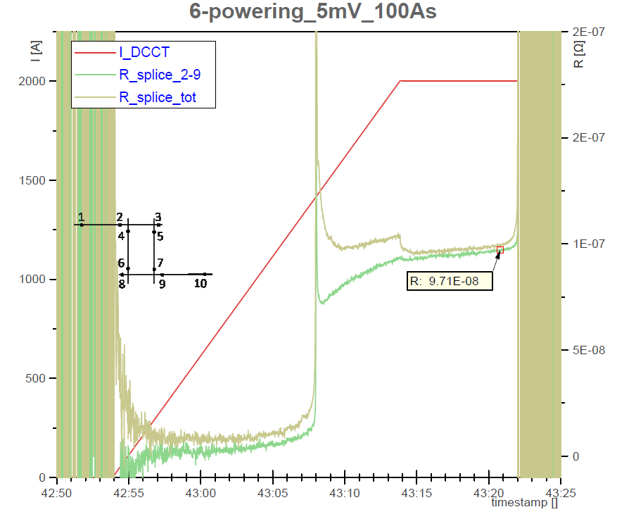

Splice V2 Nb₃Sn –HTS
Test & Results
Tried to reach 2kA with different ramp rates (10As, 50As, 100As, 200As)
$$R_{1Joint }=97 nΩ$$
PSI Center for Accelerator Science and Engineering A.Stampfli ( Courtesy M. Duda)

Slide 13
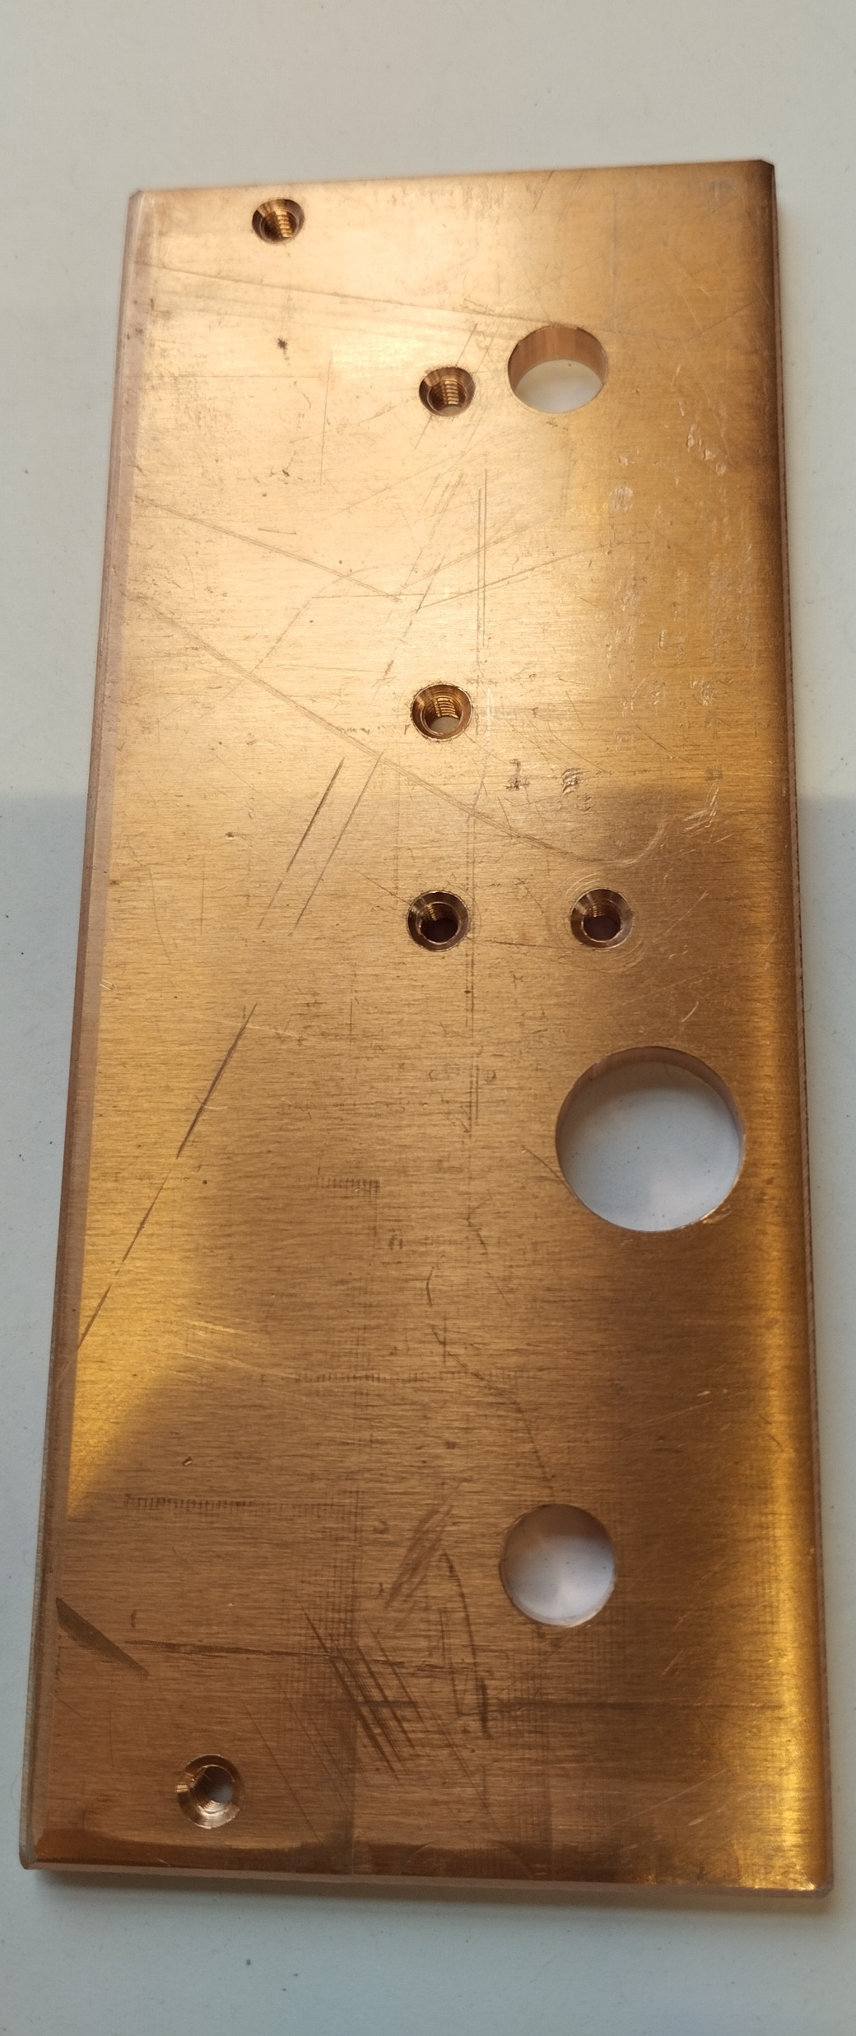
Splice V3 HTS - HTS
By Julia Haack
HTS to HTS Splice at 4K
Maybe with heaters
Improvements
Temperature sensor directly onto HTS Tapes from bottom
To be produced…
PSI Center for Accelerator Science and Engineering A.Stampfli (Courtesy D. M. Araujo, M. Duda, C.Müller)

Slide 14
Conclusion
NbTi worked well for SubSMCC1
HTS Splices
  needed for HTS subscale Magnet
  maybe easier if coils 1-4/2-3 or 1-3/2-4 need to be connected
  Need less space
  => with 10 As ramping rate and 2x 4mm low grade HTS Tapes reached 1730 A (Cryocooled)
  Could be upscaled to 10…20… kA
For SMACC1:
NbTi or HTS Splice possible

