Slide 1
Instrumentation and Bladder Tests
For SMACC1 and from SubSMCC1
This work was performed under the auspices of and with support from the Swiss Accelerator Research and Technology (CHART) program.
Anna Stampfli, D. M. Araujo, C.Müller (Courtesy T.Michlmayr, A.Brem)
Villigen PSI, 14 Januar 2025, SMACC1 Review
Notes:
T.Michlmayr, C.Müller, A.Brem, D. M. Araujo,

Slide 2
Agenda
SMACC1 Observables
Bladder Tests
subSMCC1:
SG (Strain Gauges) Development
SG Experience and Results
Voltage Taps

Slide 3


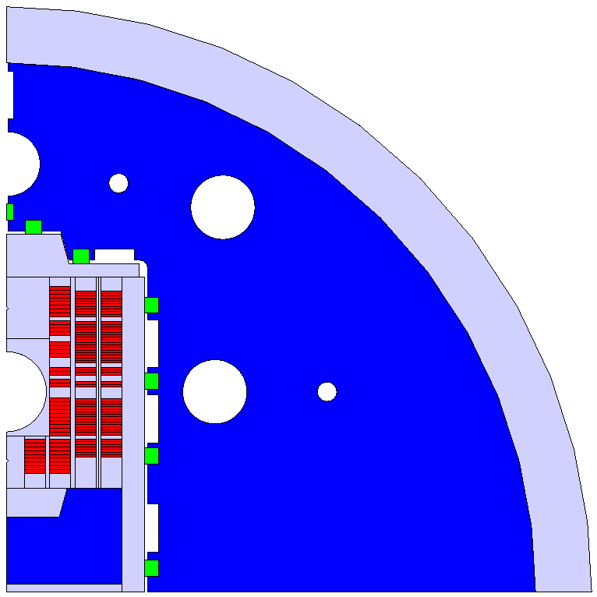
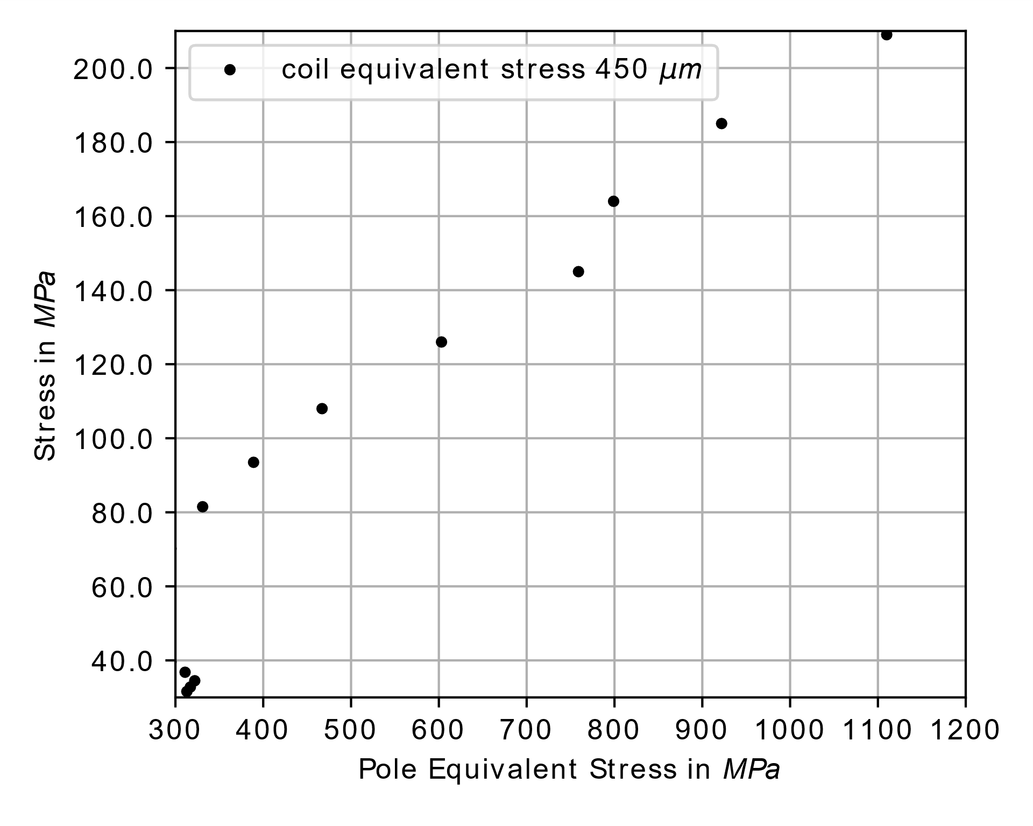
SMACC1 | Observables
Poles
Pole Equivalent Stress – Coil Equivalent Stress Correlation

Slide 4
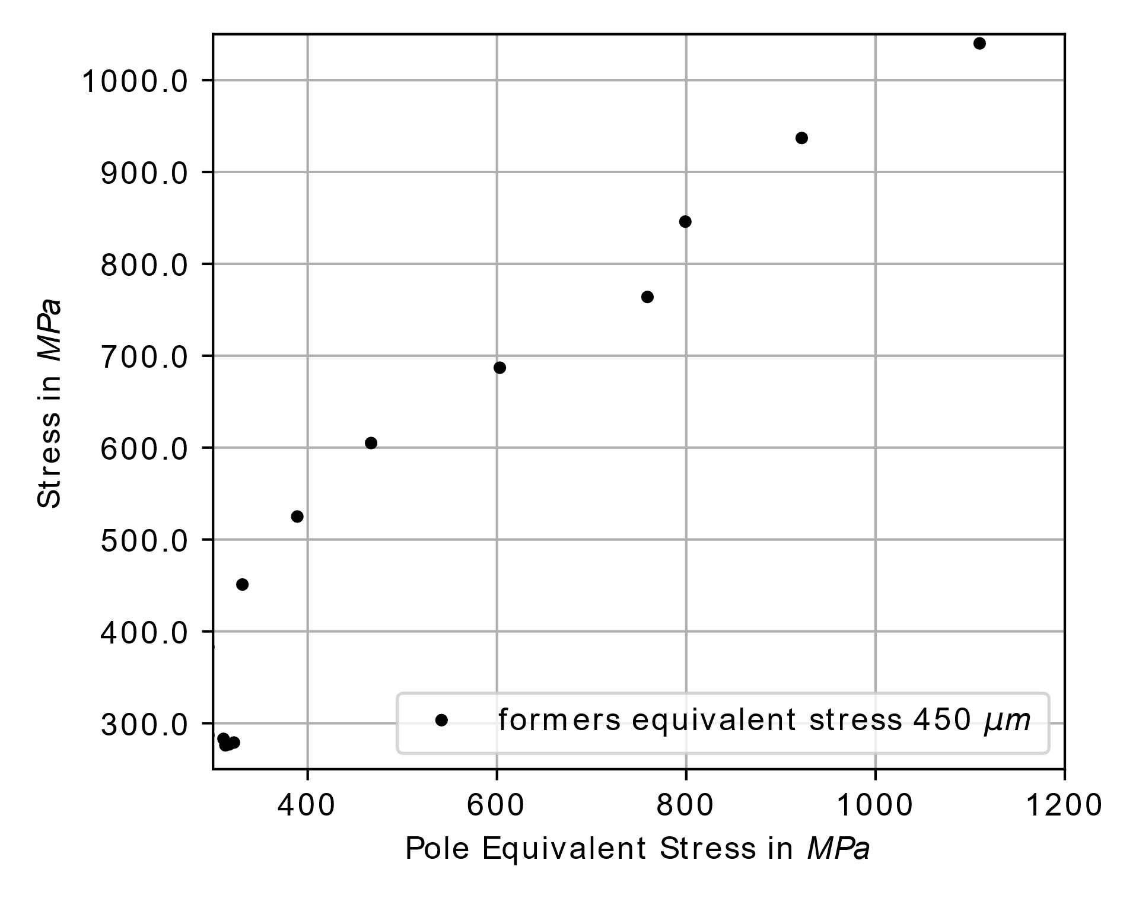
SMACC1 | Observables
Poles
Pole Equivalent Stress – Former Equivalent Stress Correlation

Slide 5
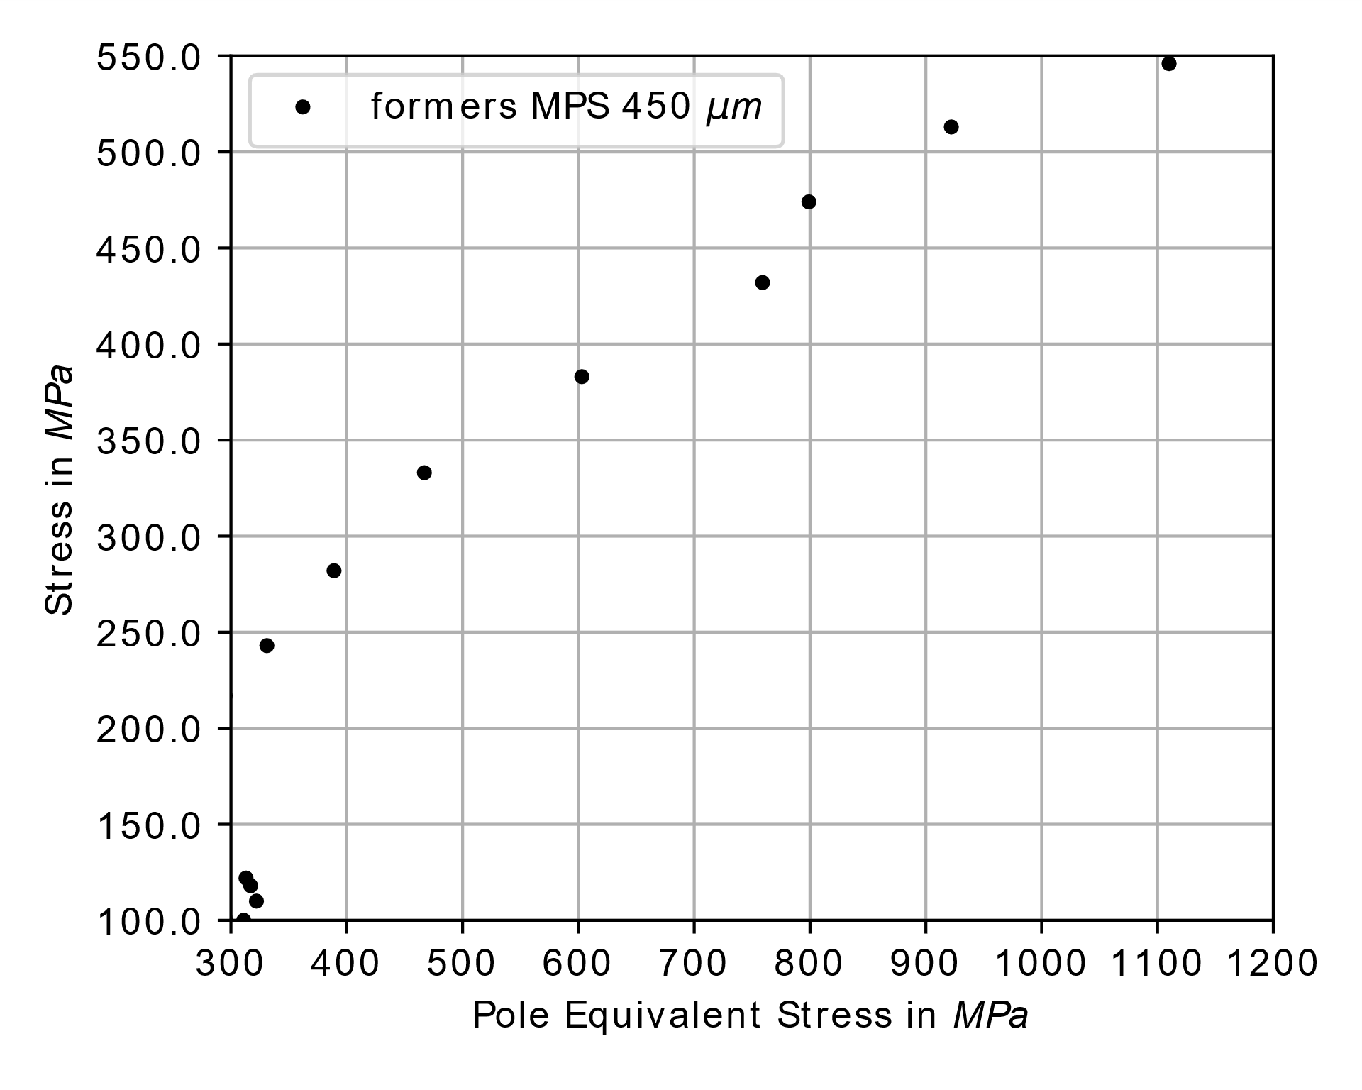
SMACC1 | Observables
Poles
Pole Equivalent Stress – Former Max Principal Stress Correlation

Slide 6
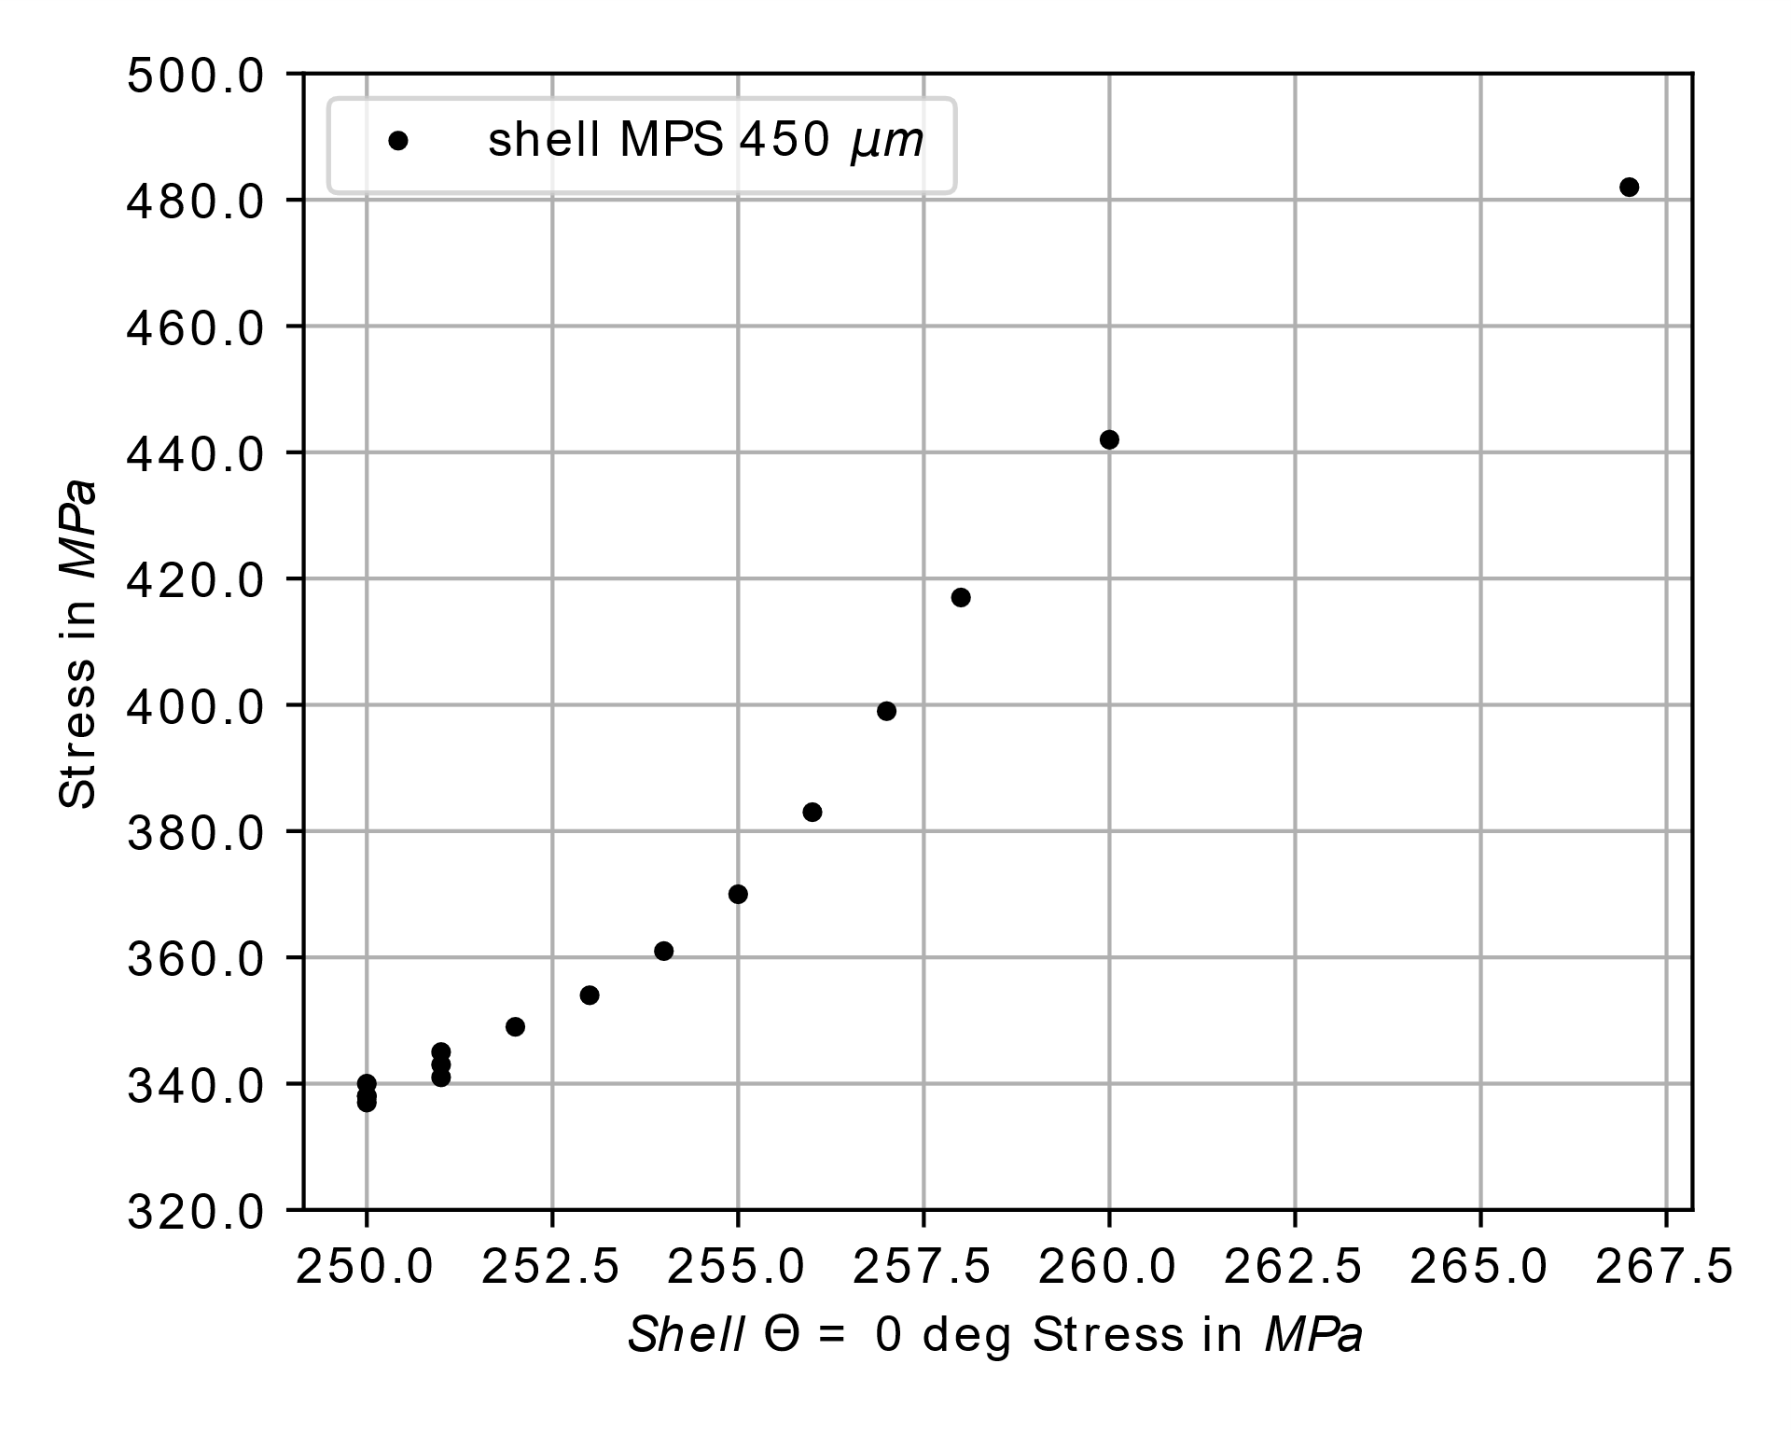
SMACC1 | Observables
Shell
Shell Azimuthal Stress – Shell Max Principal Stress Correlation
0 deg

Slide 7
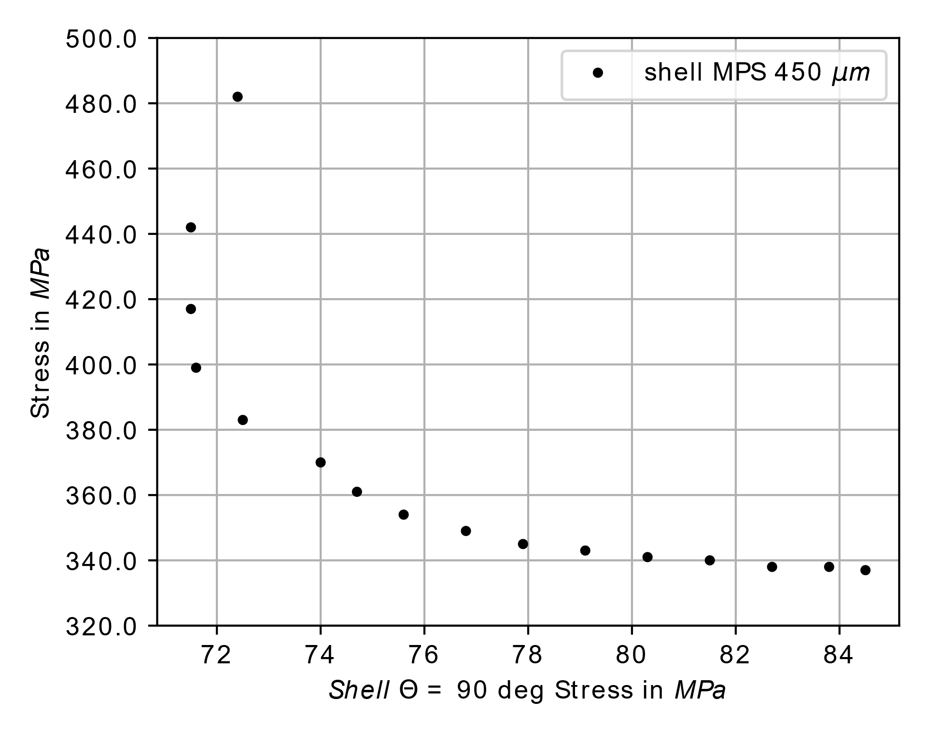
SMACC1 | Observables
Shell
Shell Azimuthal Stress – Shell Max Principal Stress Correlation
90 deg

Slide 8
SMACC1 | Observables
Pole
Shell 0 deg
Shell 45 deg
Rods
0 deg

Slide 9
SMACC1 | Instrumentation
Nomenclature of voltage taps (former 1)
V1.1 (after inner splice)
V1.2 (before outer splice)
V1.3 (after outer splice)
VF.P
Former
number
Position
number

Slide 10
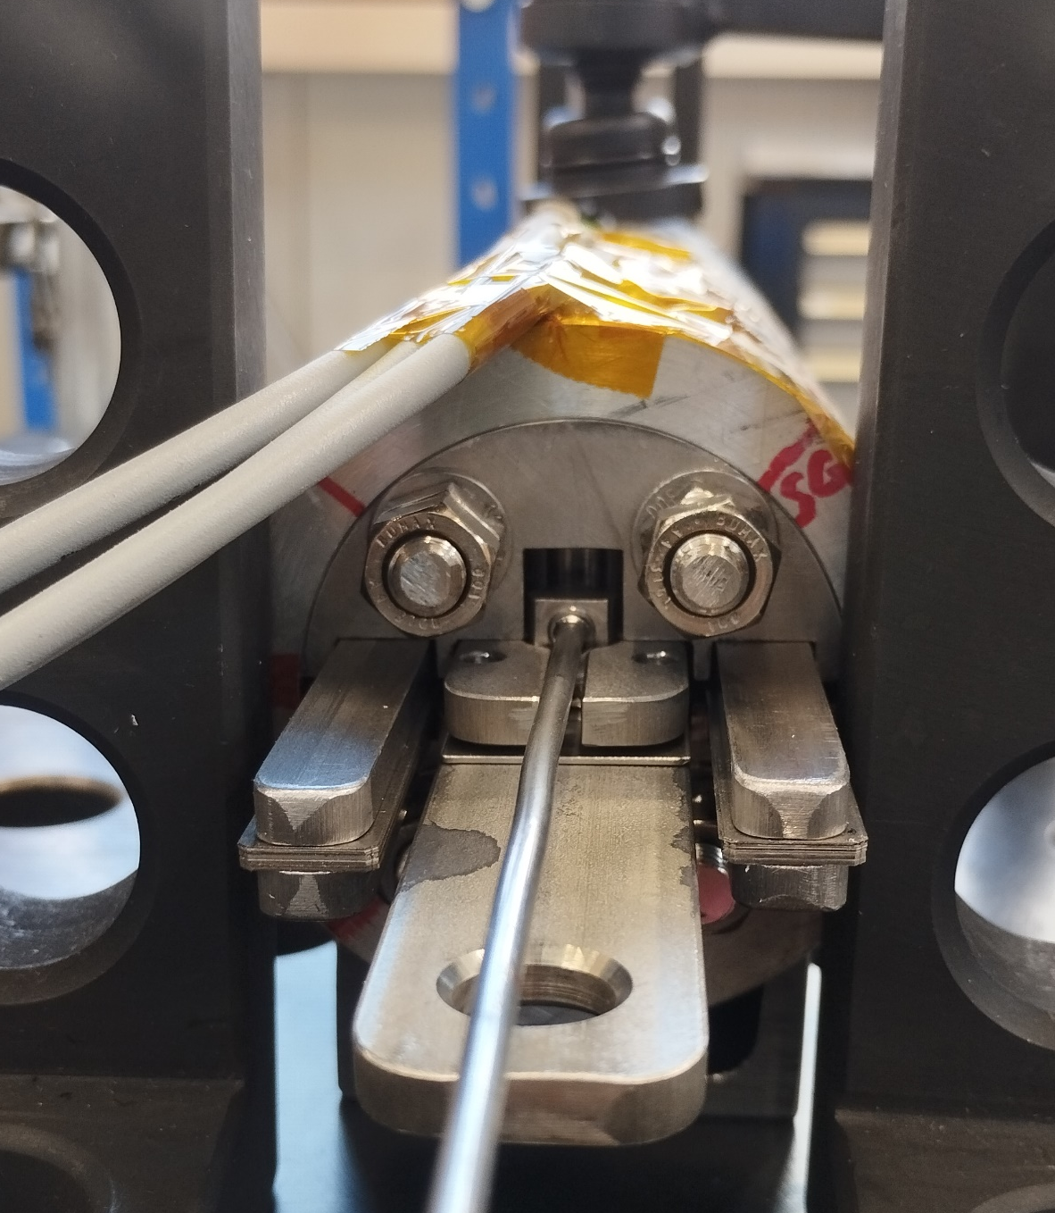
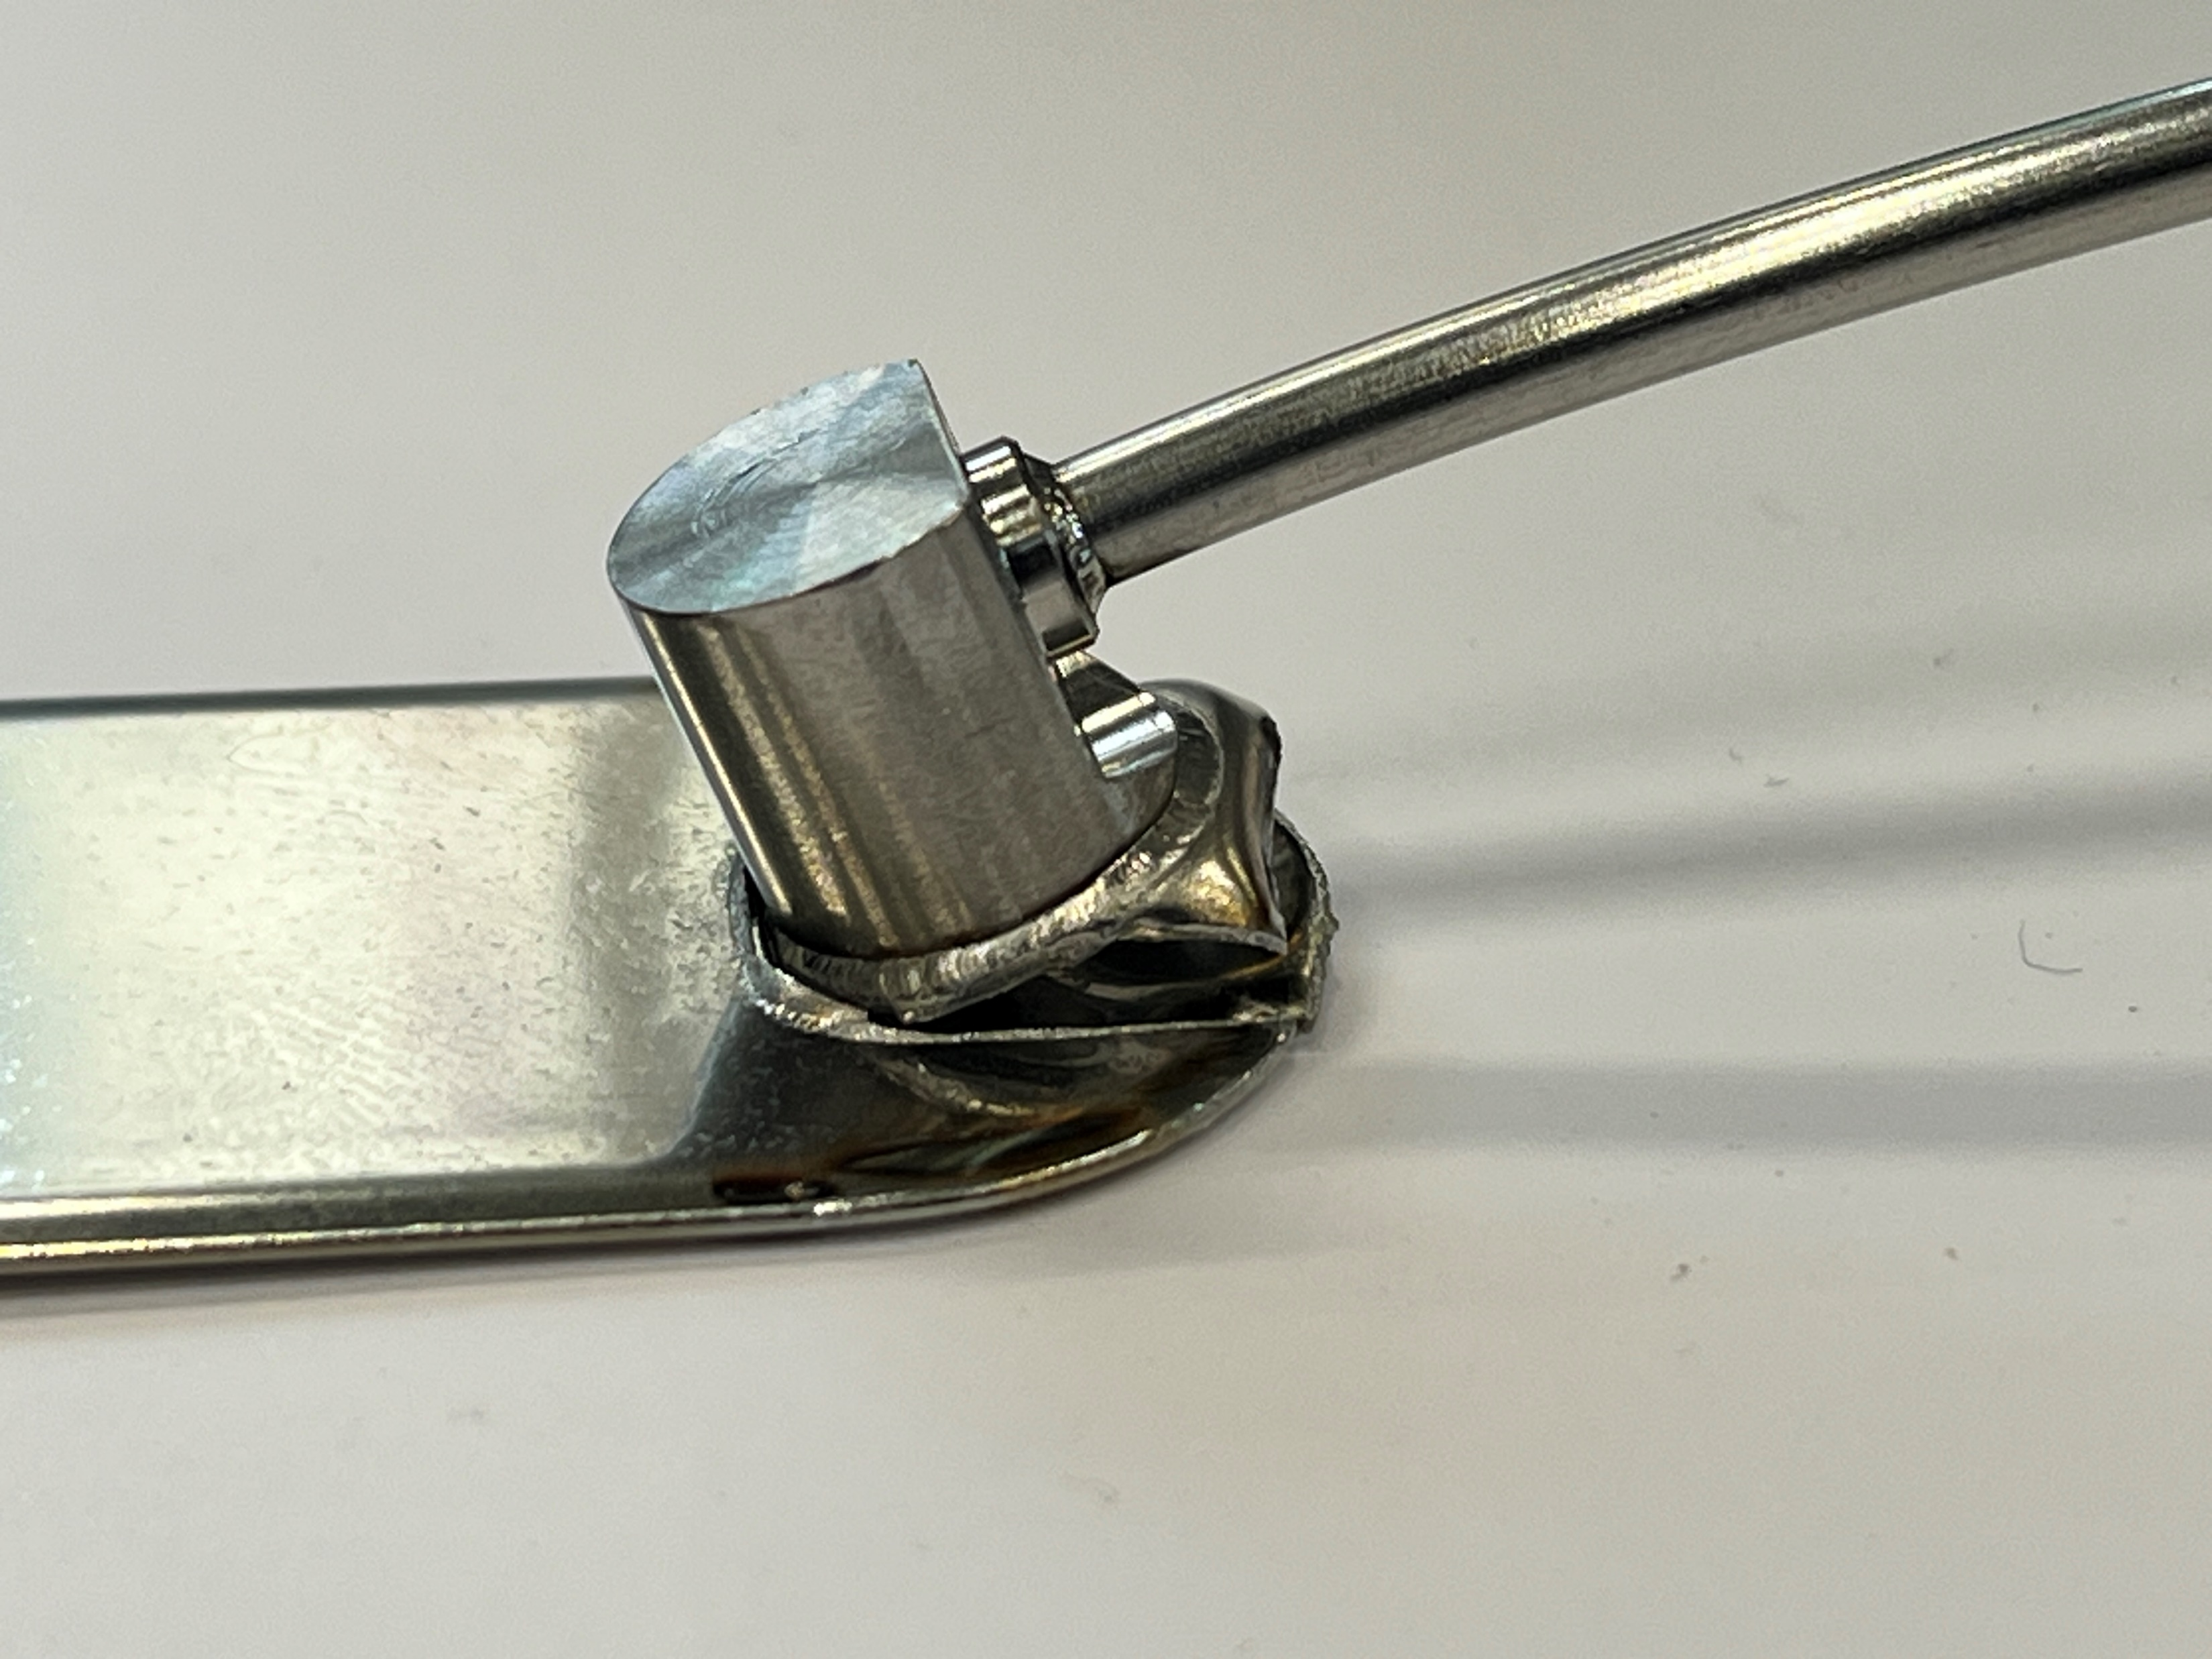
Bladder Tests
keys
Setup
SMACC Bladder design
Keys and bladder shimed
3 Strain Guages at 45°
Aluminium shell
1st Bladder Test
Broken at 400 bar
No proper shimming procedure possible
bladder
& support plates

Slide 11
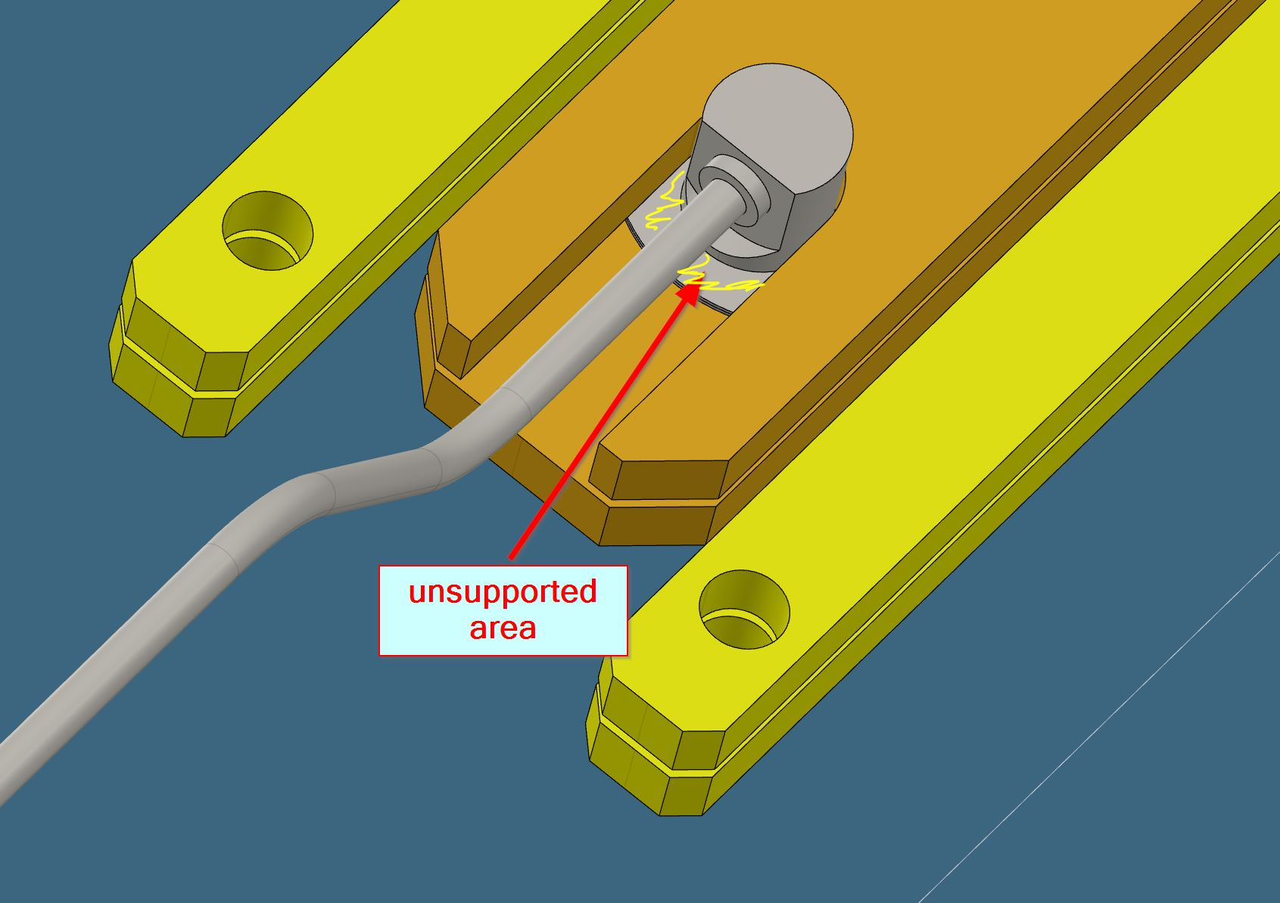
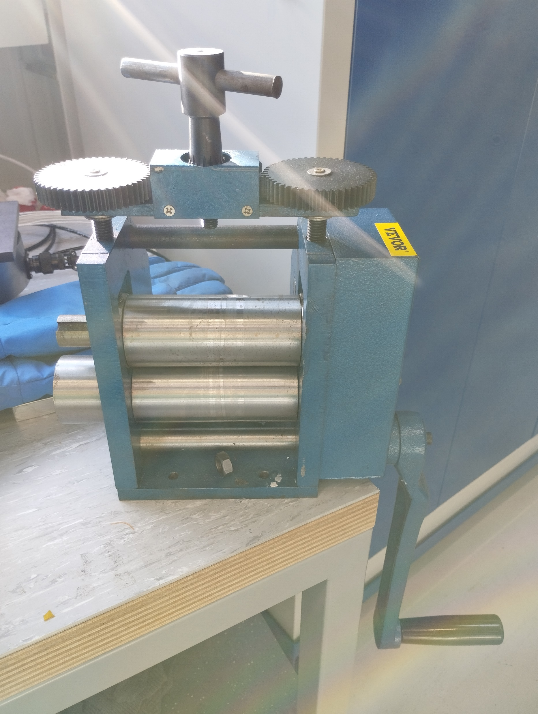
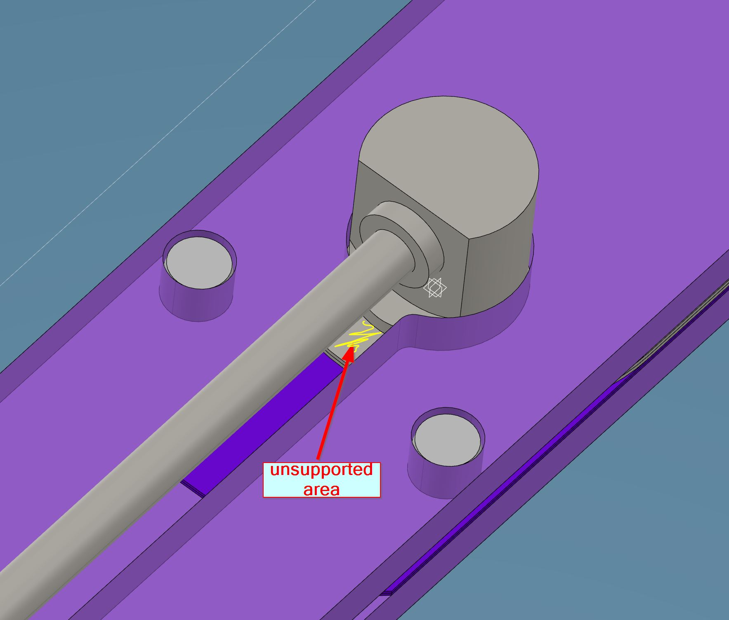
Bladder Test
2nd Bladder Test
Improved design to reduce unsupported area
700 bar reached
flattened with a mill
800 bar reached
No proper shimming procedure possible
More cycles...
  2x 700 bar + flattened + broken at 840 bar
=> 1st Bladder Design: broke after 5x cycles >700bar
To be continued…
new Bladder Design: 0.4mm thick (before 0.3mm)
mill

Slide 12
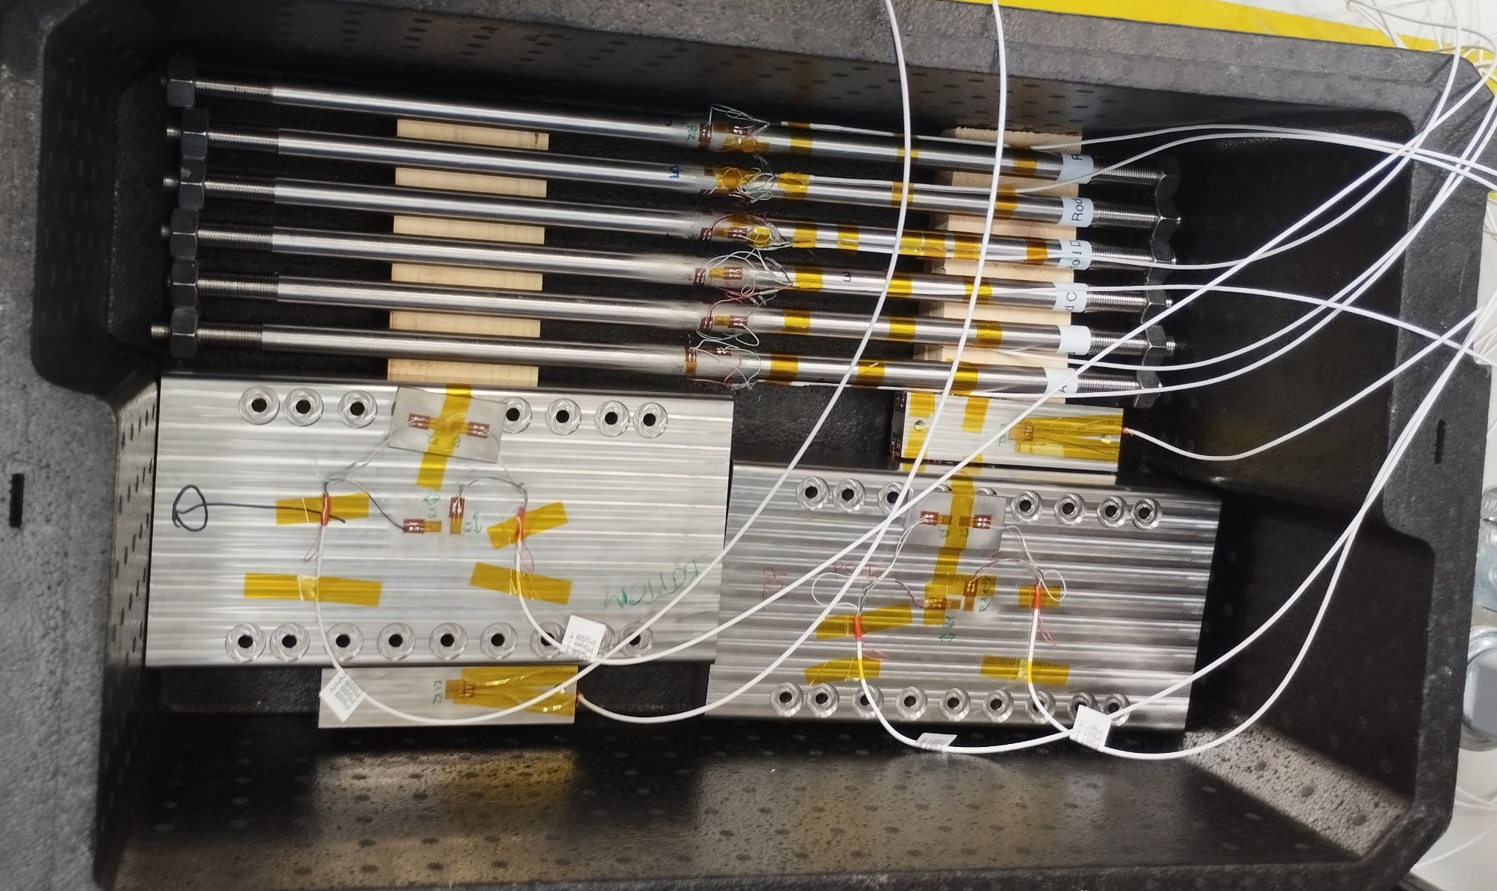
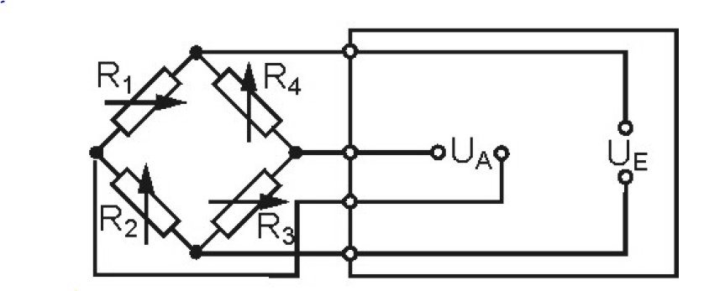
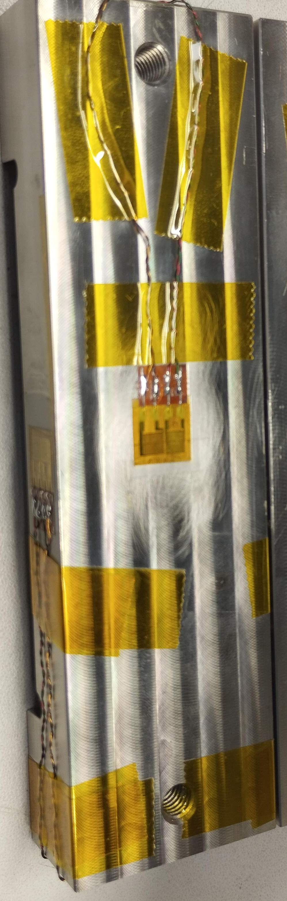
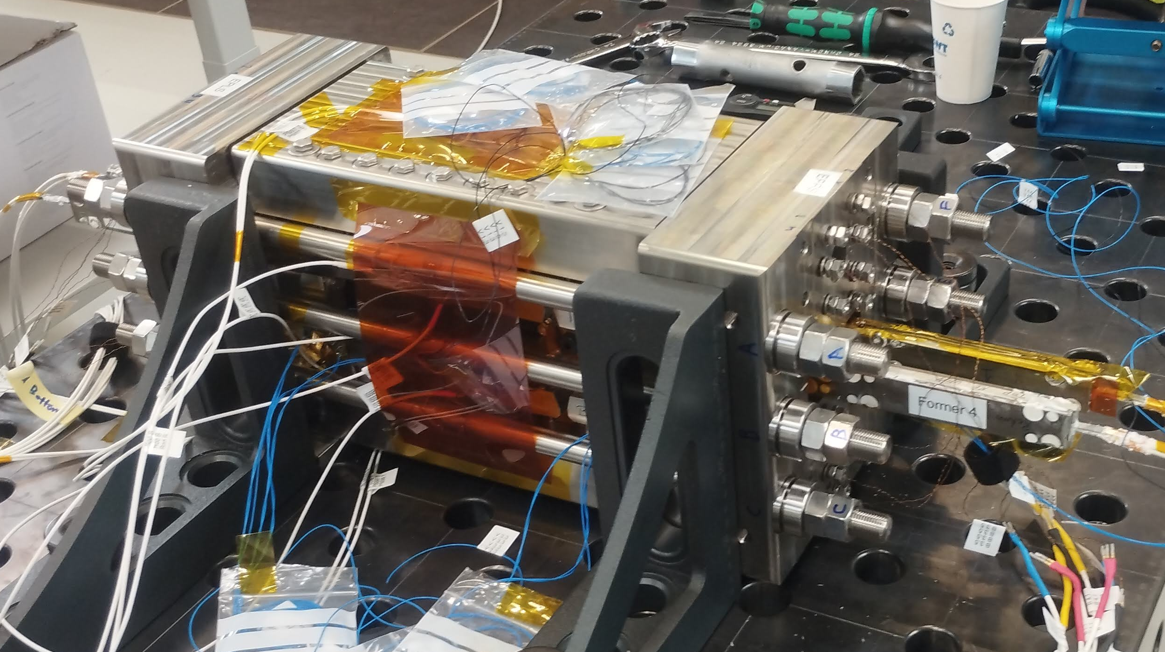
Strain Gauges for subSMCC1: Overview
6 x Rods with Full Bridges
2 x C Clamp Pads with compensated Half Bridges in 2 directions
2 x Inner Straight Pads with Half Bridges
16 x Bullets V1 with quarter Bridges

Slide 13
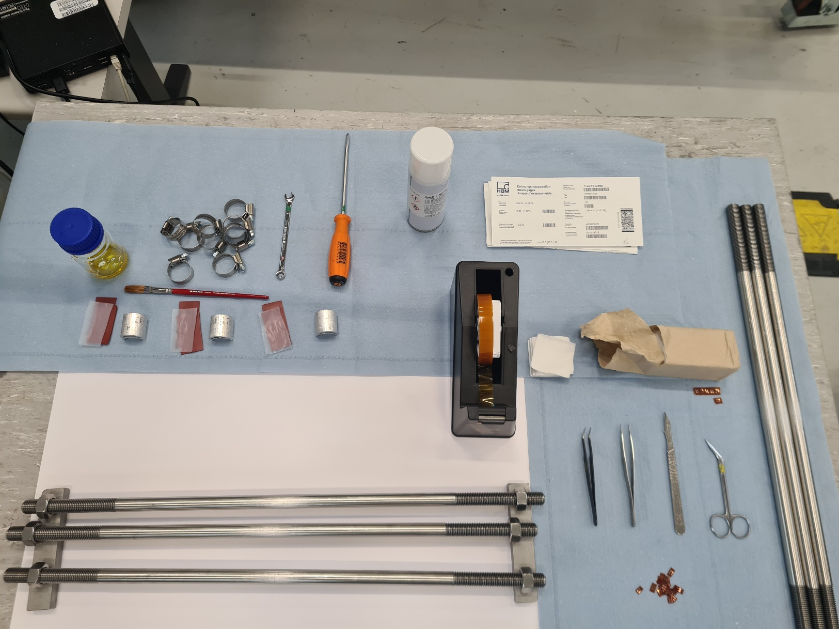
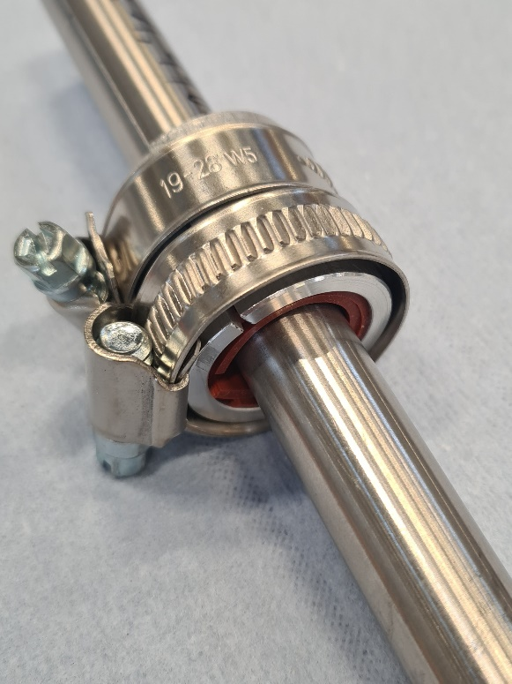
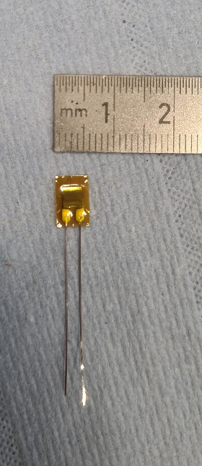
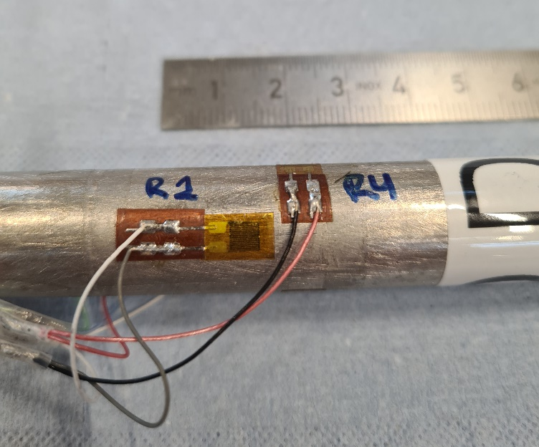
Strain Gauges for subSMCC1: Production
Gluing on the Rods

Slide 14
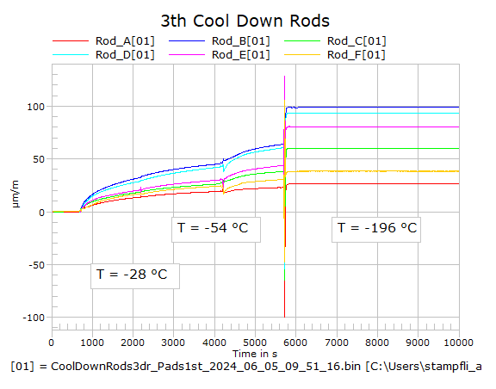
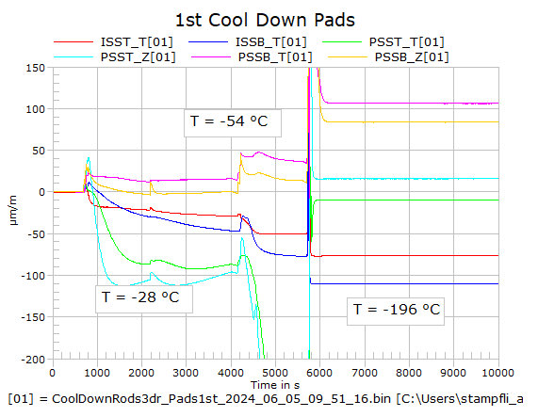
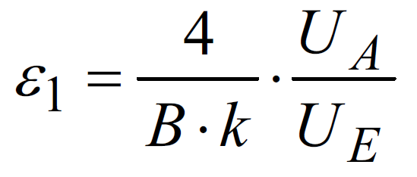
SG for subSMCC1: Tests before Assembly
DAQ from HBM: MX840B
Cool Down to LN₂
  3 x for Rods
  1 x for Pads
  => ±100 µm/m @ LN₂
Weight test 100kg with Rods
To check…
k = Strain Guage Factor
B = Bridge Factor
Other Observation
Offset value sensitive to humidity, temperature, sunlight
Notes:
Cool Down to LN2: slowly without shocking to -135°, to check the Gluening. See how Offset Values Drift
If wet Strain Guages have a huge offset, even after drying Offset of <100um/m remains
Weight test 100kg at Rods, to check B and k factor, and confirm absolute strain values

Slide 15
Strain Gauges for subSMCC1: Experience
Used Rods to tighten evenly to + 600 µm/m
Comparison: after Assembly PSI, inside Cryo CERN, at 4K before Testing
Notes:
Rods quite reliable, Pads don’t understand

Slide 16
Strain Gauges for subSMCC1: Experience
Comparison with simulated strains from 3D model
Notes:
Fig. 9. (left) Rods instrumentation; (center ) longitudinal strain on rods; (right) variation of longitudinal strain and stress
A. Strain measurements on rods
Fig. 9 (left) shows the position of each one of the 6 rods (a - f). The strain gauges instrumentation is placed on the center of the stainless-steel rods. The instrumentation procedure had been validated, before the magnet assembly, with a controlled weight on a bending sample, both at room temperature and at cryogenic temperature and through several thermal cycles.
Fig. 9 (center) shows the absolute value of strain from the beginning to the end of powering (quench number 17). Fig. 9 (right) show an excellent agreement in terms of increase of strain due to the mechanical load between the 3D model and measurements. The unbalance between rods appears to be modest.

Slide 17
Strain Gauges for subSMCC1: Experience
Comparison with simulated strains
Notes:
Fig. 10. (left) Inner pad instrumentation; (center) transversal strain; (right) variation of transversal strain and stress.
B. Strain measurements on the pad
Fig. 10 (left) shows the inner pad instrumentation. The strain gauges are placed on the center of the pad and allow for the measurement of transversal strain with temperature and field compensation. Fig. 10 (center) shows the absolute value measured in both inner pads as well as simulated values. Fig. 10 (right) shows the value of incremental strain (actual strain minus initial strain at 0 kA) measured in both inner pads and simulated.
The computed strain is higher than the measured one. This could come due to the fact that during the longitudinal pre-loading step, a part of the axial load is going into the transversal direction. Therefore, during powering, part of the Lorentz forces is being reacted on the endplates first, before it pushes also on the inner and outer pads. Once this offset is removed the simulated data fits well the measured values.

Slide 18
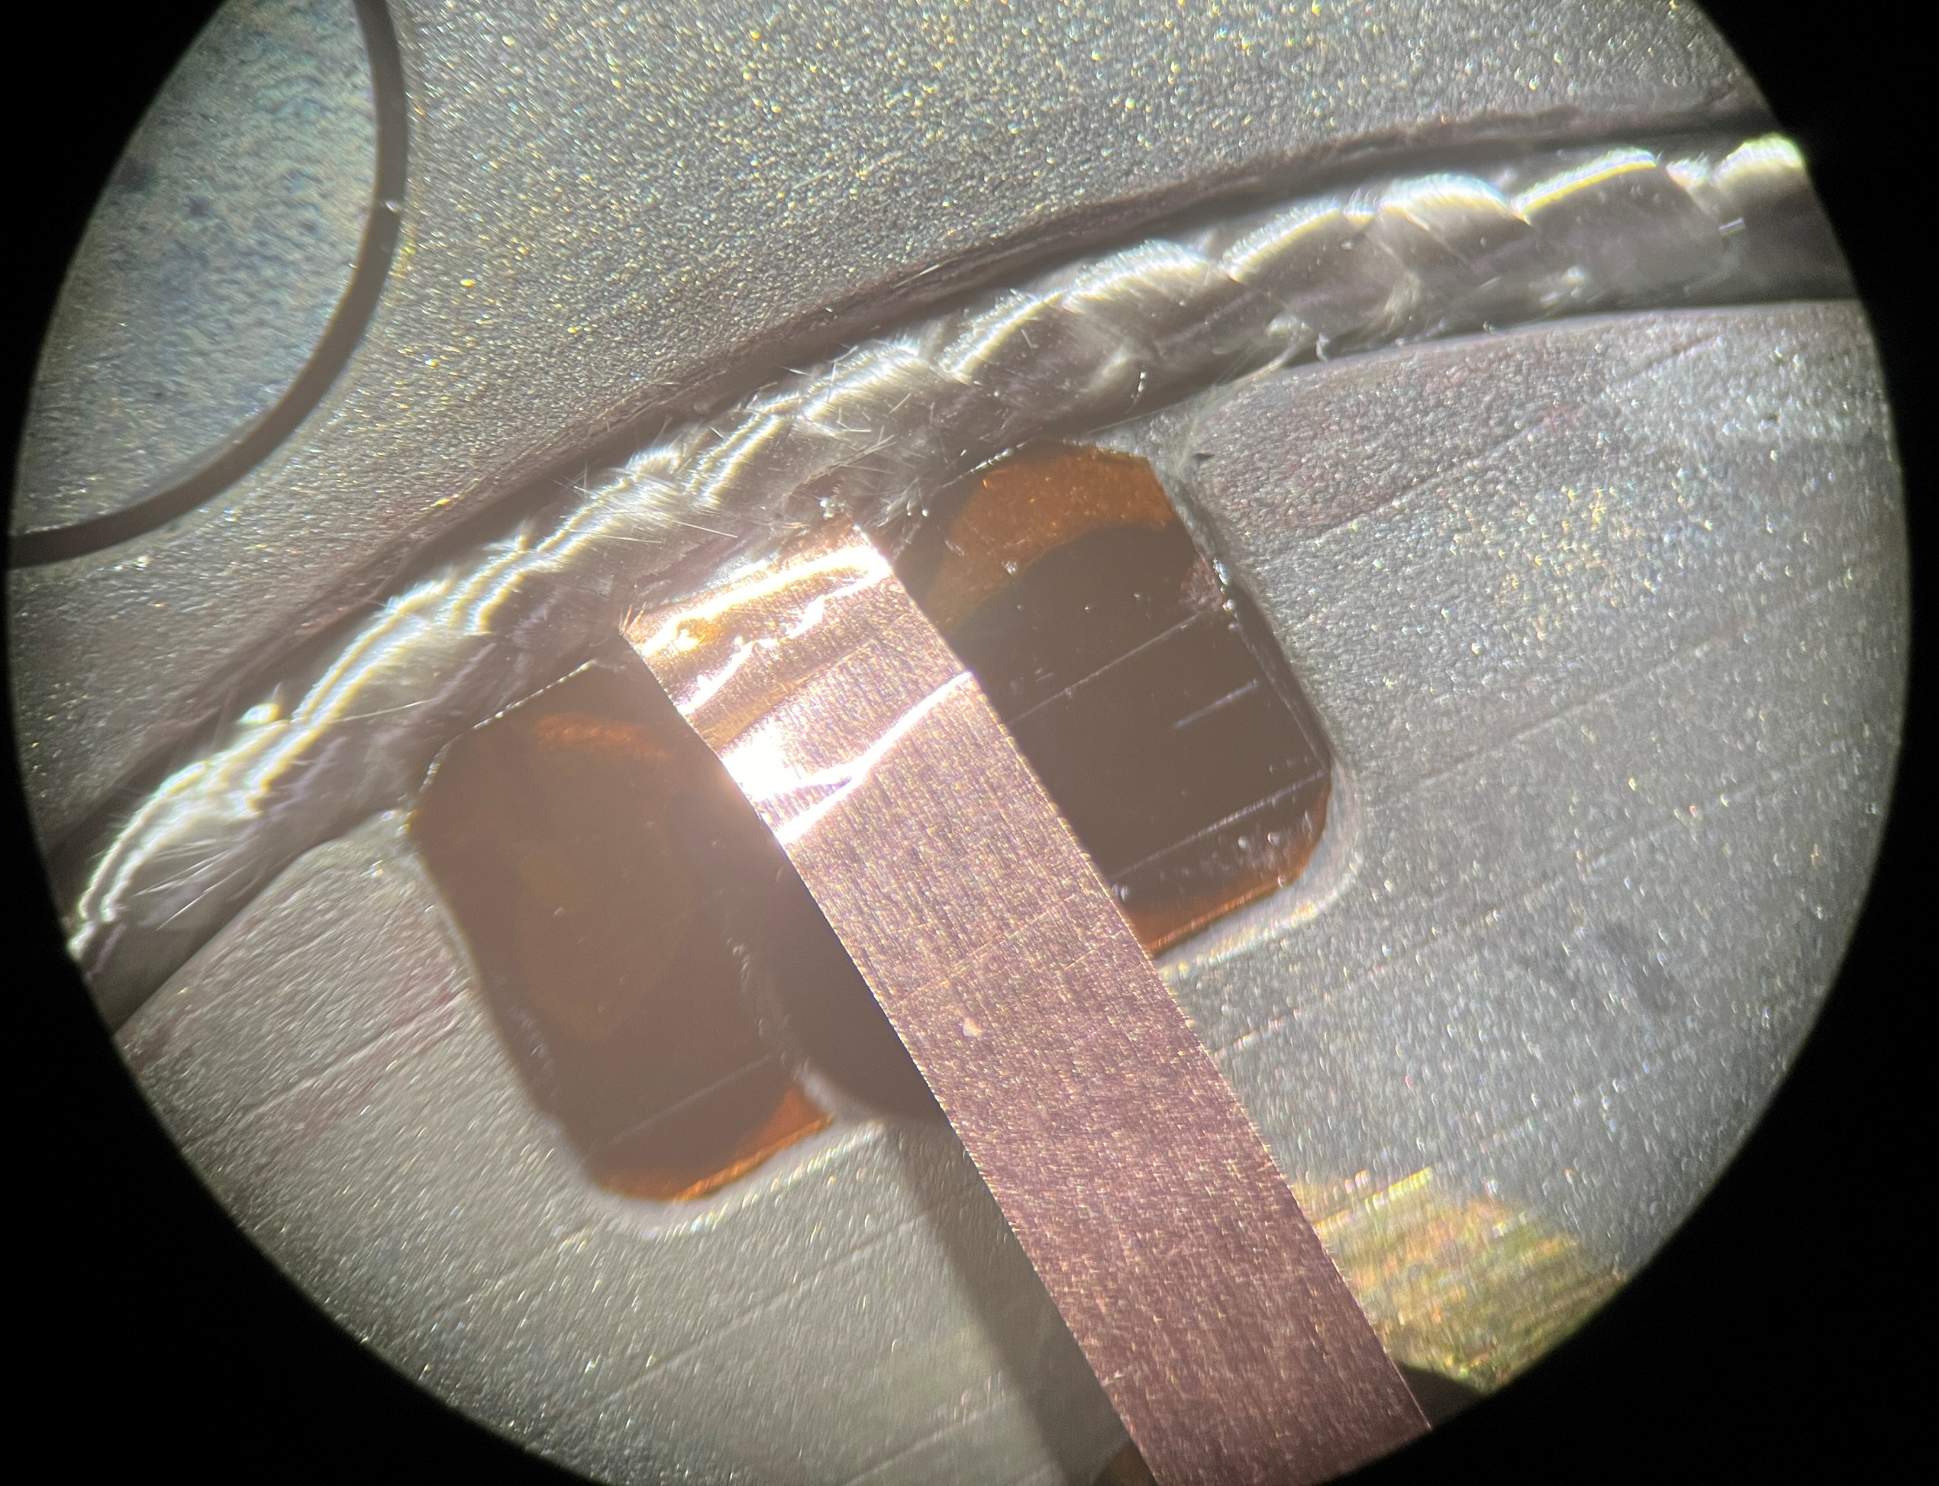
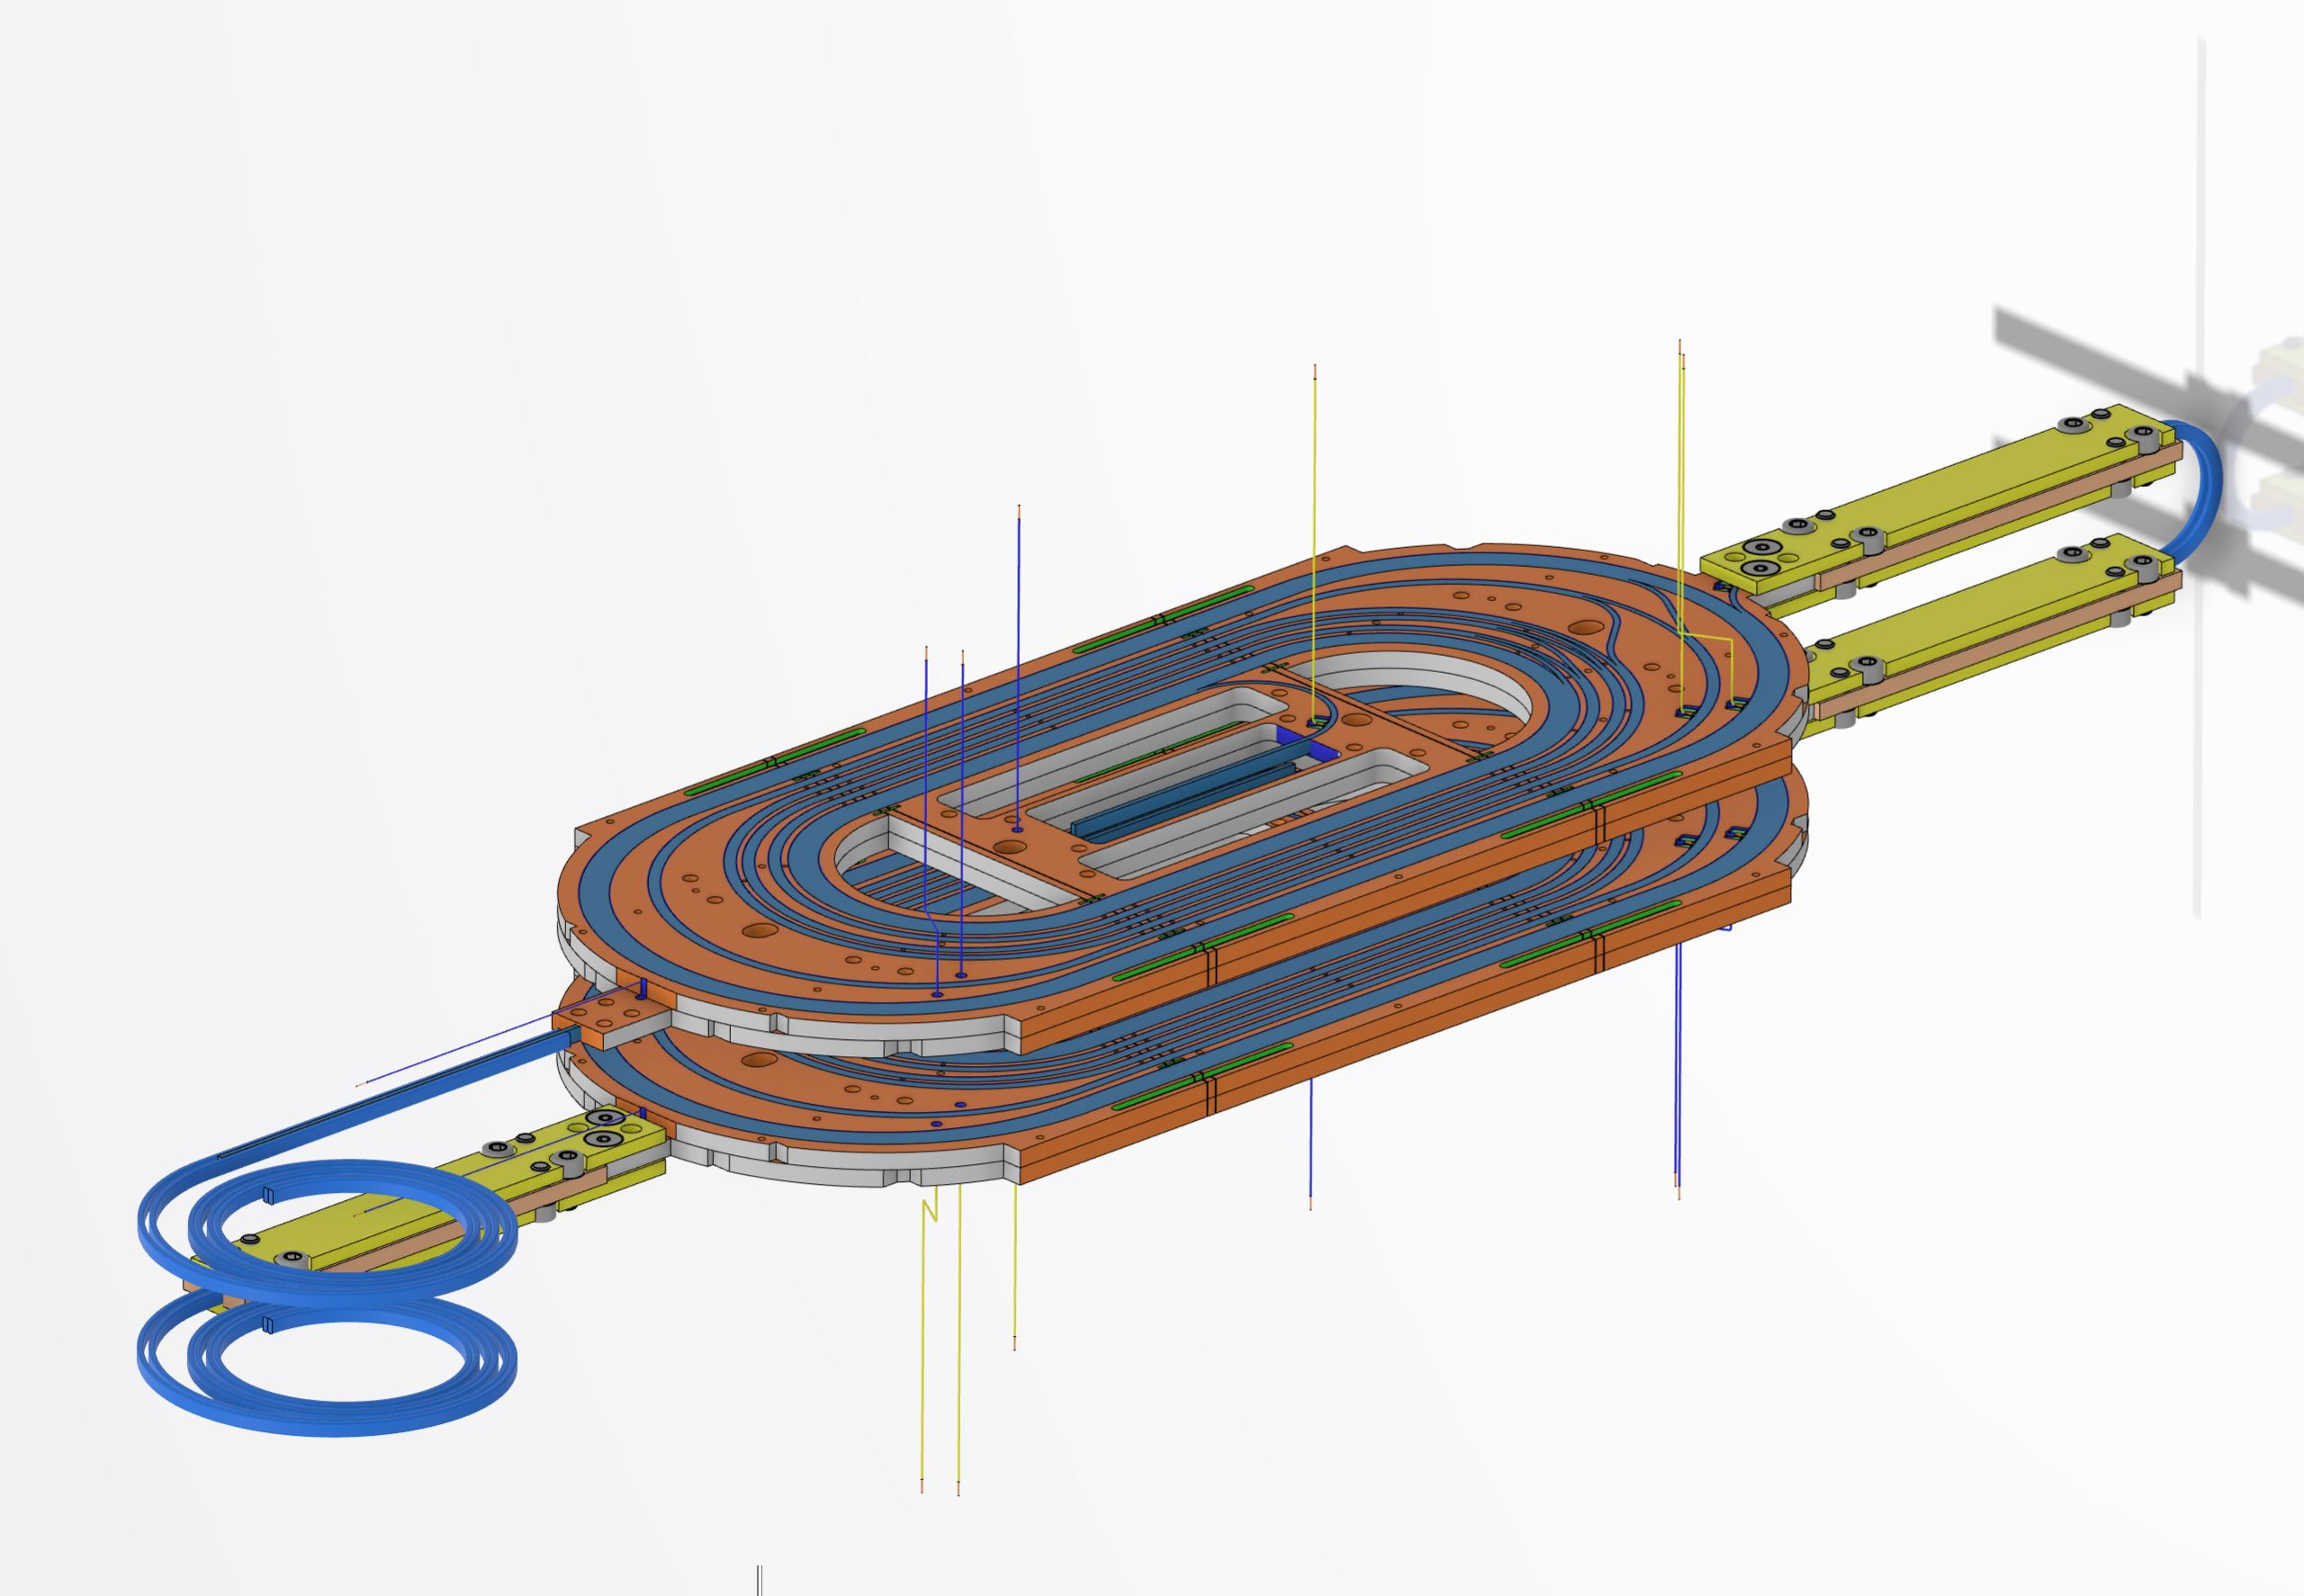
Voltage Taps on SubSMMC1
4 Voltage Taps per Former
Installation
Cut open fibre glass insulation
Insert Copper Flag with some silver glue on it (conducting)
Solder 2 cables
Cover in Stycast
Notes:
Determination of the factor Force / Strain

