Slide 1
Stress-Managed Asymmetric Common-Coils Magnet SMACC1
End Note
PSI SMACC1 Design Review
D. Araujo, B. Auchmann, A. Brem, T. Michlmayr, A. Stampfli and C. Müller
Haziot (CERN)
This work was performed under the auspices of and with support from the Swiss Accelerator Research and Technology (CHART) program.
13 January 2025

Slide 2


Agenda
Discussion on risks and risk mitigation
Central Pole
Rods
Spare Cables
Protection
Electrical Integrity
Cooling
Splices
Choice of heat treatment for the high-field coils

Slide 3
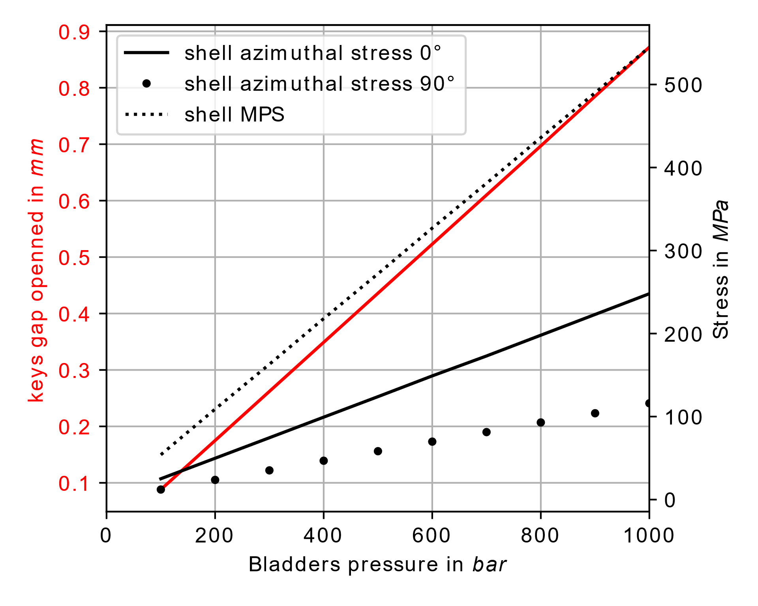
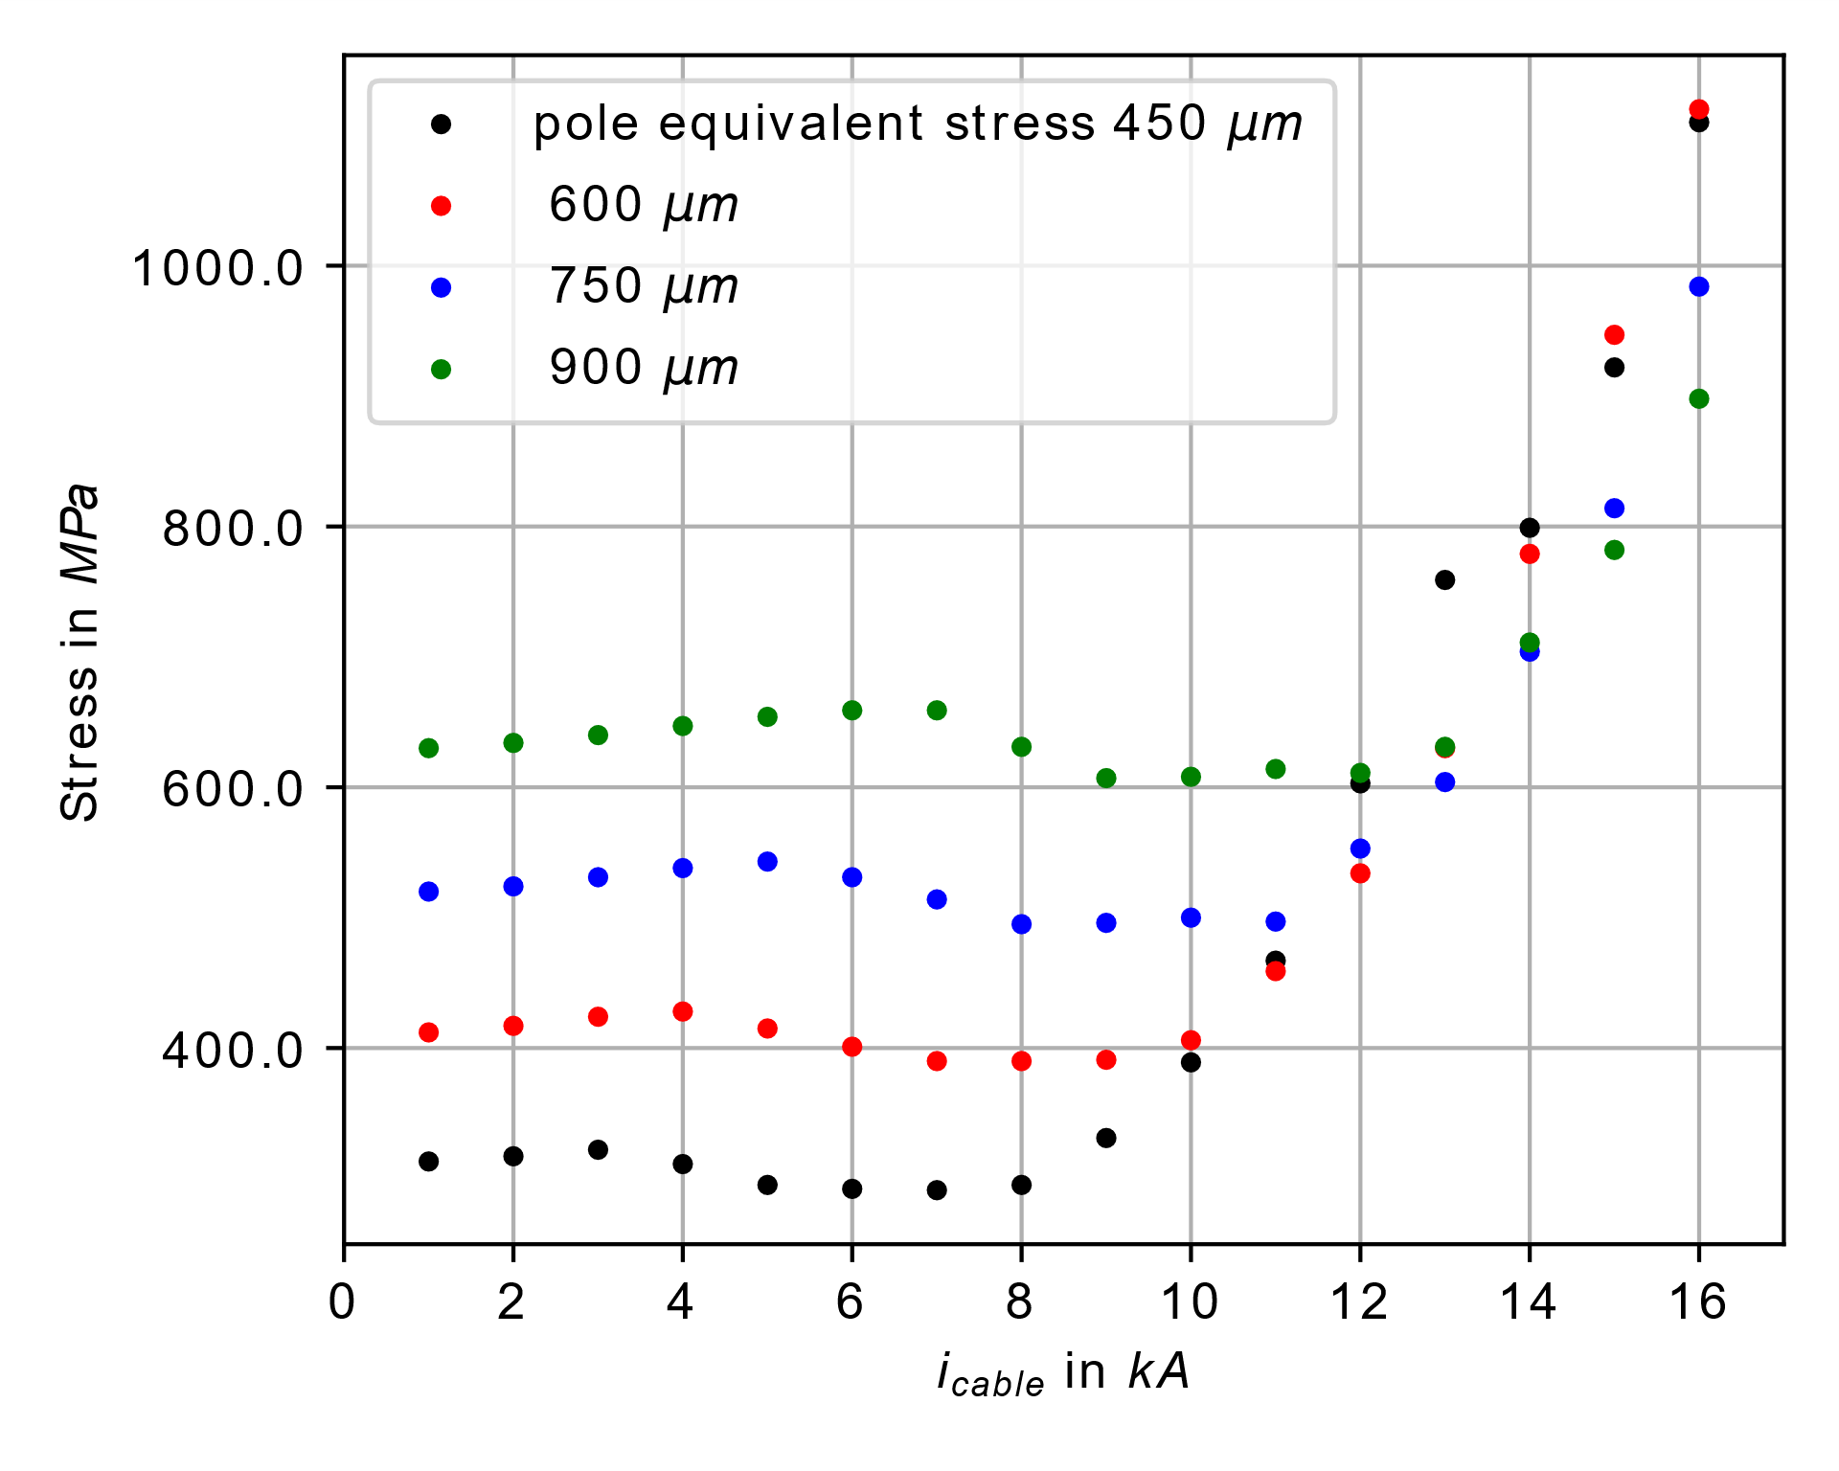
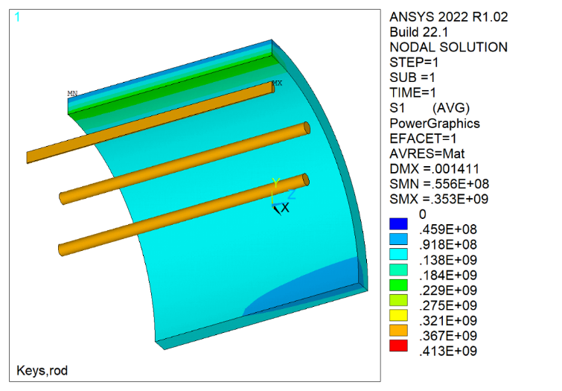
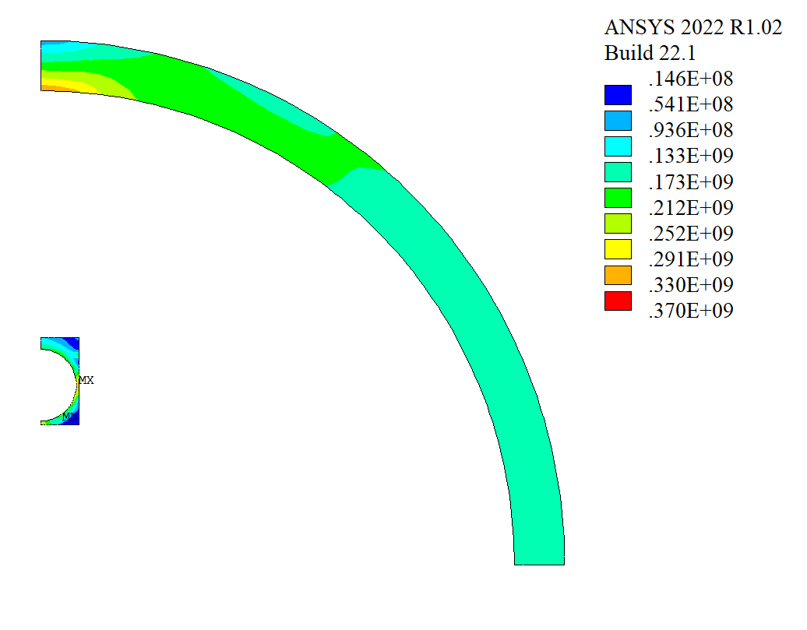
End Note on the pre-load and Pole
During the pre-load on the cross-sectional direction, with the instrumentation, the stress on the pole will be directly monitored and the stress on the shell will be indirectly monitored. The limit of ~350 MPa (for Austenitic steel 316LN) will be respected.
With the 2D model, the limit on the pole (1050 MPa), would be reached at more than 15.5 kA with a compressive load.
If a central pole made of Nitronic 40 is used the limit would no be reached at short sample current.

Slide 4
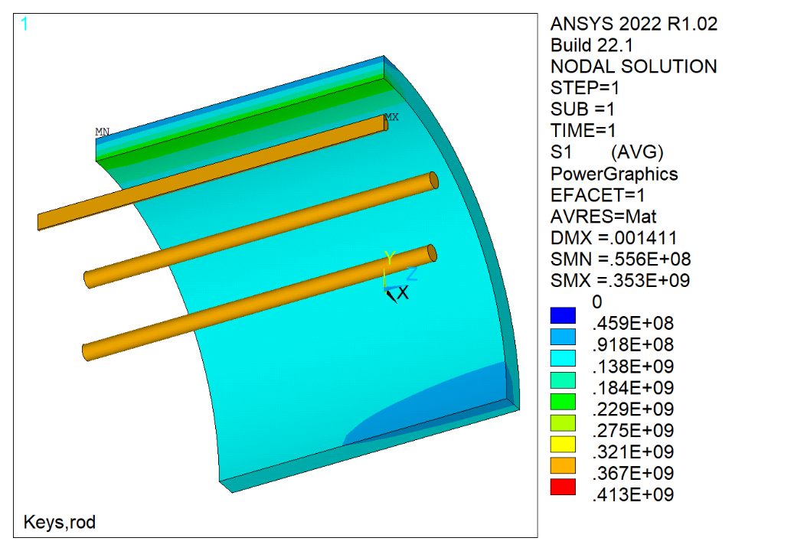
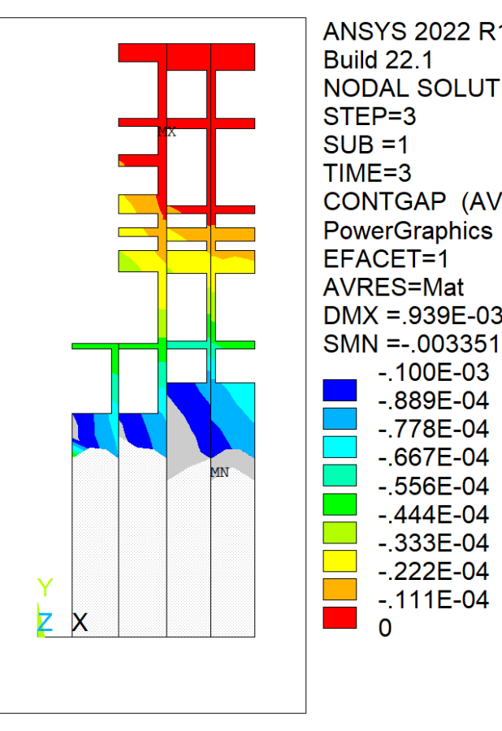
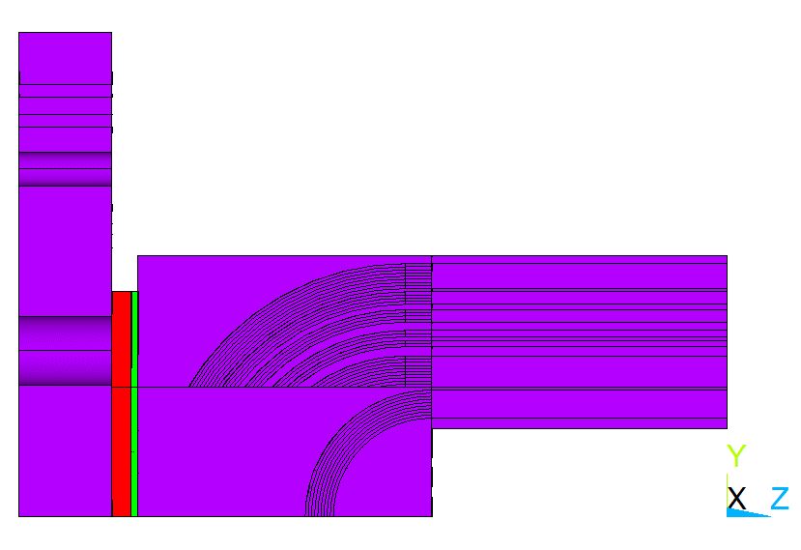
End Note on the
Rods and Axial Pre-load
The pre-load on the rods is limited to 350 MPa limit to respect the adopted limit for Austenitic steel 316LN.
At 12-T, a maximum gap of 100 μm opens between the former pieces.
At higher fields, the gap has a tendence to grow, as the axial force increases.
With the use of Nitronic 40 based rods, we can increase the pre-load at room-temperature (by a factor two) and by further optimizing the position of the pusher, eliminate gaps on the former pieces.
Pa
Lateral view of formers, pusher and end-plate
m

Slide 5
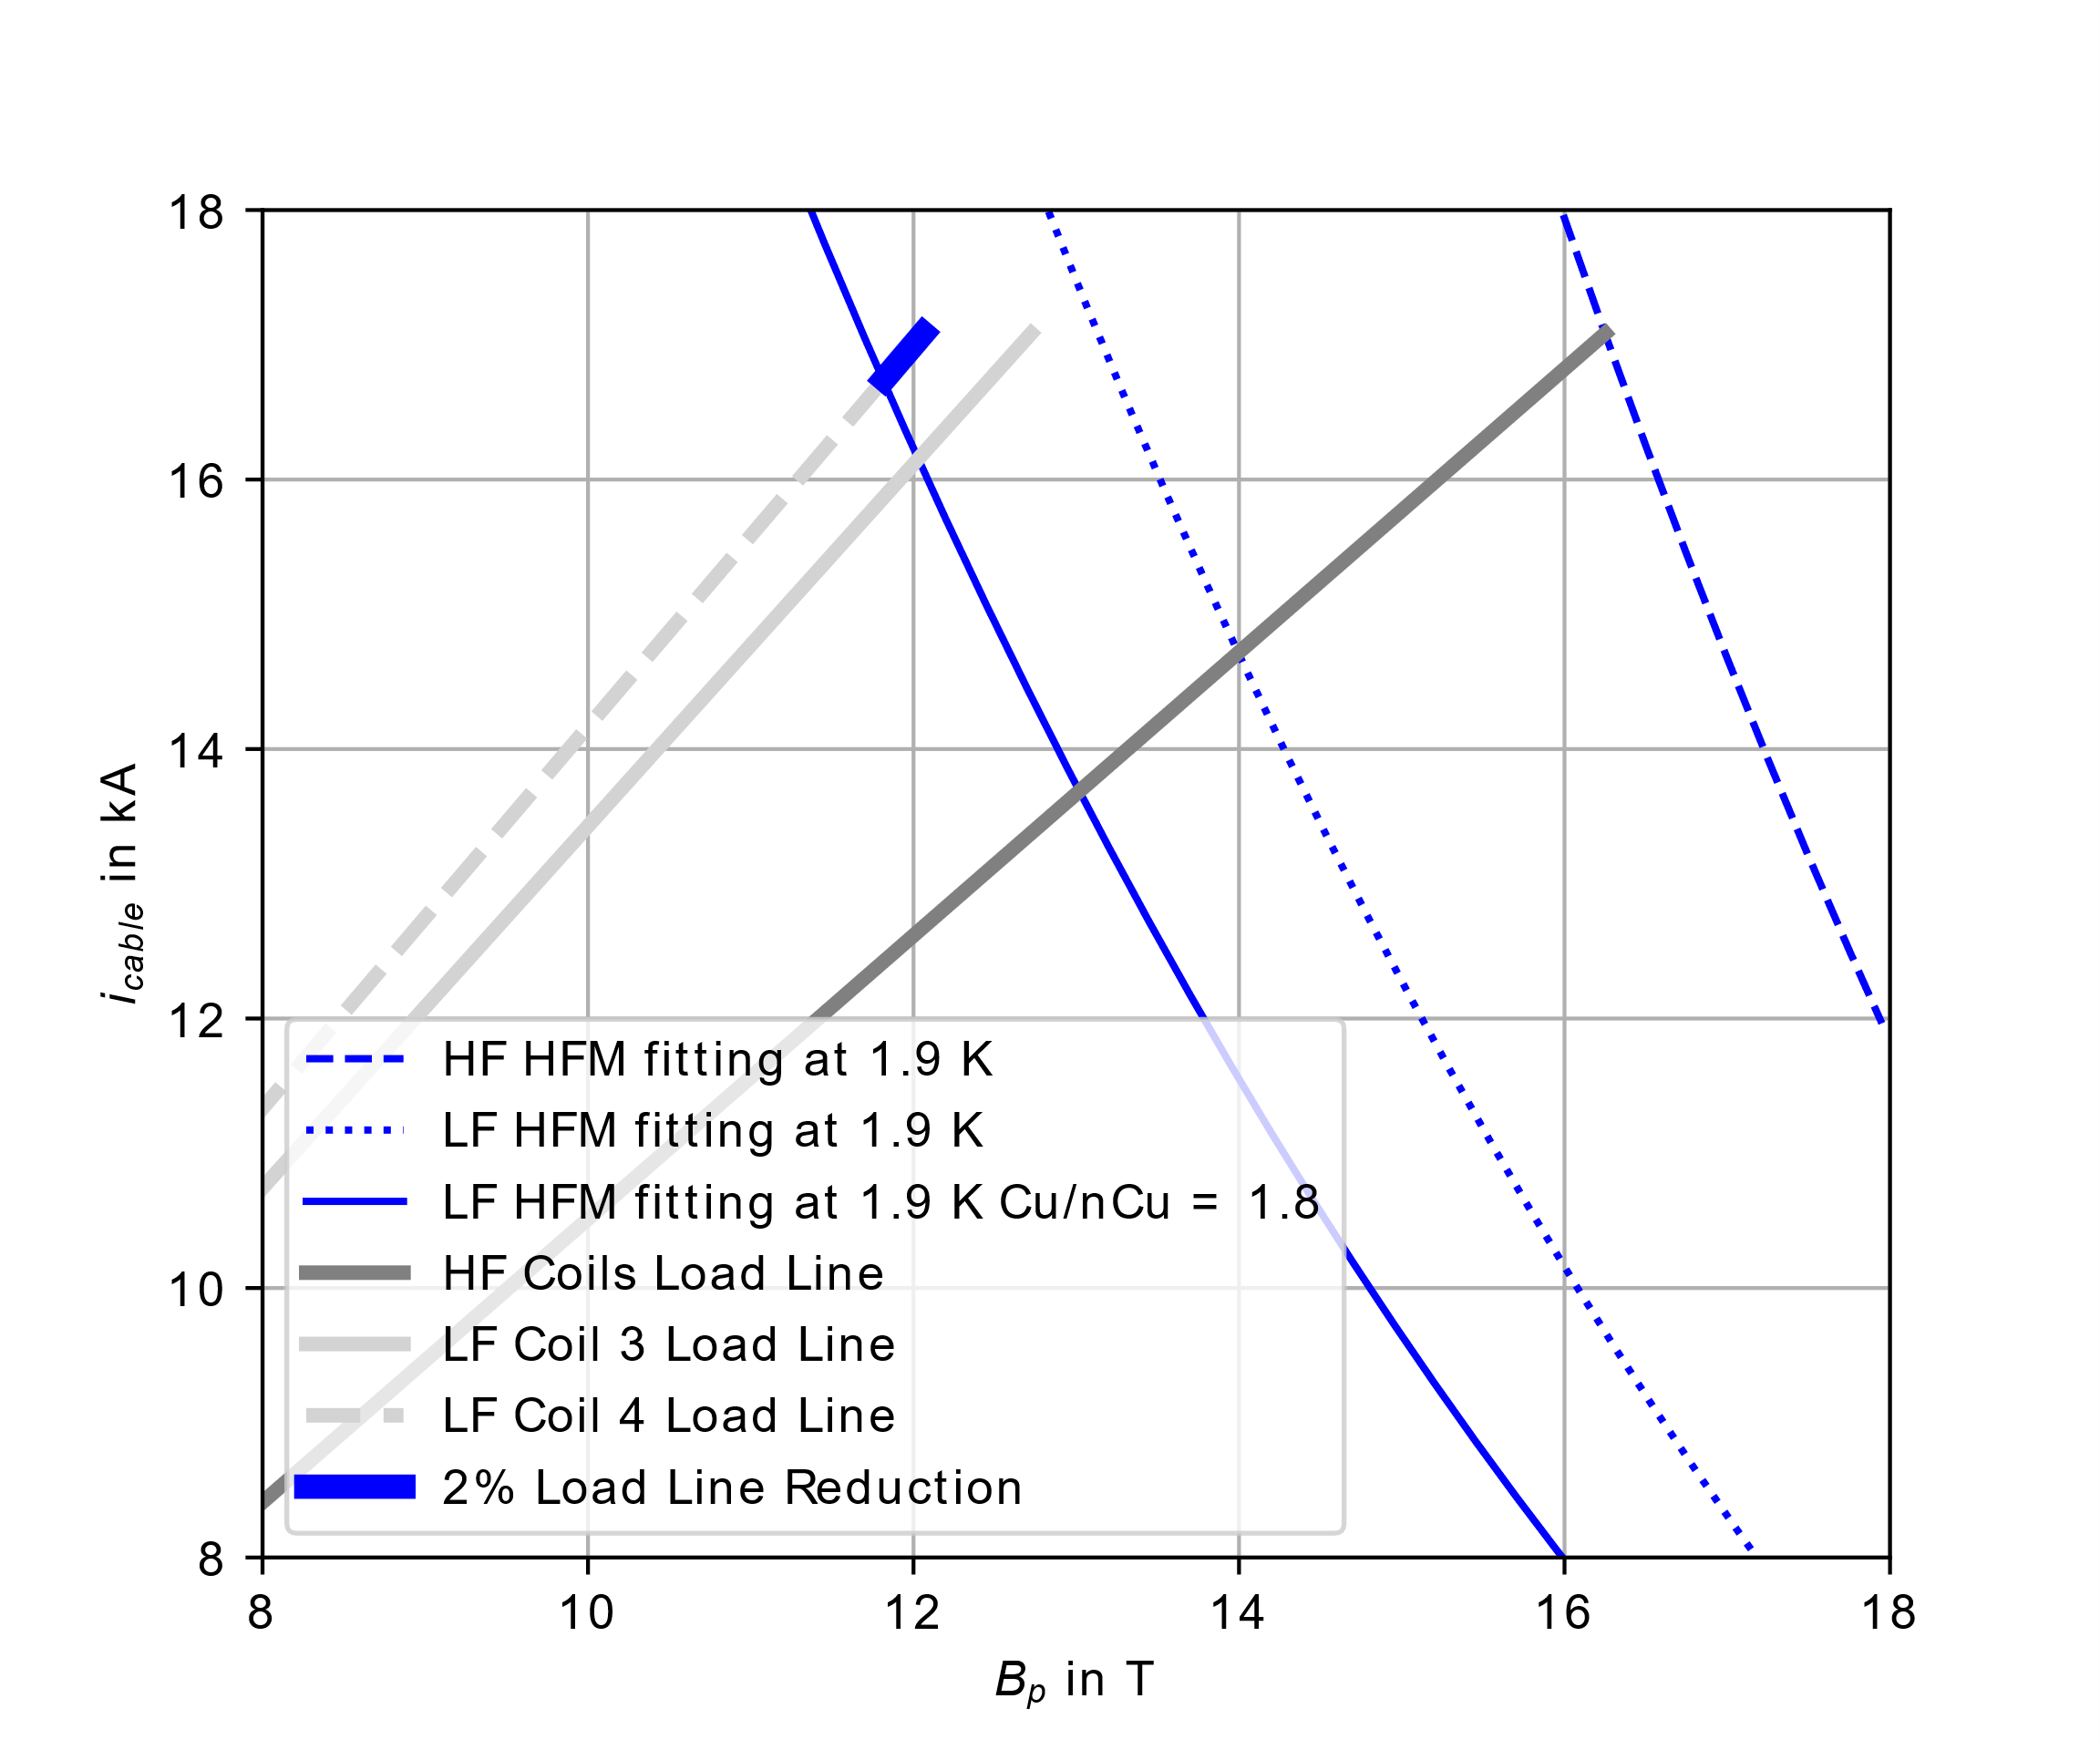
End Note on the Conductor Availability
There is risk associated to the cable length availability.
For the low-field cable, an alternative would be to use the R2D2 low-field cable, based on a Cu/nCu conductor of 1.8 instead of 1.2 (SMACC1 low-field cables). This would represent a limitation of only about 2% on the load line fraction.
Possible risk mitigation, tbd:
Mutualizing the spare conductor between SMACC1 and R2D2.
Producing spare cables on “need basis”.

Slide 6
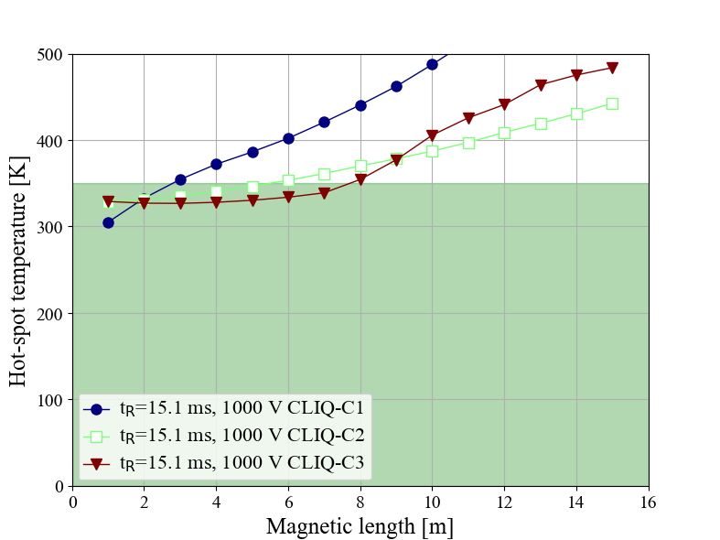
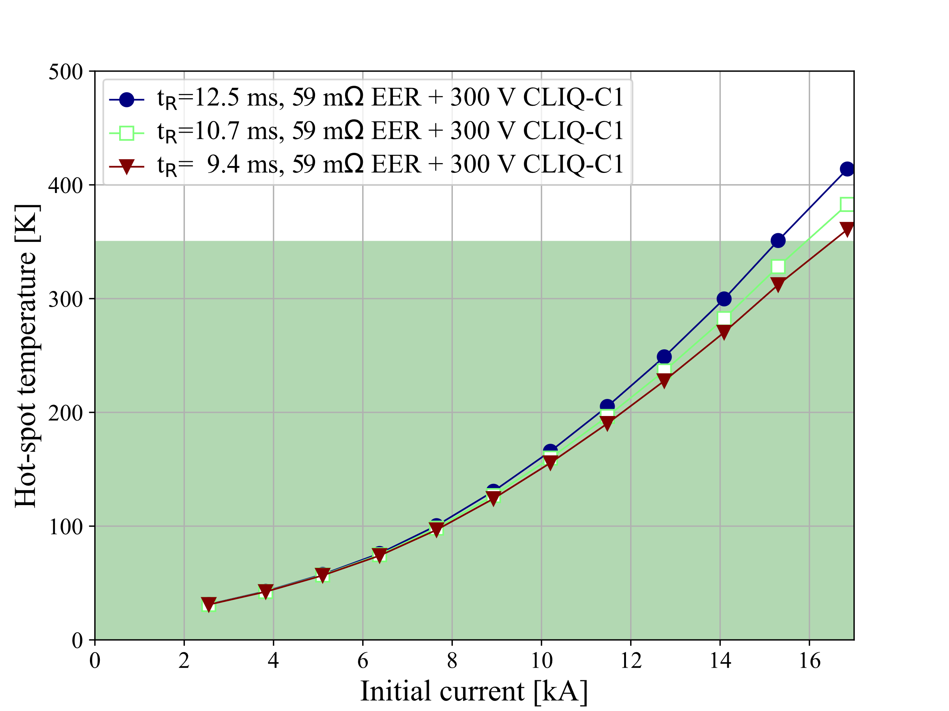
End Note on the Magnet Protection
At 12-T, with CLIQ configuration 3 and 15.1 ms, an 8 m long version can be protected. For a short version magnet, CLIQ configuration 1 is more effective but not enough to allow us testing the magnet to short sample. So we move to CLIQ + Dump.
With a dump resistor that limits the voltage to 1 kV and CLIQ configuration 1, computed with the current equivalent to short sample, the magnet can not be tested to short sample without crossing the hotspot temperature limit of 350 K, if the total time is 15 ms.
- A reduction of the total time form 12.5 ms to 9.4 ms would bring the hot-spot temperature to a value close to 350 K.
- The magnet can be monitored during the test campaign and parameters tuned using holding points at certain level fields to perform analysis.
Courtesy E. Ravaioli

Slide 7
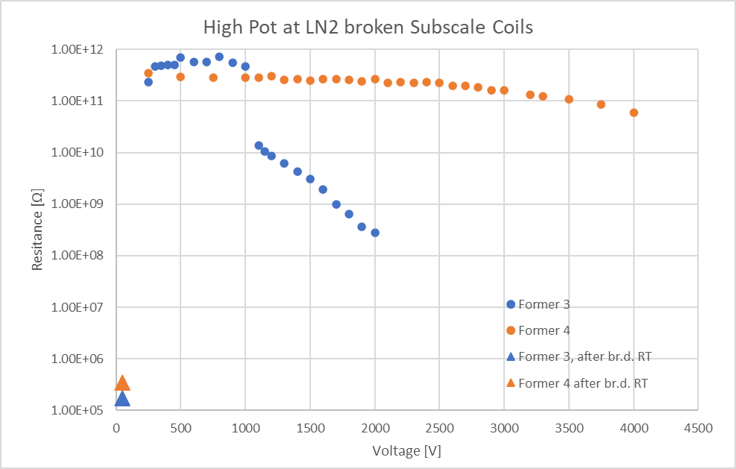
End Note on Electrical Integrity
For SMACC1 the formers are electrically insulated one in respect to the other.
The maximum voltage of 1 kV during the extraction is divided between the 8 coils.
The proofed voltage for subscale SMCC1 coils is more than one order of magnitude higher than the coil – former voltage during an EE of SMACC1.
A. Stampfli

Slide 8
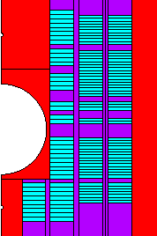
End Note on Cooling Channels
Two modifications of the horizontal pad and central bore pieces are being considered to improve cooling during operation.
Channels machined from the outer side of the central poles
Channels machined from the inner side of the central poles
Using the 2D models, this option did not produce any relevant change on the mechanics
Channels machined from the inner side of the horizontal pad

Slide 9
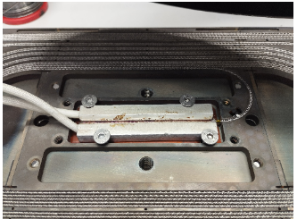
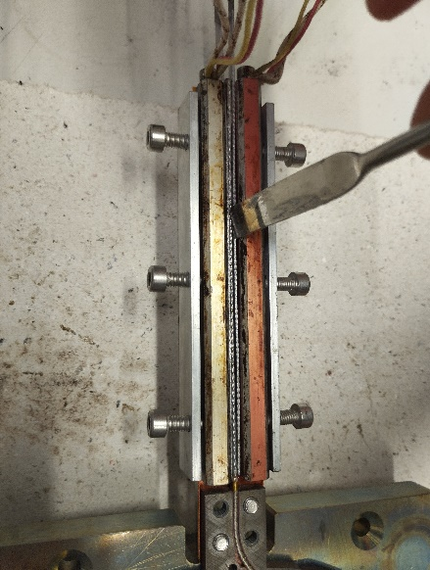
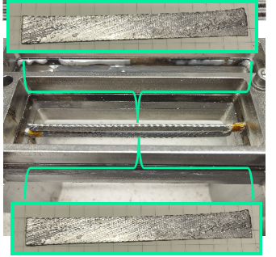
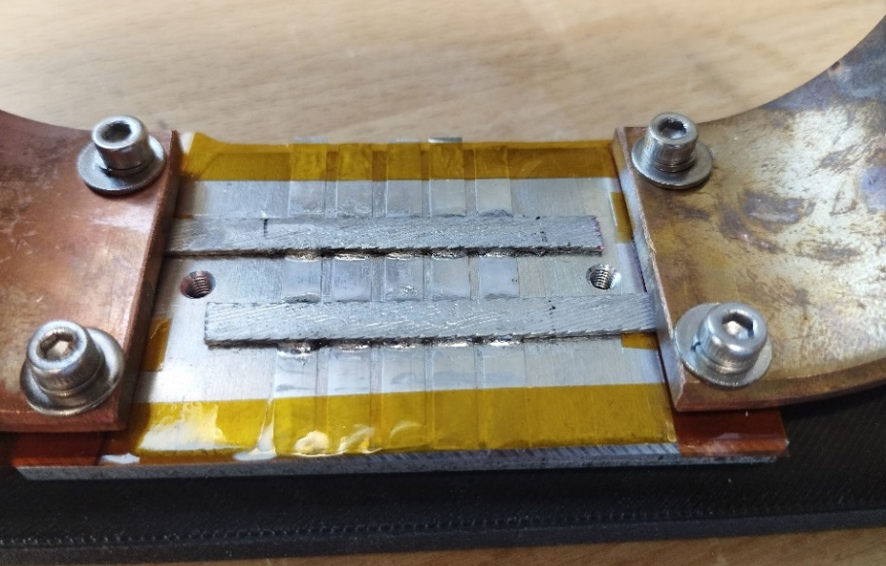
End Note on Splices
NbTi splices can be used, as it was validated with the subscale SMCC1 magnet. The short straight section of smacc1 (~445 mm) limits the length available for the chicane (445 – 2* twist pitch = 120 mm). HTS splices have been developed and validated with subscale parameters (4 mm tape) and with a conduction cooling set-up.

Slide 10
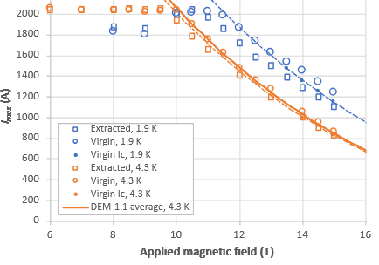
End Note on the Choice of heat treatment for the high-field coils
SMACC1 strand current at short sample (1.9 K) is 810 A

Slide 11
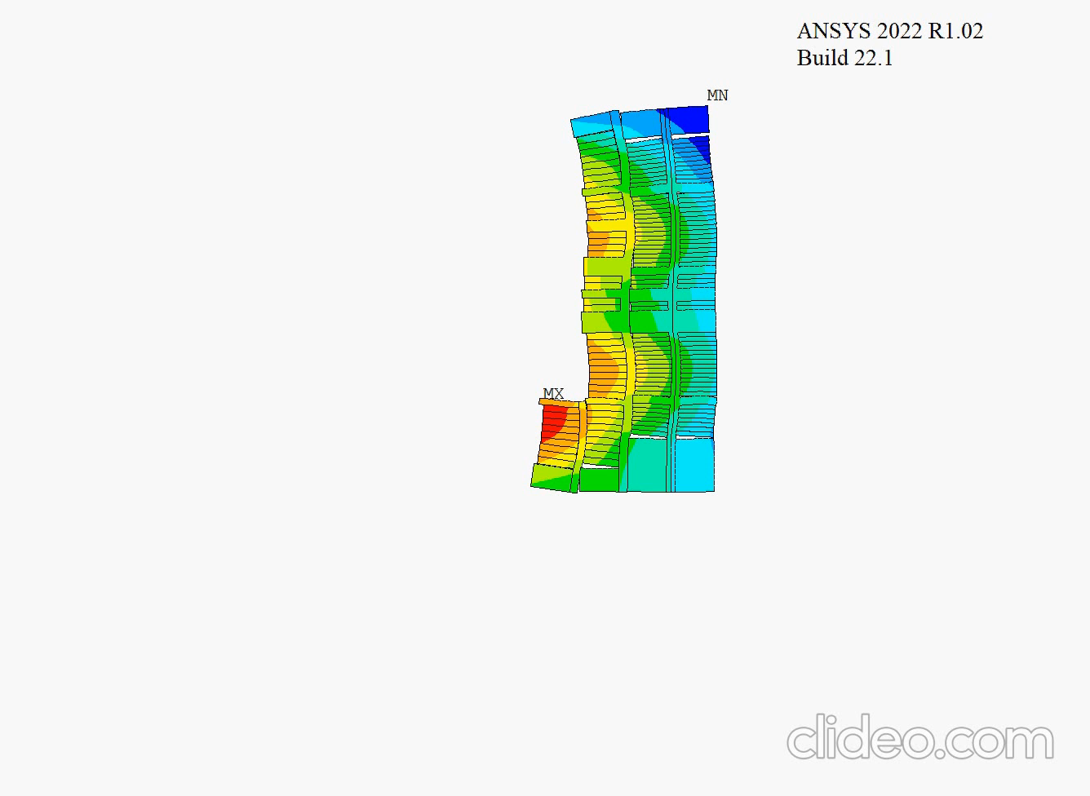
Coil and formers displacement ux in m

