Slide 1
Update muX meeting 17/01
Michael Heines

Slide 2
Time cut systematic

Slide 3
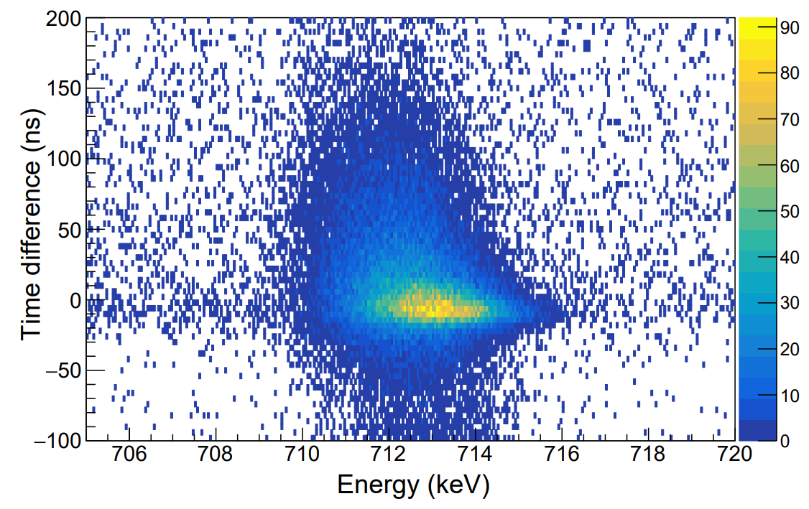
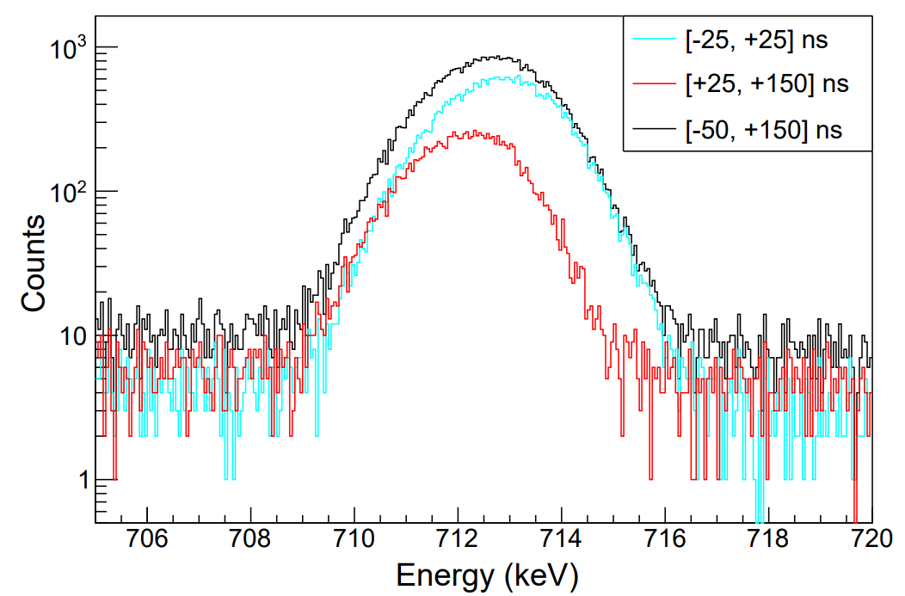
Issue with bias time cuts
Centroid position is affected by choice of time cut!
Ge09: Worst detector for this effect

Slide 4
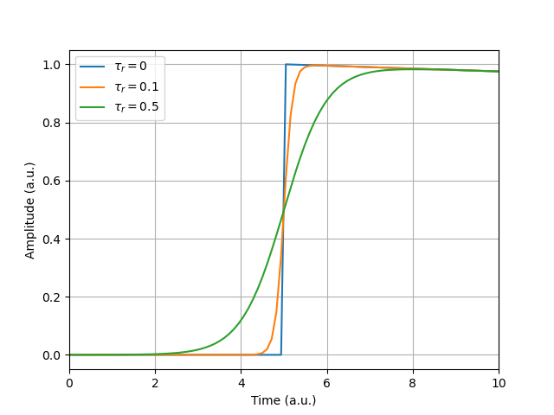
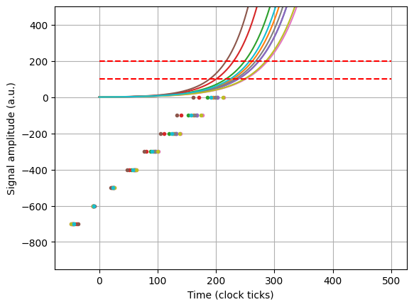
Understanding the issue
Slow rise time pulses are registered as “later”
Slow rise time pulses have lower energy

Slide 5
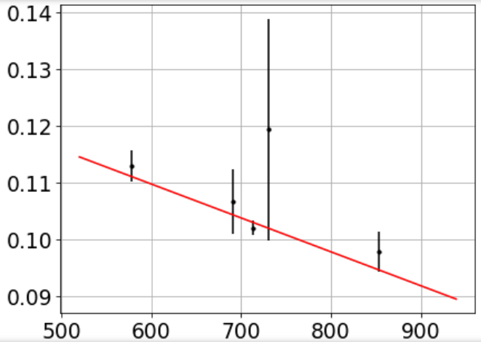

Correcting for it
$$δ=a_{0}+a_{1} E$$
Idea of correction:
  Narrow time cut shifts output
  Consider a broad time cut which takes all pulses
  Probe the centroid difference in broad and narrow cut
  Estimate shift at different energies → Linear fit

Slide 6
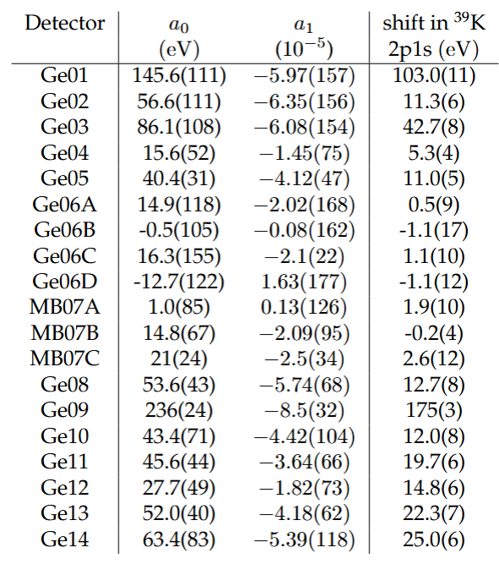
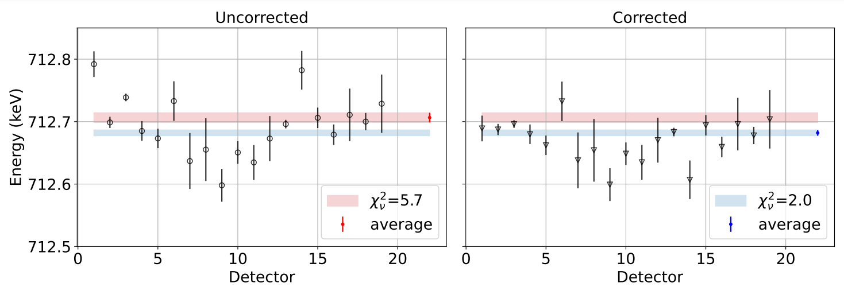
Quite big effect

Slide 7
Ideal ⁴⁰K time cut

Slide 8
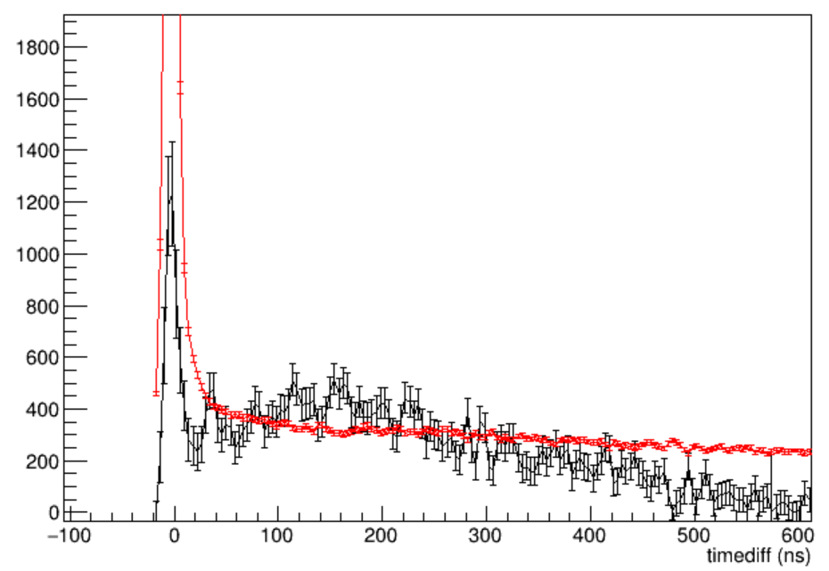
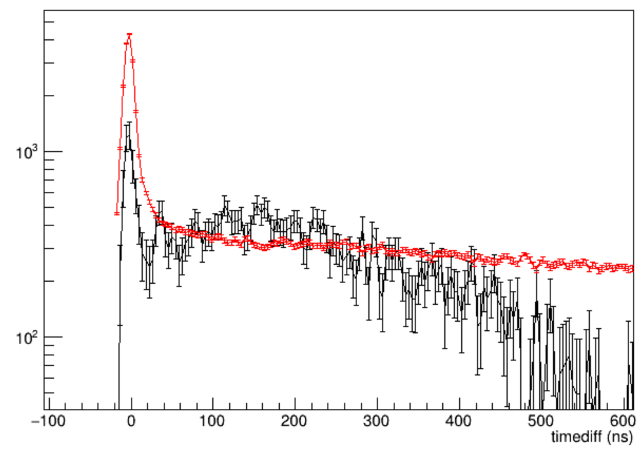
Time behaviour in ⁴⁰K data
Red: Background per keV
Black: Signal integral
It makes sense to start after t=0 → Cut out Titanium 2p1s Compton continuum and edge

Slide 9
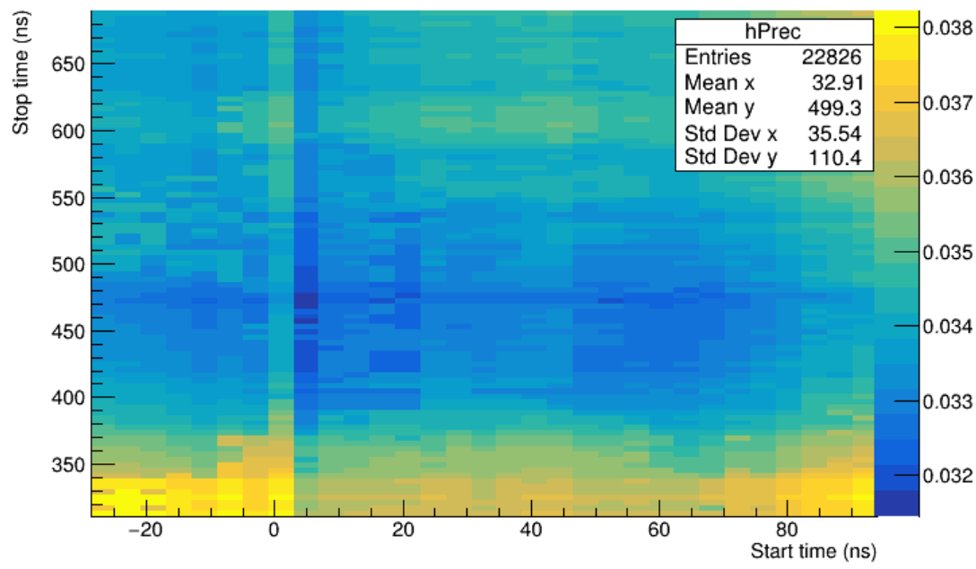
Best time cut for ⁴⁰K data
Ideal start window: 2 local minima around 4ns and 60 ns
  Minimal reduction in first local minimum
  Opting for second to work with cleaner spectrum
Ideal stop window: Consistent around 480 ns

Slide 10
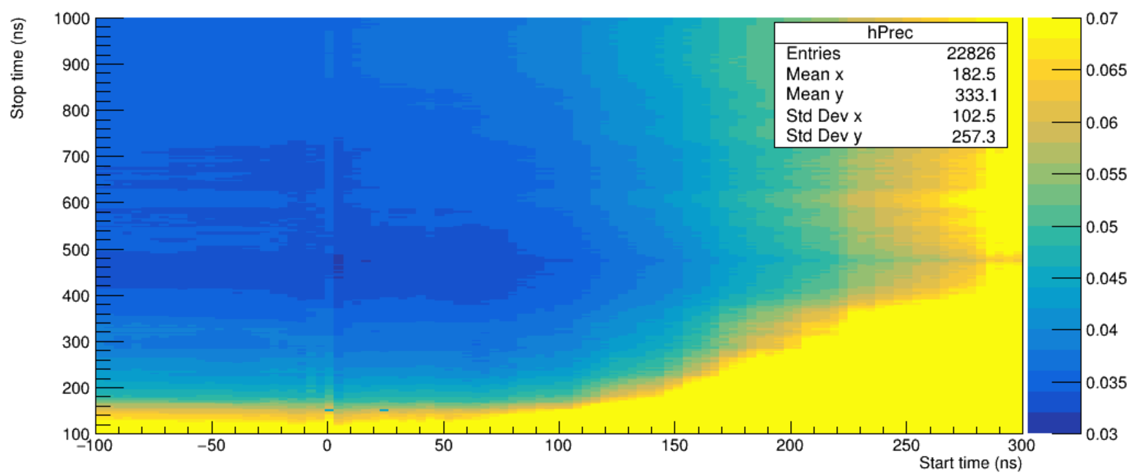
Best time cut for ⁴⁰K
Graph does not tell the fully story:
  Ti 2p1s Compton edge → Almost fully suppressed delayed
  Capture lines → Suppressed with delayed + shorter interval
  ⁷⁴Ge(n, n’) Scattering structure → Suppressed with delayed + shorter interval
  ^{110m}Ag calibration line → Suppressed with shorter interval

Slide 11
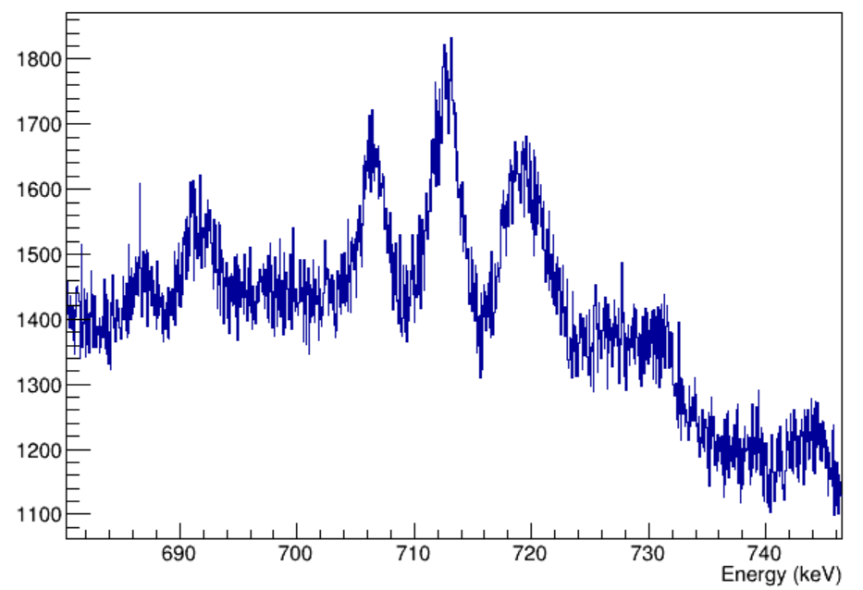
The standard [-50, 500] ns cut
2p1s
^{110m}Ag
^{nat}Ti(µ, xn)
⁷⁴Ge(n, n’)
^{nat}Ti 2p1s Compton

Slide 12
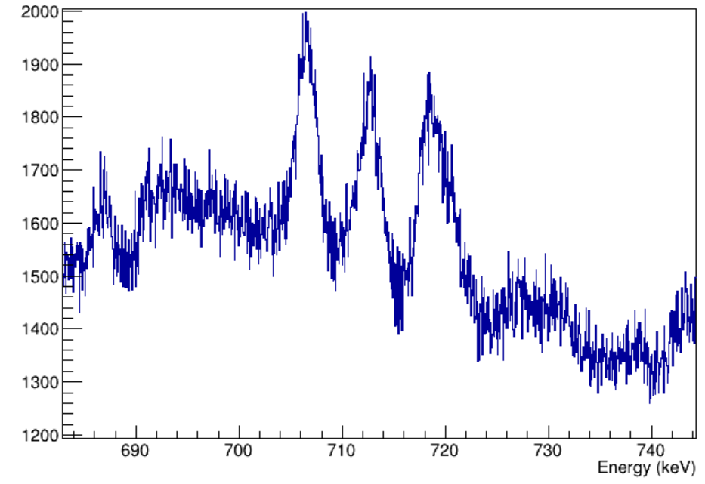
Long delayed [50, 1000]ns cut
^{110m}Ag
2p1s
⁷⁴Ge(n, n’)
^{nat}Ti(µ, xn)

Slide 13
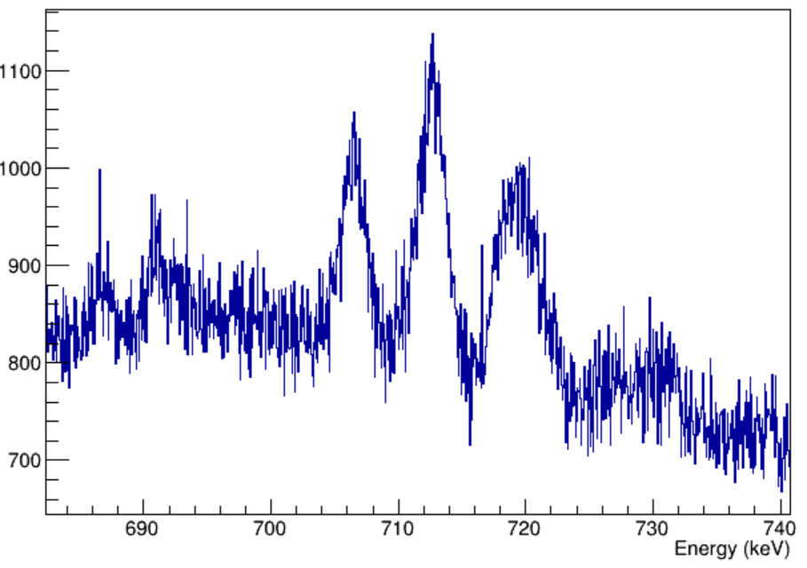
The finalized spectrum
2p1s
^{110m}Ag
^{nat}Ti(µ, xn)
⁷⁴Ge(n, n’)

Slide 14
Radius extraction

Slide 15
Nuclear polarization
Contributions:
  Nuclear part:
    Low lying states (mostly uncorrelated between isotopes)
    Giant resonance (highly correlated between isotopes)
  Nucleon part:
    nucleon polarization (highly correlated between isotopes)

Slide 16
NP uncertainties
Error on nuclear part based on spread based off ⁴⁰Ca → ~20%
Error on nucleon part based of Misha’s estimates → ~10%
Adding uncertainties linearly as a conservative estimate
35Cl : NP = 103.9(208) +14.8(15) = 118.7(223) eV
37Cl : NP = 100.1(201)+16.0(16) = 116.1(217) eV
Relative uncertainty of ~19%

Slide 17
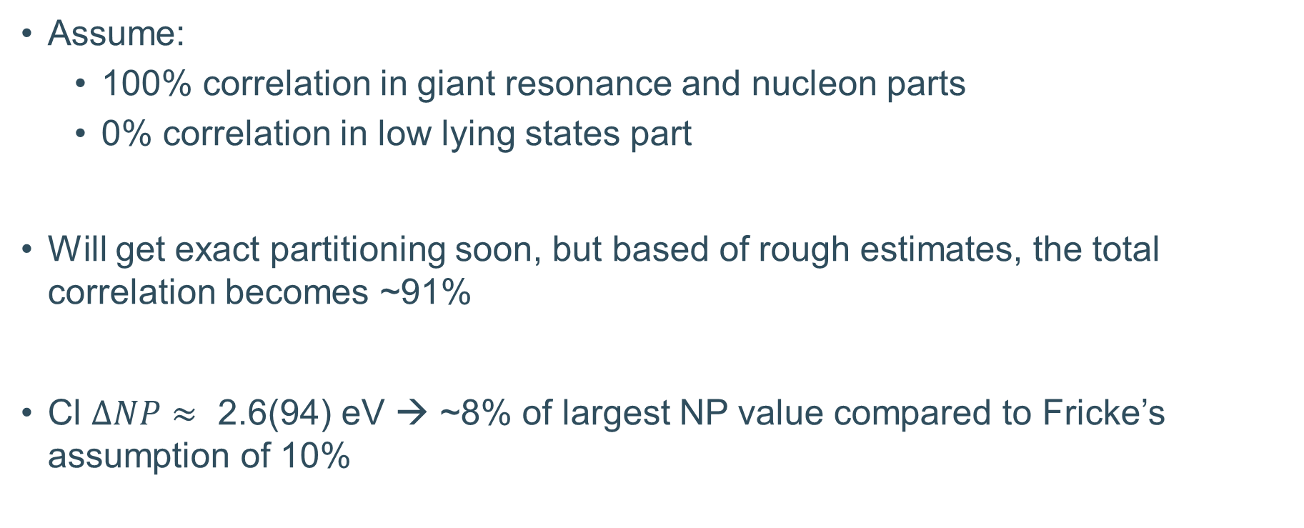
NP differences
Assume:
  100% correlation in giant resonance and nucleon parts
  0% correlation in low lying states part
Will get exact partitioning soon, but based of rough estimates, the total correlation becomes ~91%
Cl $ΔNP≈\text{ 2.6(94) }\text{eV}$ → ~8% of largest NP value compared to Fricke’s assumption of 10%

Slide 18

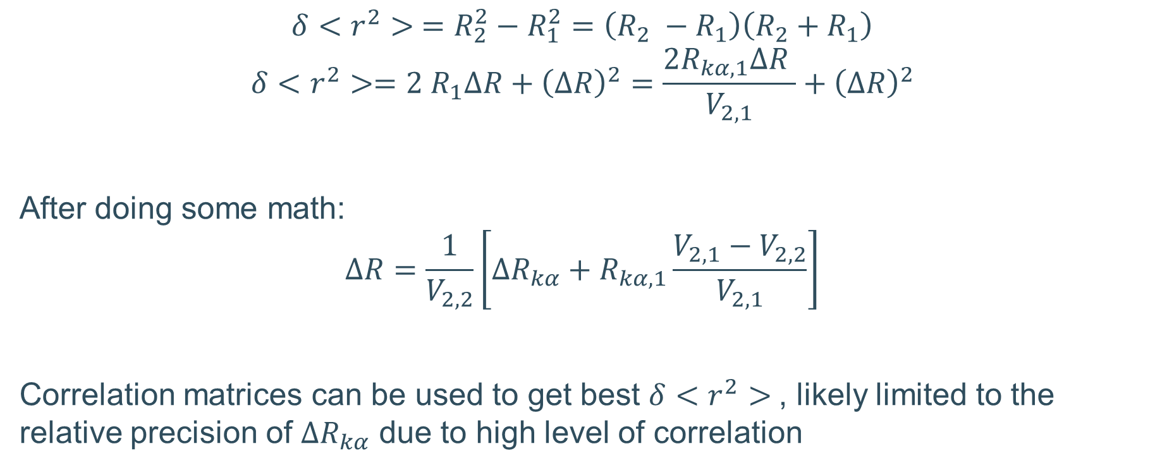
Abusing correlation for $δ<r^{2}>$
$$δ<r^{2}> =R_{2}^{2}−R_{1}^{2}=\left(R_{2} −R_{1}\right)\left(R_{2}+R_{1}\right)$$
$$δ<r^{2}>=2 R_{1}ΔR+{\left(ΔR\right)}^{2}=\frac{2R_{kα, 1}ΔR }{V_{2, 1}}+{\left(ΔR\right)}^{2}$$
After doing some math:
$$ΔR=\frac{1}{V_{2,2}}\left[ΔR_{kα}+R_{kα, 1}\frac{V_{2,1}−V_{2,2}}{V_{2,1}}\right]$$
Correlation matrices can be used to get best $δ<r^{2}>$, likely limited to the relative precision of $ΔR_{kα}$ due to high level of correlation

Slide 19

Abusing correlation for $δ<r^{2}>$
$$δ<r^{2}> =R_{2}^{2}−R_{1}^{2}=\left(R_{2} −R_{1}\right)\left(R_{2}+R_{1}\right)$$
$$δ<r^{2}>=2 R_{1}ΔR+{\left(ΔR\right)}^{2}=\frac{2R_{kα, 1}ΔR }{V_{2, 1}}+{\left(ΔR\right)}^{2}$$
After doing some math:
$$ΔR=\frac{1}{V_{2,2}}\left[ΔR_{kα}+R_{kα, 1}\frac{V_{2,1}−V_{2,2}}{V_{2,1}}\right]$$
Correlation matrices can be used to get best $δ<r^{2}>$, likely limited to the relative precision of $ΔR_{kα}$ due to high level of correlation
~1e-3
<< $2 R_{1}ΔR$
~4
~5(4)e-4
Based of estimates, left term about 10x bigger than right term
O(e-2)
O(e-3)
~1e-3
Notes:
Estimates: 2e-3 for second term, O(1e-2) for first

