Slide 1
muX meeting 17/01/2024
Marie Deseyn

Slide 2
G4 simulations

Slide 3
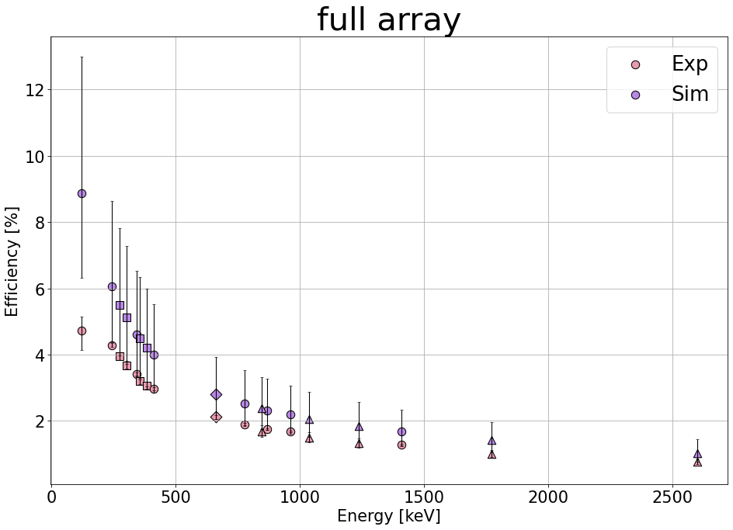
G4 simulation
Simulations mostly agree within 1 sigma with experiment for the efficiency
Redesign of the scintillator: plan to have weekly meetings with Narongrit + implementing stepping action to see more of the history

Slide 4
Step size

Slide 5
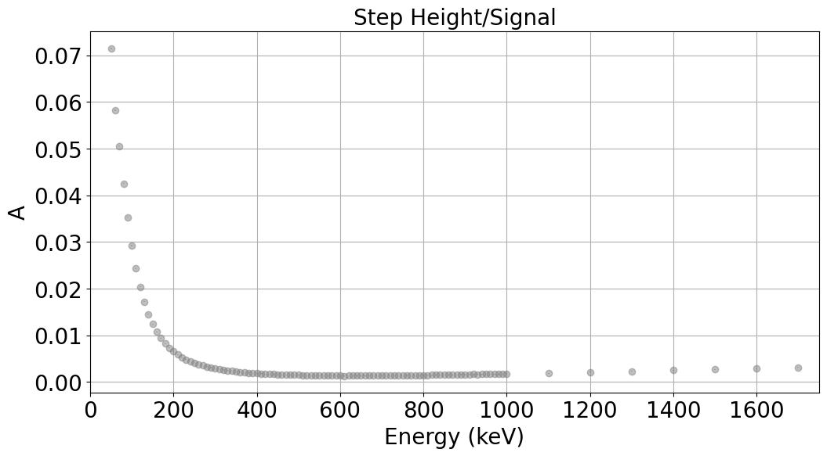
Step height
Simulate single energy photons for Leuven75 geometry
Infinite resolution
Step/signal
Trend???

Slide 6
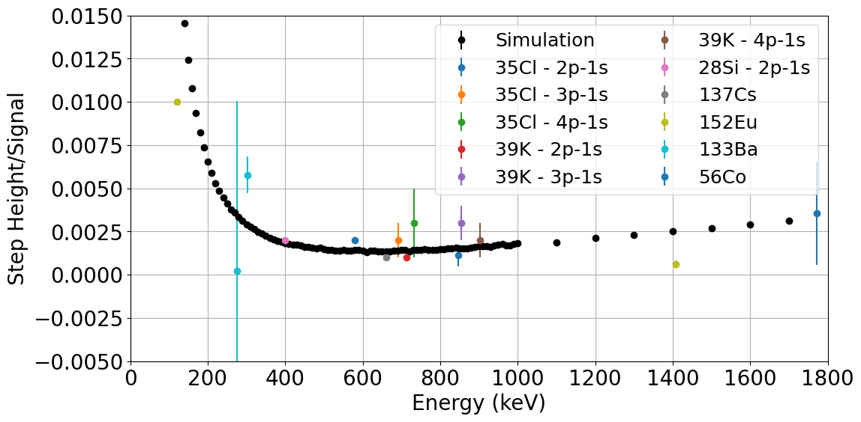
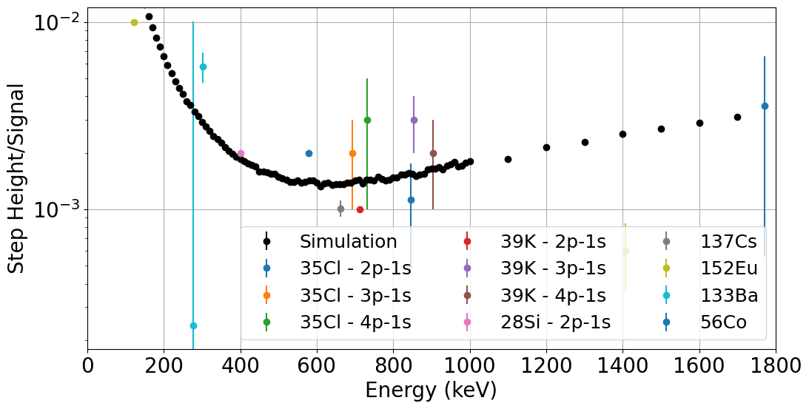
Step height
Note: Si 2p-1s E is not yet calibrated fully

Slide 7
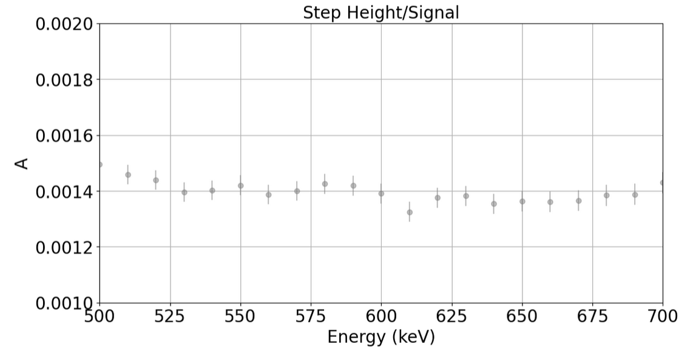
Step height – Si data fitting idea
fit (rescaled data) from 200 to 600 keV and then allow a general shift of this curve (B and C’ fixed; E0 = 600 keV; S(E0) = fitparameter)
Did the hypermet fitting for Si data, for Leuven75 only
Converged nicely + stepheight at 600keV (fitparam):
  Run3: 0.001403(46)
  Run4: 0.001295(38)
  Run5: 0.001424(45)

Slide 8
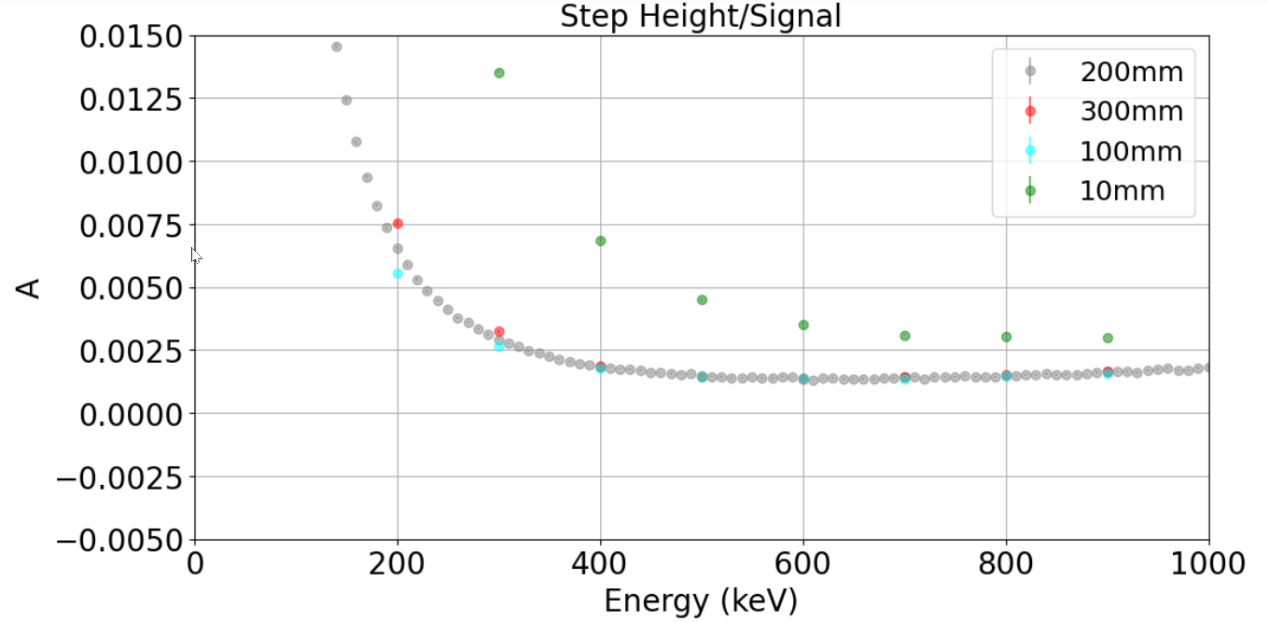
Step height
Distance dependence:

Slide 9
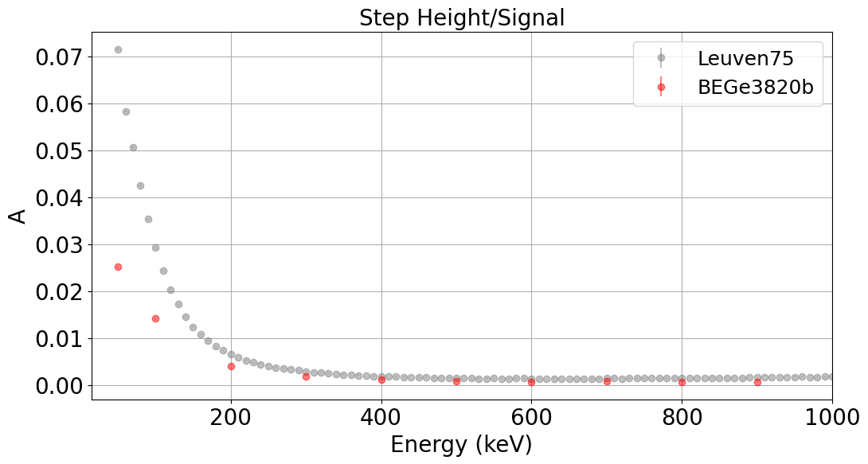
Step height
Distance dependence
Detector dependence:

Slide 10
Step height
Do simulation for full array → for right positions
Step height increases all of a sudden ???

Slide 11
Rise time

Slide 12
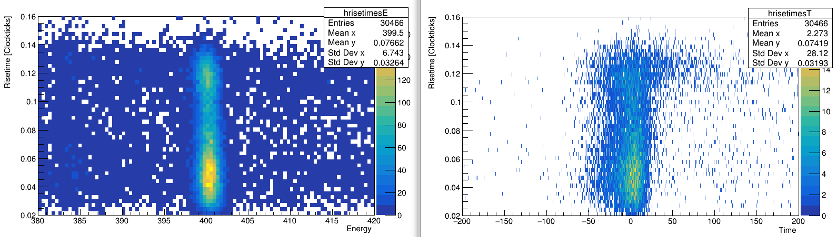
Rise time
Currently investigating how we can correct for the different risetimes by adding risetime as a branch in the output tree of the analyzer
Ge06

Slide 13
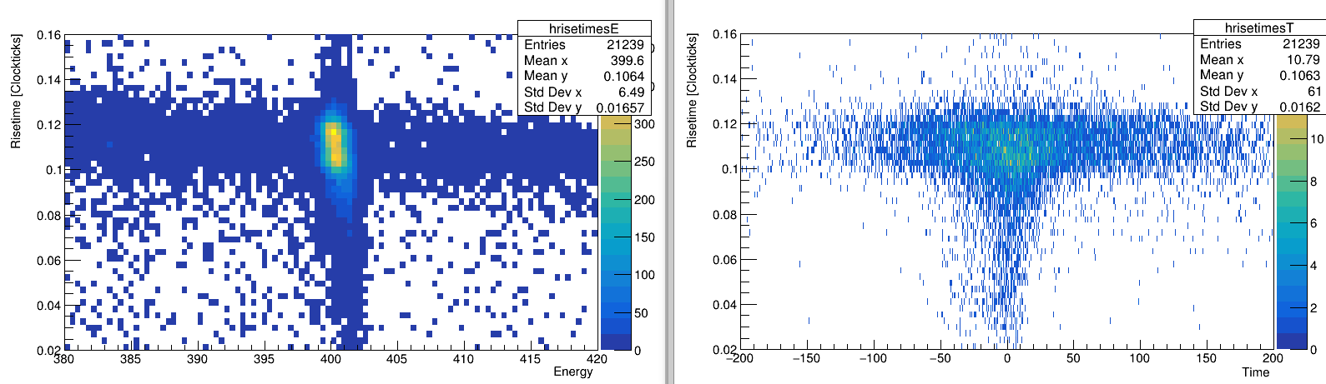
Rise time
Currently investigating how we can correct for the different risetimes by adding risetime as a branch in the output tree of the analyzer
Ge03

Slide 14
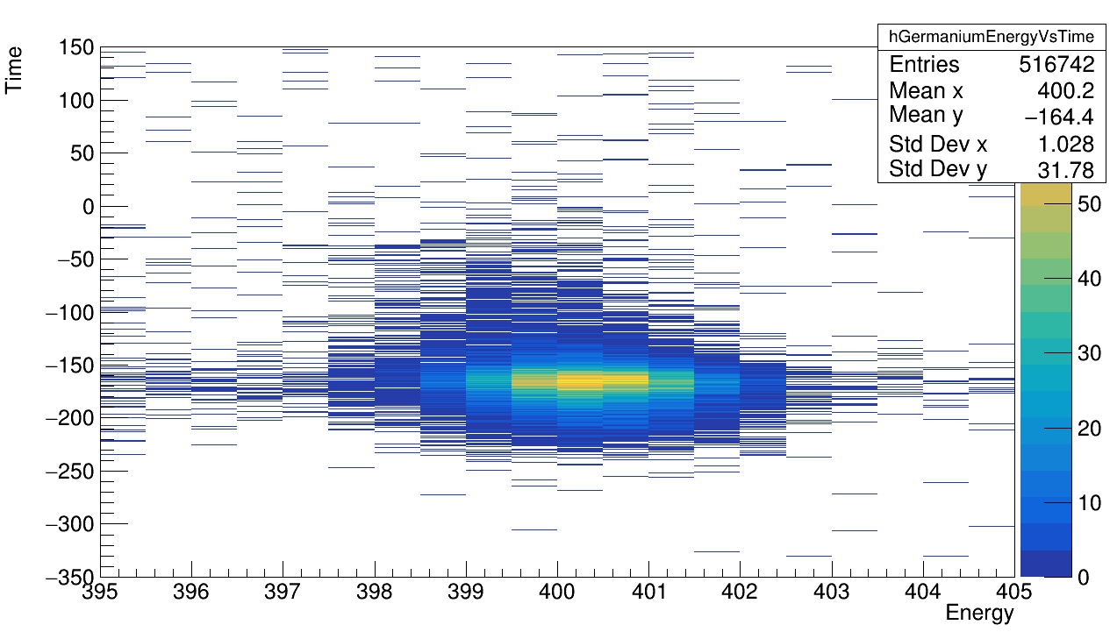
Time dependent energy
Risetime = x(y=0.3*ADC) – x(y=0.1*ADC)
Inspired by Michaels “problem”
Energy “drifts” towards lower values for increasing time difference
Idea: slower risetime pulses, correspond to a slightly smaller energy

Slide 15
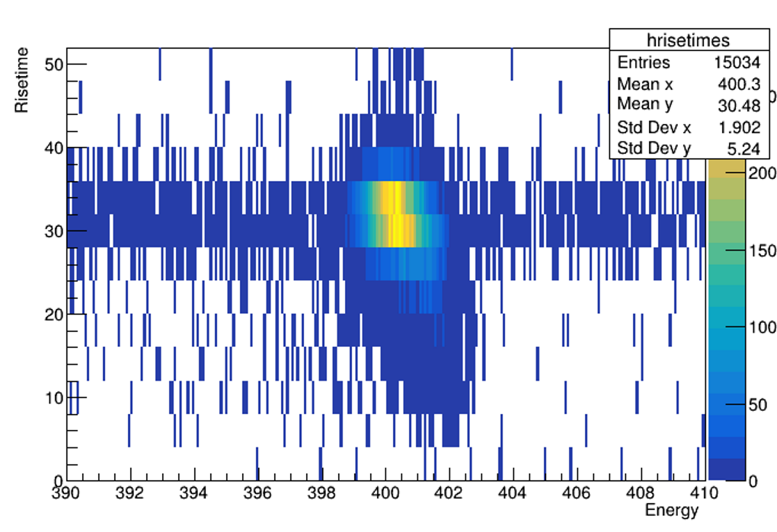
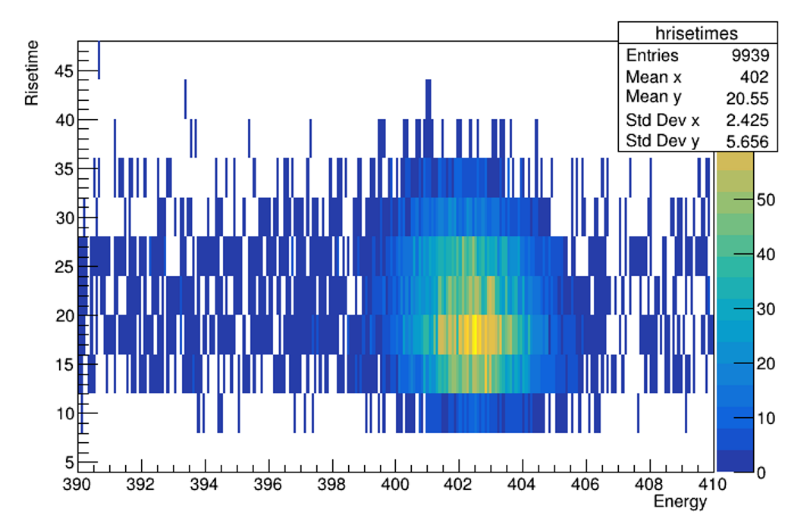
Time dependent energy
Risetime = x(y=0.3*ADC) – x(y=0.1*ADC)
Longer risetime = lower energy
For Si muonic x ray at 400
Ge03
Ge09

Slide 16
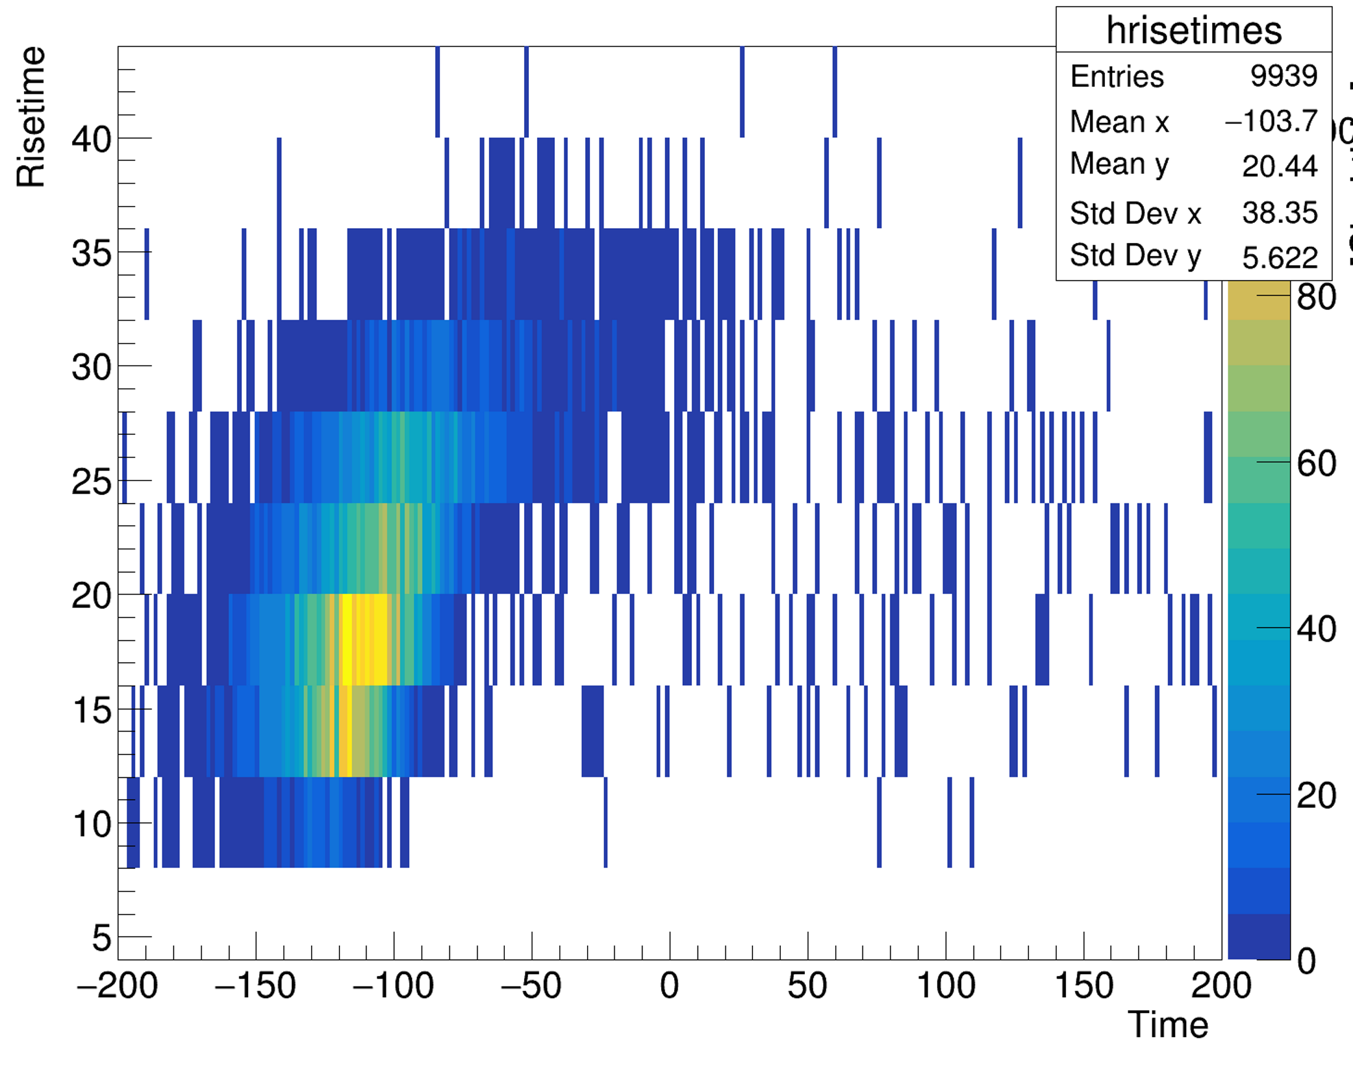
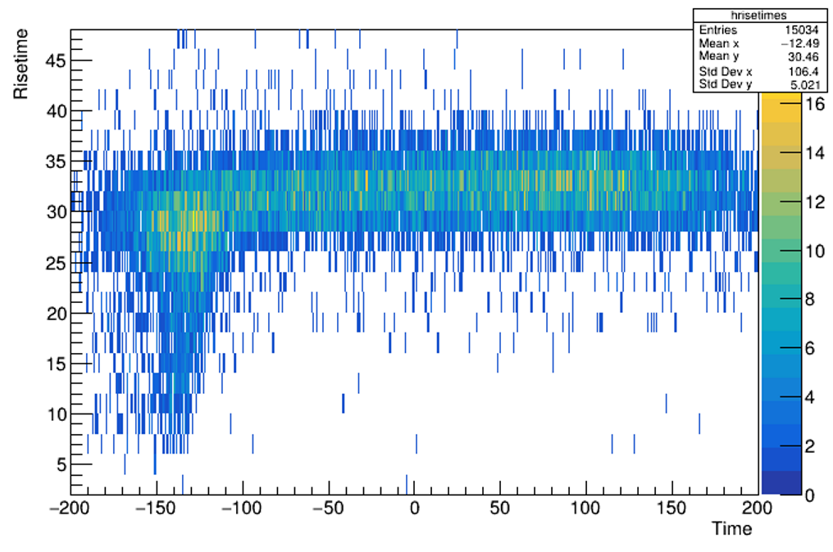
Time dependent energy
Risetime = x(y=0.3*ADC) – x(y=0.1*ADC)
Longer risetime = bigger time
For Si muonic x ray at 400
Ge09
Ge03

Slide 17
Time dependent energy
Added the risetime as a branch in the output tree of the analyzer (only on Marie branch so far)
→ Able to extract risetime from the tree
→ Reran the analyzer for 5 runs first

Slide 18
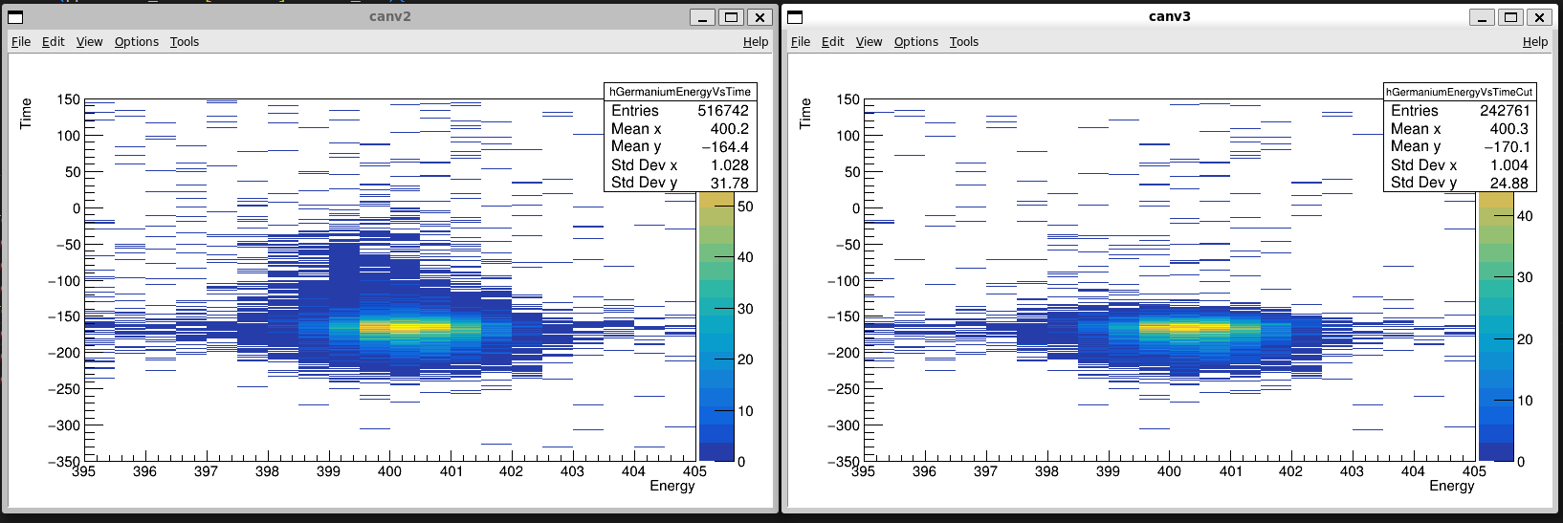
Time dependent energy
Without cut
With cut

Slide 19
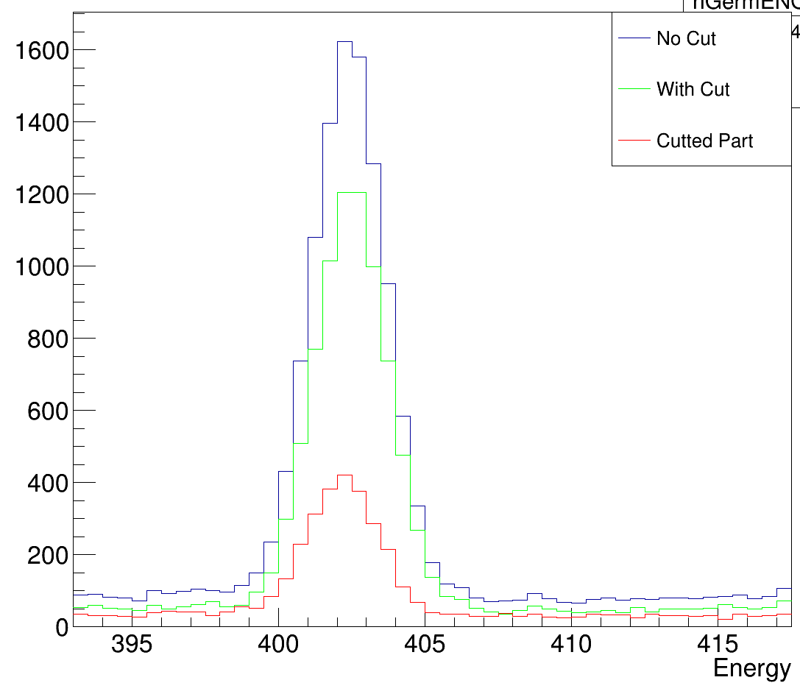
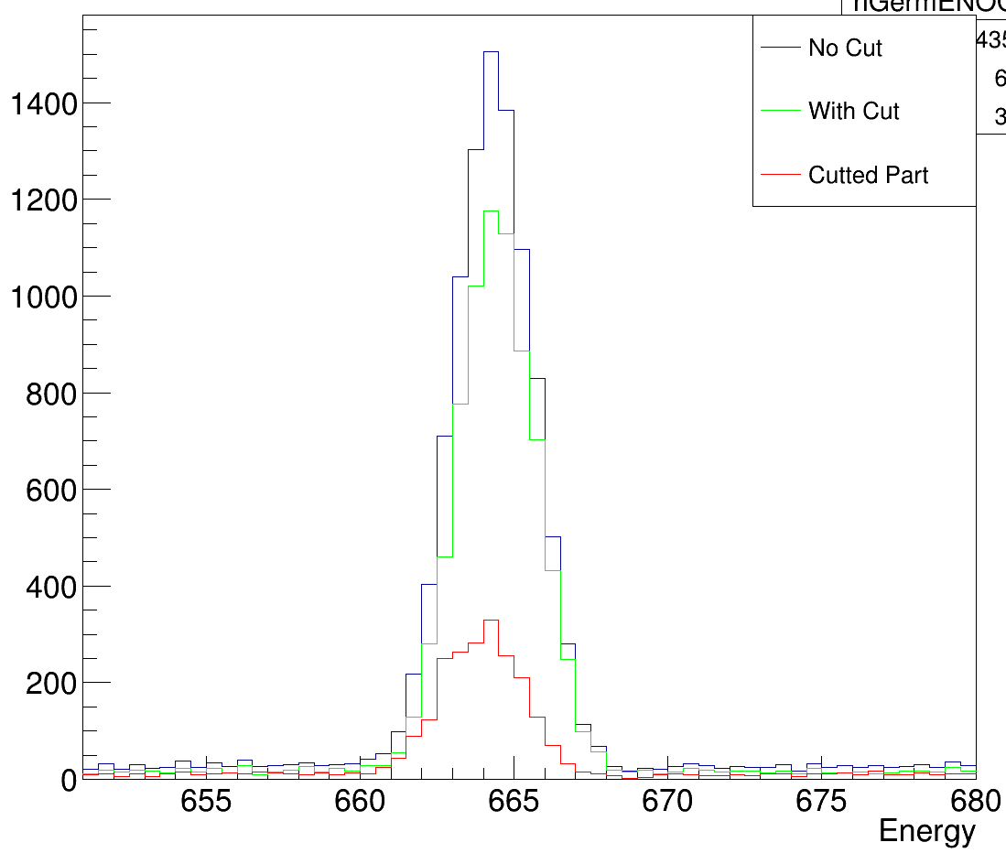
Time dependent energy
Ge09

Slide 20
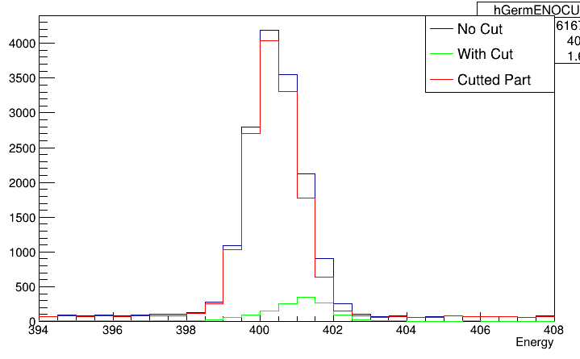
Time dependent energy
Ge03

Slide 21
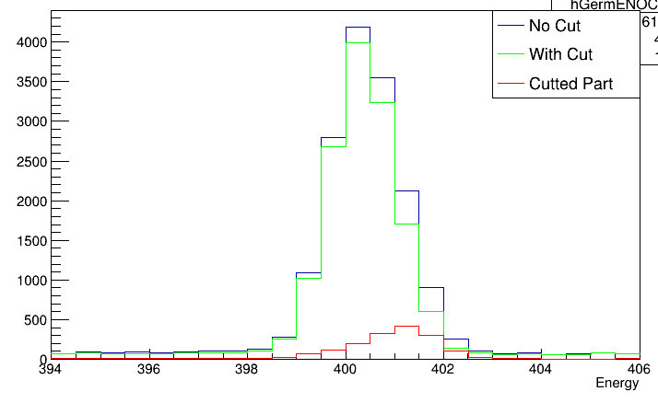
Time dependent energy
Extreme loss in statistics, as most events have long rise-time:
Ge03 – reverse cut

Slide 22
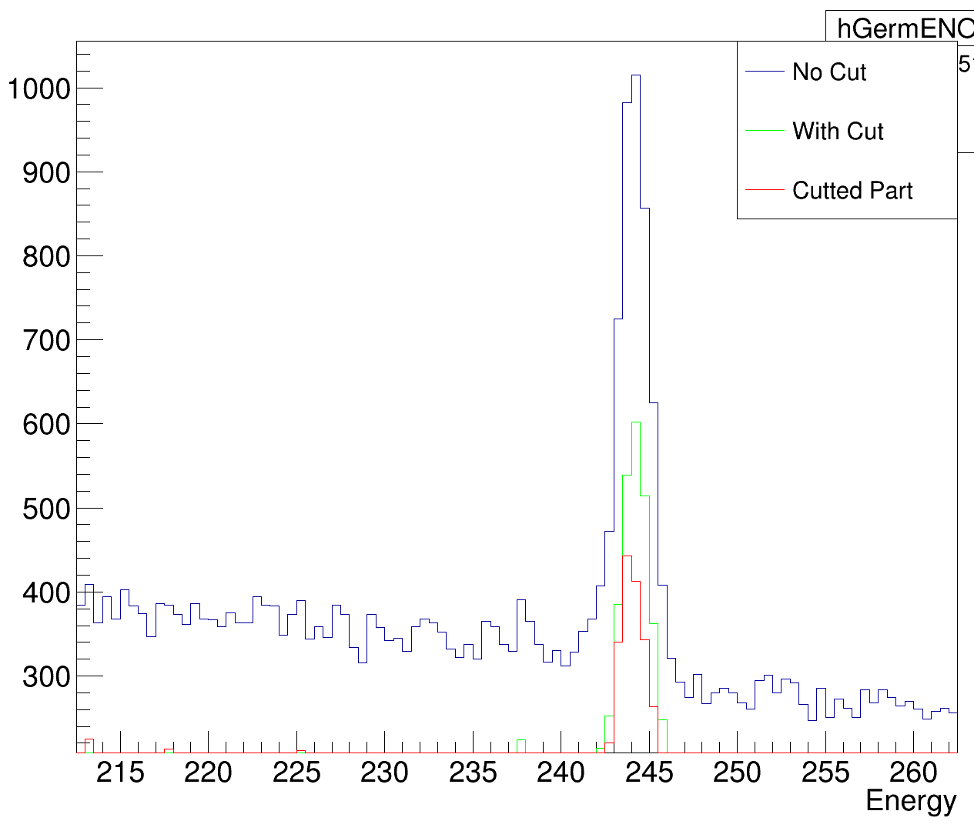
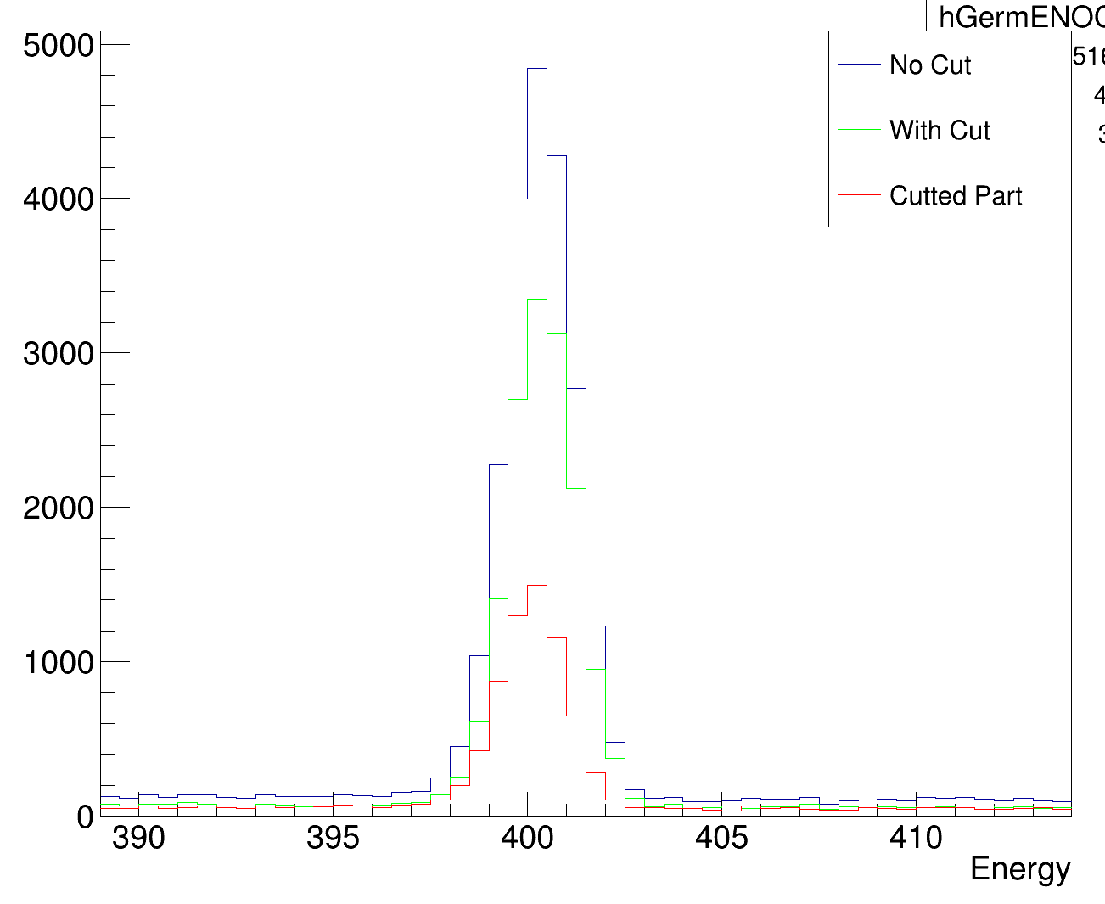
Time dependent energy
Ge06

Slide 23

Time dependent energy
Should we instead correct?
Somehow try to make a fit through the data, to then use as a correction

Slide 24
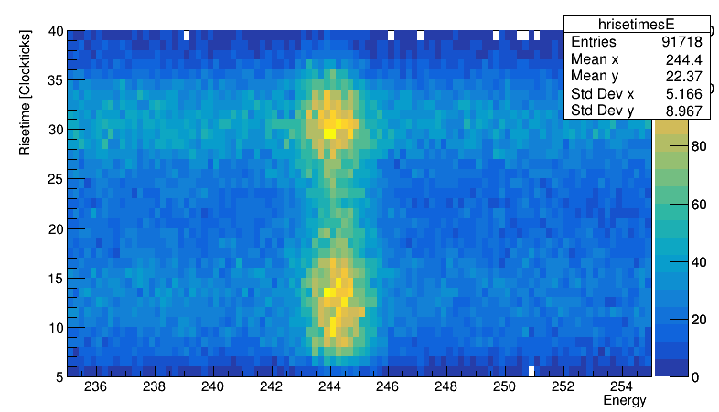
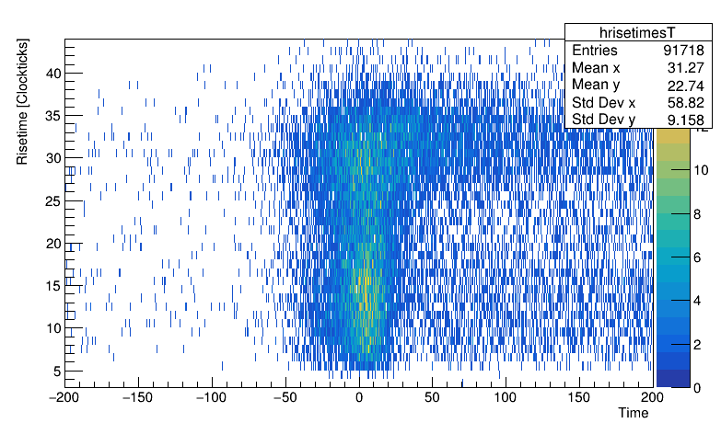
Time dependent energy
So far:
  Reran the analyzer for some more files
  Hard drive problems

Slide 25
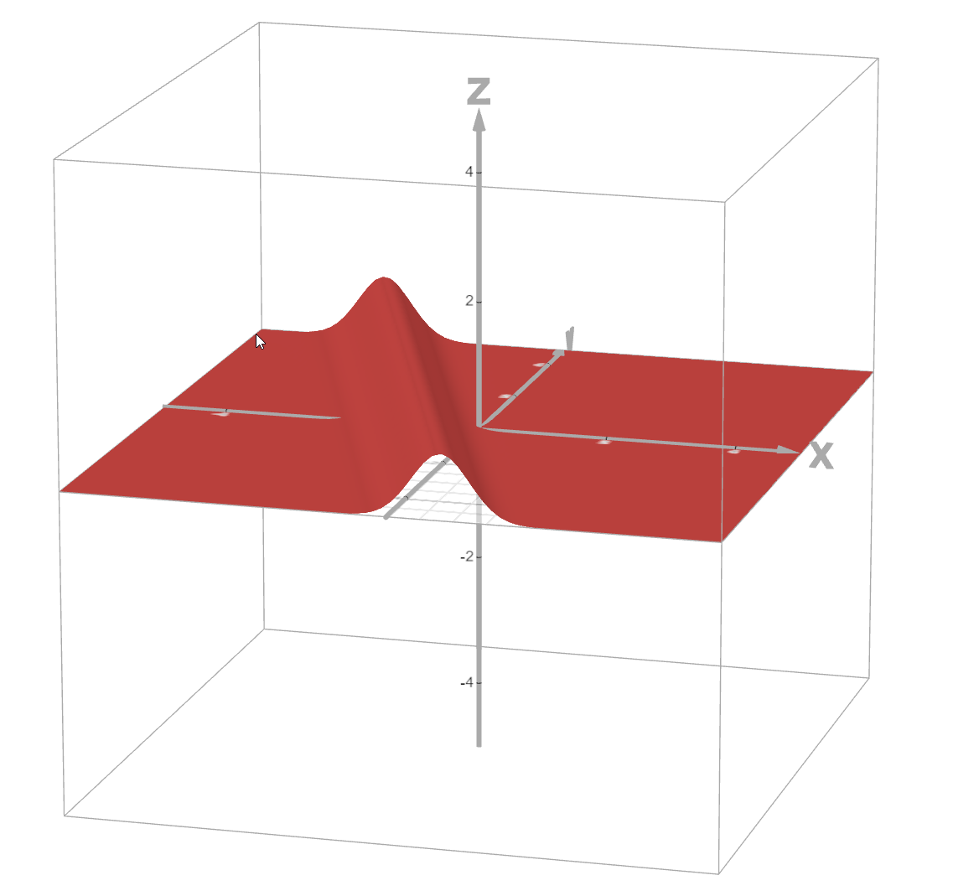
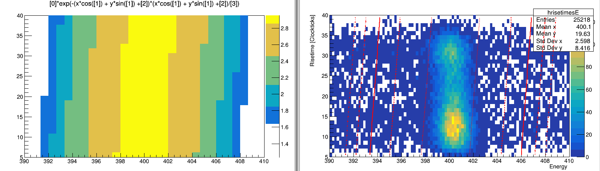
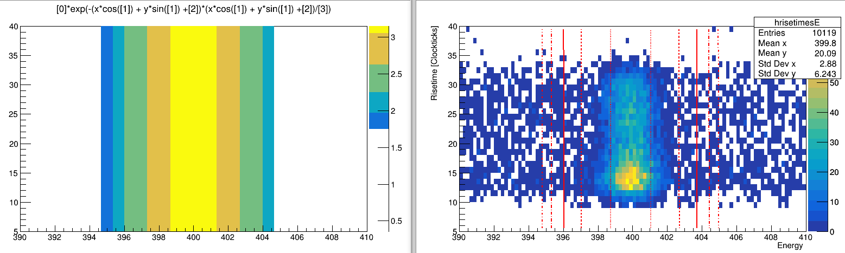
Time dependent energy
So far:
  Reran the analyzer for some more files
  Hard drive problems
  Tried 2 different ways for energy
    Fit with “Gaussian tube”
      Worked not OK, likely because not right shape

Slide 26
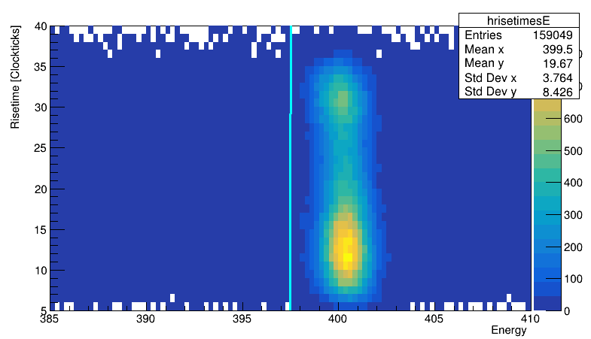
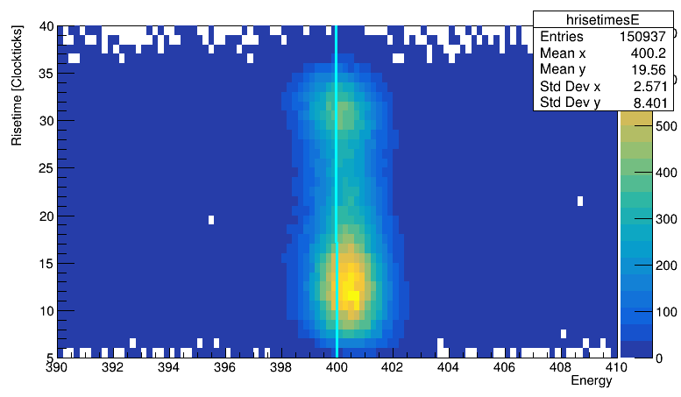
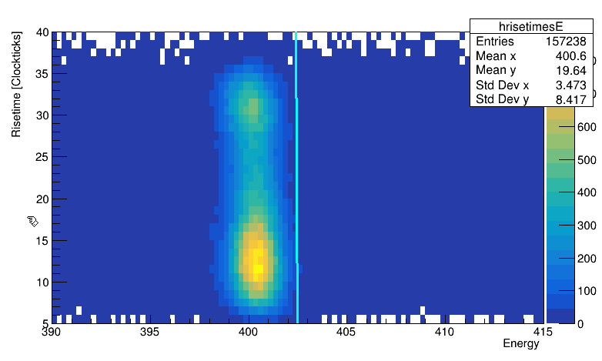
Time dependent energy
So far:
  Reran the analyzer for some more files
  Hard drive problems
  Tried 2 different ways for energy
    Fit with “gausian tube”
    Fit with weights (get energy and risetime of each bin and add an error = 1/weight to that point with
    weight = bincontent) → very much range dependent ☹

Slide 27
Time dependent energy
So far:
  Reran the analyzer for some more files
  Hard drive problems
  Tried 2 different ways for energy
    Fit with “gausian tube”
    Fit with weights (get energy and risetime of each bin and add an error = 1/weight to that point with
    weight = bincontent) → very much range dependent ☹
    Looking for a better approach

