Slide 1
Update muX meeting 31/01
Michael Heines

Slide 2
⁴⁰K fitting

Slide 3
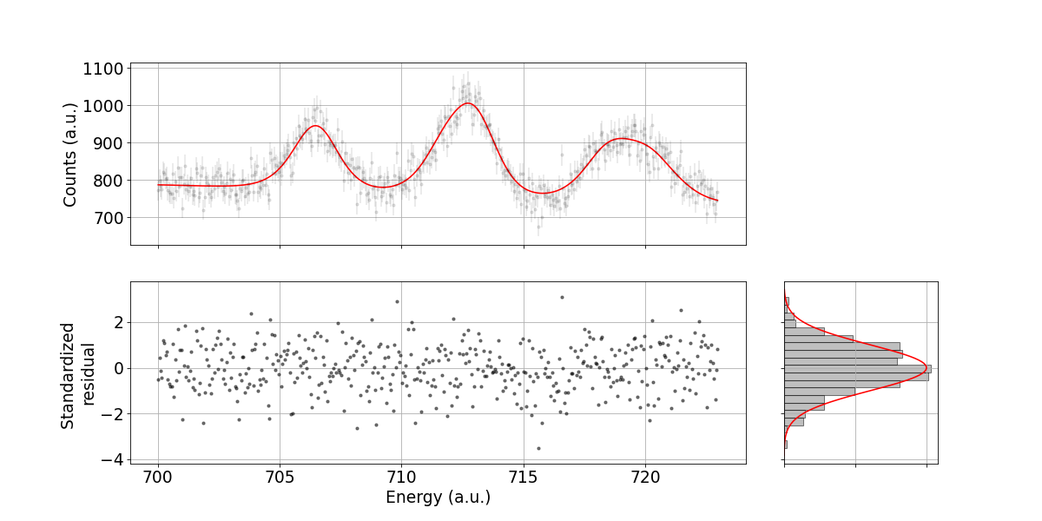


Fitted spectrum
110mAg
2p1s
Ti($μ, ν xn$)Sc
$$χ_{ν}^{2}=1.05$$

Slide 4
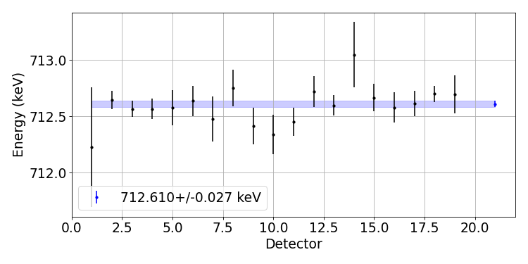
Averaging over detectors
$χ_{ν}^{2}=0.72$ → ~20% quantile in chisquare distribution

Slide 5
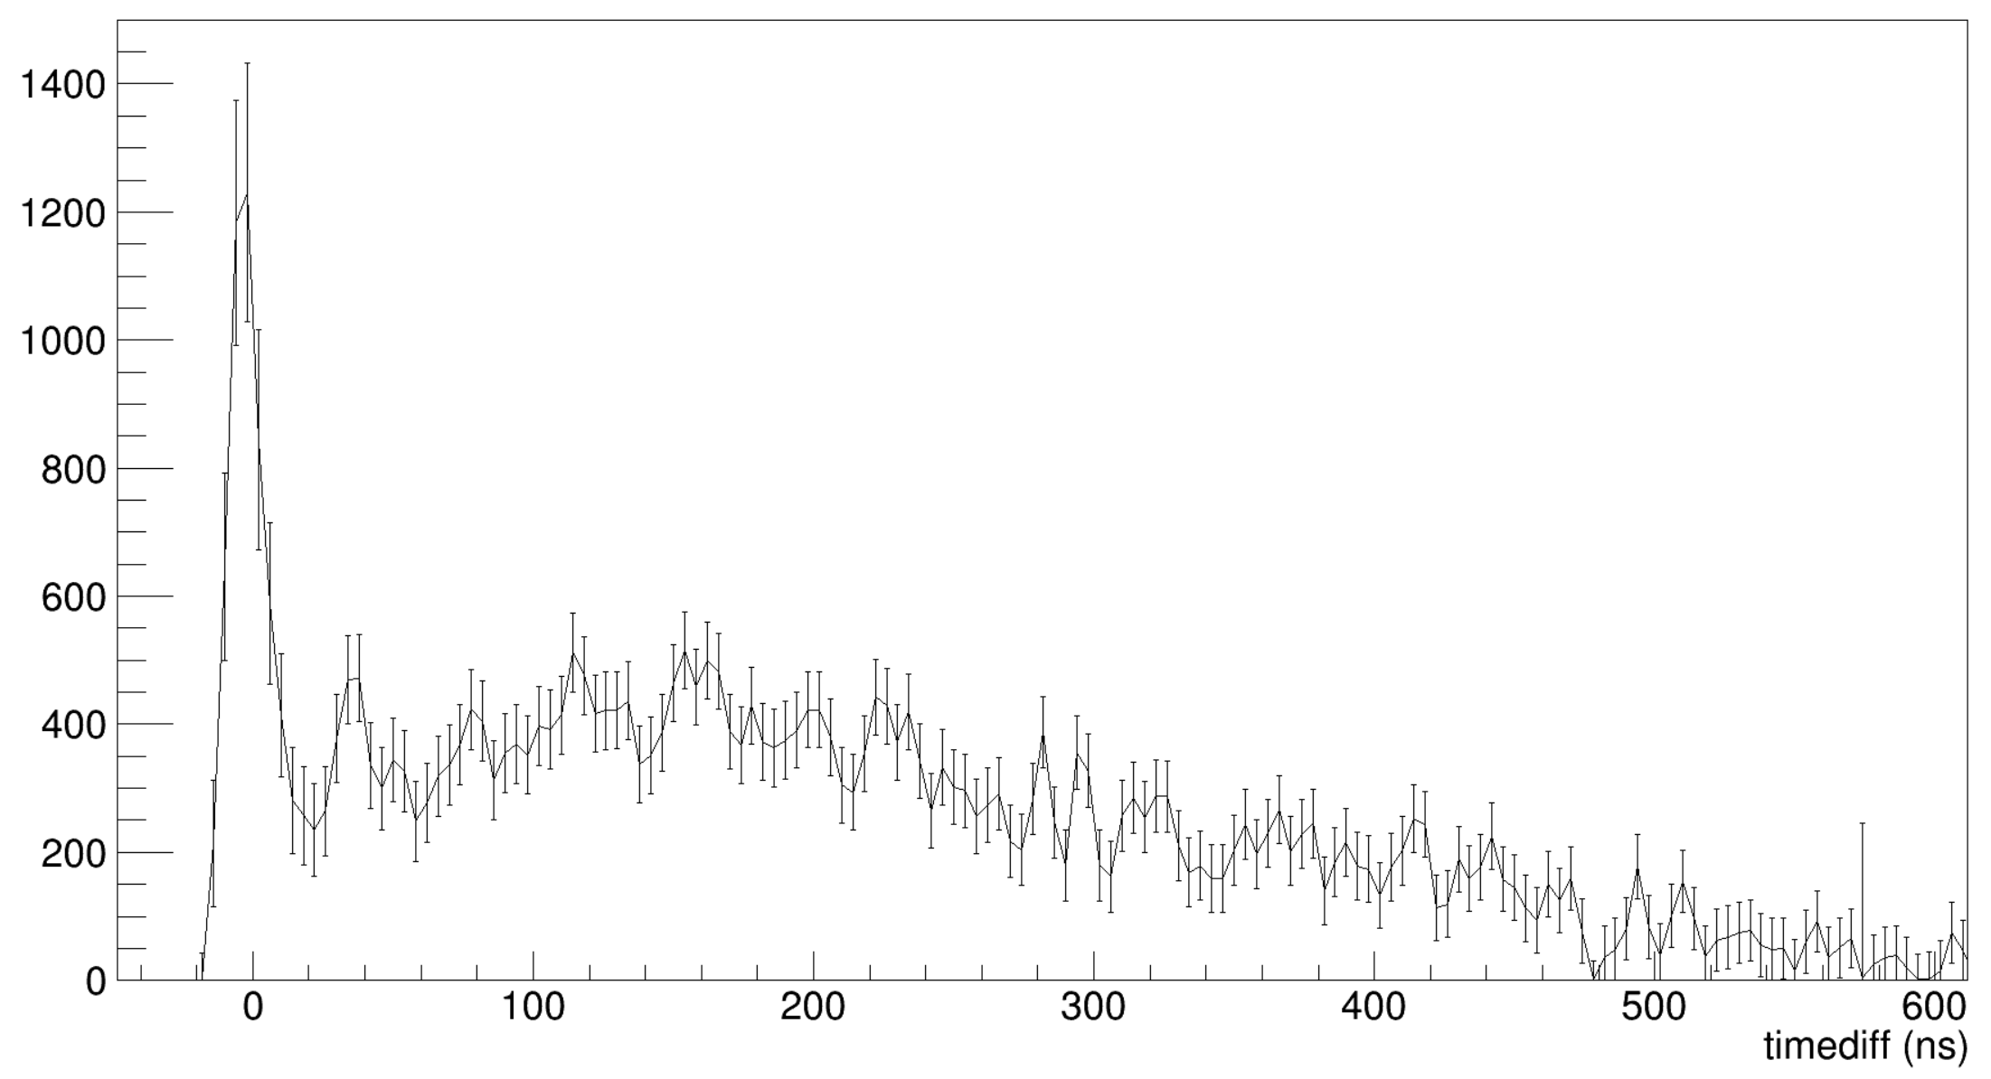
What about time cut systematics
Some systematic
Approx. no systematic

Slide 6
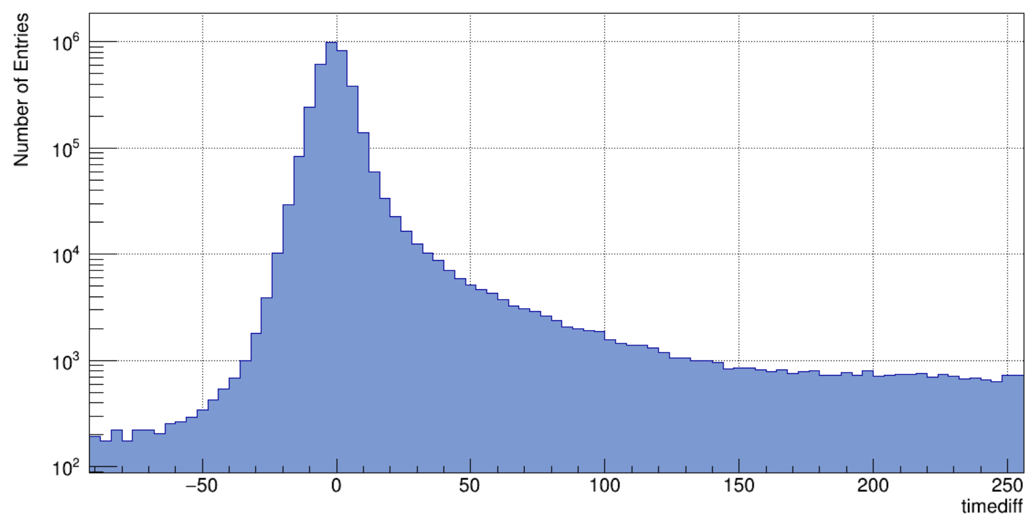
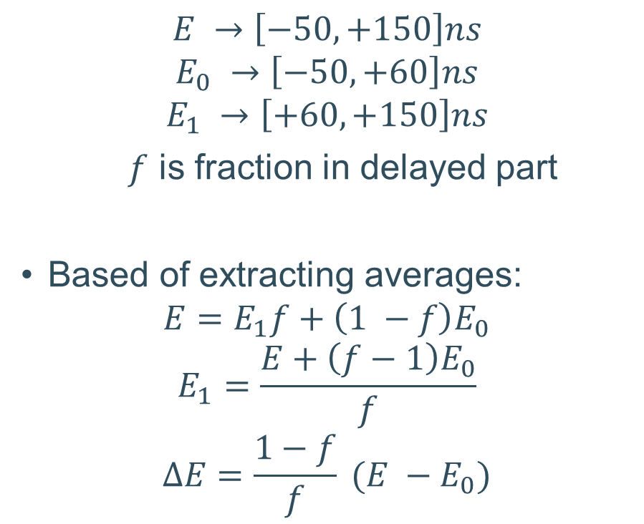

Time cut systematic
From ³⁹K data
$$E →\left[−50, +150\right]ns$$
$$E_{0} →\left[−50, +60\right]ns$$
$$E_{1} →\left[+60, +150\right]ns$$
$f$ is fraction in delayed part
Based of extracting averages:
$$E=E_{1}f+\left(1 −f\right)E_{0}$$
$$E_{1}=\frac{E+\left(f−1\right)E_{0}}{f}$$
$$ΔE=\frac{1−f}{f} (E −E_{0})$$
$$f$$
Note: This plot is just a projection of the histogram, not based of fitting

Slide 7


Time cut systematic
Systematic error on ⁴⁰K extraction
$$σ_{sys}=ΔE⋅f⋅R$$
$$R≈0.127$$
Effect ≲ 1 eV → Ignore
$$R$$

Slide 8
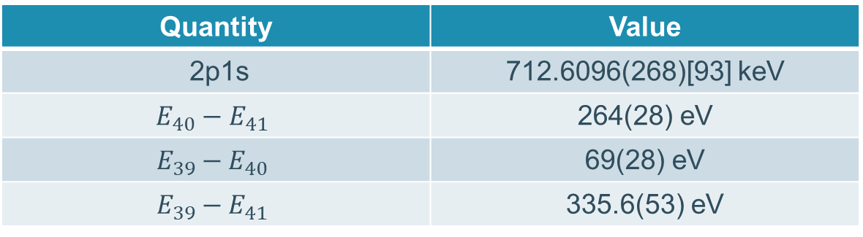
Results
Quantity | Value
2p1s | 712.6096(268)[93] keV
$$E_{40}−E_{41}$$ | 264(28) eV
$$E_{39}−E_{40}$$ | 69(28) eV
$$E_{39}−E_{41}$$ | 335.6(53) eV
Literature errors on 39, 41K
  Absolute error → 32 eV; 28 eV
  IS error → 24 eV

