Slide 1
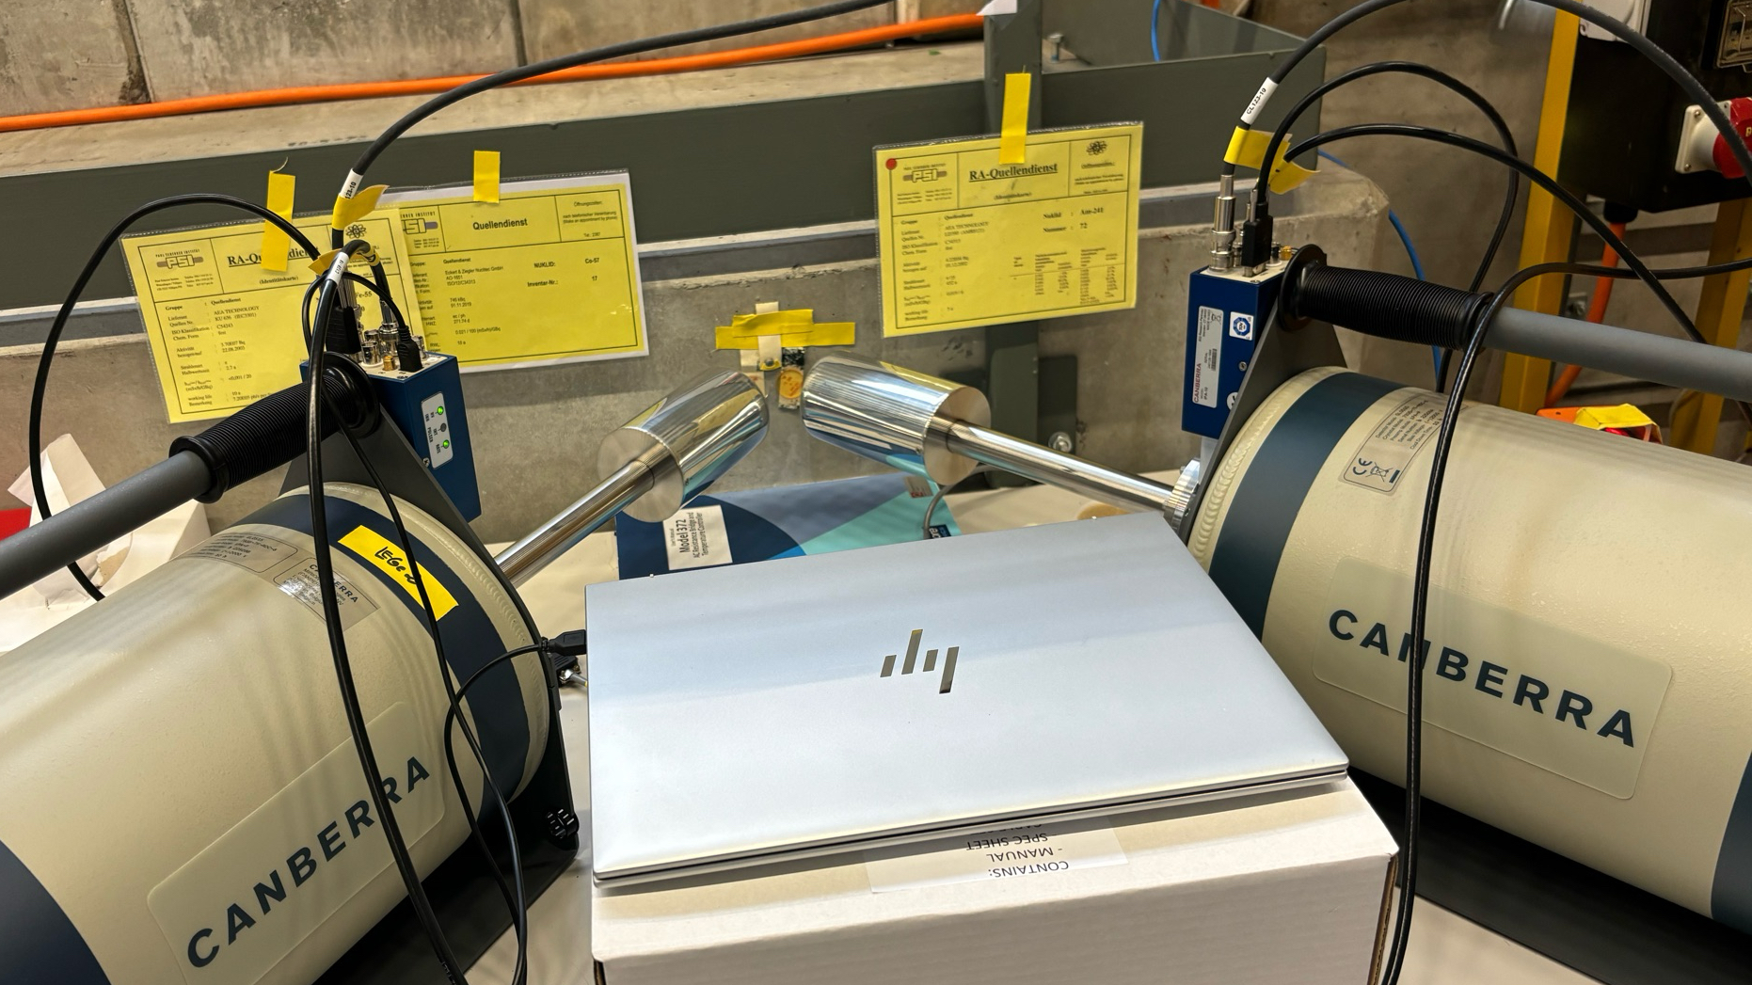
Testing the new
Low Energy Germanium
Detectors (LEGe)

Slide 2
Setting up/ Parameters
Set the gain of the Intelligent Preamplifier at its maximum option: x10
Trapezoid filter Parameters
LEGe 1
Trapezoid Parameters | Tau (ns) | Gap | Peaking
Used | 49.19 | 300 | 2600
Manufacturer |  | 200 | 1800
LEGe 2
Trapezoid Parameters | Tau (ns) | Gap | Peaking
Used | 48.96 | 250 | 2100
Manufacturer |  | 200 | 1800

Slide 3
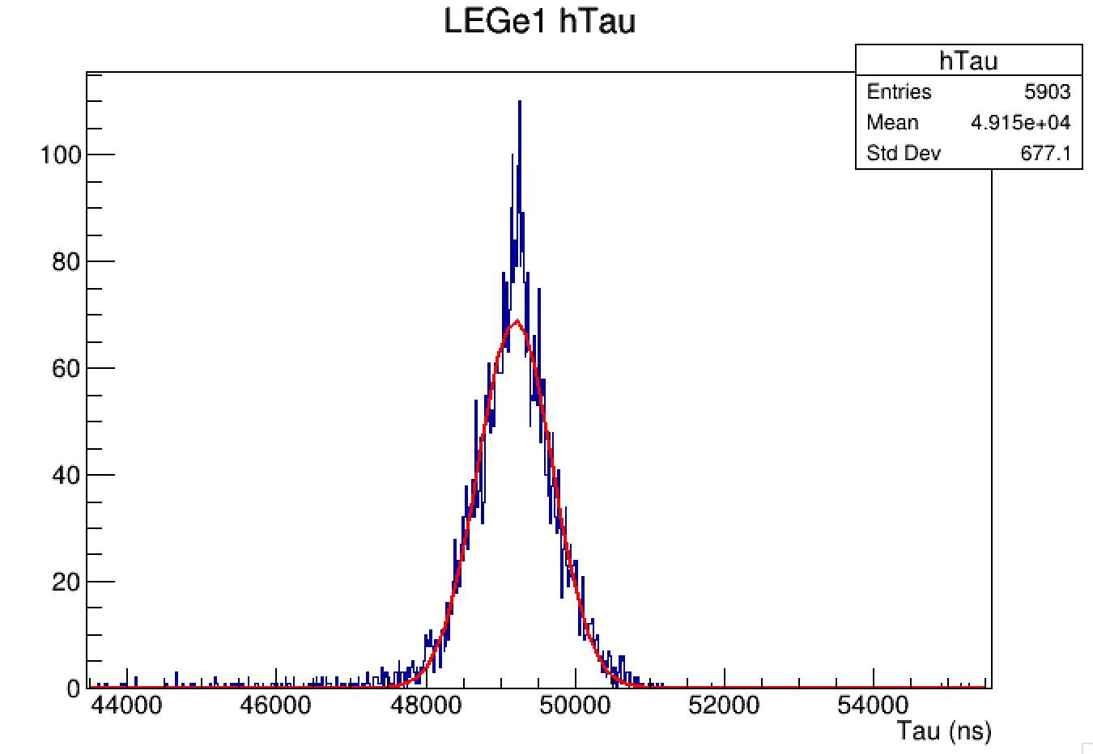
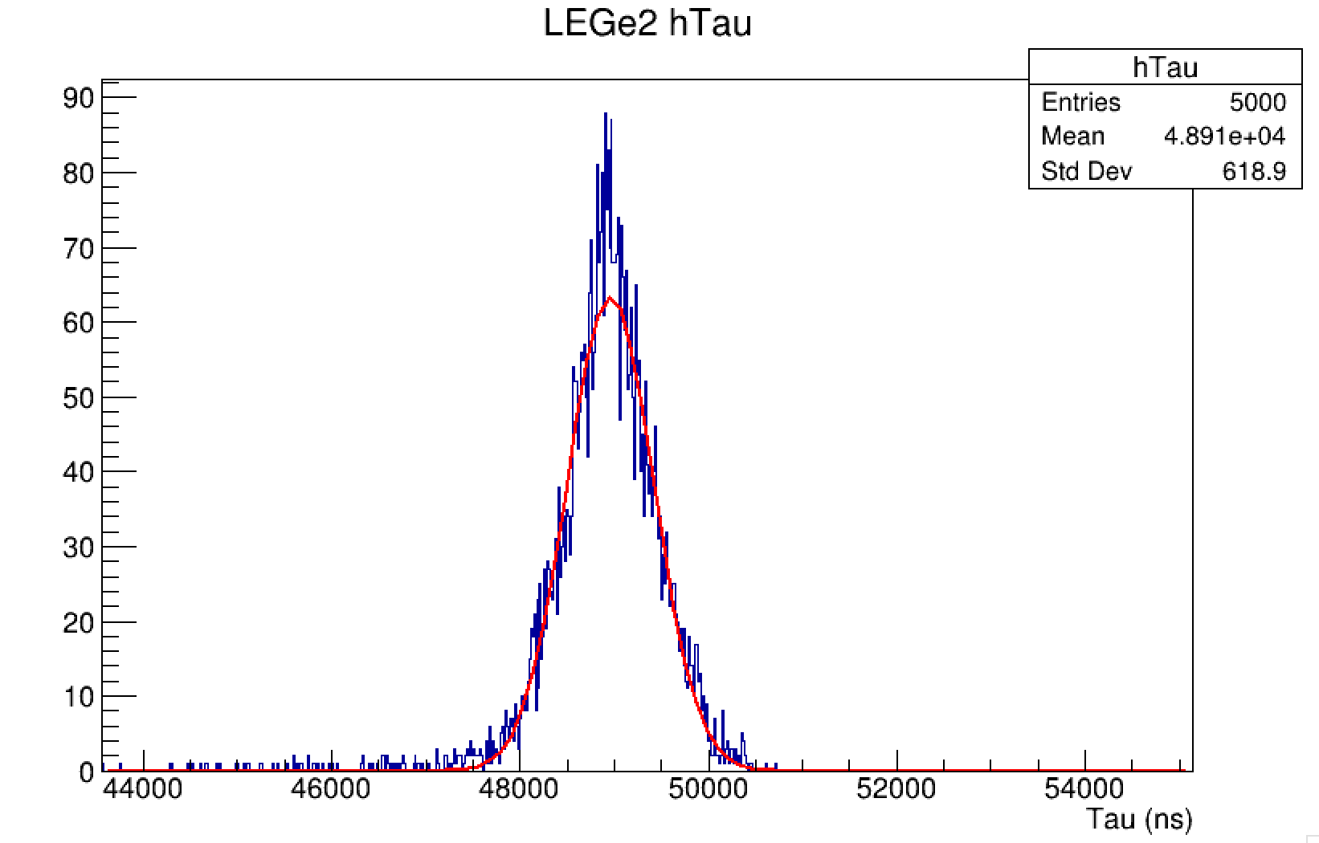
Tau Parameter
Taking long traces with 25000 buffer length

Slide 4
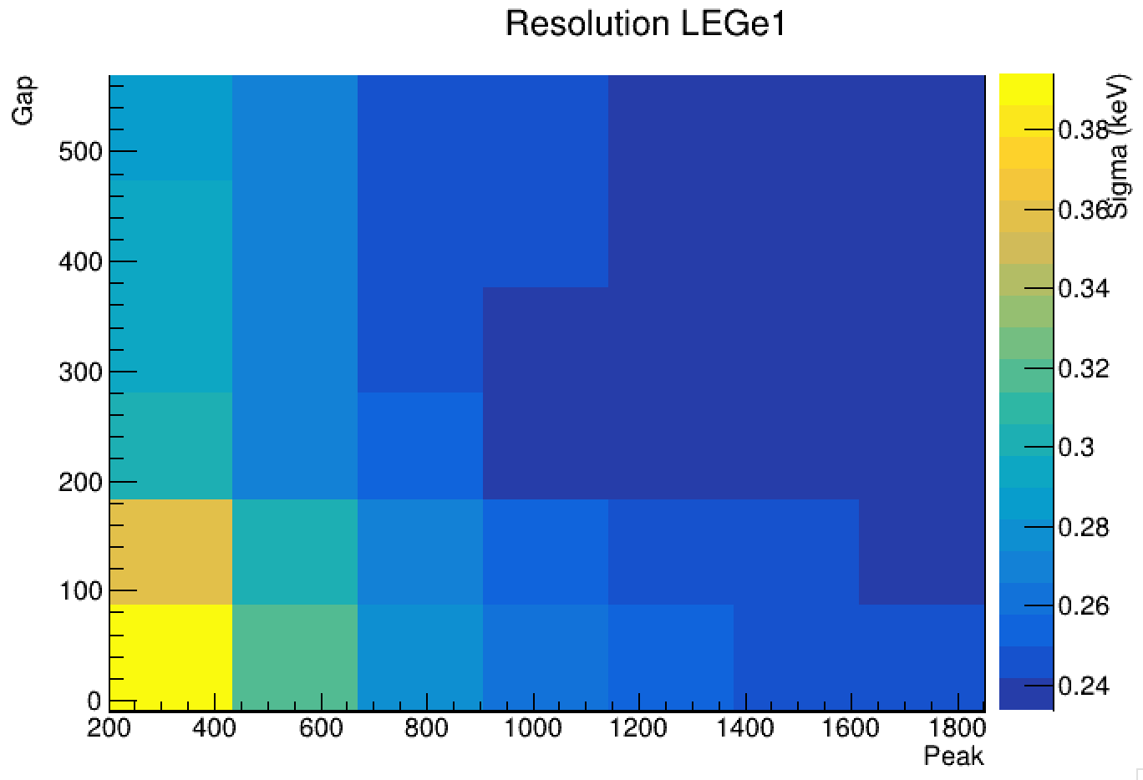
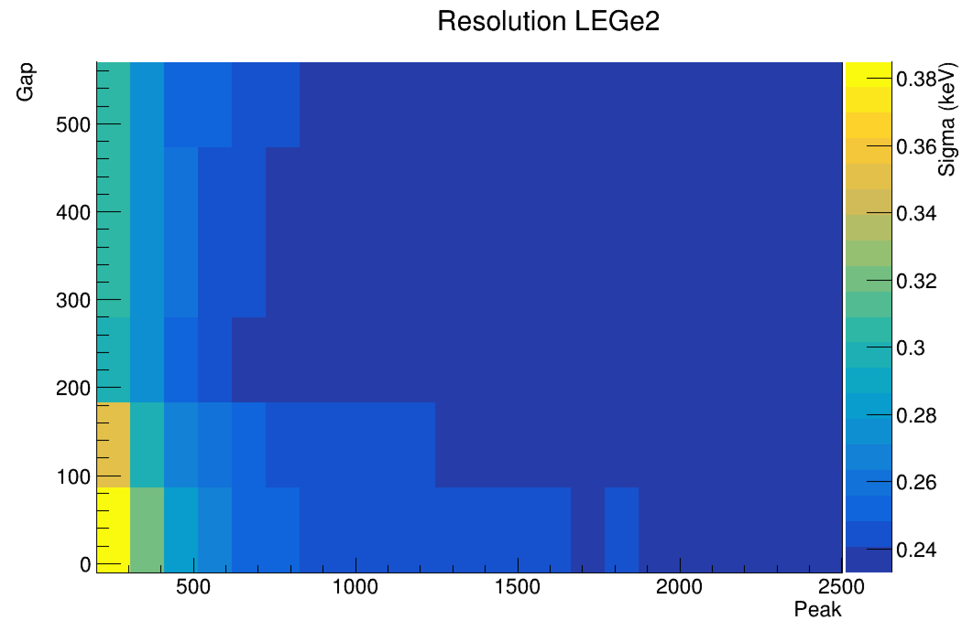
Gap and Peaking
Running the trapezoid filter with Michaels Trapezoidal Optimization code.

Slide 5
Gap and Peaking
Choosing gap at 300 for LEGe1 and 250 for LEGE2.

Slide 6
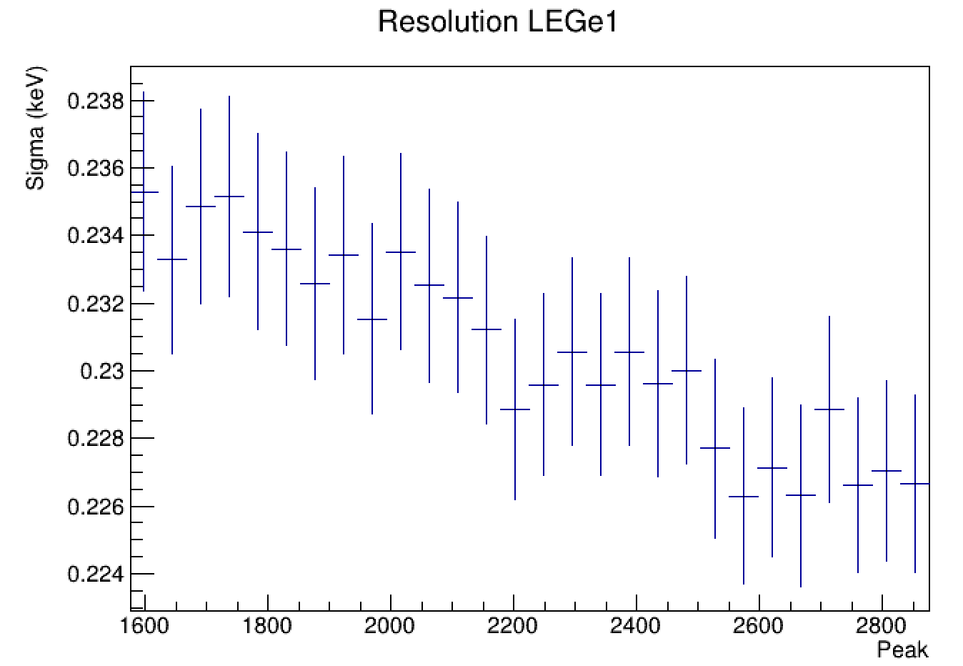
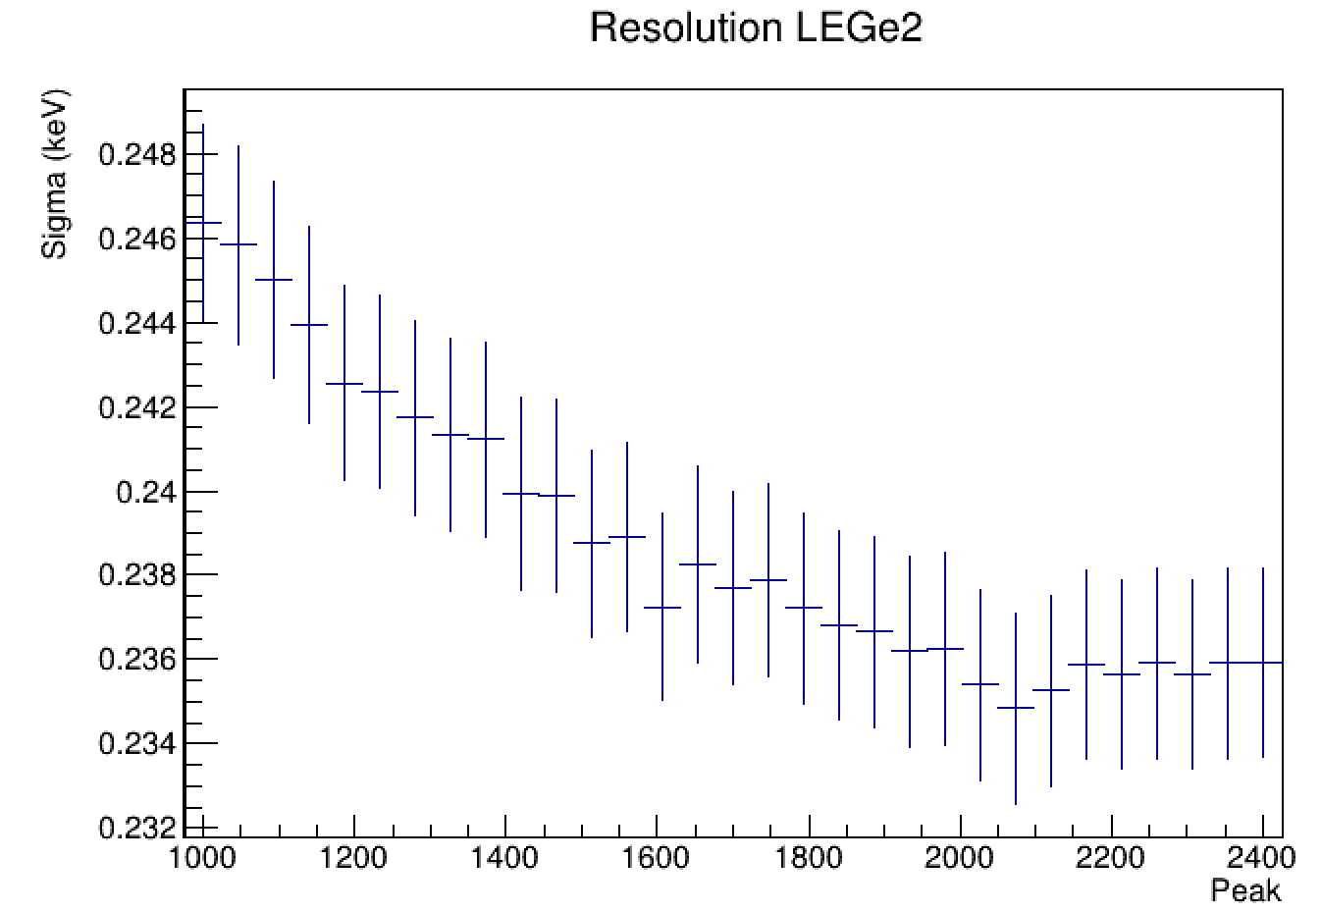
Gap and Peaking
Fixing the Gap we study the minimum resolution for the Peak parameter

Slide 7
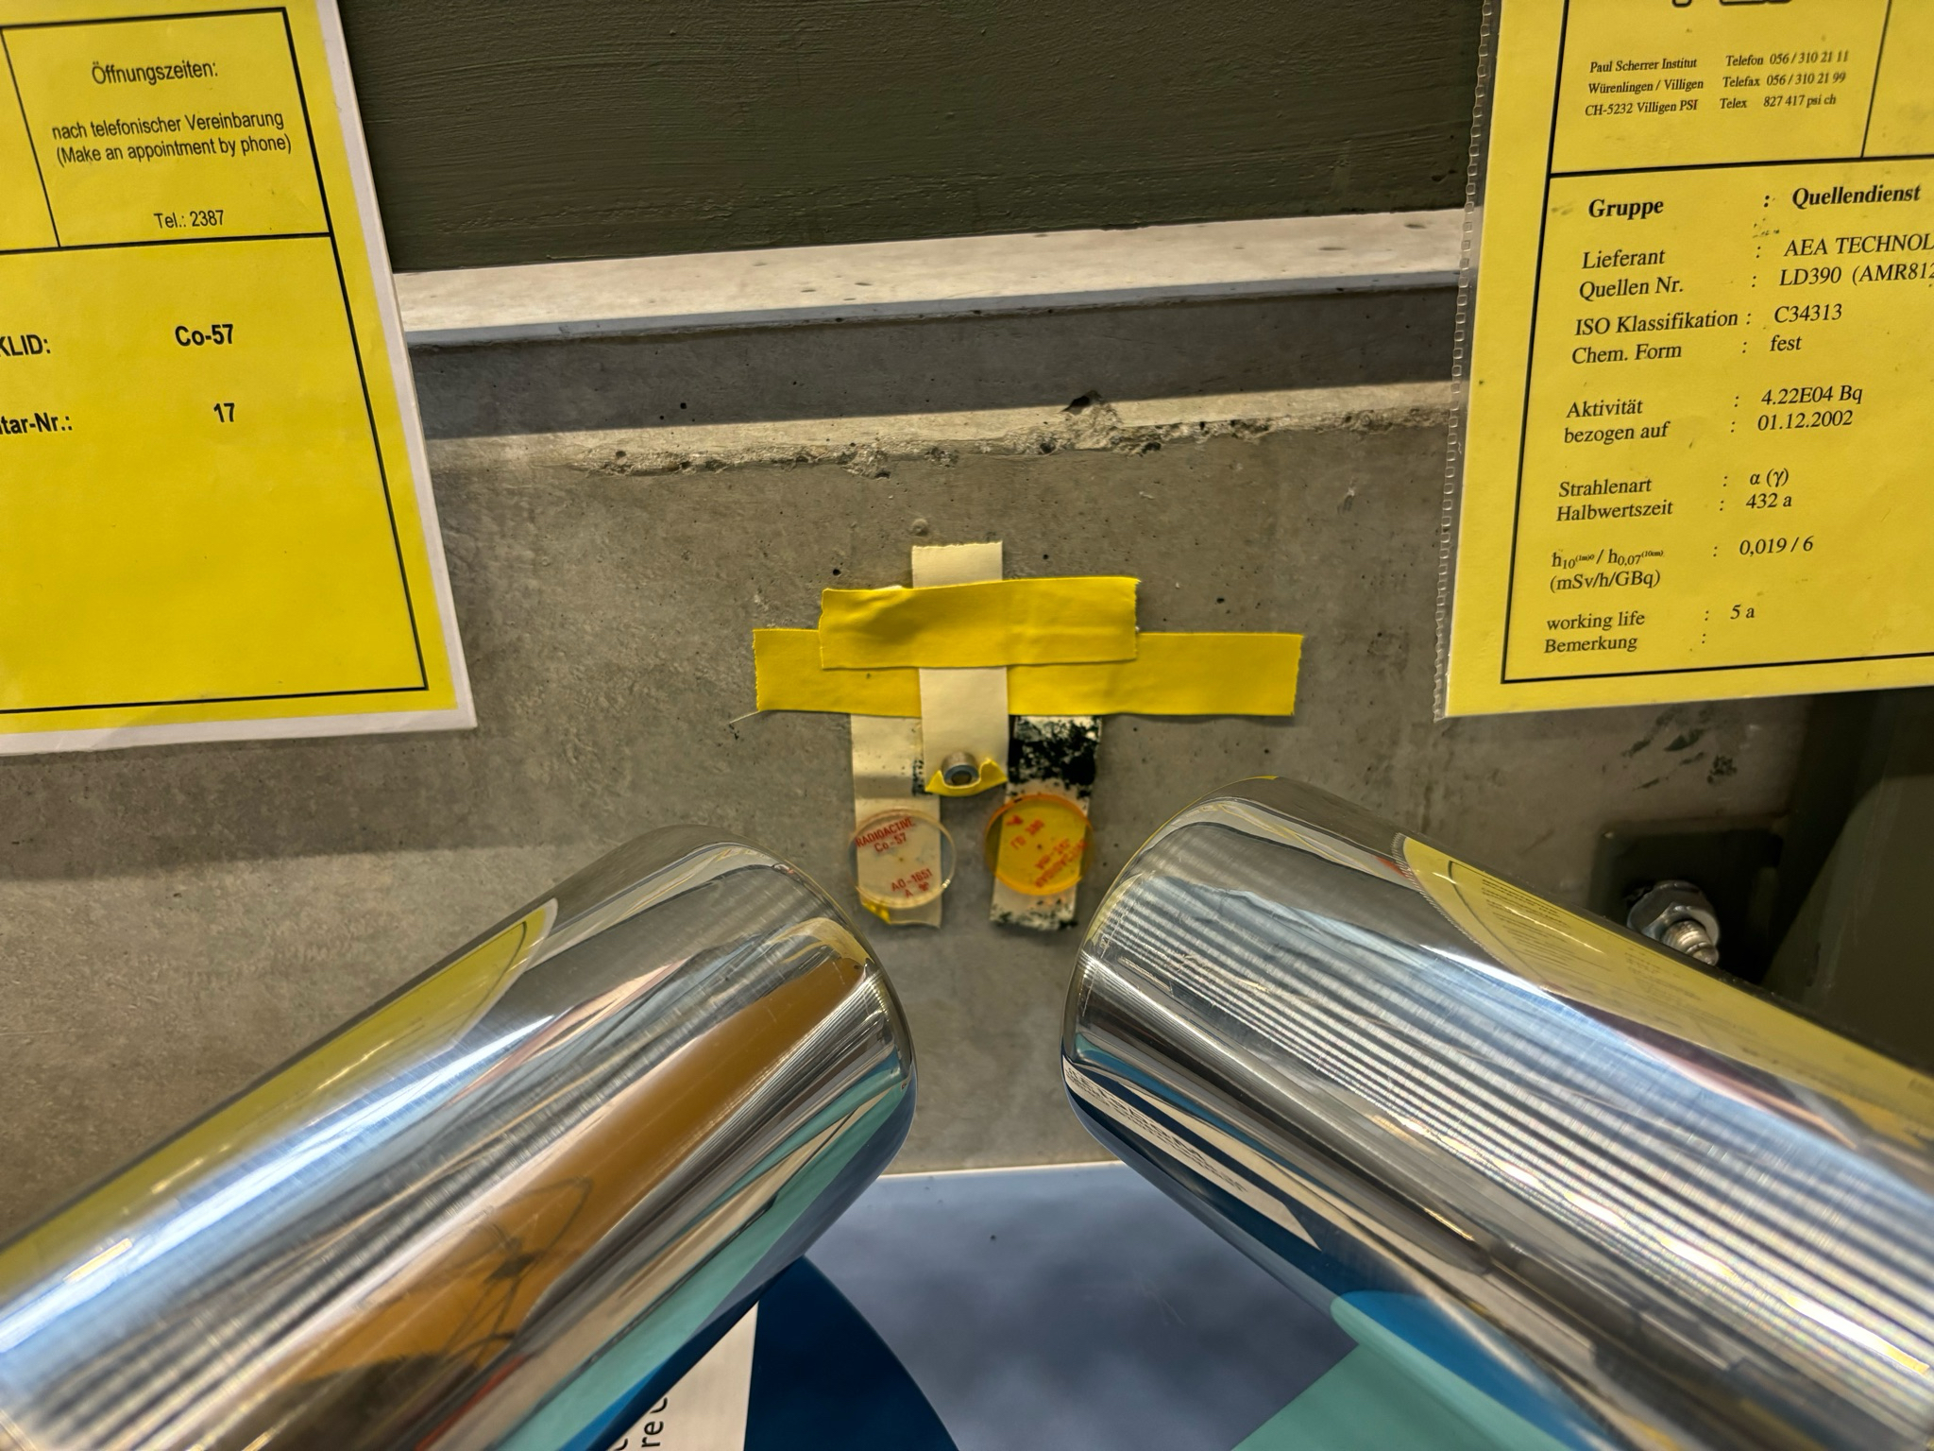
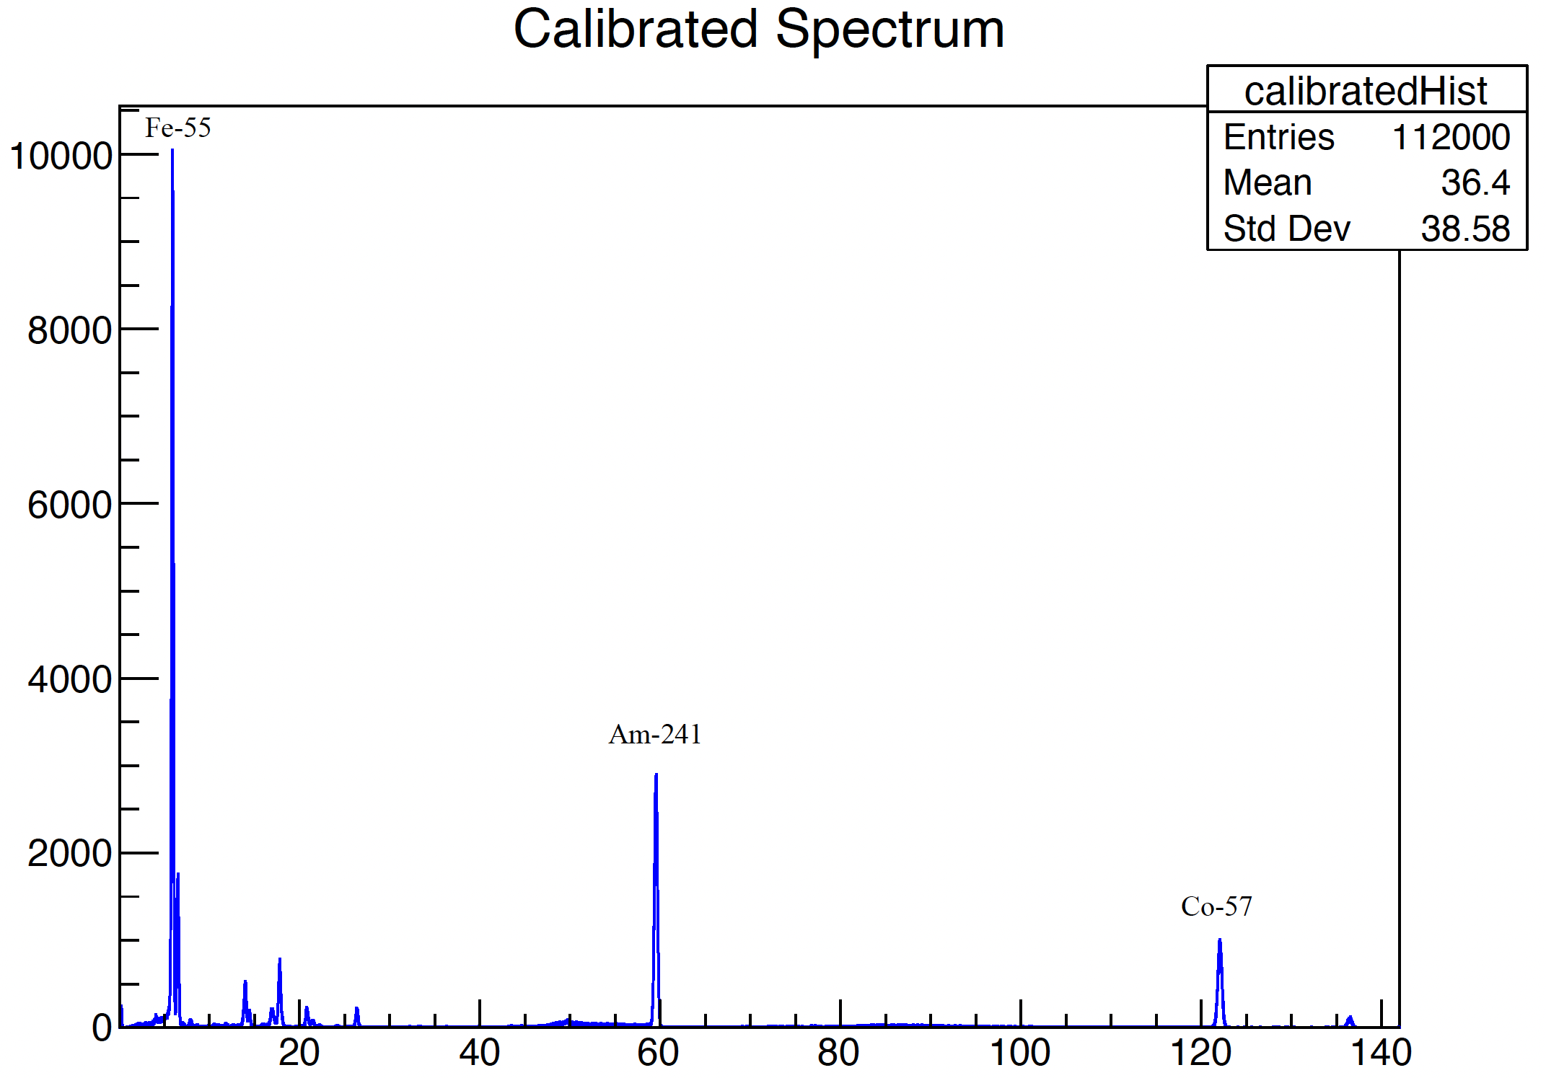
Spectra
Using three sources at the same time: Fe-55, Co-57 and Am-241

Slide 8
Fitting the Peaks
x 40.8

Slide 9
Resolution
LEGe 1
Isotopes | Fe-55 | Am-241 | Co-57
Energy (keV) | 5.9 | 59.54 | 122
Calculated (eV) | 235 | 377 | 517
Manufacturer (eV) | 220 | - | 525
LEGe 2
Isotopes | Fe-55 | Am-241 | Co-57
Energy (keV) | 5.9 | 59.54 | 122
Calculated (eV) | 235 | 400 | 542
Manufacturer (eV) | 220 | - | 525

Slide 10
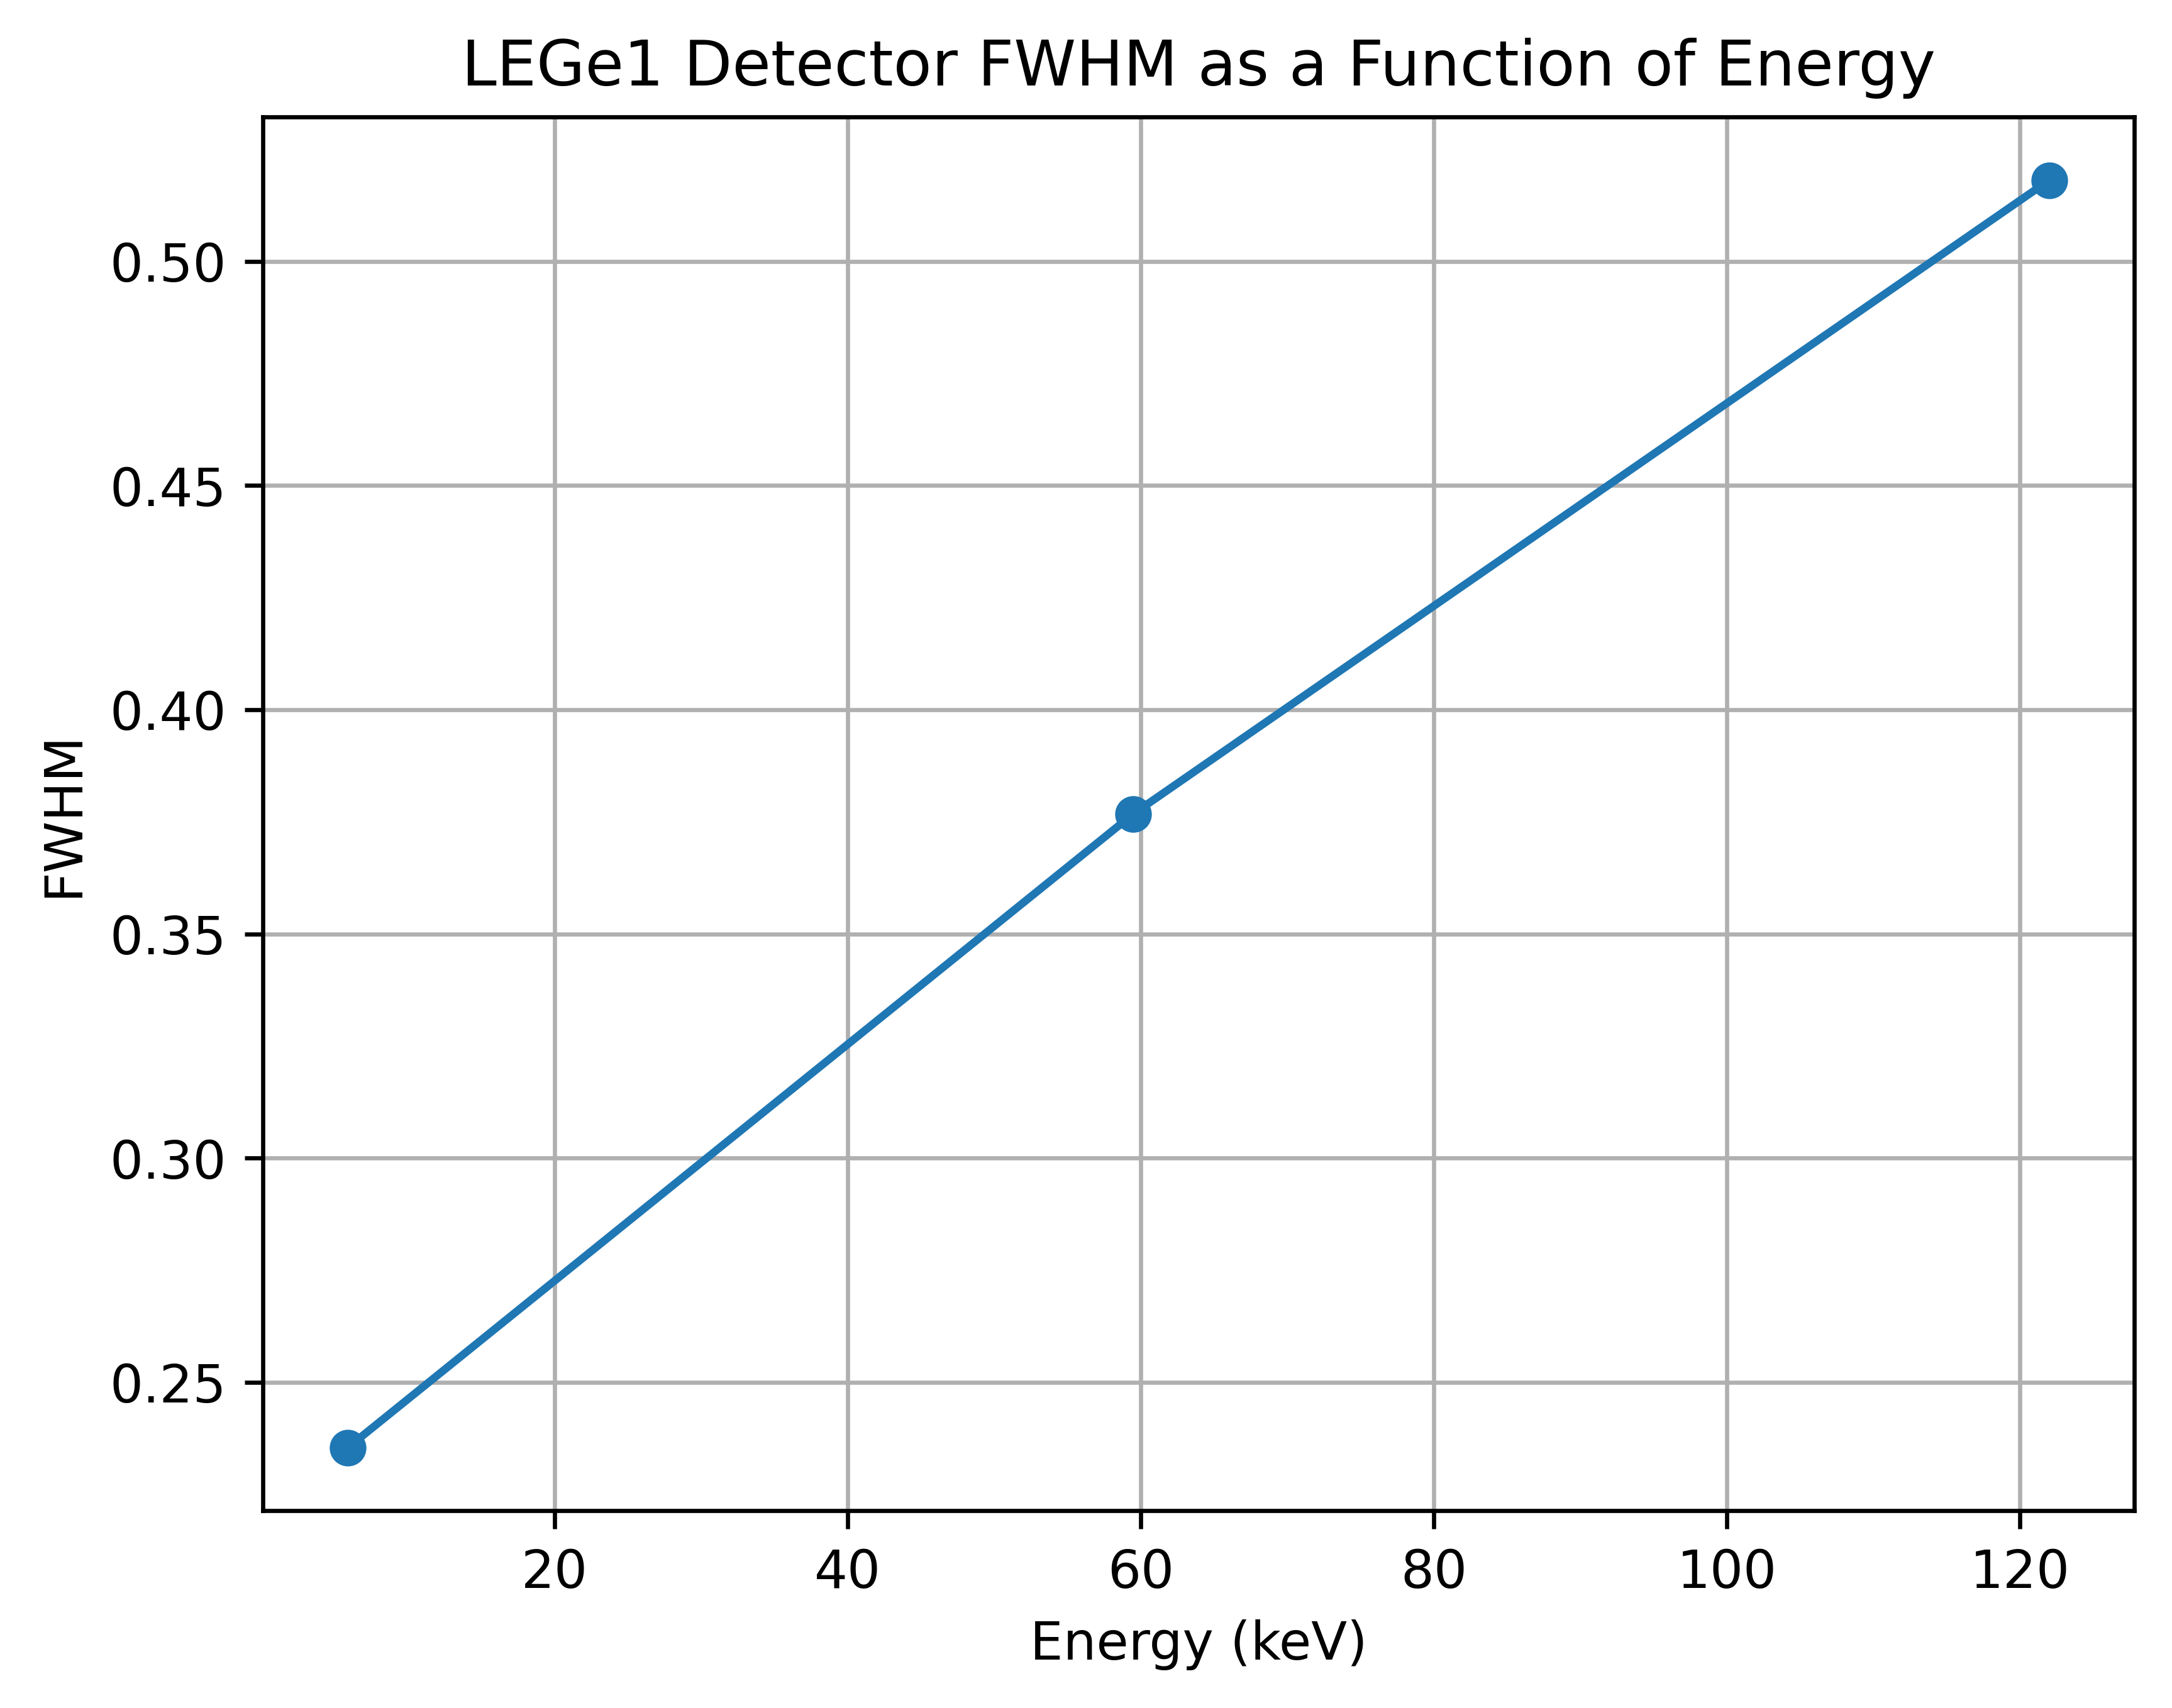
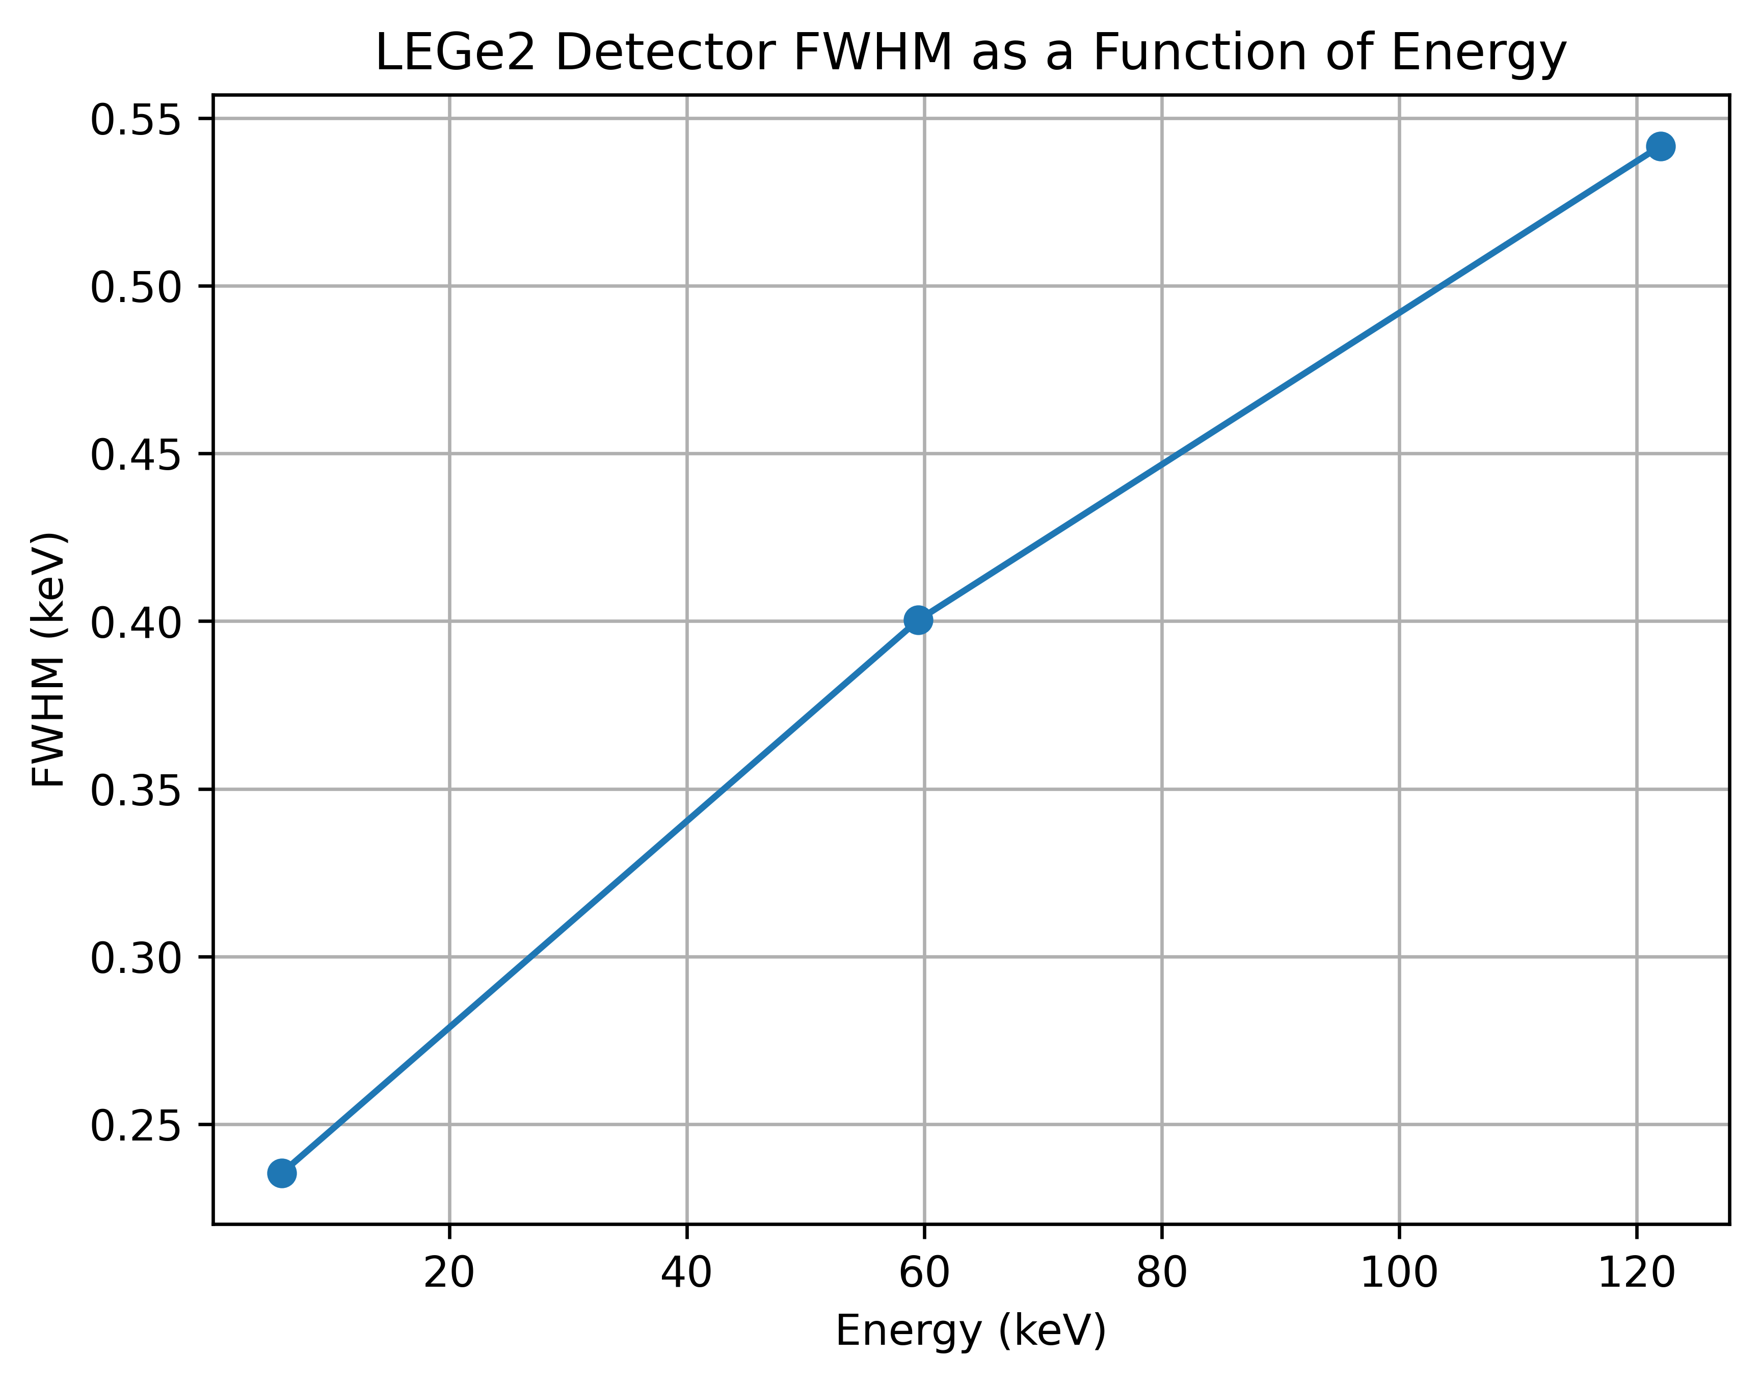
Resolution

Slide 11
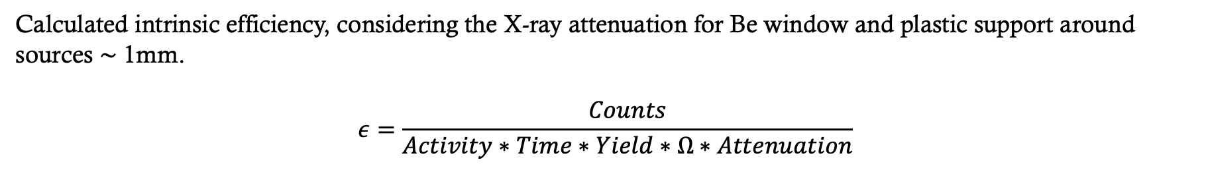
Efficiency
Calculated intrinsic efficiency, considering the X-ray attenuation for Be window and plastic support around sources $\sim$ 1mm.
$$ε=\frac{Counts}{Activity∗Time∗Yield∗Ω∗Attenuation}$$

Slide 12
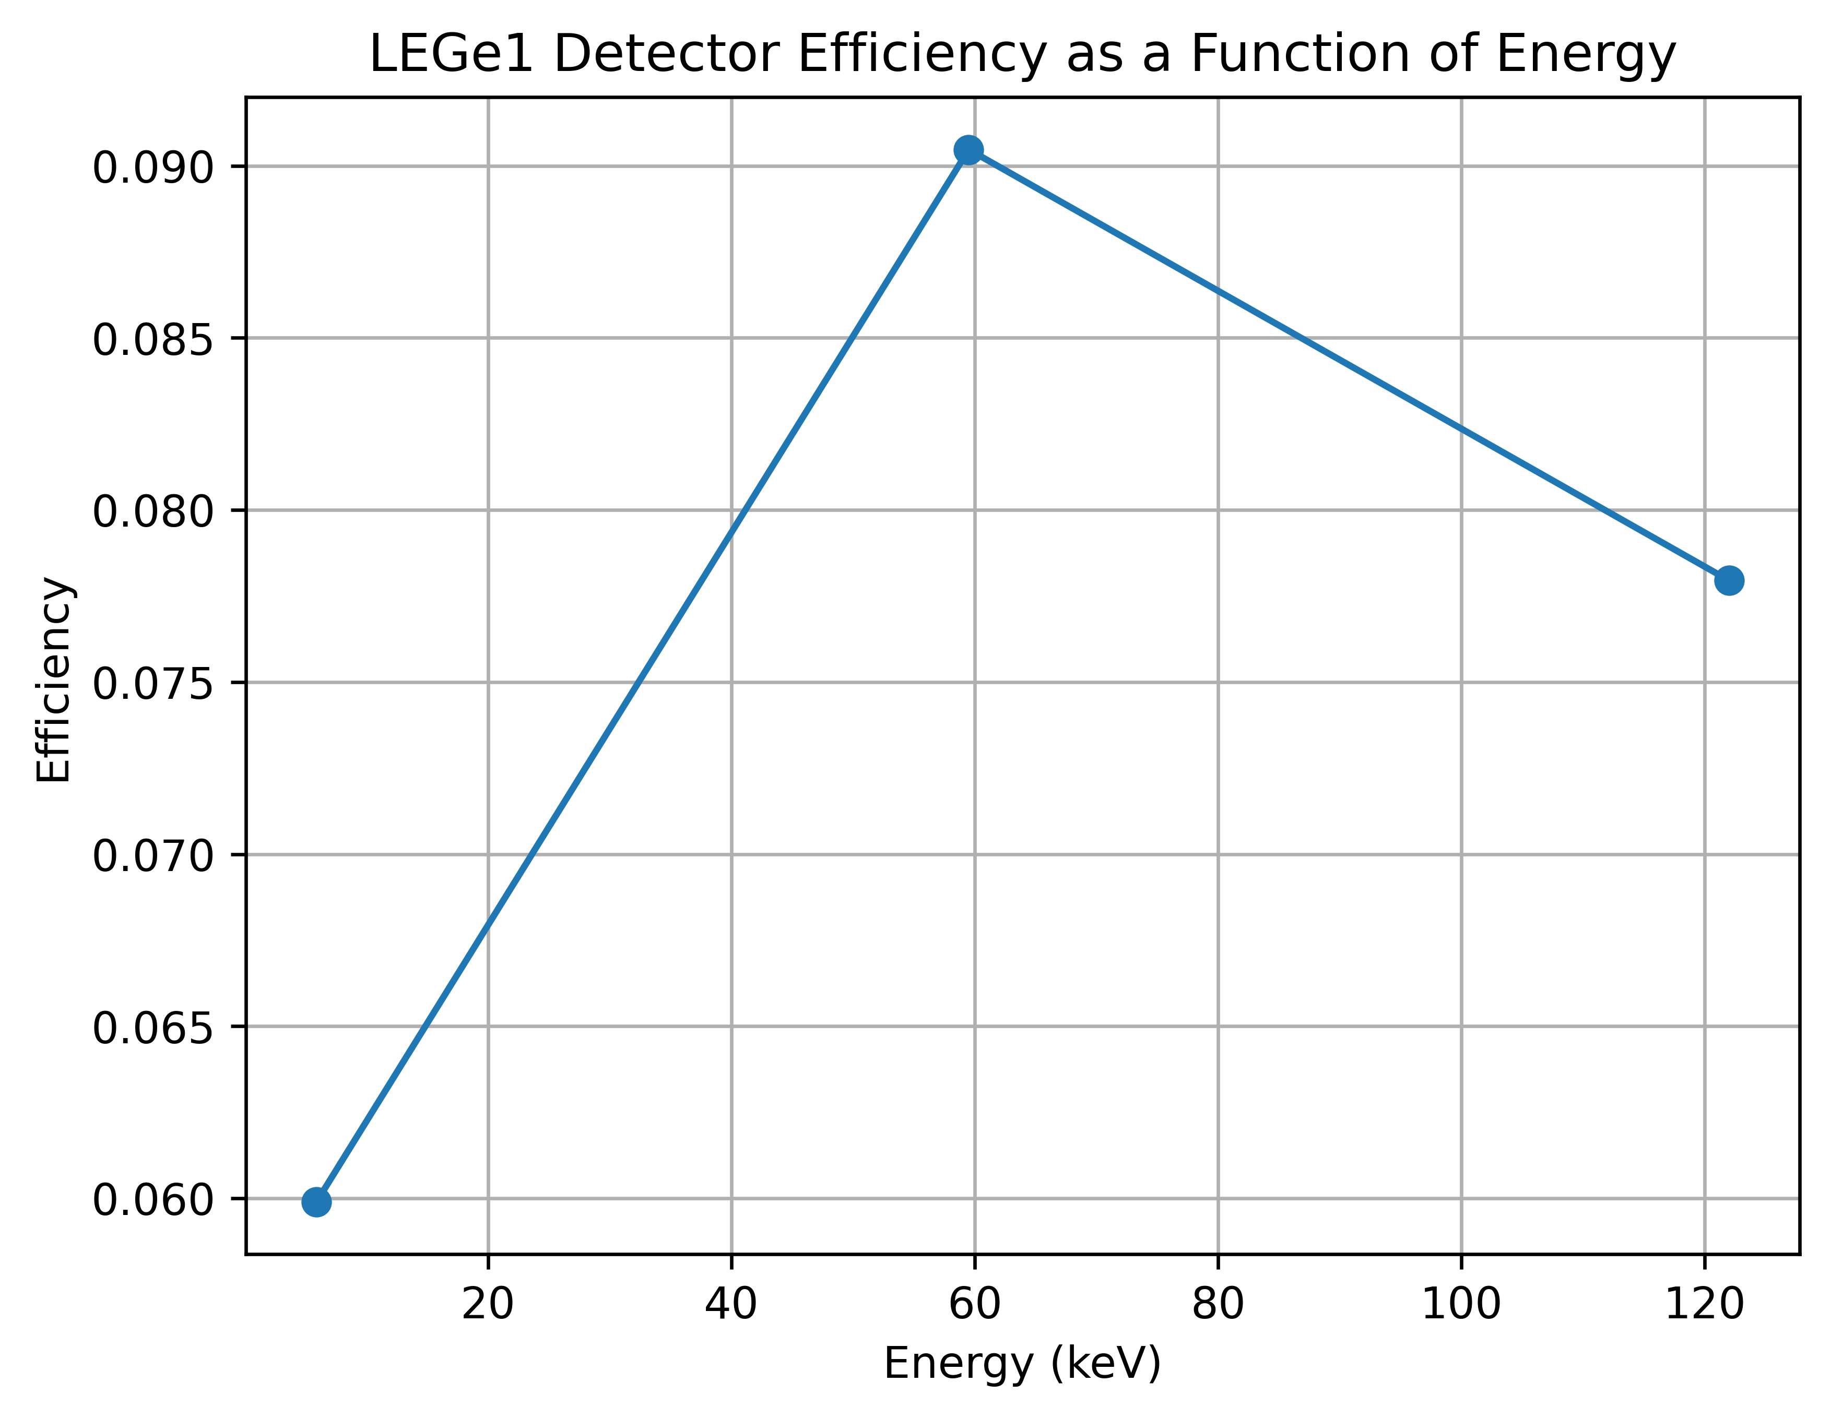
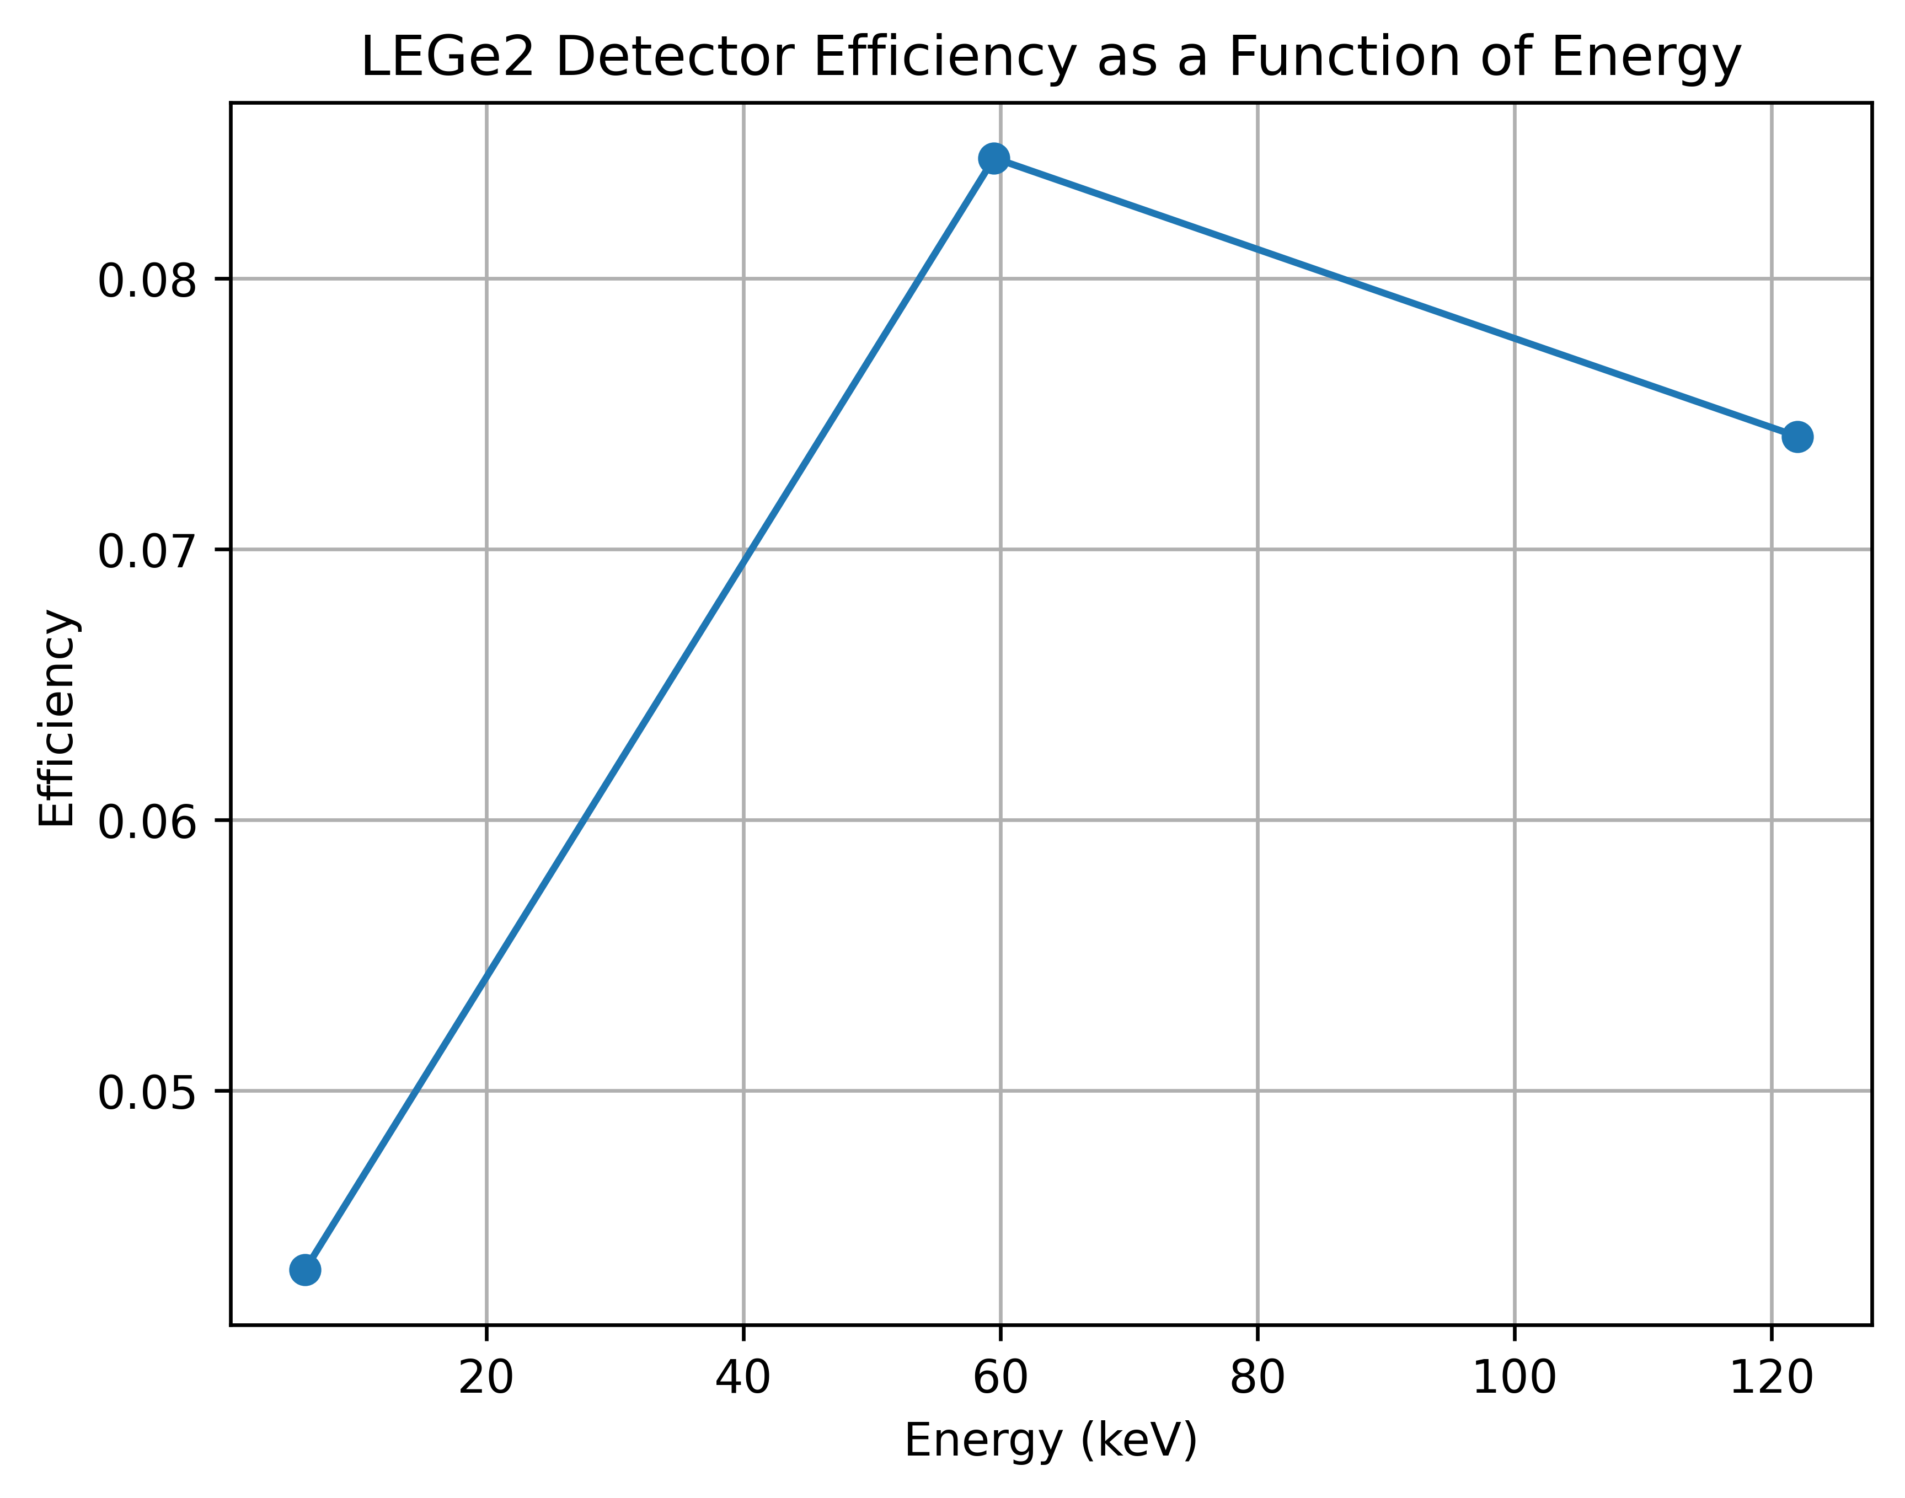
Efficiency
Calculated intrinsic efficiency, considering the X-ray attenuation for Be window and plastic support around sources $\sim$ 1mm.

Slide 13
Discussion Topic: The peaking normalization
When we removed at the BankDecoder.cpp the peaking normalization from trigger.energy we got a much better resolution, especially for Fe-55 source

Slide 14
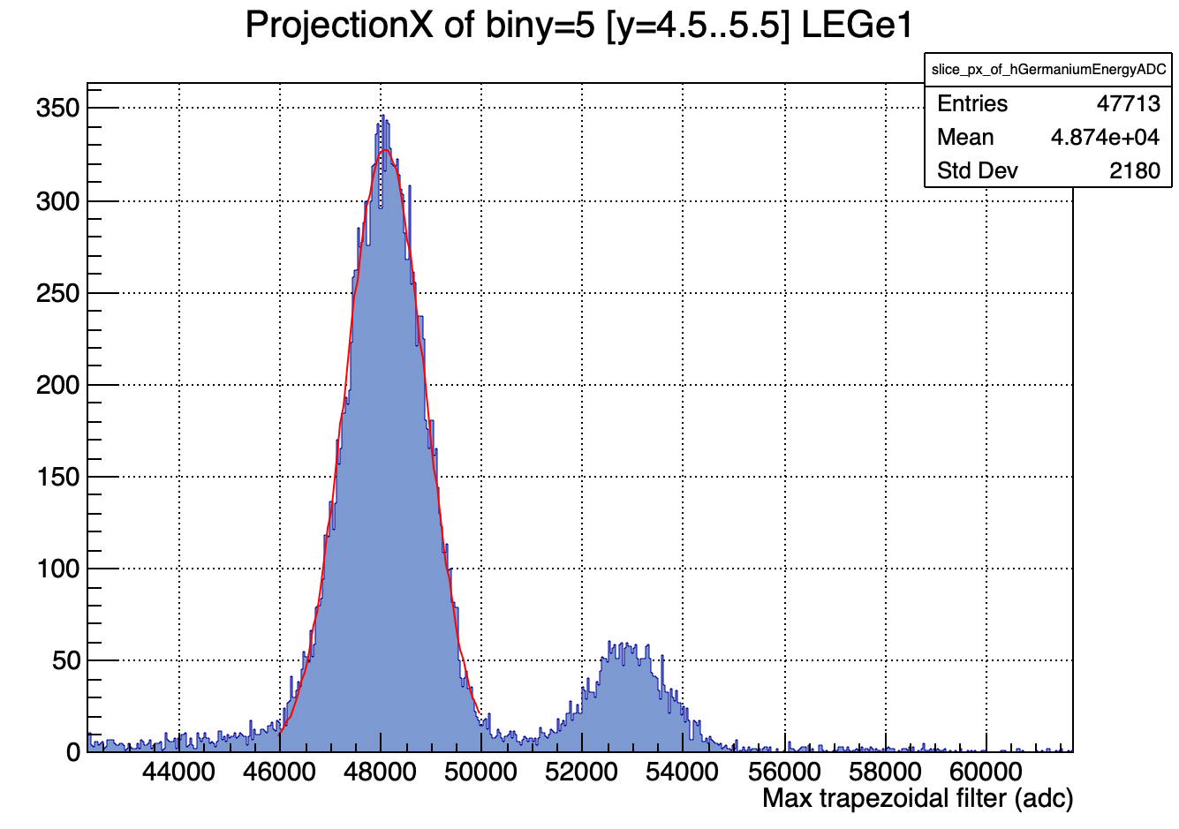
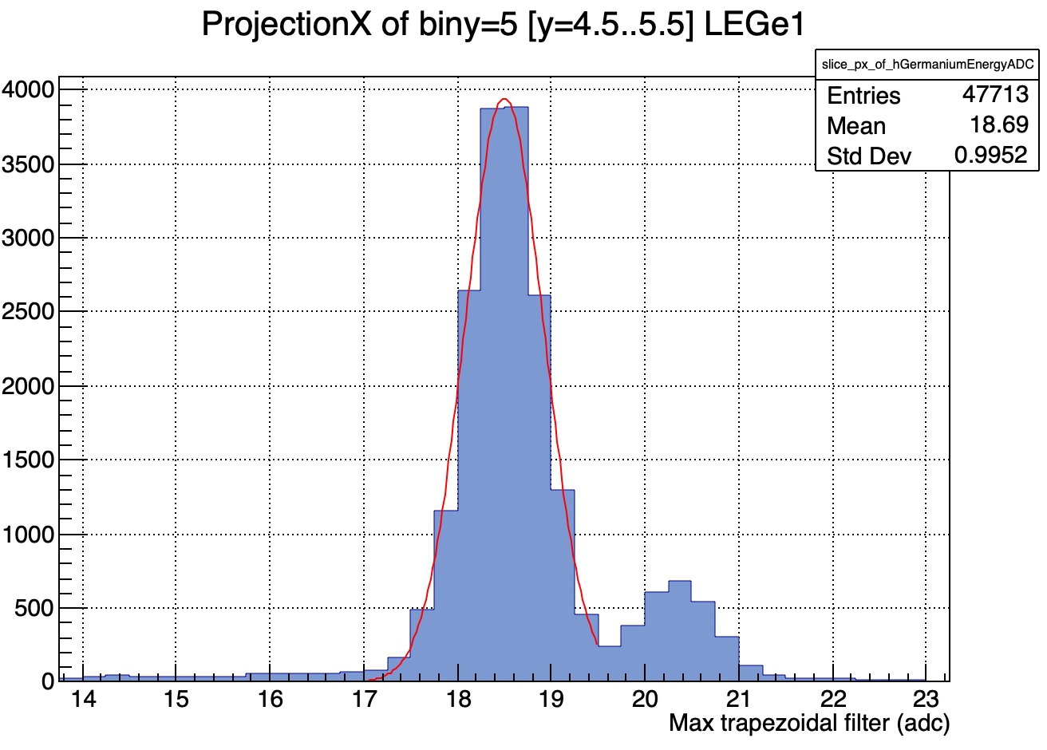
Discussion Topic: The peaking normalization
When we removed at the BankDecoder.cpp the peaking normalization from trigger.energy we got a much better resolution, especially for Fe-55 source
No peaking normalization: FWHM(eV): 0.228
Peaking normalization: FWHM(eV): 0.314

