Slide 1
Update 28/02
Michael Heines

Slide 2
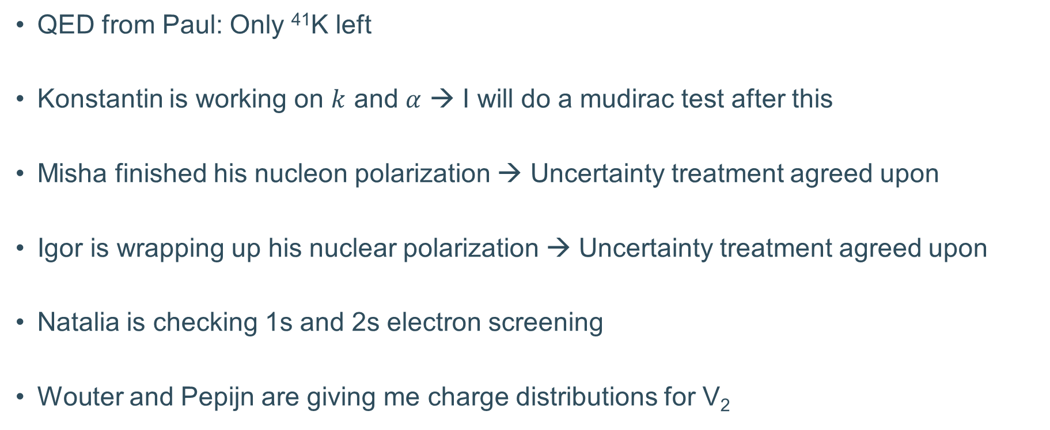
Theory progress
QED from Paul: Only ⁴¹K left
Konstantin is working on $k$ and $α$ → I will do a mudirac test after this
Misha finished his nucleon polarization → Uncertainty treatment agreed upon
Igor is wrapping up his nuclear polarization → Uncertainty treatment agreed upon
Natalia is checking 1s and 2s electron screening
Wouter and Pepijn are giving me charge distributions for V₂

Slide 3
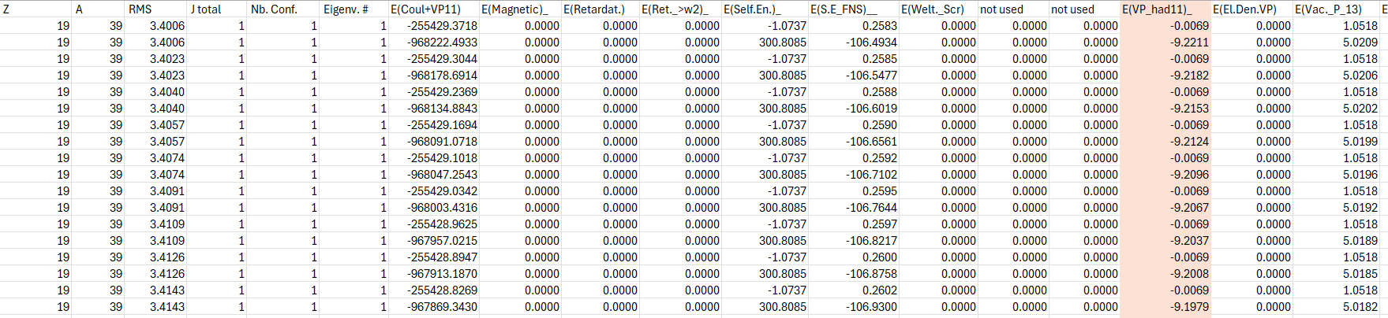
QED from Paul
QED contributions
…
Rms radius
Only term with significant radius sensitivity
Spread with radius ~ 1eV

Slide 4
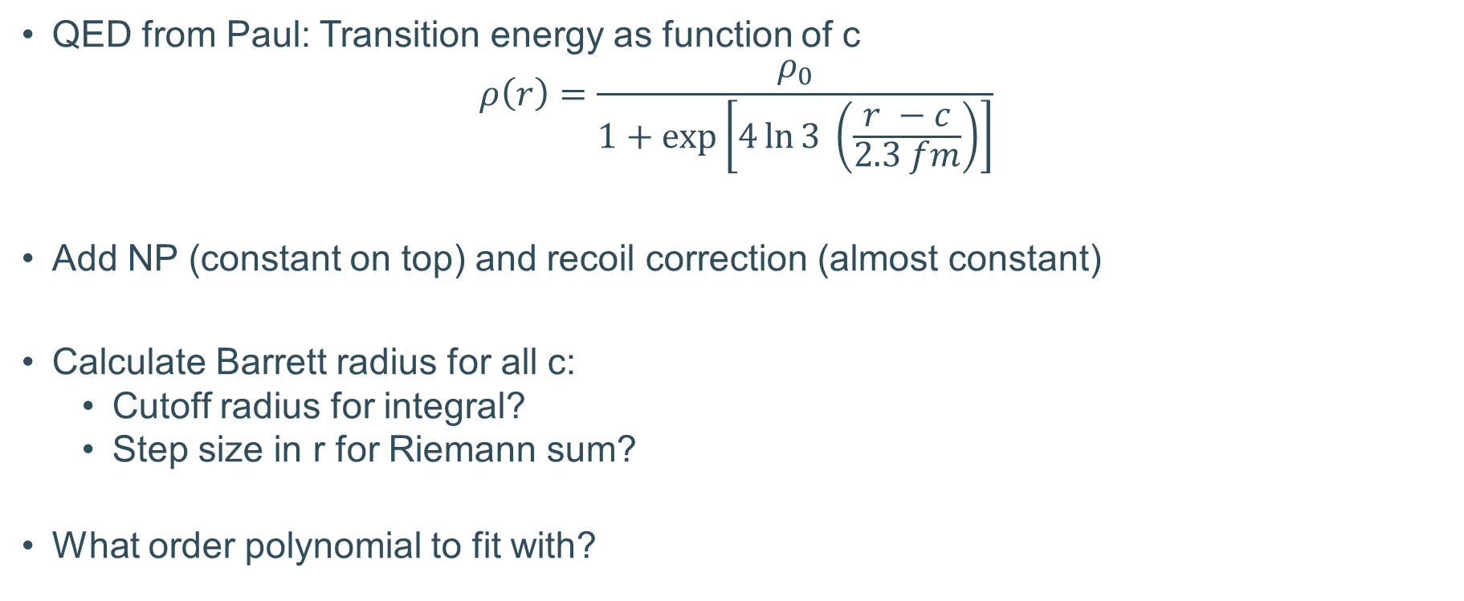
What to do
QED from Paul: Transition energy as function of c
$$ρ\left(r\right)=\frac{ρ_{0}}{1+exp⁡\left[4\ln{3 }\left(\frac{r −c}{2.3 fm}\right)\right]}$$
Add NP (constant on top) and recoil correction (almost constant)
Calculate Barrett radius for all c:
  Cutoff radius for integral?
  Step size in r for Riemann sum?
What order polynomial to fit with?

Slide 5
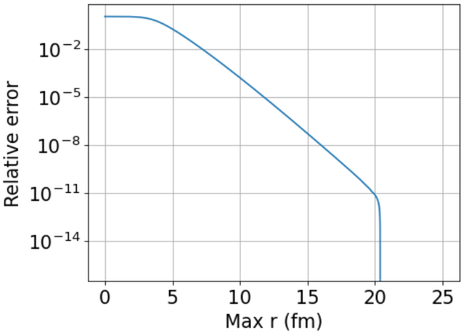
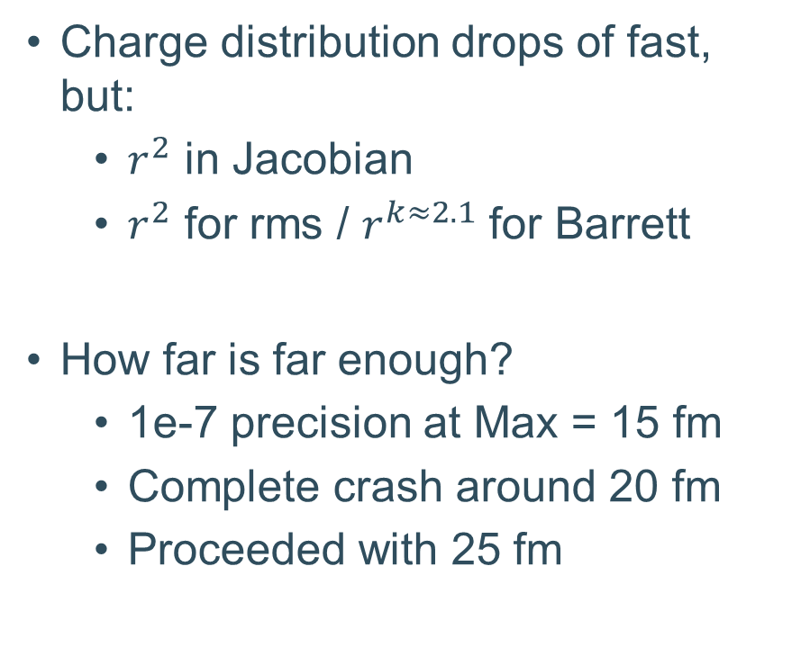
Cutoff radius
Charge distribution drops of fast, but:
  $r^{2}$ in Jacobian
  $r^{2}$ for rms / $r^{k≈2.1}$ for Barrett
How far is far enough?
  1e-7 precision at Max = 15 fm
  Complete crash around 20 fm
  Proceeded with 25 fm

Slide 6
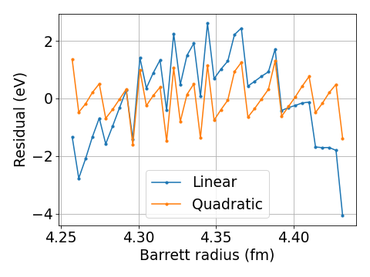
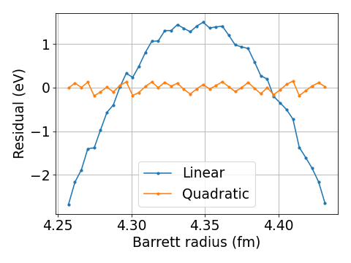
Coarseness in r
Riemann sums → How small is small enough?
0 → 25 fm with 1e-4 fm spacing (~10-20 seconds)
0 → 25 fm with 1e-5 fm spacing (~2 minutes)

Slide 7
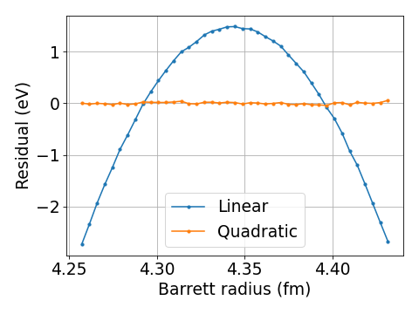
Coarseness in r
Riemann sums → How small is small enough?
0 → 25 fm with 1e-5 fm spacing (few minutes)
0 → 25 fm with 1e-6 fm spacing (~20-30 mins)

Slide 8
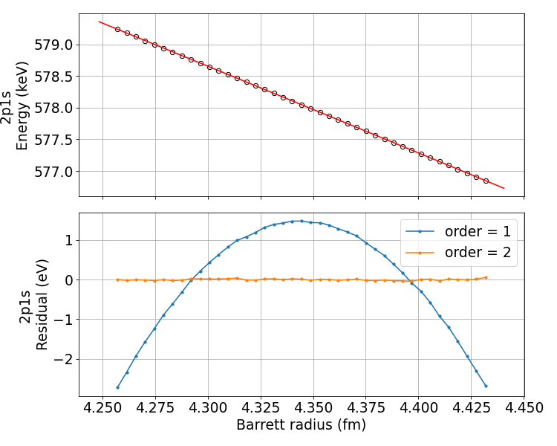
Decision
Using 1e-6 fm steps
< 0.05 eV deviation in Cl
Precision:
  Exp = ~15 eV
  NP = ~40 eV

Slide 9
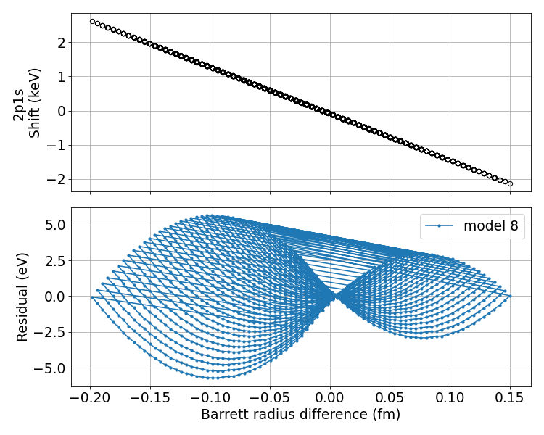
What about differences?
Isotope shifts better than absolute energies
NP on difference better than absolute values
Calculate the isotope shift as function of Barrett radius difference
Mostly linear, some weird additional trends

Slide 10
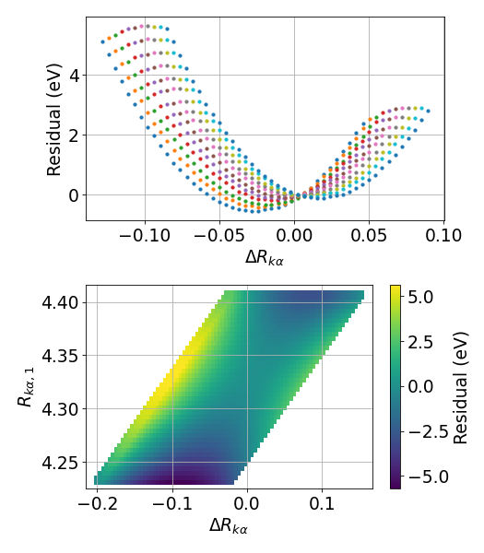
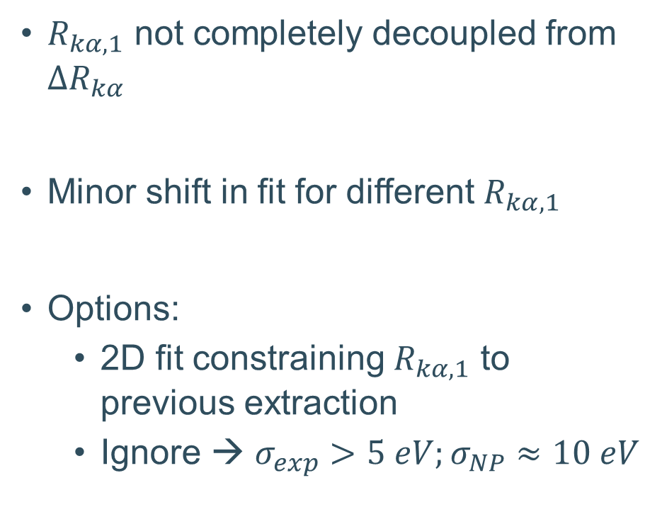
What is it? Do we care?
$R_{kα, 1}$ not completely decoupled from $ΔR_{kα}$
Minor shift in fit for different $R_{kα, 1}$
Options:
  2D fit constraining $R_{kα, 1}$ to previous extraction
  Ignore → $σ_{exp}>5 eV;σ_{NP}≈10 eV$

Slide 11
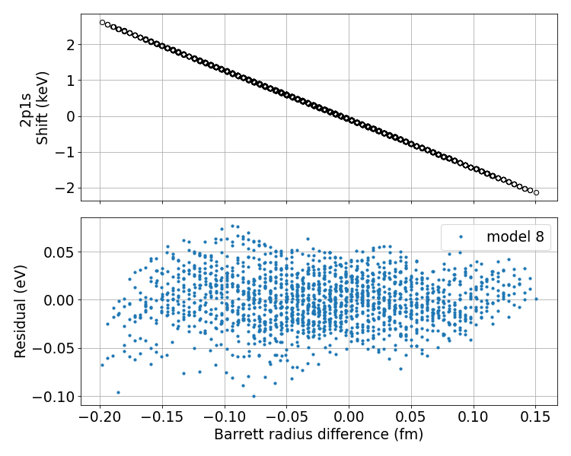
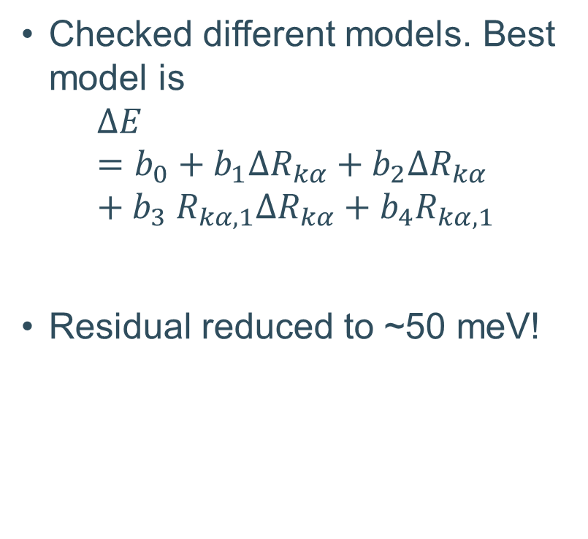

Accounting for $R_{kα}$
Checked different models. Best model is
$$ΔE=b_{0}+b_{1}ΔR_{kα}+b_{2}ΔR_{kα}+b_{3} R_{kα, 1}ΔR_{kα}+b_{4}R_{kα, 1}$$
Residual reduced to ~50 meV!

Slide 12
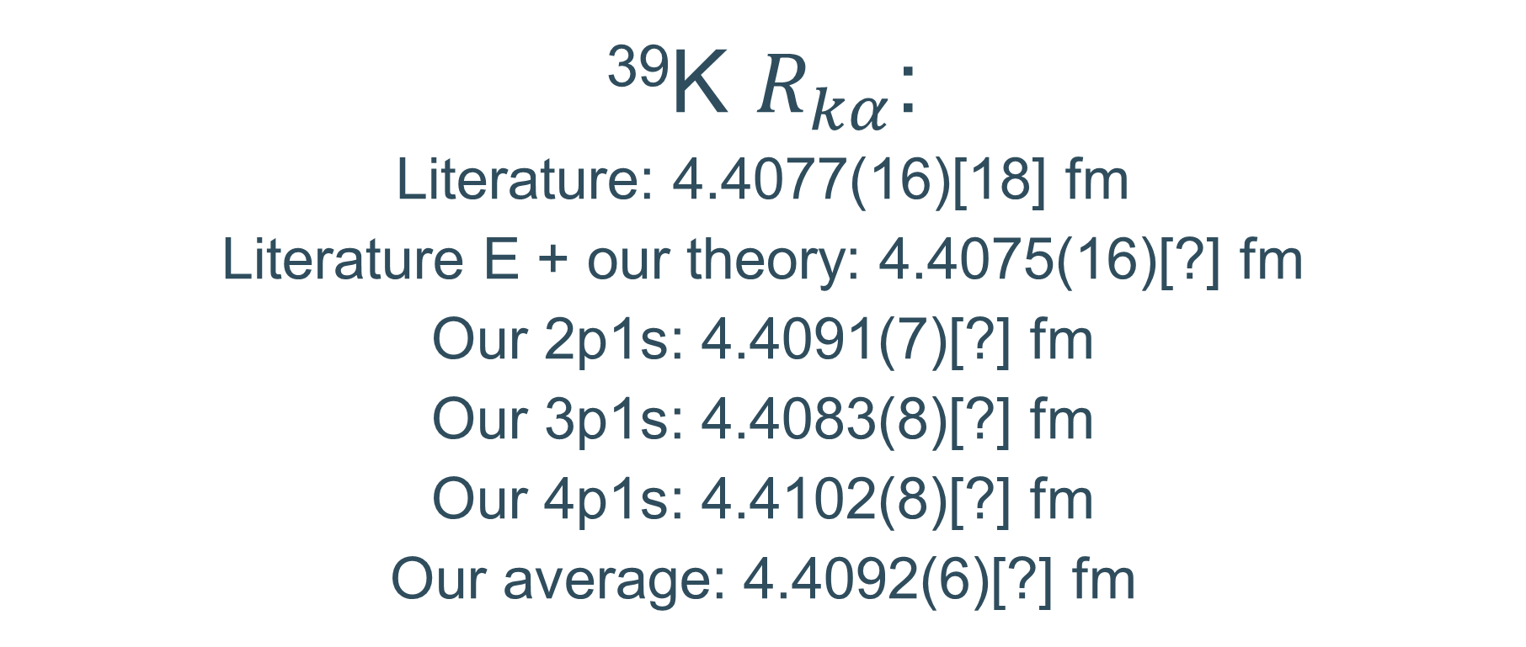

Drumroll...
³⁹K $R_{kα}$:
Literature: 4.4077(16)[18] fm
Literature E + our theory: 4.4075(16)[?] fm
Our 2p1s: 4.4091(7)[?] fm
Our 3p1s: 4.4083(8)[?] fm
Our 4p1s: 4.4102(8)[?] fm
Our average: 4.4092(6)[?] fm
$$χ_{ν}^{2}=1.61 (p≈0.2)$$

Slide 13
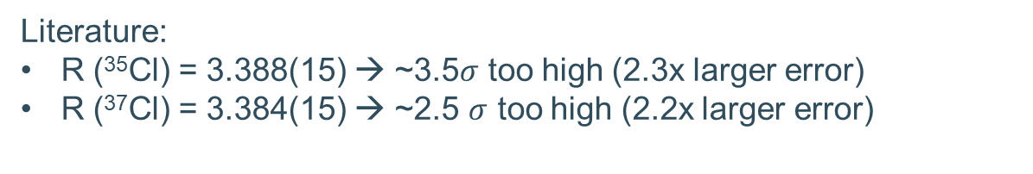
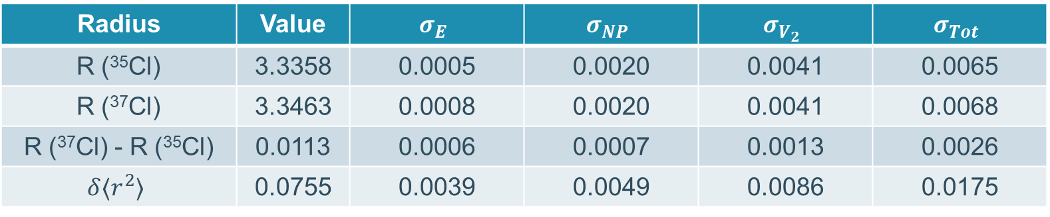
Radii of Cl
Radius | Value | $$σ_{E}$$ | $$σ_{NP}$$ | $$σ_{V_{2}}$$ | $$σ_{Tot}$$
R (³⁵Cl) | 3.3358 | 0.0005 | 0.0020 | 0.0041 | 0.0065
R (³⁷Cl) | 3.3463 | 0.0008 | 0.0020 | 0.0041 | 0.0068
R (³⁷Cl) - R (³⁵Cl) | 0.0113 | 0.0006 | 0.0007 | 0.0013 | 0.0026
$$δ⟨r^{2}⟩$$ | 0.0755 | 0.0039 | 0.0049 | 0.0086 | 0.0175
Assuming 95% V2 correlation
Literature:
R (³⁵Cl) = 3.388(15) → ~3.5$σ$ too high (2.3x larger error)
R (³⁷Cl) = 3.384(15) → ~2.5 $σ$ too high (2.2x larger error)

Slide 14
Radii of Cl
Radius | Value | $$σ_{E}$$ | $$σ_{NP}$$ | $$σ_{V_{2}}$$ | $$σ_{Tot}$$
R (³⁵Cl) | 3.3358 | 0.0005 | 0.0020 | 0.0041 | 0.0065
R (³⁷Cl) | 3.3463 | 0.0008 | 0.0020 | 0.0041 | 0.0068
R (³⁷Cl) - R (³⁵Cl) | 0.0113 | 0.0006 | 0.0007 | 0.0013 | 0.0026
$$δ⟨r^{2}⟩$$ | 0.0755 | 0.0039 | 0.0049 | 0.0086 | 0.0175
Assuming 95% V2 correlation
X10 improvement on literature
Literature:
R (³⁵Cl) = 3.388(15) → ~3.5$σ$ too high (2.3x larger error)
R (³⁷Cl) = 3.384(15) → ~2.5 $σ$ too high (2.2x larger error)

Slide 15
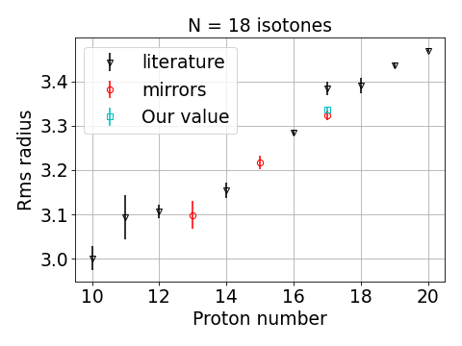
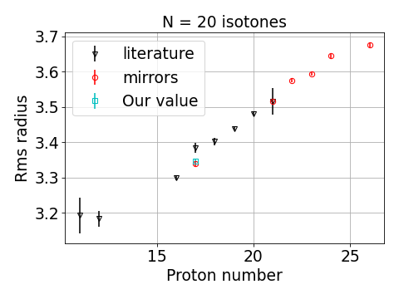
Do those preliminary radii make sense

Slide 16
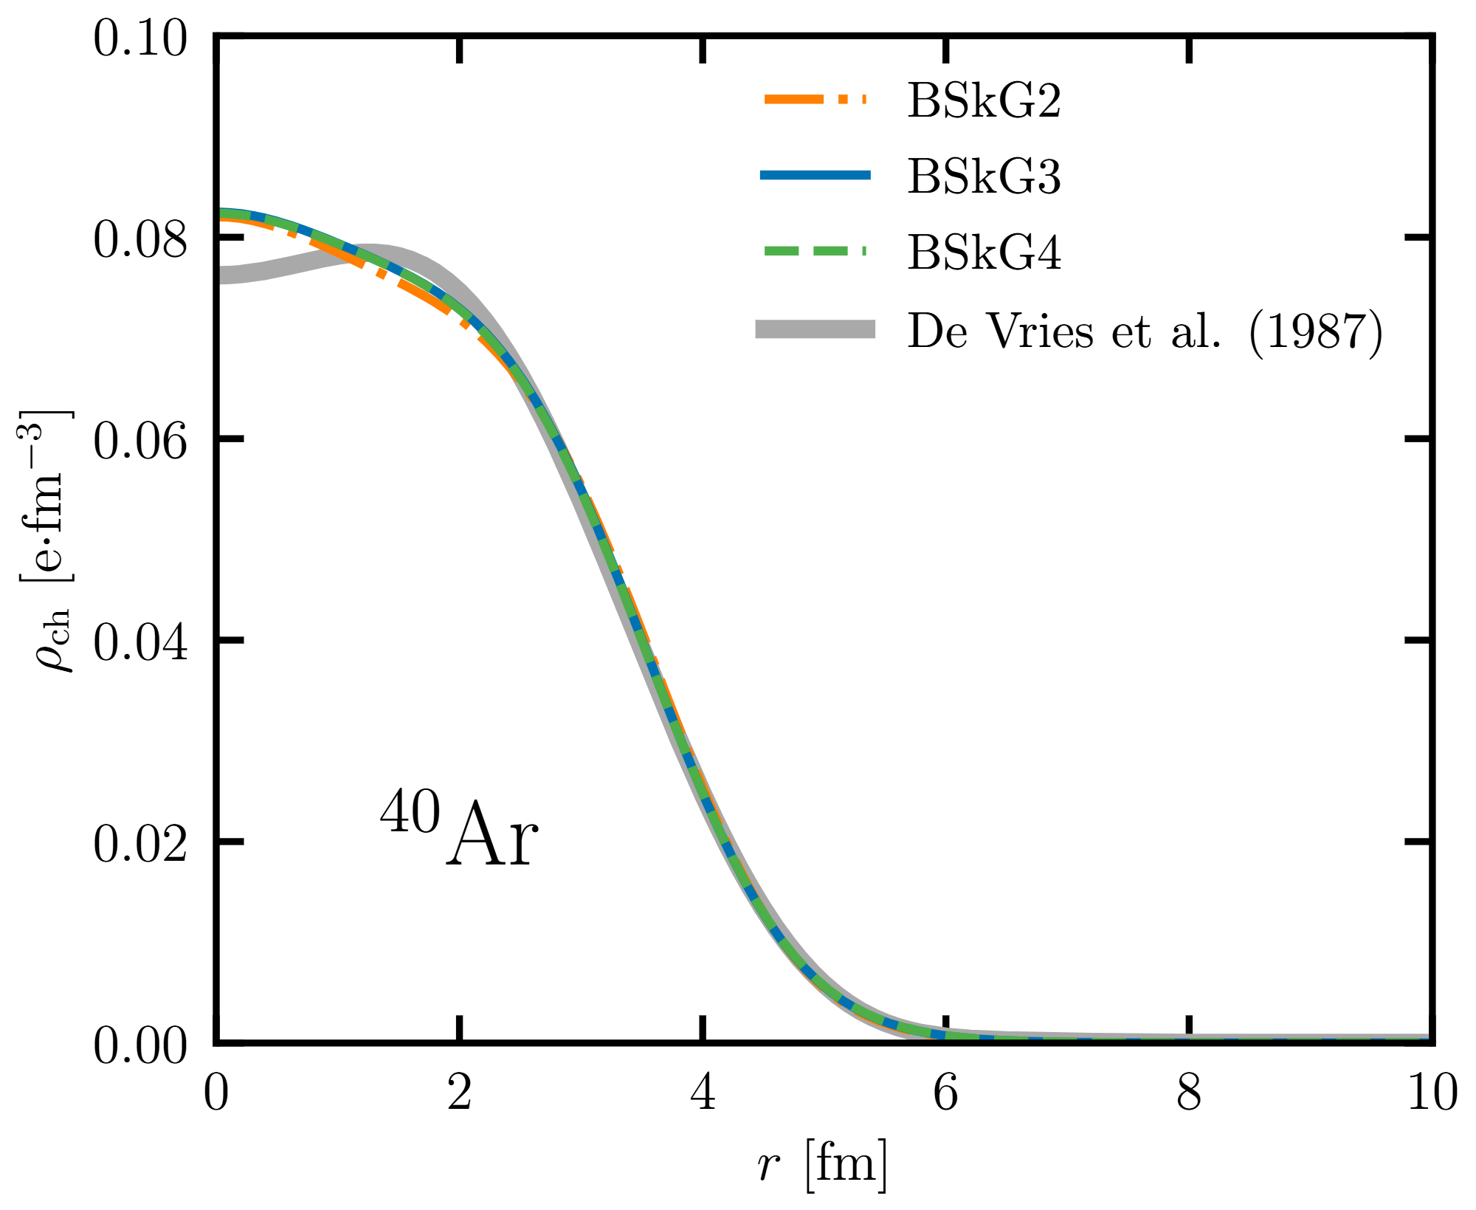
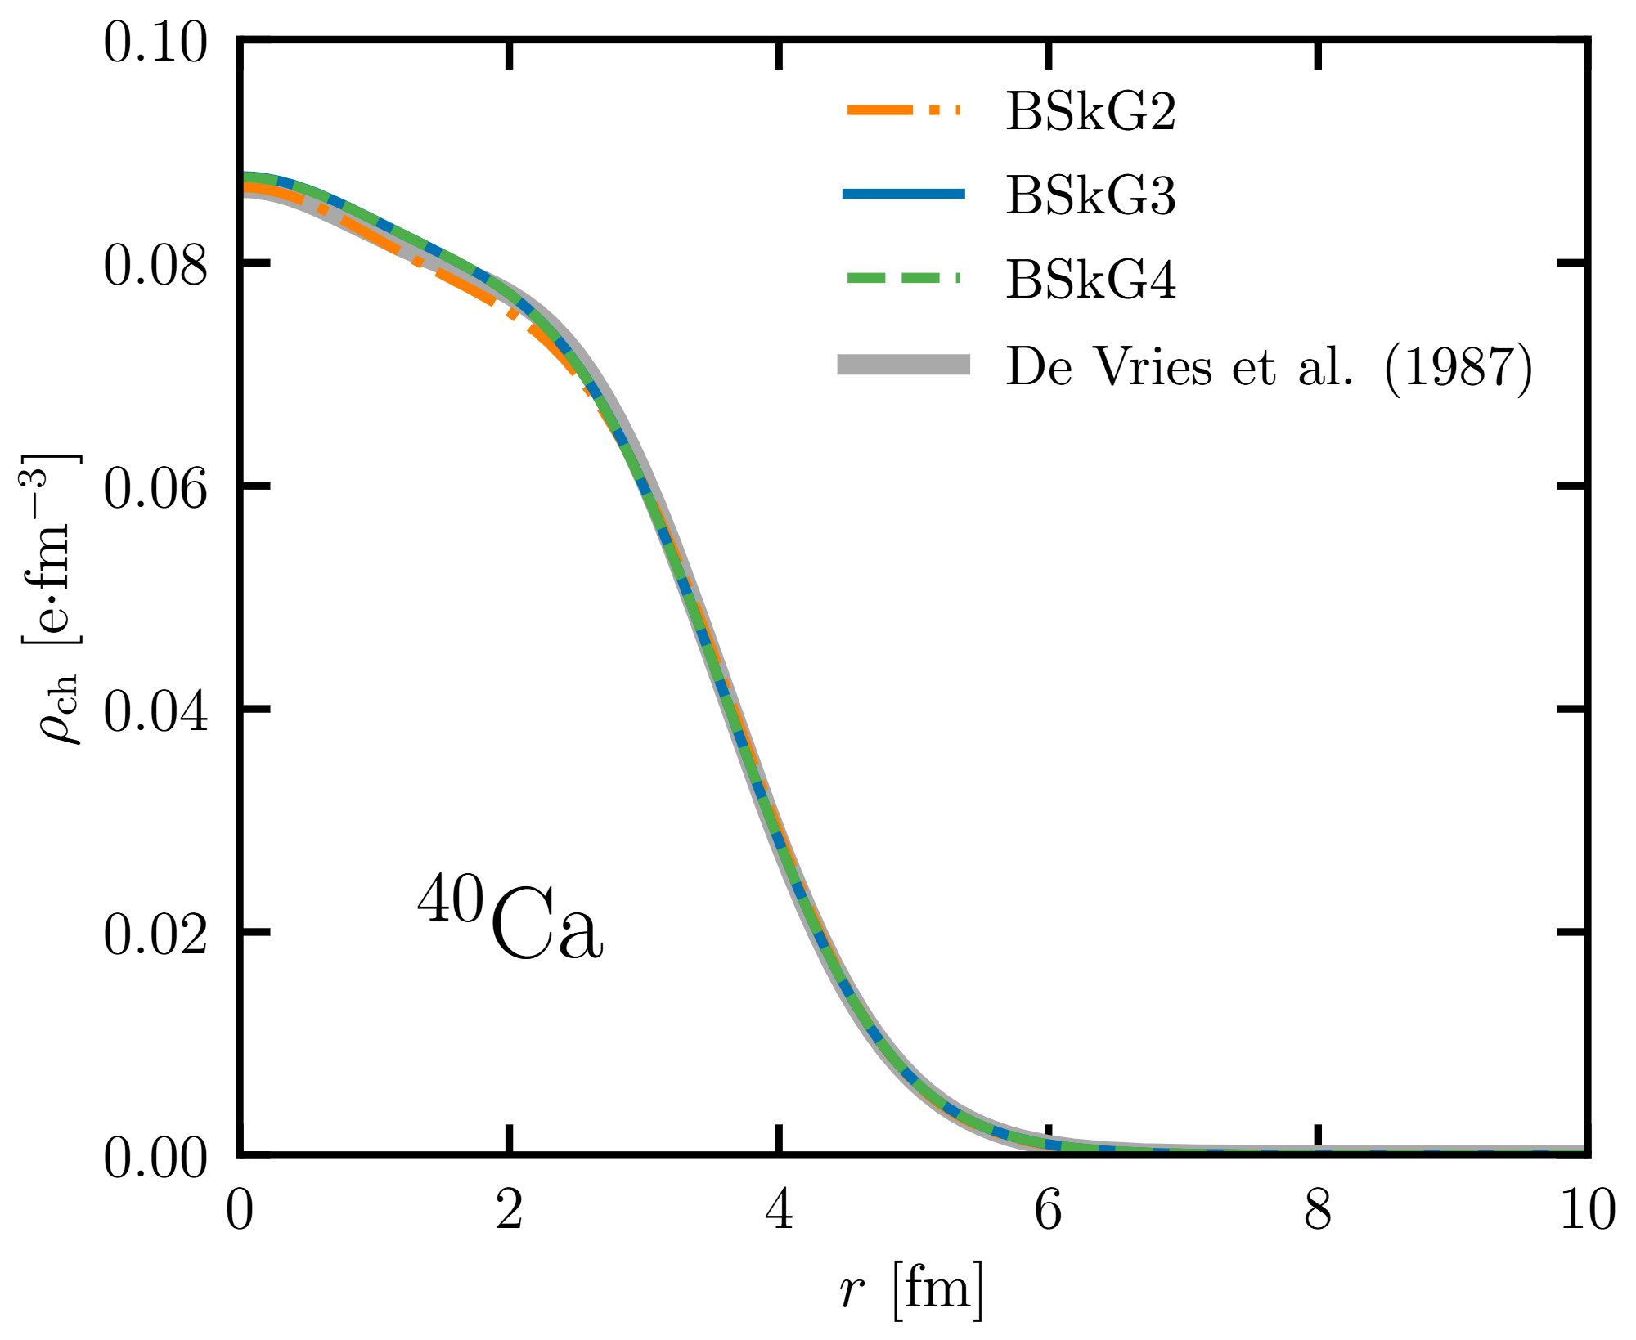
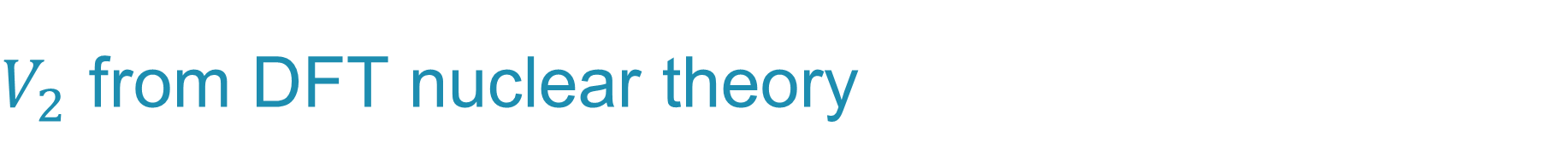


$V_{2}$ from DFT nuclear theory
$$q_{max}=1.8$$
$$q_{max}=3.7$$

Slide 17
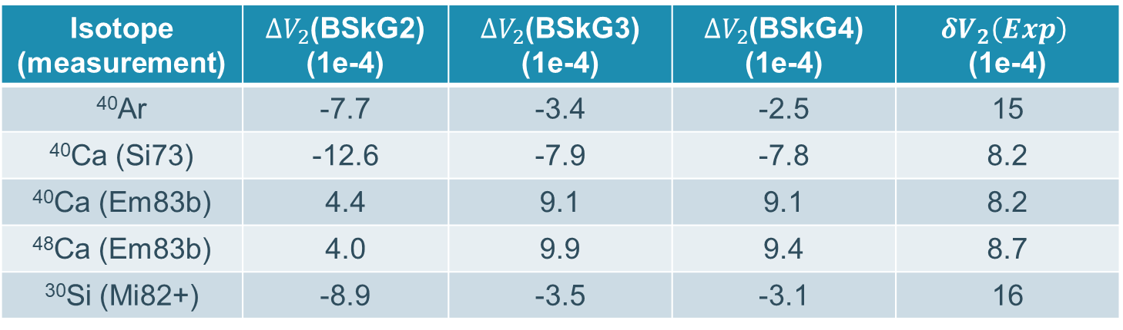

$V_{2}$ from DFT nuclear theory
For now: some test cases
$$ΔV_{2}=V_{2}\left(Exp\right)−V_{2}(DFT)$$
Very good agreement! Equivalent to high q scattering experiment?
Isotope (measurement) | $ΔV_{2}$(BSkG2) (1e-4) | $ΔV_{2}$(BSkG3) (1e-4) | $ΔV_{2}$(BSkG4) (1e-4) | $$δV_{2}\left(Exp\right)$$ (1e-4)
⁴⁰Ar | -7.7 | -3.4 | -2.5 | 15
⁴⁰Ca (Si73) | -12.6 | -7.9 | -7.8 | 8.2
⁴⁰Ca (Em83b) | 4.4 | 9.1 | 9.1 | 8.2
⁴⁸Ca (Em83b) | 4.0 | 9.9 | 9.4 | 8.7
³⁰Si (Mi82+) | -8.9 | -3.5 | -3.1 | 16
Differences better than absolutes

