Slide 1
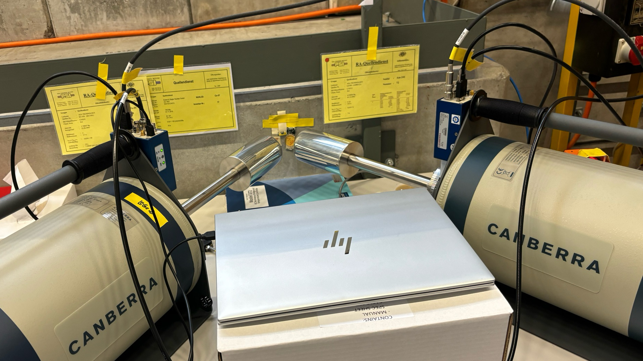
Testing the new
Low Energy Germanium
Detectors (LEGe)

Slide 2
Setting up/ Parameters
Set the gain of the Intelligent Preamplifier at its maximum option: x10
Trapezoid filter Parameters
LEGe 1
Trapezoid Parameters | Tau (ns) | Gap | Peaking
Used | 49.19 | 300 | 2600
Manufacturer |  | 200 | 1800
LEGe 2
Trapezoid Parameters | Tau (ns) | Gap | Peaking
Used | 48.96 | 250 | 2100
Manufacturer |  | 200 | 1800

Slide 3
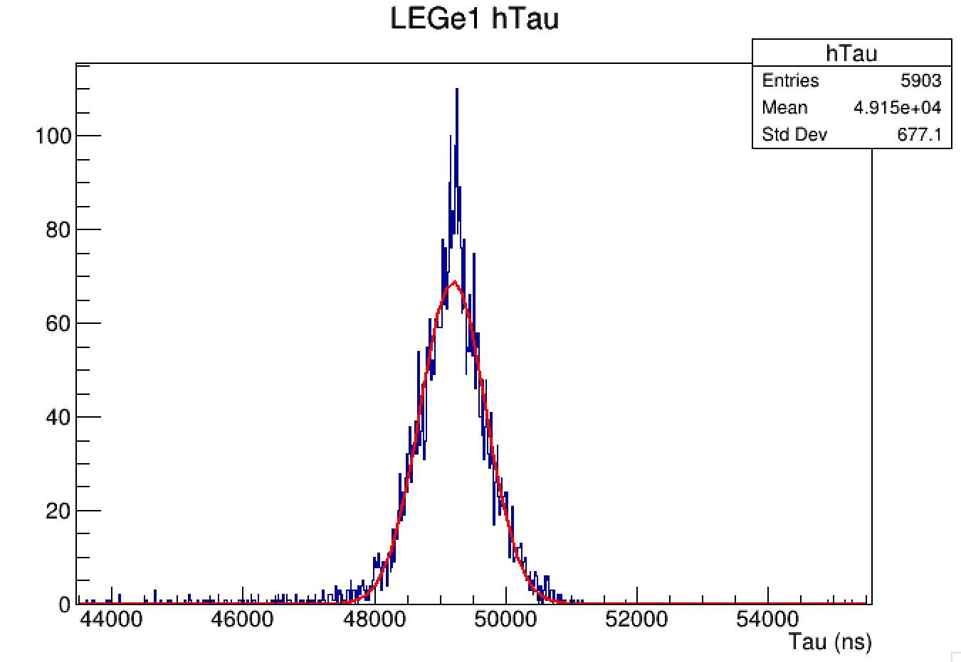
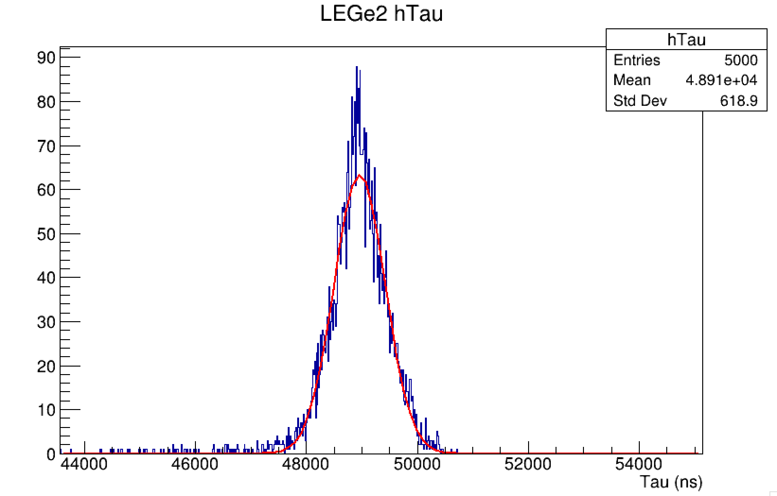
Tau Parameter
Taking long traces with 25000 buffer length

Slide 4
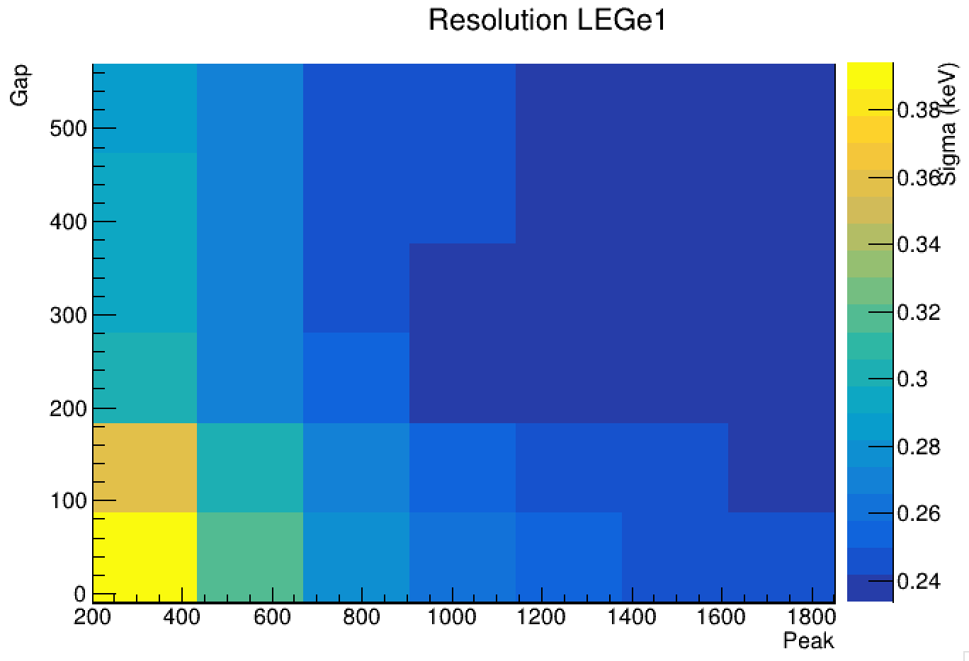
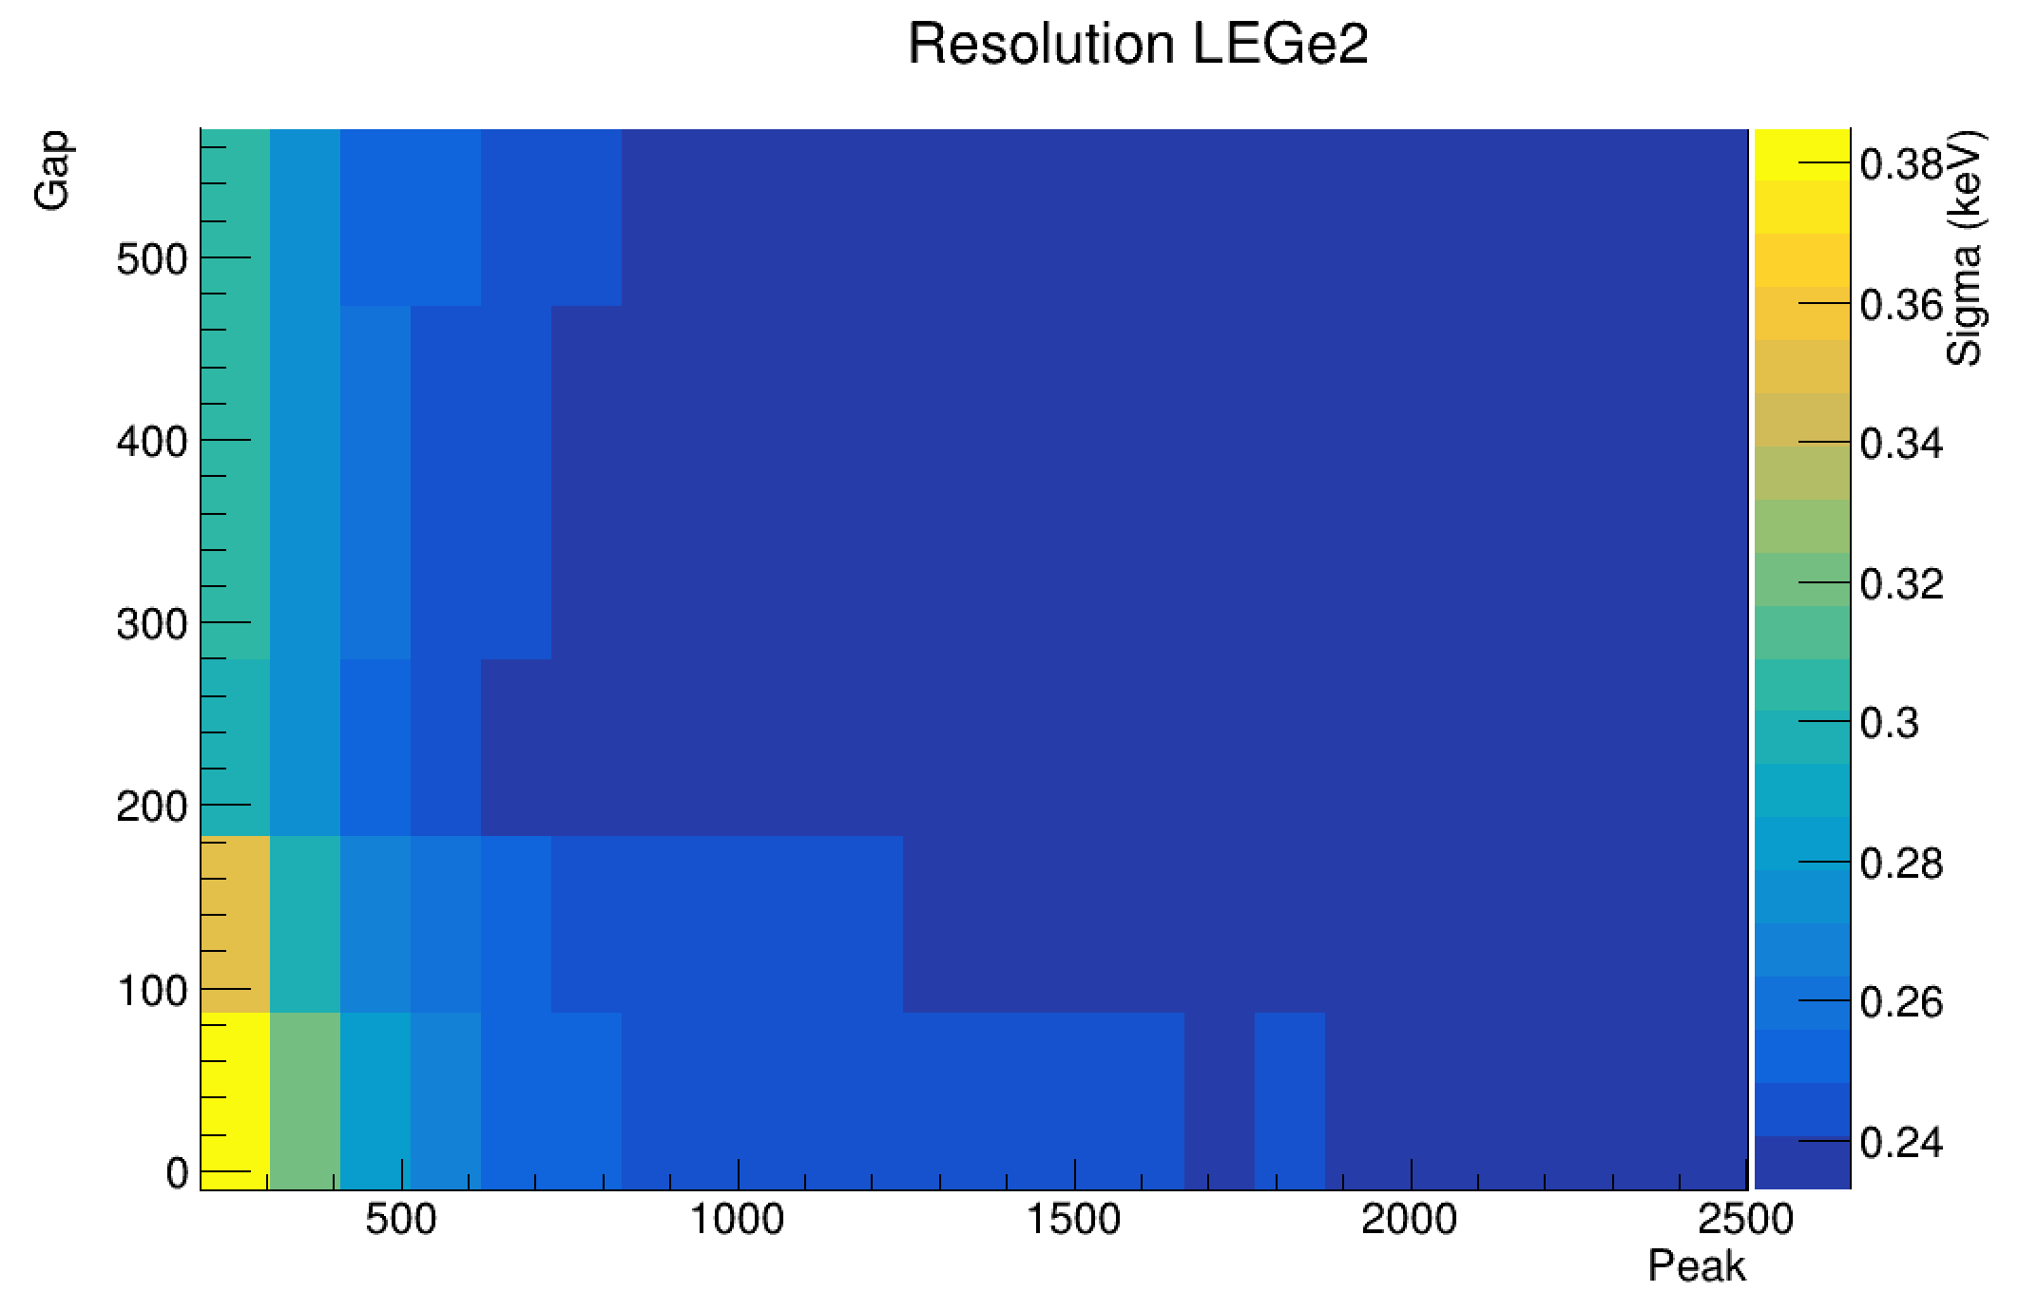
Gap and Peaking
Running the trapezoid filter with Michaels Trapezoidal Optimization code.

Slide 5
Gap and Peaking
Choosing gap at 300 for LEGe1 and 250 for LEGE2.

Slide 6
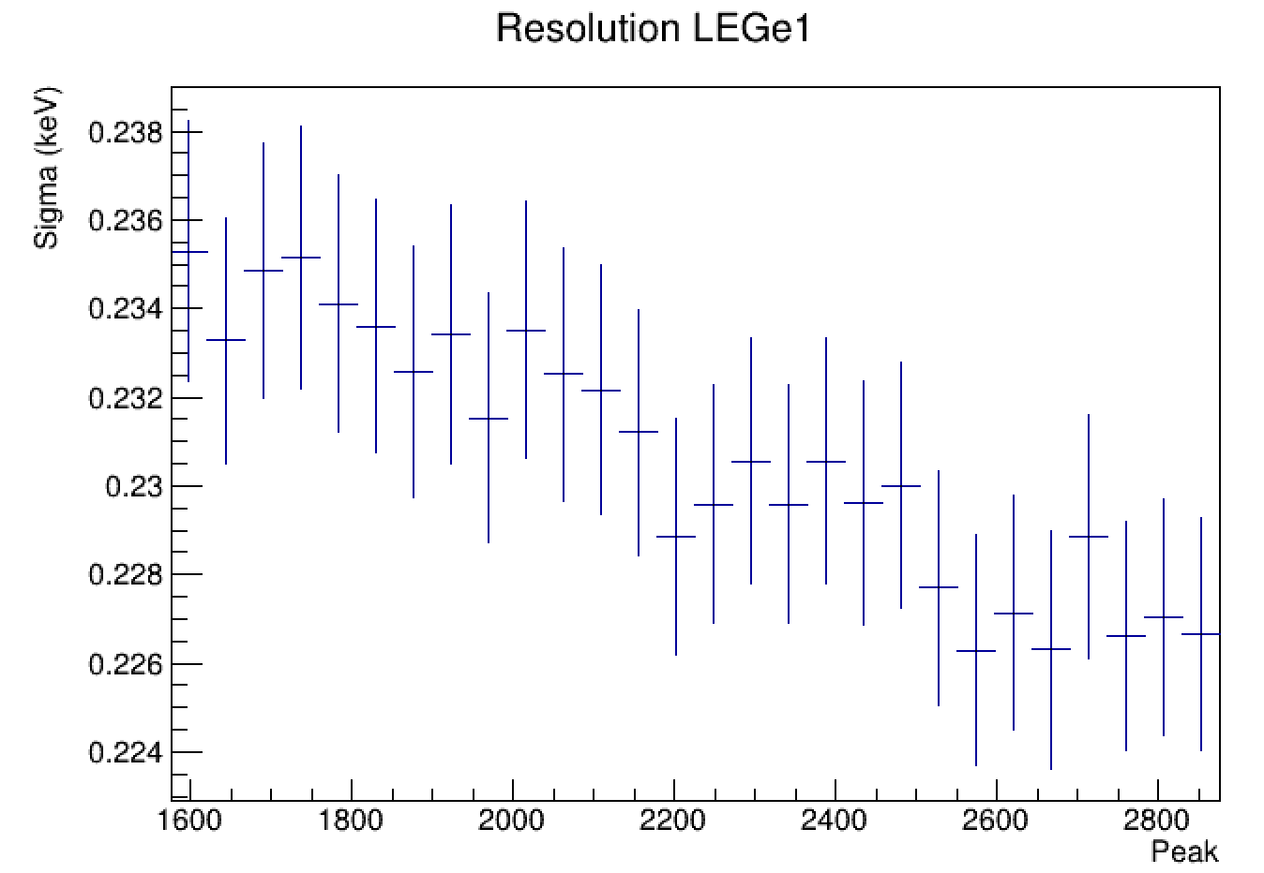
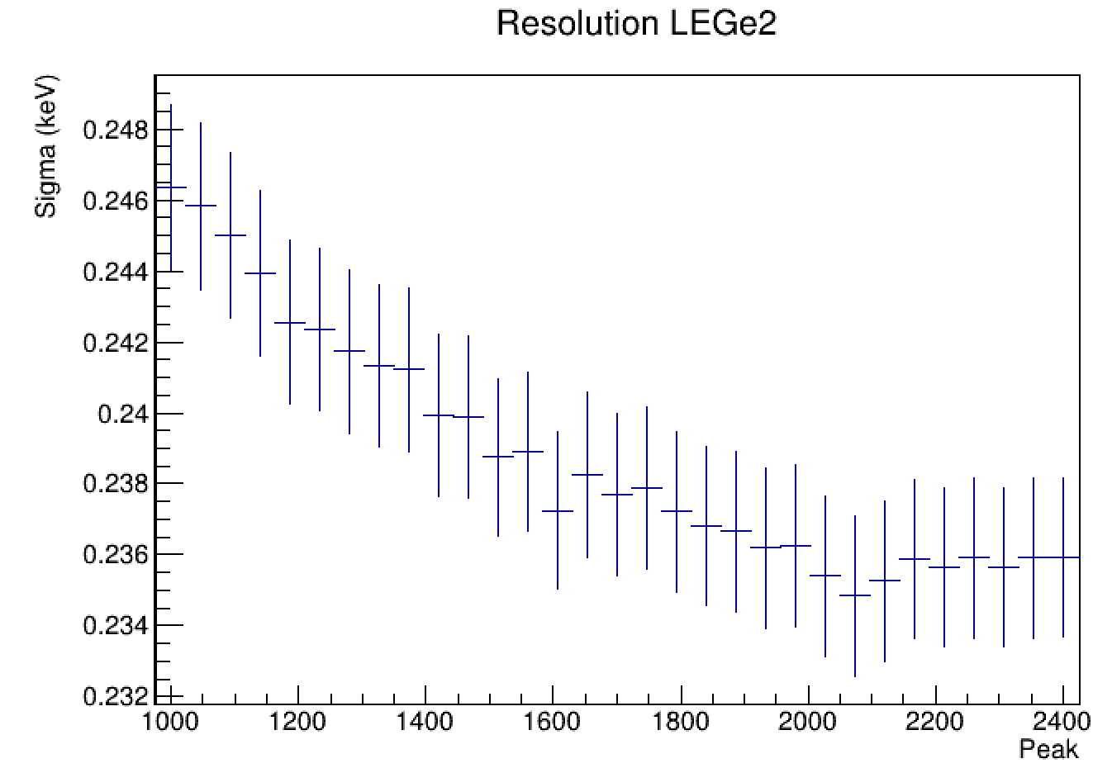
Gap and Peaking
Fixing the Gap we study the minimum resolution for the Peak parameter

Slide 7
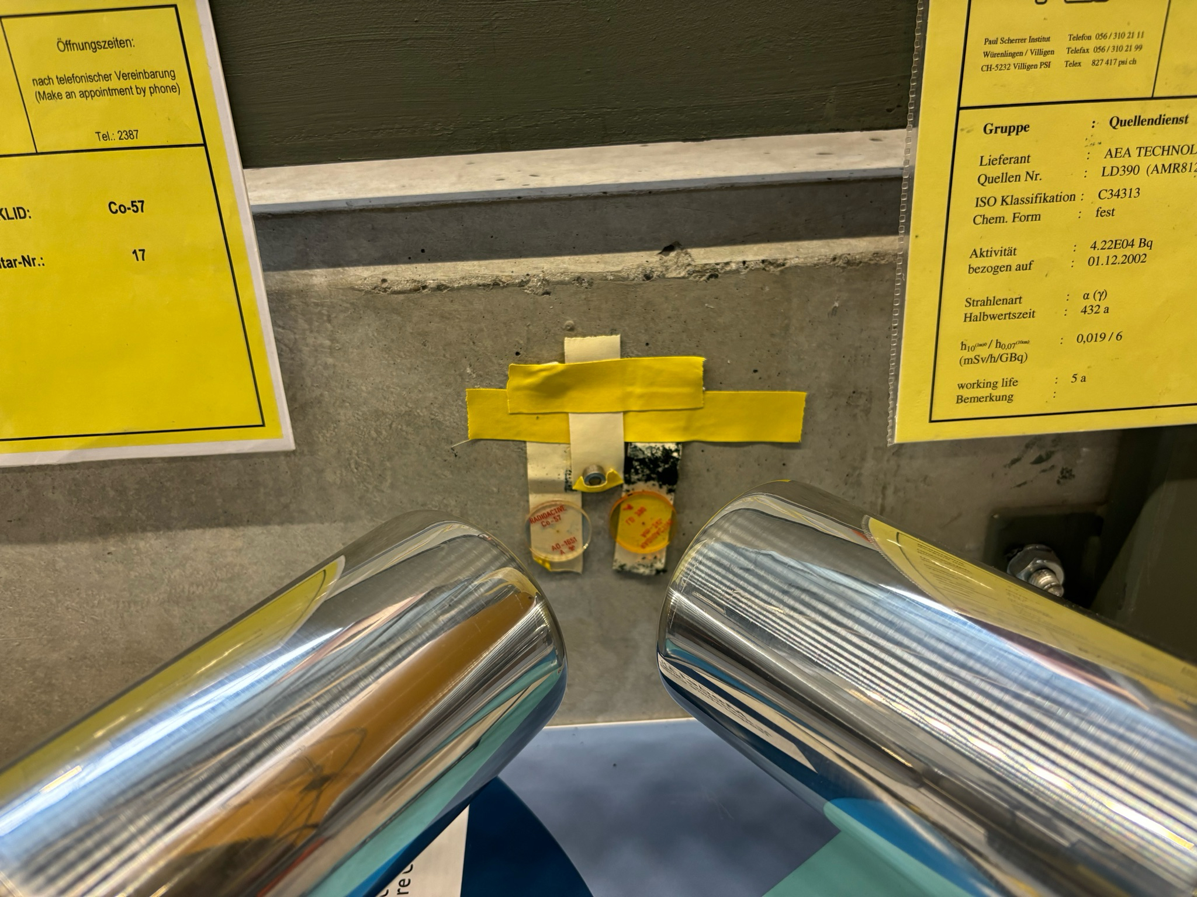
Spectra
Using three sources at the same time: Fe-55, Co-57 and Am-241
Fe-55
Am-241
Co-57

Slide 8
RESOLUTION PROBLEM SOLVED
Source | Calculated FWHM (eV) | Manufacturer FWHM (eV)
Fe-55 | 320 | 220
Reminder We observed bad resolution especially at low energies:
Solution
In the case of low energies (Fe-55) electronic noise is dominant and by subtracting the energy with the baseline correction (HitObjects.h) we double count this electronic noise (error propagation)
For higher energies (Co-57 and Am-241) electronic noise is not so dominant so we kept the baseline correction for the MAW filter
That’s why, as a temporary solution, we removed the baseline correction of the MAW filter only for the low energy, Fe-55 source
Conclusion: The double counting of the electronic noise from the baseline correction affected the resolution and it was particularly obvious at low energies (Fe-55)

Slide 9
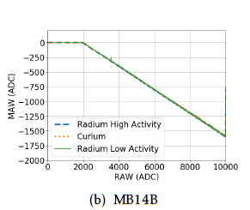
FUTURE ENDEAVOR
Create baseline correction plots of MAW vs RAW (ADC)
* Development of a new method to perform muonic atom spectroscopy with microgram targets, Skawran PhD Thesis

Slide 10
Fitting the Peaks

Slide 11
Fitting the Peaks

Slide 12
Resolution
LEGe 1
Isotopes | Fe-55 | Am-241 | Co-57
Energy (keV) | 5.9 | 59.54 | 122
Calculated (eV) | 235 | 423 | 564
Manufacturer (eV) | 220 | - | 525
LEGe 2
Isotopes | Fe-55 | Am-241 | Co-57
Energy (keV) | 5.9 | 59.54 | 122
Calculated (eV) | 235 | 423 | 564
Manufacturer (eV) | 220 | - | 525

Slide 13
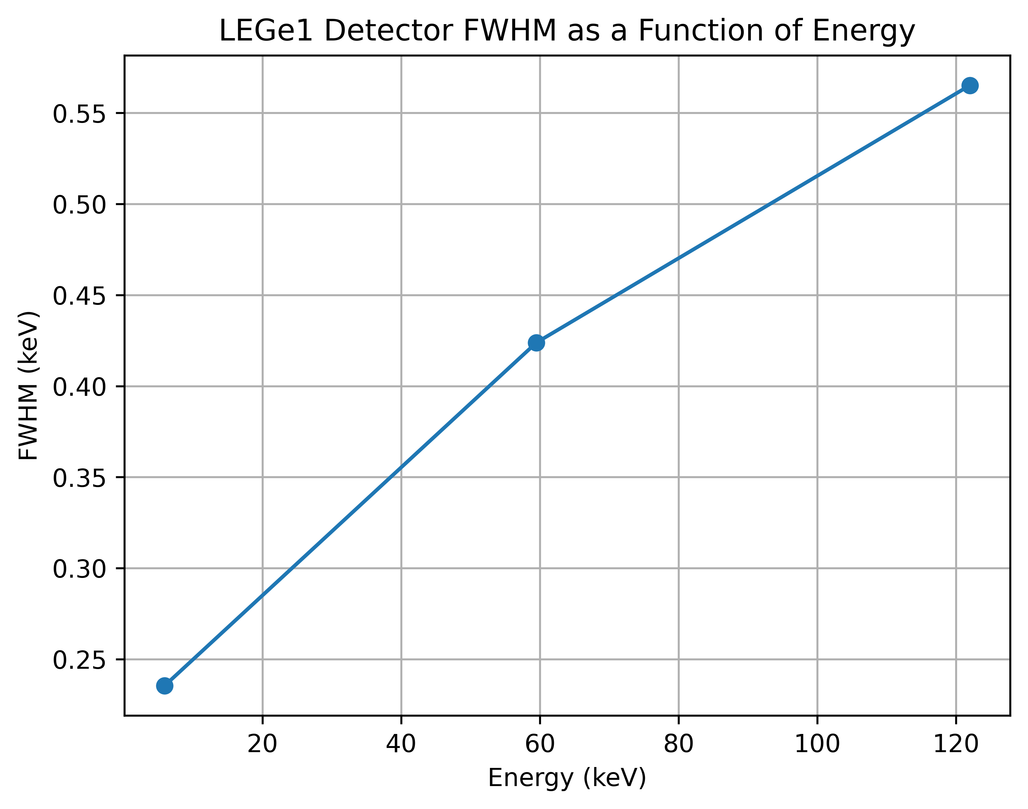

Resolution

Slide 14
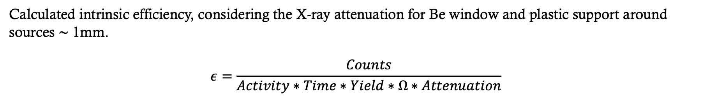
Efficiency
Calculated intrinsic efficiency, considering the X-ray attenuation for Be window and plastic support around sources $\sim$ 1mm.
$$ε=\frac{Counts}{Activity∗Time∗Yield∗Ω∗Attenuation}$$

Slide 15
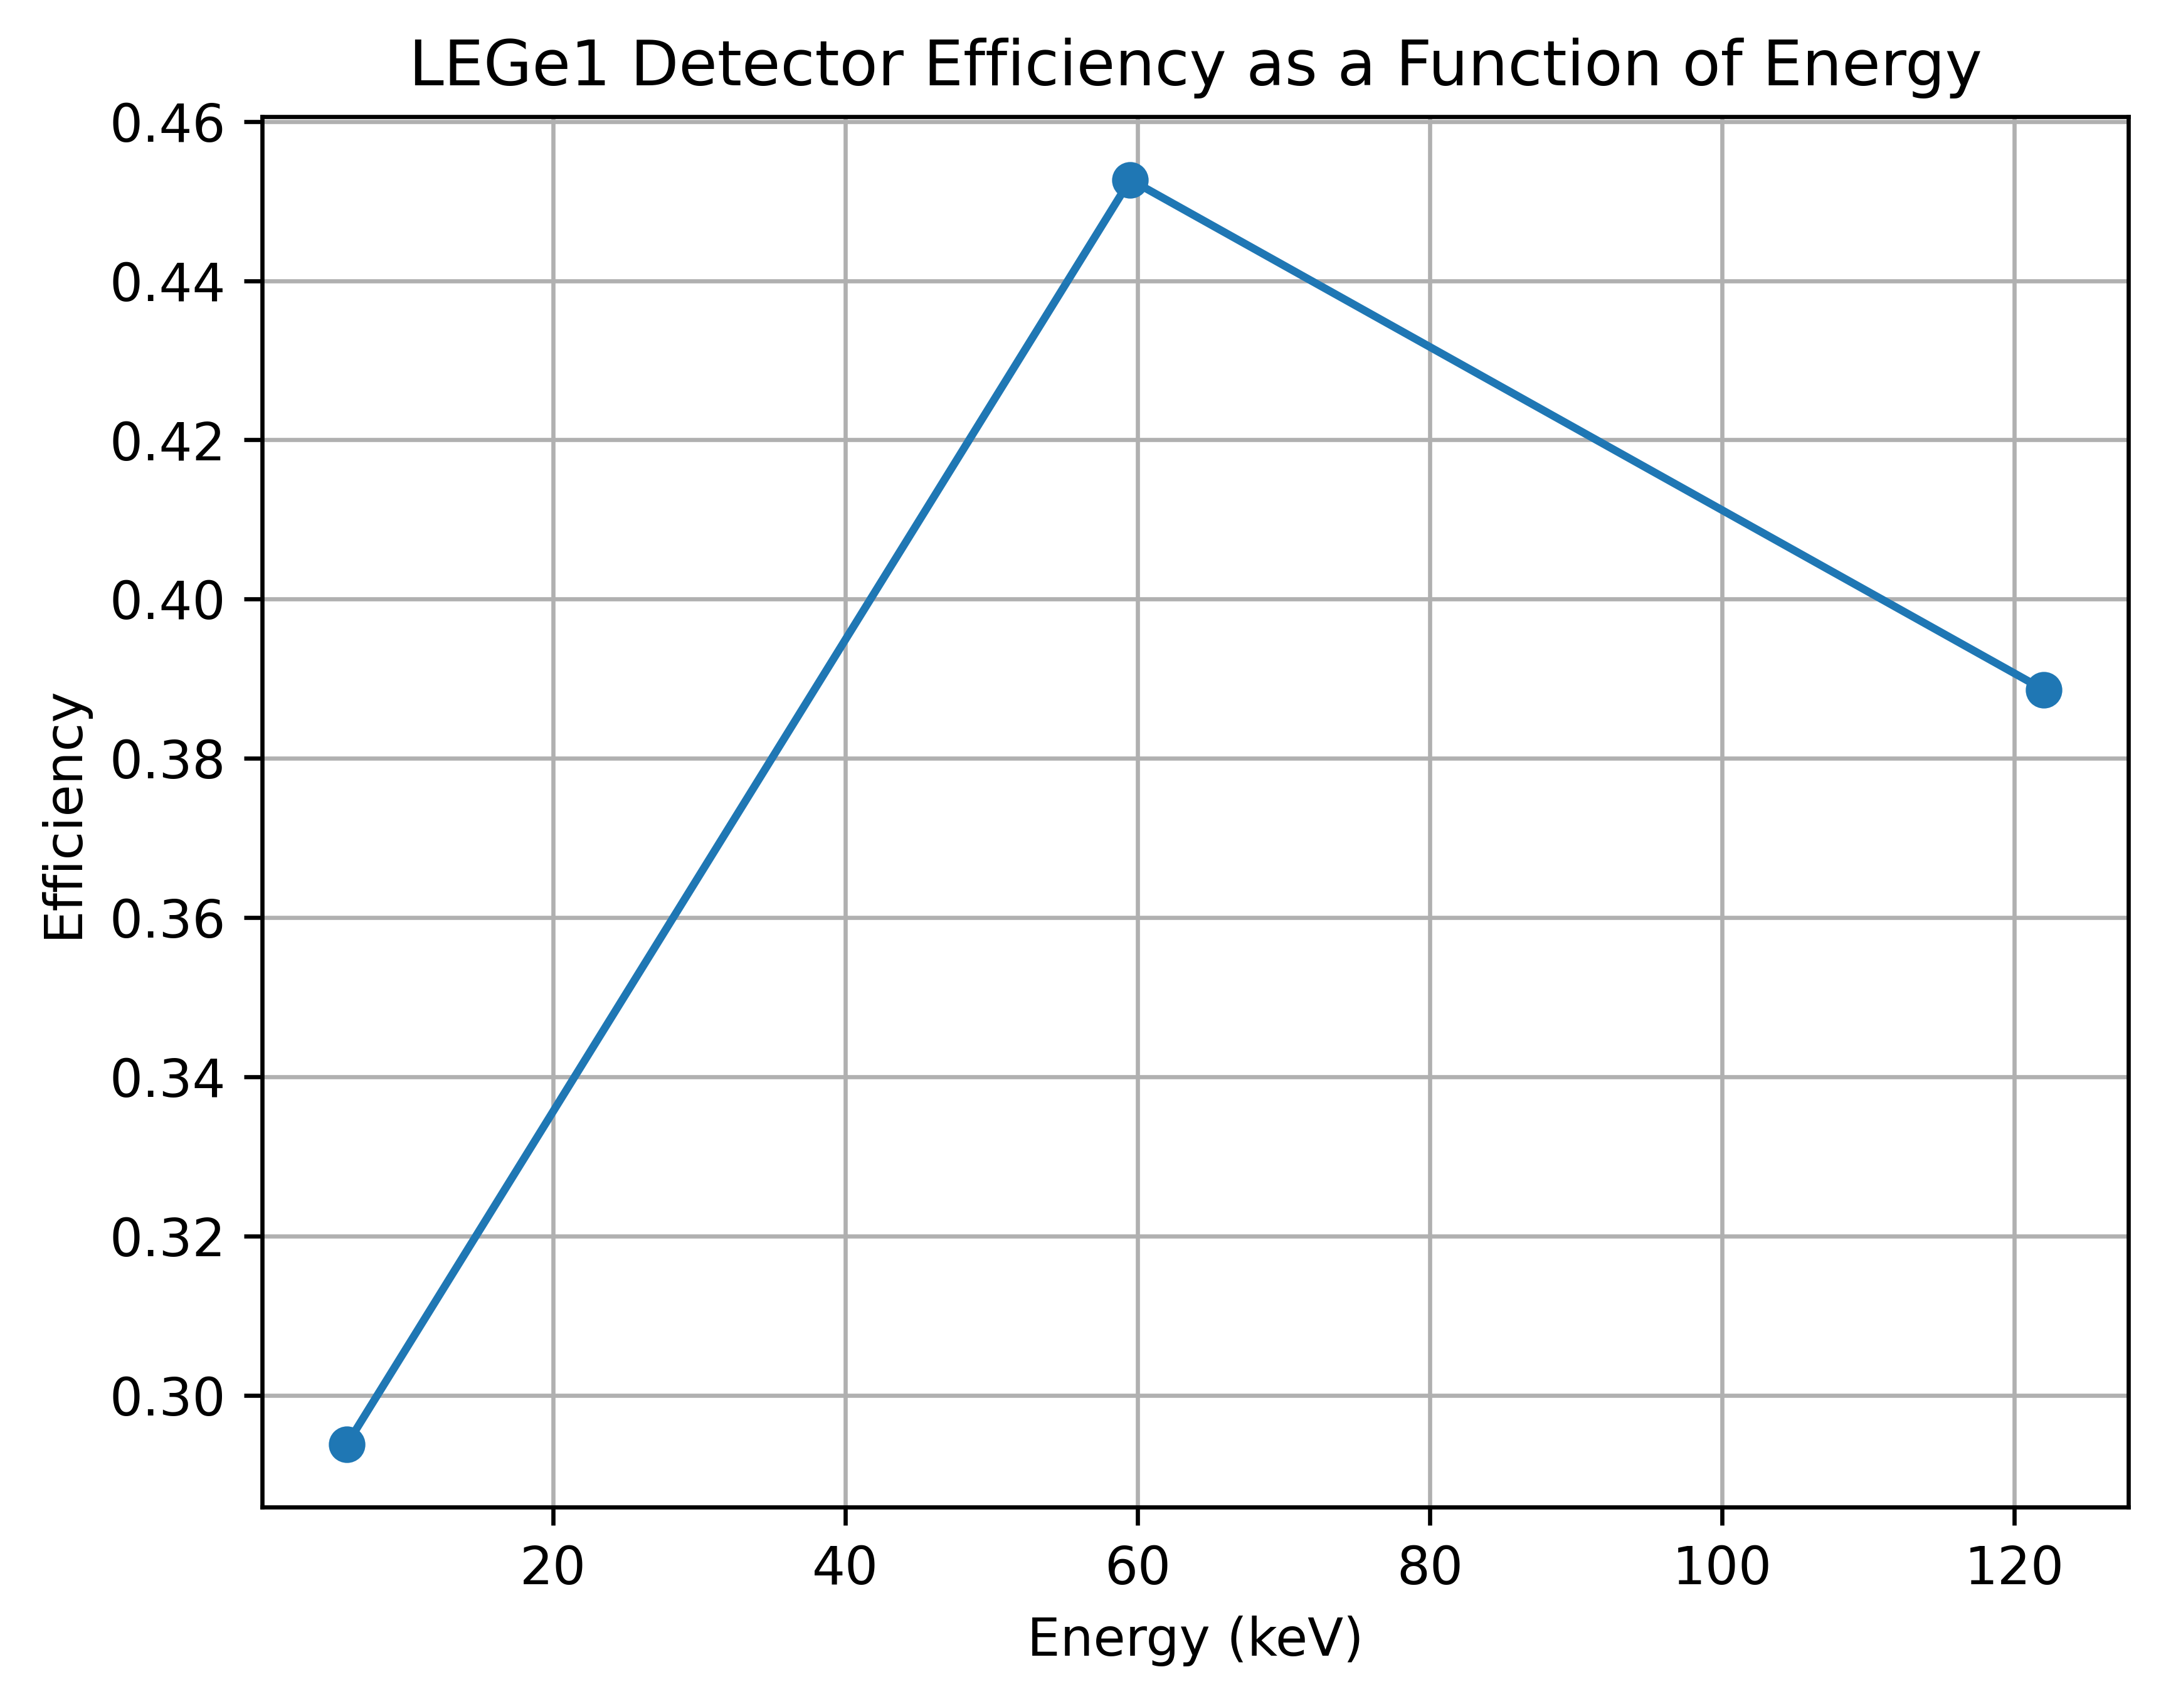
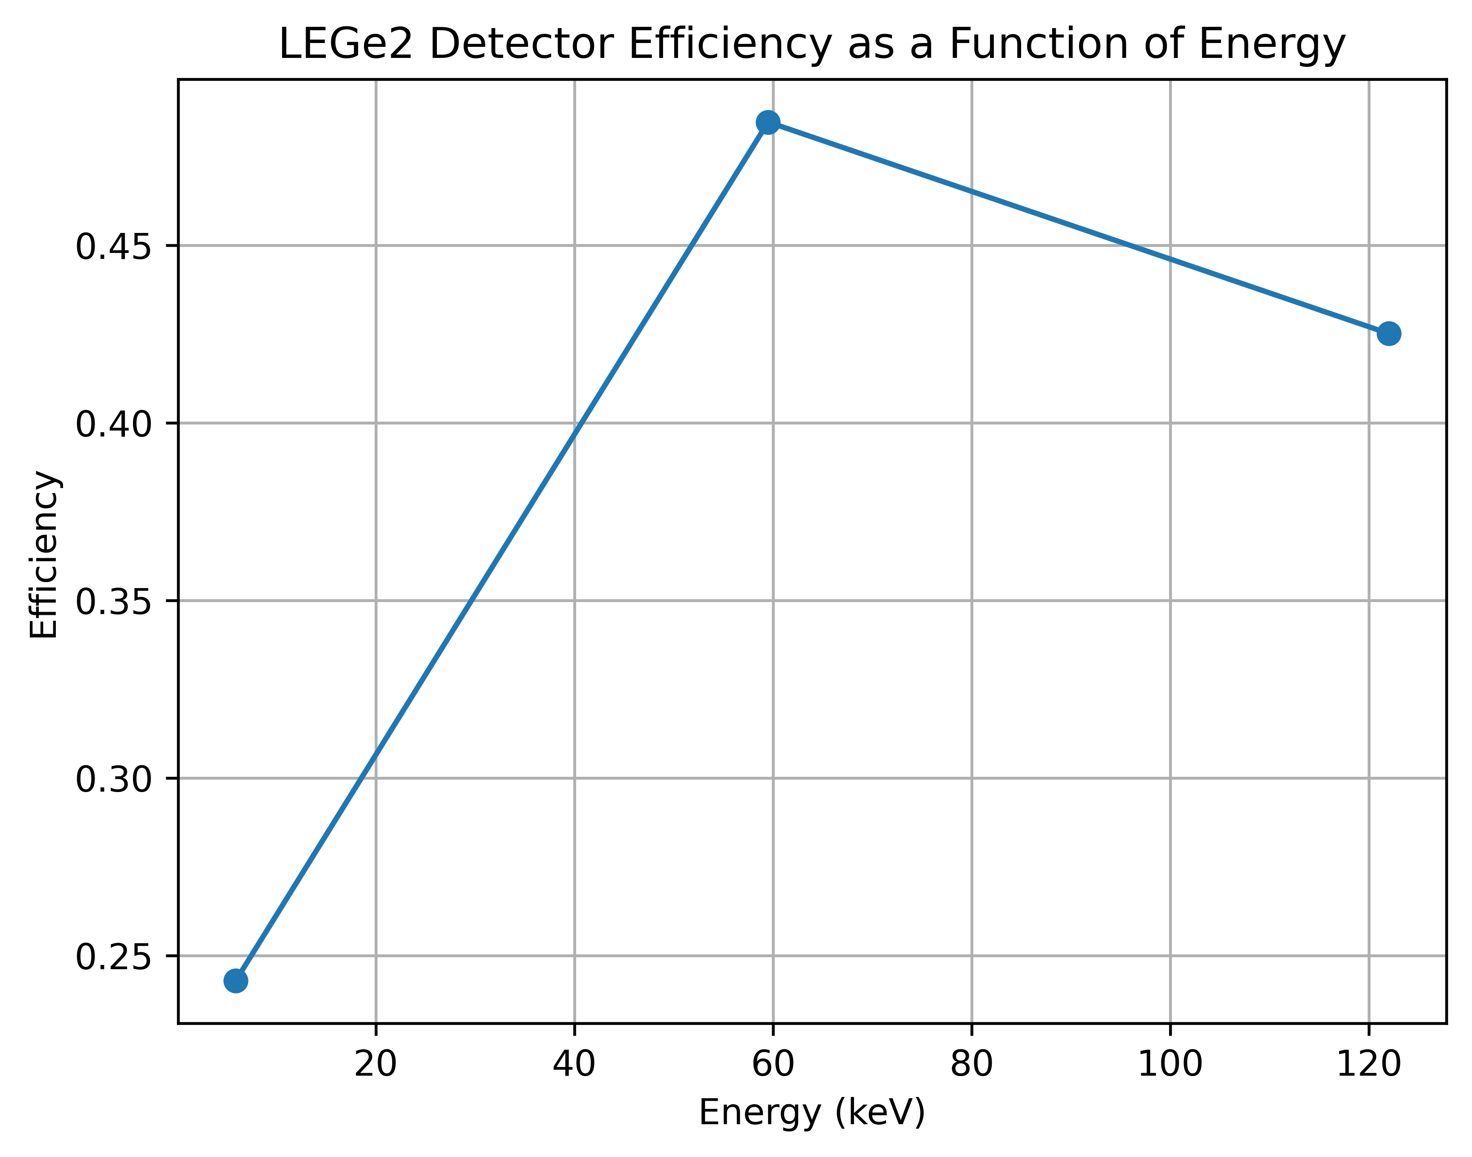
Efficiency
Calculated intrinsic efficiency, considering the X-ray attenuation for Be window and plastic support around sources $\sim$ 1mm.
Notes:
Efficiencies are too high; maybe the bin width multiplication to the counts was wrong, or some other efficiency parameter

