Slide 1
Update 14/03
Michael Heines

Slide 2
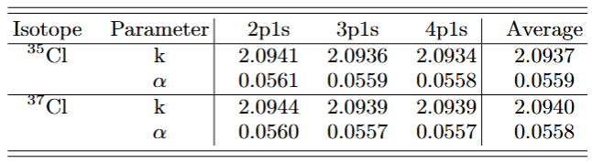
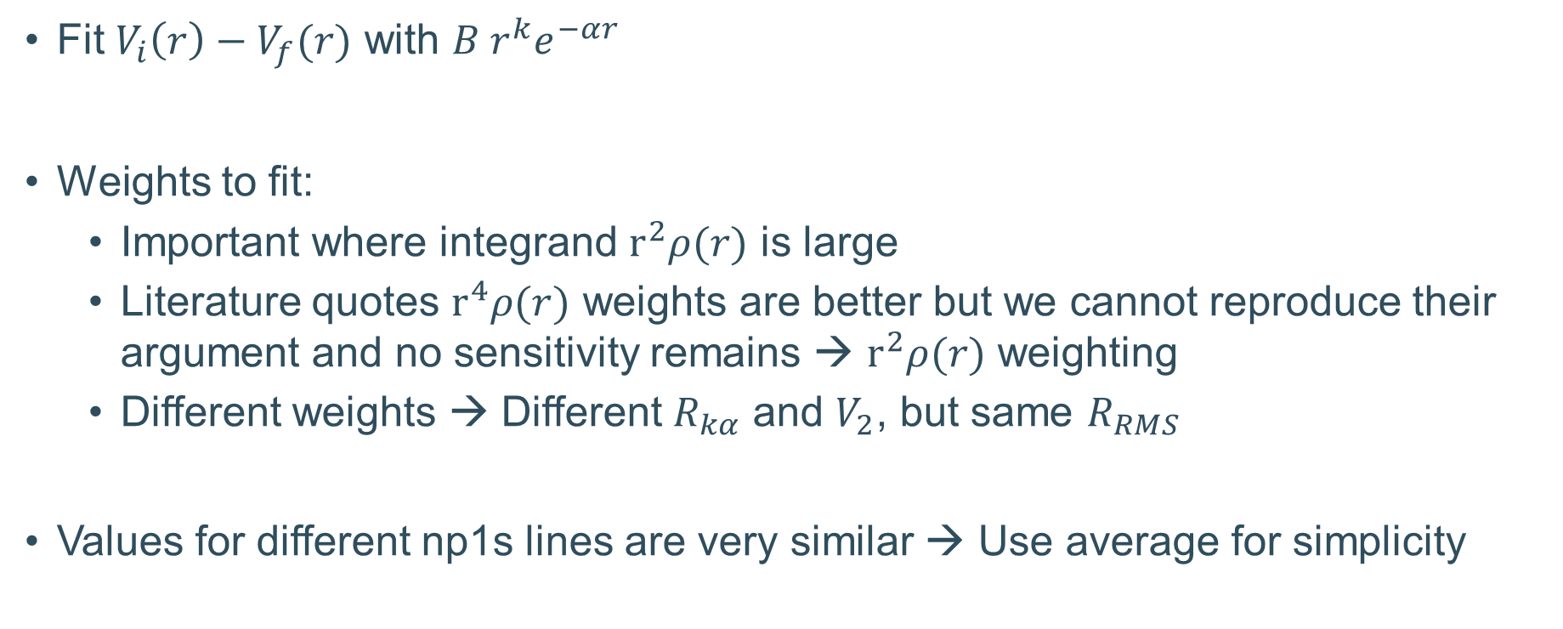
Extraction of k and alpha
Fit $V_{i}\left(r\right)−V_{f}(r)$ with $B r^{k}e^{−αr}$
Weights to fit:
  Important where integrand $r^{2}ρ(r)$ is large
  Literature quotes $r^{4}ρ(r)$ weights are better but we cannot reproduce their argument and no sensitivity remains → $r^{2}ρ(r)$ weighting
  Different weights → Different $R_{kα}$ and $V_{2}$, but same $R_{RMS}$
Values for different np1s lines are very similar → Use average for simplicity

Slide 3
Electron screening
Natalia calculated screening from (1s)²(2s)² configuration
Small effect
Drops for isotope shifts
Experimental errors > ~15 eV
Element | 2p1s | 3p1s | 4p1s
Cl | -0.42 eV | -1.12 eV | -1.53 eV
K | -0.45 eV | -1.39 eV | -1.98 eV

Slide 4
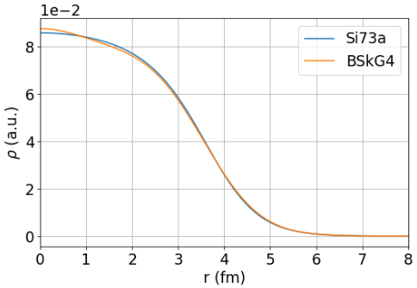
V2 from BSkG
Distributions from different models agree well with one another
Pepijn and Wouter recommend the most refined model to be used (BSkG4)
Nice agreements
³⁹K measurement versus DFT

Slide 5
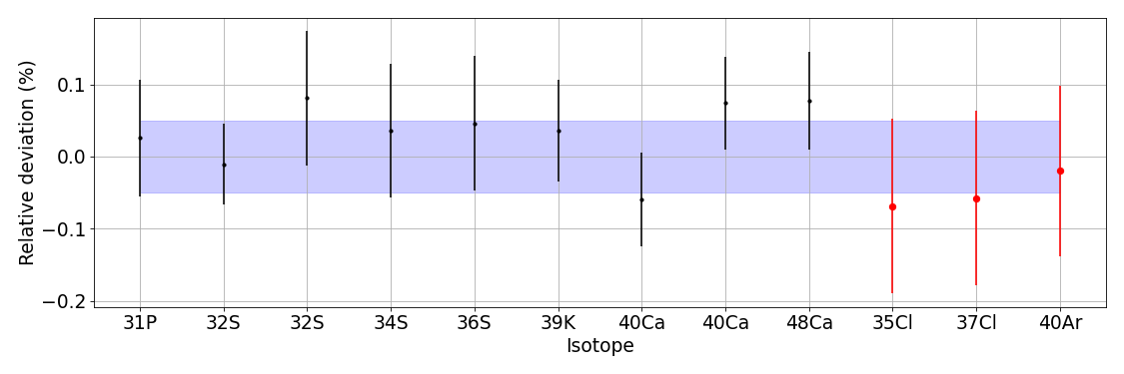
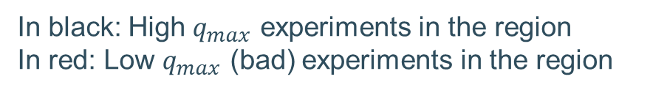
How good is good?
In black: High $q_{max}$ experiments in the region
In red: Low $q_{max}$ (bad) experiments in the region
Relative error of ~0.05% → Factor 2.5 better than Cl experiment!

Slide 6
Nuclear polarization
Nuclear part:
  Low-lying states (Pygmy)
  Higher states (Giant resonance)
  23% uncertainty → Deviation from most different skyrme
  Calculated for np and 1s state → p states < 1% contribution
Nucleon part
  Individual particle contribution
  10% uncertainty
  Only calculated for 1s

Slide 7
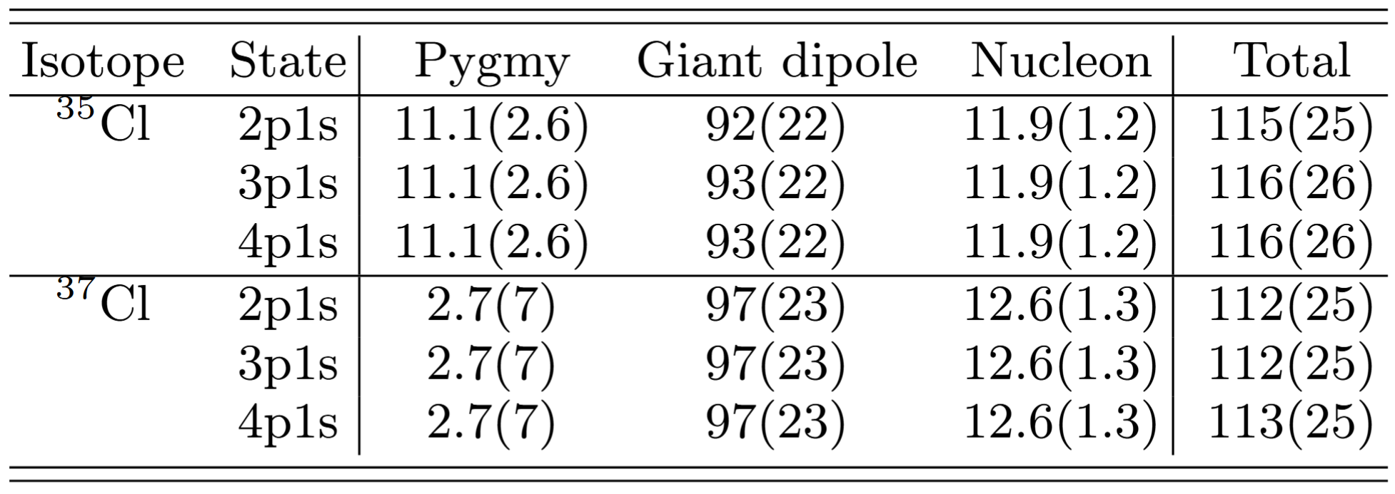
Uncertainty on absolute numbers
Linear addition of errors from three terms (conservative estimate)

Slide 8
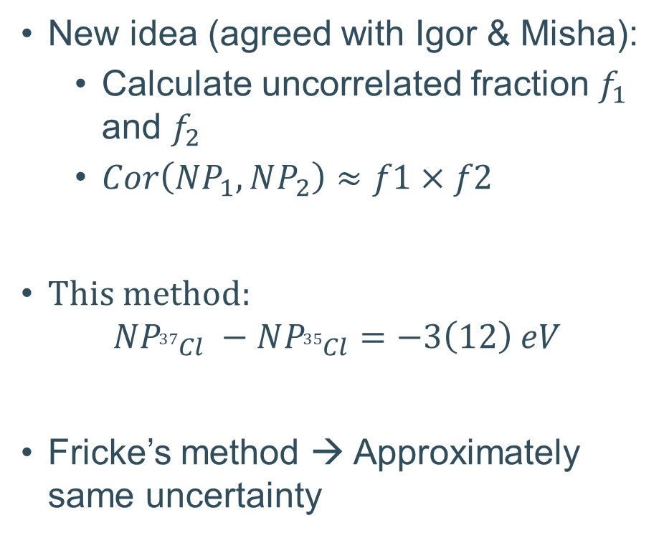
Uncertainty on differences
Initial idea:
  Split contributions
  Giant resonance and nucleon fully correlated
  Pygmy fully uncorrelated
  Add differences linearly
Issue relative error on Pygmy >> Relative error on Pygmy + Giant resonance
New idea (agreed with Igor & Misha):
  Calculate uncorrelated fraction $f_{1}$ and $f_{2}$
  $Cor\left(NP_{1}, NP_{2}\right)≈f1×f2$
This method:
$$NP_{37Cl} −NP_{35Cl}=−3\left(12\right) eV$$
Fricke’s method → Approximately same uncertainty

Slide 9
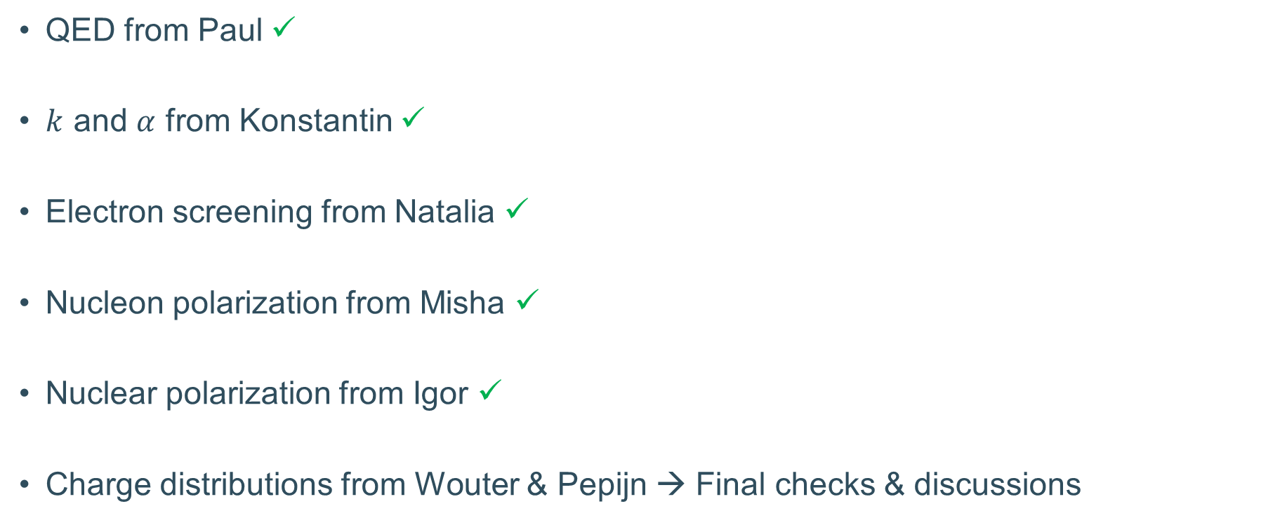
Theory for Cl publication
QED from Paul ✓
$k$ and $α$ from Konstantin ✓
Electron screening from Natalia ✓
Nucleon polarization from Misha ✓
Nuclear polarization from Igor ✓
Charge distributions from Wouter & Pepijn → Final checks & discussions

