Slide 1
Update 28/03
Michael Heines

Slide 2
V2 meeting
Group from Brussels is quite excited that their model does well for V2
They seem to agree on my method for estimating the uncertainty
Curiosity with how well other DFT models perform
They’ve done some calculations for 40-48Ca → We could reanalyze that chain

Slide 3
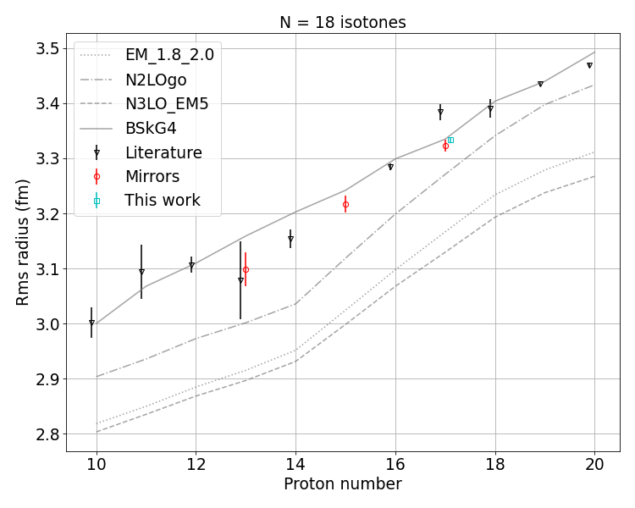
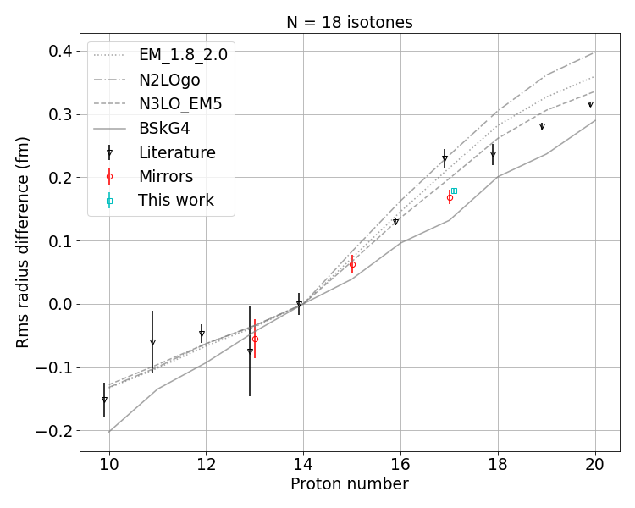
Isotones at N=18

Slide 4
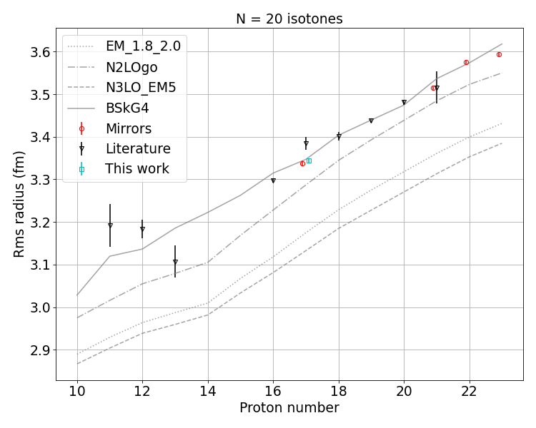
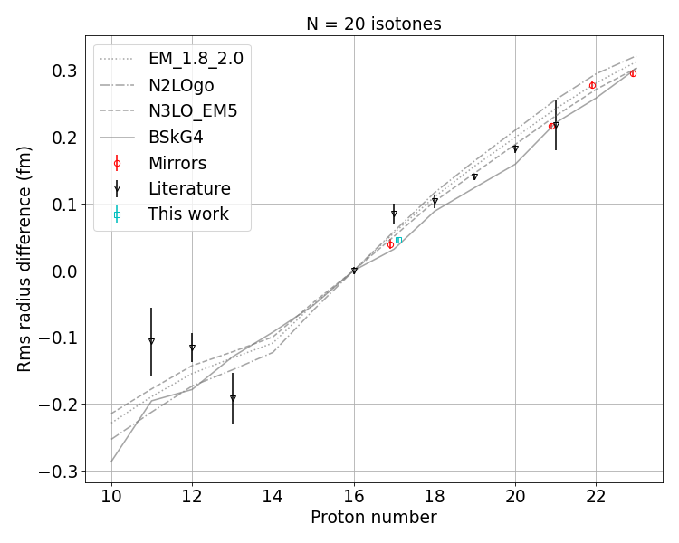
Isotones at N=20

Slide 5
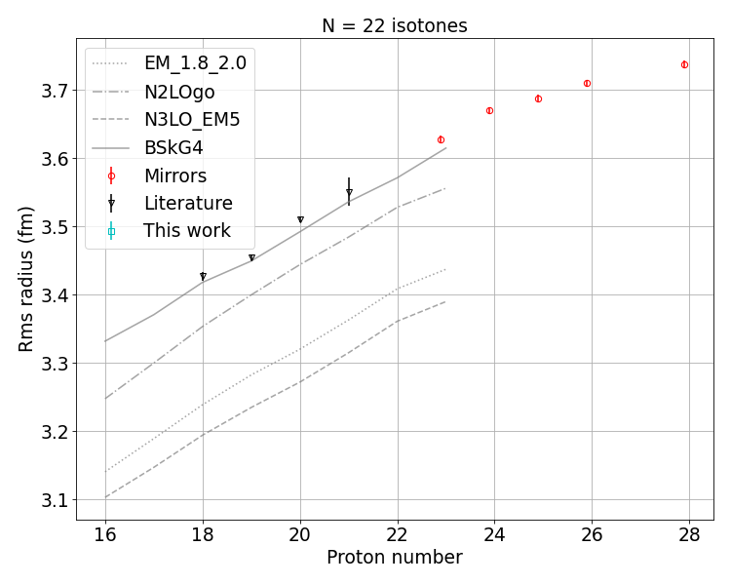
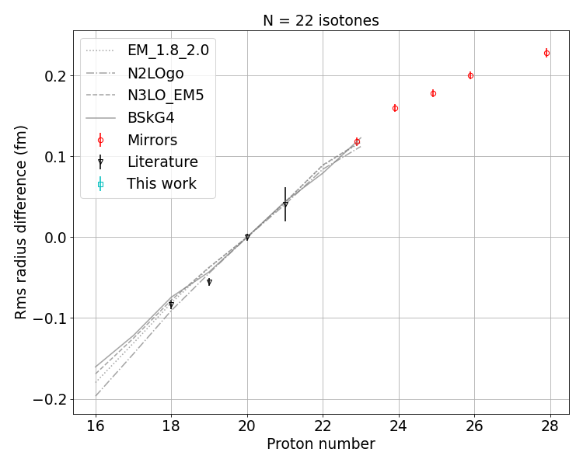
Isotones at N=22

