Slide 1

Overview:
Search for a muon EDM at PSI
R21-02.1
Philipp Schmidt-Wellenburg
PSI, 10.02.2025

Slide 2
Today’s agenda:
Introduction to the muEDM experimental concept and collaboration overview + Schedule and Beam time Request [15 + 5] (Philipp).
Beam time 2024: Major achievements [20 + 15] (Diego)
Detailed reports from some sub-projects
  Injection SC channels [10 + 5] (Pranas)
  Compensation coils [10 + 5] (Alex Bainbridge)
  Kicker system [10 + 5] (Tim)
  Muon trigger detector [10 + 5] (Kim-Siang)
  Positron tracker + DAQ [20 + 5] (Angela)
  (Systematics studies [10 + 5 ]) (Chavdar)
  (Numerical simulation of future solenoid field for Phase II [10+5]) (Frederique)
  (Simulation/Numerical framework [10 + 5] ) (Joe Price)

Slide 3
Introduction & Motivation
Collaboration overview
Schedule and Beam time Request

Slide 4


















CP violation & edm
$$\vec{μ}=μ\vec{s}$$
$$\vec{d}=d\vec{s}$$
A non-zero particle EDM
violates P, T and,
assuming CPT conservation, also CP.
$$|\left.↑\right\rangle$$
$$|\left.↑\right\rangle$$
$$U=− \vec{μ}⋅\vec{B}$$
$$U=− \vec{d}⋅\vec{E}$$
$$ΔU=ℏω_{e}$$
$$|\left.↓\right\rangle$$
$$|\left.↓\right\rangle$$
$$B$$
$$E$$
`
T
T
$$|\left.↑\right\rangle$$
$$U=−\vec{μ}⋅\vec{B}$$
Baryon asymmetry
of the Universe
$$U=\vec{d}⋅\vec{E}$$
$$|\left.↑\right\rangle$$
$$B$$
$$E$$
Arises “naturally” in
beyond SM theories
EDM
CPV
Strong CP violation
($θ$-term)
Notes:
Symmetries and the breaking of symmetries are an important concept of all modern physics theories.
To better understand the violation of discrete symmetries by an EDM I have made this sketch of the energie levels of a spin-1/2 particle in a magnetic and electric field.
The left side every body is familiar with. It corresponds to the classical zeeman splitting in atoms. Depending on the spin of the particle the magnetic moment will lead to an increase or decrease in energy.
Similar on the right side, the electric dipole moment leads to a similar level splitting in the electric field.
Lets concentrate on the spin up state. [click]
Now we apply a Ti

Slide 5
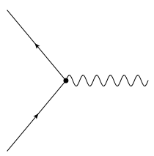



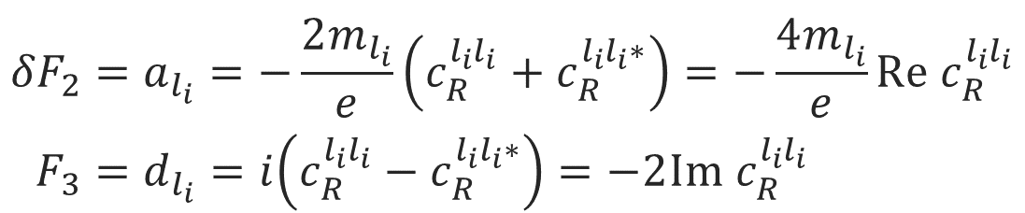

Lepton form factors and dipole moments
$$l_{f}$$
$$ℋ_{eff}=c_{R}^{l_{f}l_{i}}{\overline{l}}_{f}σ_{μν}P_{R}l_{i}F^{μν}+h.c.$$
$$F^{μν}$$
Effective Hamiltonian:
$$l_{i}$$
magnetic-dipole
Anapole - moment
$$\left\langle p′ | J_{μ}^{EM} | p\right\rangle =\overline{Ψ}\left(p^{′}\right)\left[F_{1}γ_{μ}+\frac{iF_{2}}{2M}σ_{μν}q^{ν}+\frac{iF_{3}}{2M}σ_{μν}γ_{5}q^{ν}+\frac{F_{4}}{M^{2}}(q^{2}γ_{μ}−γ^{μ}q_{μ}q_{μ})\right]Ψ\left(p\right)$$
charge
electric-dipole
$${δF}_{2}=a_{l_{i}}=−\frac{2m_{l_{i}}}{e}\left(c_{R}^{l_{i}l_{i}}+c_{R}^{l_{i}l_{i}∗}\right)=−\frac{4m_{l_{i}}}{e}Re c_{R}^{l_{i}l_{i}} \\ F_{3}=d_{l_{i}}=i\left(c_{R}^{l_{i}l_{i}}−c_{R}^{l_{i}l_{i}∗}\right)=−2Im{ c}_{R}^{l_{i}l_{i}}$$
Notes:
For the purpose of a general discussion, effective field theories are particular useful, as no assumptions are needed for the exact realization of a high energy theory.
The most general form in which one can write down the interaction of a lepton current with an external electric/magnetic field is using this electro magnetic current with all possible bilinears.
In this case the first form factor is the electric charge, the second the magnetic and the third the electric dipole moment. The anapole moment I just depicted for completeness
Interestingly the anomalous magnetic moment is connected to the same Wilson coefficient as the electric dipole moment in effective field theories. The real part of this Wilson coefficient is proportional to the anomalous magnetic momentum, while the imaginary part is related to the electric dipole moment.

Slide 6
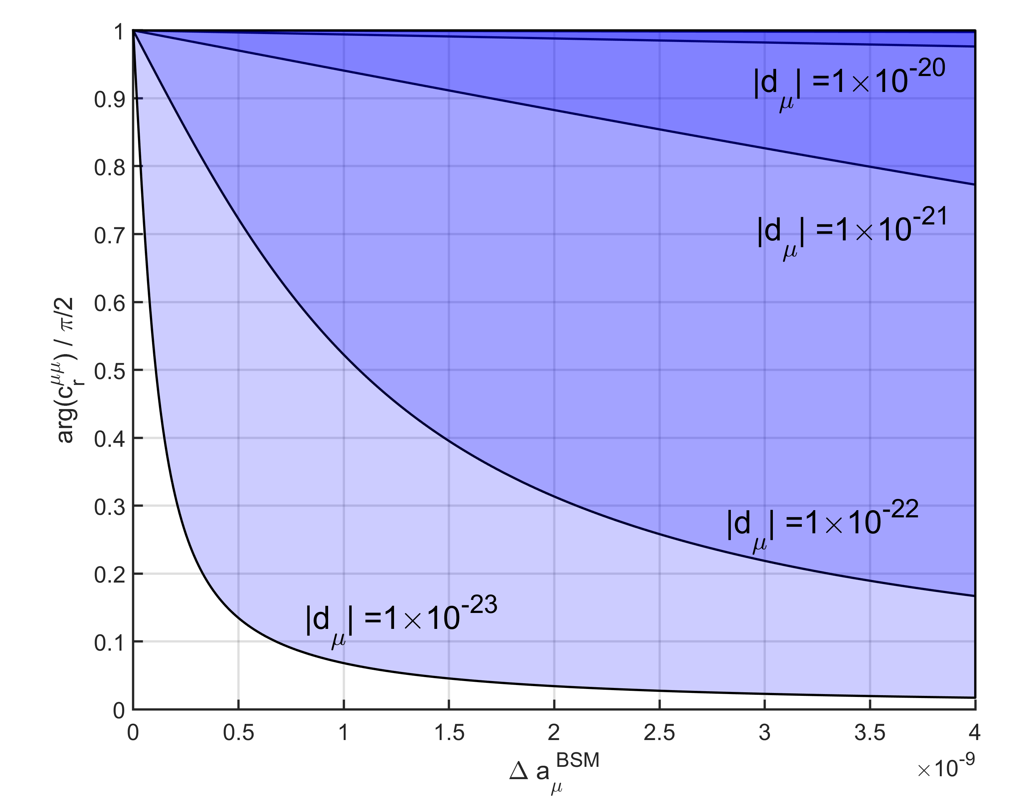
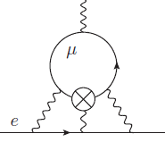
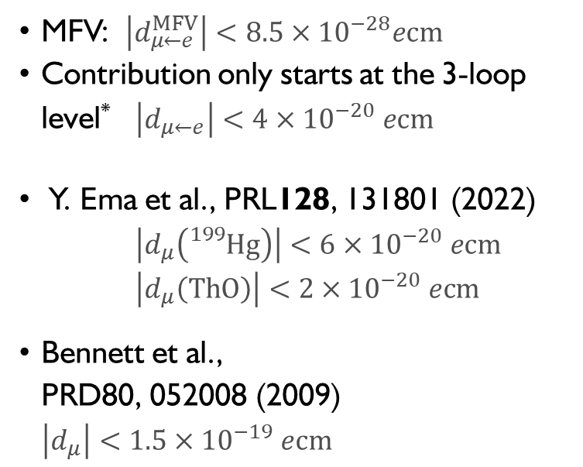
General limits on $μ$EDM
MFV: $\left|d_{μ←e}^{MFV}\right|<8.5×{10}^{−28}ecm$
Contribution only starts at the 3-loop level* $\left|d_{μ←e}\right|<4×{10}^{−20} ecm$
Y. Ema et al., PRL128, 131801 (2022)
$\left|d_{μ}\left({}_{}^{199}{Hg}\right)\right|<6×{10}^{−20} ecm$
$\left|d_{μ}\left(ThO\right)\right|<2×{10}^{−20} ecm$
Bennett et al.,
PRD80, 052008 (2009)
$\left|d_{μ}\right|<1.5×{10}^{−19} ecm$
Fermilab/J-PARC
PSI (frozen spin)
BMW24
2018 calculations
*A.Crivellin, M. Hoferichter, PSW PRD 98, 113002 (2018)

Slide 7
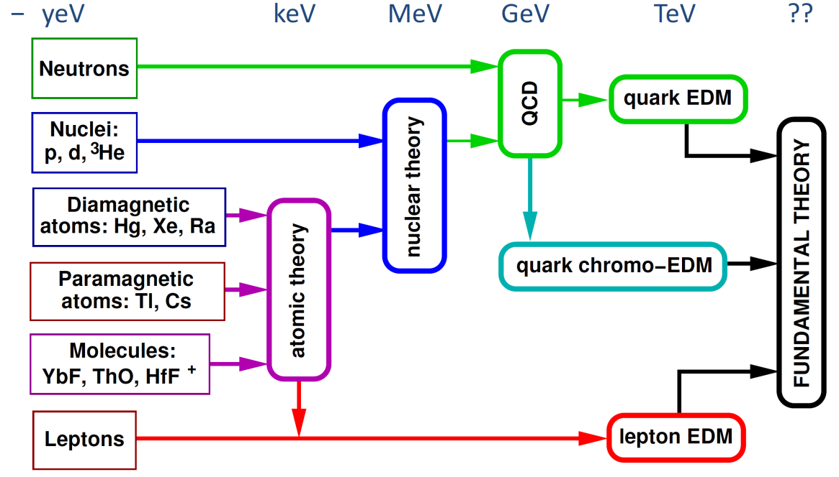
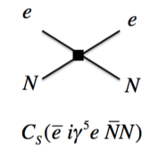

Complementarity of EDM searches
$$≤$$
proton,
neutron
d,³He
electron
Muon
Scheme: adapted from Rob G. E. Timmermans
Notes:
This complementarity will be essential once we stop searching for EDM and actually start finding them.
This Metro map of EDM searches tries to visualize this complementarity. On the far right we see depicted underlying fundamental high energy theory of everything, which should explain the necessary CP violation for baryon asymmetry.
However, already at lower energies you could have CP violating mediated down in effective CP violating terms at low energy.
On the far left you see the actual EDM we are searching and eventually will be measuring. So if you measure the EDM of a bare baryon you only have to make sure to correctly estimate the contributions from the QCD term and quark EDMs,
While the further you walk down the list the more you have an interplay of different contributions to your EDM which could all include some sort of CP- violating effect.
So in polar molecules one will have to understand all the effects of atomic theory, nuclear theory, may be QCD or not…
At the far bottom you have the very simple and pure lepton, essential bare only possible as muon EDM which only relates to leptonic EDM theories – hence a very pure probe.

Slide 8
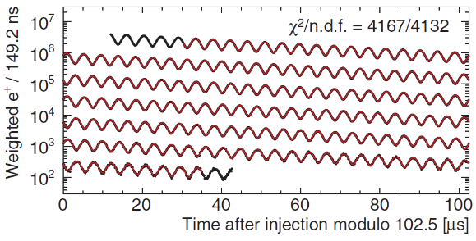
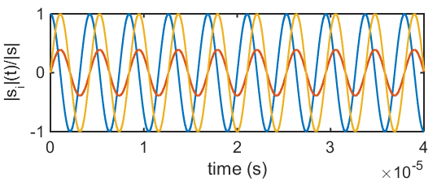


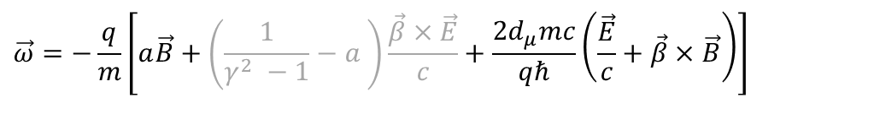


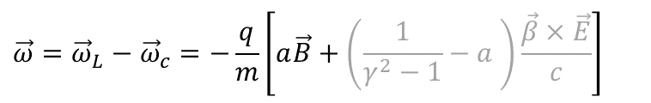






Muon dipole moments and frequencies
$$\vec{ω}=−\frac{q}{m}\left[a\vec{B}+\left(\frac{1}{γ^{2} −1}−a \right)\frac{\vec{β}×\vec{E}}{c}+\frac{2d_{μ}mc}{qℏ}\left(\frac{\vec{E}}{c}+\vec{β}×\vec{B}\right)\right]$$
$$\vec{ω}={\vec{ω}}_{L}−{\vec{ω}}_{c}=−\frac{q}{m}\left[a\vec{B}+\left(\frac{1}{γ^{2}−1}−a \right)\frac{\vec{β}×\vec{E}}{c}\right]$$
g-2 term $ω_{a}$
EDM term $ω_{e}$
B
$${\vec{ω}}_{a}$$
$$\sqrt{{\vec{ω}}_{a}^{2}+{\vec{ω}}_{e}^{2}}$$
$$ζ$$
$$R=7.114 m$$
$$ζ=\operatorname{atan}\left(\frac{2d_{μ}βcm}{a}\right)$$
$$\vec{s}$$
FNAL* & JPARC**:
$$σ\left(d_{μ}\right)≈{10}^{−21}ecm$$
$${\vec{ω}}_{e}$$
[Abi et al., PRL126 141801(2021)]
[*Chislett et al., EPJConf.118 01005(2016), Abi et al., PRL126 141801(2021), **Abe et al., PTEP053C02 (2019)]
Notes:
Many of you probably know about the g-2 measurement of the muon at Fermilab.
The principle physics are described in the equation. The difference between the Larmor frequency of the muon, essentially the precision due to the magnetic moment, and the cyclotron frequency of the muon moving in a magnetic and electric field.
The muon moves along its reference orbit perpendicular to the main magnetic field. Due to the small anomalous magnetic moment the difference is not exactly zero and one can observe the famous wiggle plot by measuring in the number of decay positrons per time.
The electric field is required for steering the muon inside the storage ring. By selecting the correct momentum the electric term can be set to zero and the observed oscillation frequency directly relates to the anomalous magnetic moment.
Now in the presence of a electric dipole moment the plane of oscillation tilts and one could observe a tiny vertical observation of the positron intensity, and the measured frequency would be a little bit larger.
The prospected sensitivity is about 10E-21 ecm for the EDM at Fermilab and JPARC.

Slide 9
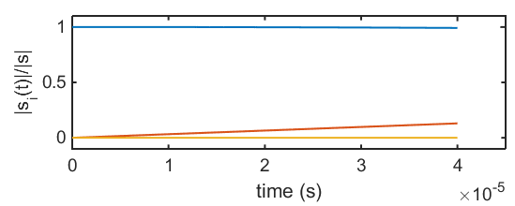


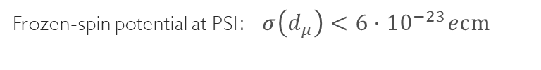



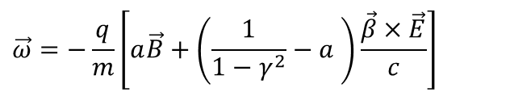


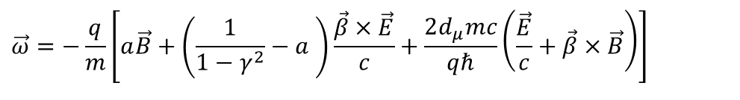


Muon dipole moments –freezing the spin at PSI
$$\vec{ω}=−\frac{q}{m}\left[a\vec{B}+\left(\frac{1}{1−γ^{2}}−a \right)\frac{\vec{β}×\vec{E}}{c}+\frac{2d_{μ}mc}{qℏ}\left(\frac{\vec{E}}{c}+\vec{β}×\vec{B}\right)\right]$$
$$\vec{ω}=−\frac{q}{m}\left[a\vec{B}+\left(\frac{1}{1−γ^{2}}−a \right)\frac{\vec{β}×\vec{E}}{c}\right]$$
g-2 term $ω_{a}$
EDM term $ω_{e}$
$$s_{z}$$
Frozen-spin potential at PSI:$σ\left(d_{μ}\right)<{6⋅10}^{−23}ecm$
B
$$s_{y}$$
$$R=31 mm$$
$${\vec{ω}}_{e}$$
E
$$s_{x}$$
set $E ≅aBcβγ^{2}$
Phase I: $σ\left(d_{μ}\right)<{4⋅10}^{−21}ecm$
[*Farley et al,, PRL93 042001 (2004) ] ,
Notes:
To further increase the sensitivity to a muon EDM we propose to use the frozen-spin technique to measure the electric dipole moment.
By applying a well tuned electric field this entire term can be canceled and the spin exactly follows the momentum, essentially it is frozen to the momentum.
The only term present is the one of the electric dipole moment which leads to a precession of the spin around the radial axis like a bicycle going in a circle.
This in turn leads to a build up of a asymmetry of positron decays along and against the direction of the magnetic field, the signal we are searching for.

Slide 10
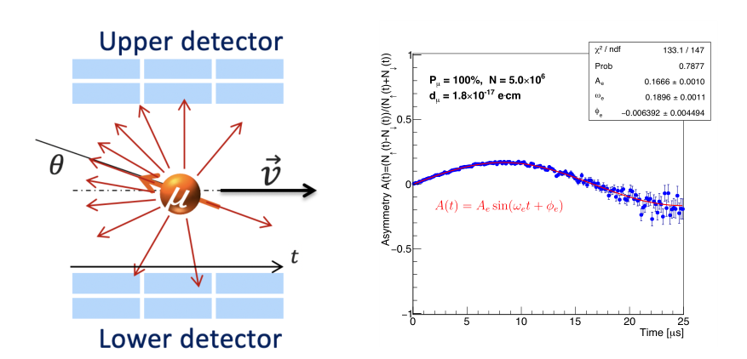


The general experimental idea
B
If the EDM ≠ 0, then there will be a vertical precession out of the plane of the orbit
  An asymmetry increasing with time will be observed recording decay positrons
If the EDM = 0, then the spin should always be parallel to the momentum
asymmetry should be zero
Some asymmetry could still be
observed due to systematic effects
$$R=31 mm$$
$${\vec{ω}}_{e}$$
E

Slide 11
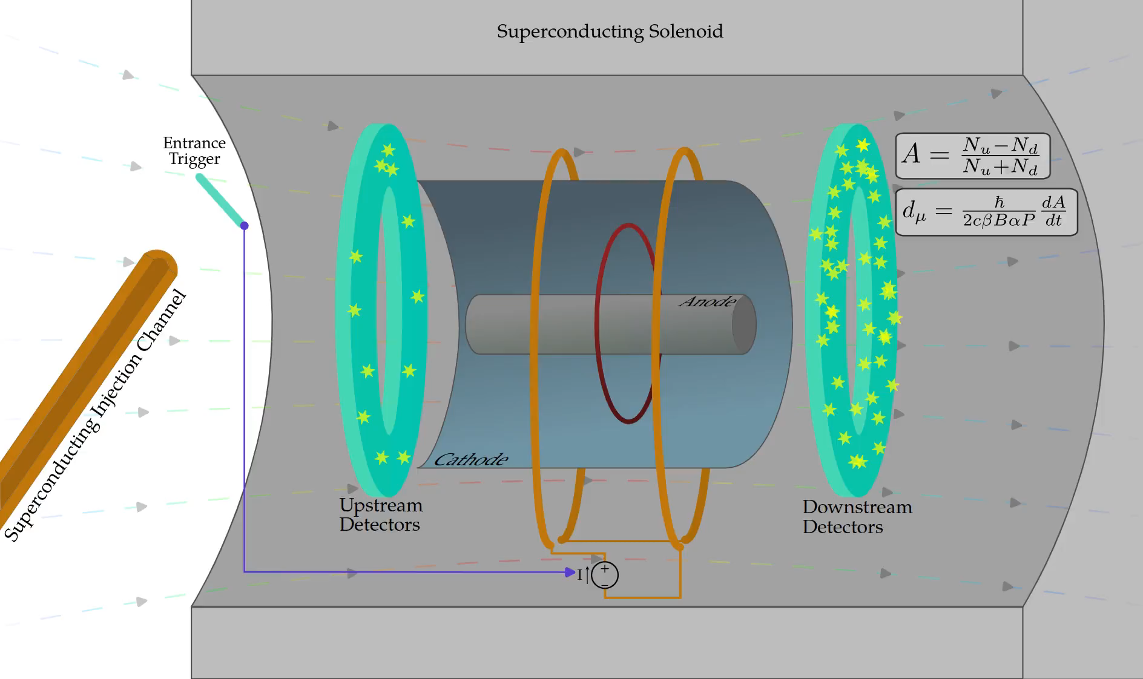
The Experiment - Concept

Slide 12
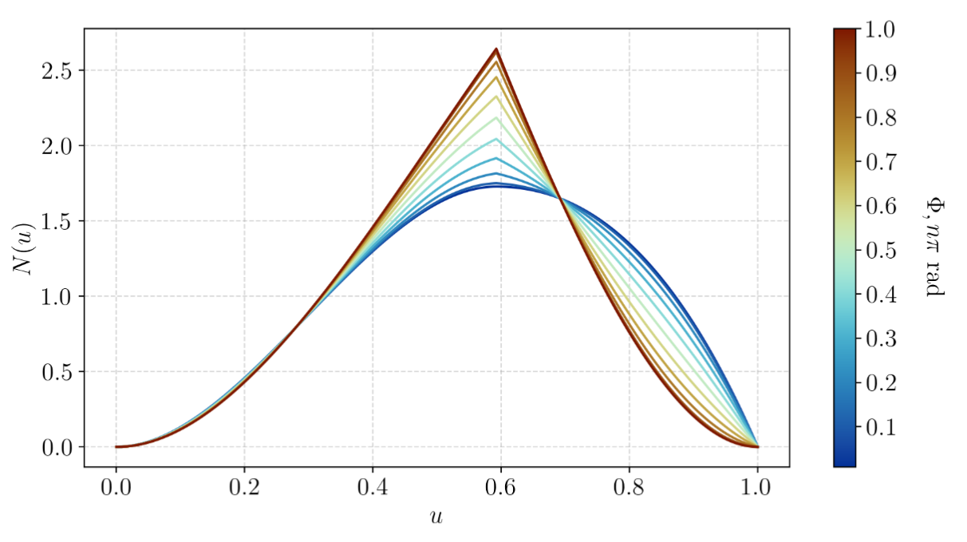
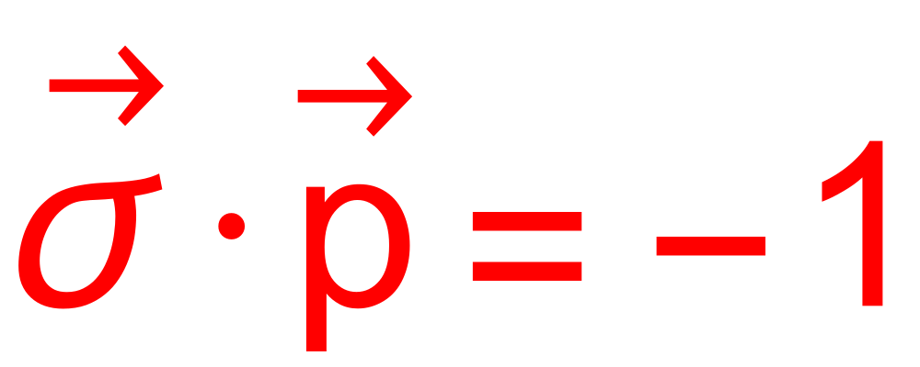
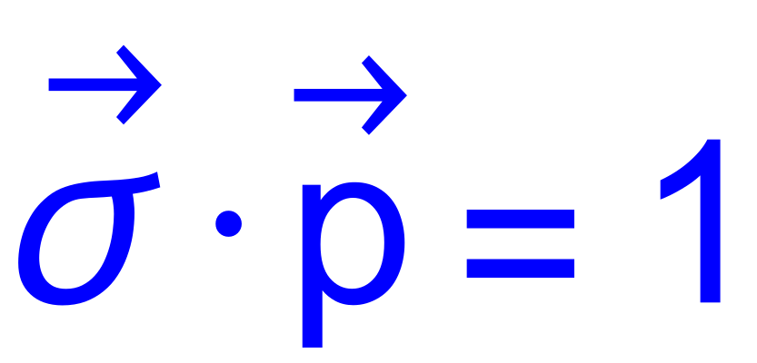
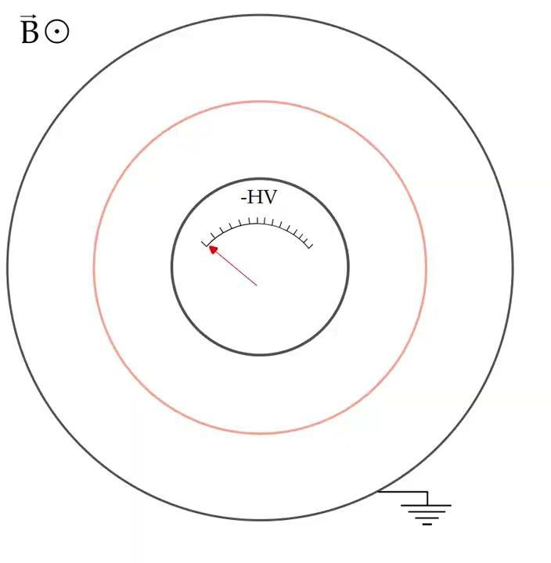
The Experiment - Freezing The Spin
Credit: Chavdar Dutsov
Counts oscillate between the red curve and the blue curve.
Counts above a threshold would give the g-2 oscillation signal.
Increase the electric field until the g-2 oscillations “freeze”

Slide 13
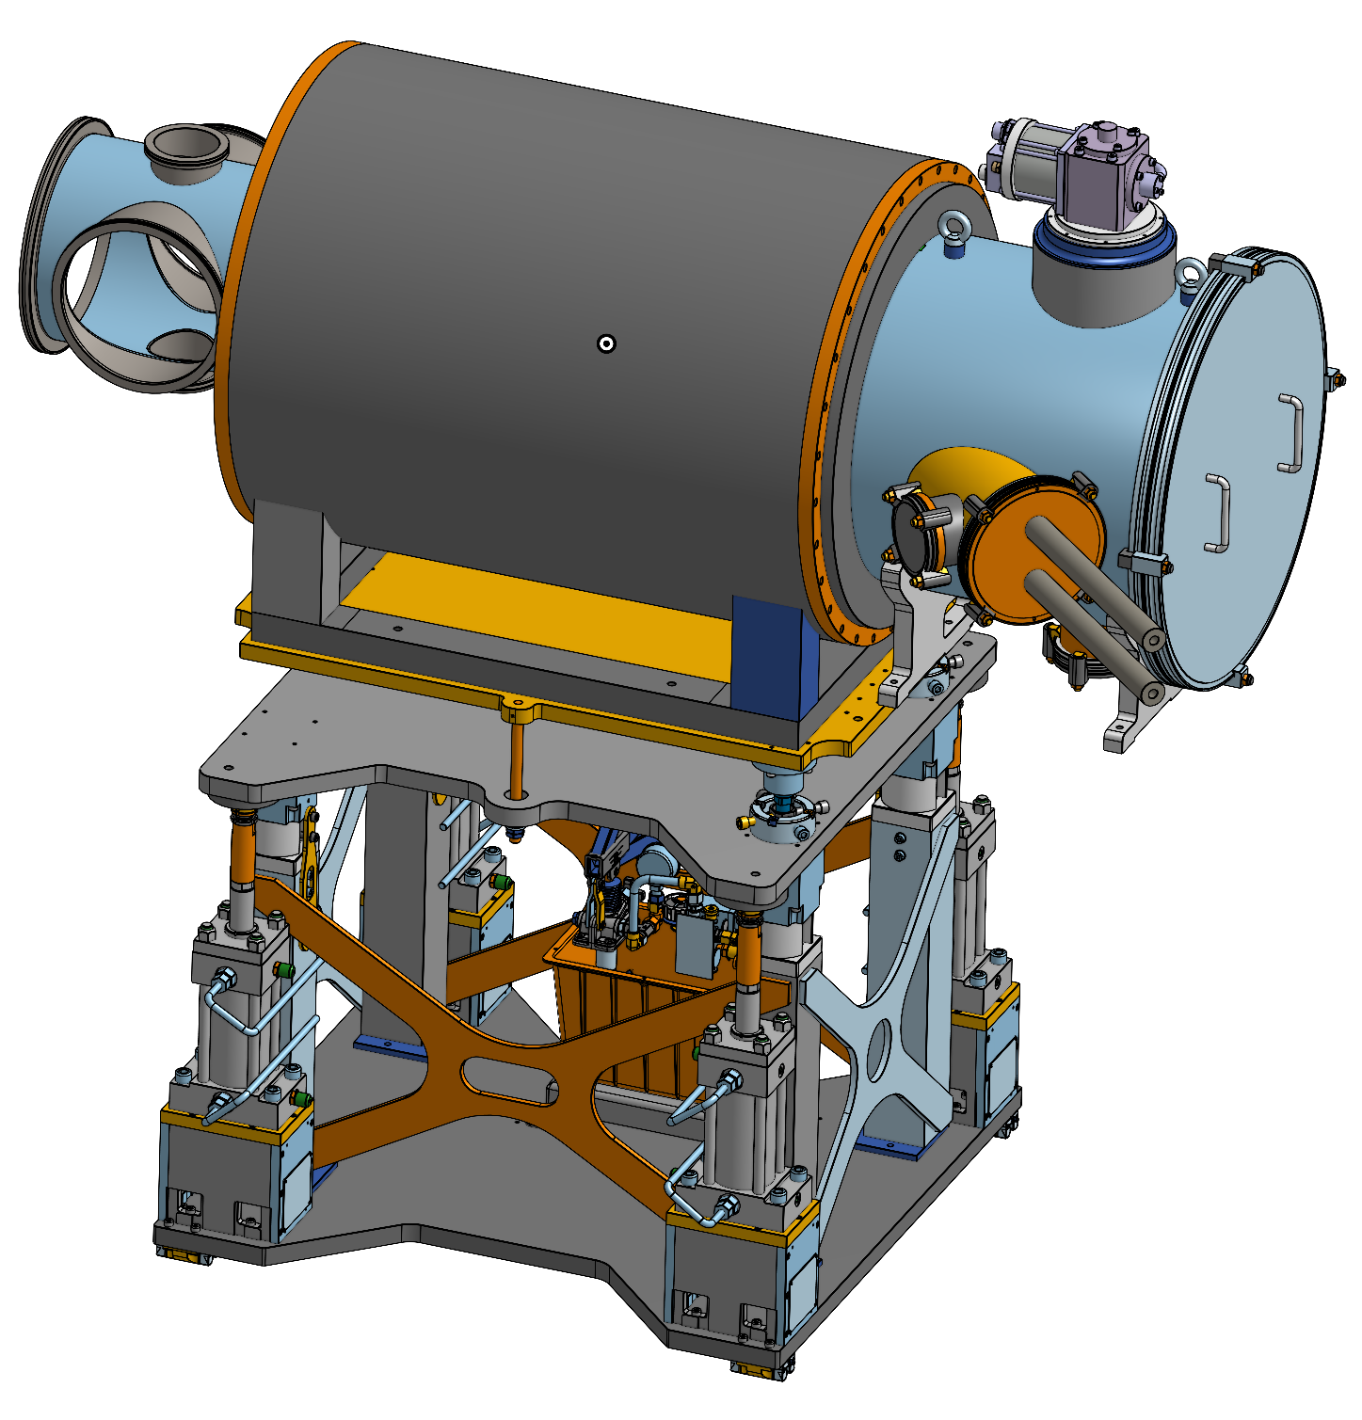
The Experiment - Phase-1 Parts
4K Cryo cooler
Vacuum cross for services
SC storage magnet
Cryostat in vacuum
Off-axis Injection tubes
Magnet lifter

Slide 14
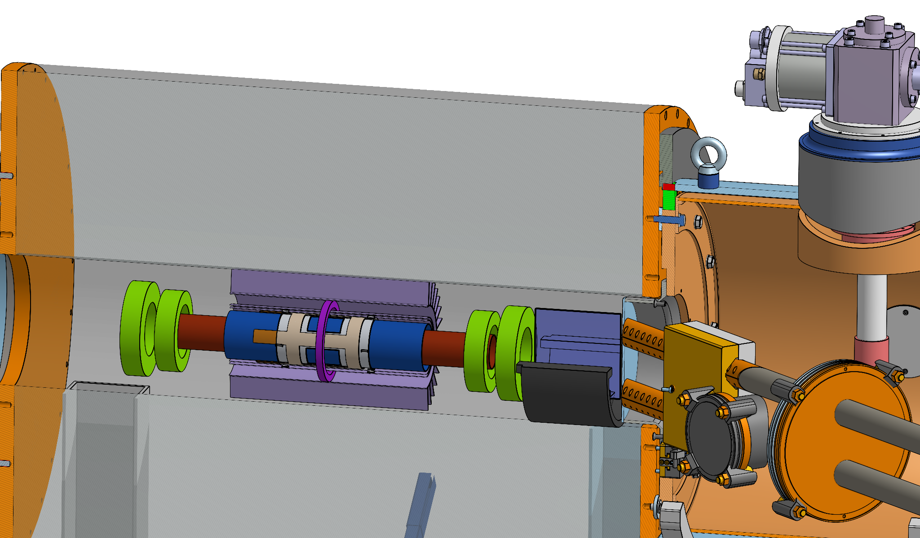
The Experiment - Phase-1 Parts - Inside
Water cooled correcting coils
Magnetic kicker
SciFi Tracker
Trigger detector
SC tubes
HV electrode
Weakly focusing coil
GND shell
Magnetic steel tubes

Slide 15
Introduction & Motivation
Collaboration Overview
Schedule and Beam Time Request

Slide 16
modifies
MoU
defines
reports /
request
Two Co-Spokespersons
(One from PSI)
Representation of collaboration
CHRISP (PSI)
Science council
Collaboration board
(one representative per institution;
takes decisions on organization, structure, and strategy, chaired by elected member)
elects
accepts /
advices
P. Schmidt-Wellenburg
A. Papa
Magnetic fields
elects
elects
advices
CB Chair
Numerical
methods
C. Calzolaio
M. Giovannozzi
Electric field
J. Price
Coordination officers
Task managers
Analysis
P. Schmidt-
Wellenburg
tbd
Mechanics
Cryogenics
Muon
detection
Aux
detectors
Positron detection
Beam line
DAQ
Electronics
M. Hildebrandt
P. Schmidt-
Wellenburg
K.S. Khaw
F. Renga
A. Papa
M. Giovannozzi
L. Galli
D. Sanz-Becerra

Slide 17
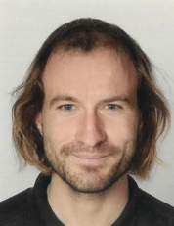

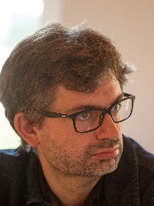




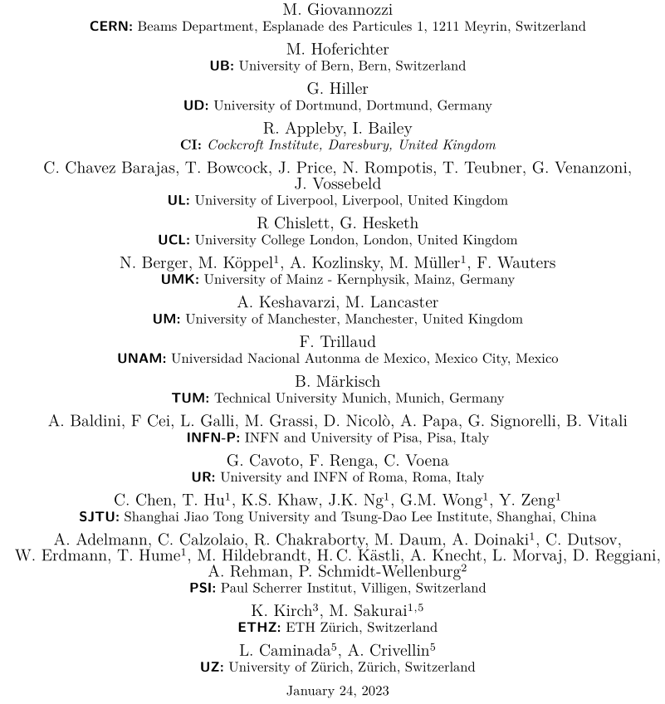
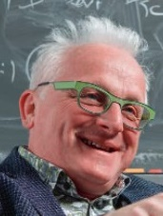
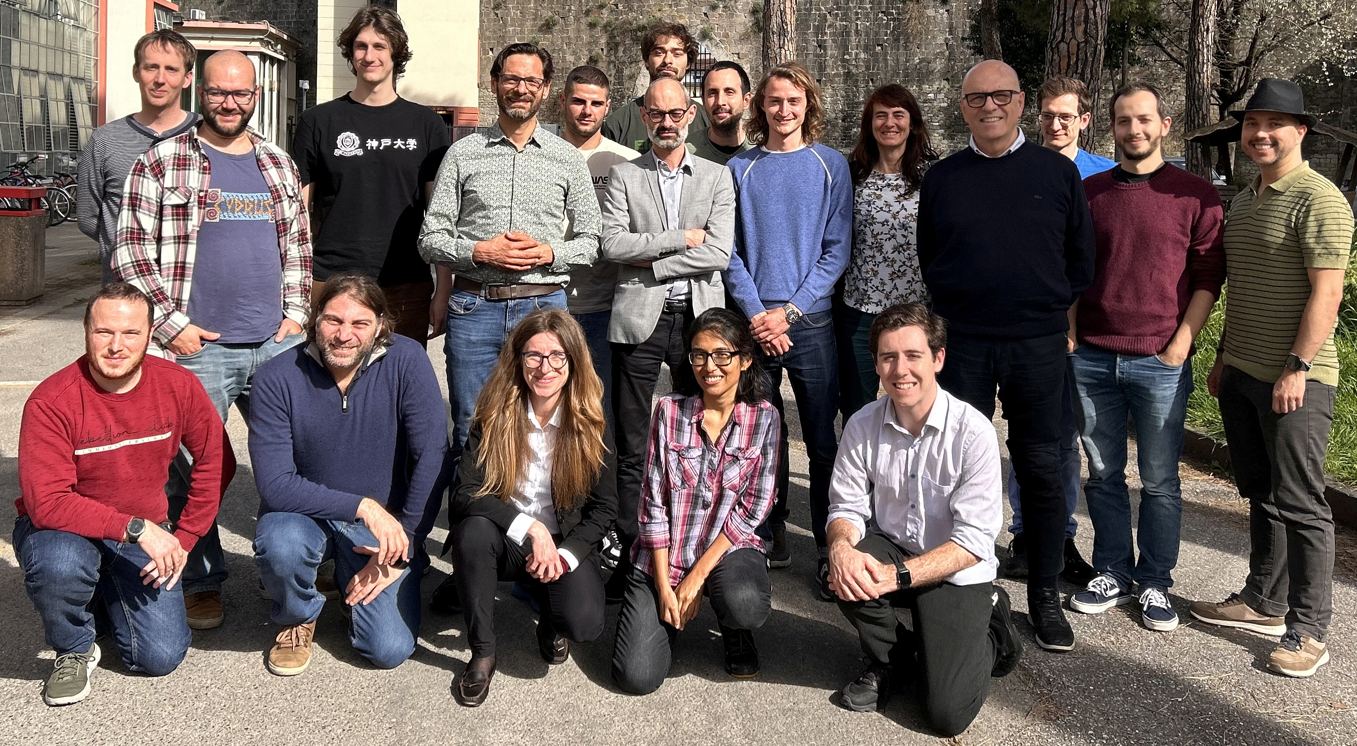
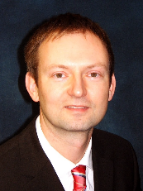
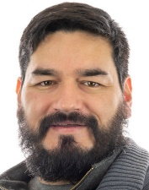






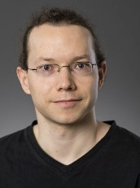
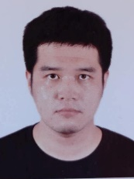
The collaboration open for participation
PSI proposal R-21-02.1

Slide 18
Introduction & Motivation
Collaboration Overview
Schedule and Beam Time Request

Slide 19
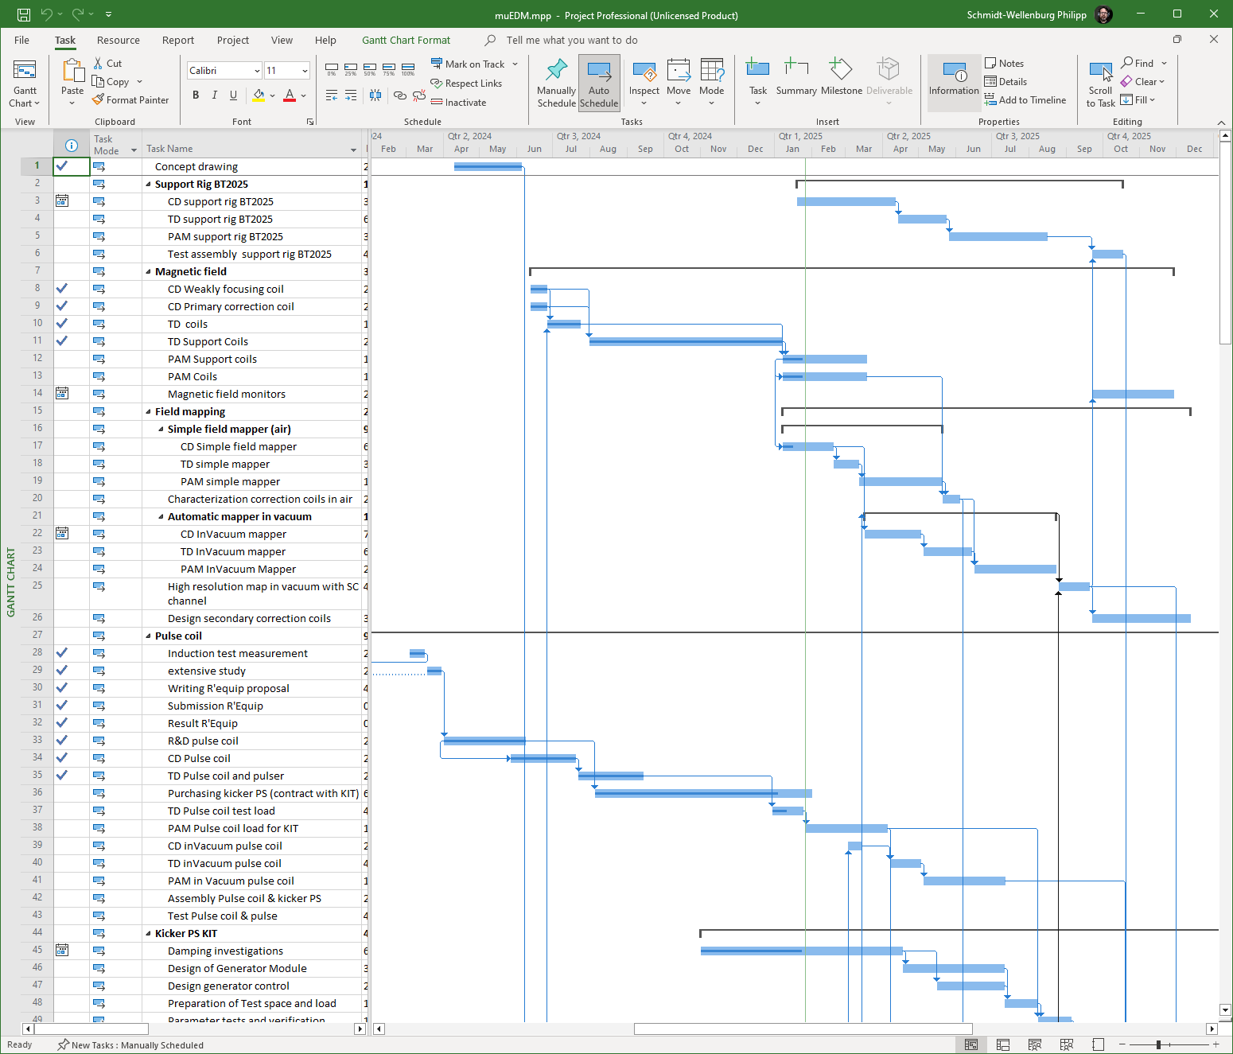
Full interdependent project plan
A total of 211 individual tasks
  Subdivided into phases
    Concept Phase (mostly concluded)
    Technical Design
    Procurement and manufacturing
    Assembly
    Commissioning
Progress is monitored in regular meetings
Regular update of high level plan

Slide 20
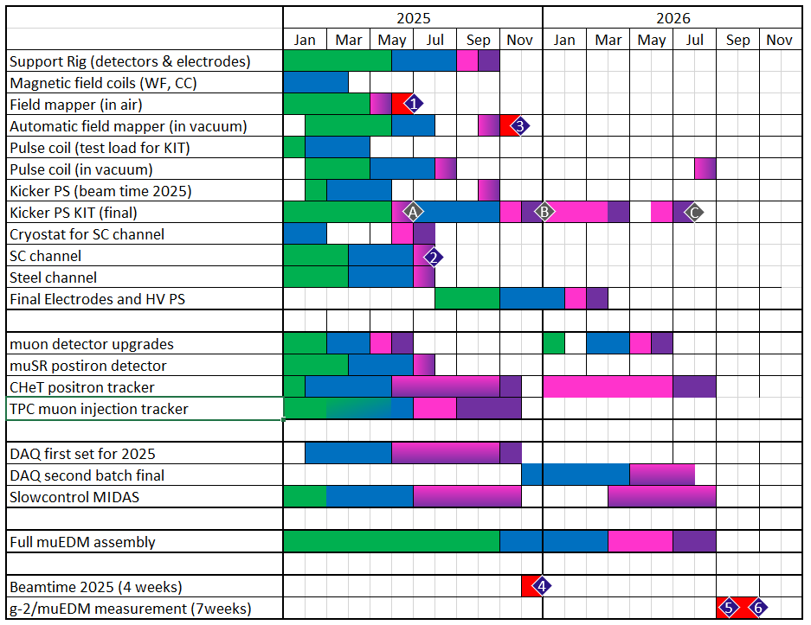
Top level plan for 2025 / 2026
2025: Demonstration of
critical methods and techniques
  Preparation of magnetic field
  Preparation of kicker field (preliminary)
  Preparation of cryogenic injection
  Preparation of positron detection
  Preparation of TPC injection tracker
  Preparation of FRES DAQ system
2026: Prepapartion and demonstration of
g-2/muEDM measurement
Design (Concept and technical)
Procurement and manufacturing
Assembly
Commissioning
Measurements

Slide 21
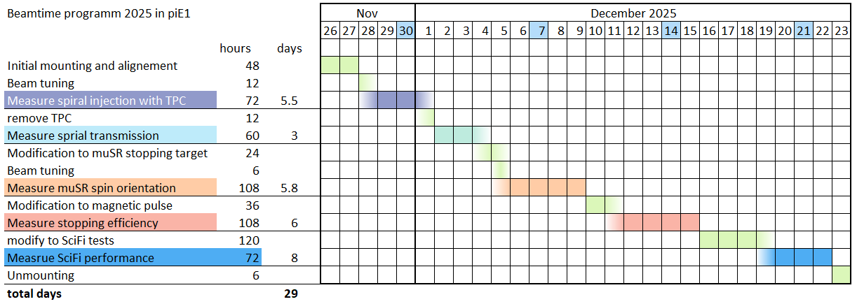
Test beam 2025

