Slide 1

Status of the superconducting injection channels for the muEDM experiment
Pranas Juknevicius
BVR56 2025-02-10

Slide 2
Outline
Overview
Thermal simulation of superconducting injection channels
Magnetic field shielding simulation
Magnetic field shielding and force measurement at LHe
Conclusions

Slide 3
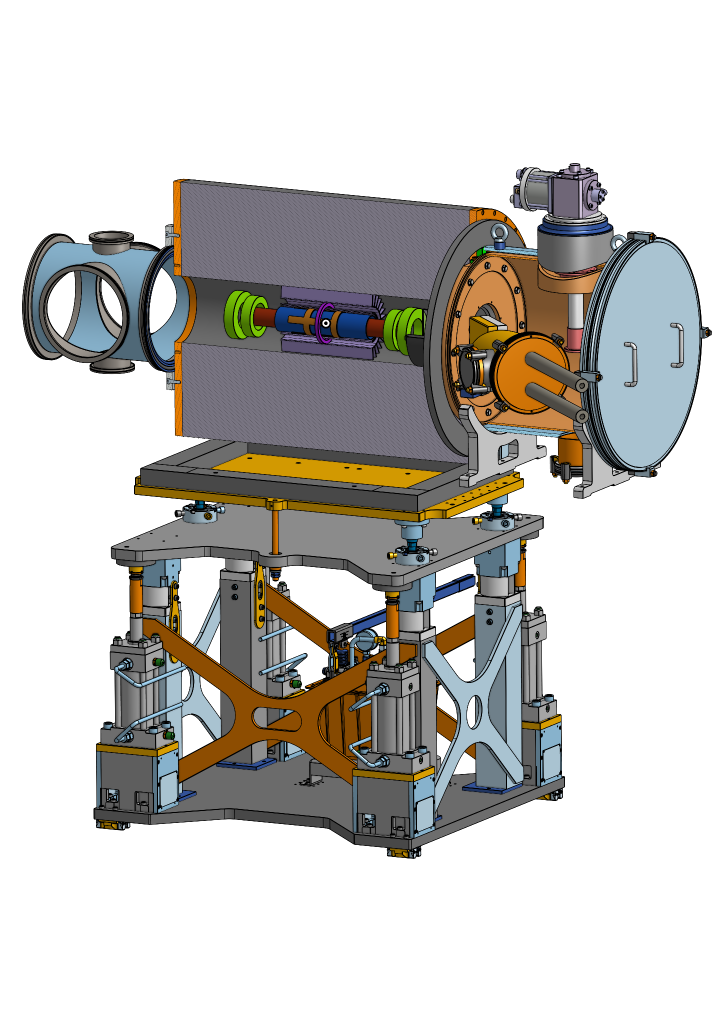
Sc injection tube holder (in production) ✓
Objectives for the superconducting injection channels
Injecting muons into the bore of the 3T solenoid magnet requires penetrating the fringe field. This can be achieved by guiding the muons using superconducting hollow tubes.
Muon storage and injection studies show that successful storage can be achieved, when inner B field transversal components < 100 mT.
Superconductors must be cooled below critical temperatures at operation.
Cryostat head (RDK-408D2) ✓
Injection channels (iron tubes + sc tubes) ✓

Slide 4
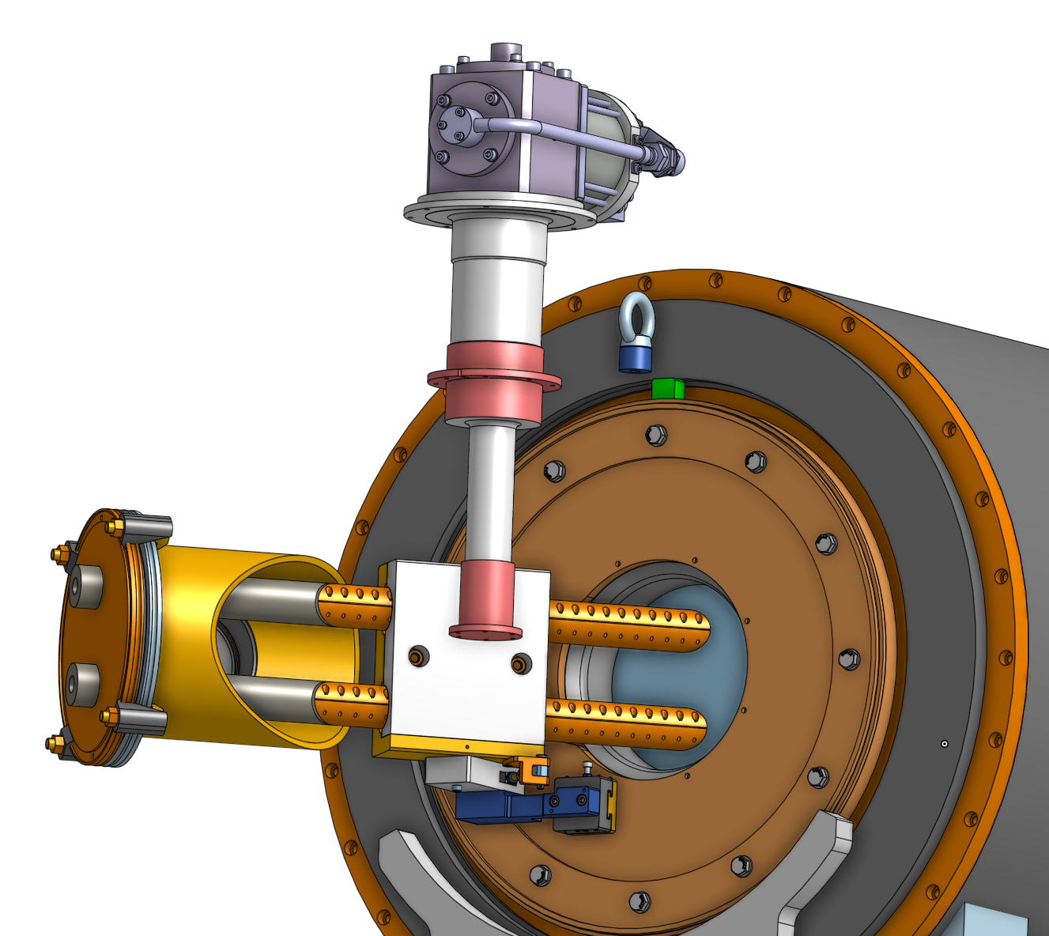
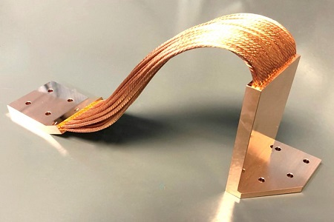
Cryostat head (SRDK-408D2) ✓
Injection channels (copper tubes + sc tubes) ✓
Sc injection tube holder (in production) ✓
Thanks to Mike G. and Diego B. for the drawing.

Slide 5
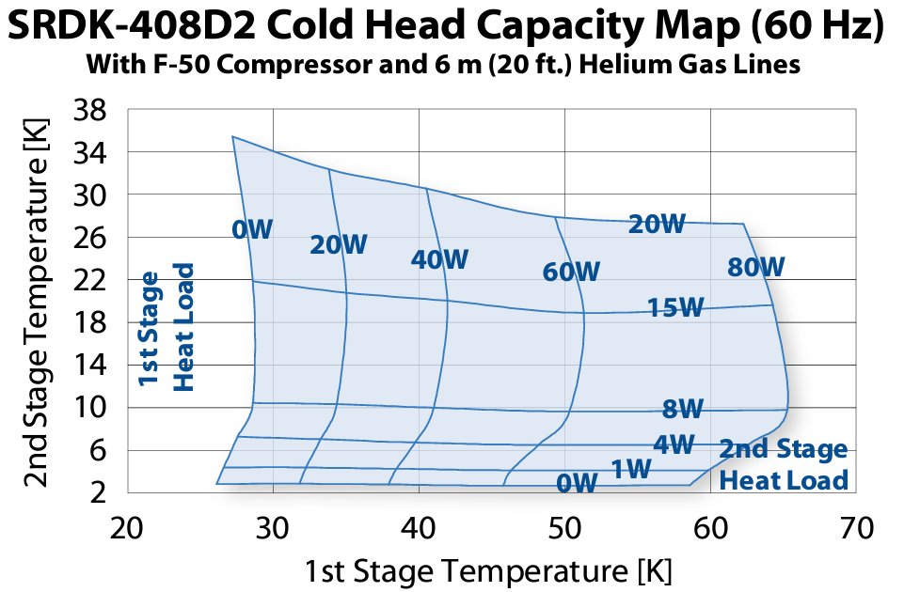
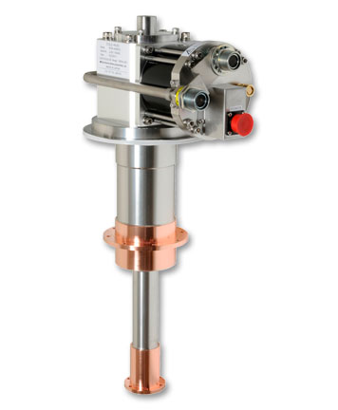

SRDK-408D2 Cold head ✓
Cryostat production finishes in February
1st stage
2nd stage
Certified inspection test:
1st stage: 50W at 35.7K
2nd stage: 1W at 3.83K
Therefore we use these parameters as reference values simulation.

Slide 6
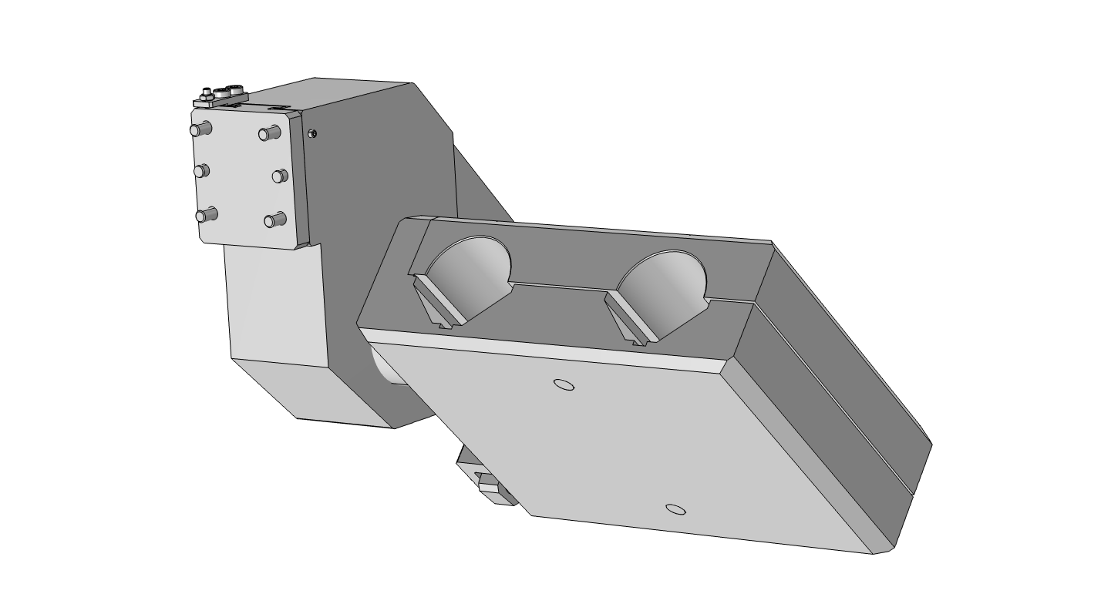
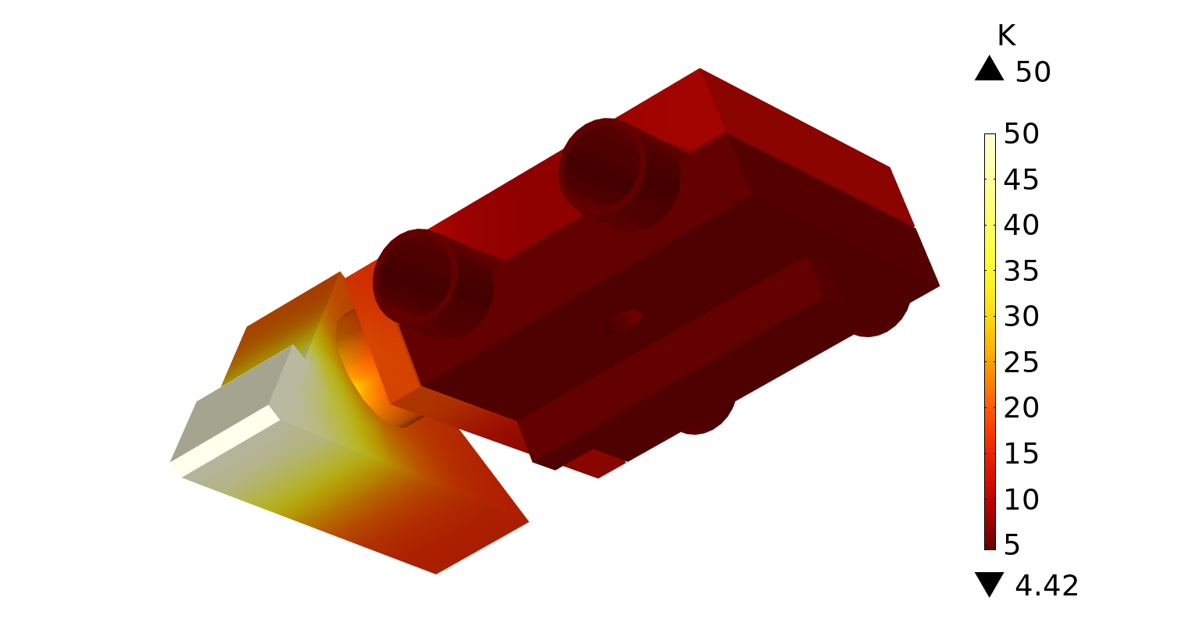
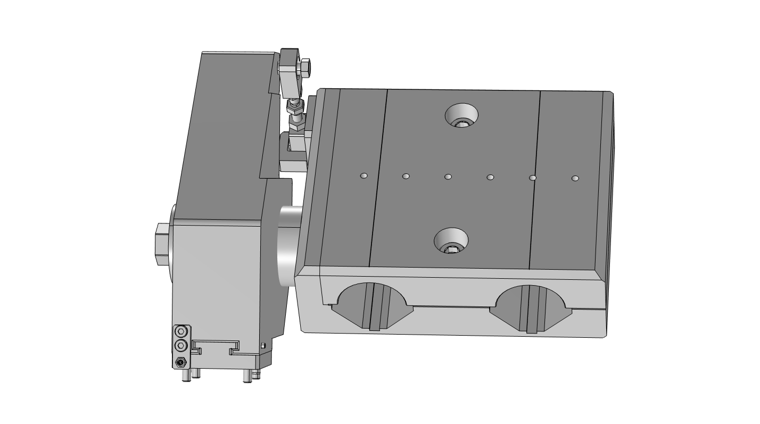
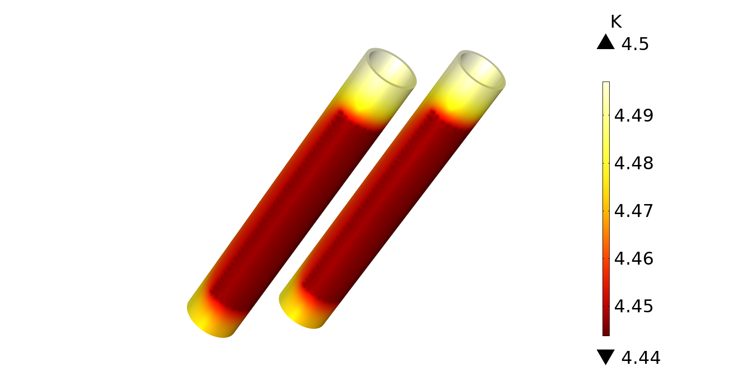
50K thermal contact
PEEK
Copper
2st stage: 1W at 3.83K + Cu braids
T = 4.46 K, dT < 0.1K

Slide 7
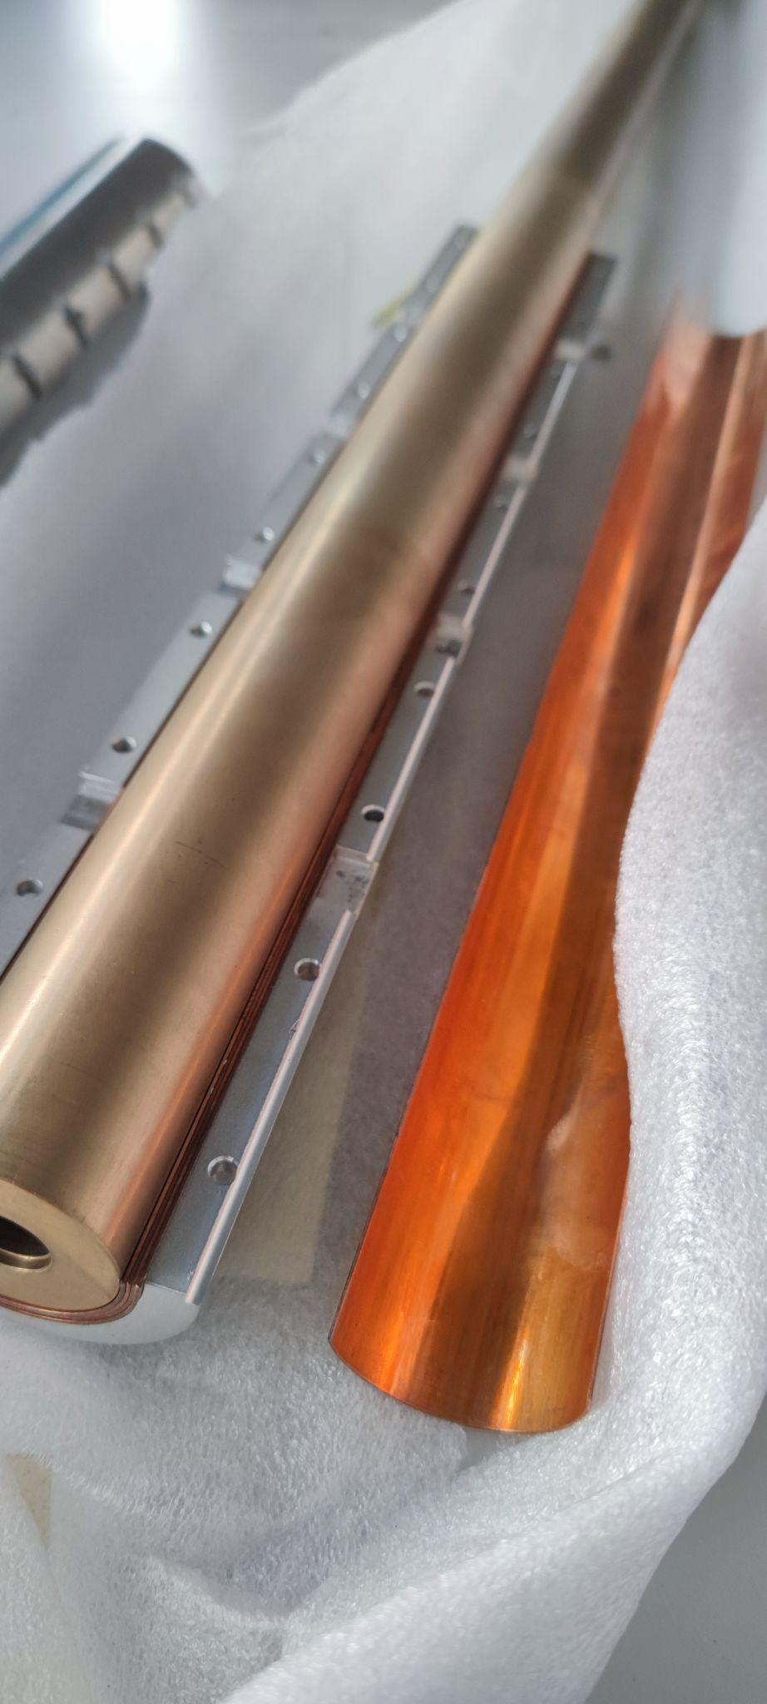
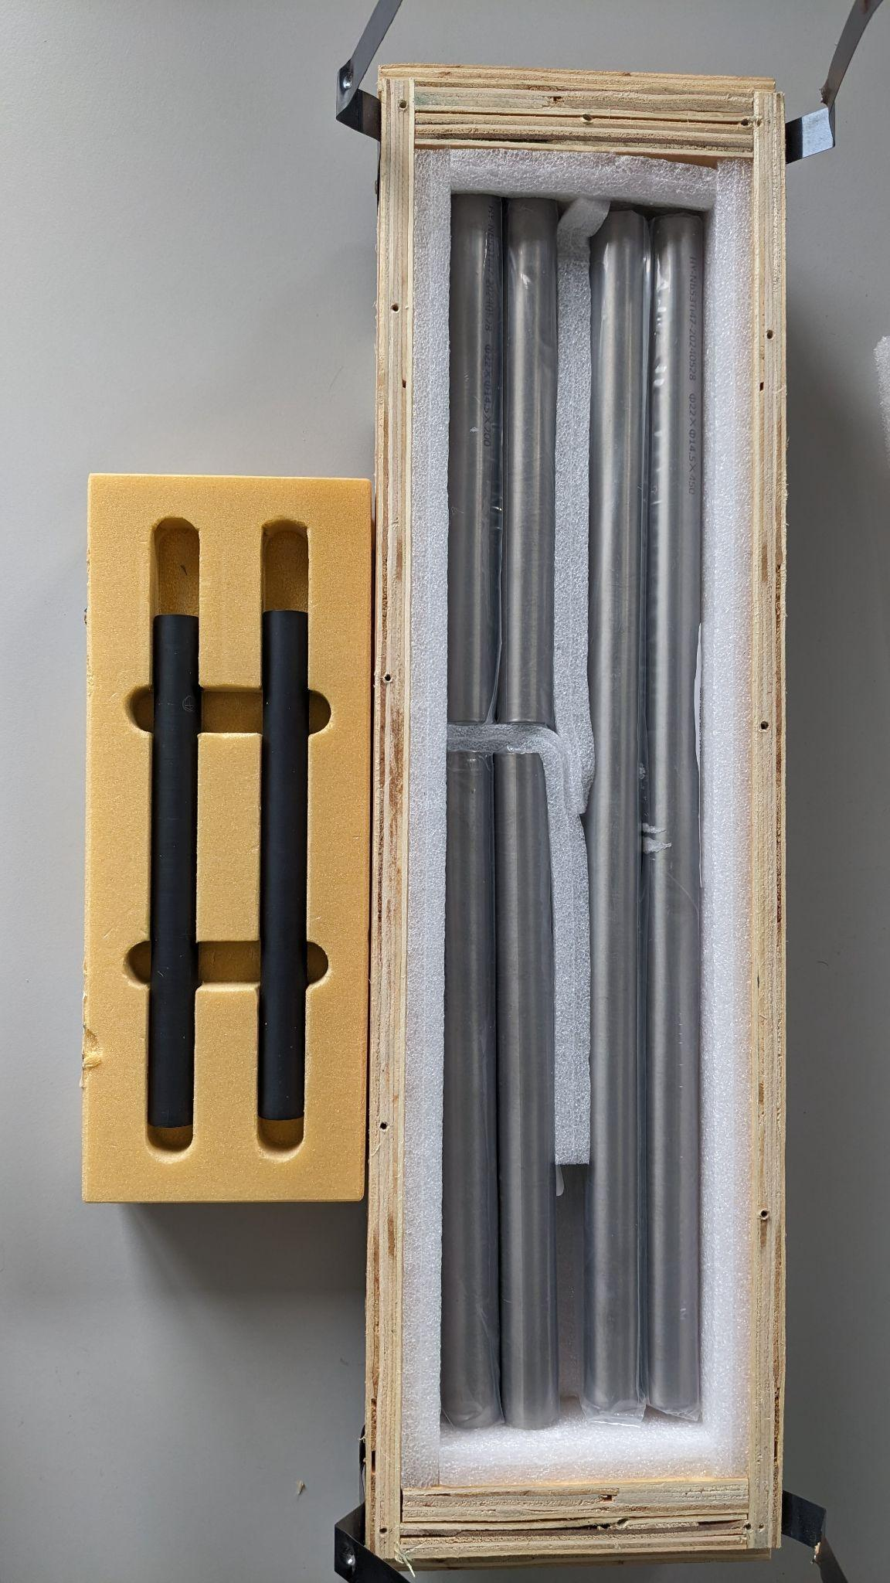
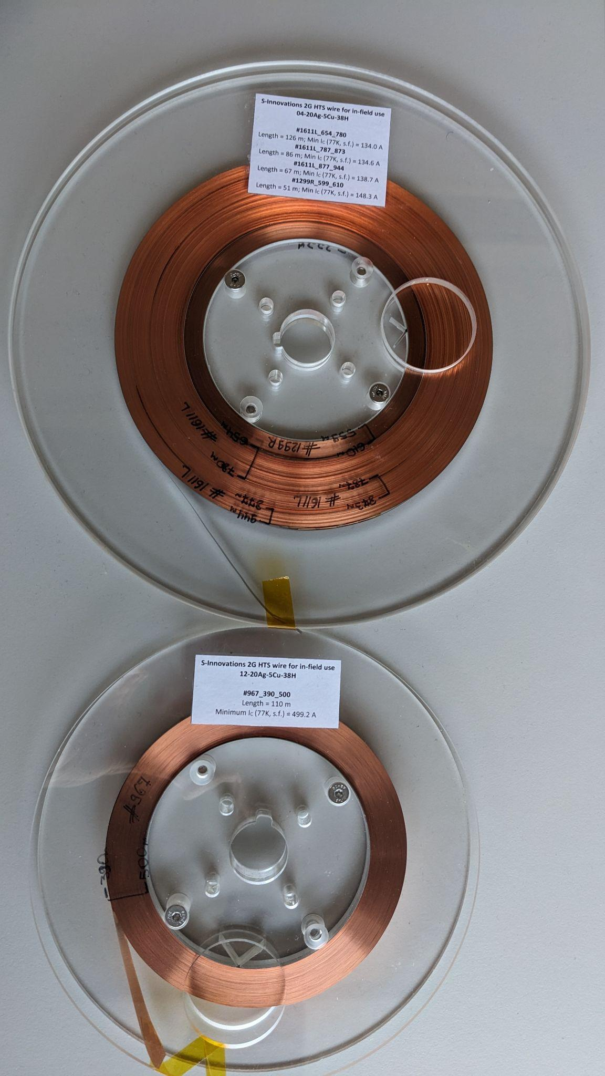
NbTi/Nb/Cu layered sheets
Used at CERN to successfully shield magnetic field up to 3.1T at 4.2K see ref: 10.1109/TASC.2018.2872860
Bismuth strontium calcium copper oxide (BSCCO2223)
S-Innovations 2G HTS tape 04-20Ag-5Cu-38H
Nb-47Ti

Slide 8
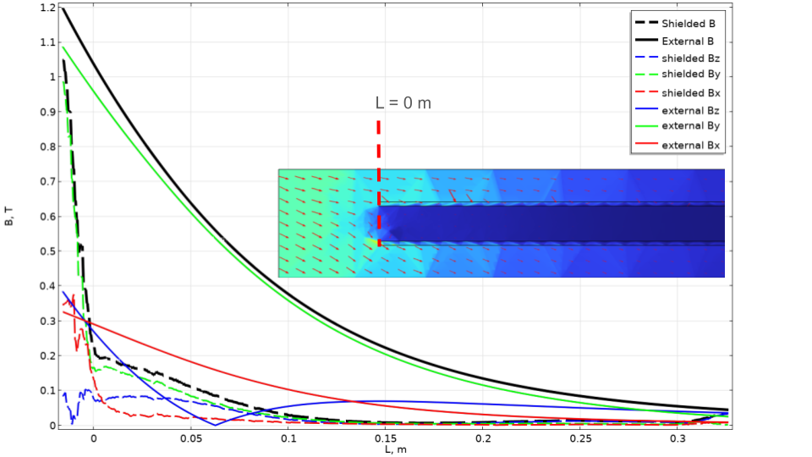
Muon storage simulations show that successful storage can be achieved, when B field transversal components < 100 mT.

Slide 9
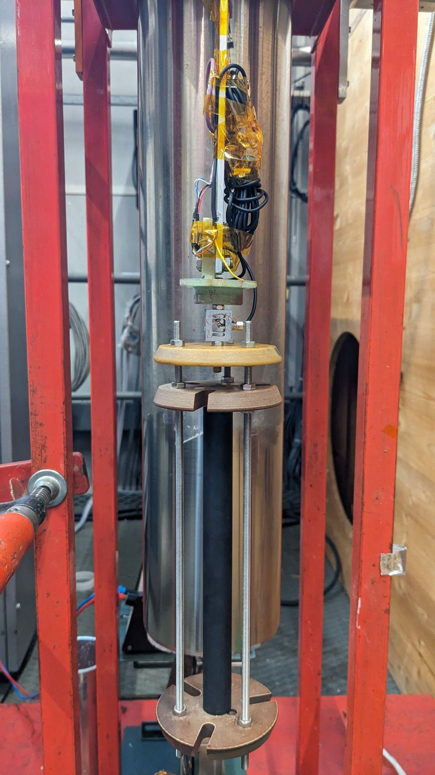
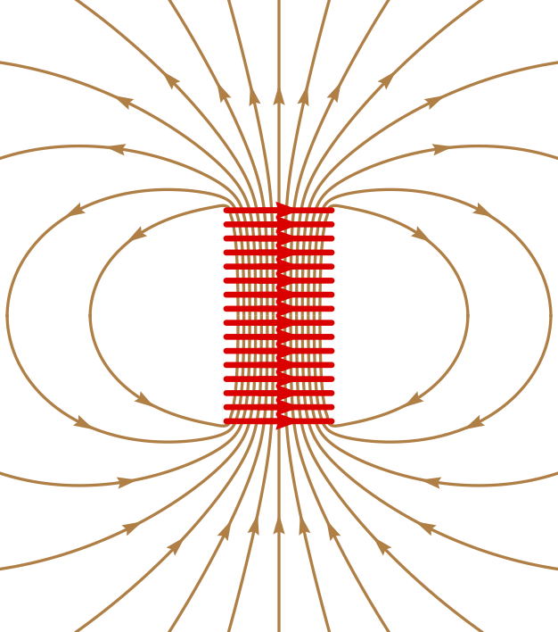
Magnetic field shielding and force measurement
Measurements performed with BSCCO2223 and Nb-47Ti superconducting tubes at LHe
Measured only axial force and axial magnetic field component
Sc tube
Solenoid magnet
Force sensor
Hall sensor
BSCCO2223

Slide 10
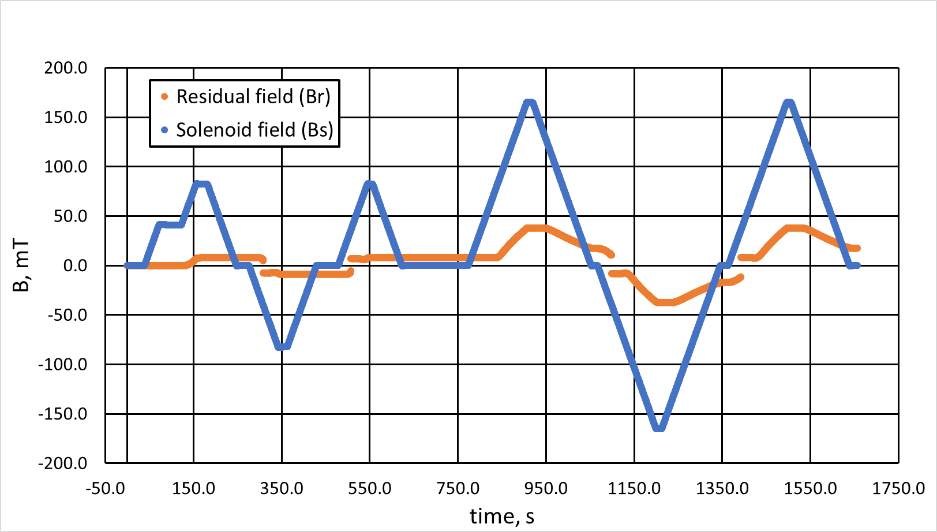
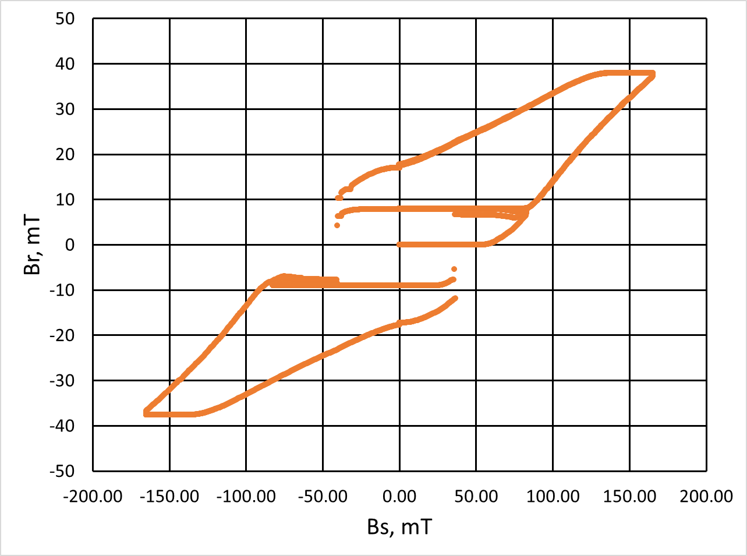
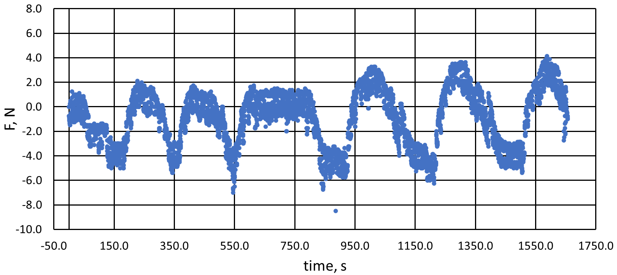
Nb-47Ti tube measurement
Fully shielded up to 60 mT
SF = Bs/Br = 4.6 at 165 mT
F = 5N @Bs = 165 mT and Br = 37 mT
(expected F = 15N @ Bs = 165mT)

Slide 11
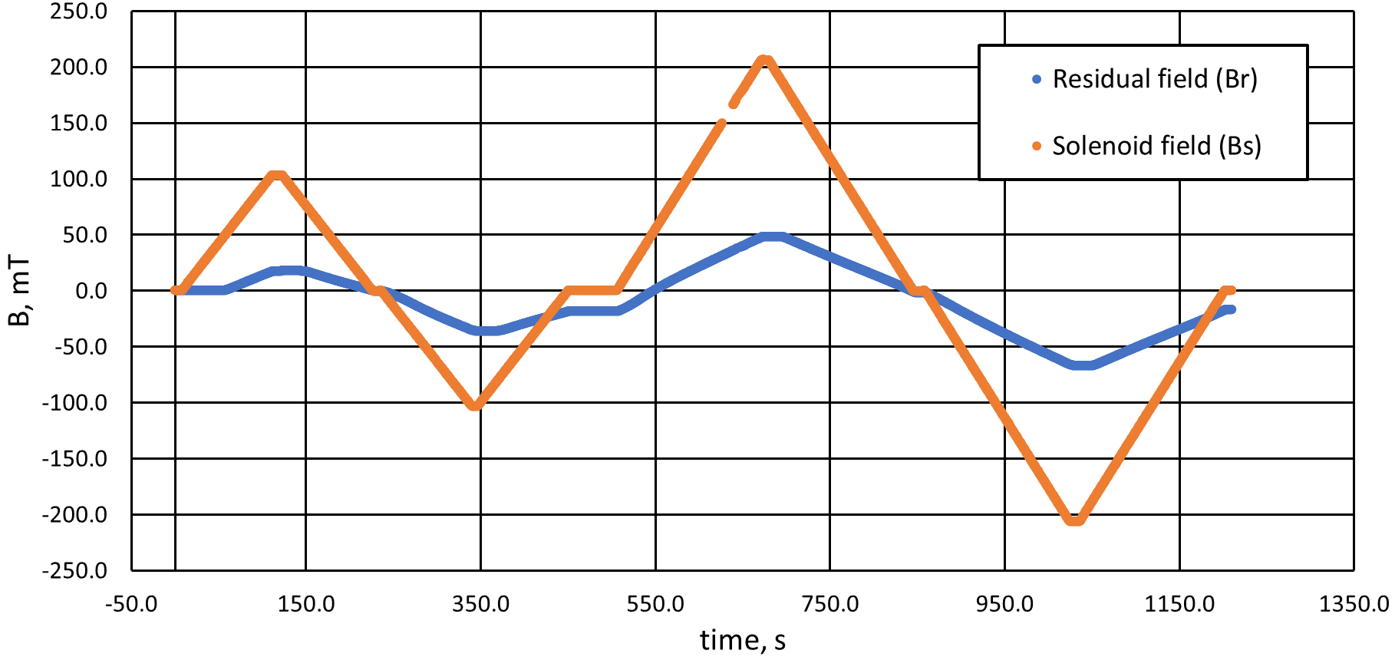
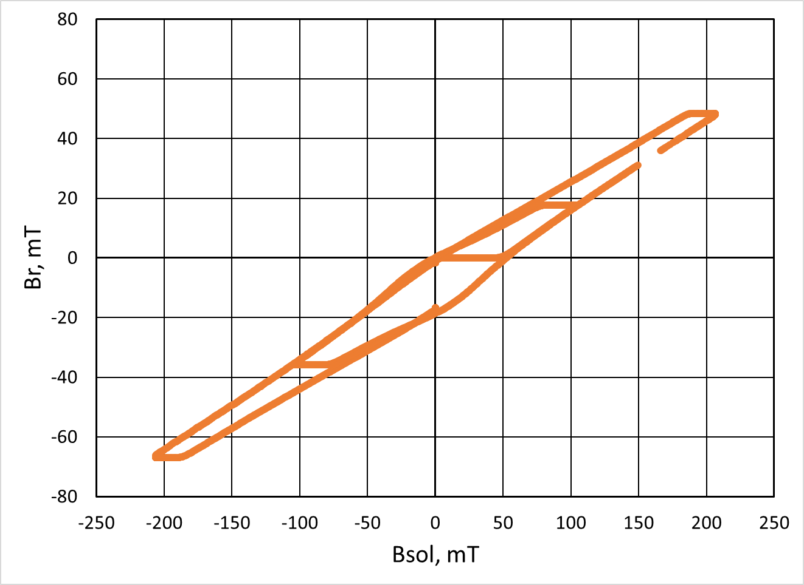
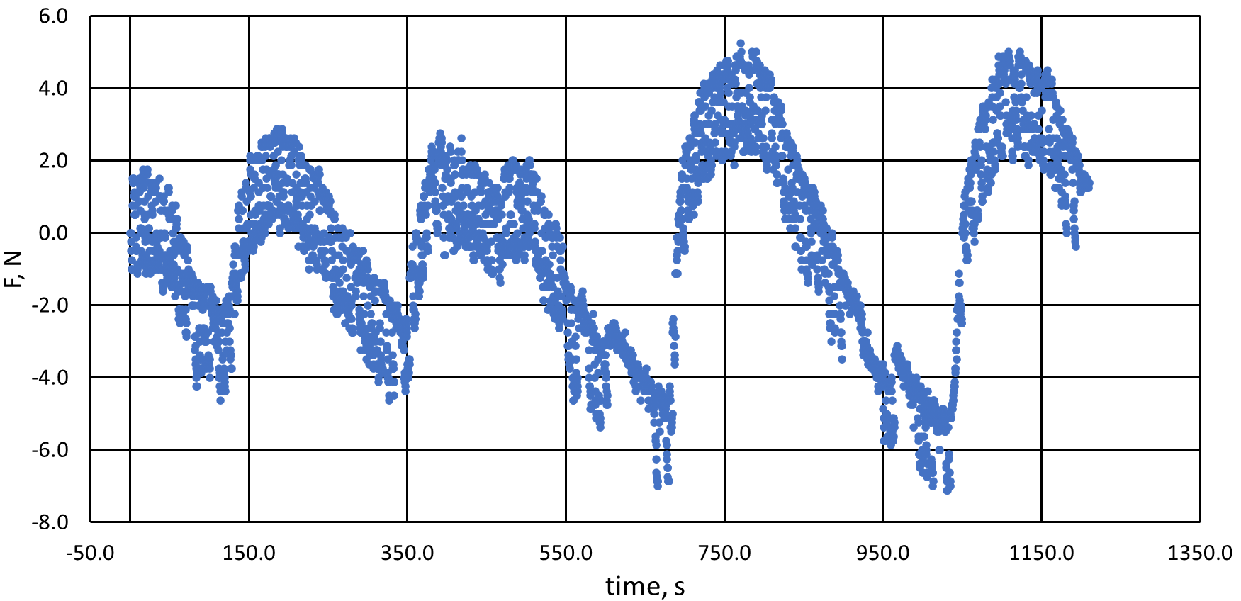
BSCCO2223 tube measurement
Fully shielded up to 52mT at 4.2K
  S Denis et al 2007 reported full shielded up to 14mT at 77K ref: 10.1088/0953-2048/20/3/014
SF = 4.2 at 200 mT
F = 4N @ Bs = 200 mT and Br = 50 mT
(expected F = 17N @Bs = 200mT)

Slide 12
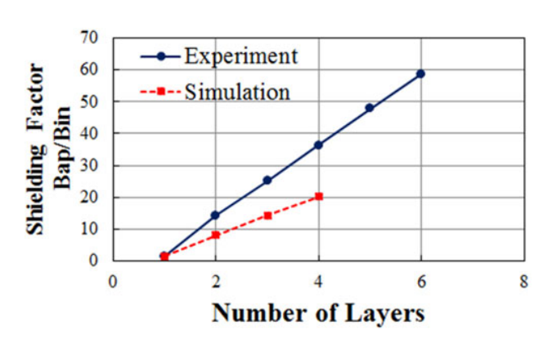
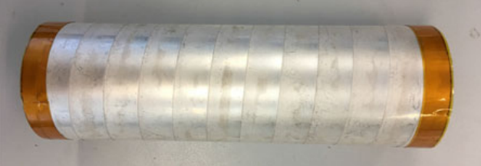
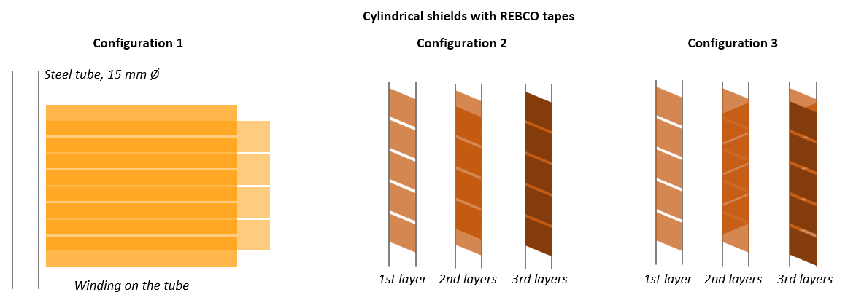
Figure taken from Y. Nagasaki et al 2018
Ref: 10.1109/TASC.2018.2808374
Image taken from Y. Nagasaki et al 2018
Ref: 10.1109/TASC.2018.2808374

Slide 13
Conclusions
Using COMSOL Multiphysics thermal simulations designed injection channel holders with sufficient cooling power and thermal properties to reach subcritical temperature for the superconducting injection channels.
Using COMSOL Multiphysics verified that magnetic field transversal components remain under 100 mT for the particle path along the injection channels.
Measured the magnetic field shielding and forces of BSCCO2223 and NbTi hollow tubes at 4.2K.
Next step is to design and investigate magnetic field shields using layered NbTi/Ti/Cu sheets, HTS tapes and combinations of different materials.

Slide 14
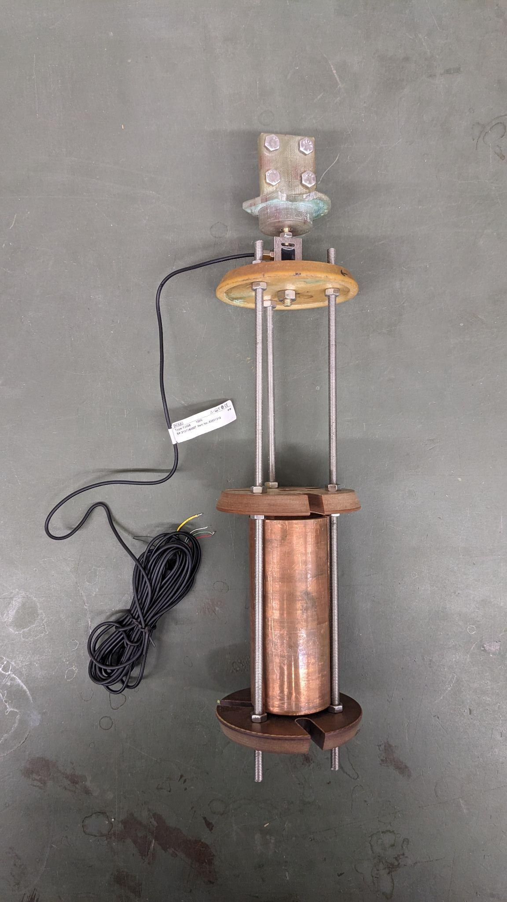
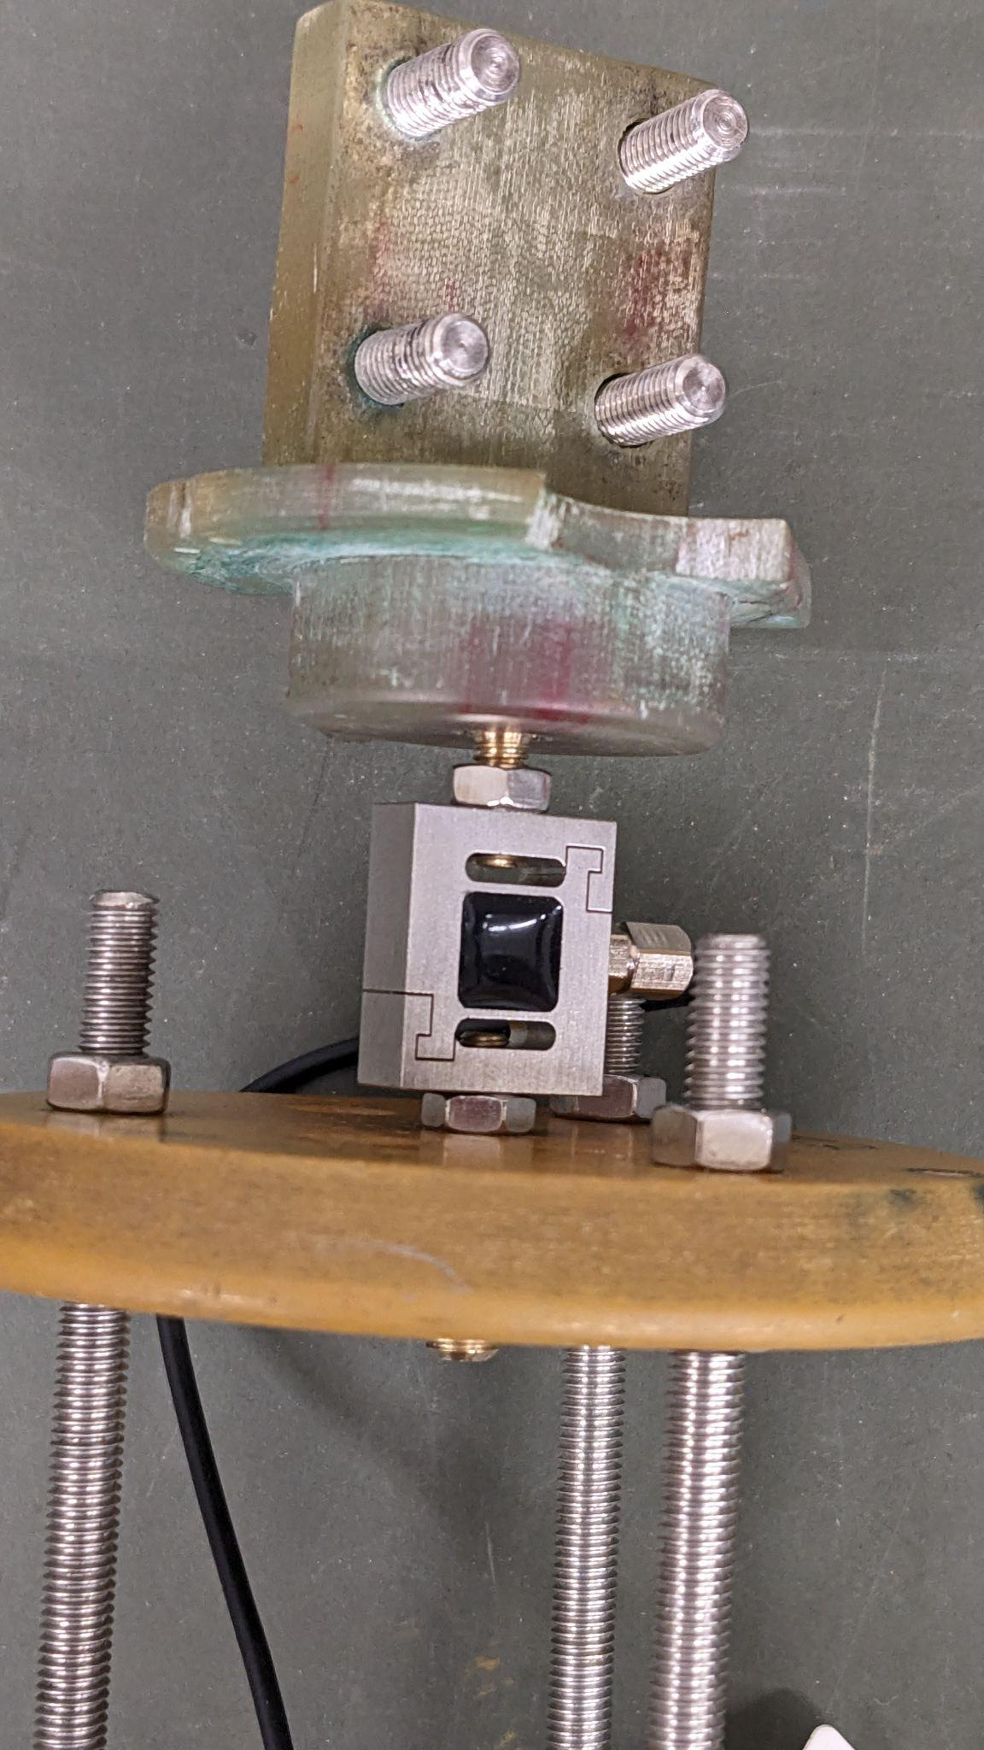
Magnetic field shielding and force measurement
FS28082210068-100N force sensor
Max load 100N
Sensitivity 2N
According to simulations at B = 250 mT expected F = 46N
Hall sensors and force sensor were calibrated at LN

Slide 15
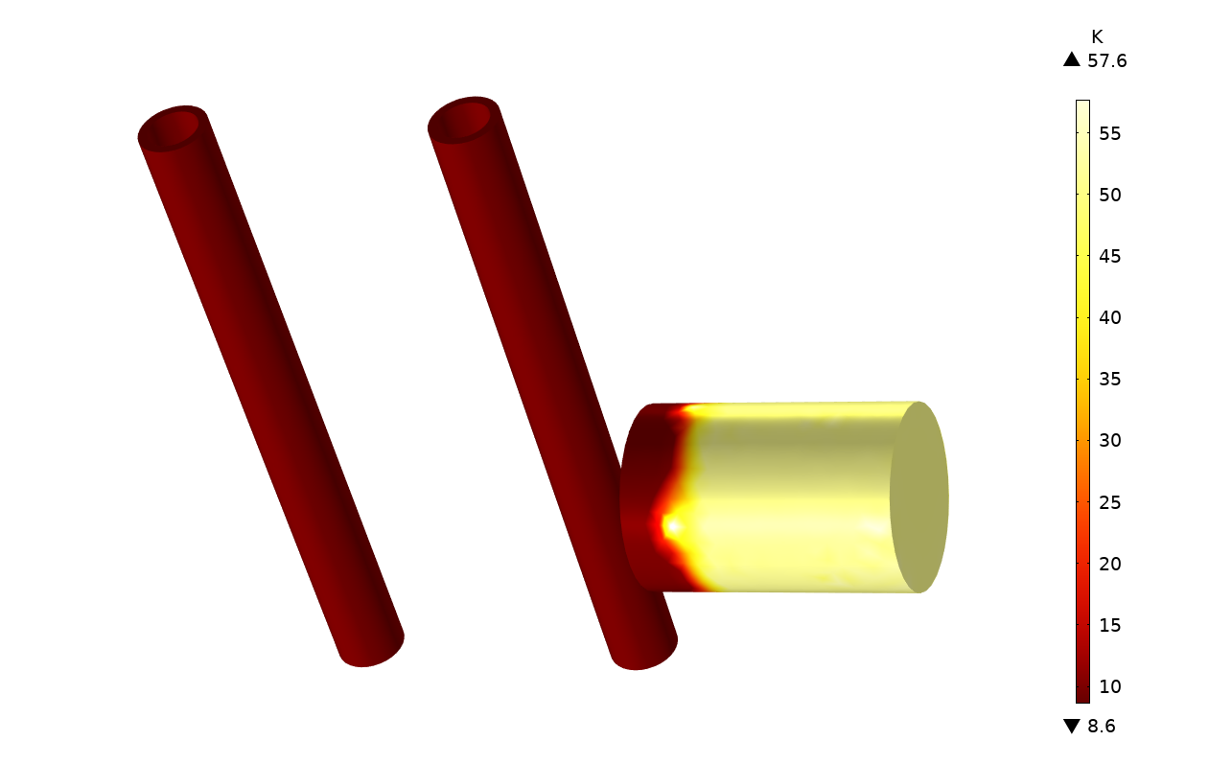
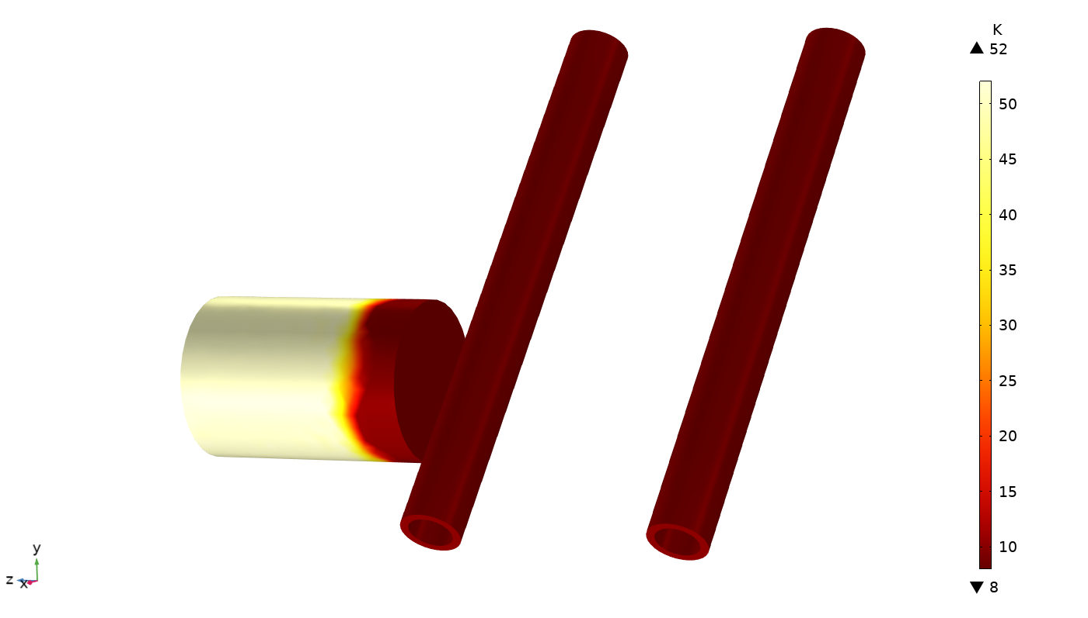
NbTi sc tubes + PEEK cylinder
BSCCO2223 sc tubes + PEEK cylinder
T = 9.1K, dT < 0.1K
T = 9.5K, dT < 0.2K
Thermal simulation of the superconducting injection tubes. We assumed 8W cooling power and used PEEK cylinder in the sc tube holder with Nb-47Ti tubes. We assumed an isotropic thermal conductivity of k = 25 W/(m K) at 10K.
Thermal simulation of the superconducting injection tubes. We assumed 8W cooling power and used PEEK cylinder in the sc tube holder with BSCCO2223 tubes. Thermal conductivity is anisotropic k = {4,4,10} W/(m K) at 10K.

Slide 16
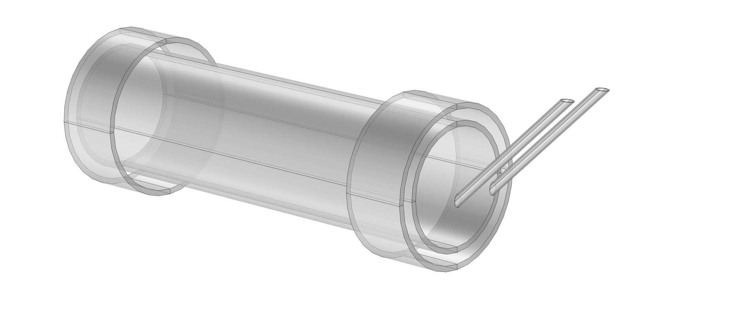
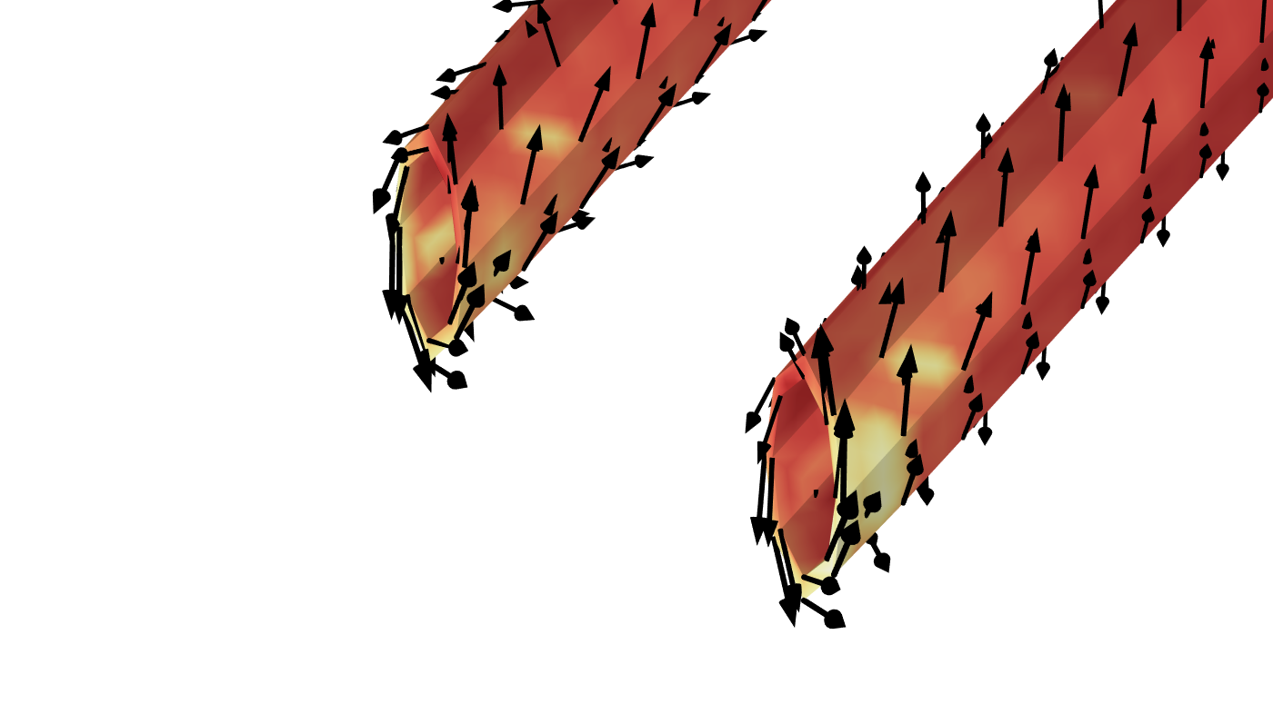
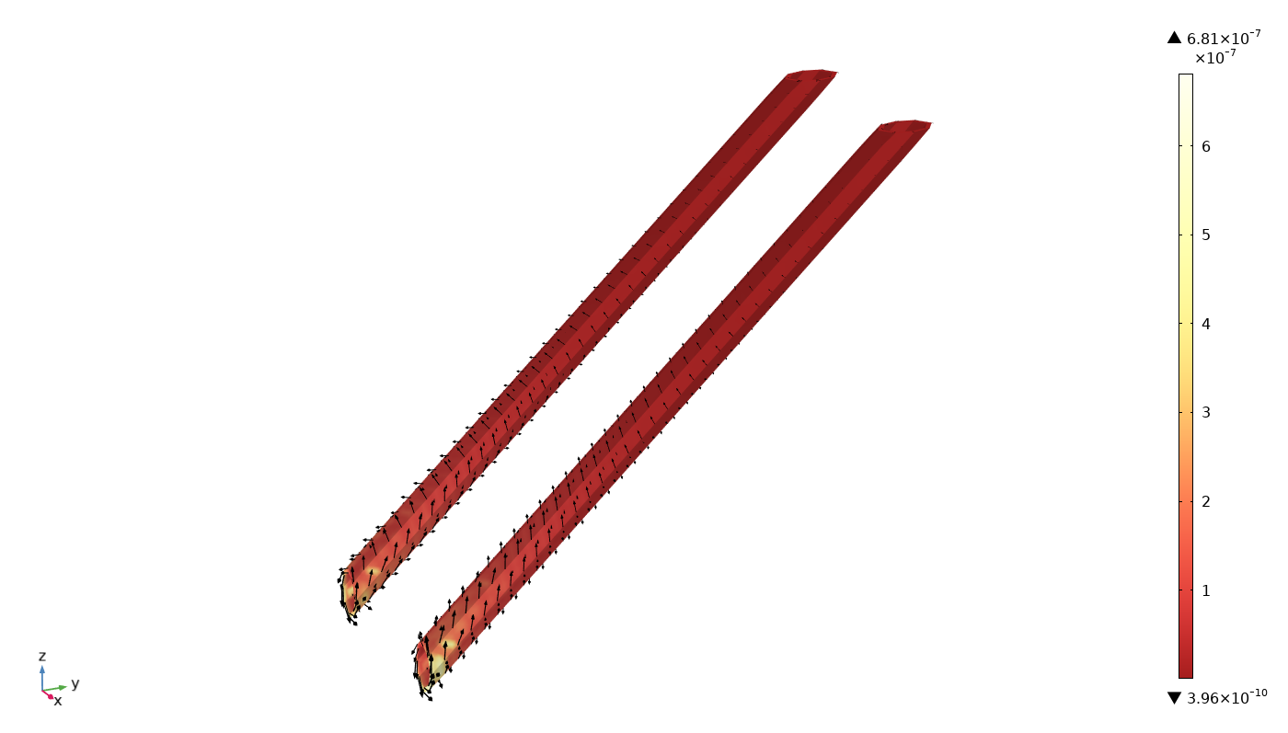
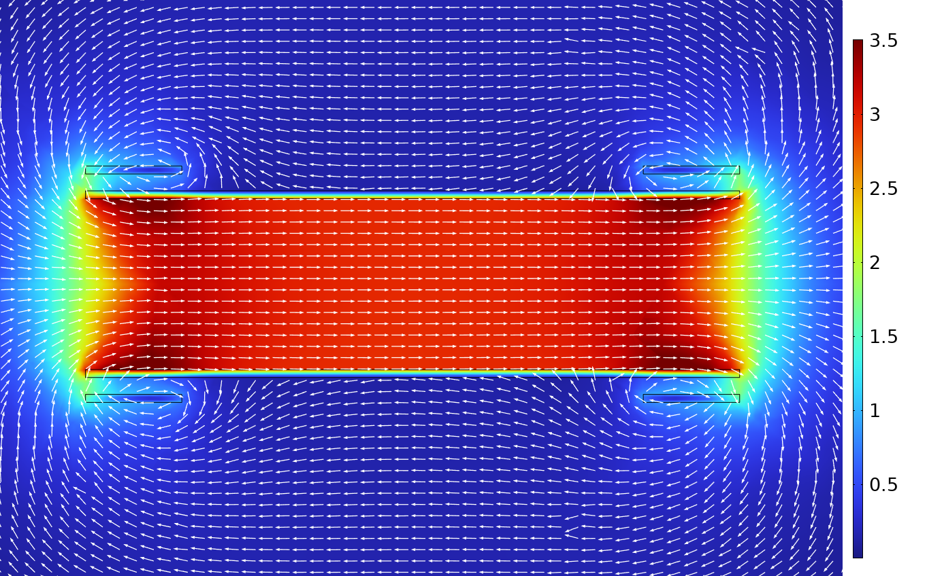
L = 0.342m
Din = 15 mm
Simulated superconducting tubes. The colormap shows the J/J_C , which is the ratio of current density and critical current density at T = 4.2K and B = 3T. The vector maps shows the flow of induced current in the superconductor.

Slide 17
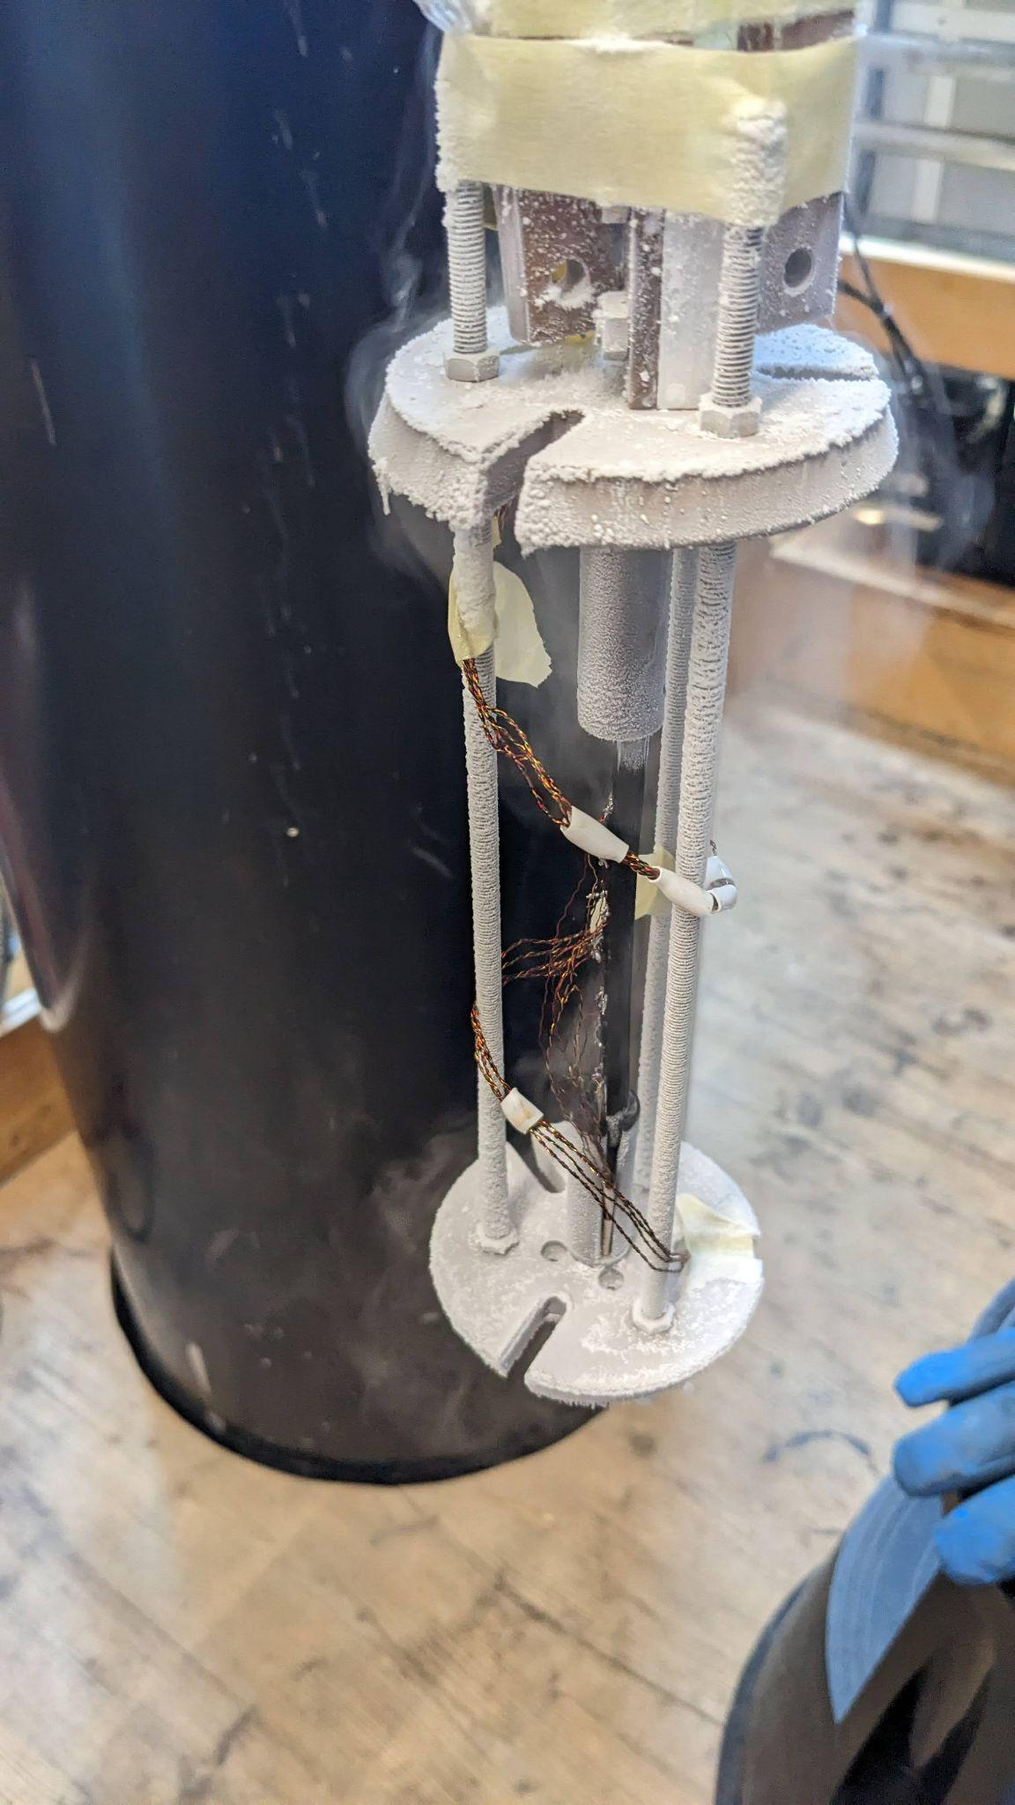
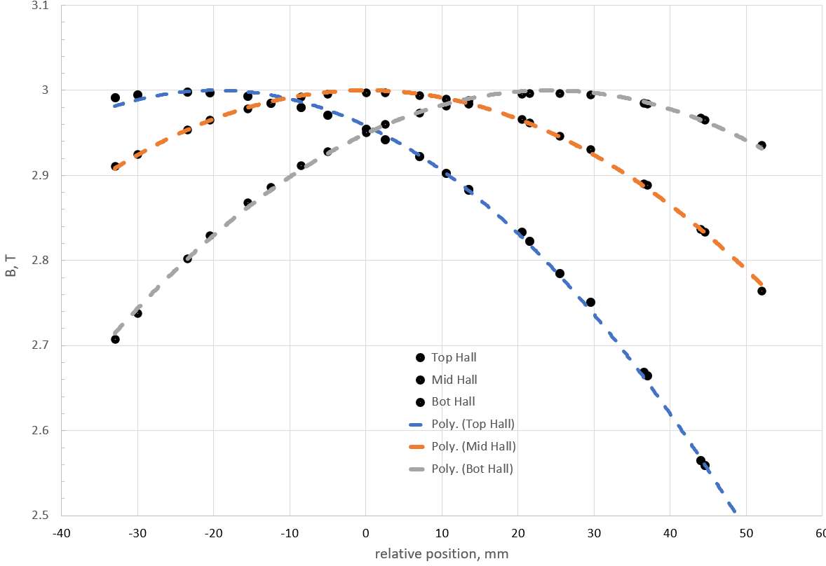
✓ Calibrated Hall sensors + ✓ Force and magnetic field shielding measurement design

Slide 18
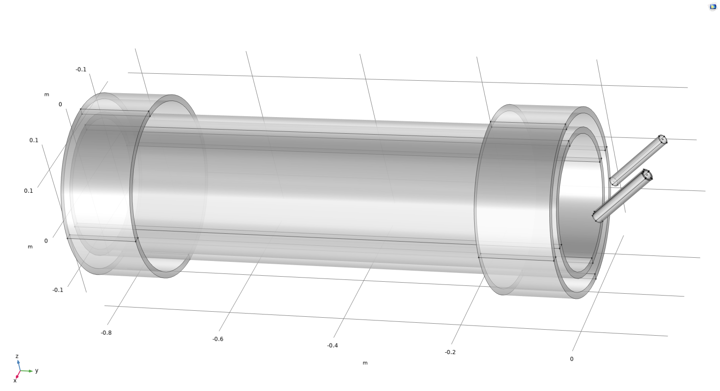
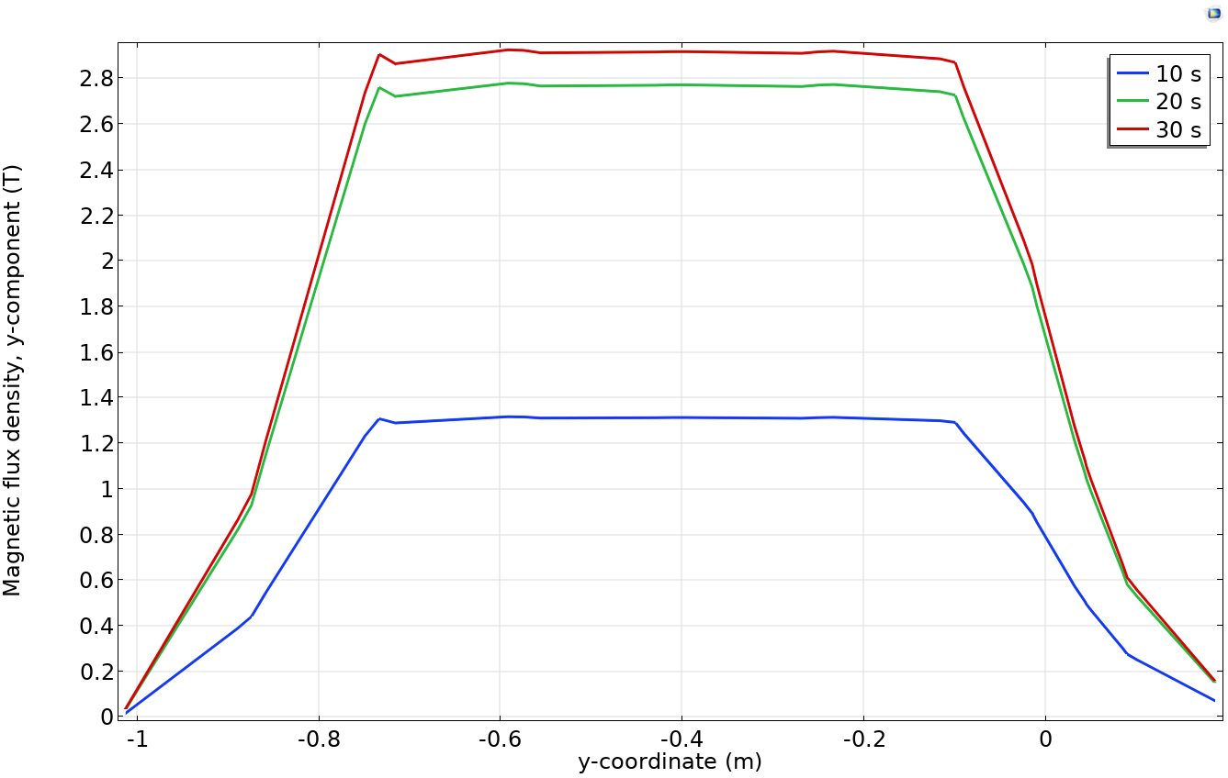
The main coil:
  L = 825.5 mm length
  D = 256.0 mm with 10 mm thickness
The shim coil D = 298.8 mm with 10 mm thickness
  L = 121.6 mm
  D = 256.0 mm with 10 mm thickness
We use Niobium-Titanium superconducting tube
  L = 125mm
  D = 16.5mm with 1mm thickness
Used A-H field formulation for the EM model
EM model is fully coupled to thermal model
The properties of the superconducting materials are described by Jc(T, B)
Simulation run time is 27-42 minutes on 3.4 GHz Quad-Core Intel Core i5

Slide 19
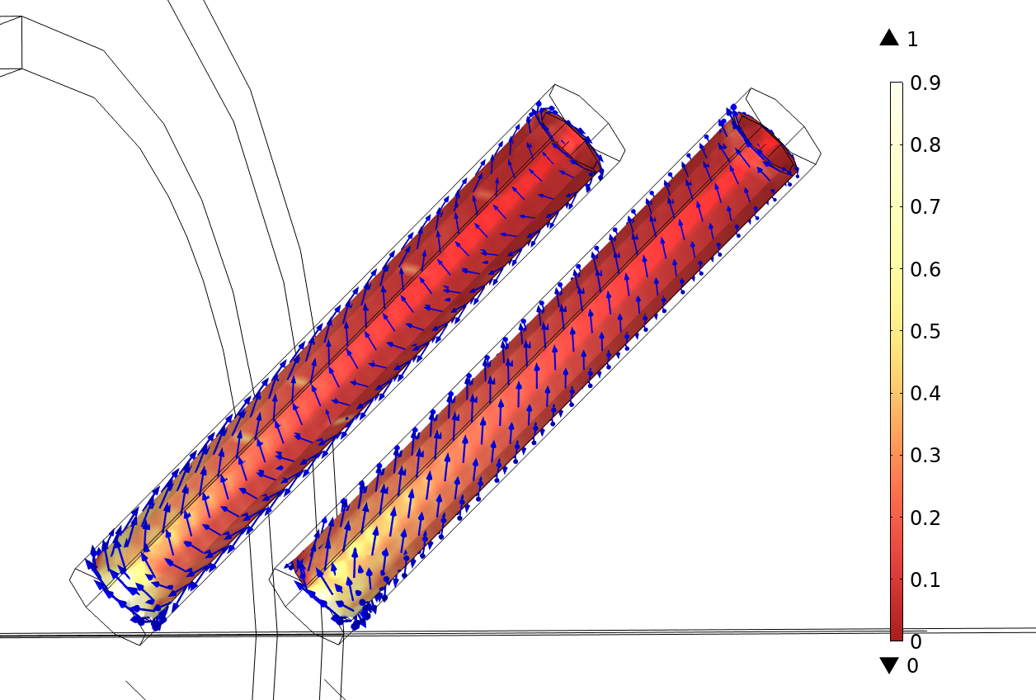
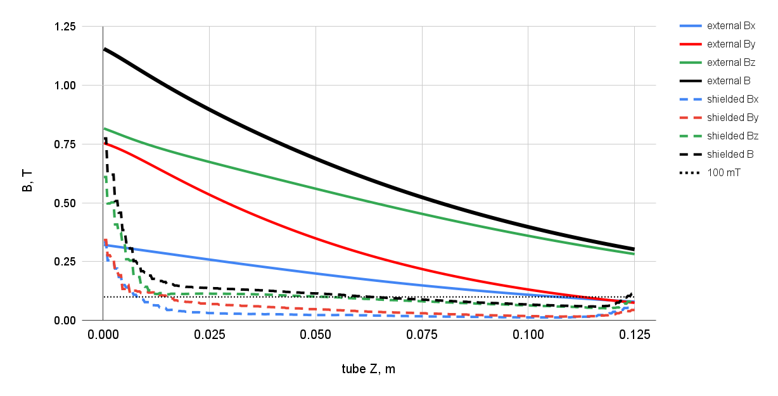
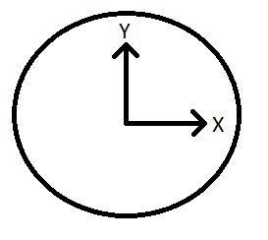
Magnetic field screening in superconducting NbTi tubes
We require magnetic field in transversal direction B < 100mT
B field along the axis of the sc tube can remain higher
Color scheme illustrates the ratio of the critical current density and local current density the J/Jc
✓ Bx and By < 100mT
✓ Bz ≈ 100mT
✓ Consistent shielding throughout the tube length

Slide 20
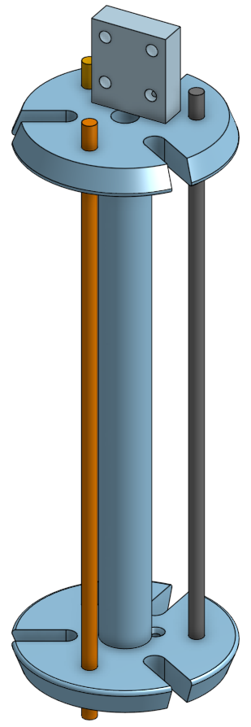
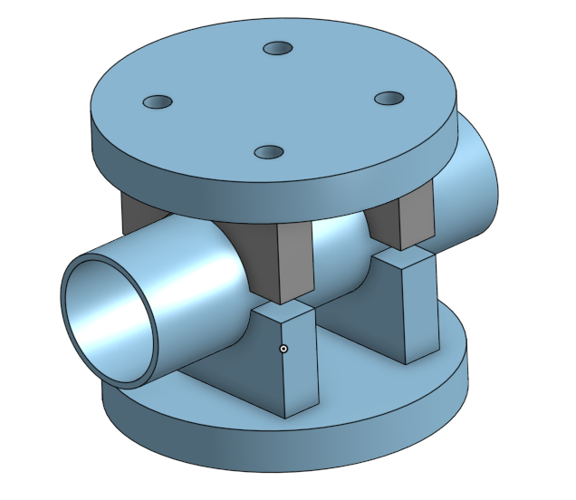
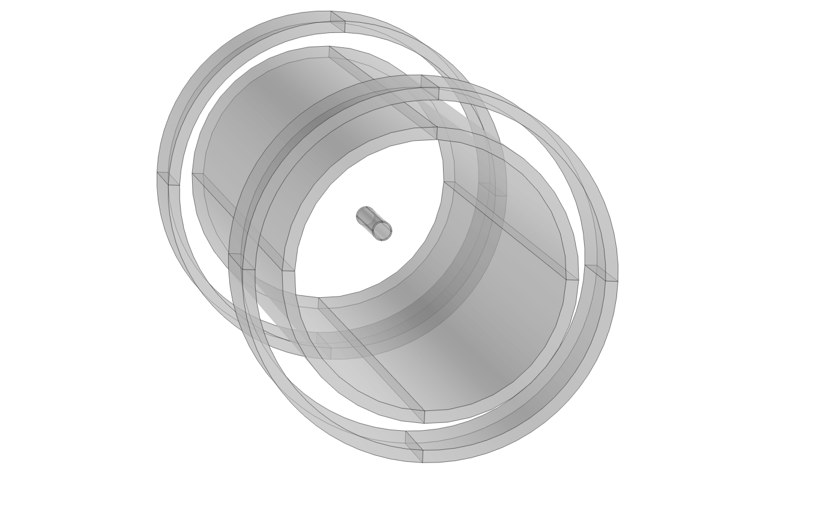
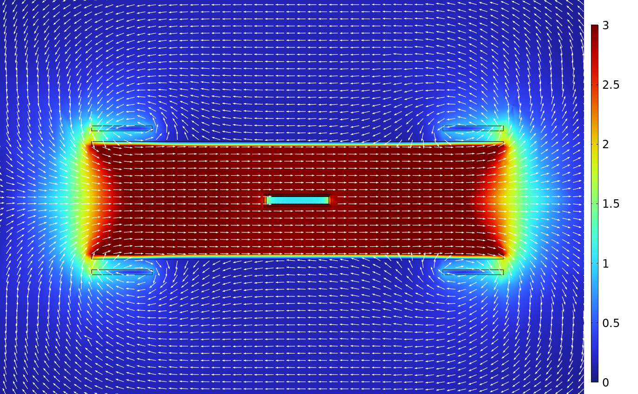
Measuring preparations for late July
Measure the magnetic field screening in BSCCO and NbTi tubes in LHe
Using 15T magnet here at PSI
Planning to measure with the tube placed || and ⊥to B

Slide 21
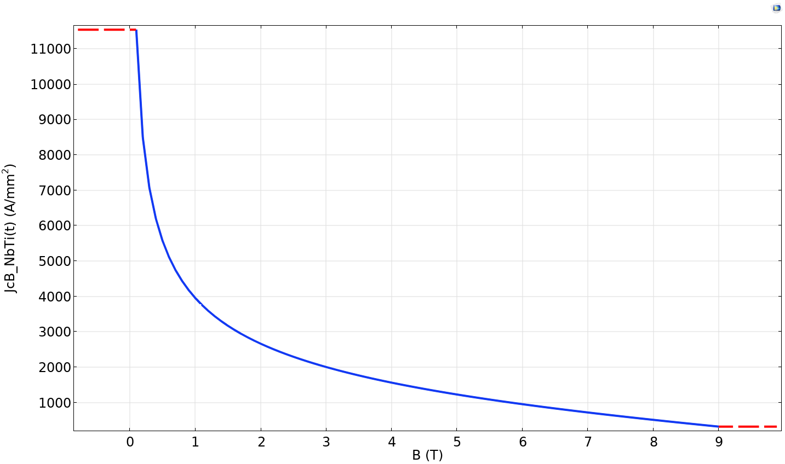

Slide 22
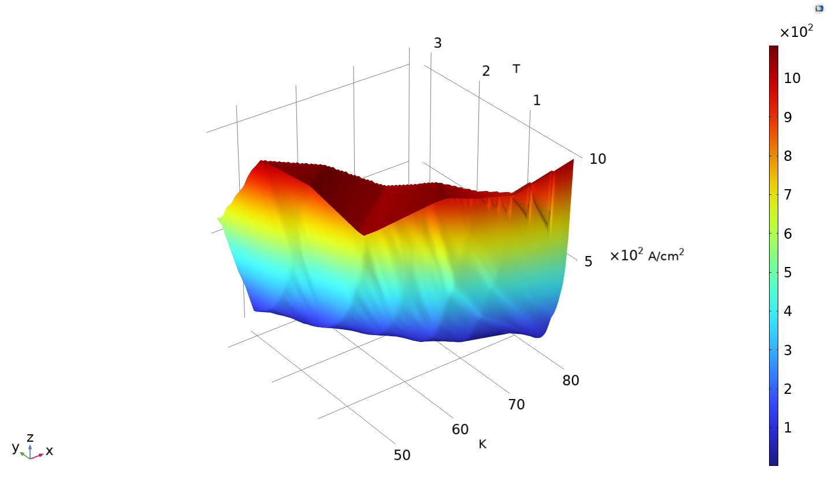

Slide 23
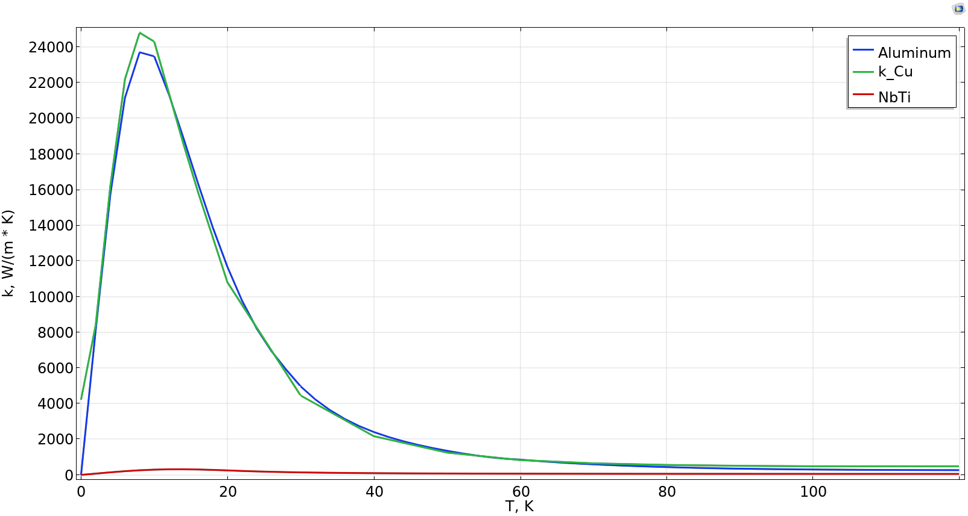
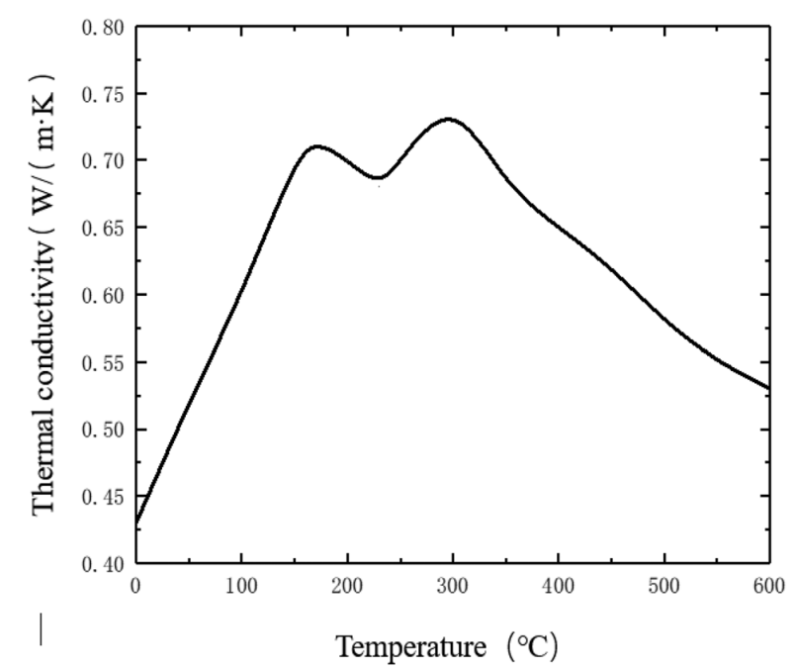
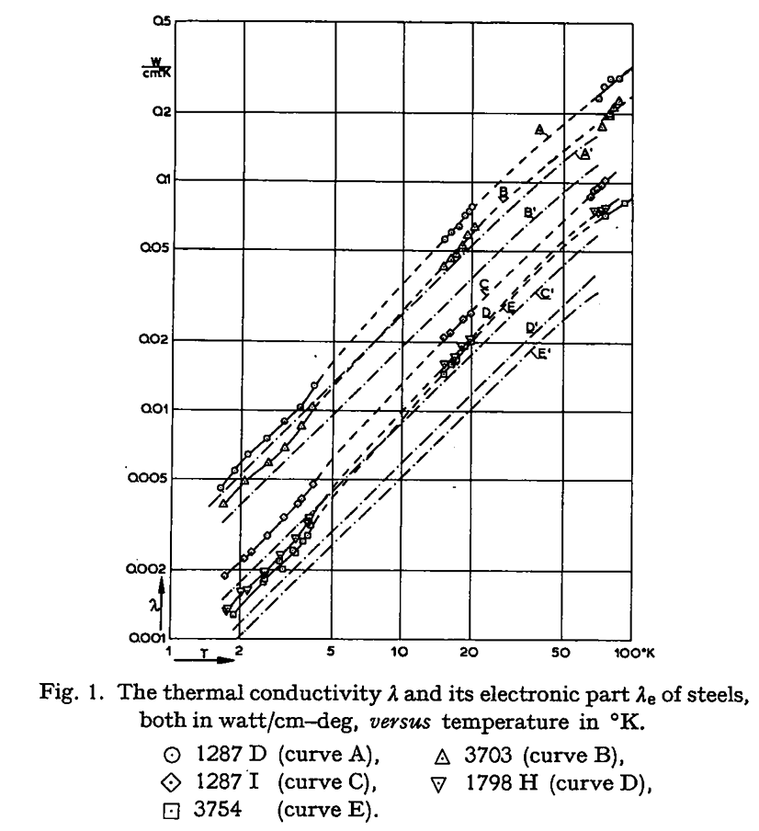
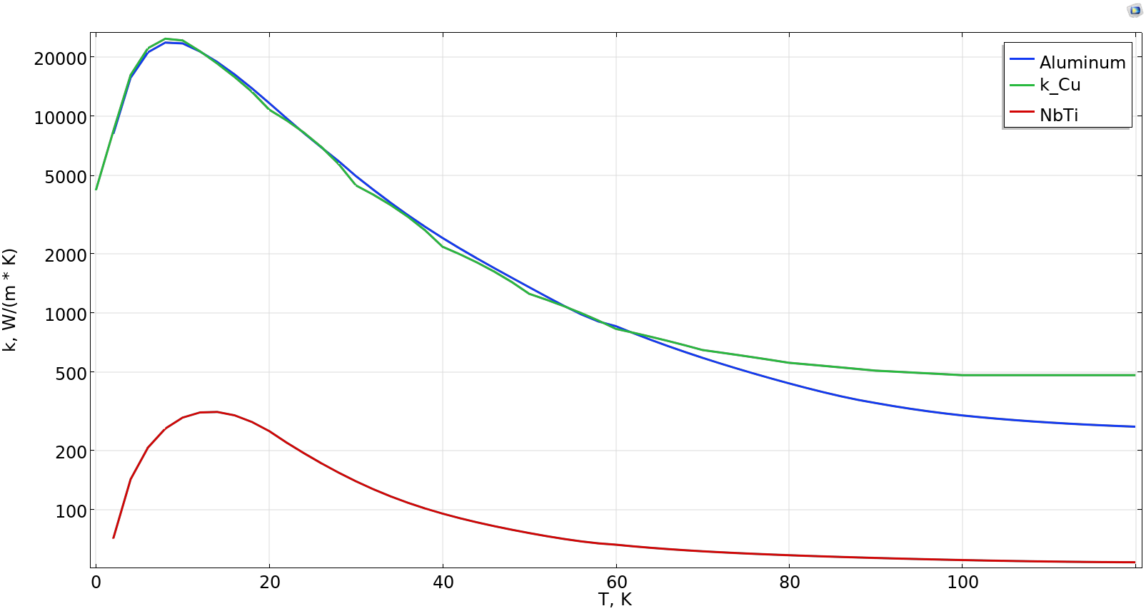
Zhao, Fuhai & Liu, Zhiqiang & Chen, Rifan & Hao, Yi & Ma, Zhihao. (2022). The effect of temperature field on the characteristics of carbon fiber reinforced thermoplastic composites in the laying and shaping process. The International Journal of Advanced Manufacturing Technology. 121. 10.1007/s00170-022-09795-9.
M.S.R. Chari, J. De Nobel,
Thermal conductivity of some steels at low temperatures,
Physica,
Volume 25, Issues 1–6,
1959,
Pages 73-83,
ISSN 0031-8914,
https://doi.org/10.1016/S0031-8914(59)91409-0.
(https://www.sciencedirect.com/science/article/pii/S0031891459914090)
Abstract: Synopsis
The measurements made in the Kamerlingh Onnes Laboratory on the thermal conductivity of steels at low temperatures were extended to liquid helium temperatures and the technique was improved. Five specimen of different composition and heat treatment have been investigated. The lattice conductivity is approximately proportional to T1.2. With increasing nickel content from 2% to 27% (Ni + Cr) it decreases by about 60, 58 and 37% at the temperatures 70, 20 and 4k respectively. The electronic thermal conductivity decreases by about 80% for the mentioned temperatures.

