Slide 1

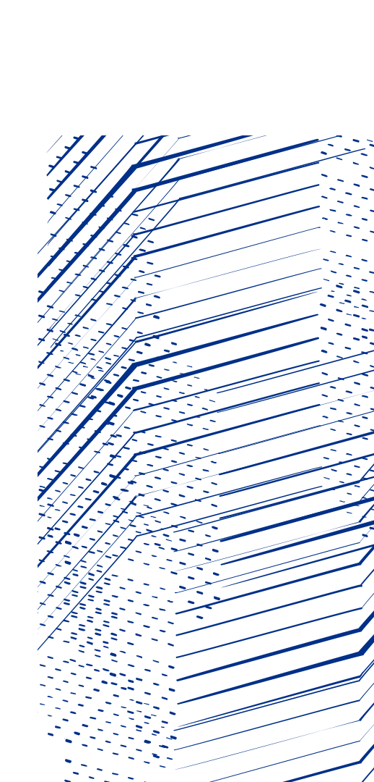

MuEDM correction coils
Review meeting
Alex Bainbridge
UKRI-STFC Daresbury Laboratory
10 February 2025

Slide 2
The objective of the corrector coils
The Objective:
The constraints:
Produce a smooth field profile that monotonically decreases away from a central dip.
Have minimal power dissipation – heat extraction is complicated!
Maintain a suitable longitudinal distance to field drop-off.
The main and trim solenoids along with their cryostat already exist – no changes to that geometry.
The main and trim solenoid current are constrained to the same ratio. 612.02/196.84 = 3.109
Need to accommodate the detector!

Slide 3
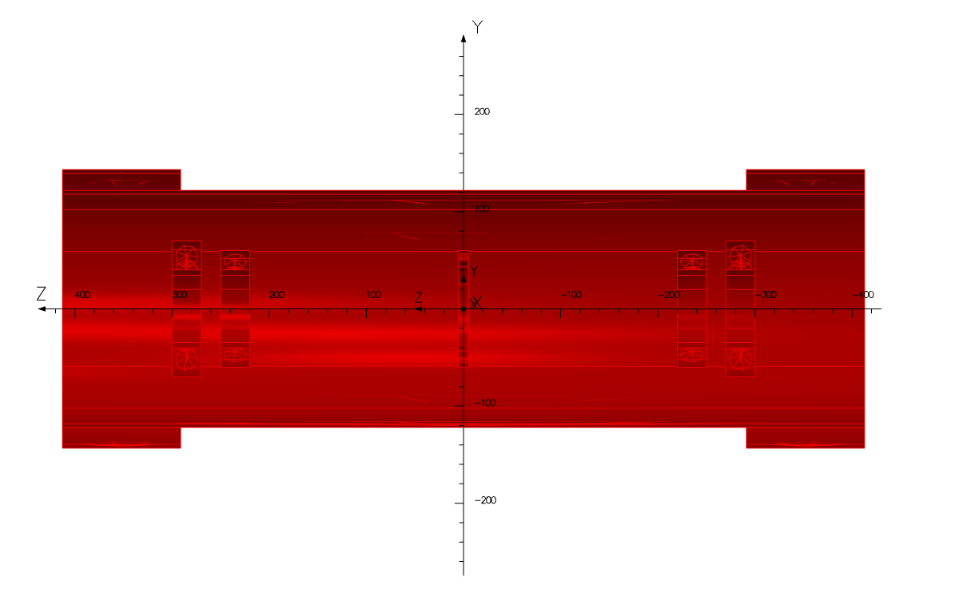
Coil parameters for solution
unchanged
Inner radius 50
Outer radius 60
Z from -5 to 5
J=-1.6 A/mm²
Inner radius 40
Outer radius 70
Z from 270 to 300
J=-1 A/mm²
Inner radius 40
Outer radius 60
Z from 220 to 250
J=-0.75 A/mm²

Slide 4
Solution Bz profile
Does not dip here, no secondary trap created, see next slide!
Bz profile along straight line 31.13 mm from axis.
Blue line is main and trim solenoids at original currents only.
Red line is with new corrector design.
Much smoother than first corrector design, hopefully no reflection

Slide 5
Solution Bz profile – zoomed in
Bz profile along straight line 31.13 mm from axis.
Blue line is main and trim solenoids at original currents only.
Red line is with new corrector design.

Slide 6
Solution Br profile
Br profile along straight line 31.13 mm from axis.
Blue line is main and trim solenoids at original currents only.
Red line is with new corrector design.
Slightly higher central fluctuation
Lower off-centre fluctuation

Slide 7
Coil windings
Need for vacuum compatibility makes coil winding tricky
Needs to be able to reach 10⁻⁶ to 10⁻⁷ mbar.
Trapped volumes in between turns cause outgassing– square profile wire better than round!
Kapton dipped wire is ideal in vacuum but is hard to get hold of in square profile.
Heat transfer from inner turns relies on good thermal contact.
Solution to all the above problems: use solid-core round wire and vacuum impregnate UHV epoxy between the turns of the coils!

Slide 8
Windings plan
Wind coils from Kapton coated copper wire with 2mm OD and 1.8mm conductor diameter (Kurt J Lesker part number FTAK18005).
Inner coil = 20x30 mm, at 0.75 Amm⁻² (assuming 100% packing factor), so 450 Ampere turns.
  20x30 mm gives 10x15 grid = 150 Turns. Needed current 3 Amps.
  1.8mm conductor diameter is 2.54 mm², so 1.18 Amm⁻²
Outer coil = 30x30 mm, at 1 Amm⁻² (assuming 100% packing factor), so 900 Ampere turns.
  30x30 mm gives 15x15 grid = 225 Turns. Needed current 4 Amps.
  1.8mm conductor diameter is 2.54 mm², so 1.57 Amm⁻²

Slide 9
Total power load
Vacuum makes it difficult to conduct heat away from the coils.
Current densities below 2 Amm⁻² will be acceptable in air, but need active heatsinking in vacuum.
Need to make sure heat conduction is directed away from the superconducting components.
Estimated heat loads for examples on previous slides:
Inner coil :
  Total length of wire estimated at 48 metres (± slight packing error).
  Need 3 Amps, 1.8mm conductor diameter is 2.54 mm², so 1.18 Amm⁻²
  Assume copper ρ=1.724*10⁻⁸ Ωm , or σ = 58001000 S/m
  R=0.326 Ω, so P=~3W
Outer coil :
  Total length of wire estimated at 78 metres (± slight packing error).
  Need 4 Amps, 1.8mm conductor diameter is 2.54 mm², so 1.57 Amm⁻²
  Assume copper ρ=1.724*10⁻⁸ Ωm , or σ = 58001000 S/m
  R=0.53 Ω, so P=~8.5W

Slide 10
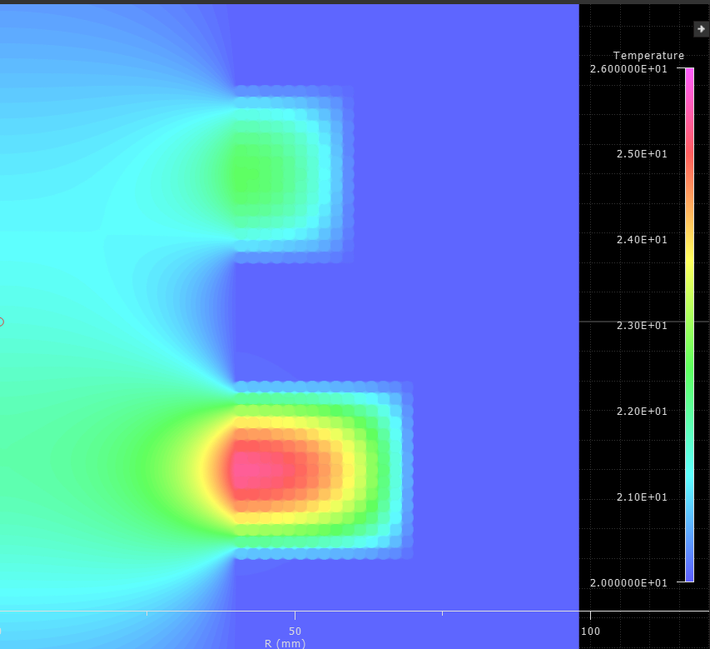
Heat flow simulations
Heat flow modelling shows that filling the vacuum space between the turns of the coil is necessary to ensure heat flow into the holder.
Leaving this space as vacuum results in poor heat conduction as expected.
Steady state temperature peaks at 26 degrees in outer coil.
So- filling in the gaps between the turns with an epoxy of similar thermal conductivity to air is a good solution.
Vacuum impregnating UHV epoxy between the turns of the coils is the optimal solution – also removes trapped volumes and reduces outgassing.

Slide 11
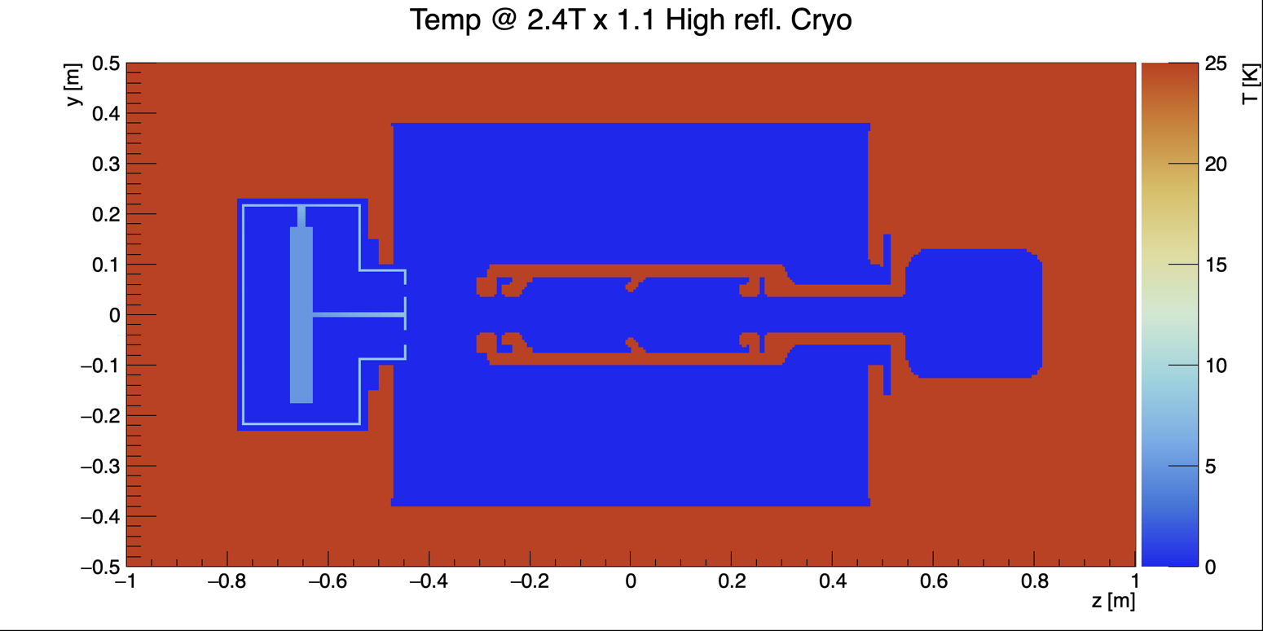
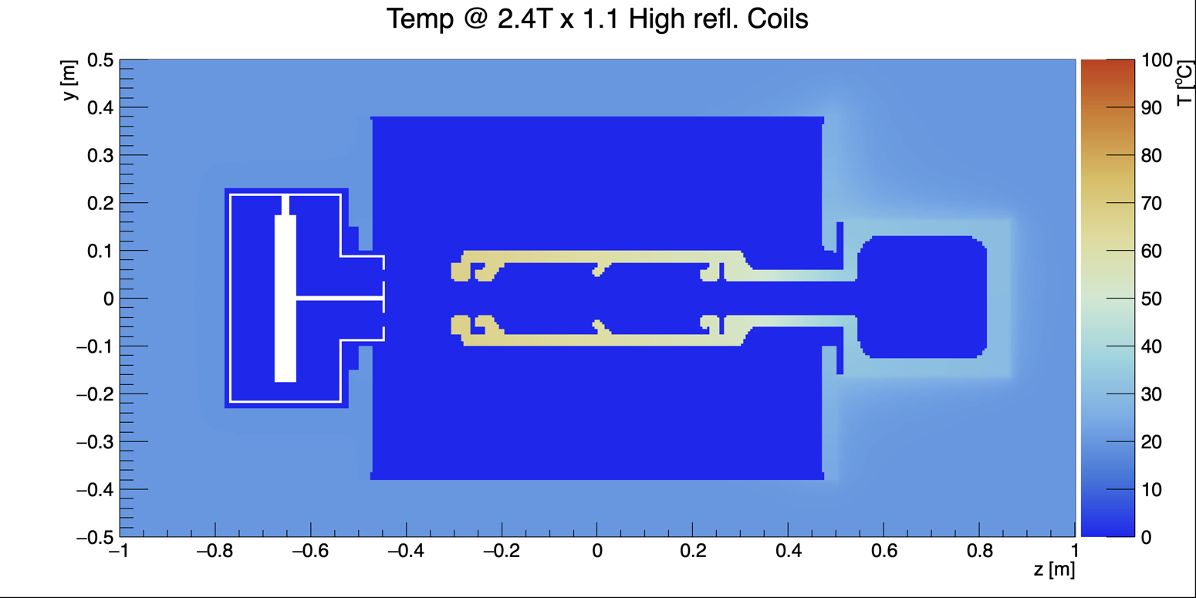
Heat flow simulations
67.3 ºC
8 K
Cu Emissivity: 0.025
Passive heat flow simulations show that heat will not conduct quickly enough out of the chamber via the support structure. Active cooling will be needed.

Slide 12
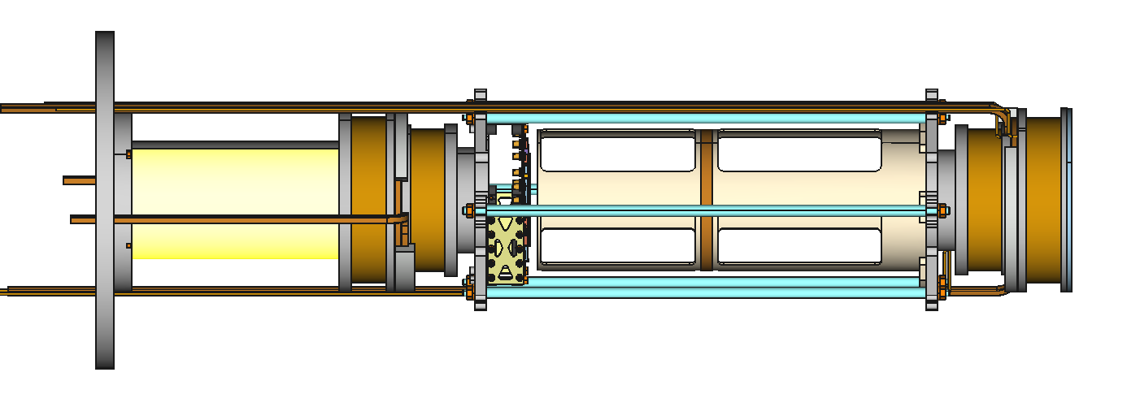
Coil mounting proposal
Aluminium Support rods
Positioned to accommodate detectors
Mounting to end flange
Central trap coil
Aluminium holder structure
Cooling tubes to connect
via Swagelock to feedthrough

Slide 13
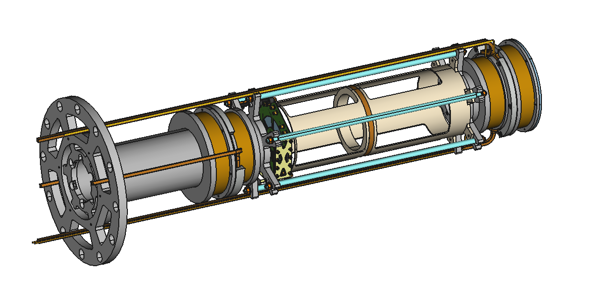
Coil mounting proposal

Slide 14
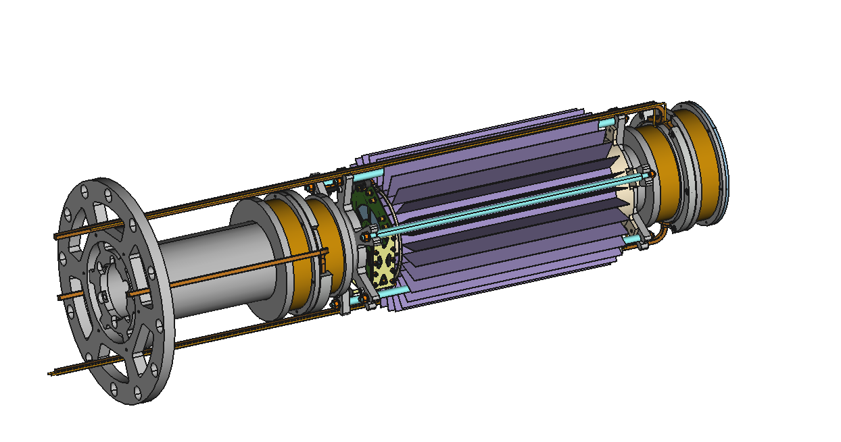
Coil mounting proposal

Slide 15
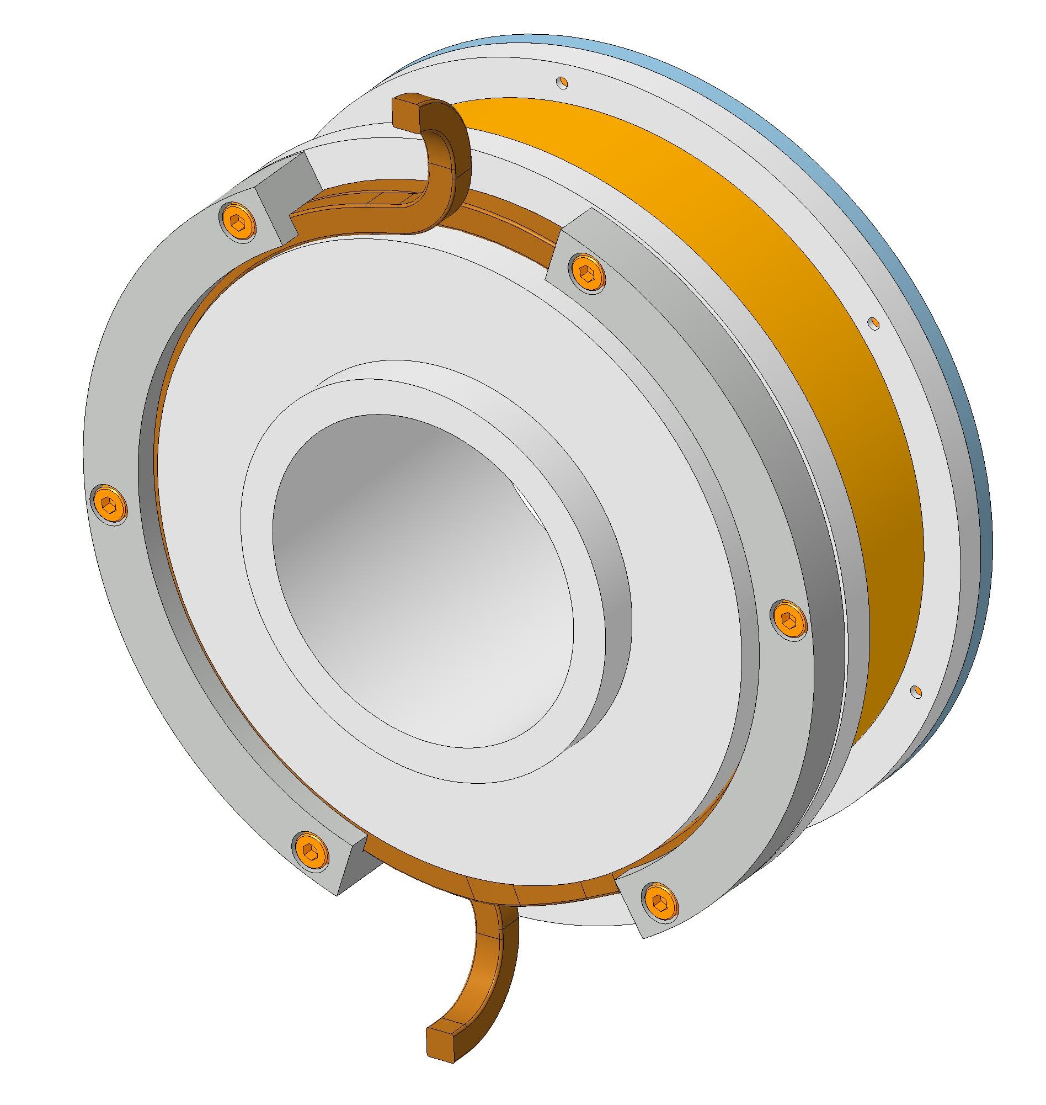
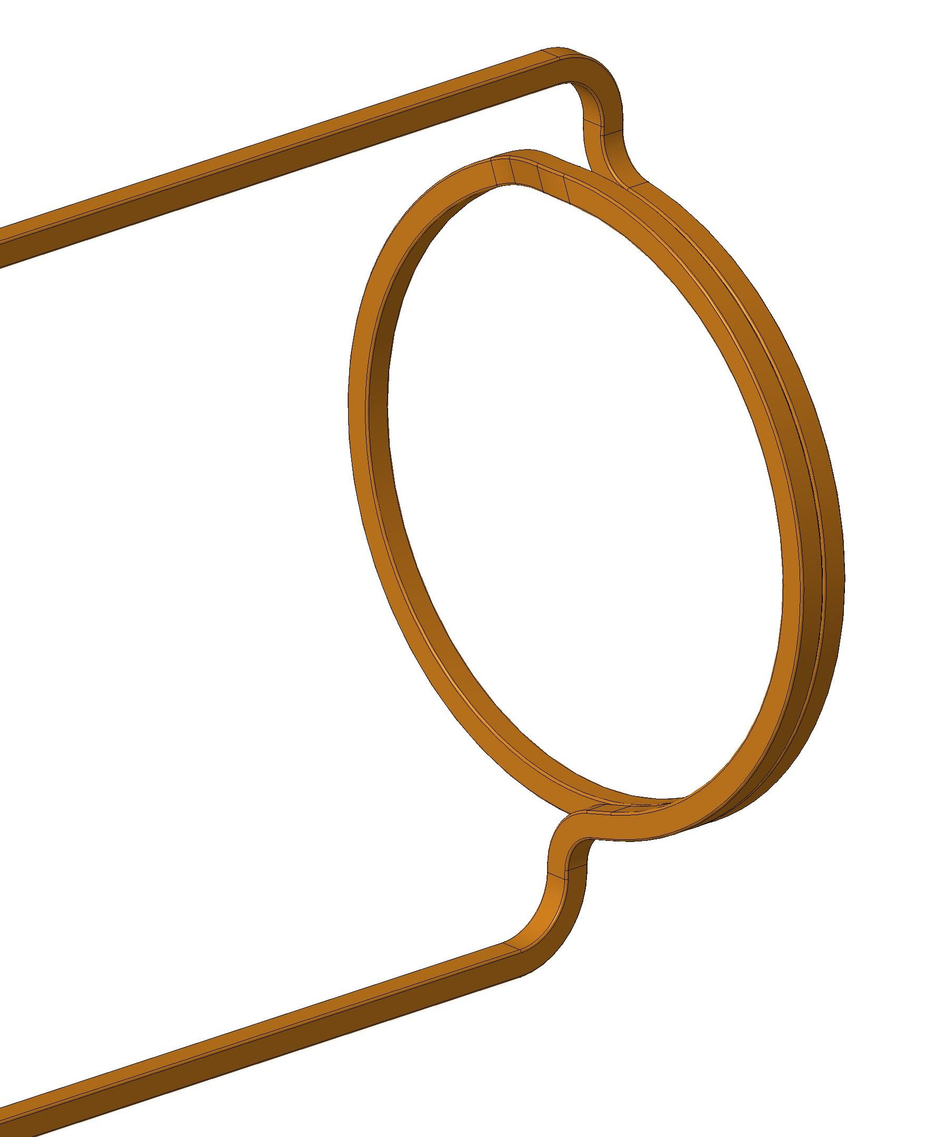
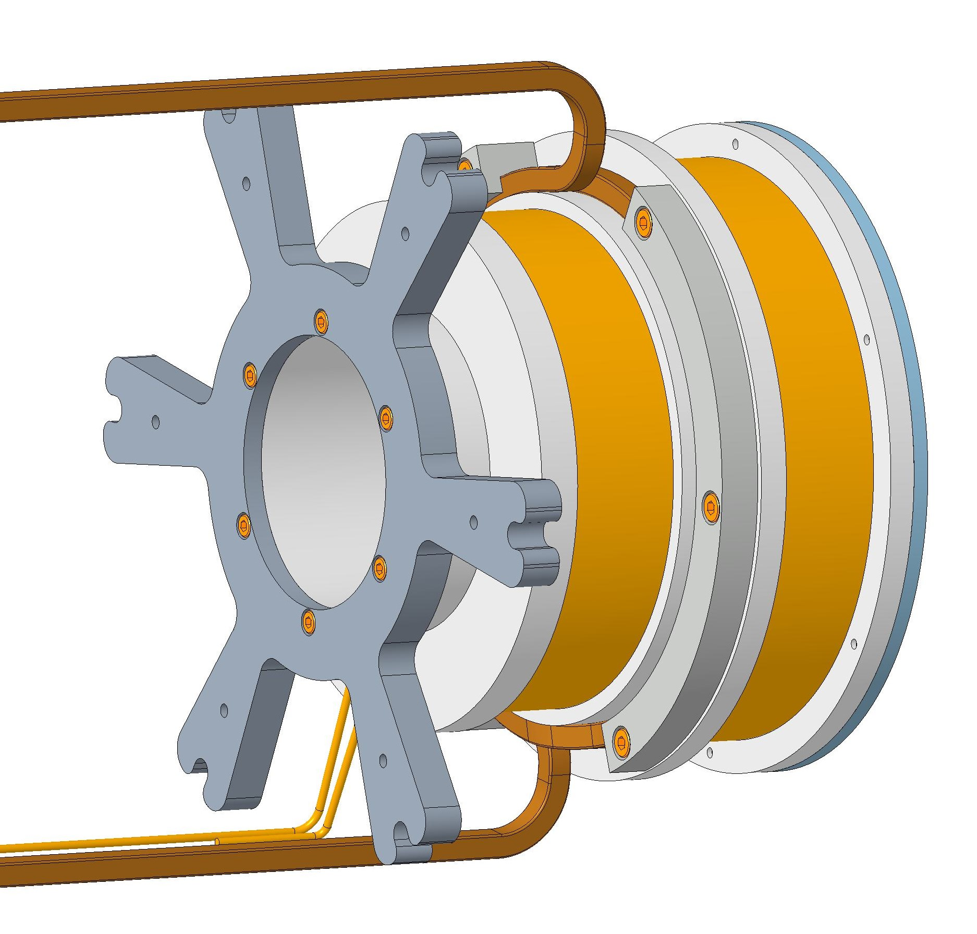
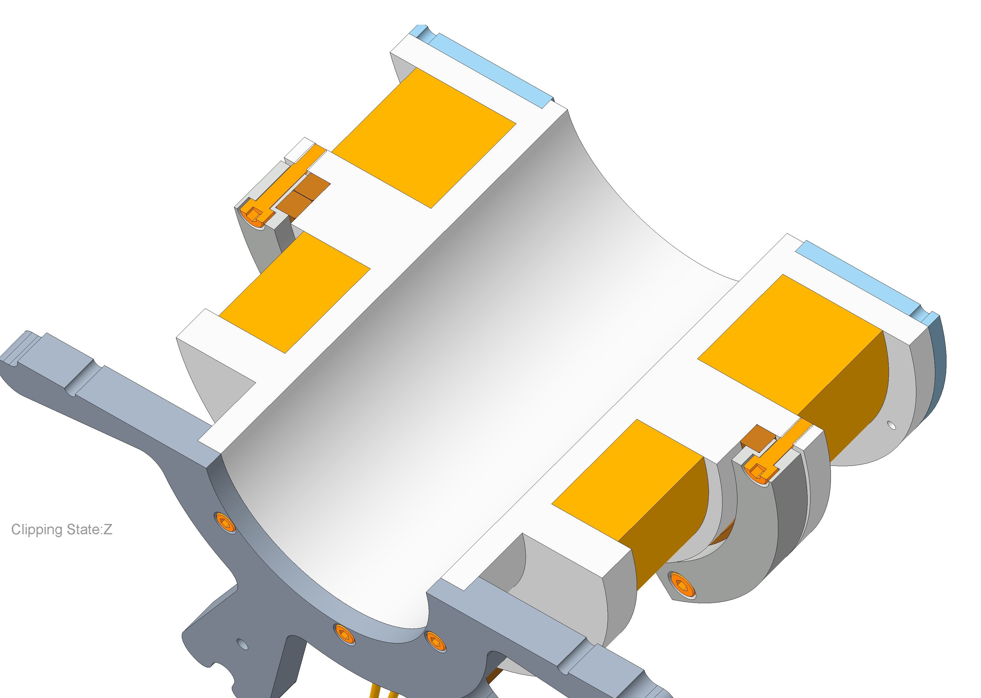
Coil mounting proposal
Cooling tube
Square section conductor held by clamping between olders
Clamps

Slide 16
Current status
A field solution is found: by having 2 corrector coils side and staggering their Ampere-turn values we can achieve a monotonically decreasing field with a central dip.
The current solution fits into all physical constraints (that we know about) – Central coil holder edited and presented at meeting on 06/02/25 to resolve conflict between central coil holder and detector.
Water-cooling of the coil holders is required.
We plan to have coils wound and potted in vacuum epoxy by colleagues at the Rutherford Appleton Laboratory, UK.
  Wire has been procured.
Coil holder design was reviewed on at 30/01/25 and 06/02/25– should now be fully compatible with detectors.
Expected delivery of complete coils to PSI March/April.

