Slide 1





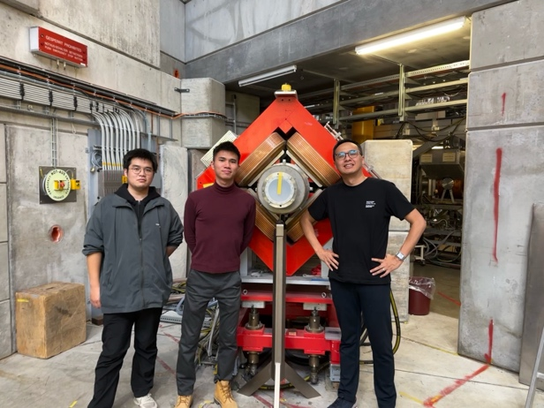



Muon Trigger Detector for the
PSI muEDM experiment
Kim Siang Khaw
muEDM BVR review @ PSI
10 Feb 2025
Muon Trigger Detector Development Team:
Tianqi Hu, Xingyun Huang, Kim Siang Khaw, Jun Kai Ng and Guan Ming Wong (with strong support from the PSI muon group)

Slide 2
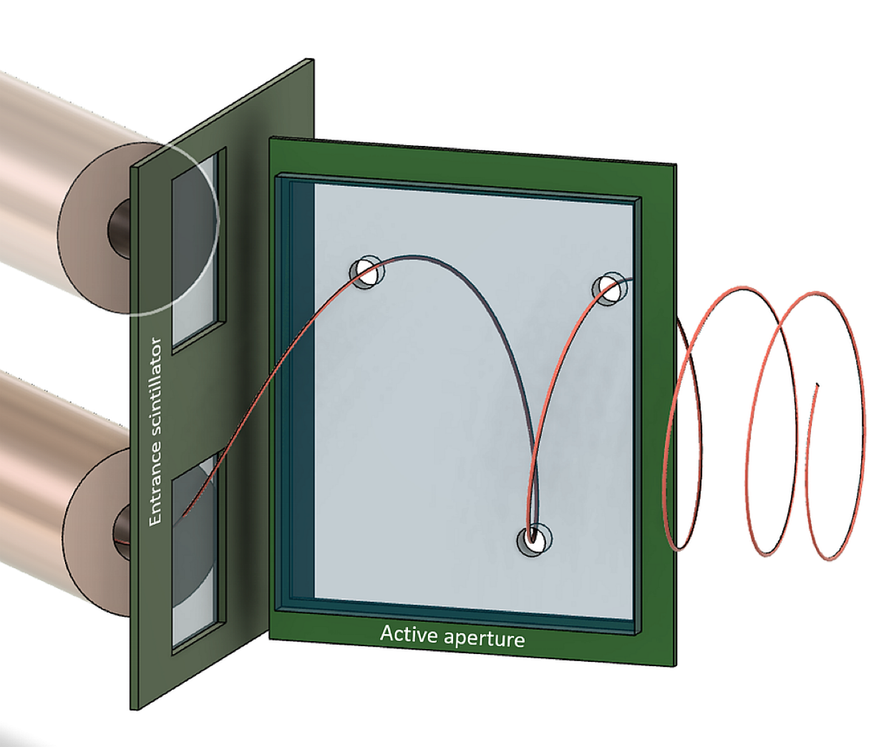
Overview of the muon trigger detector
Inside the storage solenoid
5 mm thick scintillator
Conceptual
design
Main requirements:
Detects incoming muon while minimizing scattering
Generates trigger signals for “storable” muons (~2%)
(reject out of acceptance muons)
< 25 ns signal delay from muon detection to HV switch for the magnetic kicker
100 μm thin scintillators

Slide 3
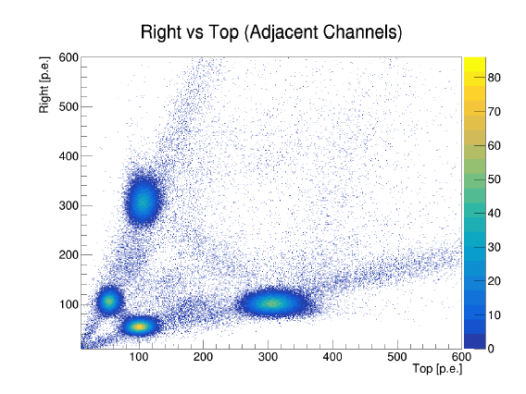
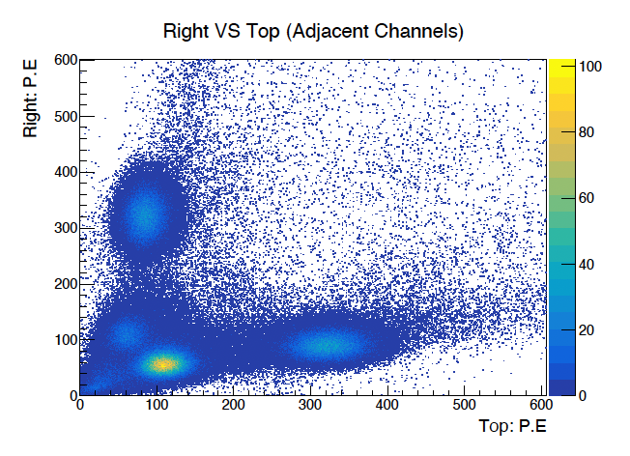
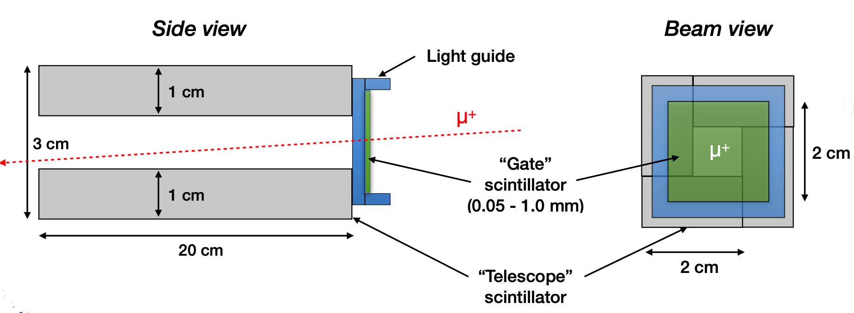
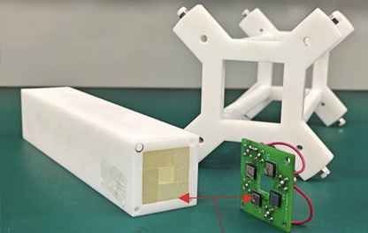
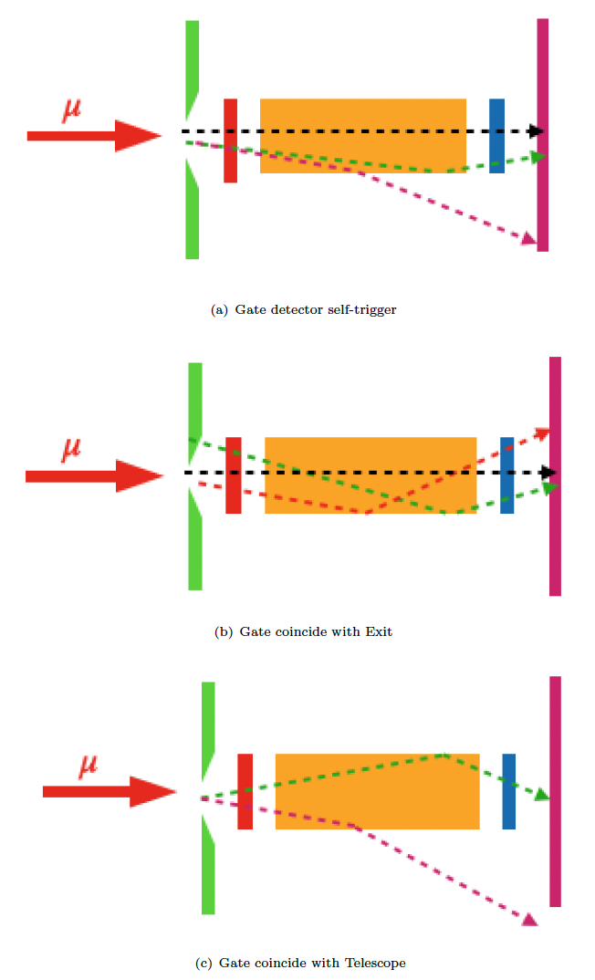
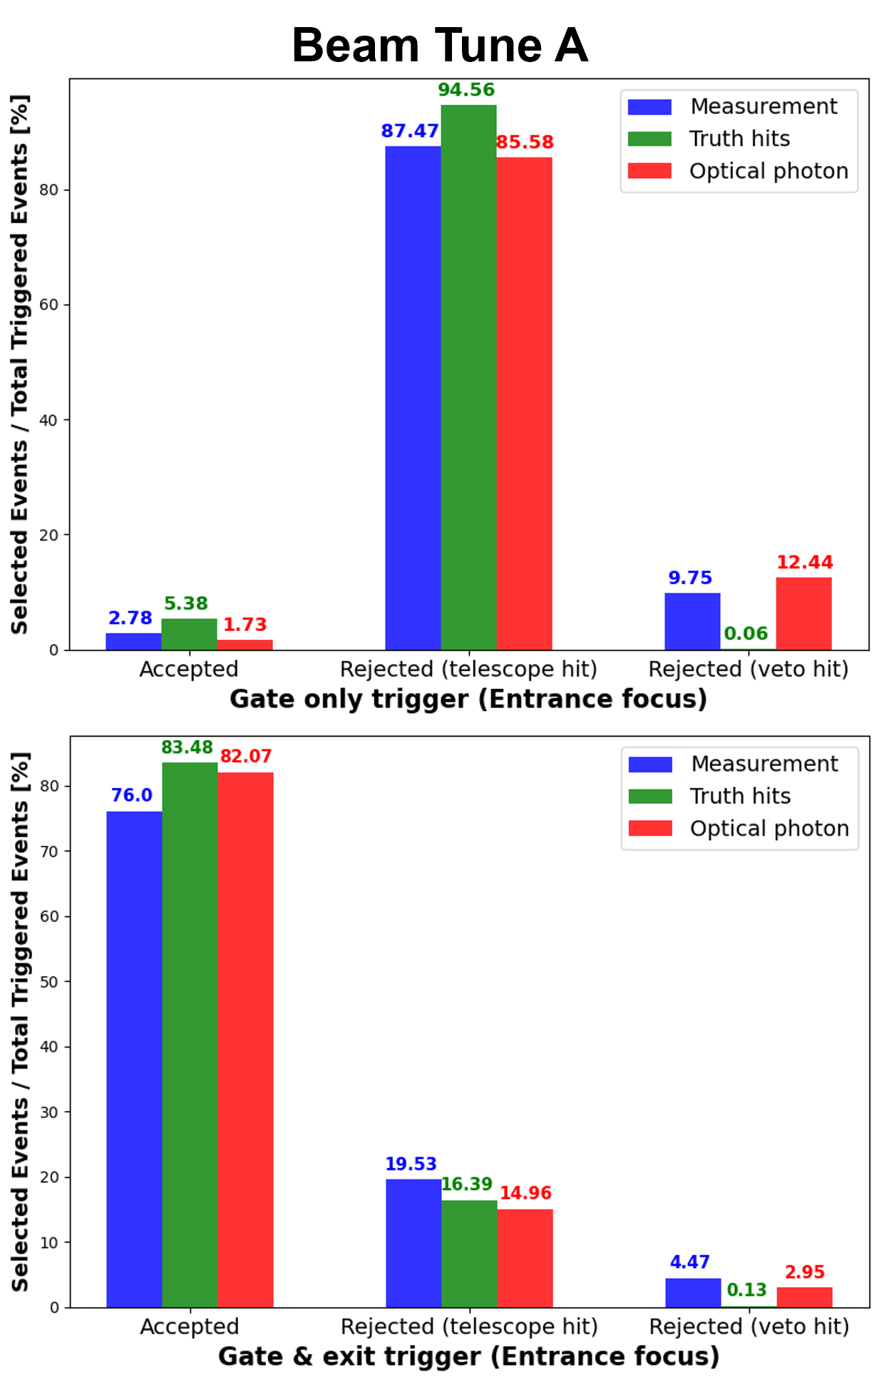
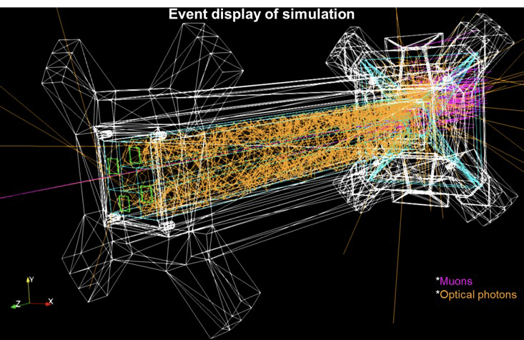
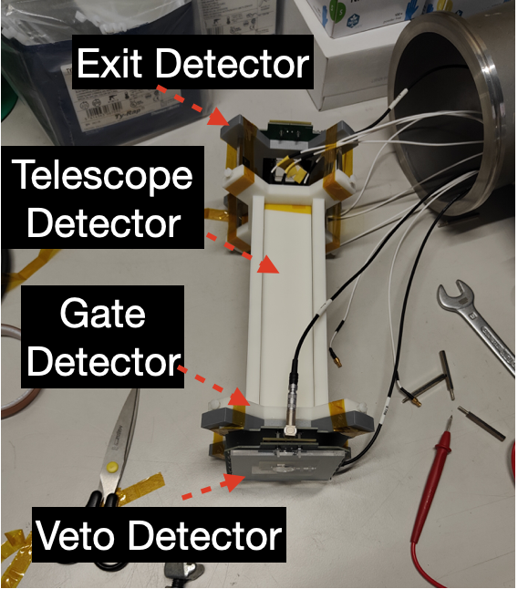
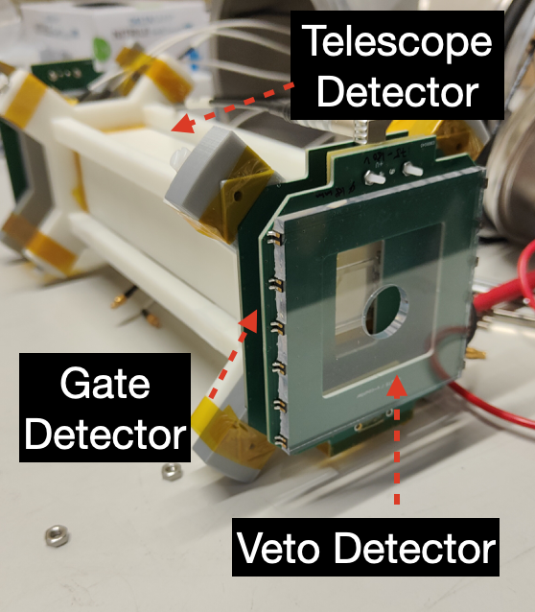
Proof of concept experiment in 2022
Beam Test at PSI in 2022 to test the idea
(no magnetic field)
Simulation
Measurement
Event topologies were reproduced following the activation of optical photon processes in Geant4.

Slide 4
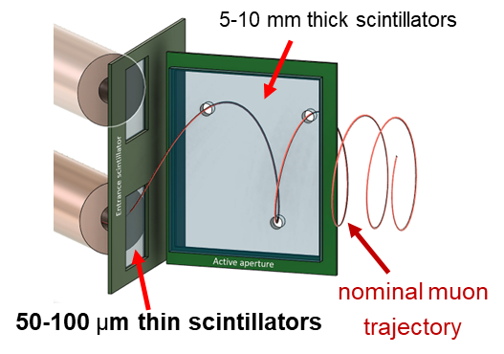
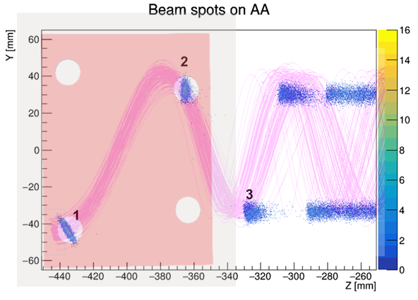
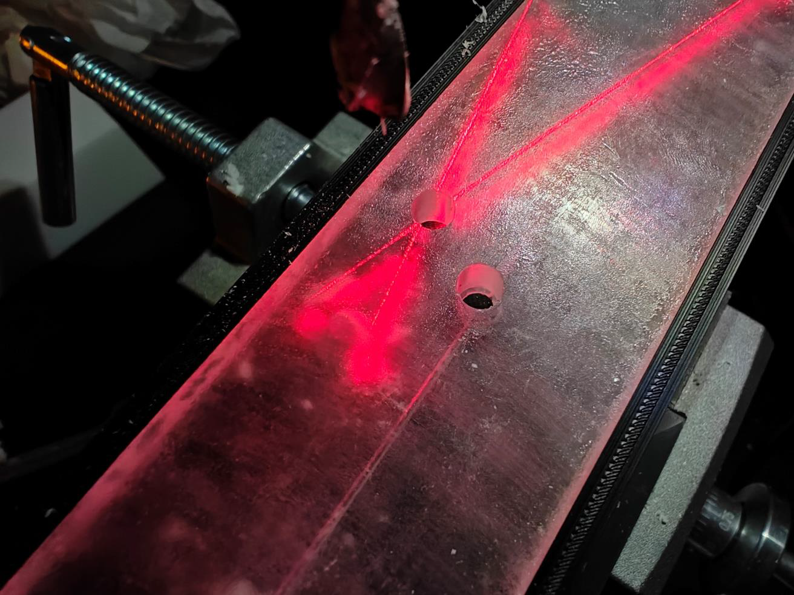
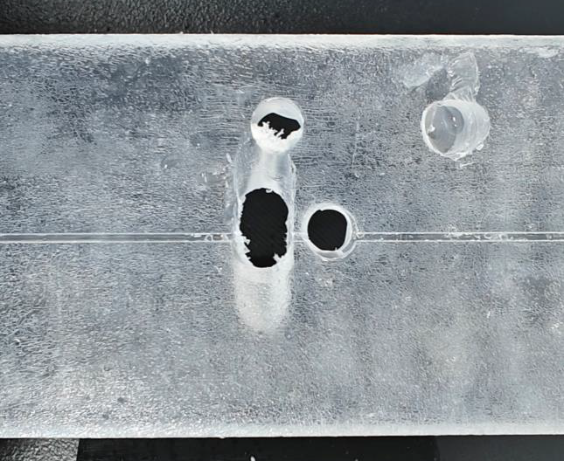
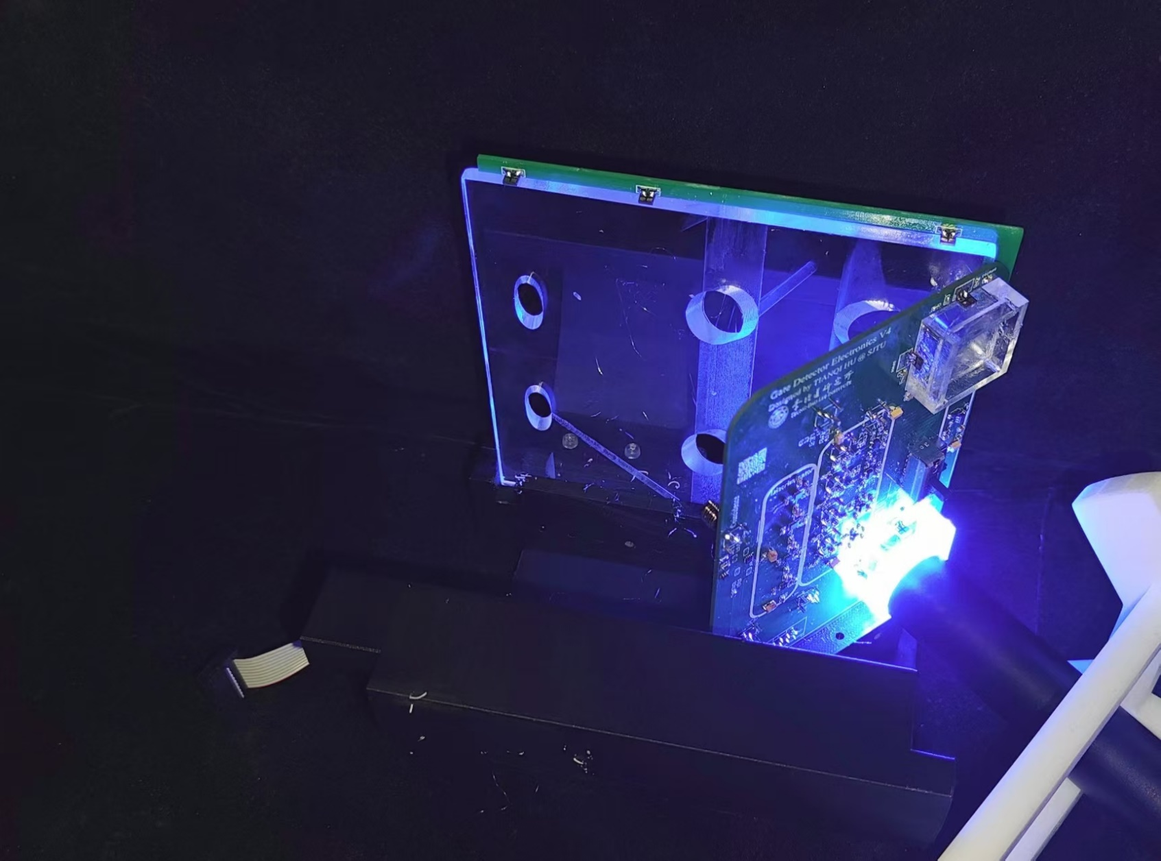
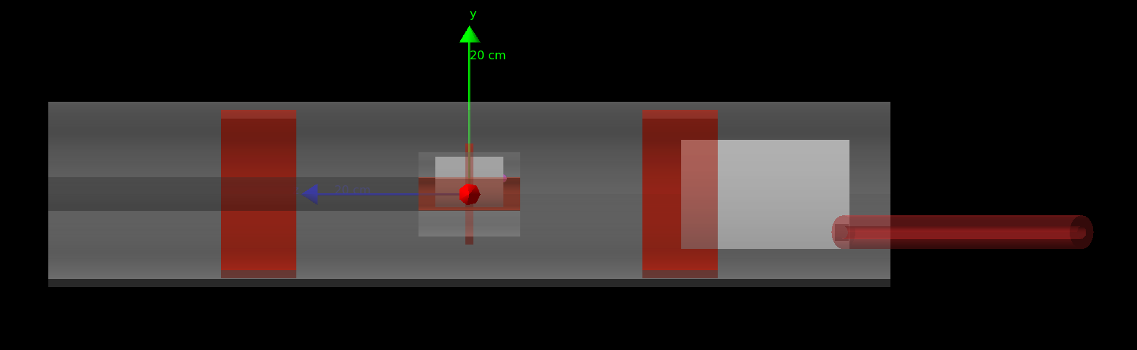
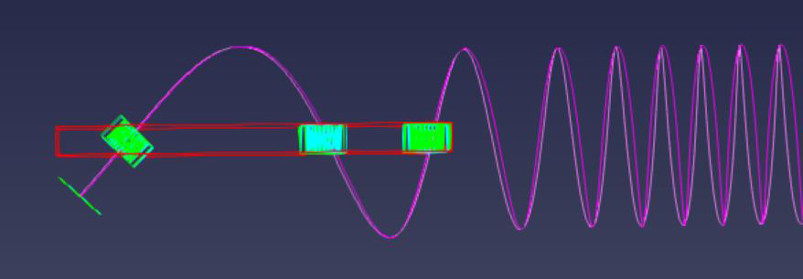
Detector design and development
Using G4beamline and musrSim models to:
Optimize detector geometry to maximize storage fraction
Optimize SiPM readout locations to maximize photon collection efficiency
Precise hole drilling using CNC machine at the TDLI muon lab

Slide 5
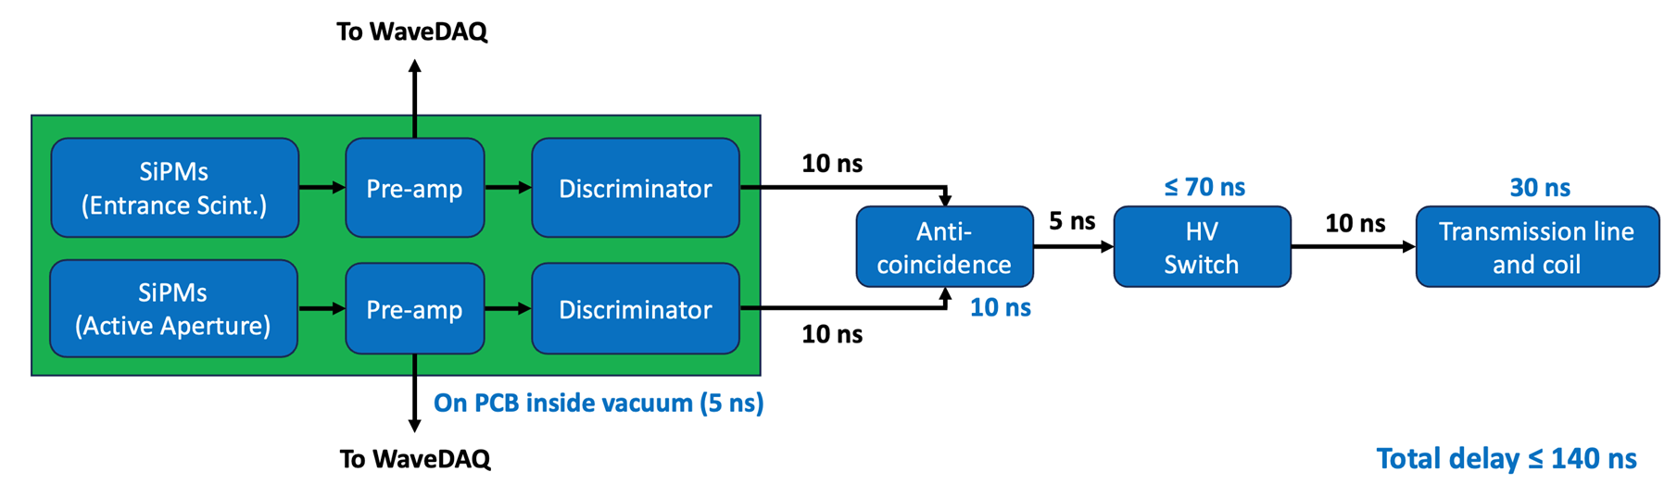
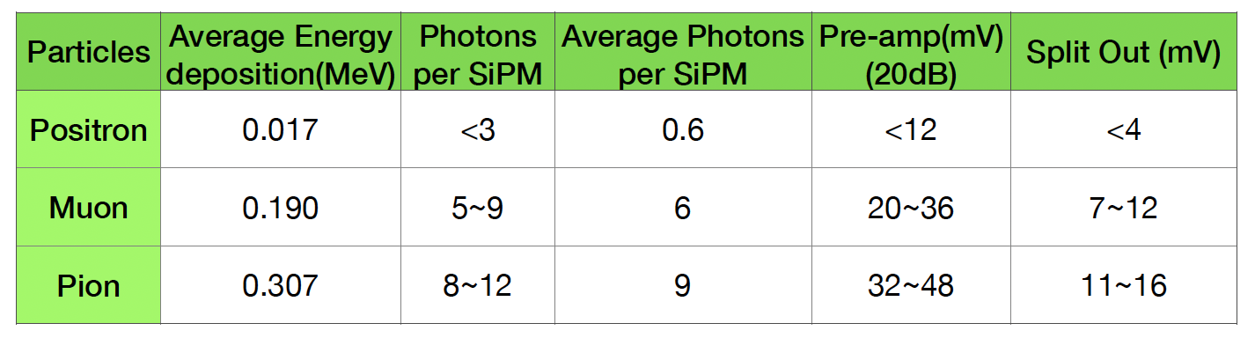
Fast trigger for the magnetic kicker
Fast electronics design to satisfy strict timing requirements
  CAEN products/WaveDAQ have delays > 10 ns
  systematically searching for all fast chips on the market for each functionality
Detector response to various particle species drives the electronic design

Slide 6
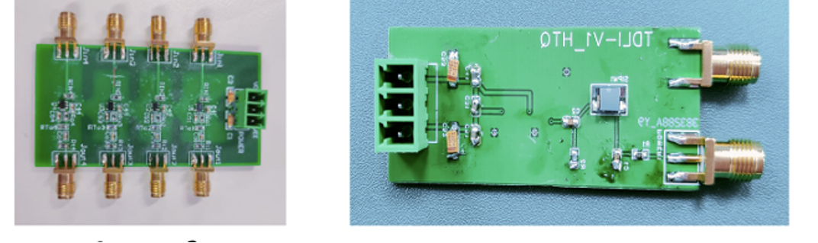
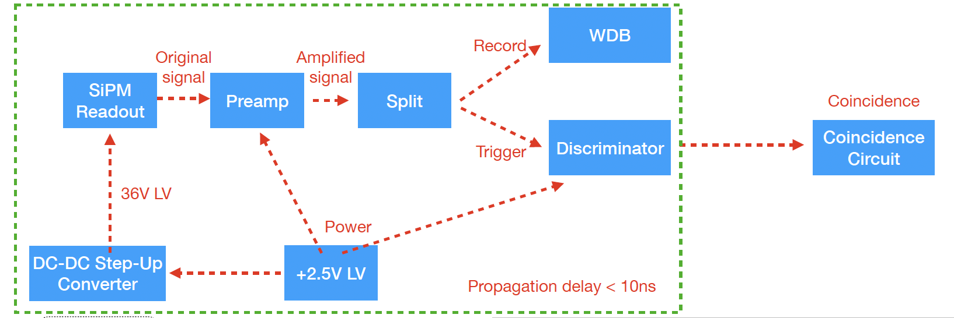
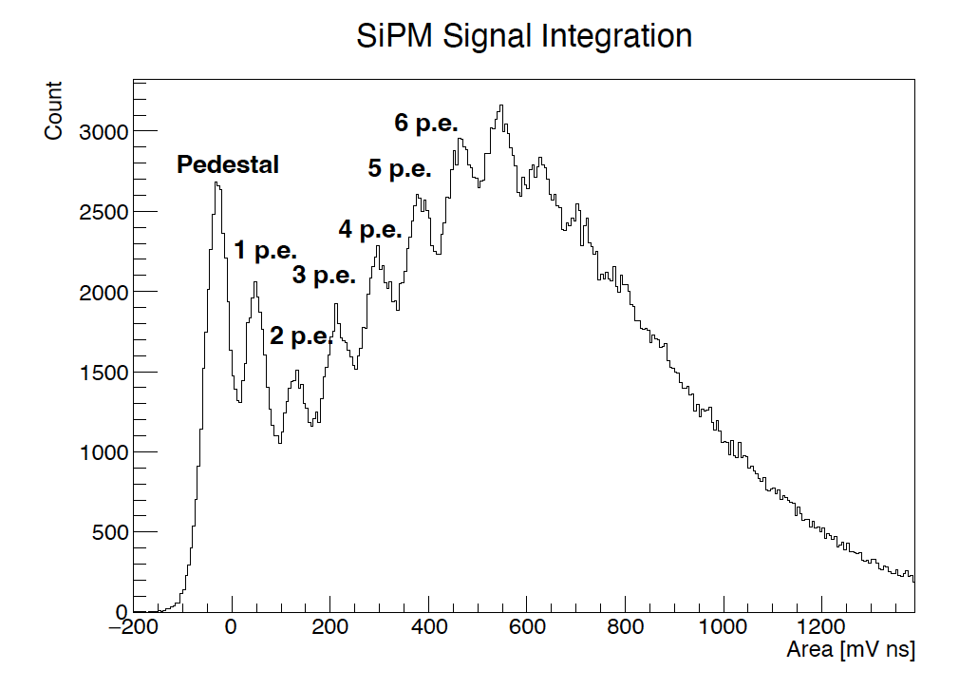
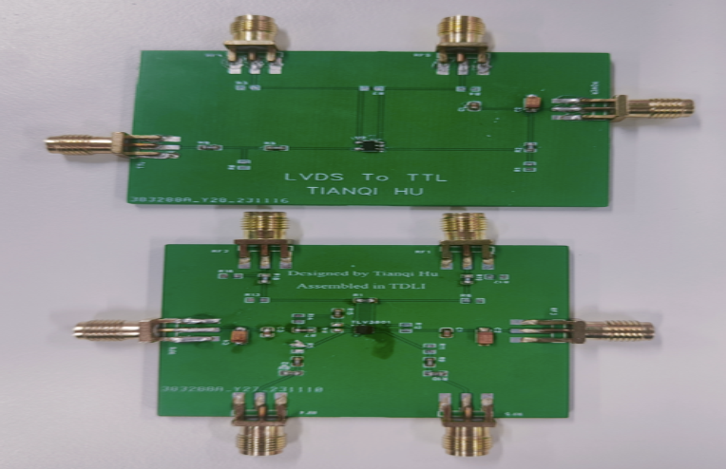
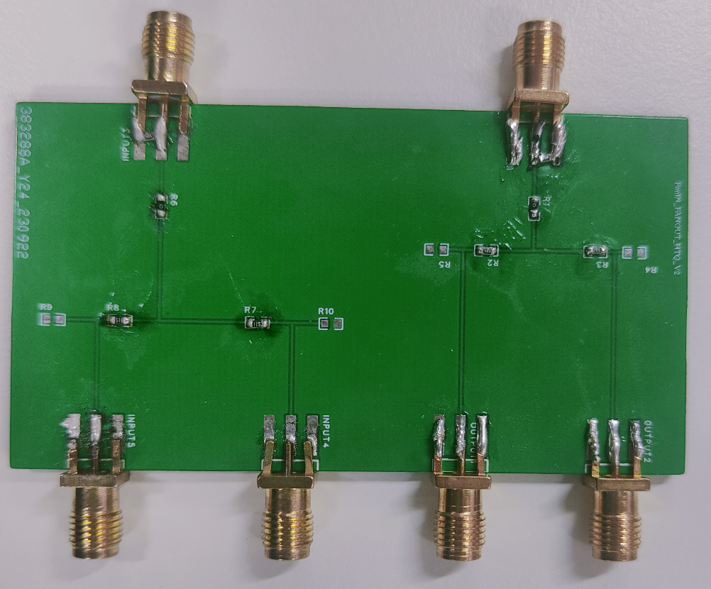
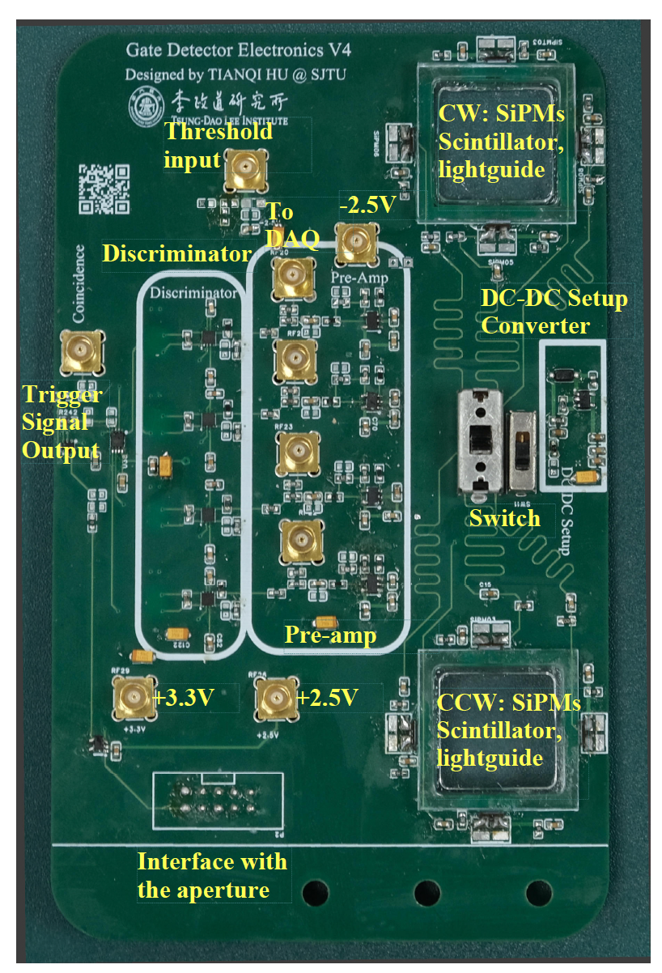
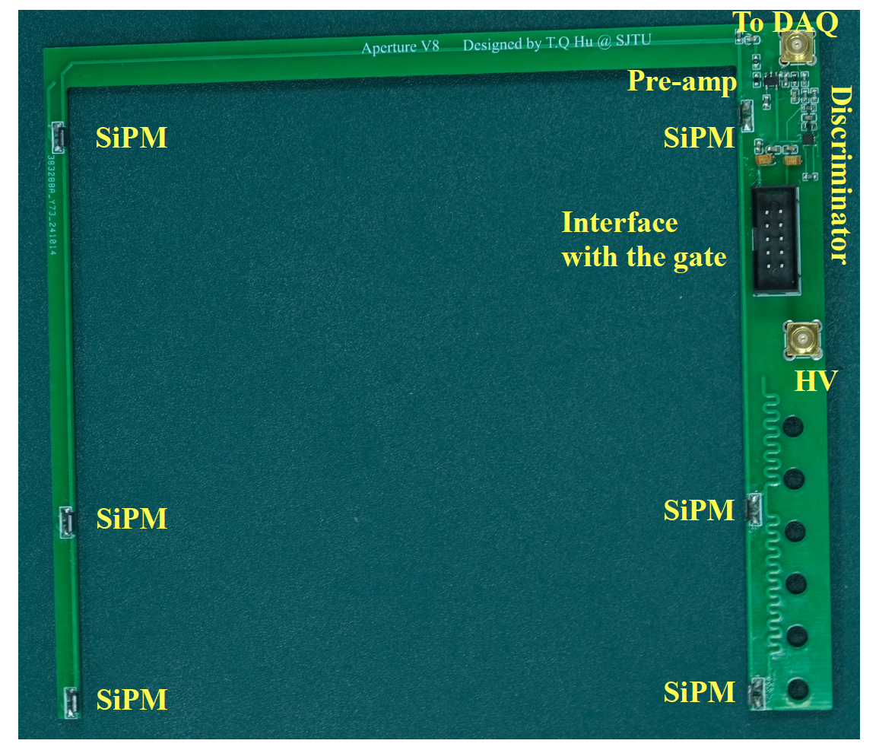
Electronic design and fabrication
Tested every component before integrating them into a single PCB
Gate PCB
Aperture PCB

Slide 7
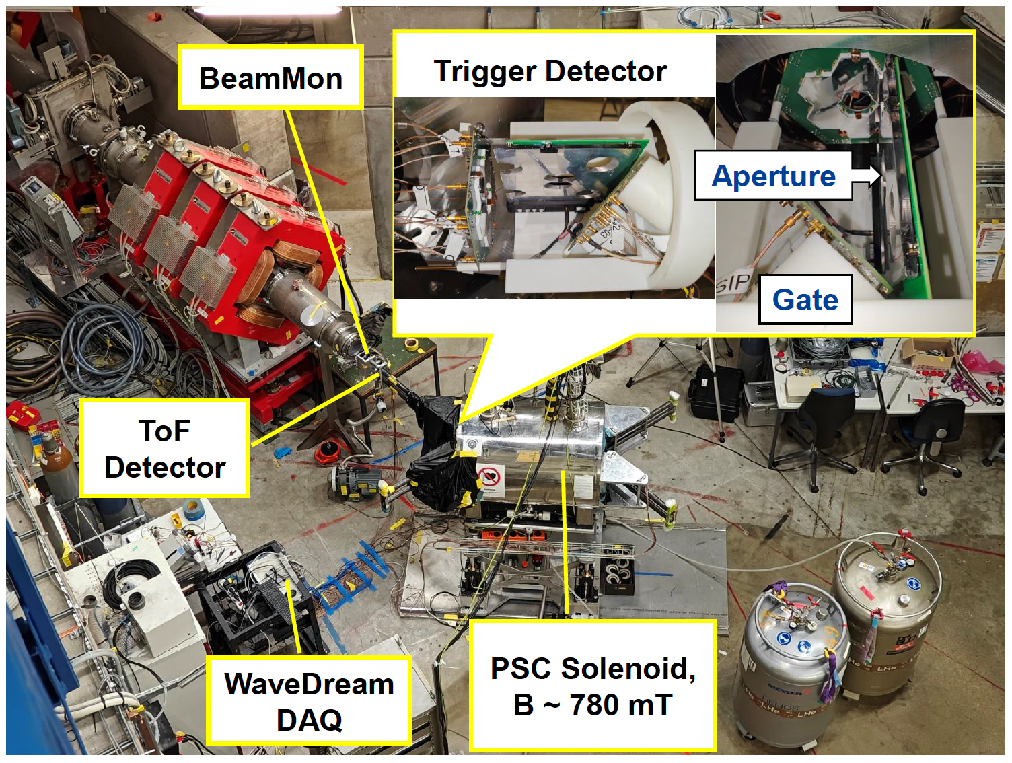
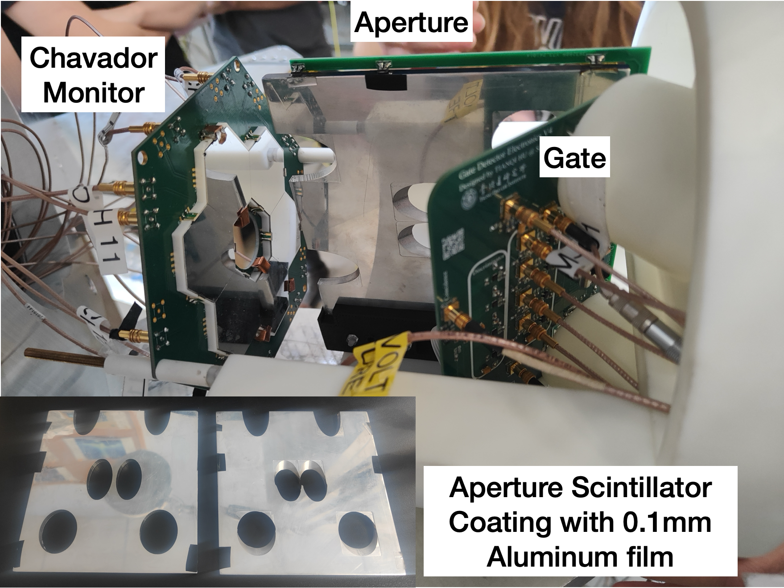

Beam time @ PSI in Oct/Nov 2024
Tested 3D spiral injection
Clockwise (CW) and counter-clockwise (CCW) injection
Momentum control when switching between CW and CCW injection
Characterized Trigger Detector
Performance of fast electronics readout
Acceptance rate and rejection rate
Induced background studies
Exit
Detector

Slide 8
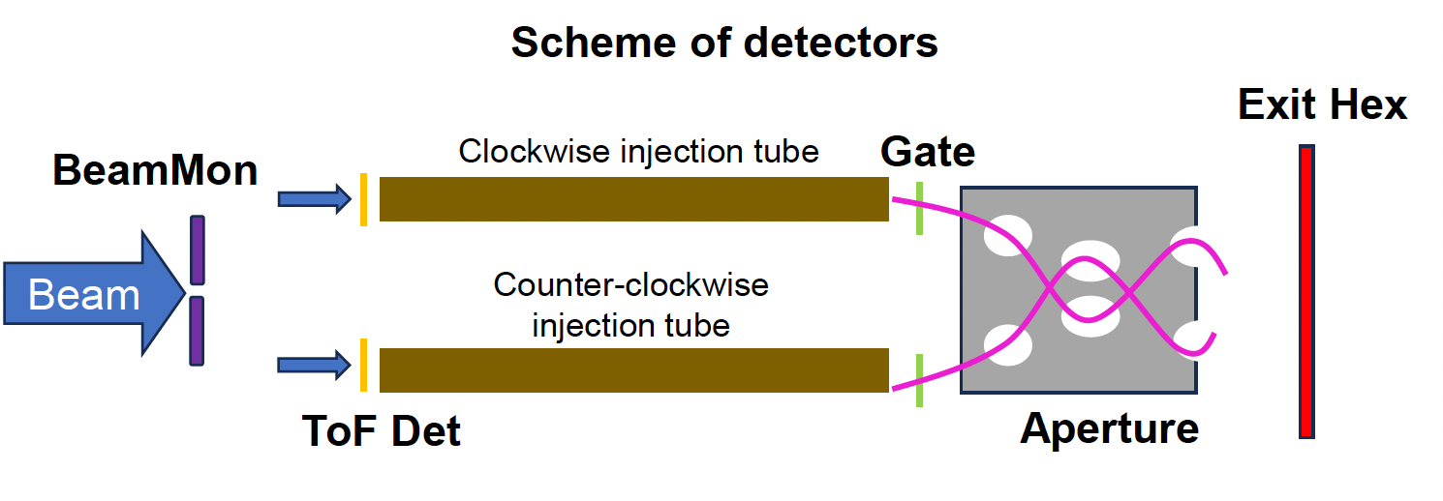
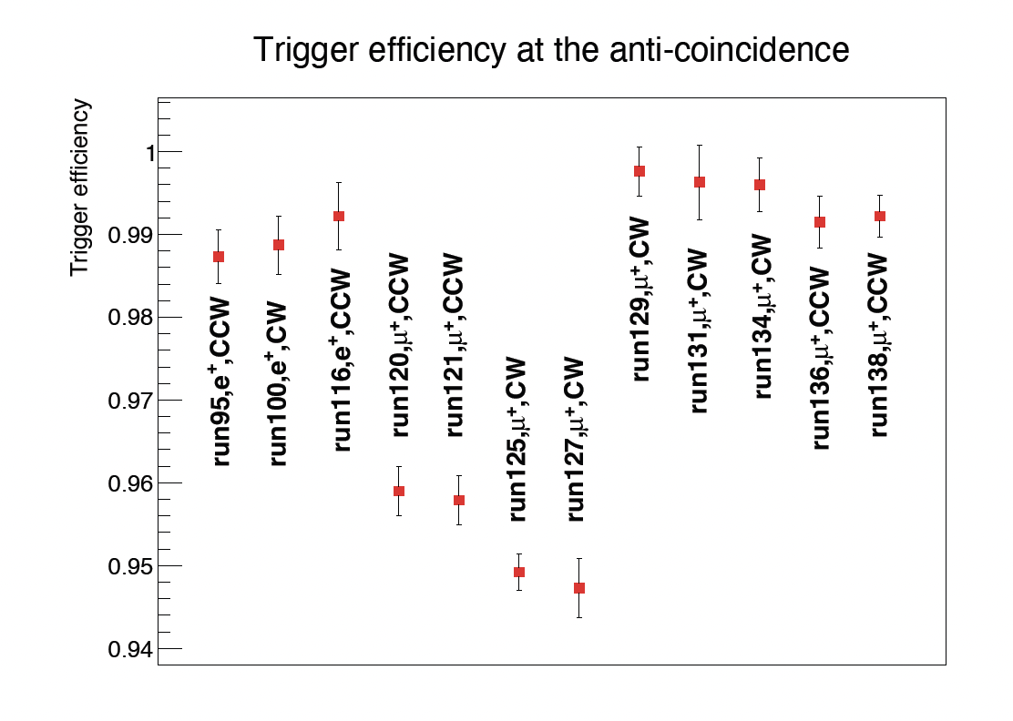
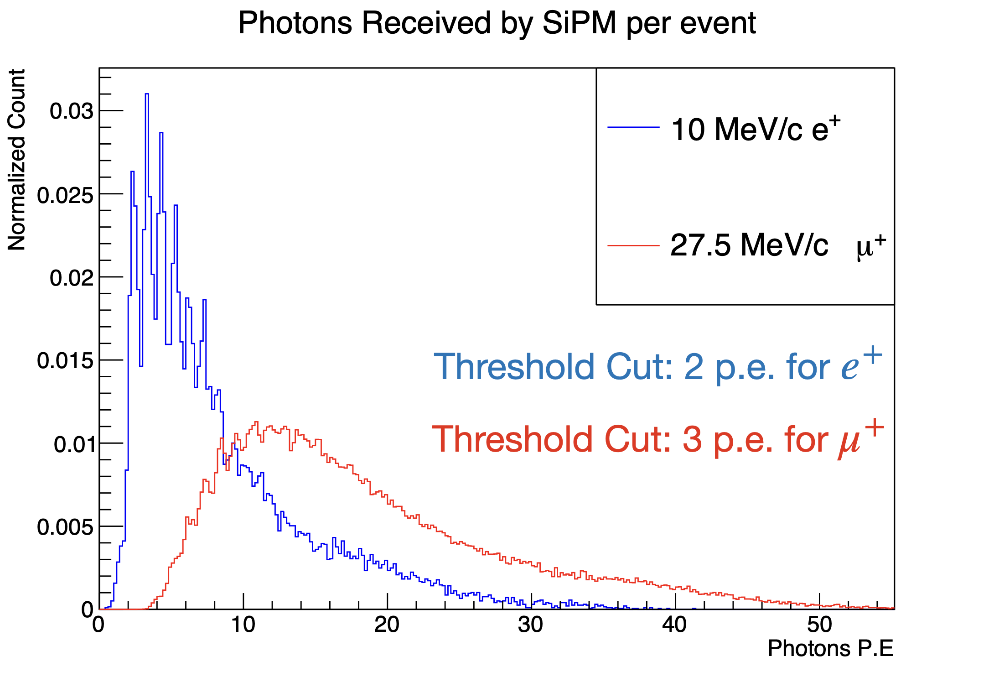
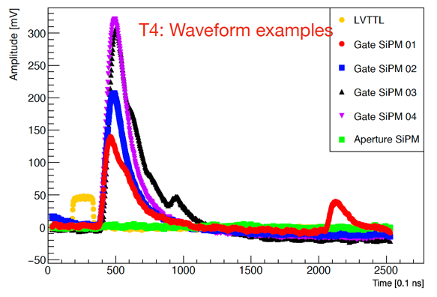
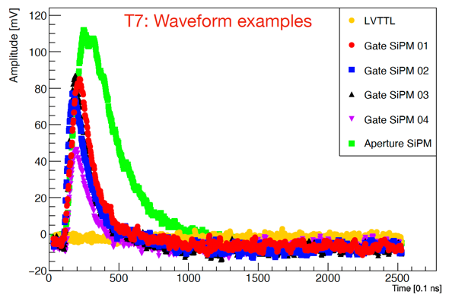
Preliminary results
Analysis ongoing,
preliminary results show
> 95% signal efficiency
Gate: Yes
Aperture: No
Gate: Yes
Aperture: Yes
Response to different particles
A good muon (with TTL signal)
A “bad” muon (without TTL signal)

Slide 9
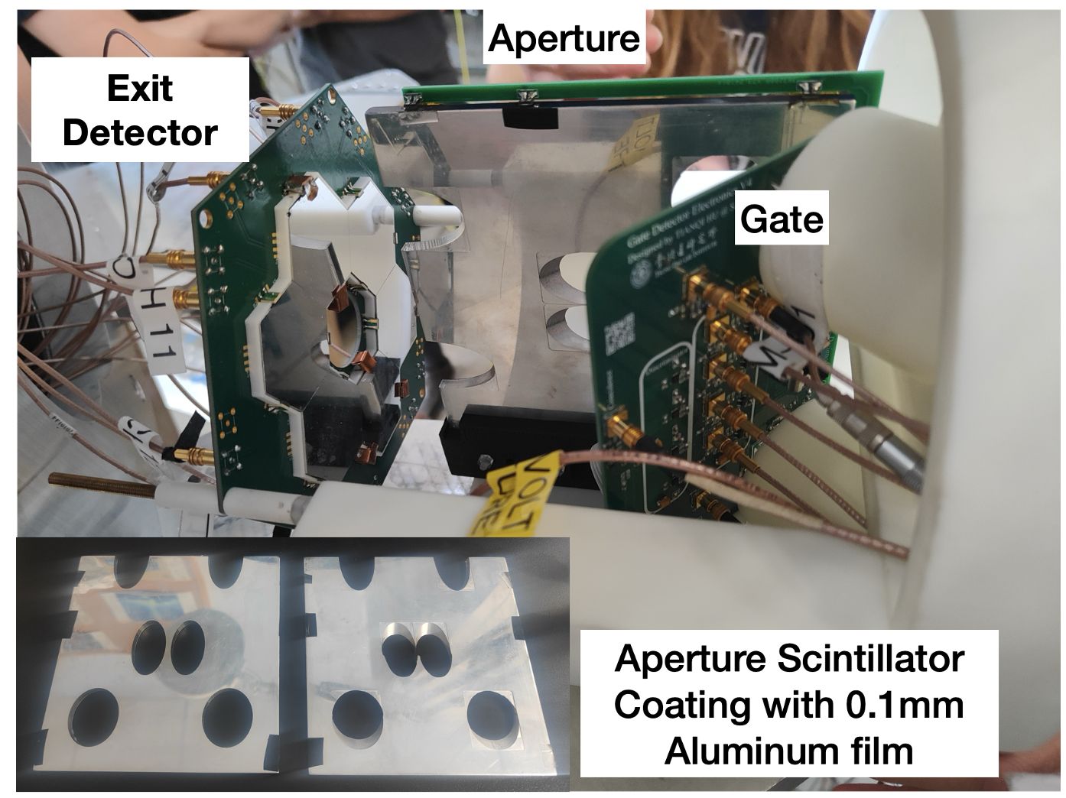
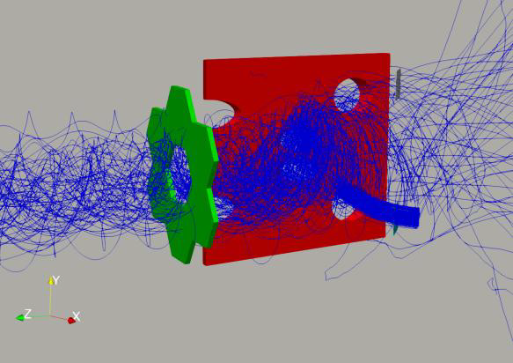
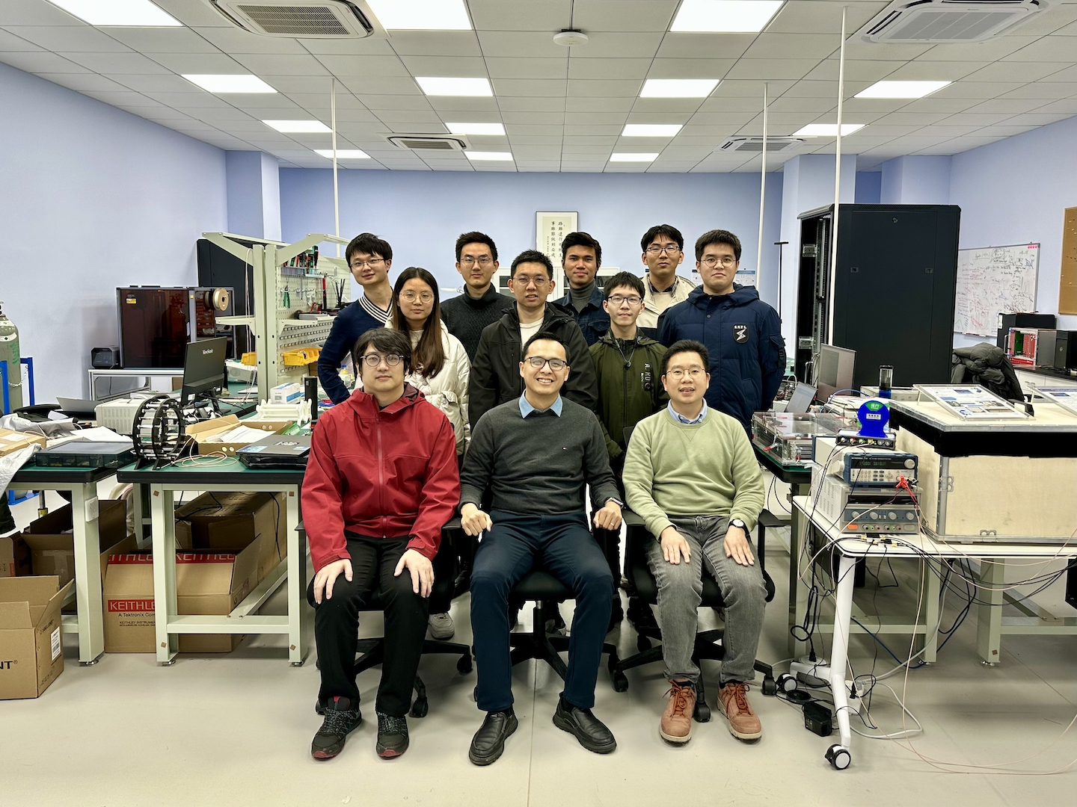
Summary and outlook
The Muon Trigger Detector is a vital part of the experiment, providing the trigger signal to the magnetic kicker for storable muons.
The choice of plastic scintillator, SiPM, and custom PCB technology is backed by the successful beam tests conducted at PSI in 2022 and 2024
Analysis and simulation on-going to finalize the Test Beam 2024 results
Another round of revisions will take place before the permanent installation of the detector for the commissioning and physics run of the experiment in 2026.

Slide 10
Talks and Publications
Talks
  MIP 2023, MIP 2024, NuFact 2023, NuFact 2024
Publications
  The muon trigger detector for the PSI muEDM experiment: design, simulation and beam test results (to be submitted to Nuclear Science and Techniques)
  Development of Fast Front-End Electronics for the Muon Trigger Detector in the PSI muEDM Experiment (to be submitted to IEEE Transactions on Nuclear Science)
  Beam test performance of a prototype muon trigger detector for the PSI muEDM experiment, arXiV:2501.01546 (submitted to RDTM for review)
  Research and development of a muon entrance trigger for the muEDM experiment at PSI, Nucl. Part. Phys. Proc. 346 (2024) 58-62

