Slide 1
muEDM: BVR: simulation
By Joe Price

Slide 2
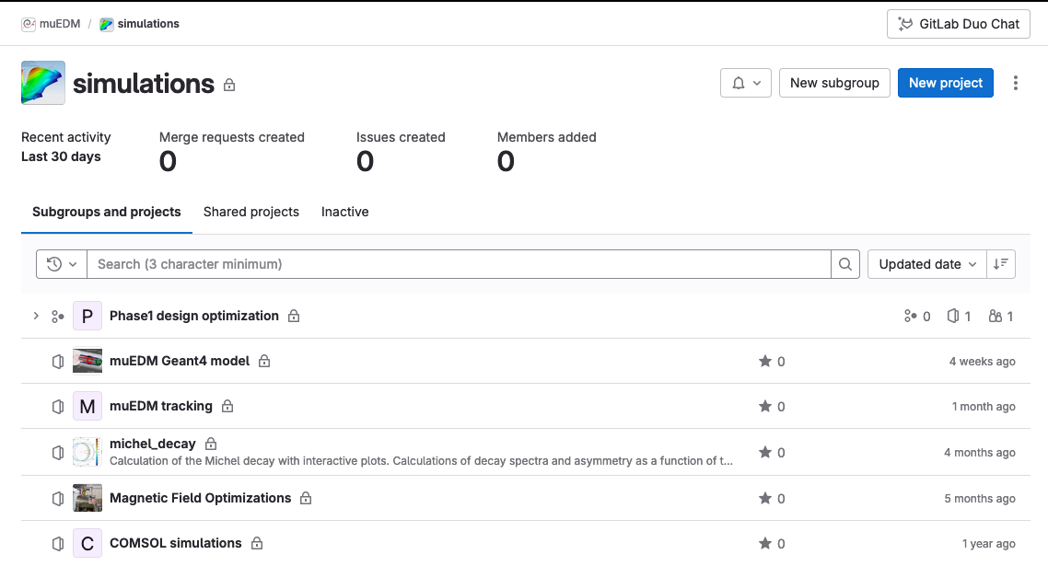
Simulation overview
We split the simulation into 3 groups:
G4Beamline
  Determine the muons arriving at the experiment, rates, momentum, polarisation, etc
  Storage efficiency, from injection to stable orbit
GEANT
  GEANT based models of the detectors and support structures
  Simulate interactions of incident particles, mimic detector response
Fields
  OPERA/COMSOL/ANSYS models of the magnetic fields used to store muons
  Time dependent fields, impacting stored muons/decay positrons etc.
Maintain, share and document the code on a git repository, hosted at PSI
Accounts for internal and external users available

Slide 3
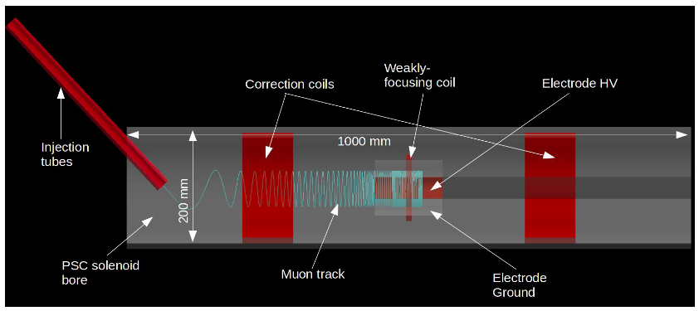
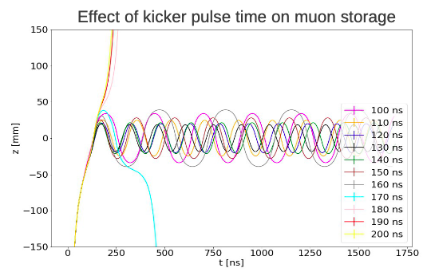
Beamline
courtesy of Ritwika Chakraborty
Study injection efficiency as kicked pulse time changes
Tweak time of pulsed field and observe effect on number of stored muons
Output distribution of stored muons

Slide 4
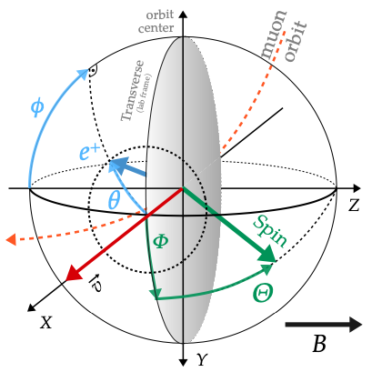
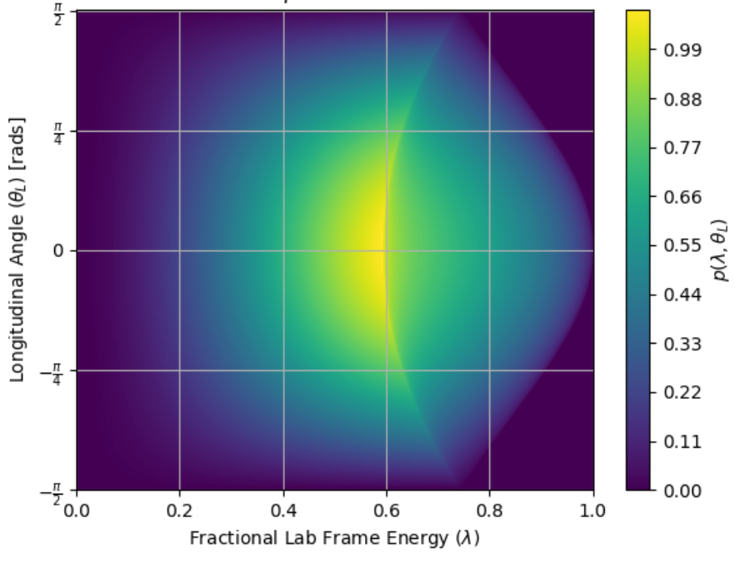
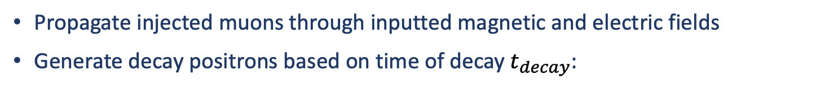
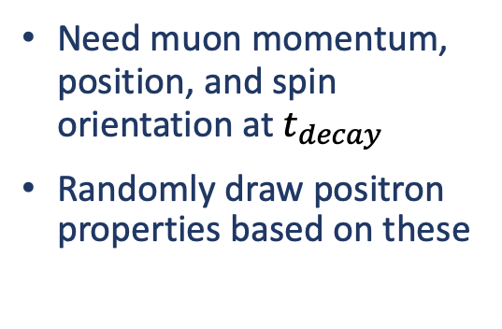
GEANT - Muon decay in simulation
Propagate injected muons through inputted magnetic and electric fields
Generate decay positrons based on time of decay $t_{decay}$:
Need muon momentum, position, and spin orientation at $t_{decay}$
Randomly draw positron properties based on these
Can choose to simulate muon with or without a muon EDM
This alters polarisation orientation at given time, and thus effects distribution of decay positrons – observable signal
Propagate decay positron through materials, recording the information as it passes through different detectors

Slide 5
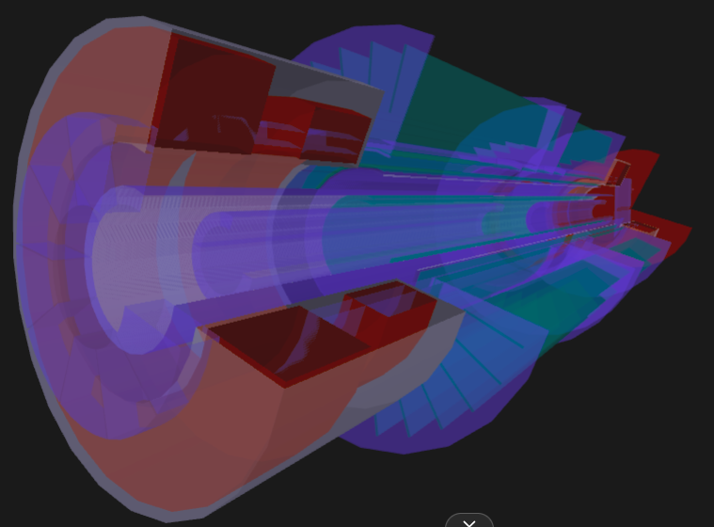
Detector placement
Detectors are placed into GEANT based on steerable input files
Shown here is a slice through the detectors in the GEANT simulation
Beampipe
Correction Coils
Triggers
E-field Anode/Cathode
Positron tracker (petals + cylinder )
Complete support structures + readout to be added

Slide 6
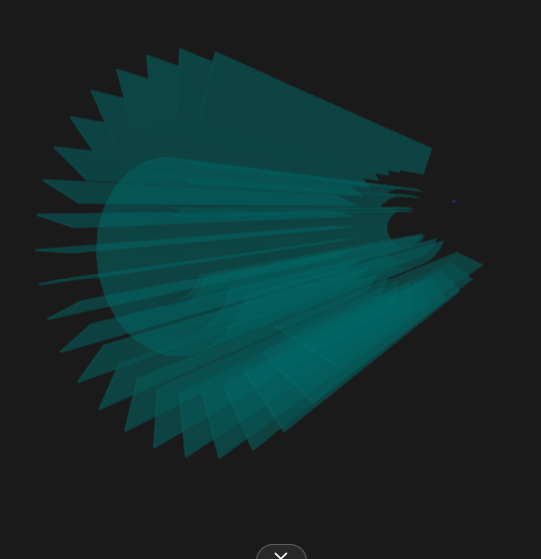
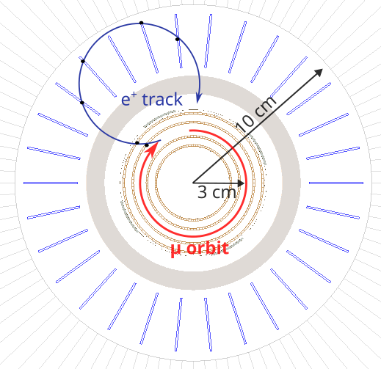
Detector response and reconstruction
Set which detectors are ‘sensitive’ – record the true positions and momenta
Multiple scattering is taken into account within GEANT
Turn on and off for systematic studies!
Positron Tracker (CHeT)
Determine response of detector to an incident particle
Include efficiency/noise etc.
Tuned to match data from test beams
Based on the reconstructed hit positions, make tracks and estimate positron properties
Antoine Venturini

Slide 7
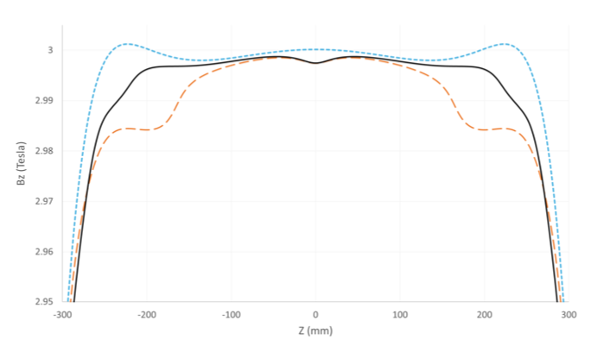
Field: simulation
Need to simulate the electric and magnetic field
Magnetic field during storage:
  Use OPERA based models and port into GEANT for charged particle propagation
Effect of the correction coils on the z component of the B-field, from OPERA
Blue line shows simulated field without correction
black is implemented in the main GEANT simulation – read in from file
Alex Bainbridge

Slide 8
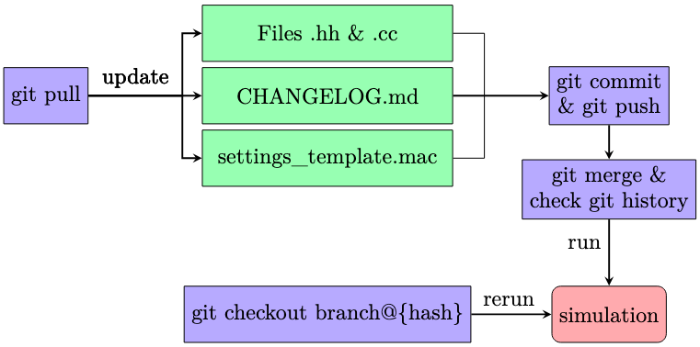
Simulation: Organisation
We have multiple people working on the simulation at the same time
Maintain a ‘master’ branch as basis for all other branches
Each analyser works on their own separate branch and merges into the master, documenting their changes
High stats are often needed for each file
More may need to be generated at a later date
Store Meta-data with the output of the files
Encapsulates status of repository when initially ran using ‘git hash’ – i.e. snapshot of the code
David Höhl

