Slide 1
Beyond standard X-ray free-electron laser pulses
Eduard Prat, Paul Scherrer Institute
Ultrafast X-ray Summer School, 1 July 2025

Slide 2
Contents
Introduction
Short pulses
High powers
Control of bandwidth and longitudinal coherence:
  External seeding
  Self seeding
  Increase of coherence length
  Large bandwidth
Multiple colors
Conclusion

Slide 3
Introduction
Standard FELs produce transversely coherent radiation with peak powers of 10-100 GW and pulse durations of tens of fs or shorter
State-of-the-art FEL facilities are based on the SASE process starting from the electrons’ shot noise. The obtained radiation is not longitudinally coherent, with power and spectral profiles consisting of multiple uncorrelated spikes. The relative bandwidth in the order of the Pierce-parameter ρ (10⁻³ – 10⁻⁴ for X-ray FELs)
In general, standard SASE-FEL is lacking individual control on several radiation properties, namely longitudinal coherence, bandwidth, polarization, pulse length and power. Moreover, SASE is not intrinsically locked to an external signal.

Slide 4
Introduction: standard SASE, seeded, and ultra-short pulses
Notes:
Standard FEL pulses start from shot noise (SASE process)
Typical FEL pulses have durations of a few tens of fs, excellent transverse coherence but poor longitudinal coherence
A typical pulse consists of multiple uncorrelated spikes in both time and spectral domains

Slide 5
Introduction
We would like to gain more control over the radiation properties: bandwidth, pulse length, power, coherence, polarization, multiple pulses, external synchronization.
Here we will see some methods to
  Create short pulses
  Increase FEL power
  Improve longitudinal coherence
  Increase or reduce bandwidth
  Make multiple pulses
The methods are mostly based on tailoring the electron beam distribution. Some also use special undulator configurations
Schemes employing lasers provide external synchronization
Disclaimer: the talk will not cover all methods and results, it will be biased towards SwissFEL

Slide 6
Short pulses

Slide 7
Introduction
  To first order, the FEL pulse duration is defined by the electron beam pulse duration which is able to lase (with proper current, emittance, trajectory, etc.). The lower limit is the FEL slippage, of 100’s of attoseconds for X rays.
  There are two basic ways to generate short FEL pulses
    Make a short electron beam (strong compression)
    Select a small fraction of the electron beam to lase… by spoiling all the electrons except a small fraction of it.

Slide 8
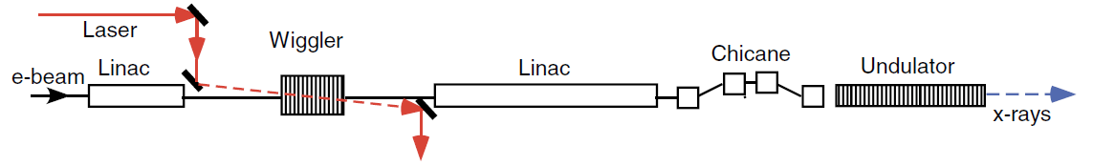
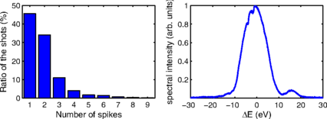
Make a short electron beam
With a laser
ESASE and similar schemes: [A. Zholents, PRSTAB 8, 040701, 2005]
Attosecond pulses demonstrated @ LCLS: [J. Duris et al, Nat. Phot. 14, 30, 2020]
energy modulation
density modulation
Without a laser
Single spike (indicating attosecond pulses) first demonstrated at LCLS
[S. Huang et al, PRL 119, 154801, 2017]

Slide 9
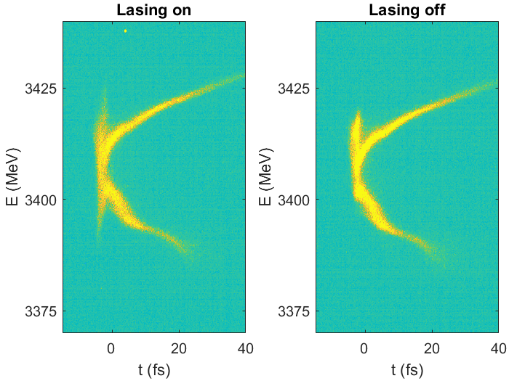
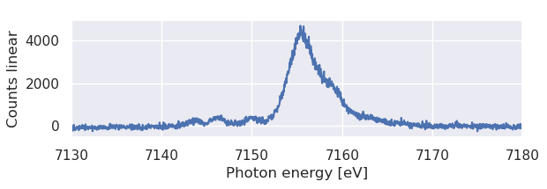
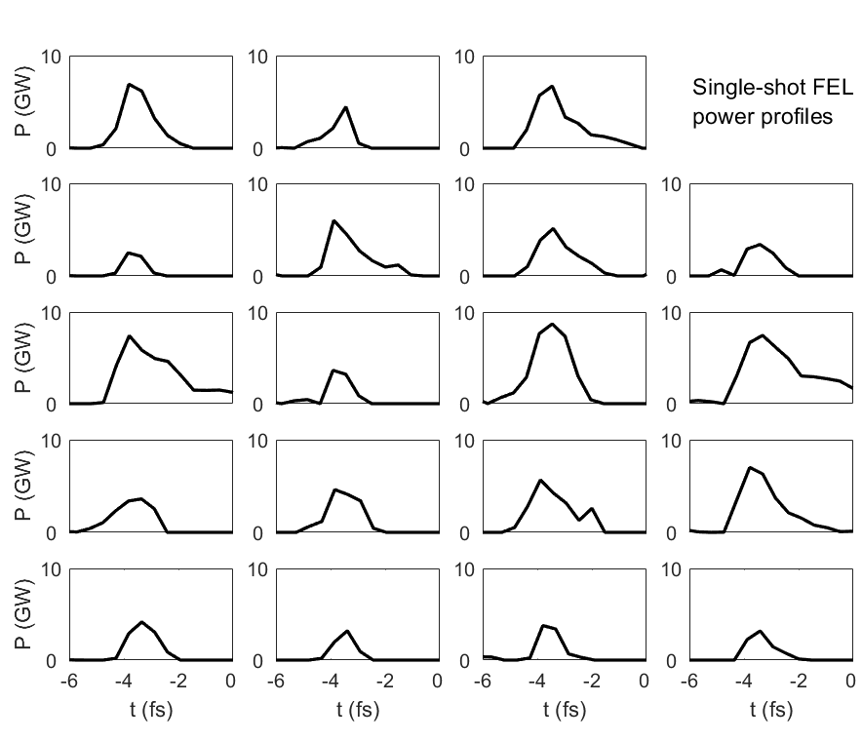
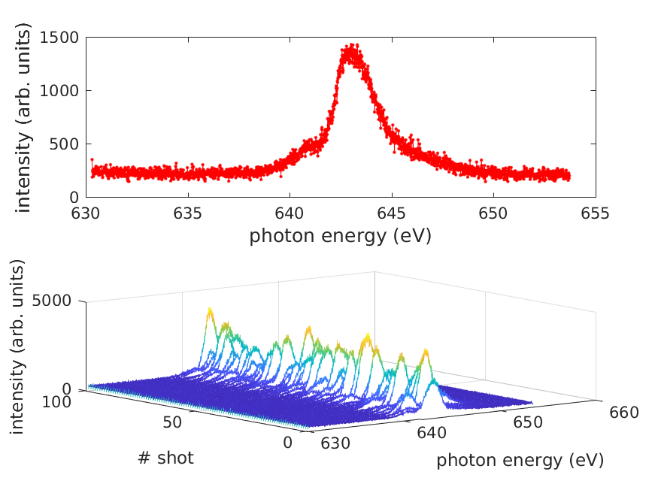
Make a short electron beam at SwissFEL
Time-resolved measurements in Athos with RF deflector (σ=0.57±0.22 fs, resolution limited)
In Aramis: [A. Malyzhenkov et al, PRR, 2, 042018(R), 2020]
Single shot
spectrum in
Aramis (σ<0.2 fs)
[E. Prat et al, Advanced Photonics 7(2), 026002, 2025]
In Athos: [E. Prat et al, APL Photonics 8, 111302, 2023]
Several single-shot spectra in Athos (σ<0.4 fs)

Slide 10
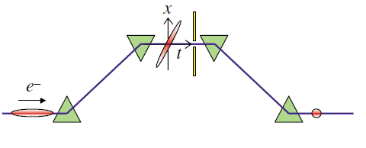
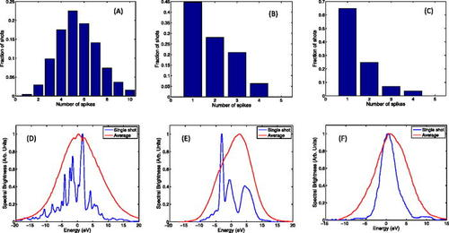
Select a small fraction of the electron beam. Example 1: tailoring the emittance with a slotted foil
In a bunch compressor
high dispersion (x-E correlation)
+
energy chirp (E-t correlation)
=
x-t correlation
→ A foil with slots in the transverse direction can be used to select time slots
Original idea
[Emma et al, PRL 92, 074801 (2004)]
No foil
220 um slot
130 um slot
Demonstrated attosecond pulses at LCLS
[A. Marinelli et al, APL 5, 111, 151101 (2017)]
Notes:
10

Slide 11
Select a small fraction of the electron beam. Example 2: tailoring the trajectory with a tilt
A transverse tilt is a correlation between the transverse and longitudinal coordinates of the electrons
A tilted beam traveling through the undulator produces XFEL radiation only for the centered (on-axis) slices
The XFEL amplification for the other slices is suppressed due to the betatron oscillations – no good transverse overlap between electrons and photons
Original idea: [P. Emma and Z. Huang, NIMA 528, 458 (2004)]
Demonstrated at several labs, e.g. at LCLS and SwissFEL, where we achieved sub-femtosecond pulses.
Tilted Beam
Betatron
oscillation

Slide 12
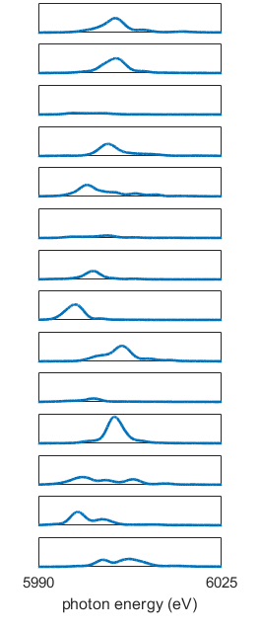
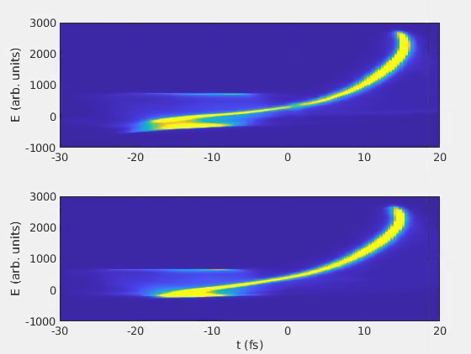
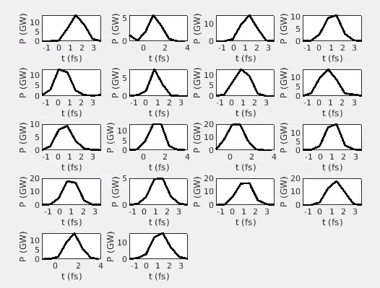
Short pulses from tilted beams at SwissFEL
Spectral measurements
σ<0.2 fs
Tilt generated by introducing dispersion to an energy chirped electron beam
Longitudinal phase-space measurements
Calculated FEL power profile
Lasing on
Lasing off
σ=0.63±0.06 fs (resolution limited)

Slide 13
High powers

Slide 14
Introduction
Typical power growth along the undulator beamline
FEL power at saturation:
saturation
exponential
growth
I: electron peak current
σ_{x}: transverse beam size
Emittance and energy spread effectively decrease ρ
Saturation power limited to 10-100 GW
Saturation power can be increased by increasing ρ, i.e. by improving the electron beam quality: increase current, reduce emittance, reduce energy spread…
Power after saturation can be increased with: tapering and methods based in superradiance. Here we see only this part.
Notes:
Saturation power (and length) depends on the electron charge density in 6D
Exponential growth stops as beam loses enough energy to upset resonant condition (power and bunching reach a maximum)
In addition, the energy spread increases so that the growth rate becomes negligible

Slide 15
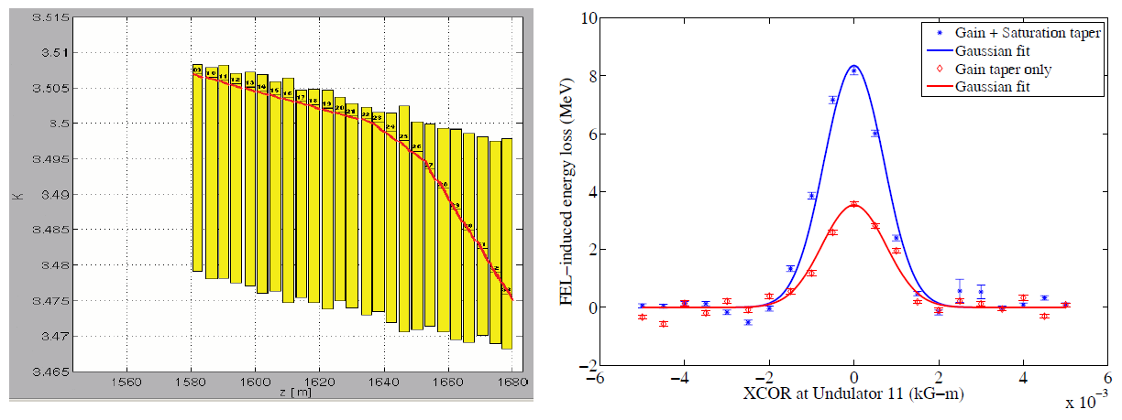
Tapering
It consists in changing the undulator field to keep the resonance condition by compensating the energy loss of the electrons.
Proposed more than 40 years ago [N. Kroll et al, IEEE JQE 17, 1436, 1981]
Experimentally demonstrated for SASE, e.g. at LCLS: [D. Ratner et al, FEL09, 221, 2010]
Taper profile
Meas. of FEL energy with & w/o taper
Increase of FEL pulse energy by more than a factor of 2
Notes:
The electrons are trapped in the FEL radiation bucket to maintain energy transfer from the electron beam to the radiation field.

Slide 16
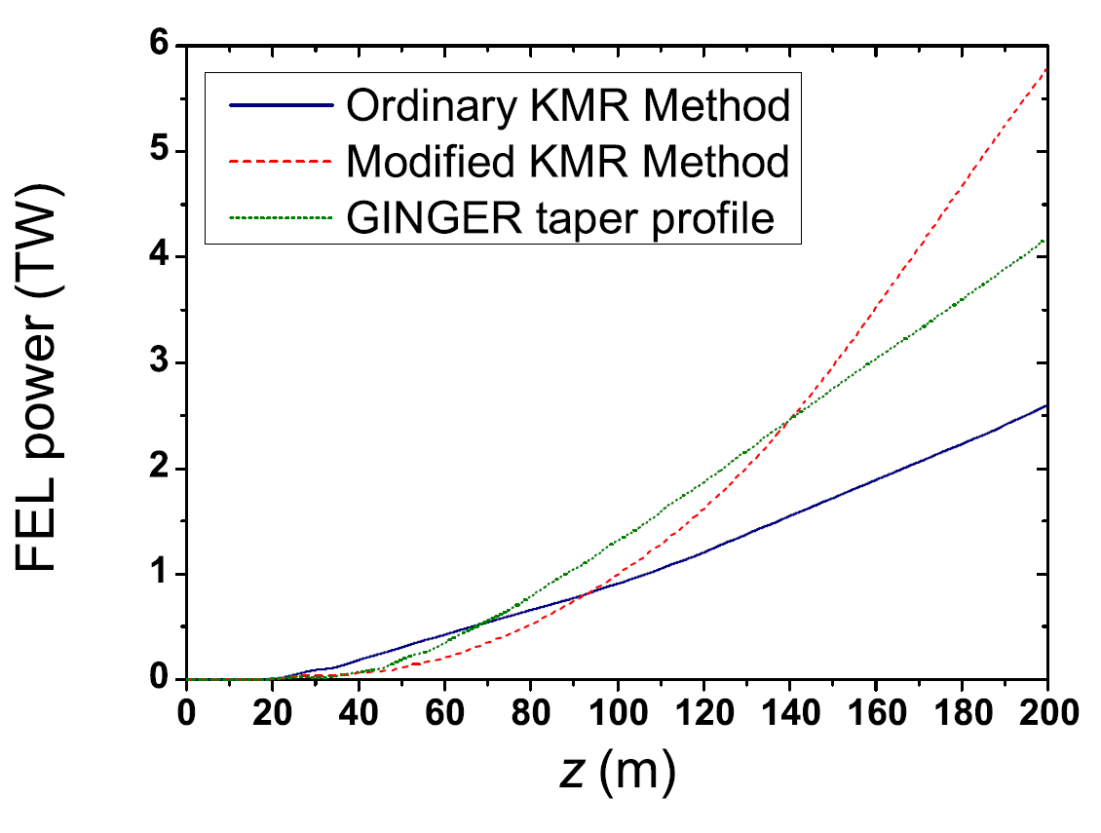
Tapering
Tapering works better if coherence is higher than in SASE [W. Fawley et al, NIMA 483, 537, 2002]
Extensive research on how to optimize taper profile (model and simulations), e.g. [E. Schneidmiller and M. Yurkov, PRSTAB 18, 030705, 2015], [A. Mak et al, PRSTAB 18, 040702, 2015]
Optimization work also with other parameters, such as transverse beam distribution, phase shifters and focusing in the undulator line, e.g.
[Y. Jiao et al, PRSTAB 15, 050704, 2012]
[C. Emma et al, PRSTAB 17, 110701, 2014]
Simulations show that several TW of power should be possible…
… but high-efficient taper has not been yet empirically demonstrated (requires long undulators)
Limit: Side-band instabilities (detrapping effect, bunching is destroyed)
Notes:
The limit is due to sideband instabilities. This means: noise in the power profile (which you have from the beginning in SASE) that evolves in reducing the FEL bucket. In SASE is much worse

Slide 17
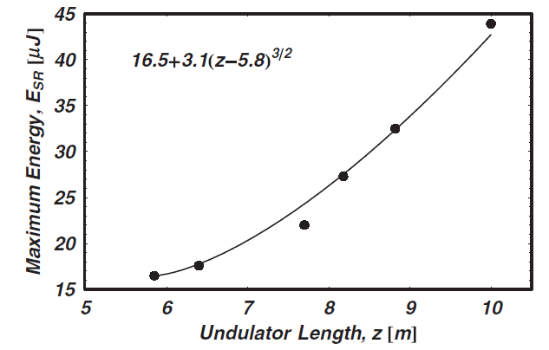
Superradiance
Superradiance
Regime after exponential growth where there is a quadratic increase of the FEL power and a shortening of the pulse length
In SASE the growth stops when the slippage equals the separation between 2 spikes, i.e. when the radiation spike interacts with degraded electrons
To keep the superradiance one can shift the radiation pulse to a bunch region with fresh electrons before the slippage is too long
It is an old concept… : [R. Bonifacio et al, NIM A 296, 358, 1990], [R. Bonifacio et al, PRA 44, R3441, 1991]
… demonstrated for λ~800 nm ~15 years ago: [T. Watanabe et al, PRL 98, 034802, 2007]
Pulse duration reduced from 150 to 80 fs
Notes:
17
It can start after the FEL exponential regime
In superradiance: $E∝Z^{\frac{3}{2}},σ∝Z^{−\frac{1}{2}},P∝Z^{2}$
Put first demonstration. https://www.ncbi.nlm.nih.gov/pubmed/17358688

Slide 18
Superradiance with multi-stage amplification
How it works:
The tail of the electron bunch generates a short FEL pulse
The short pulse is amplified with the rest of the bunch in several stages
Key components:
Magnetic chicanes between the undulator modules to shift the FEL pulse to fresh parts of the electron beam
“Fresher” to provide fresh electrons. Done by tailoring some beam property that can make short pulses.
Current (ESASE schemes): [T. Tanaka, PRL 110, 084801], [T. Tanaka et al, JSR 23, 1273, 2016]
Emittance (slotted foil): [E. Prat and S. Reiche, PRL 114, 244801, 2015]
Trajectory (beam tilt): [E. Prat et al, PRSTAB 18, 100701, 2015]
Delay + Alignment
Example with orbit (transverse tilt)
Lasing trajectory
Notes:
18

Slide 19
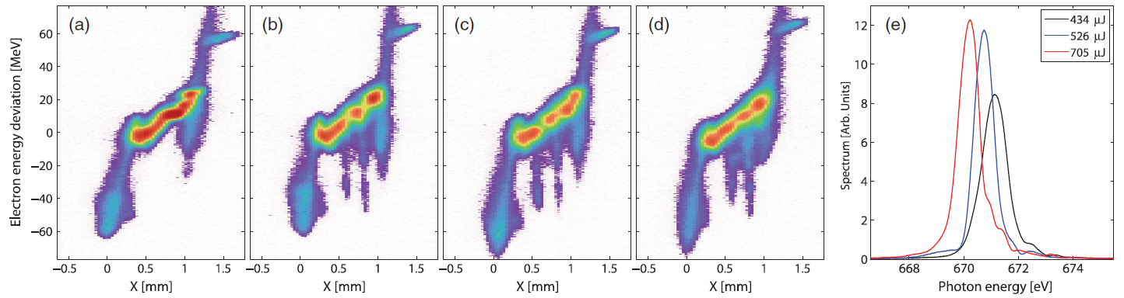
Superradiance with tilted electron beams
Shift the FEL pulse to fresh electrons for “superradiant” amplification
The fresh bunch slices are derived from a realignment of a tilted beam.
Delay + Alignment
Betatron
oscillation
First demonstrated at LCLS with 3 stages of amplification [A Lutman et al, PRL 120, 264801, 2018] (few hundreds of µJ and few fs at ~600 eV)

Slide 20

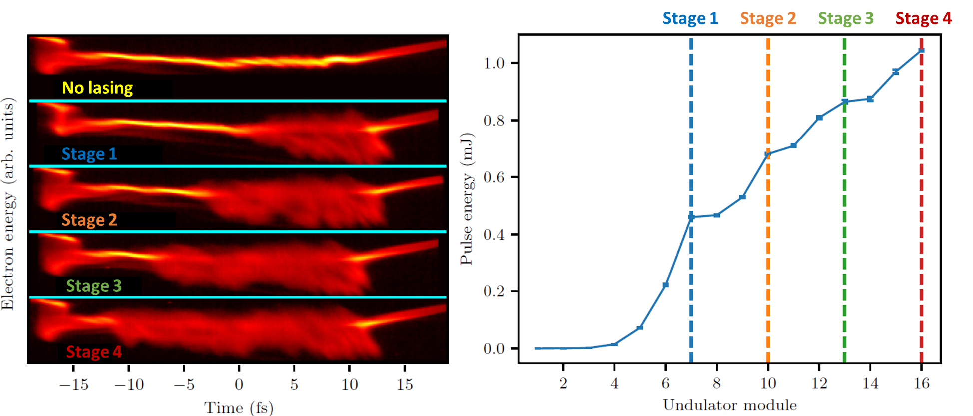
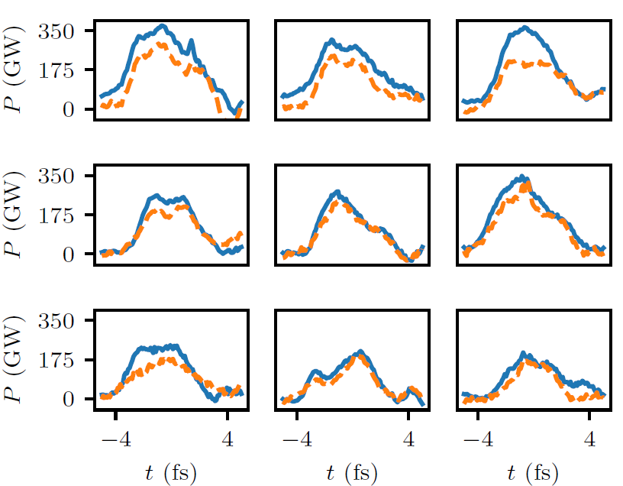
Superradiance with tilted electron beams at SwissFEL
Athos undulator
Best results:
  520 eV (shown here) : 4 stages, 1.05 mJ, 2-3 fs rms
  1 keV: 3 stages, 0.84 mJ, ~2 fs rms
[G. Wang et al, PRL 132, 035002 (2024)]
Time-resolved measurements
FEL Pulse Energy along Undulator
FEL Pulse Reconstruction

Slide 21
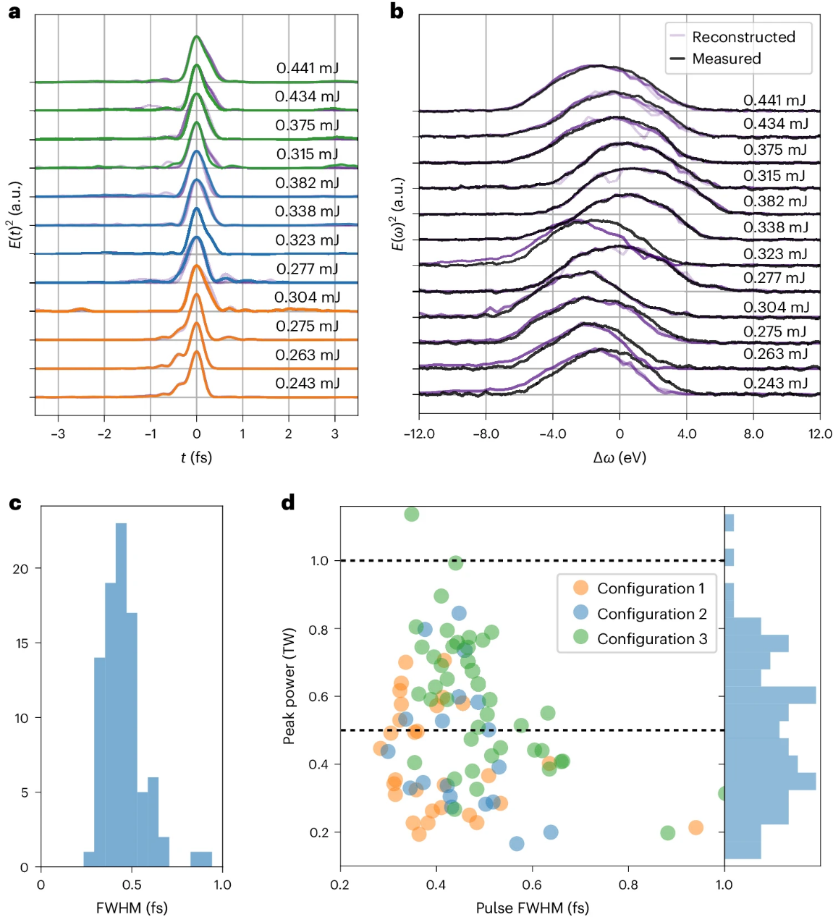
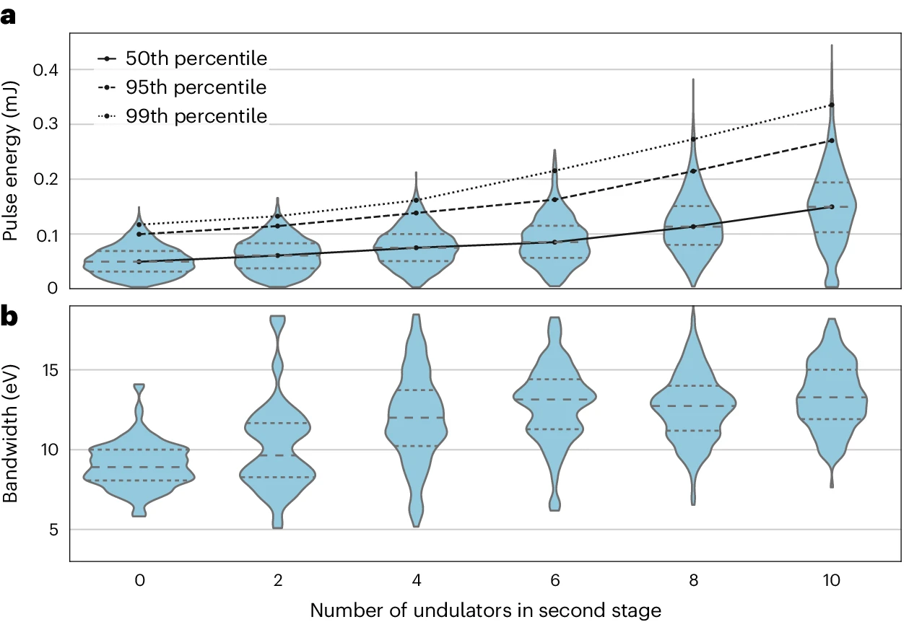
Superradiance with single spike and TW power at LCLS
2 stages of amplification, up to ~0.5 mJ with ~0.5 fs (FWHM)
[P. Franz et al, Nat. Phot. 18, 698 (2024)]

Slide 22
Control of bandwidth and longitudinal coherence

Slide 23
Introduction
Many experiments benefit from a high longitudinal coherence and low bandwidth
Ways to improve the longitudinal coherence of SASE-XFELs
(Filter the signal at the user station with monochromator (MC) → significant power loss)
Start the FEL process with a seed:
  Seed power needs to be higher than shot noise power (~kW)
  Seed can be an external laser (external seeding) or a monochromatized SASE radiation (self-seeding)
Increase the SASE cooperation length
  Use delays: reduce bandwidth with high-brightness SASE (HB-SASE) or produce frequency combs with mode-coupled (ML) or mode-locked (ML) SASE
  Use harmonic lasing (not covered here)
Short pulses with a single spike (fully coherent but bandwidth not improved)
XFEL oscillator (not covered here)

Slide 24
External seeding

Slide 25
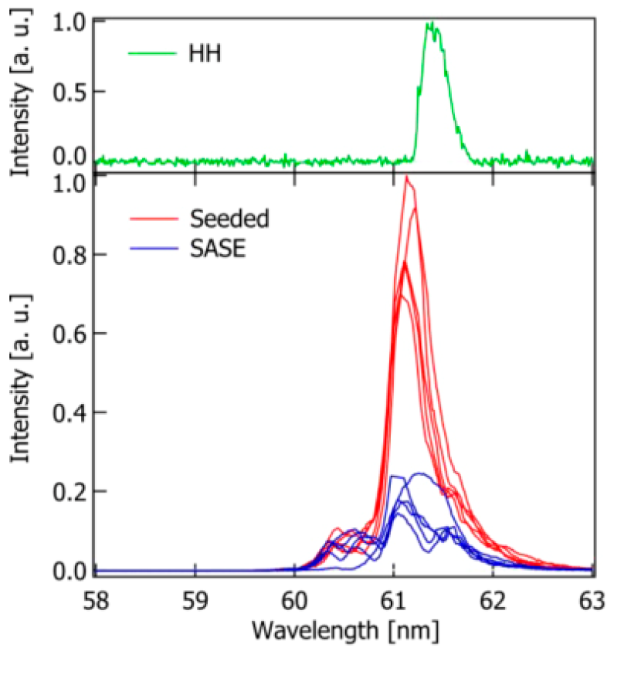
Direct seeding with high-harmonic generation (HHG)
e-beam
radiator
HHG source
Based on high harmonic conversion in gases: [E. Ferray, J. Phys. B 21, L31, 1988]
Demonstrated (some) amplification down to ~50 nm
SCSS at 60 nm: [G. Lambert et al, Nat. Phys. 4, 296, 2008], [T. Togashi et al, Optics Express 19, 317, 2011]
FLASH at 40 nm: [S. Ackermann et al, PRL 111, 114801, 2013]
Extremely difficult to reach the X-ray regime (power and spectral purity). Not much recent progress

Slide 26
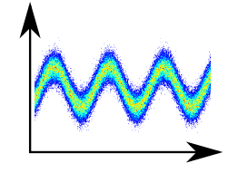
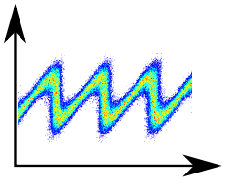
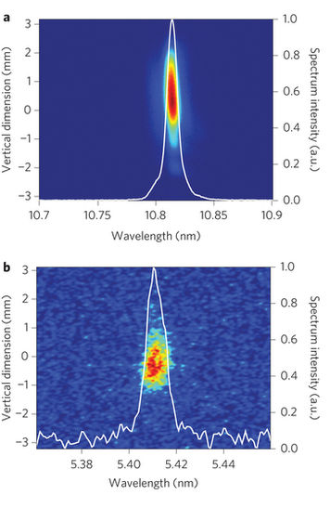
High-gain harmonic generation (HGHG)
e-beam
modulator 1
radiator
laser
An optical laser modulates the beam in energy, which is then converted to density modulation within a chicane
Bunching at harmonics is generated
Proposed long time ago: [L. Yu, PRA 44, 5178, 1991]
Energy spread is increased, limiting FEL performance. It requires more than one stage to reach soft X-rays
Demonstrated at FERMI (user facility) with single and double stage down to 4 nm: [E. Allaria et al, Nat. Photonics 7, 913, 2013]

Slide 27
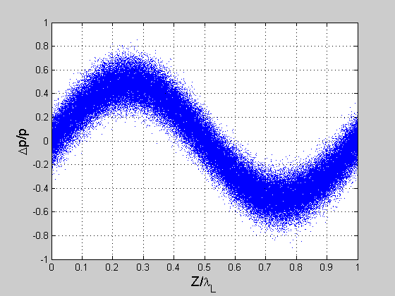
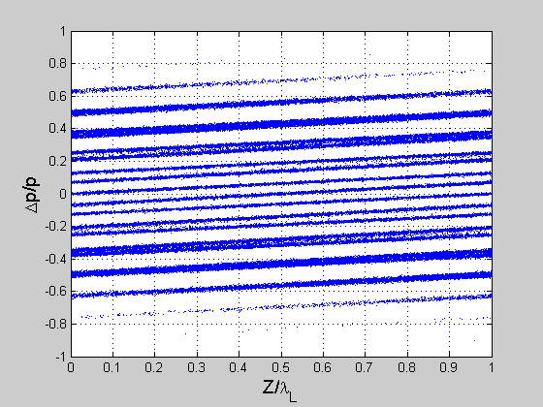
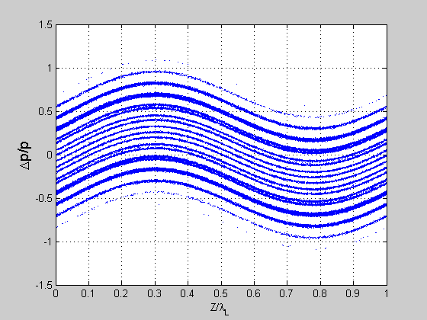
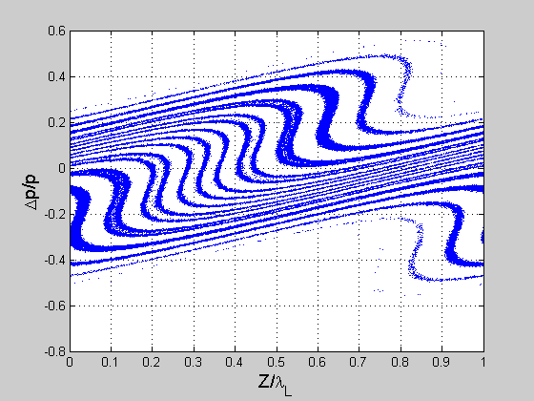
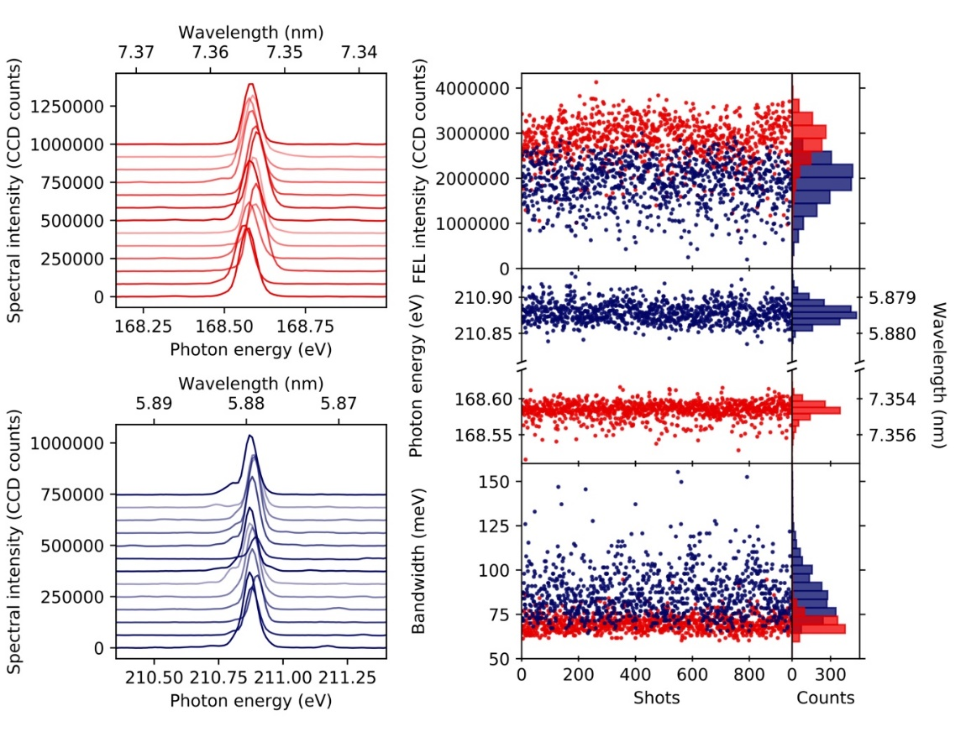
Echo-enabled harmonic generation (EEHG)
e-beam
modulator 1
modulator 2
radiator
laser 2
laser 1
  More sophisticated usage of chicanes and modulators using 2 optical lasers to get a given harmonic with less energy spread increase and better stability.
  Original idea: [G. Stupakov, PRL 102, 074801, 2009]
  Demonstrated at FERMI down to ~3 nm: [P. Rebernik et al, Nat. Phot. 13, 555, 2019]

Slide 28
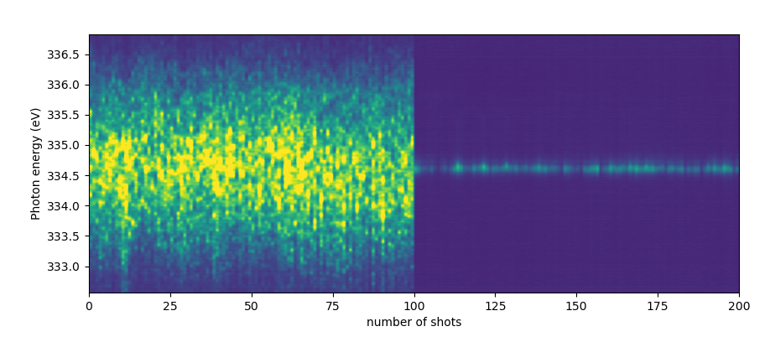
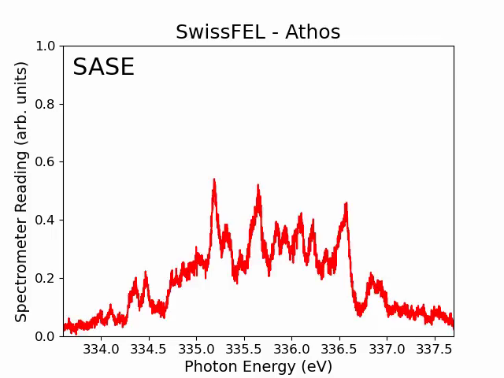
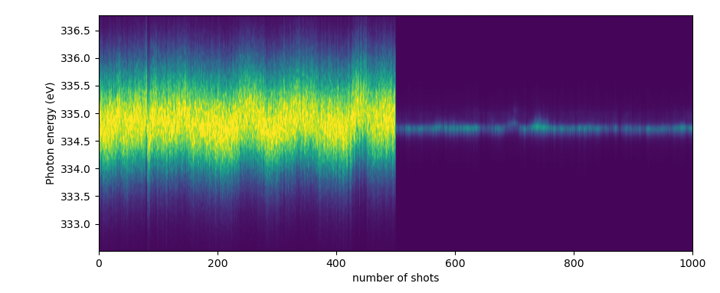
EEHG at SwissFEL
Demonstrated at ~4 nm (335 eV)
Plan to reach 1 nm
Shift 1
Bandwidth Reduction: about 14
Bandwidth improved by one order of magnitude,
enhanced photon energy stability
SASE
EEHG
Shift 2
Bandwidth Reduction: about 8.5
SASE
EEHG

Slide 29
Self seeding

Slide 30
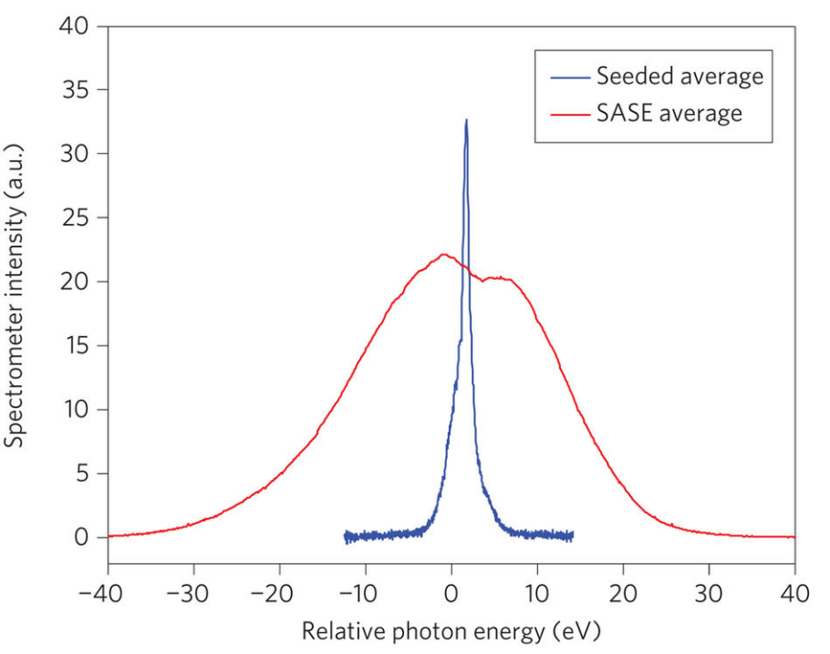
Self seeding
First concept developed more than 20 years ago for soft X-rays: SASE signal from 1st undulator section is monochromatized and seeded in a 2nd undulator section. [J. Feldhaus et al, Optic Comm. 140, 341, 1997]
For hard X-rays: use crystals as monochromator: [E. Saldin et al, NIMA 475, 357, 2001], [G. Geloni and E. Saldin, DESY 10-053, 2010]
e-
1st undulator section
SASE FEL
Grating monochromator
2nd undulator section
Seeded FEL
FEL
1st demonstrated at LCLS:
Hard X-rays: [J. Amann et al, Nat. Phot. 6, 693, 2012] . Bandwidth reduction of 40-50
Soft X-rays:[D. Ratner et al, PRL 114, 054801, 2015] . Bandwidth reduction of 10-30
Notes:
For soft X-rays: brightness improvement of 2-5

Slide 31
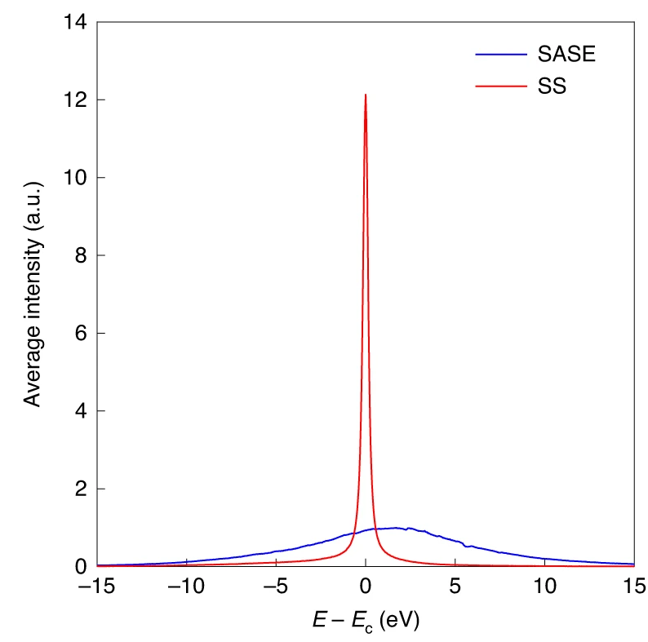
Self seeding
Self-seeding has been also demonstrated at SACLA, EXFEL and PAL-XFEL, and it is planned for SwissFEL.
Improvements with respect to standard self-seeding:
Fresh-slice self-seeding: [C. Emma et al, APL 110, 154101, 2017]
Reflection self-seeding: [I. Inoue et al, Nat. Phot. 2019] .
Best results at PAL-XFEL
[I. Nam et al, Nat. Phot. 15, 435, 2021]
Notes:
In standard self-seeding: compromise between
energy spread at section 2 (less modules wanted in section 1) &
seeding power after MC (more modules wanted in section 1)
Solution: use a fresh-slice to get high seed power and low energy spread
[C. Emma et al, APL 110, 154101, 2017]
Fresh slice with transverse beam tilt
Results: 2 times higher brightness
use a Si channel-cut crystal monochromator, seed generated by Bragg reflection. Proposed and demonstrated at SACLA: [I. Inoue et al, Nat. Phot. 2019] .
Advantages: no SASE background, higher conversion efficiency

Slide 32
Increase of coherence length

Slide 33
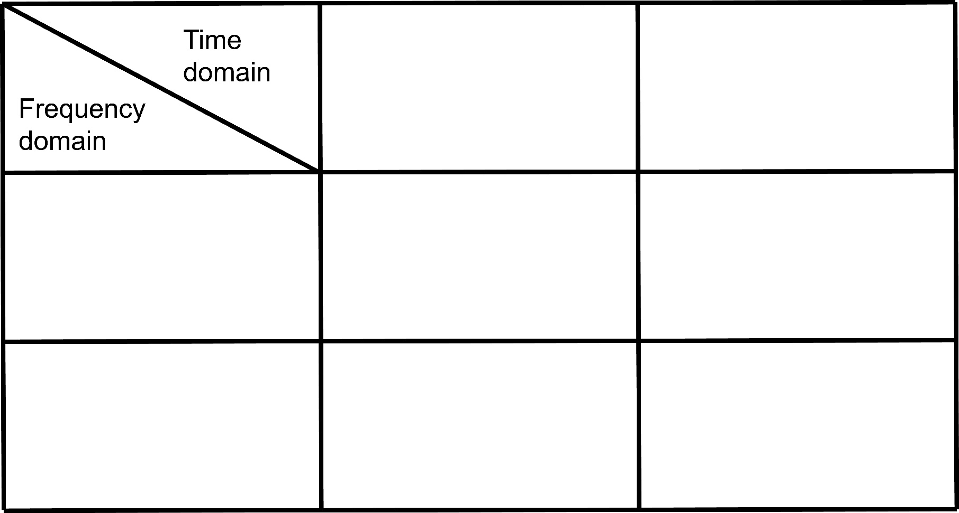
Mode-coupled (MC) and mode-locked (ML) SASE
Standard (self-amplified spontaneous emission) SASE: FEL process starts from beam intrinsic noise.
External seeding: periodic beam energy (or density) modulation regulates the output.
Chicanes in between undulator modules: improves longitudinal coherence by delaying the electrons.
Uncontrolled
Controlled, via seed laser
Uncontrolled
Standard SASE
(SASE)
Enhanced SASE
(ESASE)*
Controlled, via chicanes
Mode-coupled SASE
(MC-SASE)**
Mode-locked SASE
(ML-SASE)**
*A. A. Zholents, Phys. Rev. ST Accel. Beams, 8:040701 (2005).
**N. R. Thompson and B. W. J. McNeil, Phys. Rev. Lett., 100:203901 (2008).

Slide 34
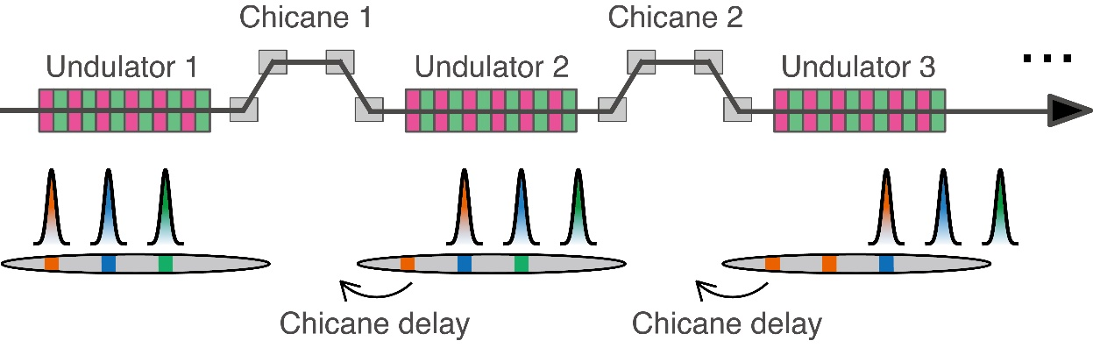
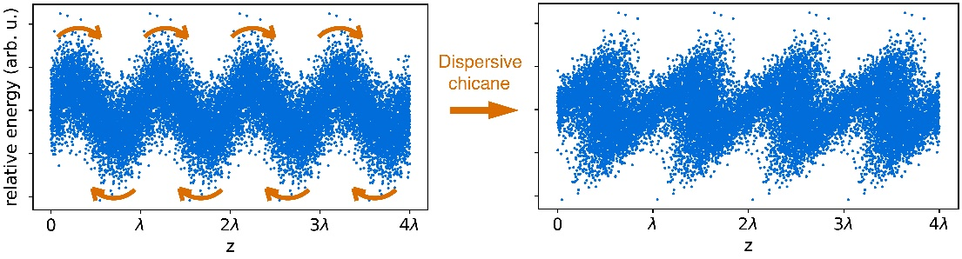
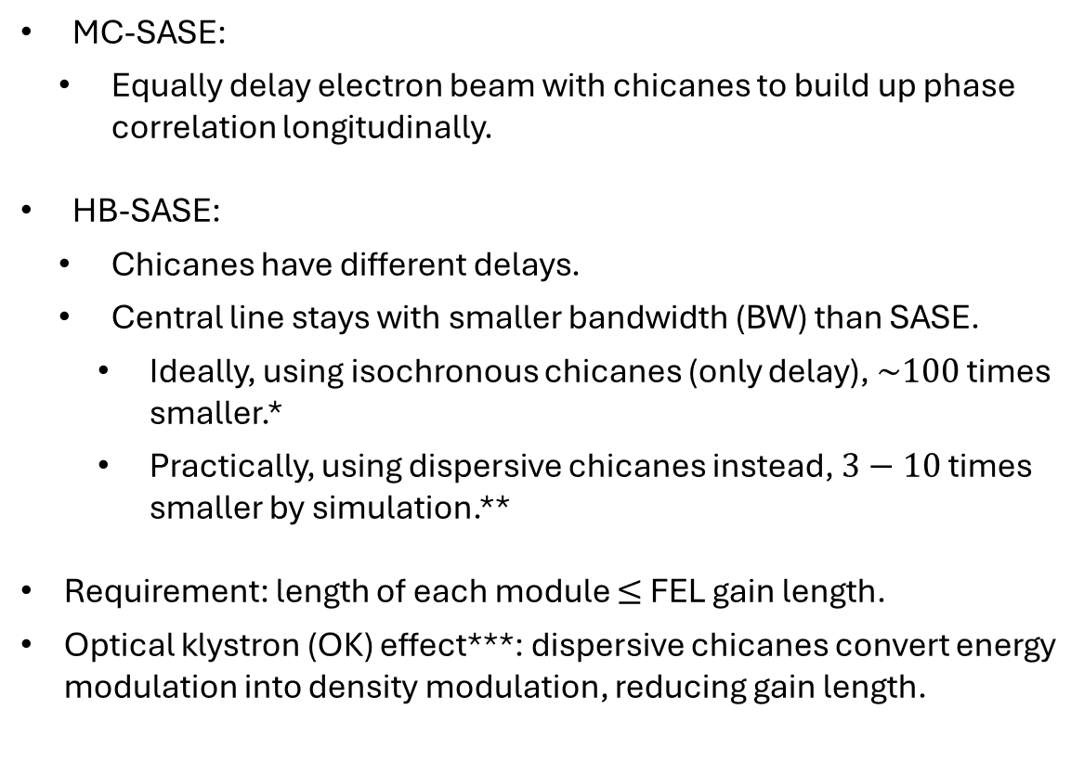
MC-SASE and high-brightness (HB) SASE
MC-SASE:
  Equally delay electron beam with chicanes to build up phase correlation longitudinally.
HB-SASE:
  Chicanes have different delays.
  Central line stays with smaller bandwidth (BW) than SASE.
    Ideally, using isochronous chicanes (only delay), $\sim 100$ times smaller.*
    Practically, using dispersive chicanes instead, $3−10$ times smaller by simulation.**
Requirement: length of each module $≤$ FEL gain length.
Optical klystron (OK) effect***: dispersive chicanes convert energy modulation into density modulation, reducing gain length.
Simulated
MC-SASE spectrum
Simulated
HB-SASE spectrum
OK effect schematic
*B. W. J. McNeil et al. Phys. Rev. Lett.,110:134802 (2013).
** E. Prat and S. Reiche. J. Synchrotron Rad.,26(4) (2019).
***E. Prat et al. Appl. Phys. Lett., 119(15):151102 (2021).

Slide 35
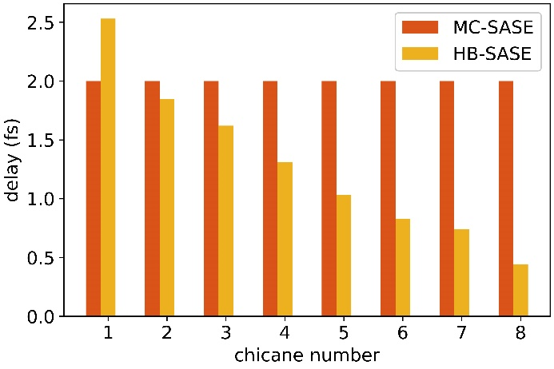
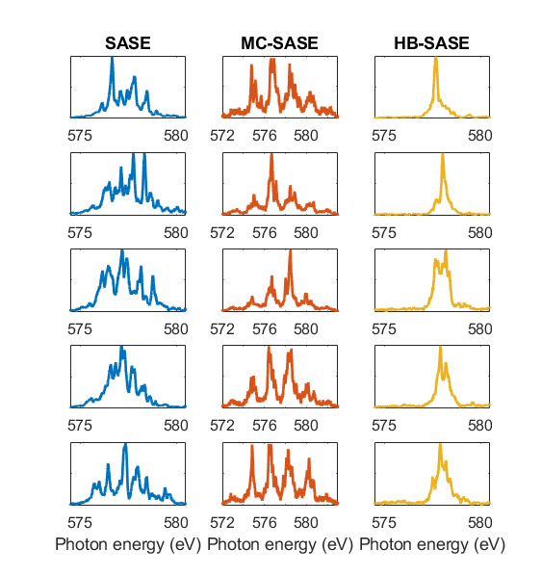
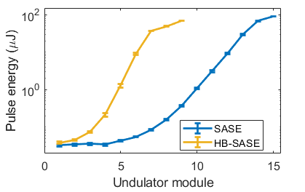
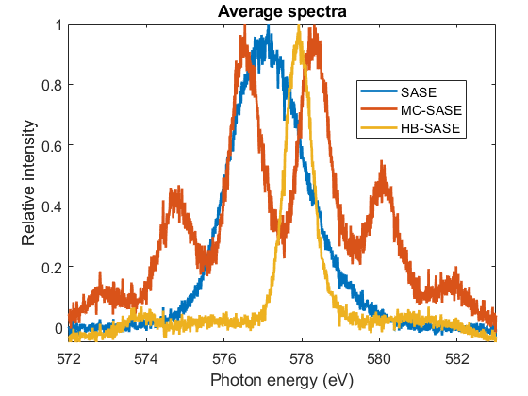
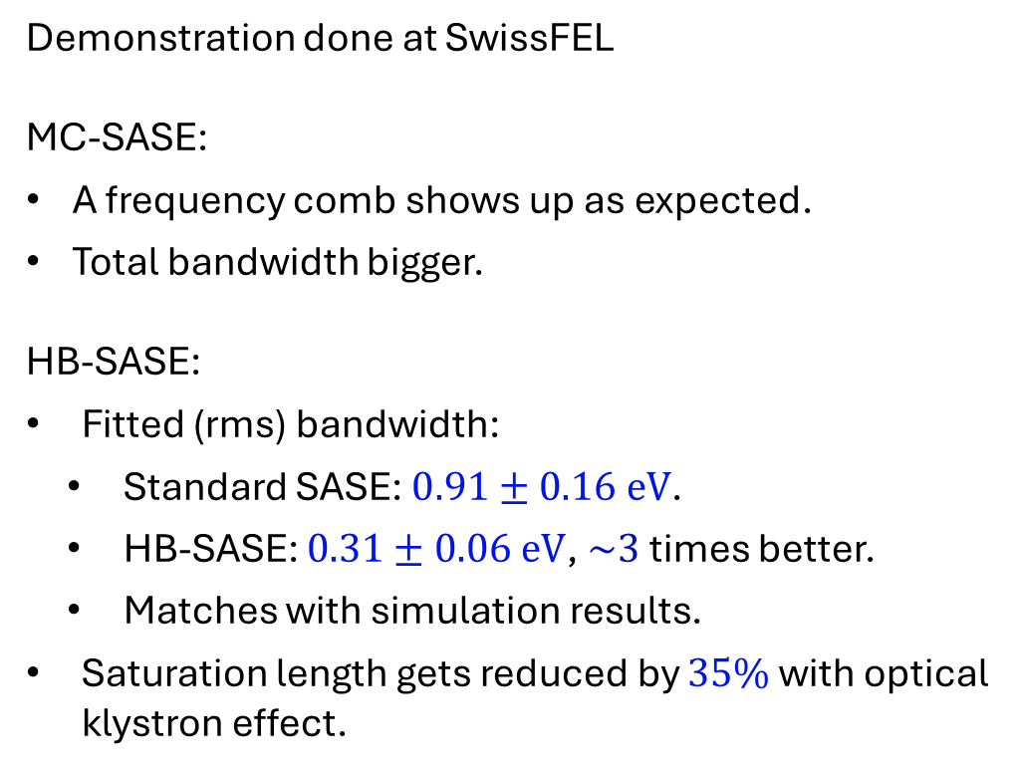
Experimental demonstration of MC-SASE and HB-SASE
Demonstration done at SwissFEL
MC-SASE:
A frequency comb shows up as expected.
Total bandwidth bigger.
HB-SASE:
Fitted (rms) bandwidth:
  Standard SASE: $0.91±0.16 eV$.
  HB-SASE: $0.31±0.06 eV$, $\sim 3$ times better.
  Matches with simulation results.
Saturation length gets reduced by $35\%$ with optical klystron effect.
Measured results
[E. Prat et al., Phys. Rev. Lett., 133, 205001, 2024]

Slide 36
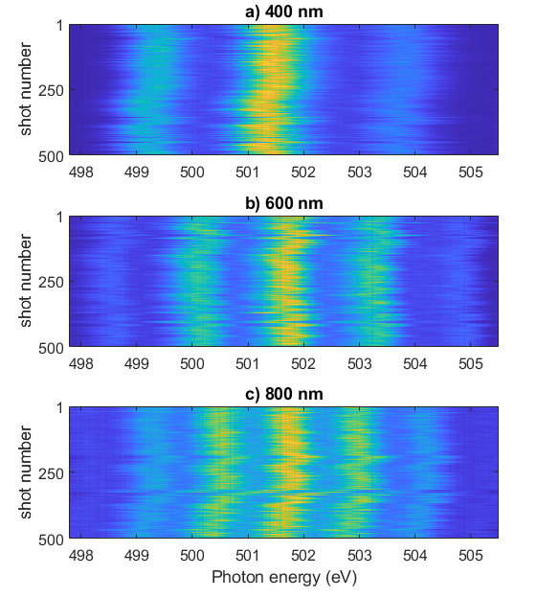
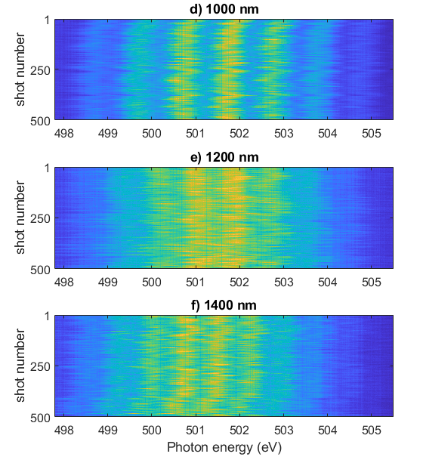
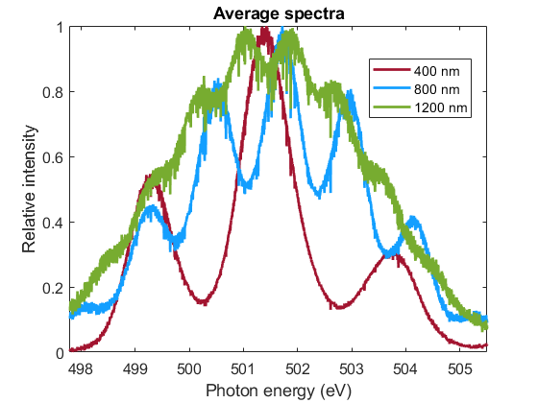
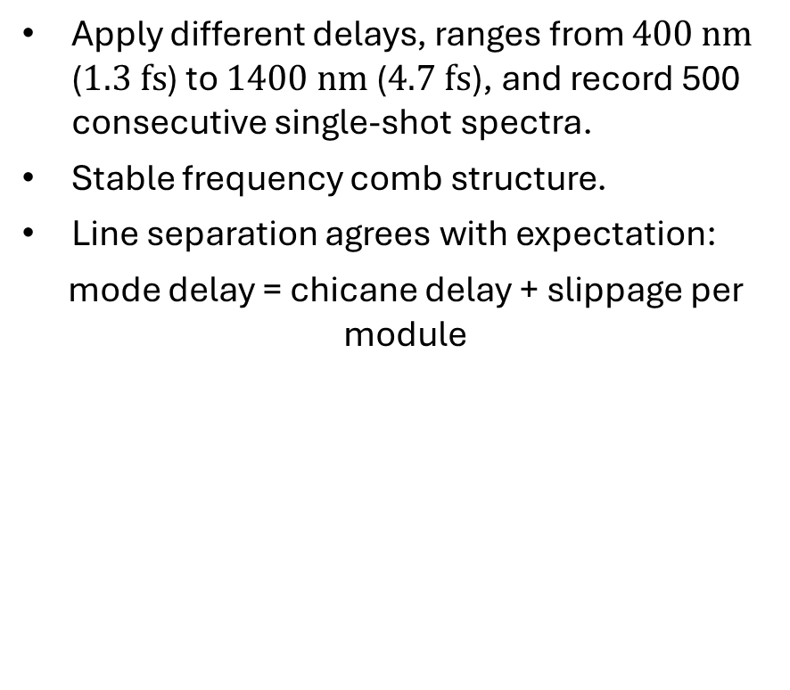
Tunability of MC-SASE
Single-shot & averaged spectra with different delays
Apply different delays, ranges from $400 nm$ ($1.3 fs$) to $1400 nm$ ($4.7 fs$), and record 500 consecutive single-shot spectra.
Stable frequency comb structure.
Line separation agrees with expectation:
mode delay = chicane delay + slippage per module
[E. Prat et al., Phys. Rev. Lett., 133, 205001, 2024]

Slide 37
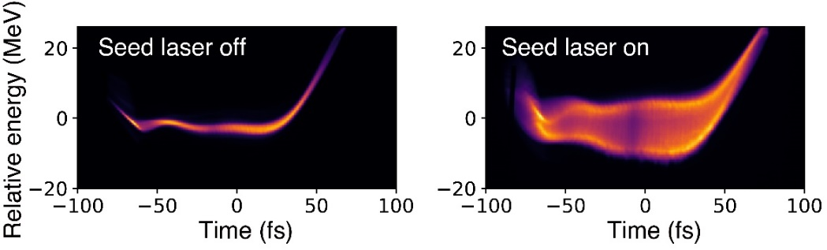
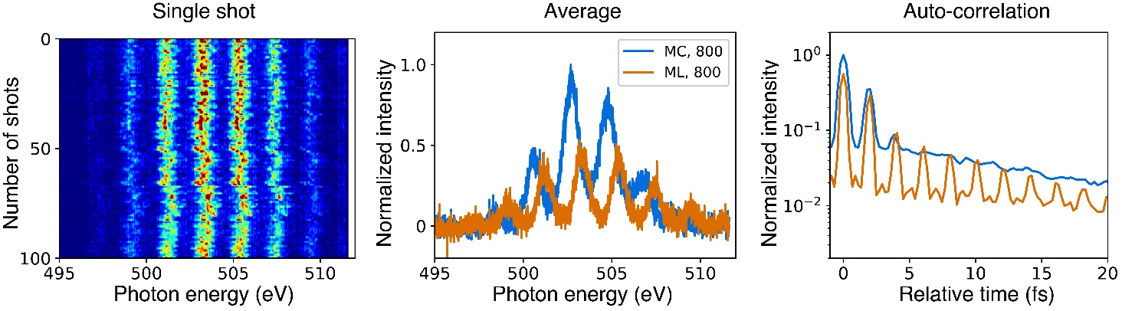
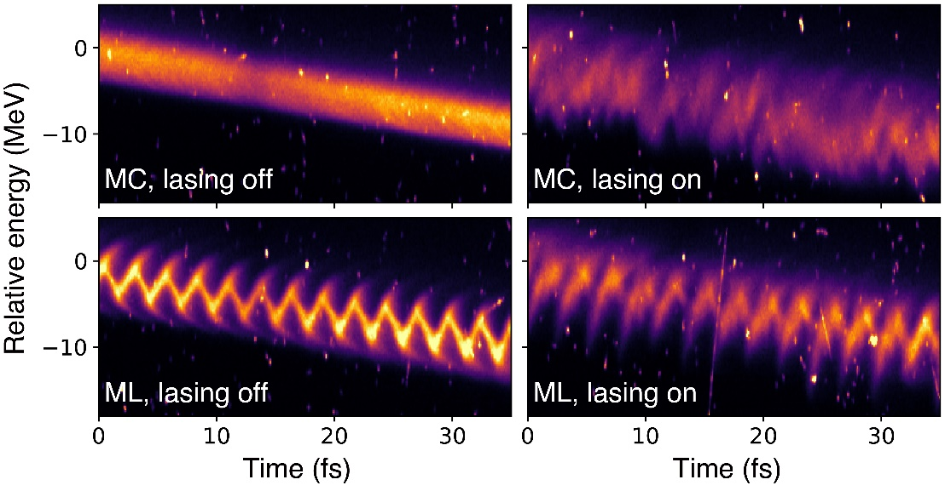
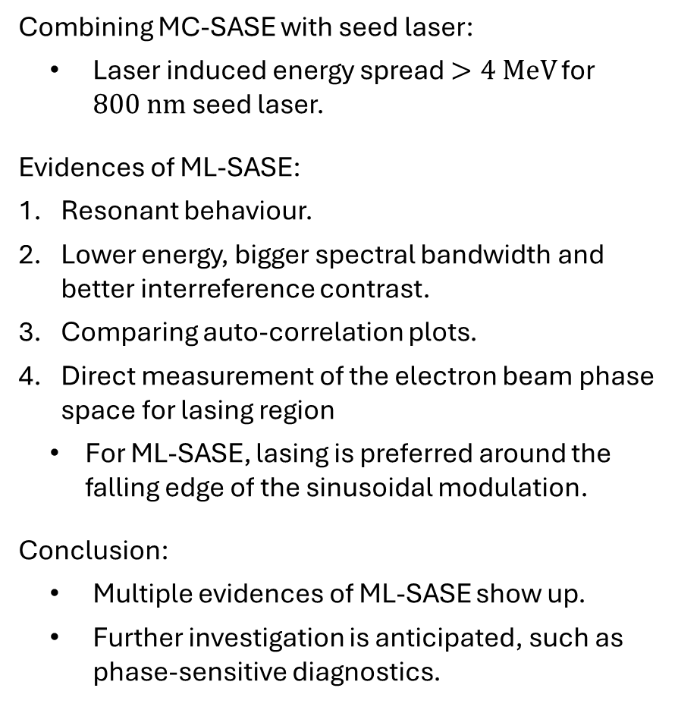
Experimental demonstration of ML-SASE
Phase space for 800 nm seed laser
Combining MC-SASE with seed laser:
  Laser induced energy spread $>4 MeV$ for $800 nm$ seed laser.
Evidences of ML-SASE:
Resonant behaviour.
Lower energy, bigger spectral bandwidth and better interreference contrast.
Comparing auto-correlation plots.
Direct measurement of the electron beam phase space for lasing region
  For ML-SASE, lasing is preferred around the falling edge of the sinusoidal modulation.
Conclusion:
  Multiple evidences of ML-SASE show up.
  Further investigation is anticipated, such as phase-sensitive diagnostics.
Spectral analysis
High-resolution phase space measurements

Slide 38
Large bandwidth

Slide 39


Large bandwidth
Some applications (e.g. spectroscopy) want large bandwidths.
Conventional method: maximize energy chirp of the electron beam (each slice of the e- beam will produce FEL with a different photon energy).
Demonstrated at LCLS and SwissFEL (up to 2% bandwidth)
Longitudinal phase spaces
FEL spectral measurements
Large
bandwidth
standard
[E. Prat el at, PRL 124, 074801, 2020]

Slide 40


Even larger bandwidth
Use a transverse-gradient undulator (K depends on transverse position) in combination with a tilted electron beam
Simulations show ~10% bandwidths
are possible for Athos
[E. Prat et al, JSR 23, 874 (2016)]

Slide 41
Multiple colors

Slide 42
Introduction
Multiple pulses with different energies (multiple colors) can be beneficial for some experiments, e.g. for X-ray pump and probe experiments. Here we focus on two colors.
K
There are two main ways to produce two colors:
Produce FEL radiation with 2 beams (or parts of the beam) at different energies in 1 undulator section (compact, less tunability)
Produce FEL radiation with the same beam in 2 undulator sections with different fields (less compact, higher tunability)
γ1
γ2
λ1
λ2
K1
K2
γ
γ
Chicane to tune time separation
λ1
λ2

Slide 43

Twin bunches
[A. Marinelli et al, Nat. Comm. 6, 6369, 2015]
2 bunches with different energies and different times of arrival, one undulator section
Tunability: few per cent in energy separation, 0 to ~100 fs in time separation

Slide 44


Two fractions of the same electron beam
2 parts of the bunch with different energies and different times of arrival, one undulator section
Need to suppress lasing for the rest of the bunch. Examples of methods:
  Orbit with sextupole magnet [P. Dijkstal et al, PRAB 23, 030703, 2020]
  Emittance with double slotted foil or with photocathode laser [C. Vicario et al, PRAB 24, 060703, 2021]
Tunability: limited by bunch itself (at SwissFEL up to 2% in energy separation, 0 to ~100 fs in time separation)
Two-color generation with a sextupole magnet

Slide 45
Two colors in split-undulator configuration: concept
2 undulator sections tuned at different wavelengths generate the two colors
Chicane between the two sections to tune the arrival time between the 2 pulses.
Large tunability on wavelength and time separation between the colors. In Athos: energies between 300 and 1400 eV, -10 fs to 1 ps.
Two variations:
  Whole bunch in both sections: correlated performance and less power, longer pulses, not possible to have negative or zero-time delay (except if 2nd pulse is tuned to an harmonic of the 1st )
  Fresh slice (e.g. with tilted beam): tail lases at 1st section, “fresh” head at the 2nd section. Uncorrelated performance and higher powers, shorter pulses, possible to have negative and zero-time delay.
Delay + Alignment
1st Stage
Tuned to 1st photon energy
2nd Stage
Tuned to 2nd photon energy
Tilted Beam
Adjustable Delay
Betatron
oscillation
1st pulse

Slide 46


Two colors in split-undulator configuration: demonstration
1st demonstration: [T. Hara et al, Nat. Comm. 4 2919, 2013]
Attosecond pulses: [Z. Guo et al, Nat. Phot. 18m 691, 2024]
Fresh-slice: [A. Lutman et al, Nat. Phot. 10 745, 2016]
Wide tunability: [E. Prat et al, PRR, 4, L022025, 2022]
Shown 350 eV / 915 eV, -30 to 500 fs time separation, ~GW power down to fs duration
Reconstruction of FEL power profile

Slide 47
Conclusion

Slide 48

Conclusion
Standard X-ray FELs provide radiation with GW power, fs durations, ~0.1% bandwidths
There are many advanced modes to improve the properties of FEL radiation. We saw methods to control:
  Pulse duration (attosecond achieved)
  Power: tapering + superradiance (TW-as achieved)
  Coherence:
    External seeding: narrow and stable BW, currently limited to few nm
    Self-seeding: narrow and stable BW, works for soft and hard X-rays
    Use of delays:
      HB-SASE: narrow bandwidth
      MC/ML-SASE: frequency combs)
  Large bandwidth (up to a few% demonstrated)
  Multiple pulses

