Slide 1
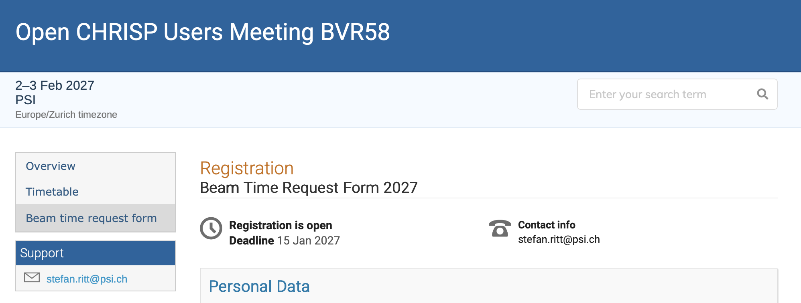
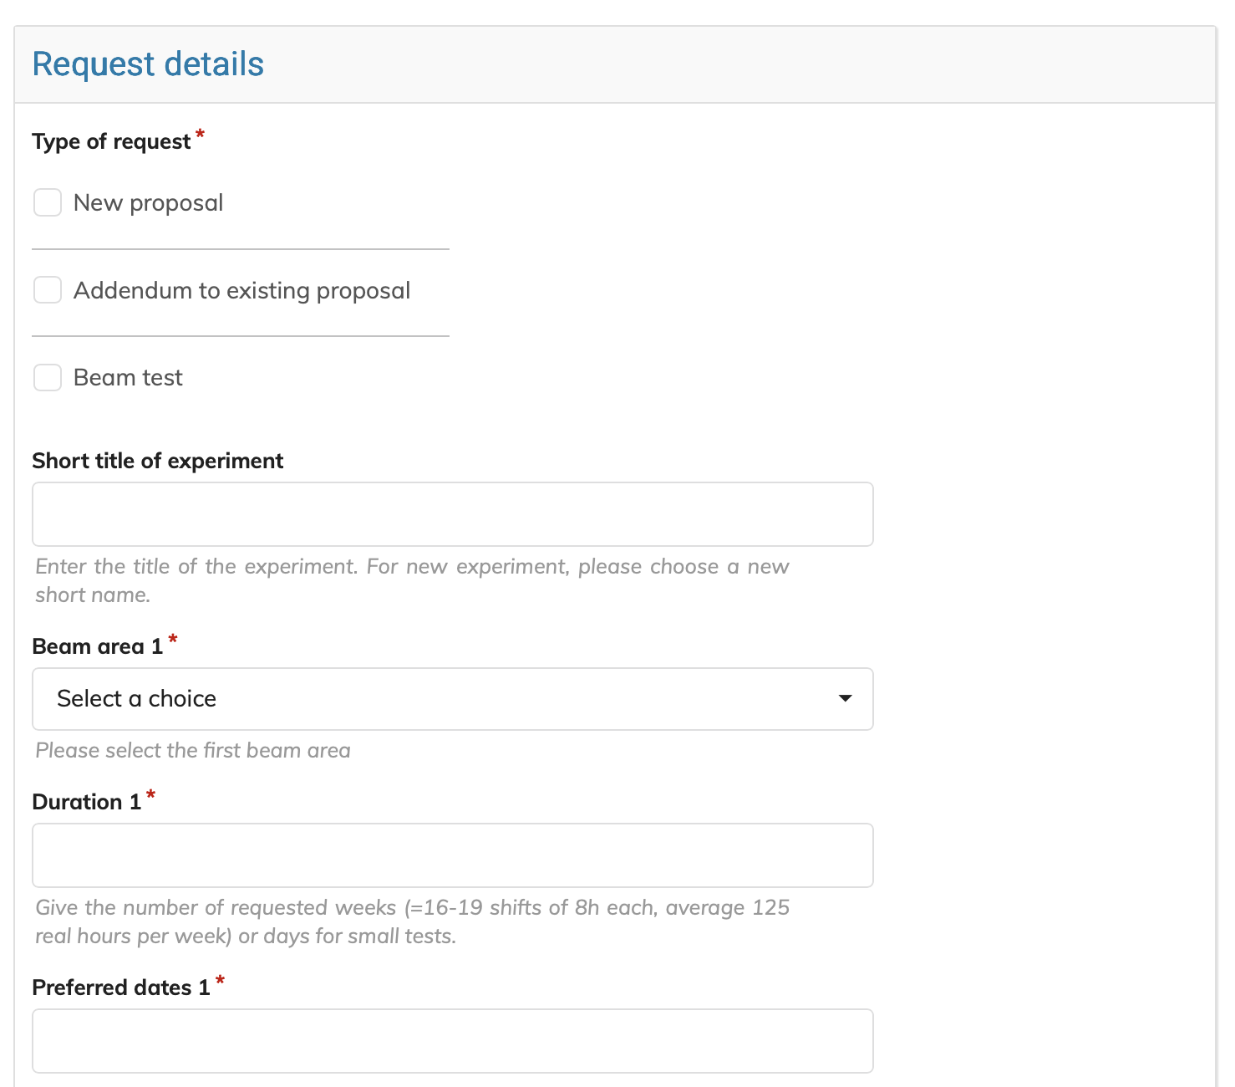
BVR58
Feb 1 (Mon reviews) to Feb 3 (Tue-Wed), 2027
Strict deadline Jan 15, 2027
All requests require a short written report, including the experiments with special reviews
Request submission including report upload will be done via Indico or DUO

Slide 2
