Slide 1
Requests for week of 27.01.2025-2.03.2025
Requests at week’s begin:
Aramis:
  Alvra: 6 keV (Tue-Wed), 13 keV pointing and low 50Hz jitter (Wed - Sat)
  Bernina: 8 keV (Tue)
  Cristallina: 13 keV (Sun)
Athos:
  Furka: 530 eV C+ (Tue), 930 eV LH >1 mJ (as much as possible, Mono) (Wed-Thu)
  Maloja: 650 eV LH >400 uJ (Fri- Sat)
  MD: TGU tests (Kittel) (Sun)
  RC: Pavle Juranic, PC: Alvra, BD: Philipp Dijkstal

Slide 2
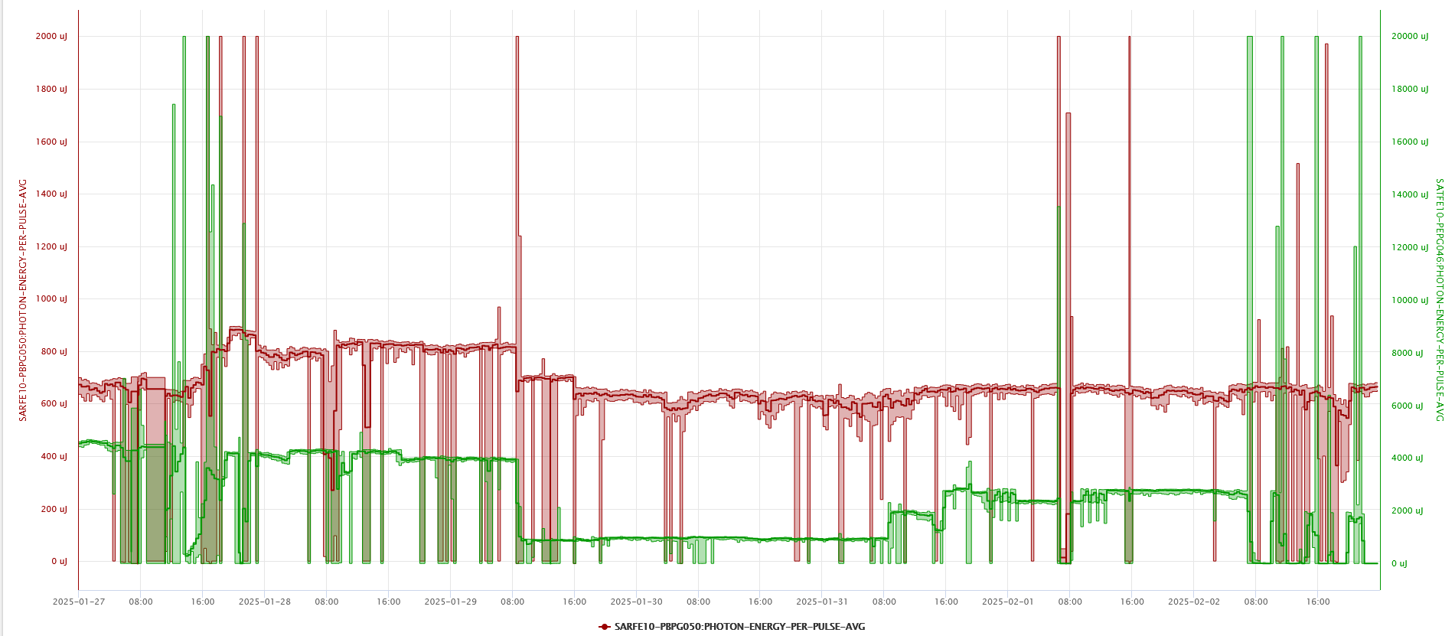
Performance
FEL performance was mostly stable and there were no major issues during beam delivery. There were a few instances of downtime and degraded performance, but they were resolved within a couple of hours at maximum, and usually faster.

Slide 3
Down time
SLG-LCAM-C052 and SLG-LCAM-C072 failed on Monday, Mizar was down for several hours.
Vacuum issue in the linac caused a short downtime on Tuesday, Vacuum group restarted it.
Virtual cathode camera malfunctions caused downtime on Wednesday and Saturday, each of several hours.
ICT in Athos did not work properly, was bypassed, causing a short downtime on Wednesday.

Slide 4
Degraded performance
PSSS camera started the week of not working. The motion and the setting of the spectrometer also had issues several times during the week.
Needed tunnel access on Monday to fix an issue with a screen in the front end.
SATMA02 polarization control was not working for some of the time.
UV Capillary issues with the camera caused the Athos pulse energy instabilities on Friday.
A change in photon energy in Athos somehow caused a large drop of pulse energy in Aramis on Friday. This was a surprise.
Vacuum issue on the Athos photon beamline on Saturday, fixed by Vacuum group.

Slide 5
Special notes
Athos photon beamline vacuum issue. The team contacted the RC via Teams message, but it would likely be faster, and more efficient, if they contacted the PC or the control room, or even call. I did not notice the message until the next morning.
There were repeated camera failures with the laser systems, and some odd behaviors from a few other camera systems that got fixed over the week.
There were several systems that were obviously not checked prior to beam start, mostly on the photon side, causing a scramble to get them working at the last moment. It would be very helpful if this could be avoided in the future by timely checking performances of key components (cameras and motion mostly) before beam is on.

Slide 6
Plan for next week
RC: Gianluca Orlandi
PC: Bernina
BD Support: Eduard Prat
Aramis:
  Bernina 8 keV, short pulses for the whole week, except Wednesday for Cristallina (also 8 keV)
Athos:
  Furka 930 eV LH, maybe also 710 eV the whole week.

Slide 7
Special thanks to
Laser Pikett (Andreas Dax) for the work on the UV capillary and virtual cathode, and also Tobias Weilbach for stepping in when Laser Pikett needed help.
The vacuum group pikett (Nazareno Gaiffi and others) for handling the vacuum issues so quickly.
The Controls group (especially Helge Brands) for quickly dealing with the camera issues as they came up.
Everyone for being so flexible and willing to step in and help out with most issues. It was nice teamwork.

