Slide 1
SwissFEL RC report, week 6, G.L. Orlandi

Slide 2
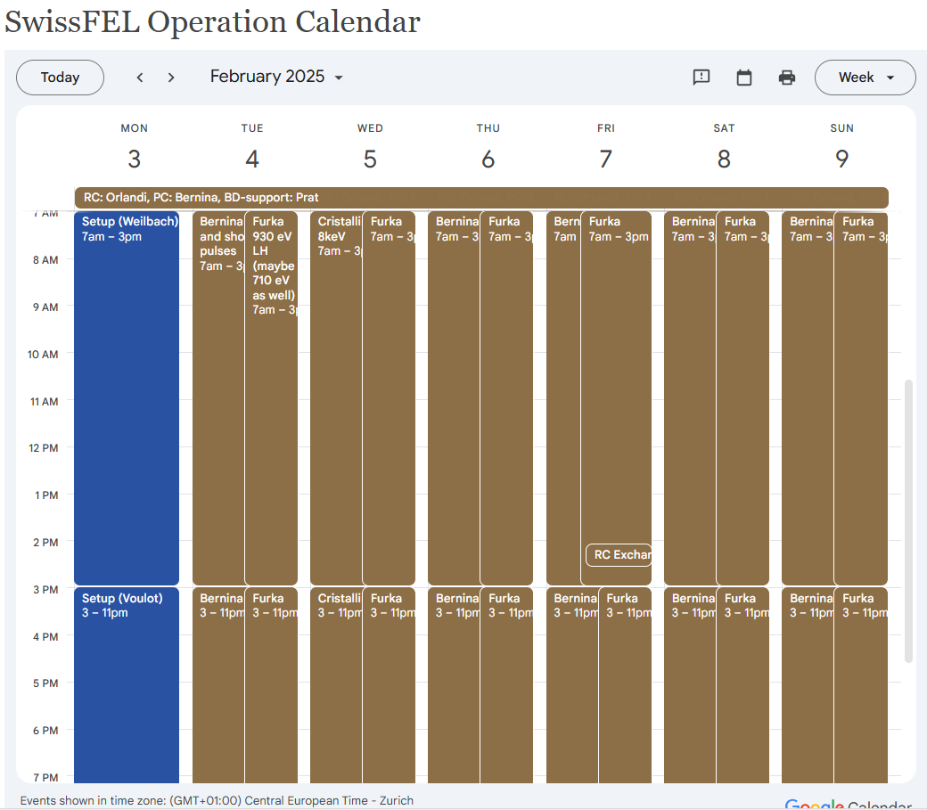
Users’ Plan for week 6
Aramis, Bernina (Cristallina Wed):
8keV short laser pulse 20fs FWHM
Short laser-pulse e-beam set-up:
  tilt the e-beam with dechirper, adjust the orbit in the undulator to make the edge of the e-beam head to lase
  short or ultra-short laser pulse length by shifting the lasing from the edge to the extreme edge of the e-beam head
  decrease of the photon pulse energy by shift the lasing from the edge to the extreme edge of the ebeam head
Athos, Furka:
  930 eV reference setting
  710 eV second option

Slide 3
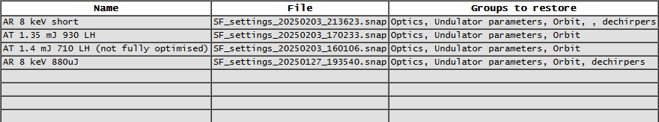
Machine set-up request for week 6

Slide 4
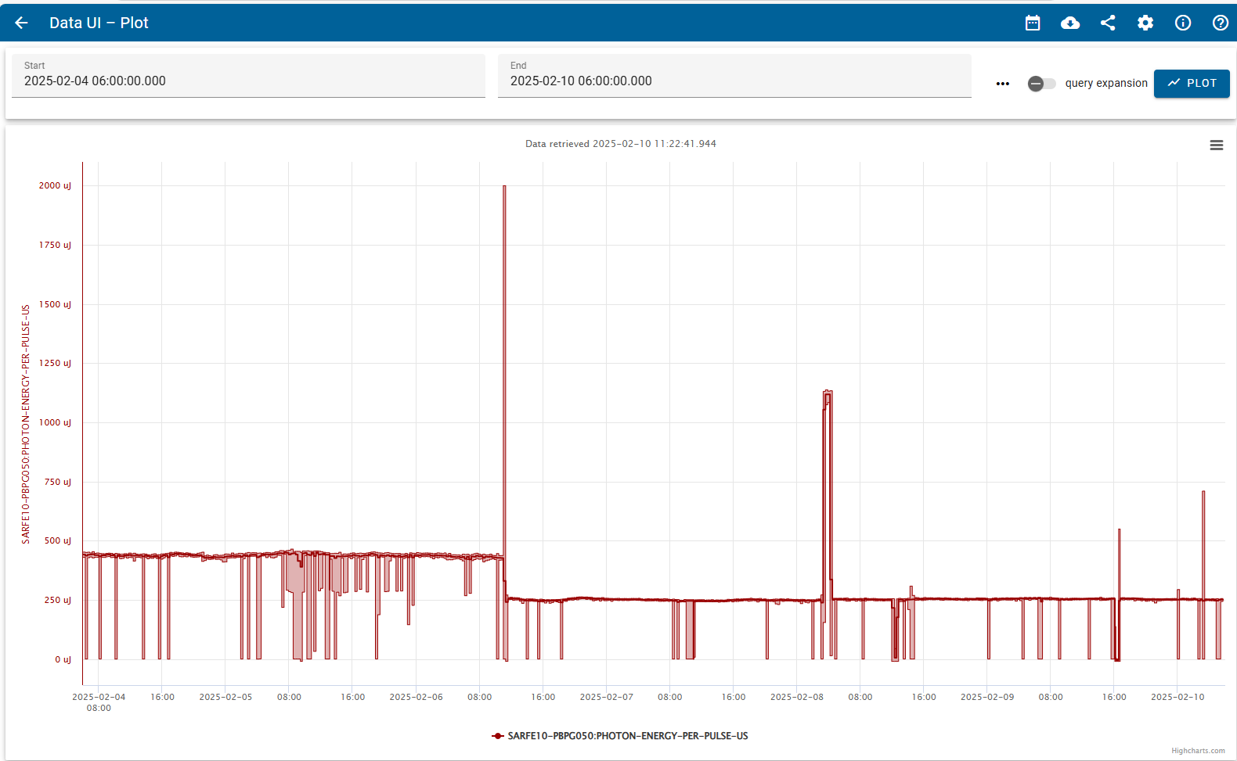
Aramis lasing:
Fixed photon energy at ~8 keV
Short laser pulse (~430 uJ) and ultra-short laser pulse (250 uJ)

Slide 5
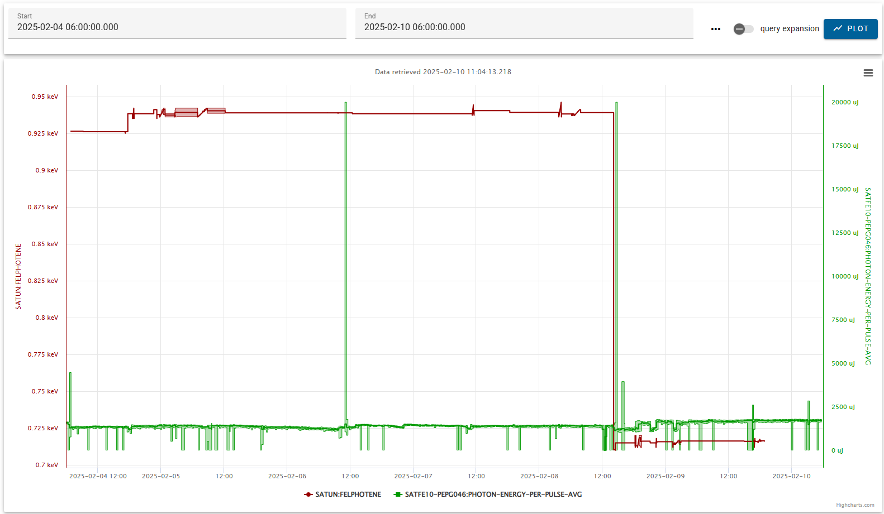
Athos lasing:
930 eV and 710 eV
Photon pulse energy ~1.3-1.4 mJ

Slide 6
Issues
Wed 05.02.25:
Laser aperture feed-back failure indirectly triggered by a camera failure and correction of a bug in the laser pointing algorithm
SINSB02 RF station auto-restart failure. RF support on place
Fri 07.02.25:
S30CB11 RF station auto-restart failure. IOC down and RF support intervention on site to reboot
Sat 08.02.2025
ICT Athos lost calibration factor. Charge readout mismatch with cavity BPM triggered Soft-MPS alarm. Problem solved by restoring the right calibration parameters
IOC SATLC01-DBLM320 disconnection. IOC rebooting needed
Sun 09.02.25:
Virtual cathode reference image lost. Laser pikett intervention.
Feedback Mizar/Alcor UV aperture and Alcor capillary pointing not running but machine kept stability

