Slide 1
HERO beamtime
SwissFEL Exchange Meeting
Wenxiang Hu on behalf of the HERO team
17/02/2025

Slide 2
Outline
Overview of the beamtime
Introduction to EEHG
Beamtime progress
Finding and difficulties

Slide 3
Overview
Generate electron beam with reduced energy spread (achieved)
Test low pulse energy diagnostics (achieved)
Re-establish EEHG at 335 eV (achieved)
Improve EEHG output at 335 eV (not achieved)
Measure averaged spectra using high resolution apparatus in Maloja (not achieved)
Generate EEHG at higher photon energies (not achieved)
If there is time, show time-domain signal of mode-locked SASE (achieved)

Slide 4
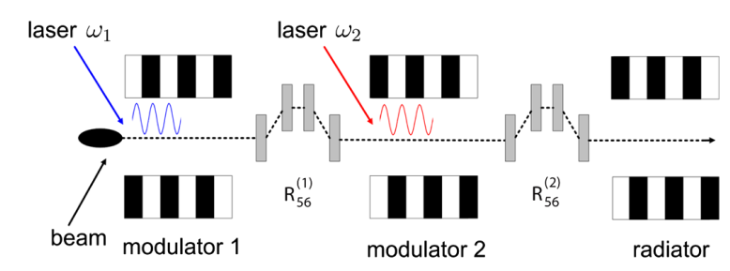
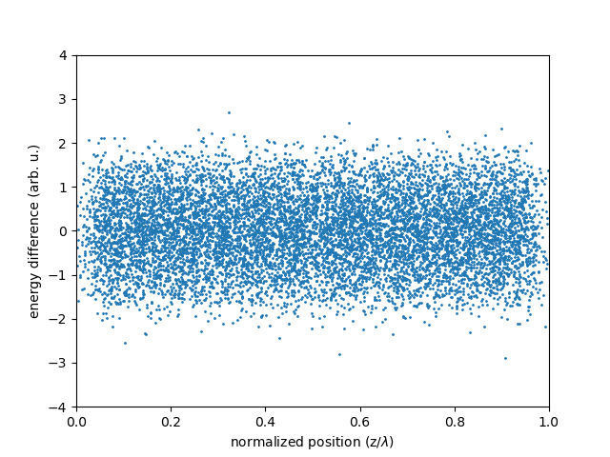
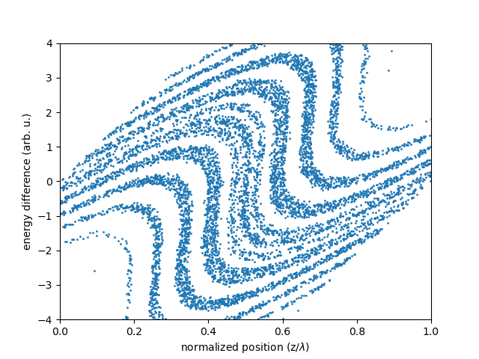
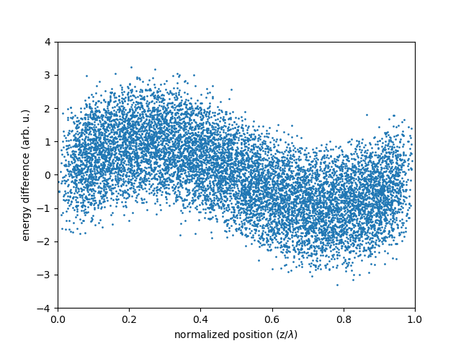
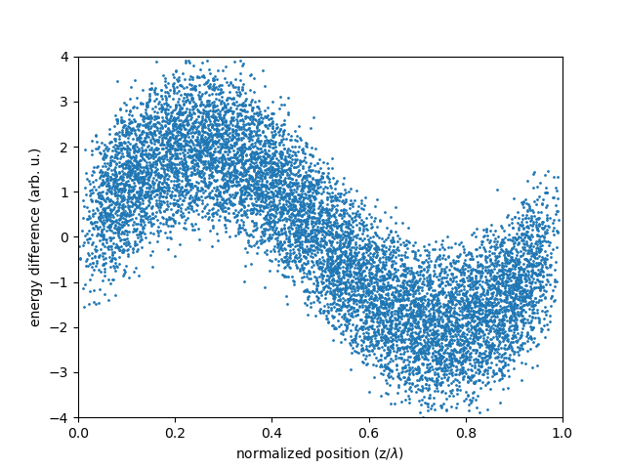
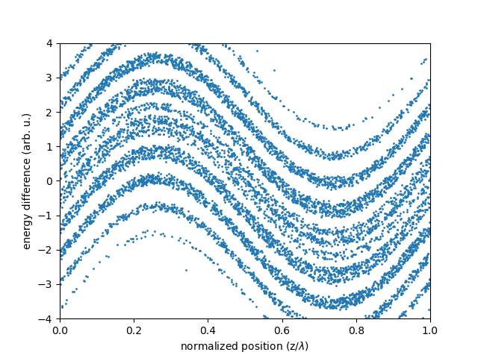
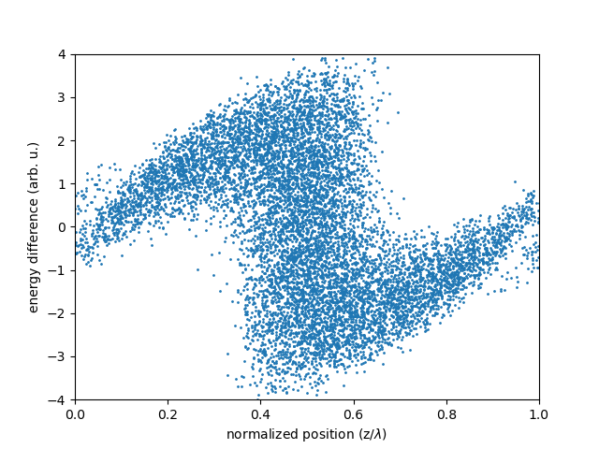
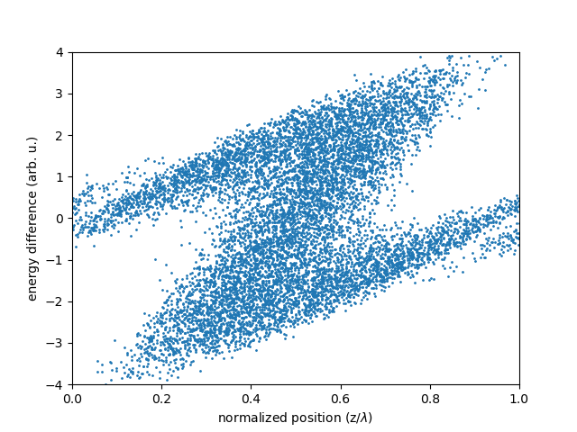
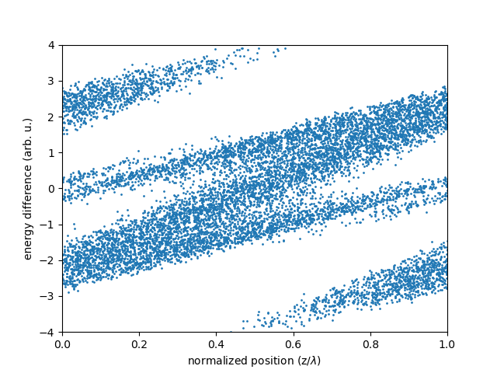
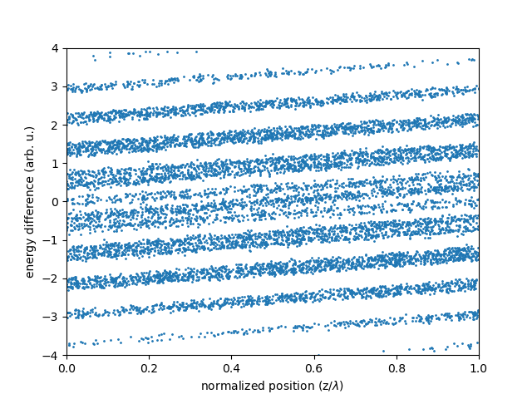
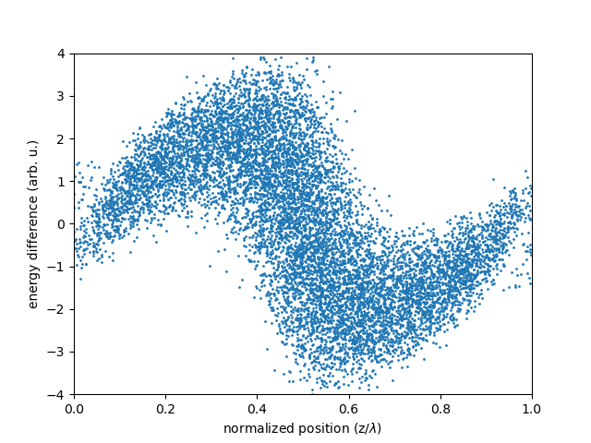
Echo-enabled harmonic generation (EEHG)
Normal SASE operation: amplification process starts with intrinsic noise of the beam, limited in longitudinal coherence.
EEHG: Modulating the electron beam to improve the longitudinal coherence of the XFEL output.
In detail:
  Periodically modulate the electron energy using external laser (265 nm), then use chicane to convert the energy modulation into density modulation.
  Two stage seeding process to reach a higher harmonics conversion.
  (For example, 72 harmonics: 265 nm / 72 = 3.7 nm, or 335 eV. )
Full coherent output in principle.
Electron beam phase space (z, E)
D. Xiang and G. Stupakov, Phys. Rev. ST Accel. Beams, 12:030702 (2009)
Mod 1
Chicane 2
Chicane 1
Mod 2

Slide 5
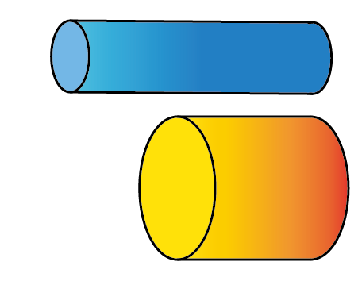
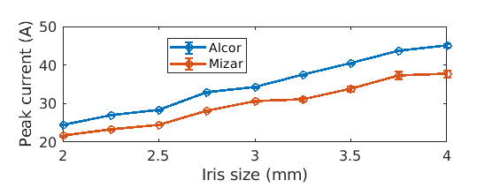
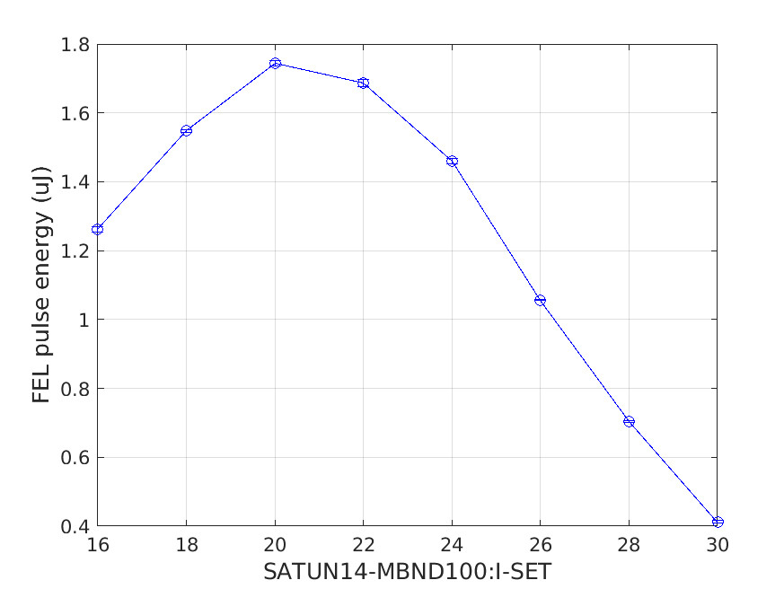
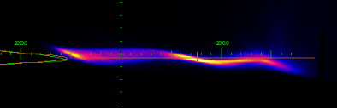
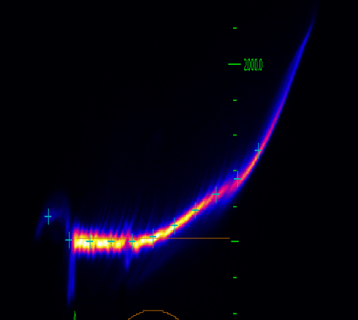
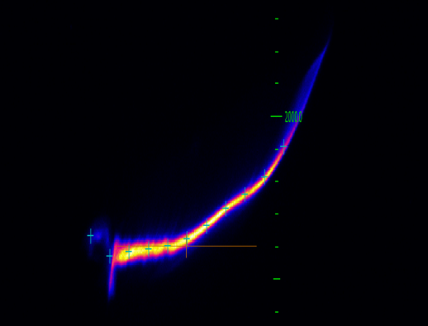
Setting up alternative injector setting
Time: Day 1-2
Changing the gun laser to short pulse mode, but scaling with laser beam size to keep 200 pC charge.
Change the gun laser iris size to 3 mm, so that the peak current is 40 A (doubled w.r.t normal setting).
Measure energy spread at the beam dump
  Measure using TDS: 250 keV
  Using Optical klystron effect*: 108 keV
Micro-bunching instability (MBI) is observed:
  Sensitive to the beamline settings.
  Can be suppressed by laser heater.
Normal operation
Peak current vs. gun laser iris
New operation
Electron beam phase space at beam dump
Optical klystron measurement
MBI
Energy
Tail
Time
LH off
LH on
*E. Prat, C. Kittel, M. Calvi, P. Craievich, P. Dijkstal, S. Reiche, T. Schietinger, and G. Wang., Phys. Rev. Accel. Beams, 27:030701 (2024).

Slide 6
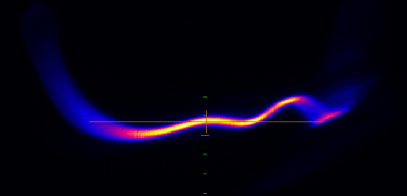
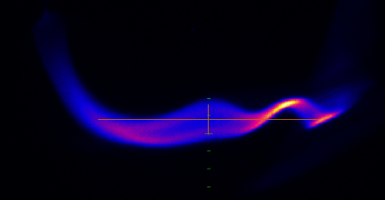
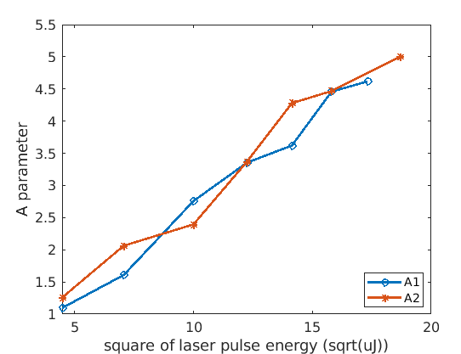
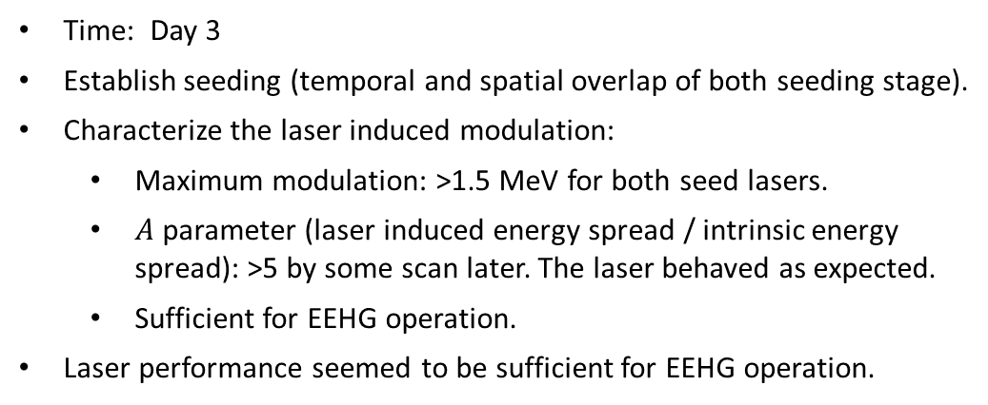
Setting up seed laser
Electron phase space
Laser off
Time: Day 3
Establish seeding (temporal and spatial overlap of both seeding stage).
Characterize the laser induced modulation:
  Maximum modulation: >1.5 MeV for both seed lasers.
  $A$ parameter (laser induced energy spread / intrinsic energy spread): >5 by some scan later. The laser behaved as expected.
  Sufficient for EEHG operation.
Laser performance seemed to be sufficient for EEHG operation.
Laser on
A parameter vs. seed energy

Slide 7
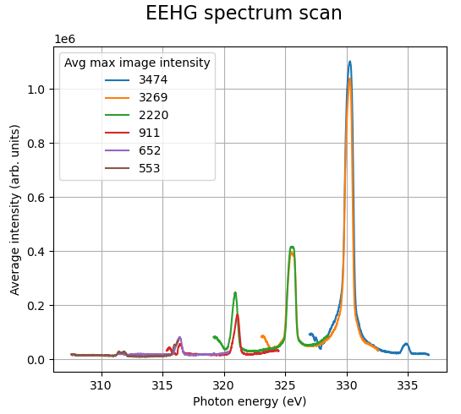
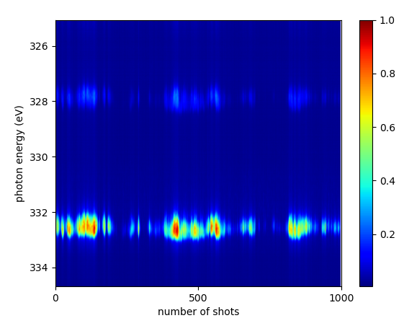
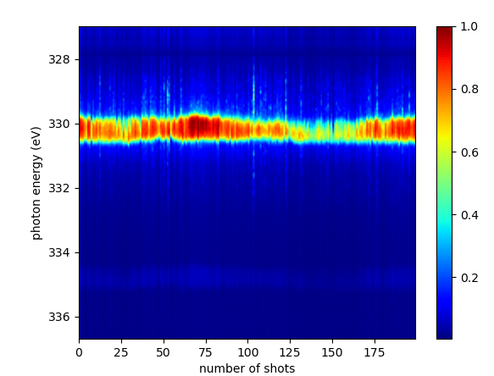
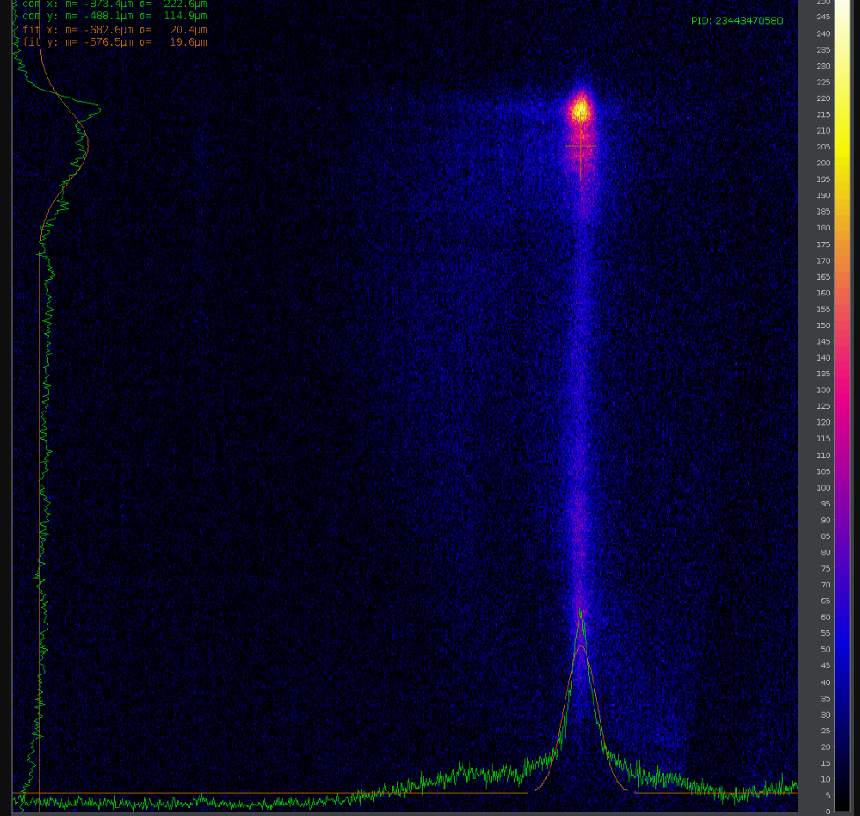
Setting up EEHG
Time: Day 4-6
Find and optimize the coherent signal based on the new injector configuration. Overall, signal was low and relatively unstable.
Reverting to the usual injector configuration. Find and optimize the coherent signal, measure spectra under different settings.
*The MCP detector seemed saturated with optimized output.
Different harmonics can be seen.
During optimization:
  Optimal overlapping in modulators seemed to change for different beam setup. EEHG seemed to work better after overlapping optimization in modulator 1.
  EEHG seemed to work better with reduced chicane strength.
  EEHG is very sensitive on trajectory, and its optimal is different from that for SASE, which indicates limited region across beam with sufficient bunching.
First coherent signal on MCP
Before optimization
After optimization

Slide 8
Findings and difficulties
New injector configuration:
  The beam characteristics (energy spread, emittance,…) of the new injector mode worked as expected.
  Micro-bunching effect was observed with the low energy spread which requires further investigation and understanding.
EEHG:
  Both seeding stage worked similarly and reached sufficient seeding power.
  Coherent signal was observed with both injector configurations. No improvement was seen using the new configuration.
  Measurements with different settings were taken at different configurations to better understand the way to optimize.
Difficulties:
  We didn’t manage to prove the new injector configuration, with seemingly better output beam characteristics, help improving EEHG output. Further investigation would be needed.

Slide 9
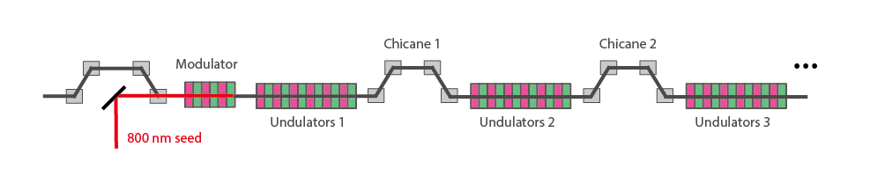
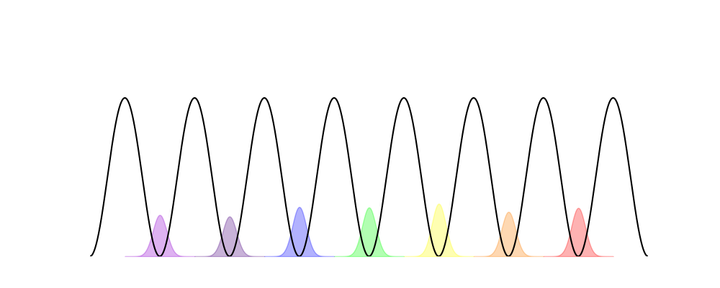
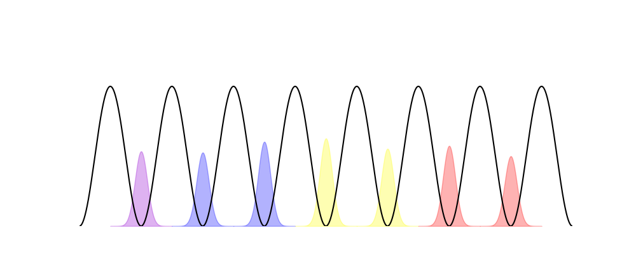
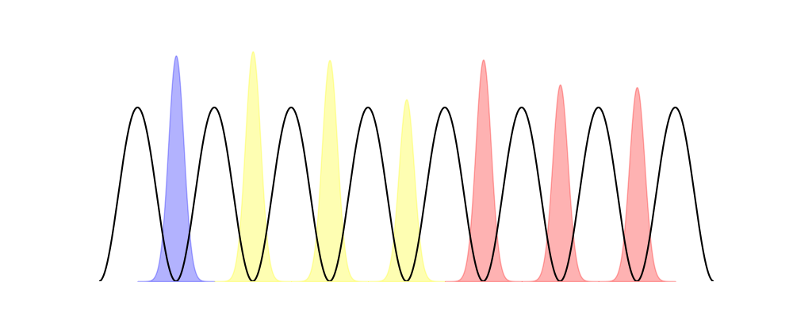
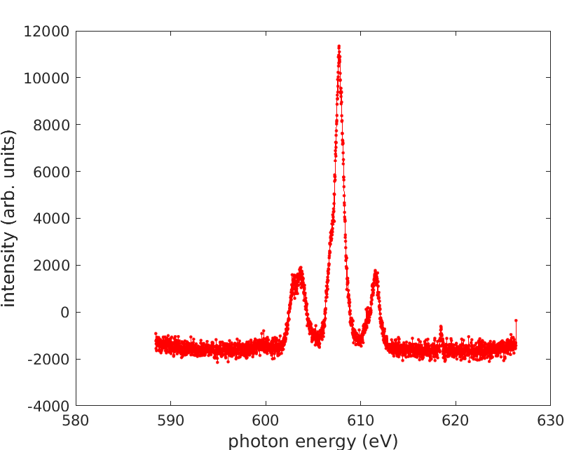
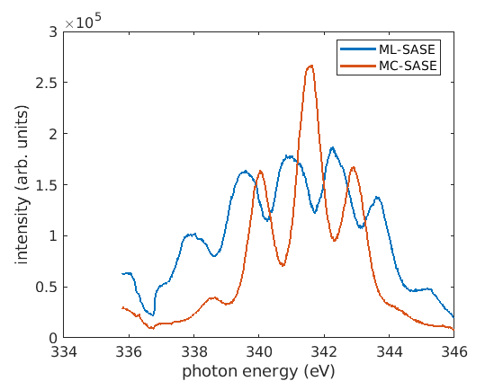
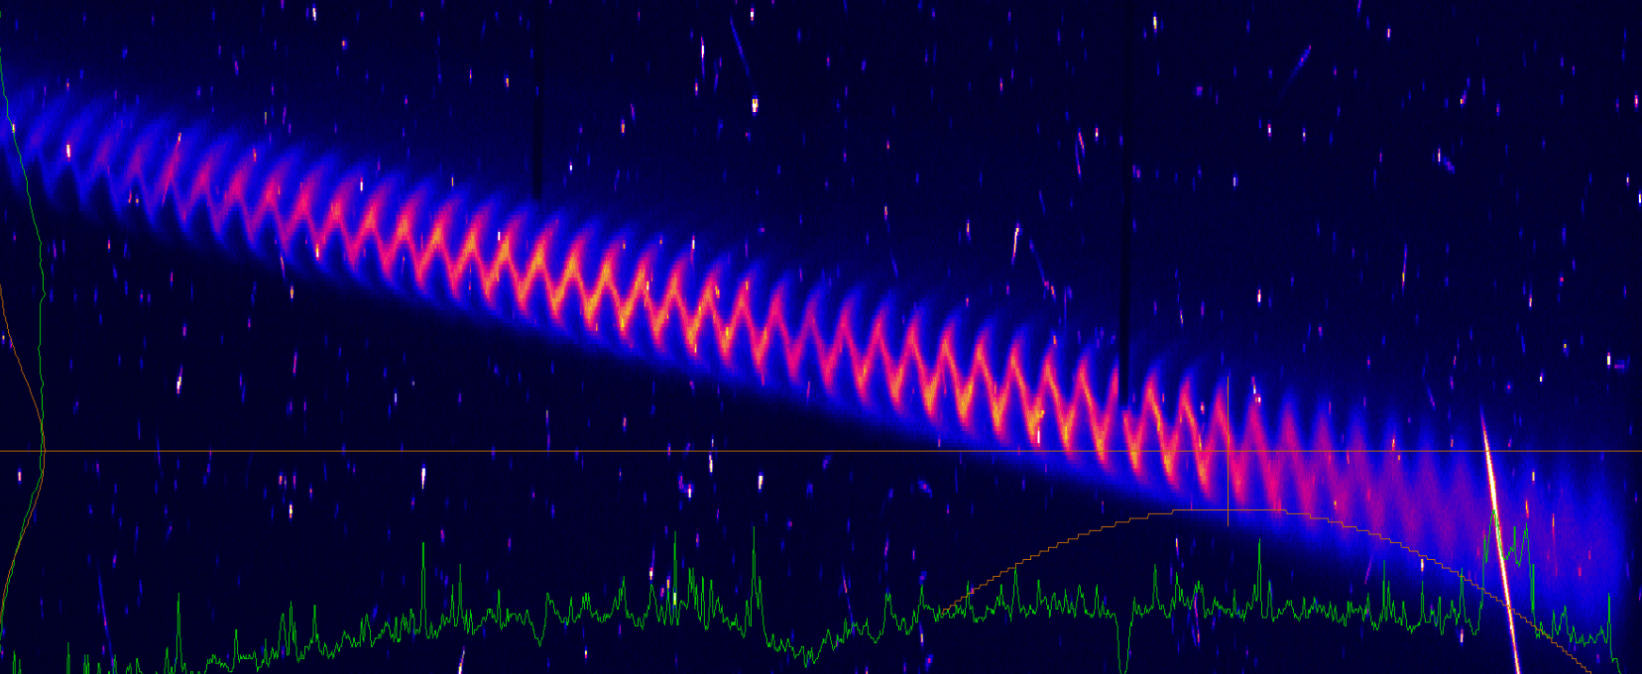
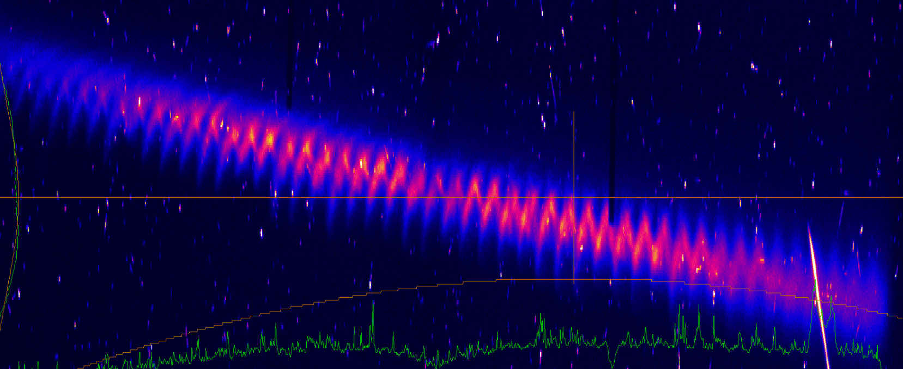
Setting up Mode-locked SASE
Time: Day 6 afternoon – day 7
Mode-locked SASE (ML-SASE):
  Based on the demonstrated Mode-coupled SASE*.
  temporal control of waveform via seeding + phase control via inter-undulator chicanes.
  Decompress the beam for long gain length (lower gain in between the chicanes to increase coherence).
Similar results were observed using 266 nm seed laser.
More evidences of Mode-locking were seen, including increased FWHM of the total spectra for ML-SASE.
With optimized output, TDS measurements of the electron phase space shows evidence of restricted lasing along beam.
ML-SASE averaged spectrum
ML-SASE vs. MC-SASE
Lasing off
Lasing on
Electron phase space
(800 nm, or 2.67 fs modulation)
*E. Prat, W. Hu, C. Arrell, M. Calvi, P. Dijkstal, R. Follath, and S. Reiche., Phys. Rev. Lett., 133:205001 (2024).

Slide 10
Acknowledgements
  Beam Dynamic
    Sven Reiche, Eduard Prat, Philipp Dijkstal
  Laser
    Alexandre Trisorio, Andreas Dax, Carlo Vicario, Martin Huppert, Yunpei Deng, Stefan Neppl
  Diagnostics
    Christopher Arrell, Rolf Follath
  Maloja
    Andre Al Haddad, Kirsten Schnorr, Antoine Sarracini
  We acknowledge support from all technical groups for the EEHG and ML-SASE projects. Thanks for your effort and help!

