Slide 1
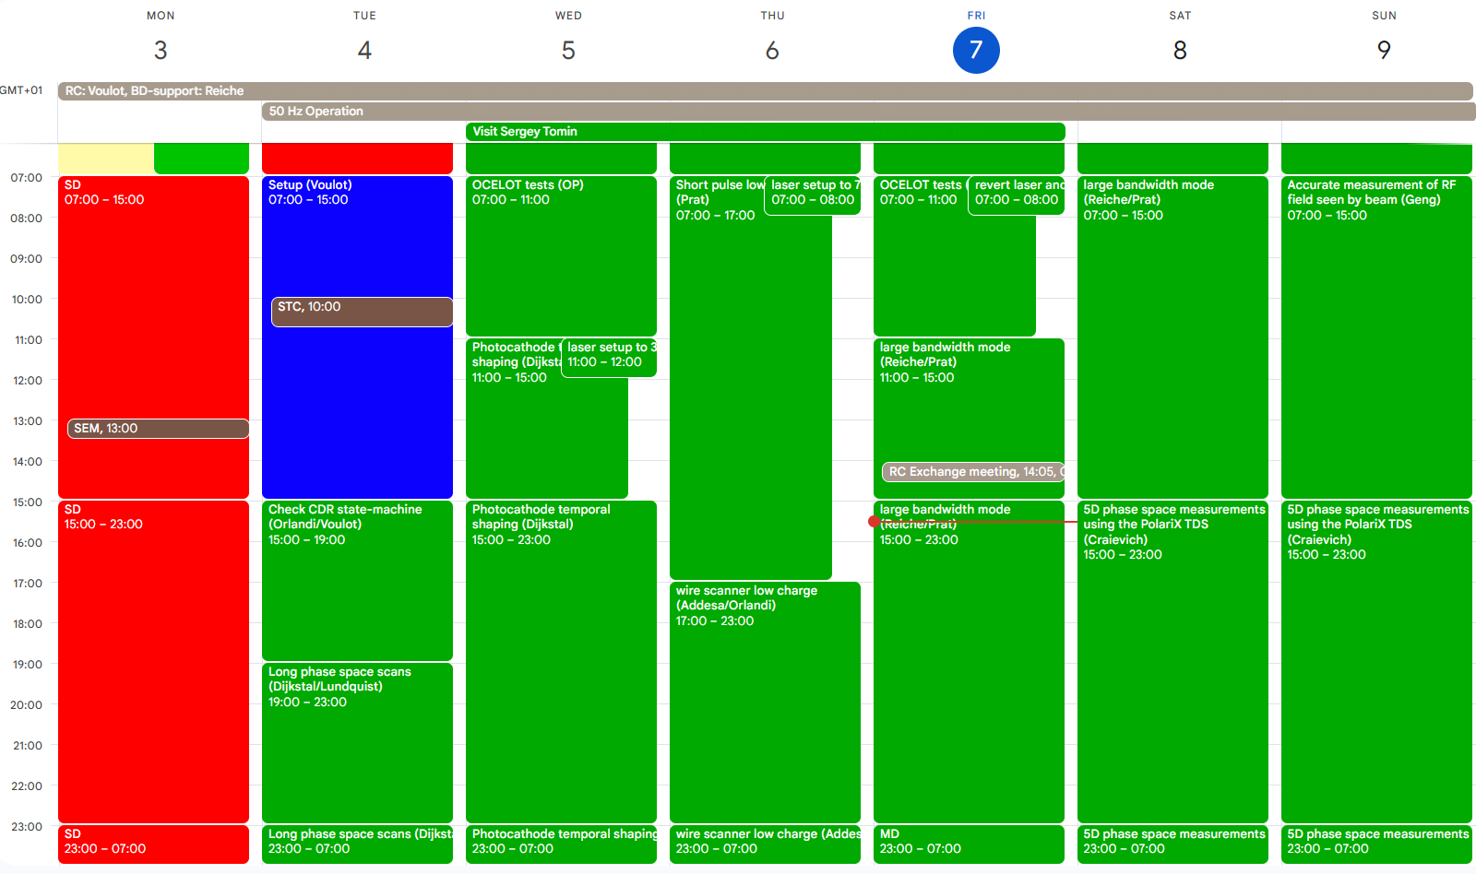

Slide 2
MD
Long. phase space scans (Dijkstal/Lundquist)
  2D rf parameter scan and LPS measurements on SATBD02 and SARCL02 screens
  Acquiring lasing enabled and disabled data for different conditions
Photocathode temporal shaping (Dijkstal, Guo)
  Current spike generation with both lasers
  Test of delaying crystal for Mizar
  Sub-femtosecond FEL pulse generation in Aramis
OCELOT-optimizer tests (Hiller/Voulot/Tomin)
Wire scanner low charge (Addesa/Orlandi)
  Study the effect of tungsten and Si3N4 wires on lasing performance
Large bandwidth mode (Reiche/Prat)
  Extra-large bandwidth mode for potential user-experiment preparation
5D phase space measurements using the PolariX TDS (Craievich/ Reiche/Prat + INFN/DESY guests)

Slide 3
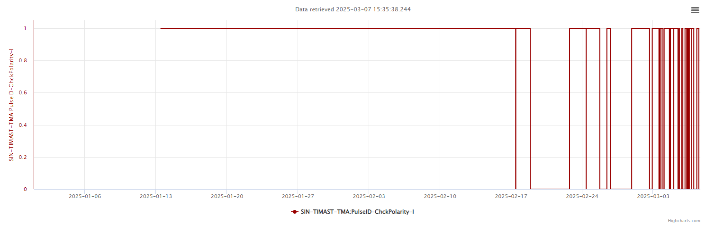
Timing bug
Since Monday 17.2 we have many timing interruptions, each time the entire RF trips off and takes about 10 min to come back. The frequency of the event has been increasing.
The problem comes from the Timing Master ioc load. The ioc needs more than 10 ms to load the next sequence. Every time an RF trigger is missed the RF stations drop to Filament.
The ioc was restarted on Friday morning. But the problem came back.
Many panels connect directly to the timing master. This should not be the case (repeater), but we are not sure this has something to do with our problem…

Slide 4
Other technical issues
None ?

