Slide 1
Machine Report
Week 12/2025
Tobias Weilbach
SwissFEL Exchange Meeting, 24 March 2025

Slide 2
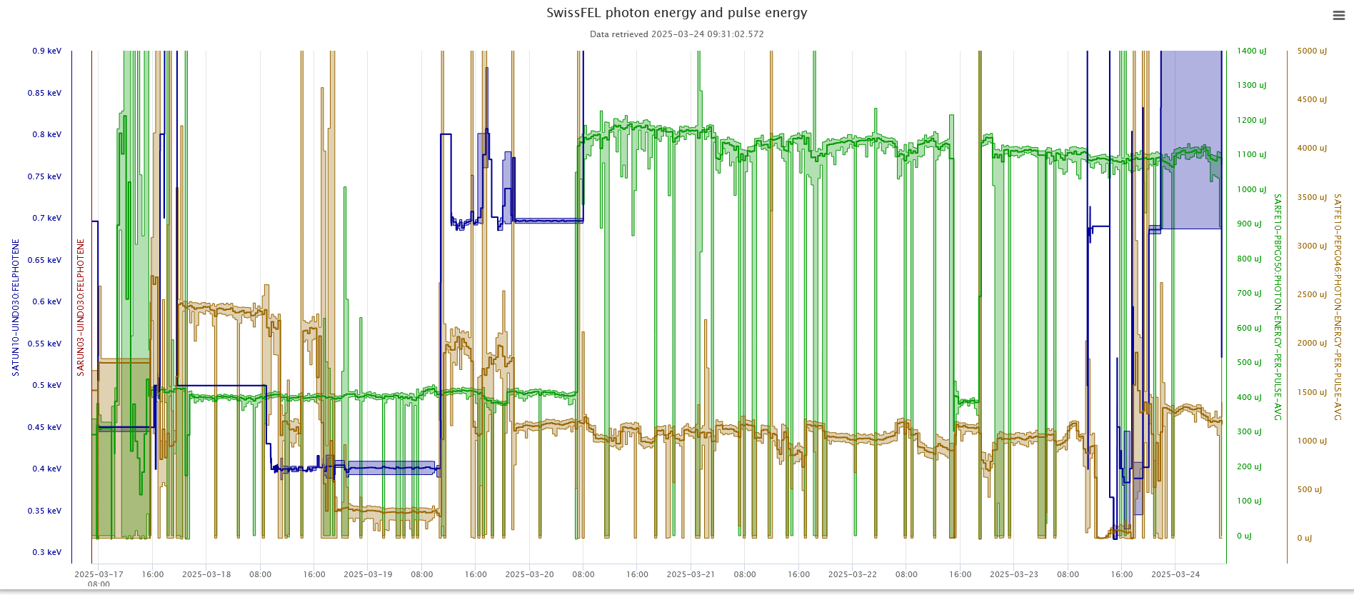
Performance during the Week
Tue/Wed & Fri - Mon: Bernina 10 keV, 1.15 mJ (40 fs), 415 µJ (21 fs) & 210 uJ (11 fs)
Thu: Cristallina: 8.98 kev, 1 mJ
Tue/Wed: Maloja 500 eV, 2.5 mJ & 800 eV, 2 mJ LH (30 & 15 fs), Thu/Fri: Furka 930 eV LV+/LH, 1.1 mJ
Athos MD
Setup
Setup

Slide 3
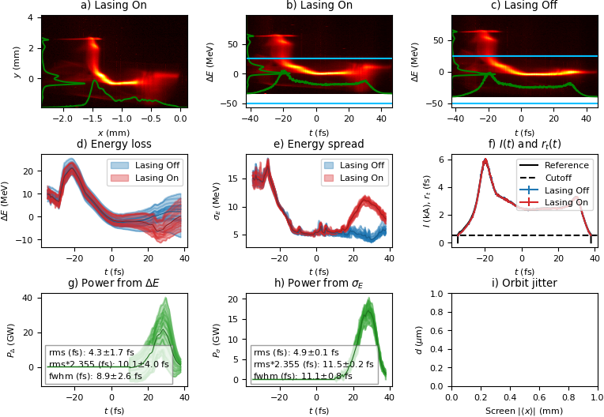
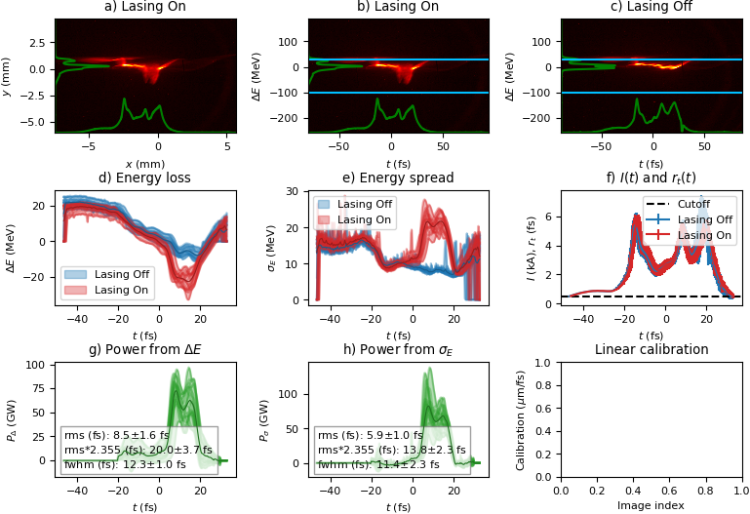
Set-up
Tunnel access needed during setup on Monday:
  SARUN 14 was checked; it could be moved from inside the tunnel and after an IOC reboot it was moving again
  S30CB14-DCOL was checked and greased, works again
  Pump of Athos gas detector was checked (SATFE10-VPFO044-A020)
  Fiber of PSSS camera was exchanged
  Pcubed installation preparations
  Clystron curve scan for SINSB02
  Short pulse setups for Bernina and Maloja
210 uJ
11 fs FWHM
1000 uJ
15 fs FWHM

Slide 4
Issues during the week
Setup
SAROP21-OAPU092 Aperture did not respond properly, was not moving correct, was checked today during setup with Expert, needed power cycle on site
User Operation:
Wednesday evening: even shorter (~10 fs ) quick setup for Maloja with Eduard
Thursday night: ICT lost calibration, needed restore and reinitializing
Sunday: S10CB07 fell to Filament and showed heating time, Pikett adjusted the time to recover quicker
MD (TGU)
SATUN 12 stuck and needed power cycle
Issues with undulator movement during TGU shift, under investigation but no influence on user operation

