Slide 1
Requests for week of 24.03.2025-31.03.2025
Requests at week’s begin:
Aramis:
  Bernina (Tue- Fri):
    6.5 keV optimized bandwidth for the monochromator, normal mode : 40 fs FWHM, low spatial jitter (vertical and horizontal
    6.5 keV optimized bandwidth for the monochromator, short mode : 20 fs FWHM, > 400 uJ, low spatial jitter (vertical and horizontal)
  Cristallina (Sat-Mon):
    Photon energy: 6.54 and 10.2 keV (Mn- and Ta-edges), scan range +-100 eV , No optimization needed
    8.65 keV (Tm-edge), scan over +-100 eV, Optimization in pulse energy (reaching say >80% of the standard) but mostly in term of stable trajectory in the horizontal: we would aim at position_jitter < 0.5 sigma_beam (at some position where we can measure)
Athos:
  Furka:
    Priority: 530 eV (scanning +/- 20 eV), polarization LV, standard pulse length, monochromatic mode (the higher the pulse energy and the shorter bandwidth, the better).
    640 eV (scanning +/- 20 eV), same parameters as above (Backup, so can be skipped in case of time issues)
  RC: Pavle Juranic, PC: Furka, BD: Sven Reiche

Slide 2
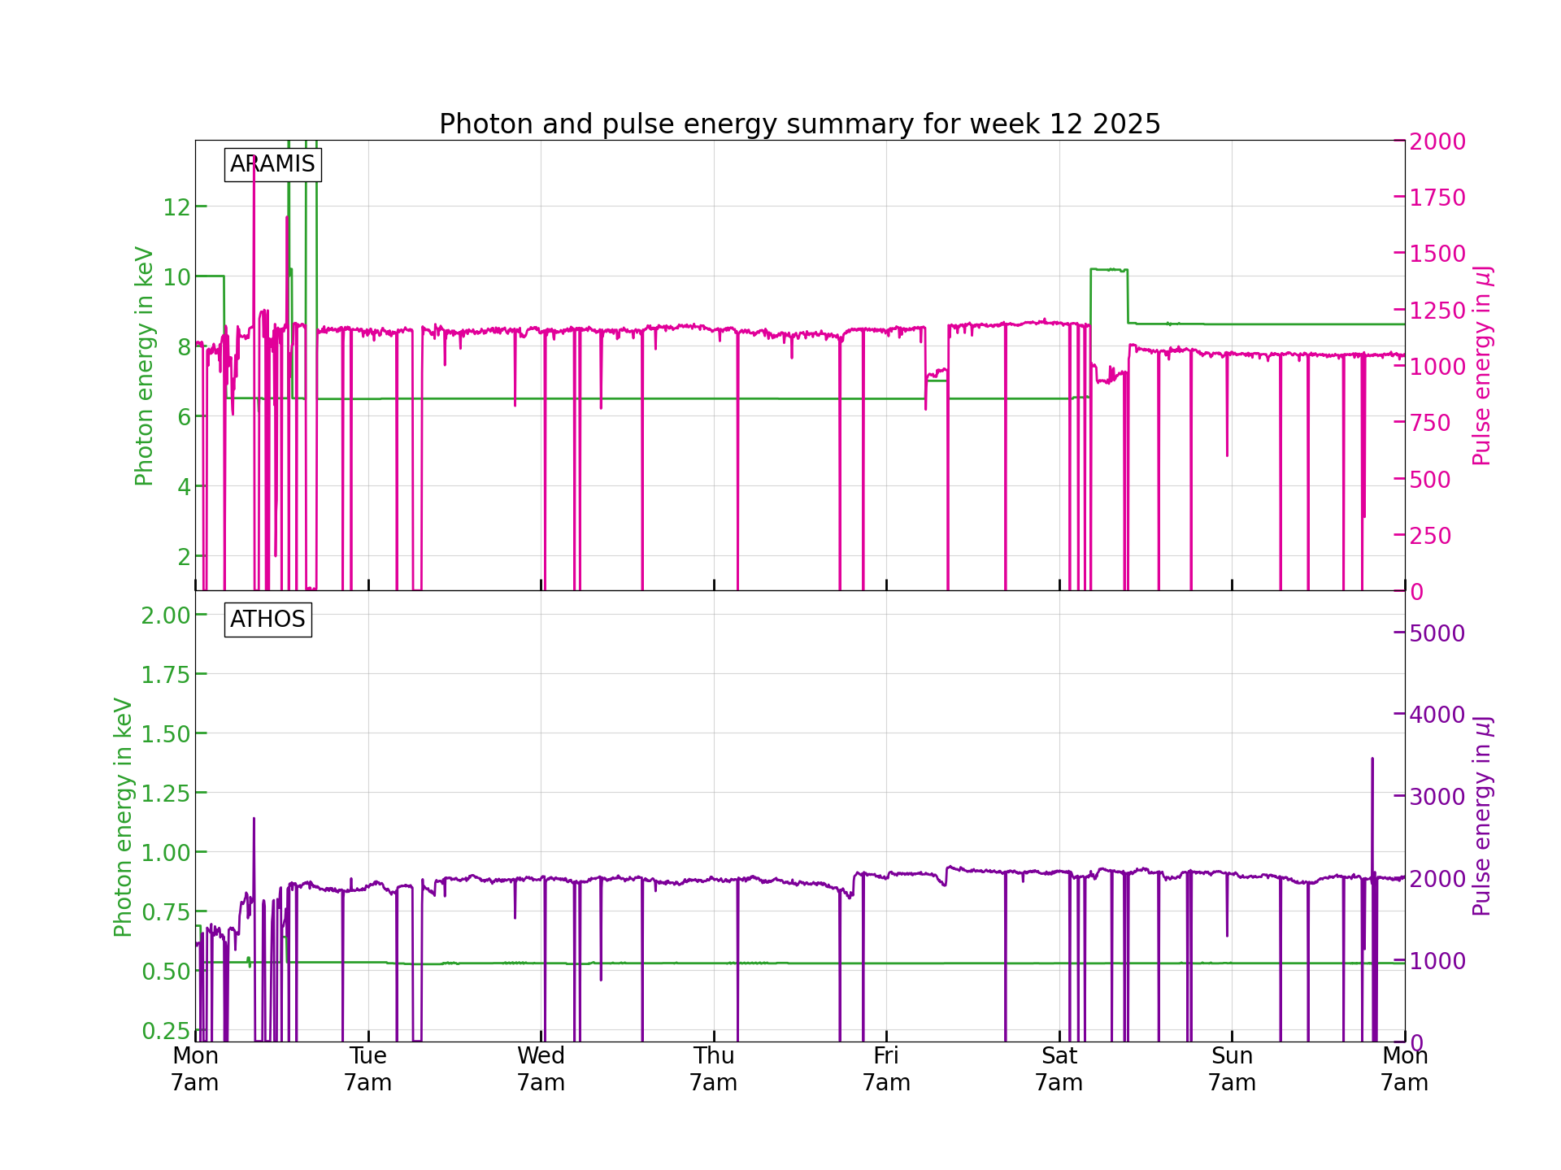
Performance
FEL performance was mostly stable. There were a few small interruptions and down-times, but overall it was a good performance.

Slide 3
Down time
SINXB01 needed a manual reset on 25.03.2025.
DRPS control system failed on 25.03.2025. The SU Pikett fixed it in in an hour.
Injector laser LAM needed to be power-cycled on Friday, 28.03.2025, not a big interruption.
28.03.2025 MPS alarm caused a short downtime due to the delay state not being activated.
31.03.2025 ICT alarm kept triggering. It got reset and fixed. Caused about a 30 minute downtime.

Slide 4
Degraded performance
25.03.2025 had the pulse energy slowly drop for a bit after the DRPS issue, but it was fixed after a readjustment of the gun solenoid and RF amplitude for the gun.

Slide 5
Special notes
Odd minor instabilities in the pulse energy for Aramis on 28.03.2025 from 3 a.m. until around 9 a.m. No correlation or reason found.
ICT issues have happened two weeks in a row now.

Slide 6
Plan for next week
Setup on Monday: Didier (early), Nicole (late), RC: Gian Luca, BD: Eduard
Aramis:
  (Tue-Fri)
    start 8.65 with short pulses, 8.35 short pulses
      8.65 keV (Tm-edge), scan over +-100 eV
      Optimization in pulse energy but mostly in term of stable trajectory in the horizontal.
    Short pulses in vertical tilted beam mode, pulse length as short as possible but in line with the horizontal stability requirement of above
    At somepoint we are going to switch photon energy to 8.35 keV (Er-edge) with the same extra requirements for the second commissioning experiment. It’s only a 300 eVshift
  (Fri-Sun 7 AM)
    Bernina: 8 keV
  Sun
    Early shift: MD Shift with wire scanner. (Gian Luca & Francesca)
    Late shift: Photocathode shaping (Philipp)
Athos:
  (Tue-Sun 7 AM)
    Maloja, need 500 eV and 600 eV with linear horizontal polarization. It will be a measurement with monochromator, the pulse duration normal and pulse energy at least 1 mJ.

Slide 7
Special thanks to
DRPS Pikett who quickly fixed the issue on 25.03.2025
The control room for dealing with some of the problems that Pikett was needed to in the past (like the ICT issue)
Everyone else that contributed to the smooth running of the machine.

