Slide 1
SwissFEL RC report, week 14, G.L. Orlandi

Slide 2
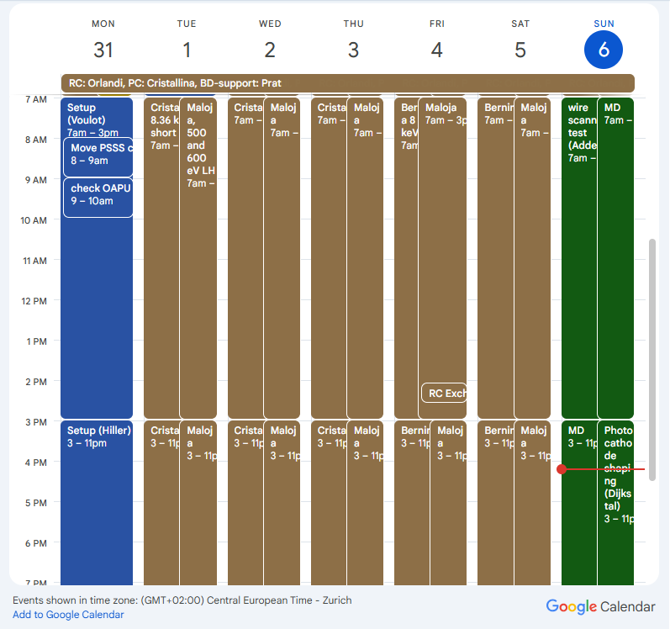
Users’ plan for week 14
Aramis:
  8.36 keV 7 fs FWHM Cristallina, (Tue-Thu)
  8.36 keV 21 fs FWHM Cristallina, (Tue-Thu)
  8 keV 1.14 mJ for Bernina (Fri-Sat)
  8 keV for Bernina (short pulses) (Fri-Sat)
Athos, Maloja:
  500-600 keV LH (2.48-2.1) mJ
MD shift (Sun):
  Wire-scanner measurement (Addesa, Orlandi)
  Photocathode shaping (P. Dijkstal)

Slide 3
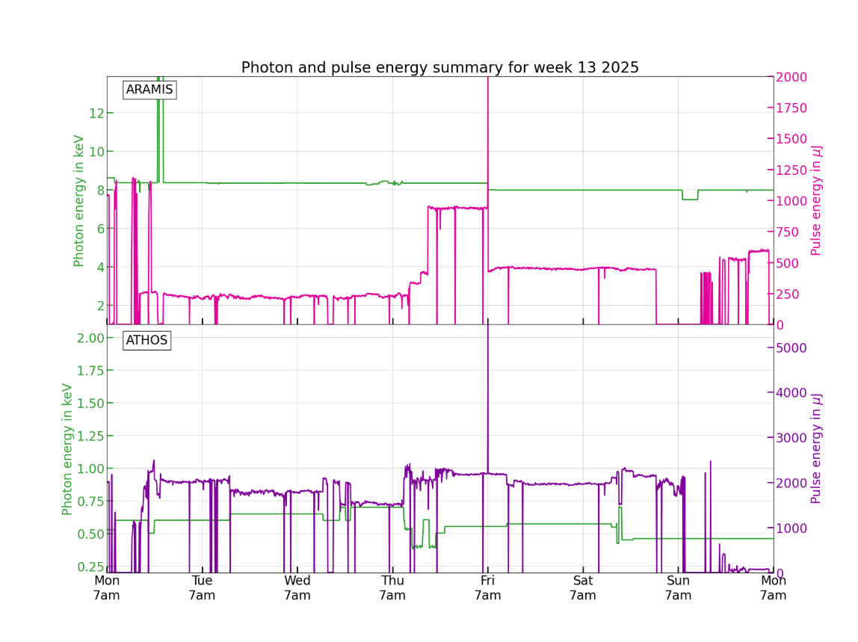
Cristallina 8.36 keV 21fs
Bernina 8keV short pulse
Cristallina 8.36 keV 7fs
Maloja,500-600 keV

Slide 4
Issues (Downtime)
RF SINEG01 (Mon): control-board replacement needed
SARCL01-VPIG-B010 (Tue): Vacuum issue
SINXB01 (Wed): filament
PSYS Alarm Aramis (Wed)
RF S30CB04 (Sun): major problem, RF station OFF during MD shift, maintenance during shut-down

