Slide 1
EIDO Update
03 March 2025

Slide 2
SLS

Slide 3
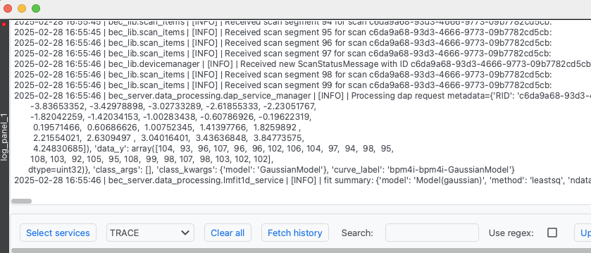
SLS
BEC Widgets
BEC Core
Release v2.0 in the upcoming weeks
  Major refactor of the plotting libraries
  Improvements to and cleanup of the CLI
  Support for save/restore through the UI
New log panel
Customized device summary
Improved file writer
  better support for partial writes
Preparation for Redis ACLs

Slide 4
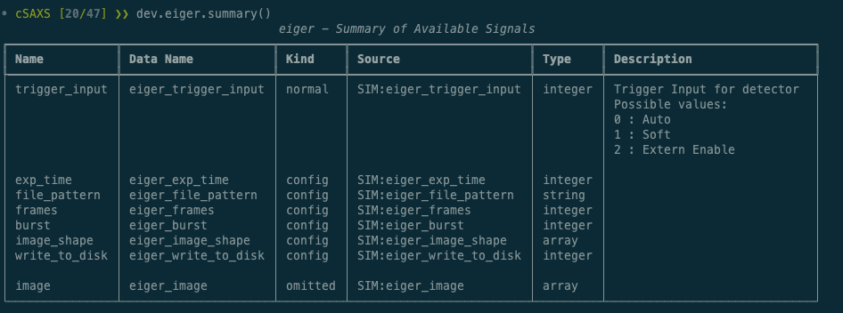
SLS
Ophyd Devices
New base class to simplify the device integration
Added possibility to document EPICS signals directly in the ophyd object.

Slide 5
SwissFEL

Slide 6
SwissFEL
General
Onboarding 6th endstation: Diavolezza 😈
New generic and customizable automatic data-processing tool:
  Monitor sf-daq broker messages for new files → submit slurm job for each
sf-daq
Power on/off individual JF modules
Yet another version change for 2 detectors:
  Version is (still) part of the detector name
  Search/replace slightly simplified since last time
Everything in systemd:
  Replaced bash script monitoring config files → path units
  Replaced cron job → timer unit

Slide 7
SwissFEL
slic
github action to build conda noarch package
Status monitor for sf-daq requests
Refactored client for sf-daq REST-API
Cleaned up scans
sfdata
github action to build conda noarch package

Slide 8
The end ☺

