Slide 1
7904 update
AWI Department meeting
Leonardo Sala
03 March 2025

Slide 2
Ra
Updates during Schaltertest
Kernel updates, GPFS 5.2.1-1, slurm 24.05.5-1
Various HPE servers’ firmware have been updated to the latest security release;
2 new Infiniband switches (200 Gb/s) installed;
Jupyter updated to:
  jupyterhub 5.2.1
  jupyterlab 4.3.3
NEW Idle Jupyter notebooks will be terminated after 12 hours of inactivity

Slide 3
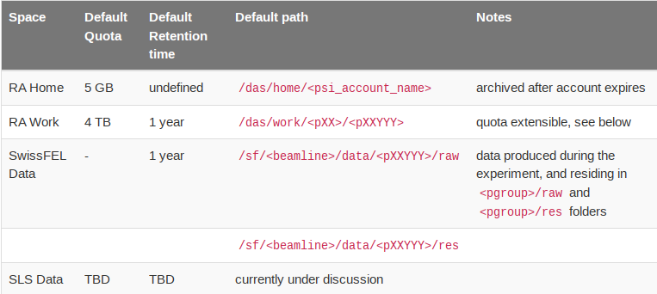
Ra
Data retention policy:
Version approved by CPS
Next steps
  Announcement to CPS, users
  Enforcement after X months

Slide 4
SLS2
Storage:
New storage system integration ongoing
Final version of storage layout and permissions: current version
Currently on track for new storage prod end of March
Compute:
New 4xL40S node for cSAXS in production
MX testing code – feedback on required nodes
Finalization of prod shared compute system ongoing
Waiting for feedback on next purchases

Slide 5
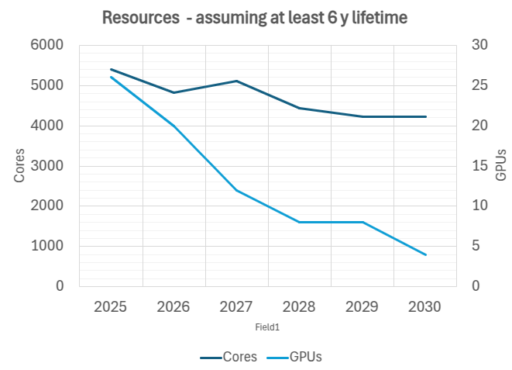
SLS2 – resources forecast

Slide 6
SwissFEL
OSFA -> WHGA migration:
Testing network setup
AIT patched fibers between two rooms, tests will begin this week
General:
Extending warranties
  Note: warranties are getting in general more expensive, and for switches they seem comparable to brand new appliances with 5y
Ra reservation nodes self-service
  Web frontend backed-up by Ra Resources API
  Initial feedback good
  Collaboration with 7901 on web design

Slide 7
Thanks to everybody!

