Slide 1
MuX Meeting 11/04/2025
Marie Deseyn

Slide 2
Rise time correction

Slide 3
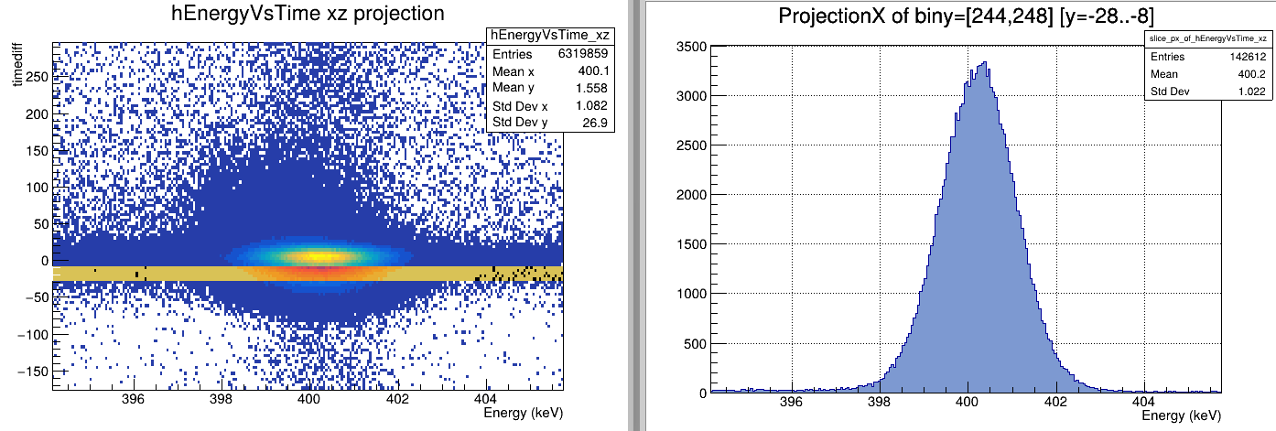
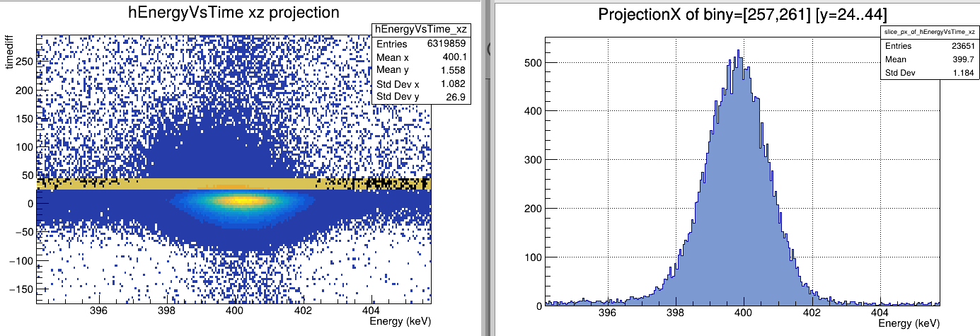
Risetime correction
Ge06

Slide 4
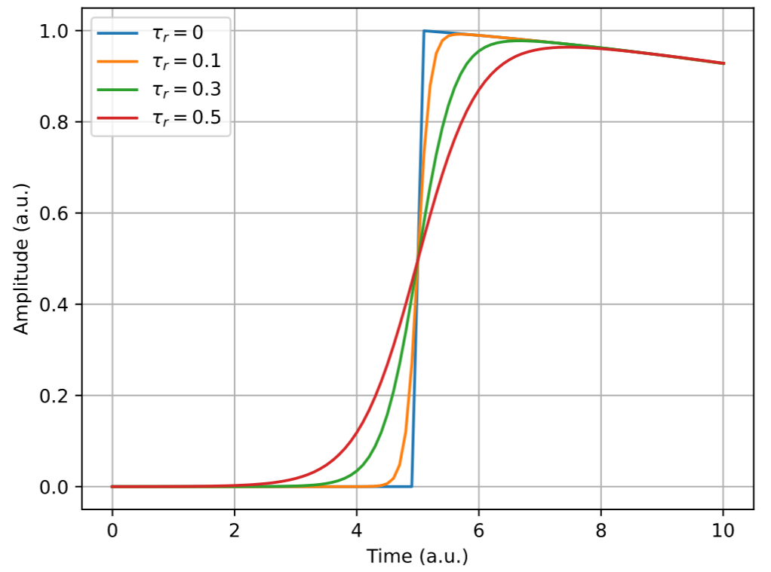
Risetime correction

Slide 5
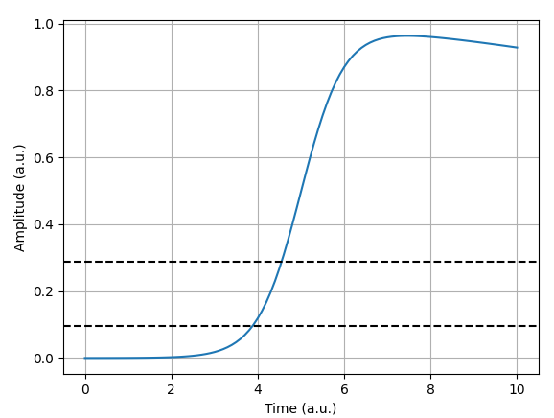
Risetime correction
Ge06
Rise Time = $\frac{t\left(y=0.3ADC\right)−t(y=0.1ADC)}{0.3ADC−0.1ADC}$ = 1/slope

Slide 6
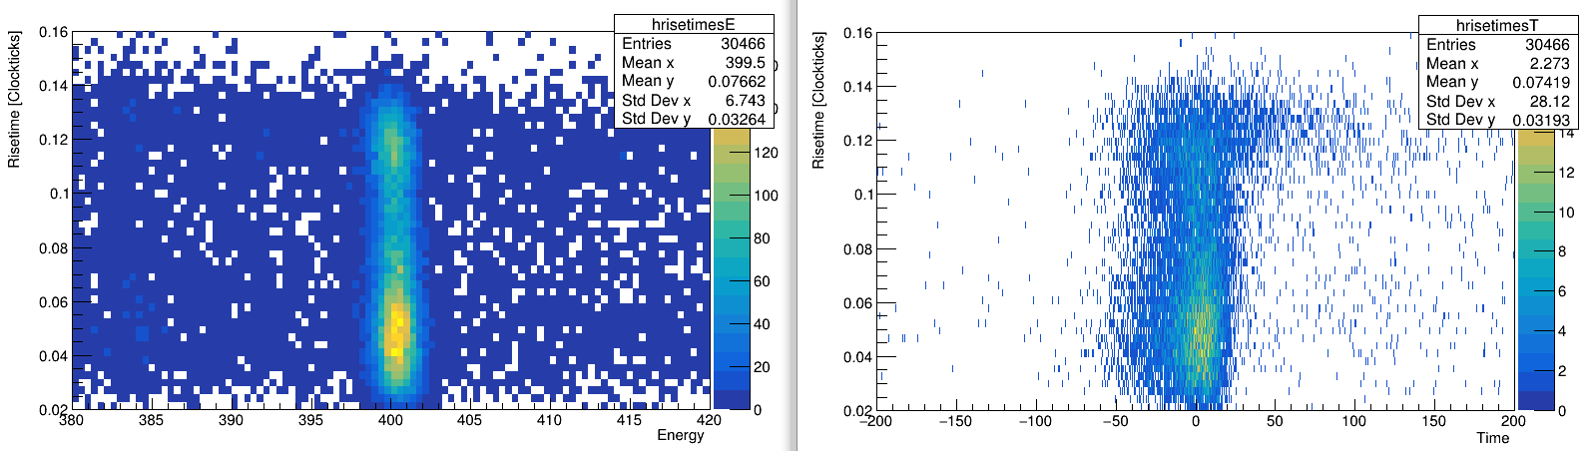
Risetime correction

Slide 7
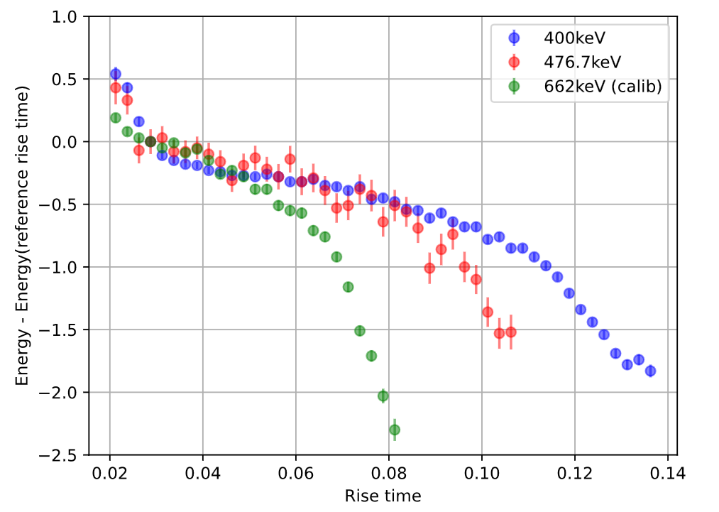
Risetime correction

Slide 8
Risetime correction
Less high energy events here, because high E is collected closer to the electrode

Slide 9
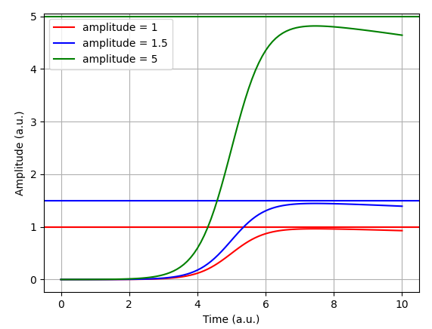
Risetime correction
Earlier deviation for high energy, because absolute difference increases
Same risetime, different amplitude

Slide 10
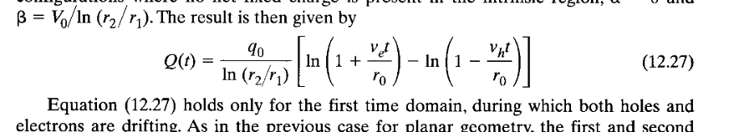
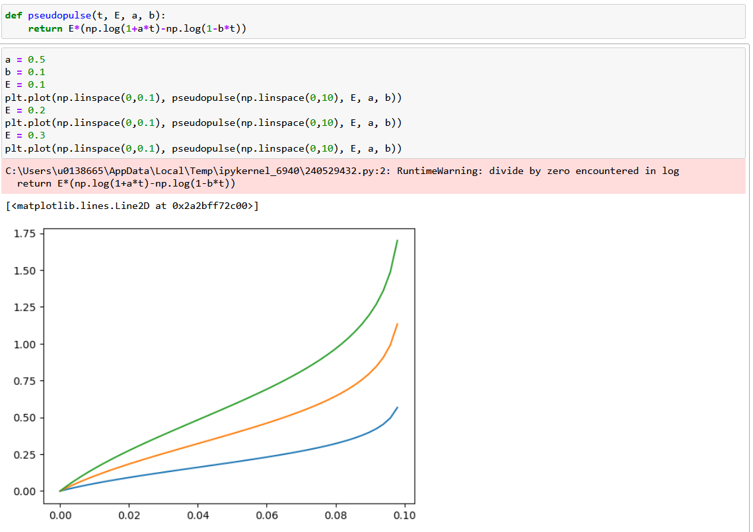
Risetime correction

Slide 11
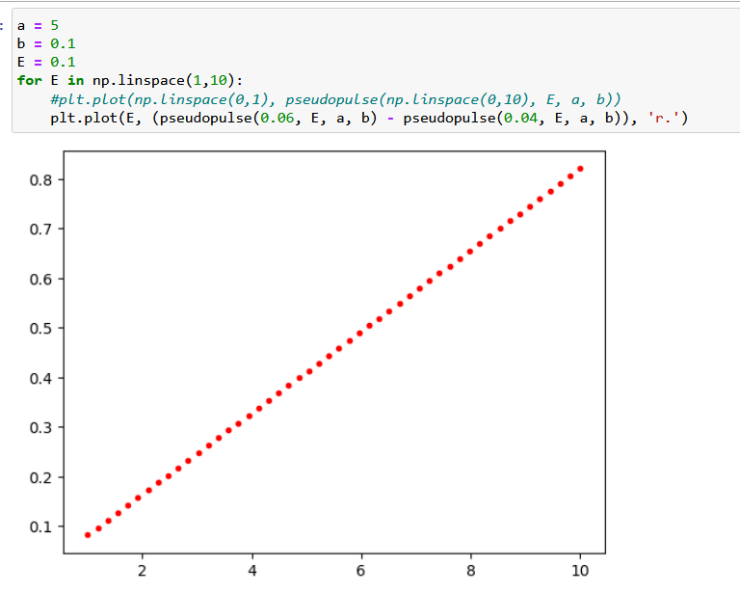
Risetime correction
Determining the slope
Seems linear in energy → What if divide by the energy?

Slide 12
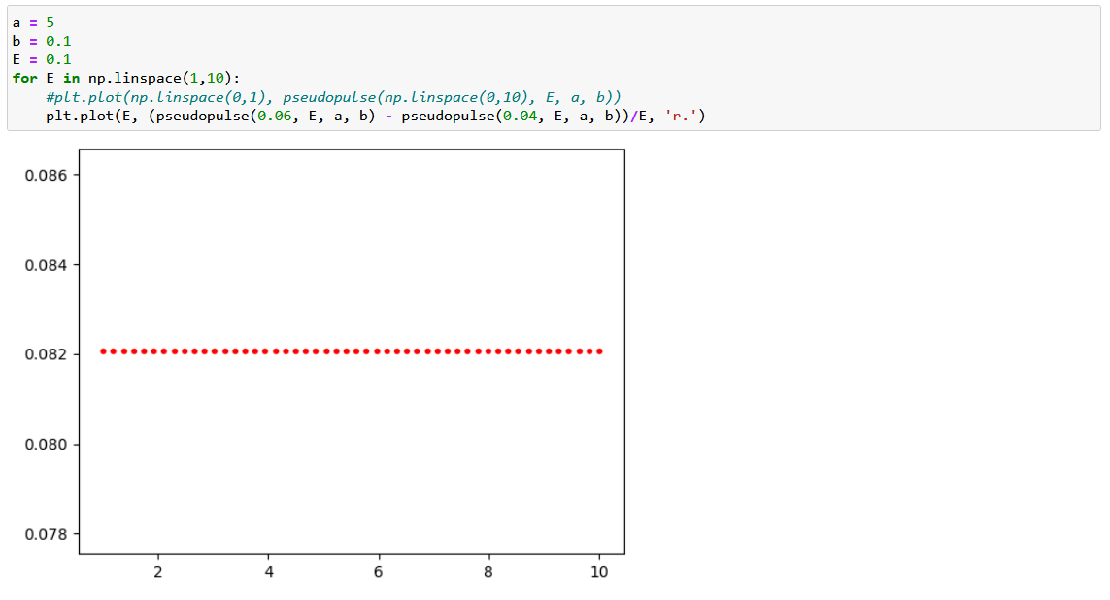
Risetime correction

Slide 13
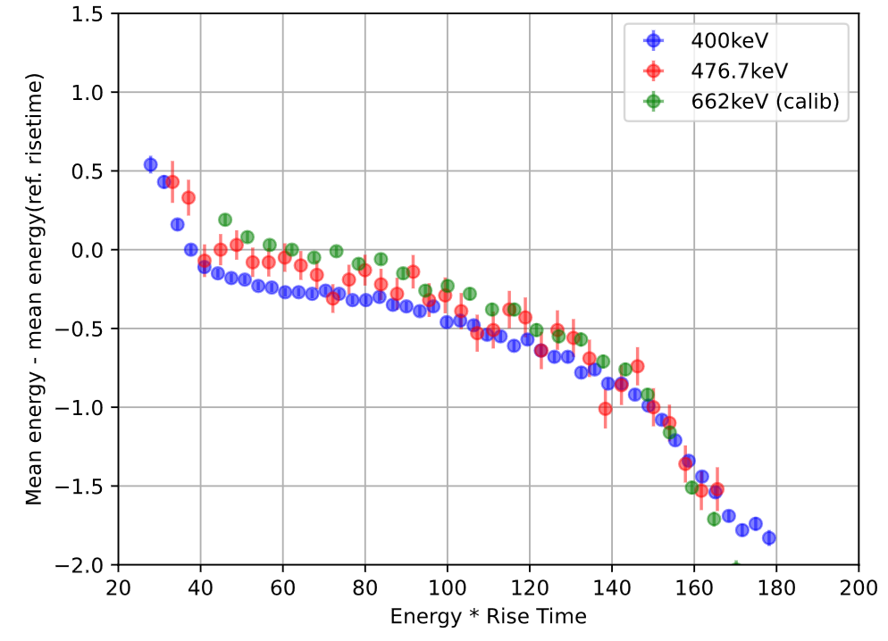
Risetime correction

Slide 14
Risetime correction
Ge06
Rise Time = $\frac{t\left(y=0.3ADC\right)−t(y=0.1ADC)}{0.3ADC−0.1ADC}$ = 1/slope

Slide 15
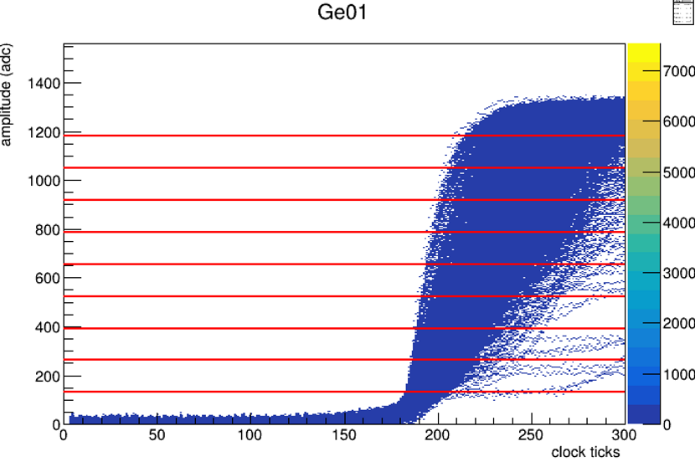
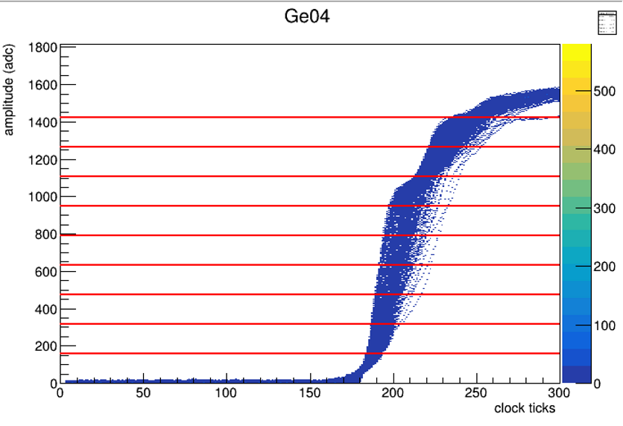
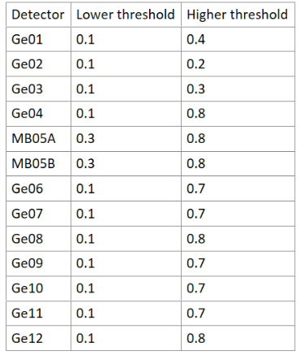
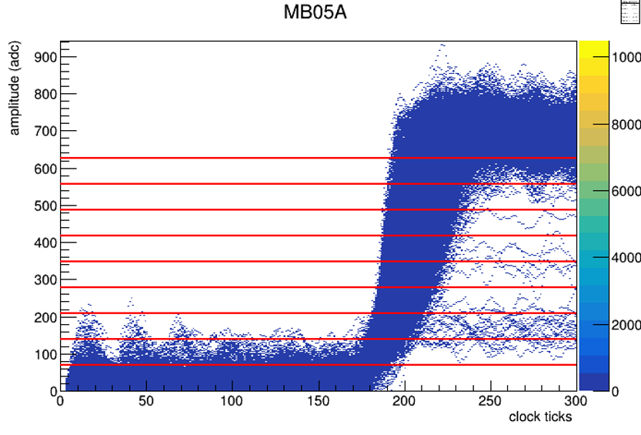
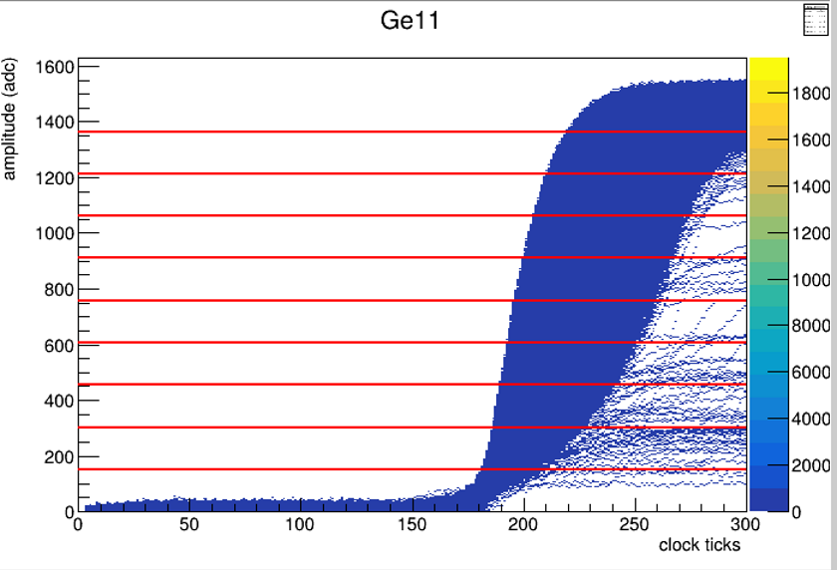
Risetime correction
Ge06
Before risetime = 1/slope(0.1*ADC and 0.3*ADC), but why this definition specific definition with 0.1 and 0.3?
DID NOT WORK ☹

Slide 16
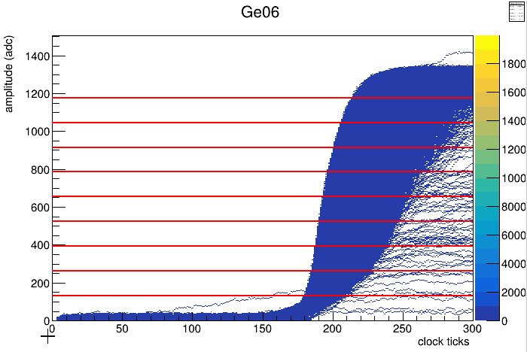
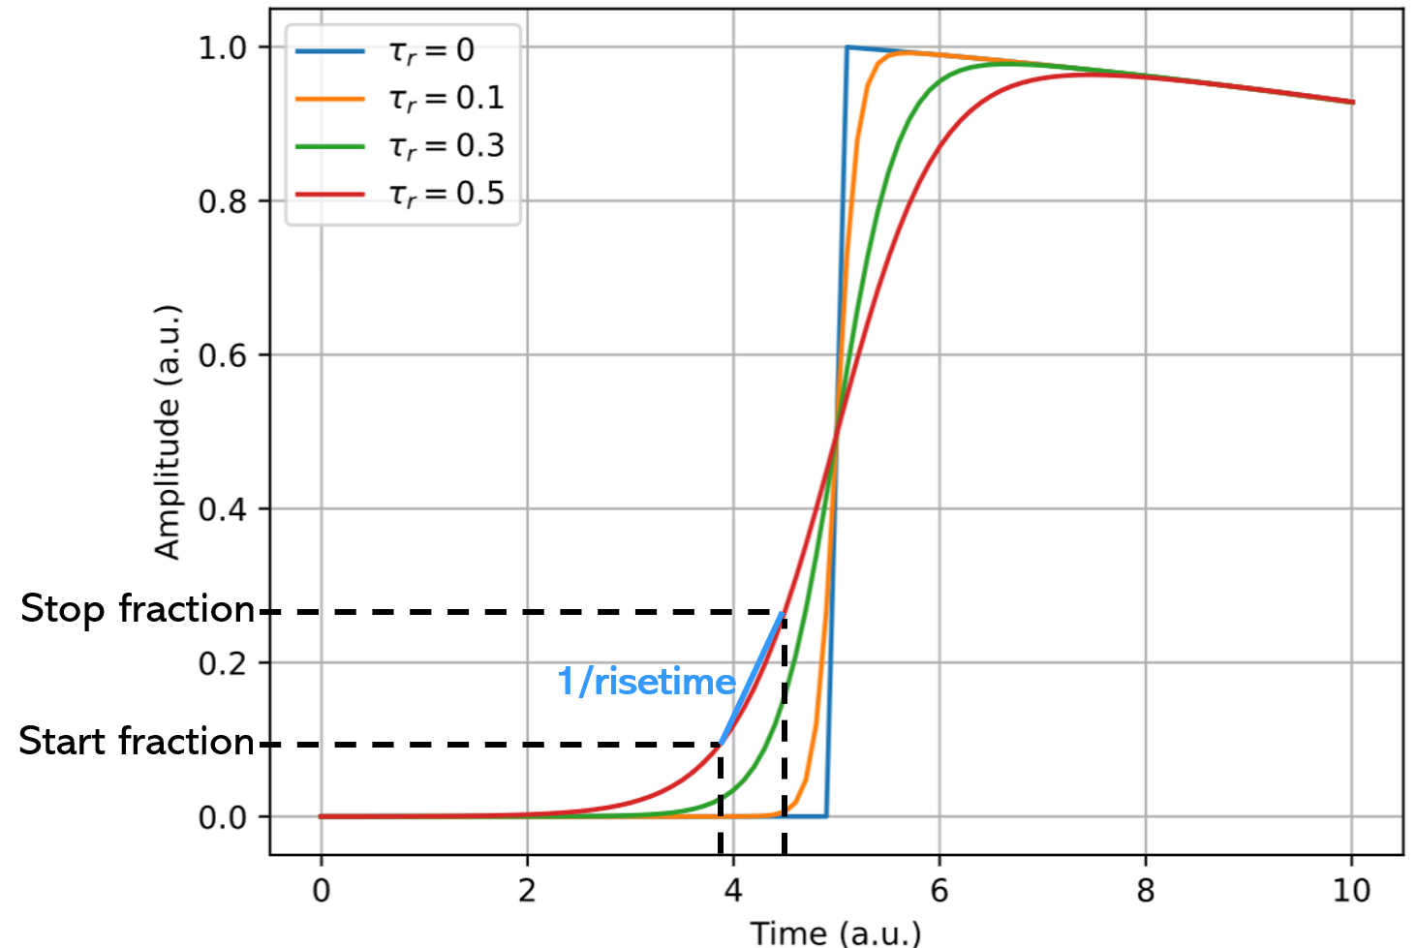
Risetime correction
Ge06
Before risetime = 1/slope(0.1*ADC and 0.3*ADC), but why this definition specific definition with 0.1 and 0.3?
Allowed now all combinations between 0.1*ADC and 0.9*ADC

Slide 17
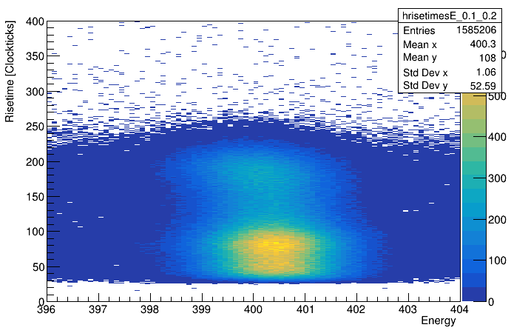
Risetime correction – idea of the correction
Ge06
Make Energy vs. Risetime 2D histogram
For every risetime bin make a gaussian fit to extract energy

Slide 18
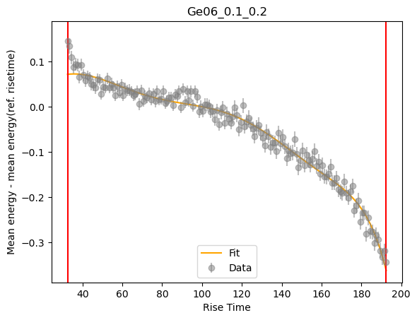
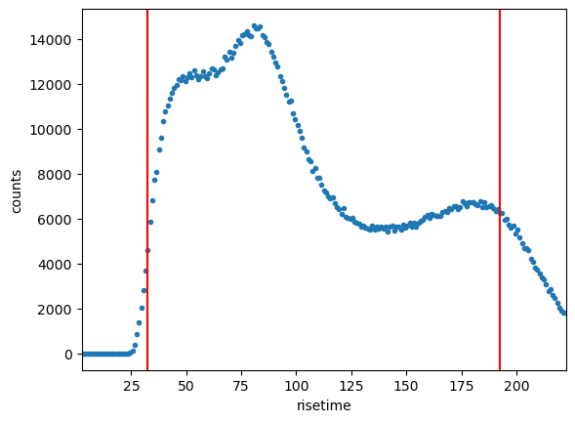
Risetime correction – idea of the correction
Ge06
Make Energy vs. Risetime 2D histogram
For every risetime bin make a gaussian fit to extract energy
Energy difference afo. Risetime → Fit (in e.g. 90% region of the data)
*ADC
* ADC

Slide 19
Risetime correction – idea of the correction
Make Energy vs. Risetime 2D histogram
For every risetime bin make a gaussian fit to extract energy
Energy difference afo. Risetime → Fit (in 90% region of the data)
Perform correction
Do something similar for the time afo risetime

Slide 20
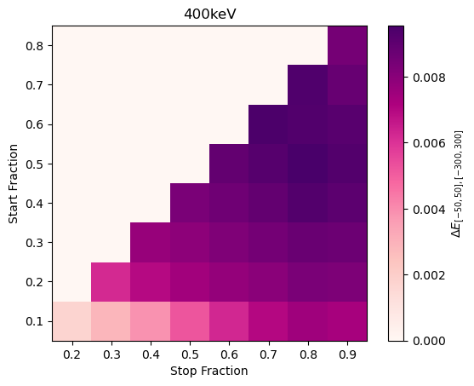
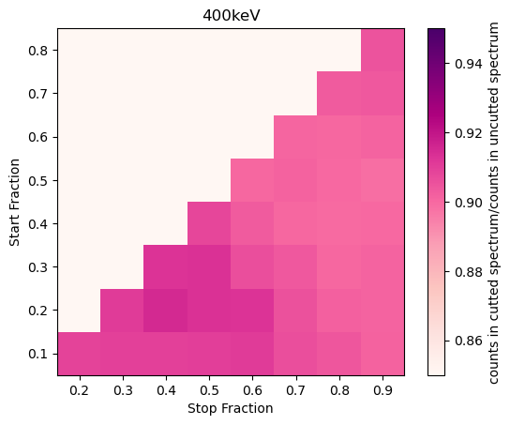
Risetime correction
Initial : 0.00839189

Slide 21

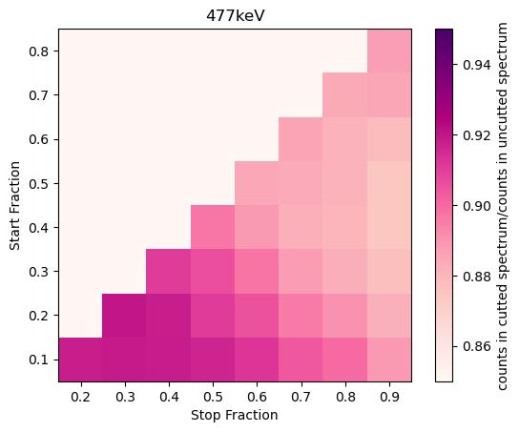
Risetime correction
Initial : 0.00331666

Slide 22
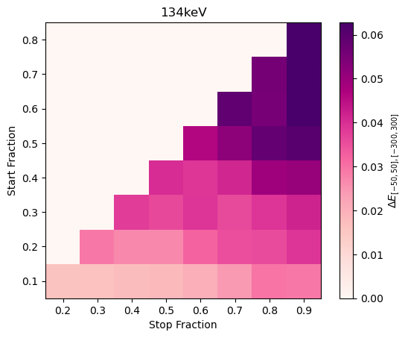
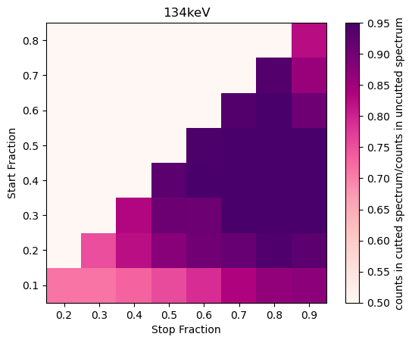
Risetime correction
Initial : 0. 0577753

Slide 23
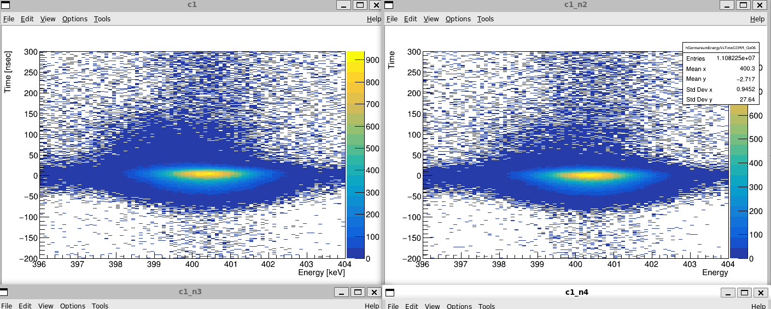
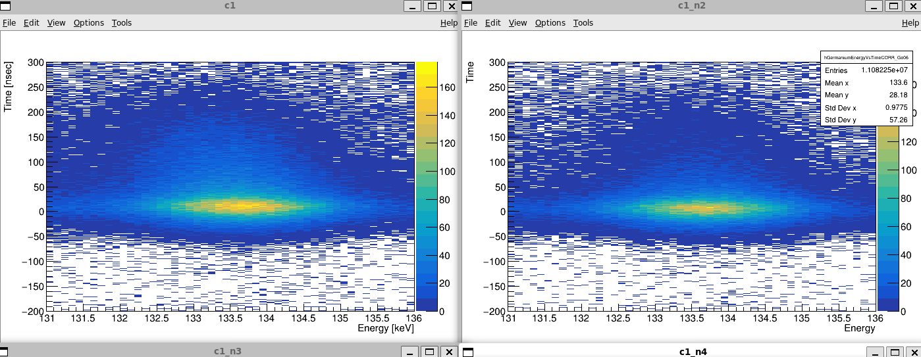
Risetime correction
Ge06
uncorrected
corrected
uncorrected
corrected

Slide 24
Risetime correction
Ge06
Energy: 400
E small interval: 400.44+-0.00116314
Difference: 0.0110092+-9.25995e-05
----------------------------
after correction:
E small interval: 400.484+-0.00120071
Difference: 0.0027611+-0.000100088
Statistics loss: 0.908689
--------------
Energy: 476.7
E small interval: 477.135+-0.00406199
Difference: 0.00560783+-0.00116701
----------------------------
after correction:
E small interval: 477.178+-0.00419535
Difference: 0.0014842+-0.000928501
Statistics loss: 0.917933
--------------
Energy: 133.5
E small interval: 133.625+-0.00264398
Difference: 0.0646389+-0.00133104
----------------------------
after correction:
E small interval: 133.668+-0.00294645
Difference: 0.0179757+-0.00114171
Statistics loss: 0.71139

Slide 25
Risetime correction
Ge06
What if I combine multiple corrections? (95% correction with 0.1-0.2 and then another 95% correction applied on the corrected data)
→ Did not improve the correction

Slide 26
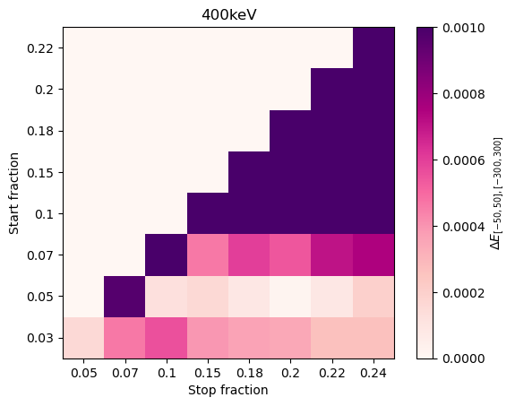
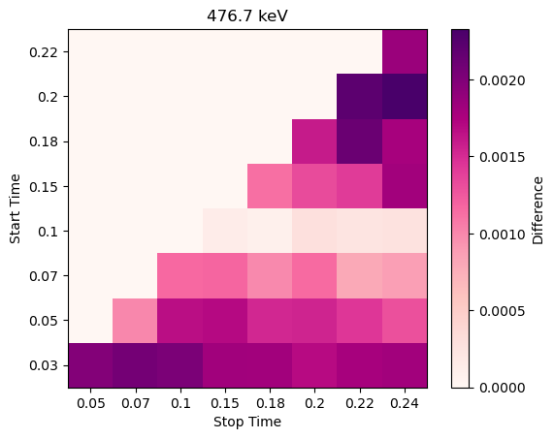
Risetime correction – narrower thresholds
Optimal point does not agree → What is the best way to go?

Slide 27
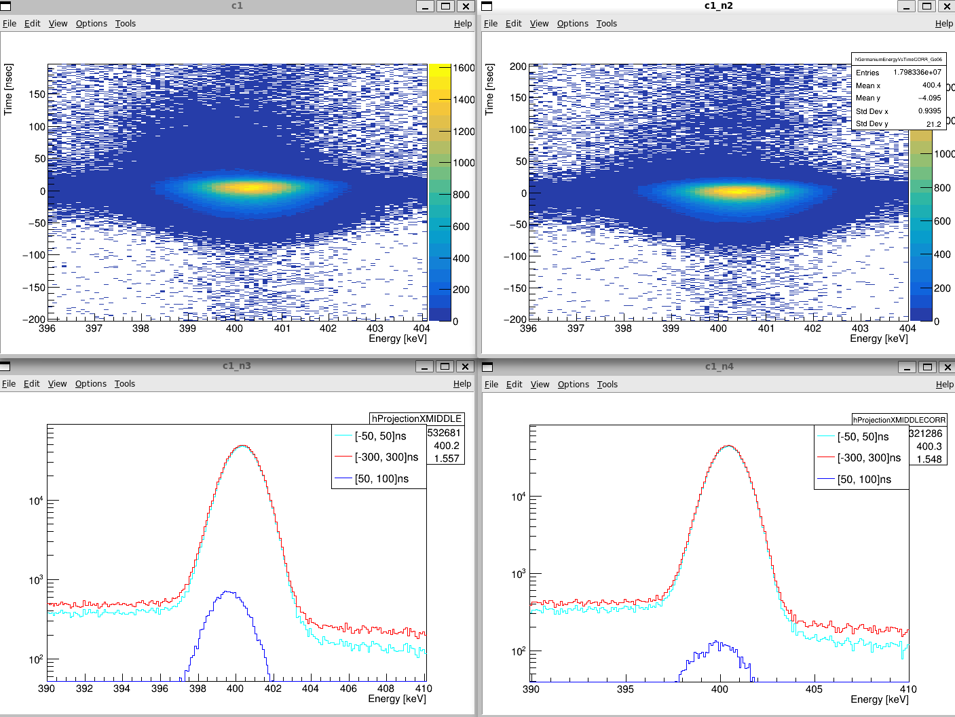
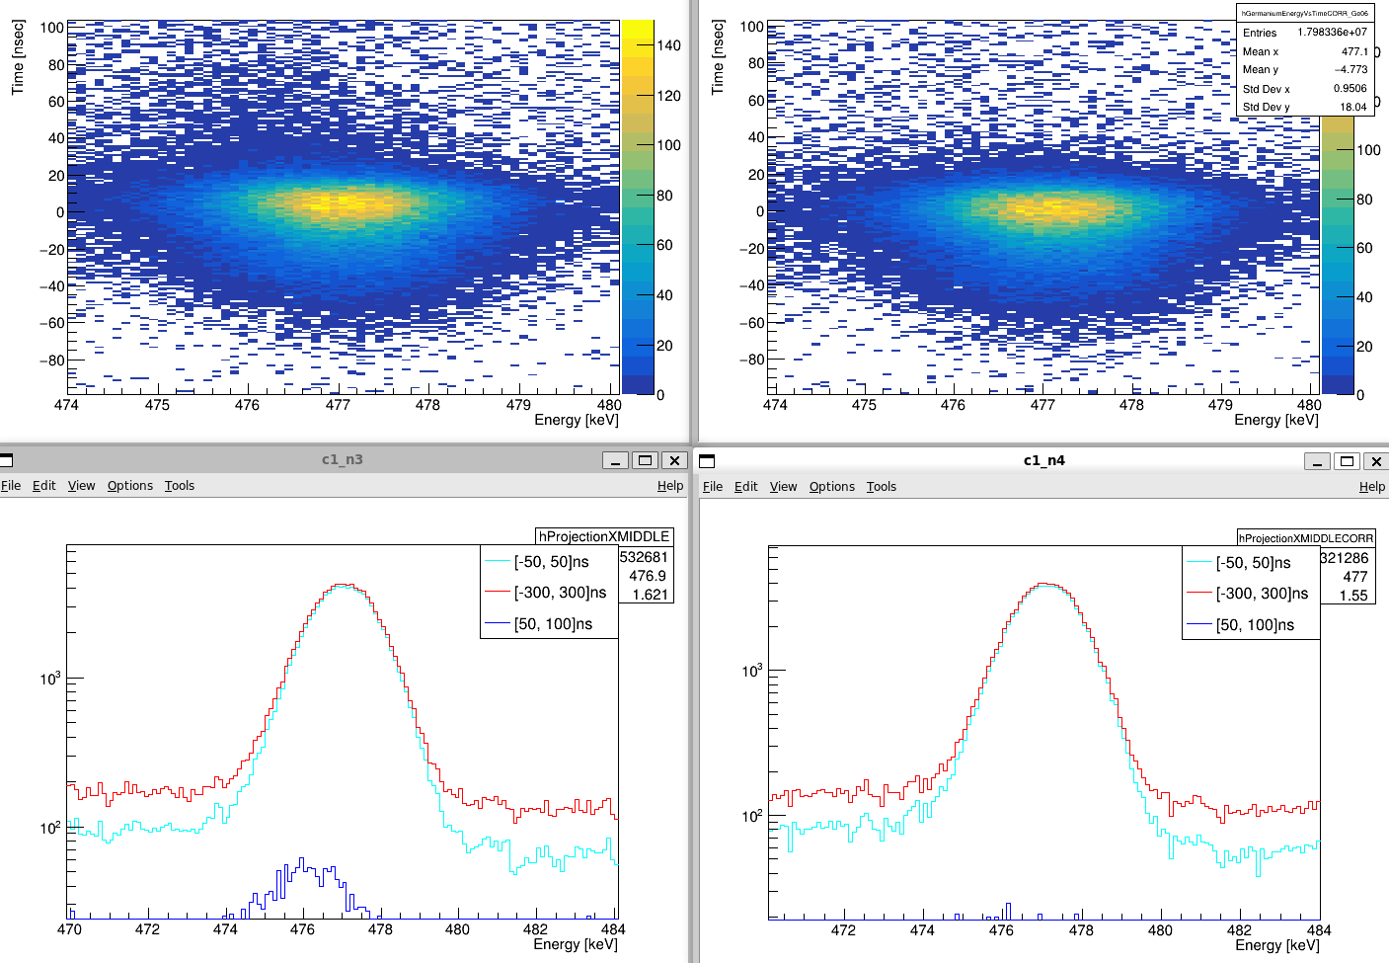
Risetime correction
Ge06
0.05;0.2
uncorrected
corrected
uncorrected
corrected

Slide 28
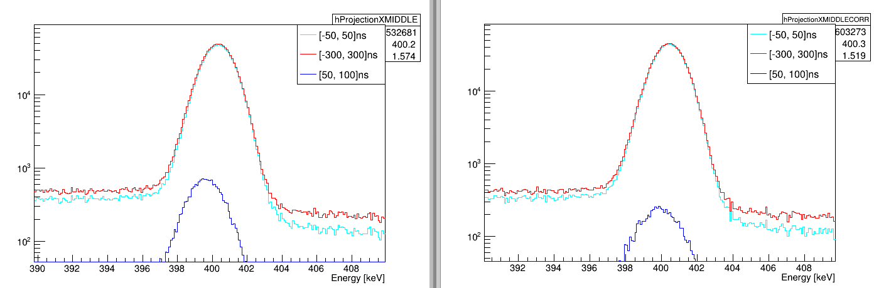
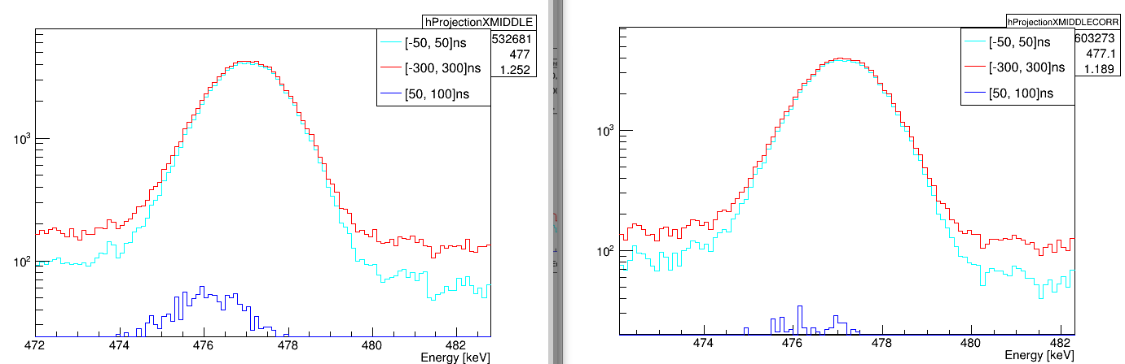
Risetime correction
Ge06
0.1;0.18
uncorrected
corrected
uncorrected
corrected
-------------------------
Energy: 400
E small interval: 400.439+-0.000883223
Difference: 0.0111056+-7.11015e-05
----------------------------
after correction:
E small interval: 400.513+-0.000913149
Difference: 0.00227965+-9.45238e-05
Statistics loss: 0.909423
--------------
-------------------------
Energy: 476.7
E small interval: 477.145+-0.00315536
Difference: 0.00586605+-0.000763042
----------------------------
after correction:
E small interval: 477.219+-0.00322782
Difference: 7.95302e-05+-0.000667945
Statistics loss: 0.921931
--------------

