Slide 1
PSI Machine Development Shift
- March 2025
Johan Lundquist, Synchrotron Radiation Research, Lund University
PhD Supervisors: Francesca Curbis, Sverker Werin, Erik Mansten

Slide 2
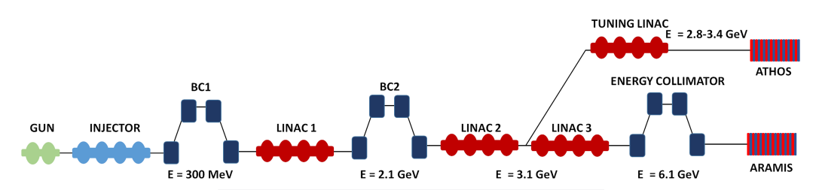
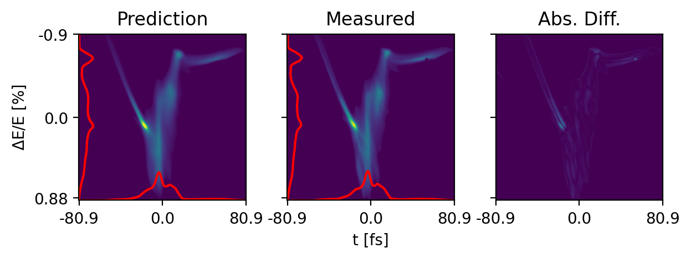
SwissFEL - “Test” Dataset and Virtual Diagnostics
Using ML to predict Longitudinal Phase Space
Data before MD shift: 983 images from Athos PolariX TDC, collected for jitter studies
X-band TDS
BCM Readings for bunch length
+ dispersive BPMs
Virtual Diagnostic

Slide 3


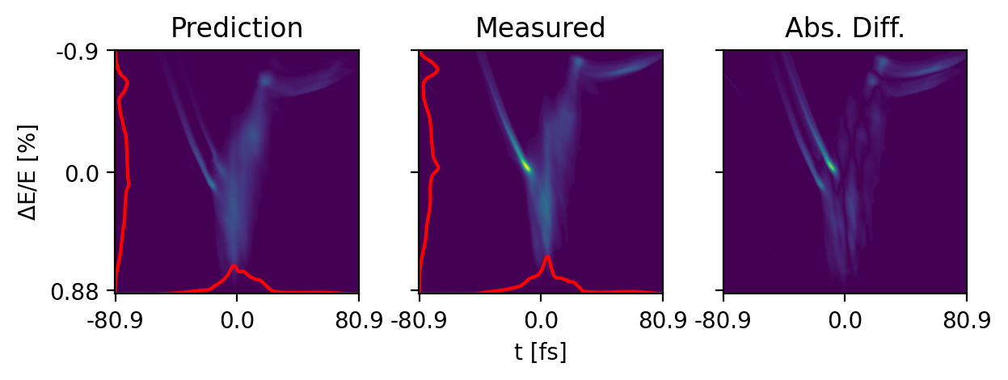
SwissFEL – LPS Predictions
Mean performance across test set
R²=92.0%
Notes:
Mention that you are seeing effect of lasing

Slide 4
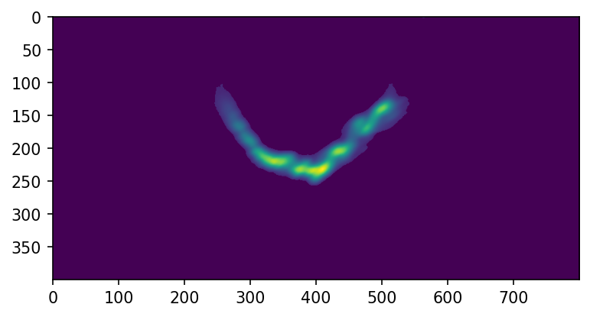
SwissFEL – Collection Plan
X-band Athos TDS
Tuesday night shift dedicated to ML data collection.
In the control room: Johan, Erik, Philipp (early), Christoph
SCAN: Injector phase, X-band amplitude and Linac 1 Phase
+ ”Step” Parameters to control Aramis/Athos split
Beam-synchronous DAQ: screen images, dispersive BPMs, rf phase and amplitude readback, bunch compression monitors
C-band Aramis TDS
Passive Streaker

Slide 5
Collection 1 – RF Step scans on Sunday night
X-band Athos TDS
Extra time on Sunday, Athos only
SCANS of RF step parameters:
X-band phase and voltage
Injector phase and voltage
Injector and X-band voltage
SCAN: Injector and Xband step parameters

Slide 6
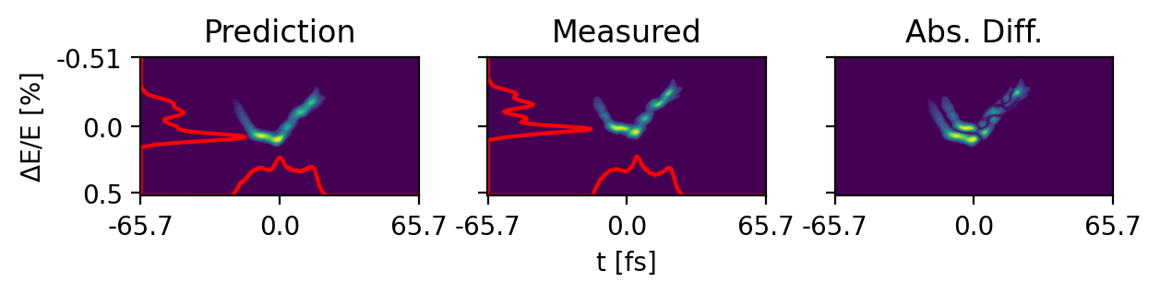
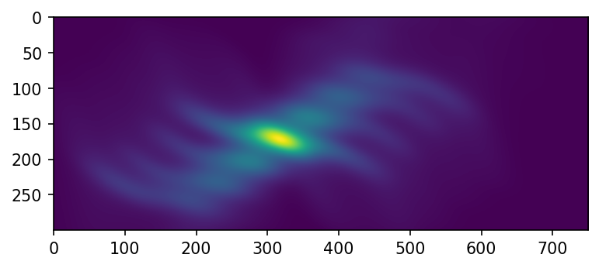
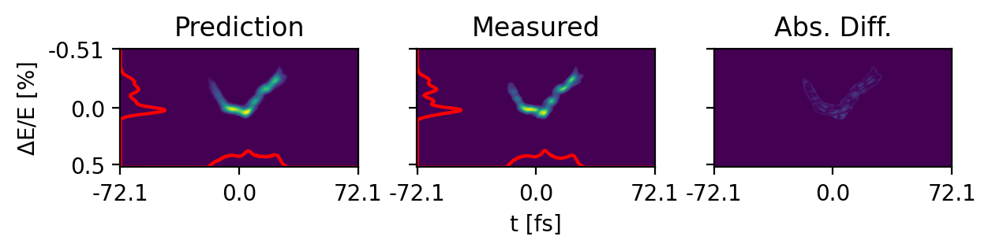
Image alignment using cross-correlation
Small offsets lowering performance without real information loss
Align beams in image after prediction using cross-correlations

Slide 7
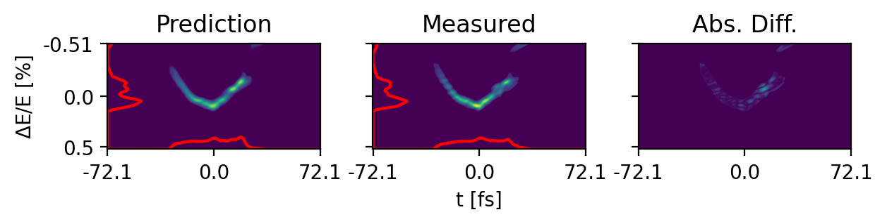
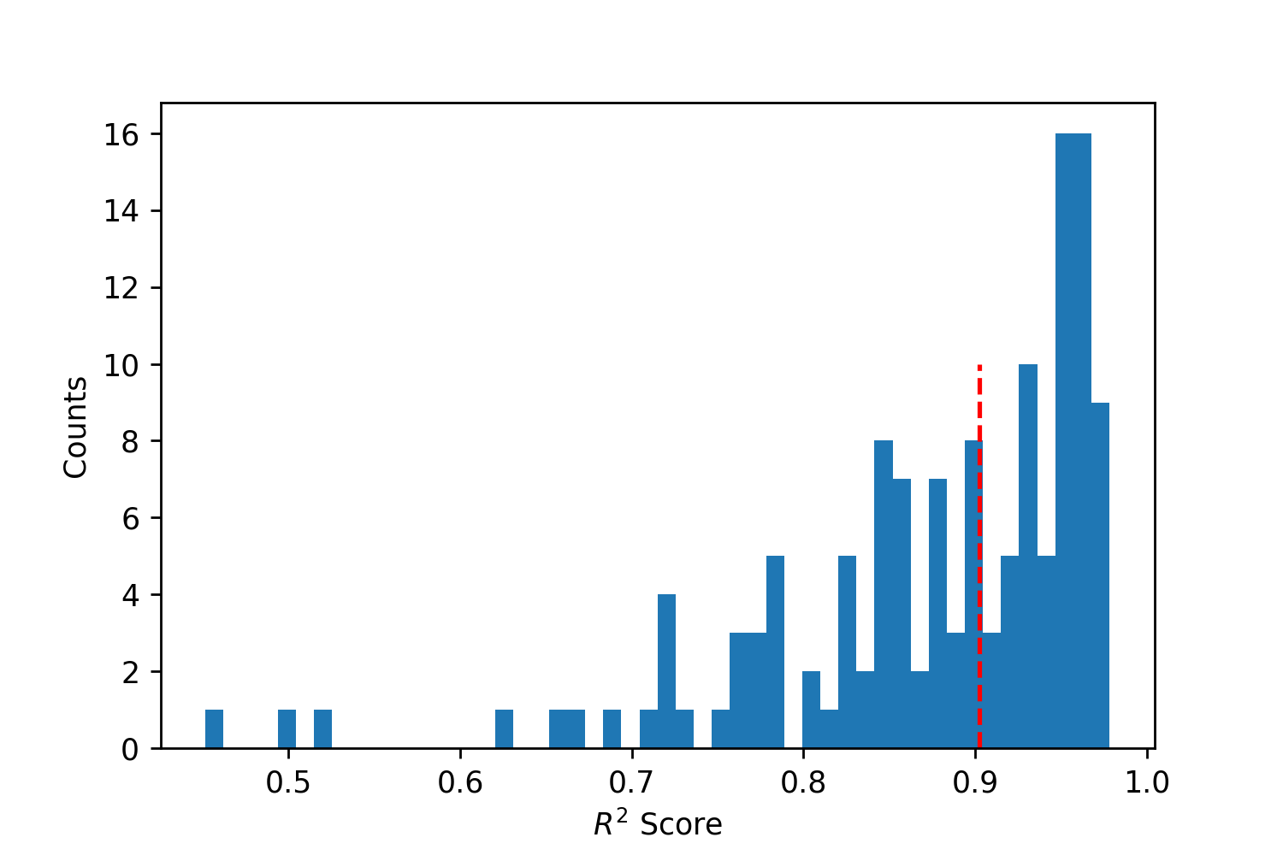

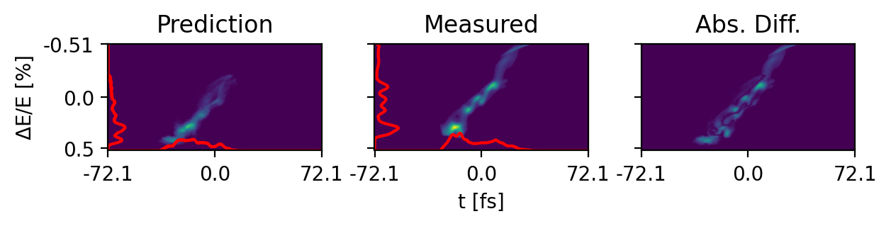
RF Step Scan Predictions
Mean: 87.4%
Median: 90.3%

Slide 8
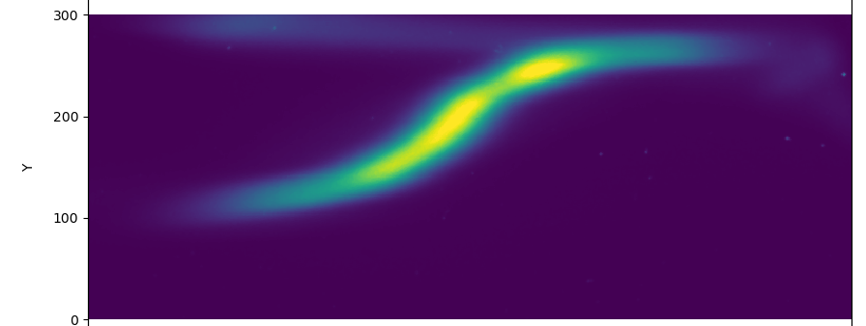
Collection 2 – Parallel C-band and X-band Collections
X-band Athos TDS
Beam-synchronous data acquisition from two screens in parallel
C-band measurement caused rapid increase of dose, quick collections at two different times.
SCANS:
First to be done, injector and L01 phases
“Inbetween points” filled in with later scans
SCAN: Injector and Linac 1 Phase
C-band Aramis TDS

Slide 9
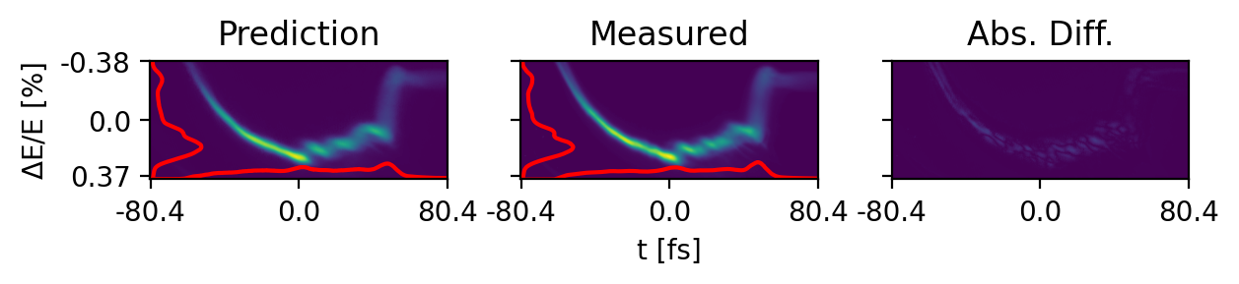
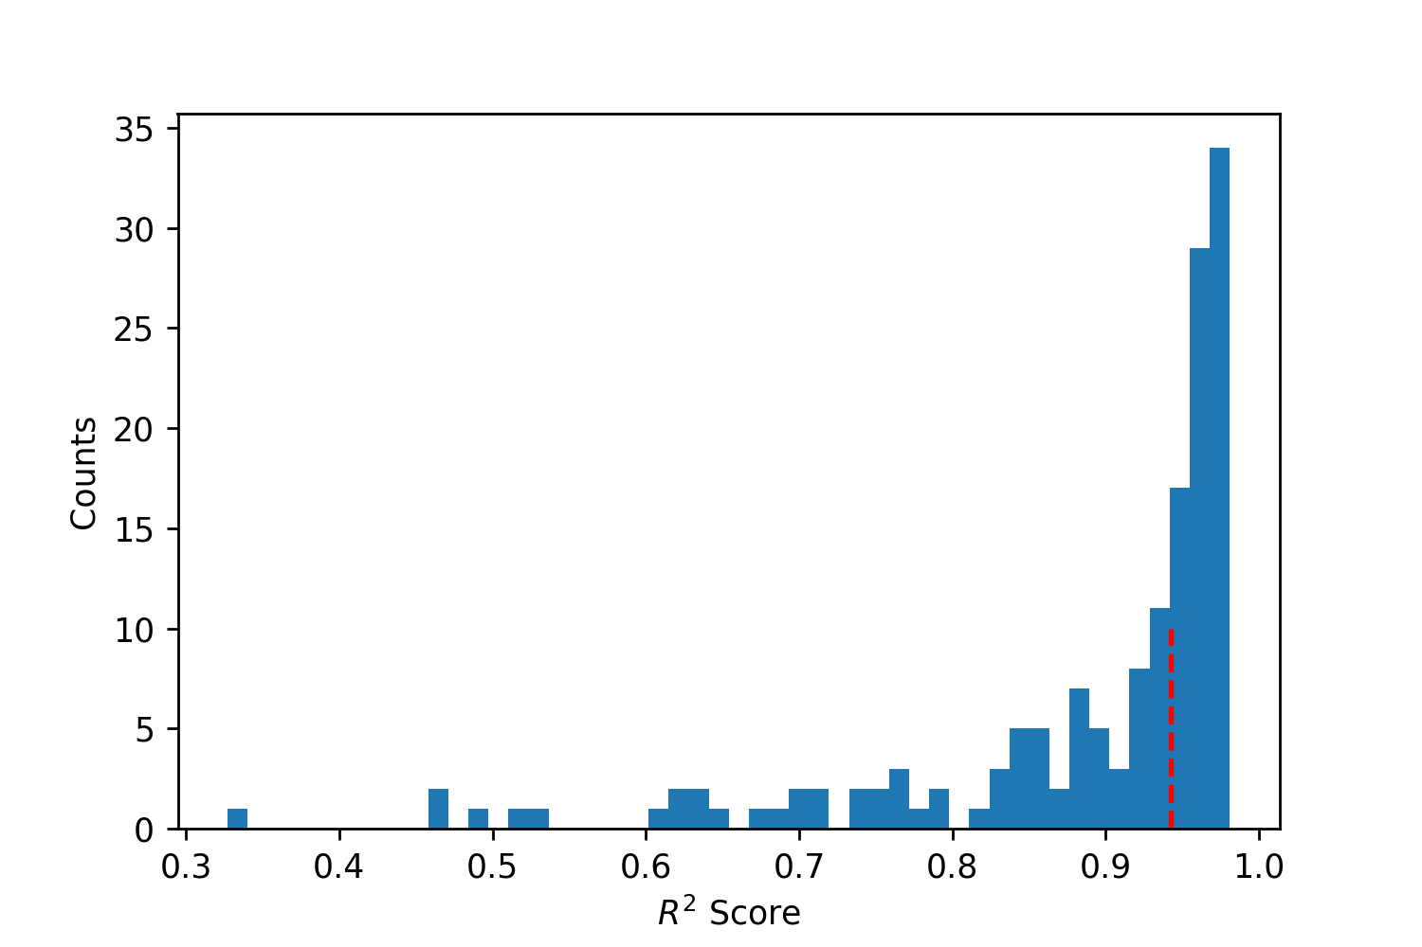
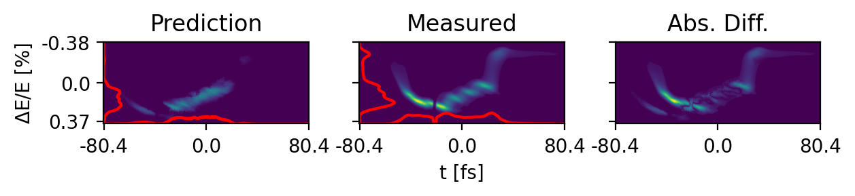

X-band TDS – Athos Line
Mean: 88.7%
Median: 95%

Slide 10
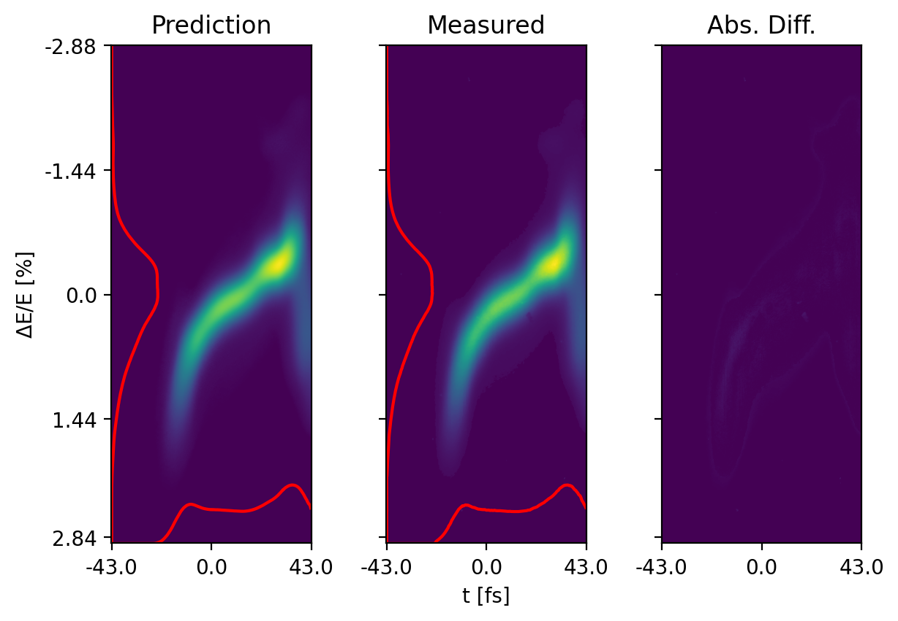
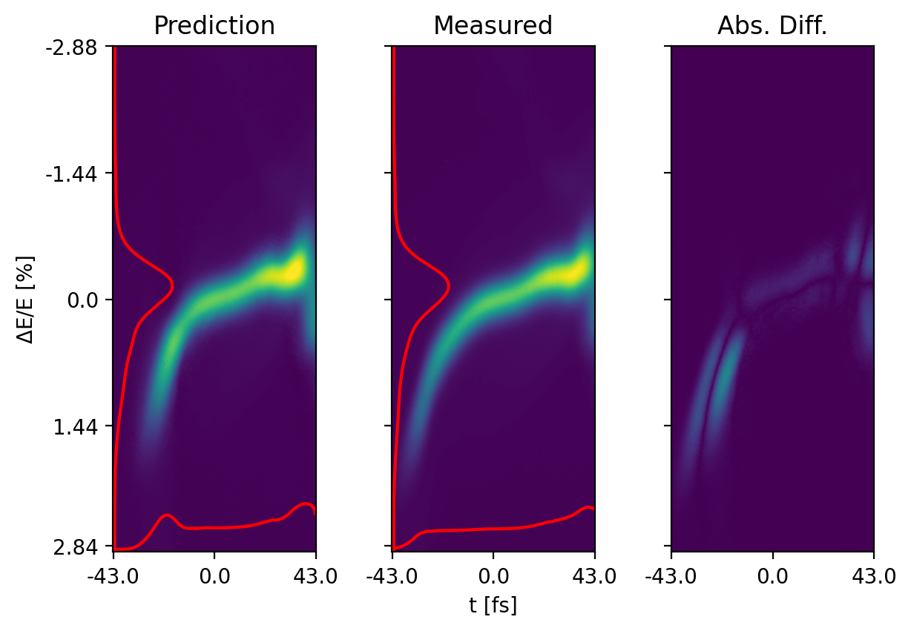
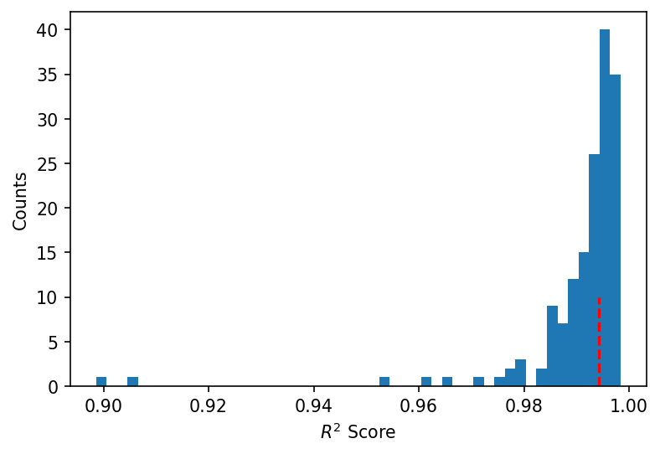
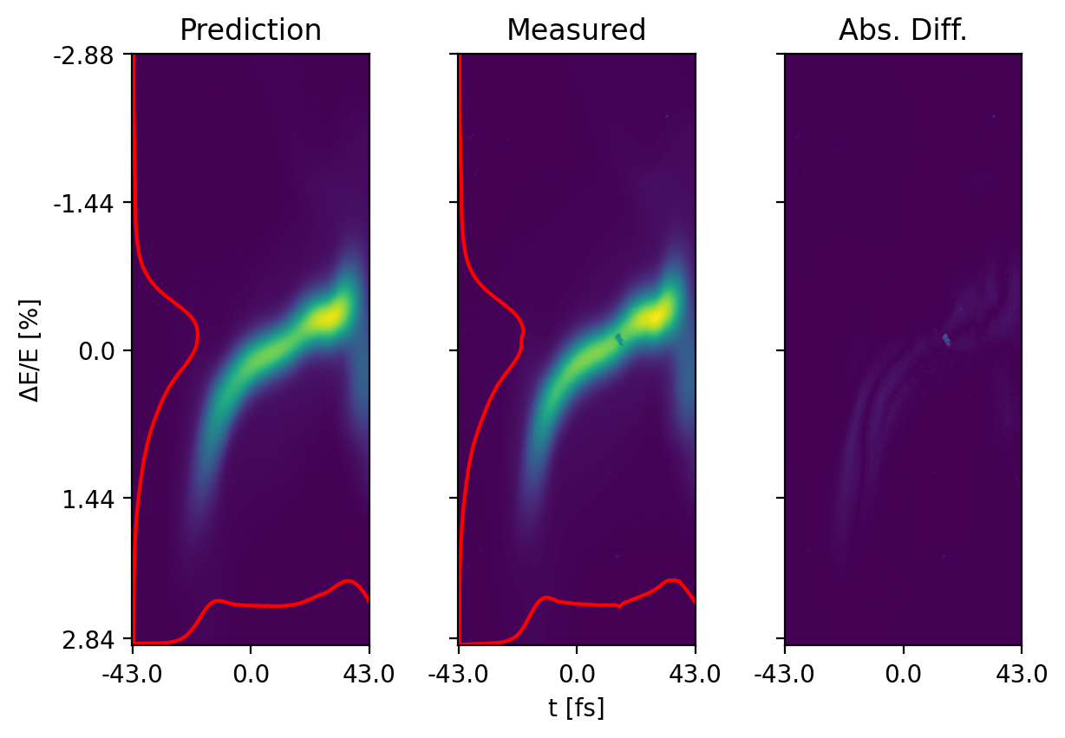
C-band TDS – Aramis Line
Mean: 99.1%
Median: 99.3%

Slide 11
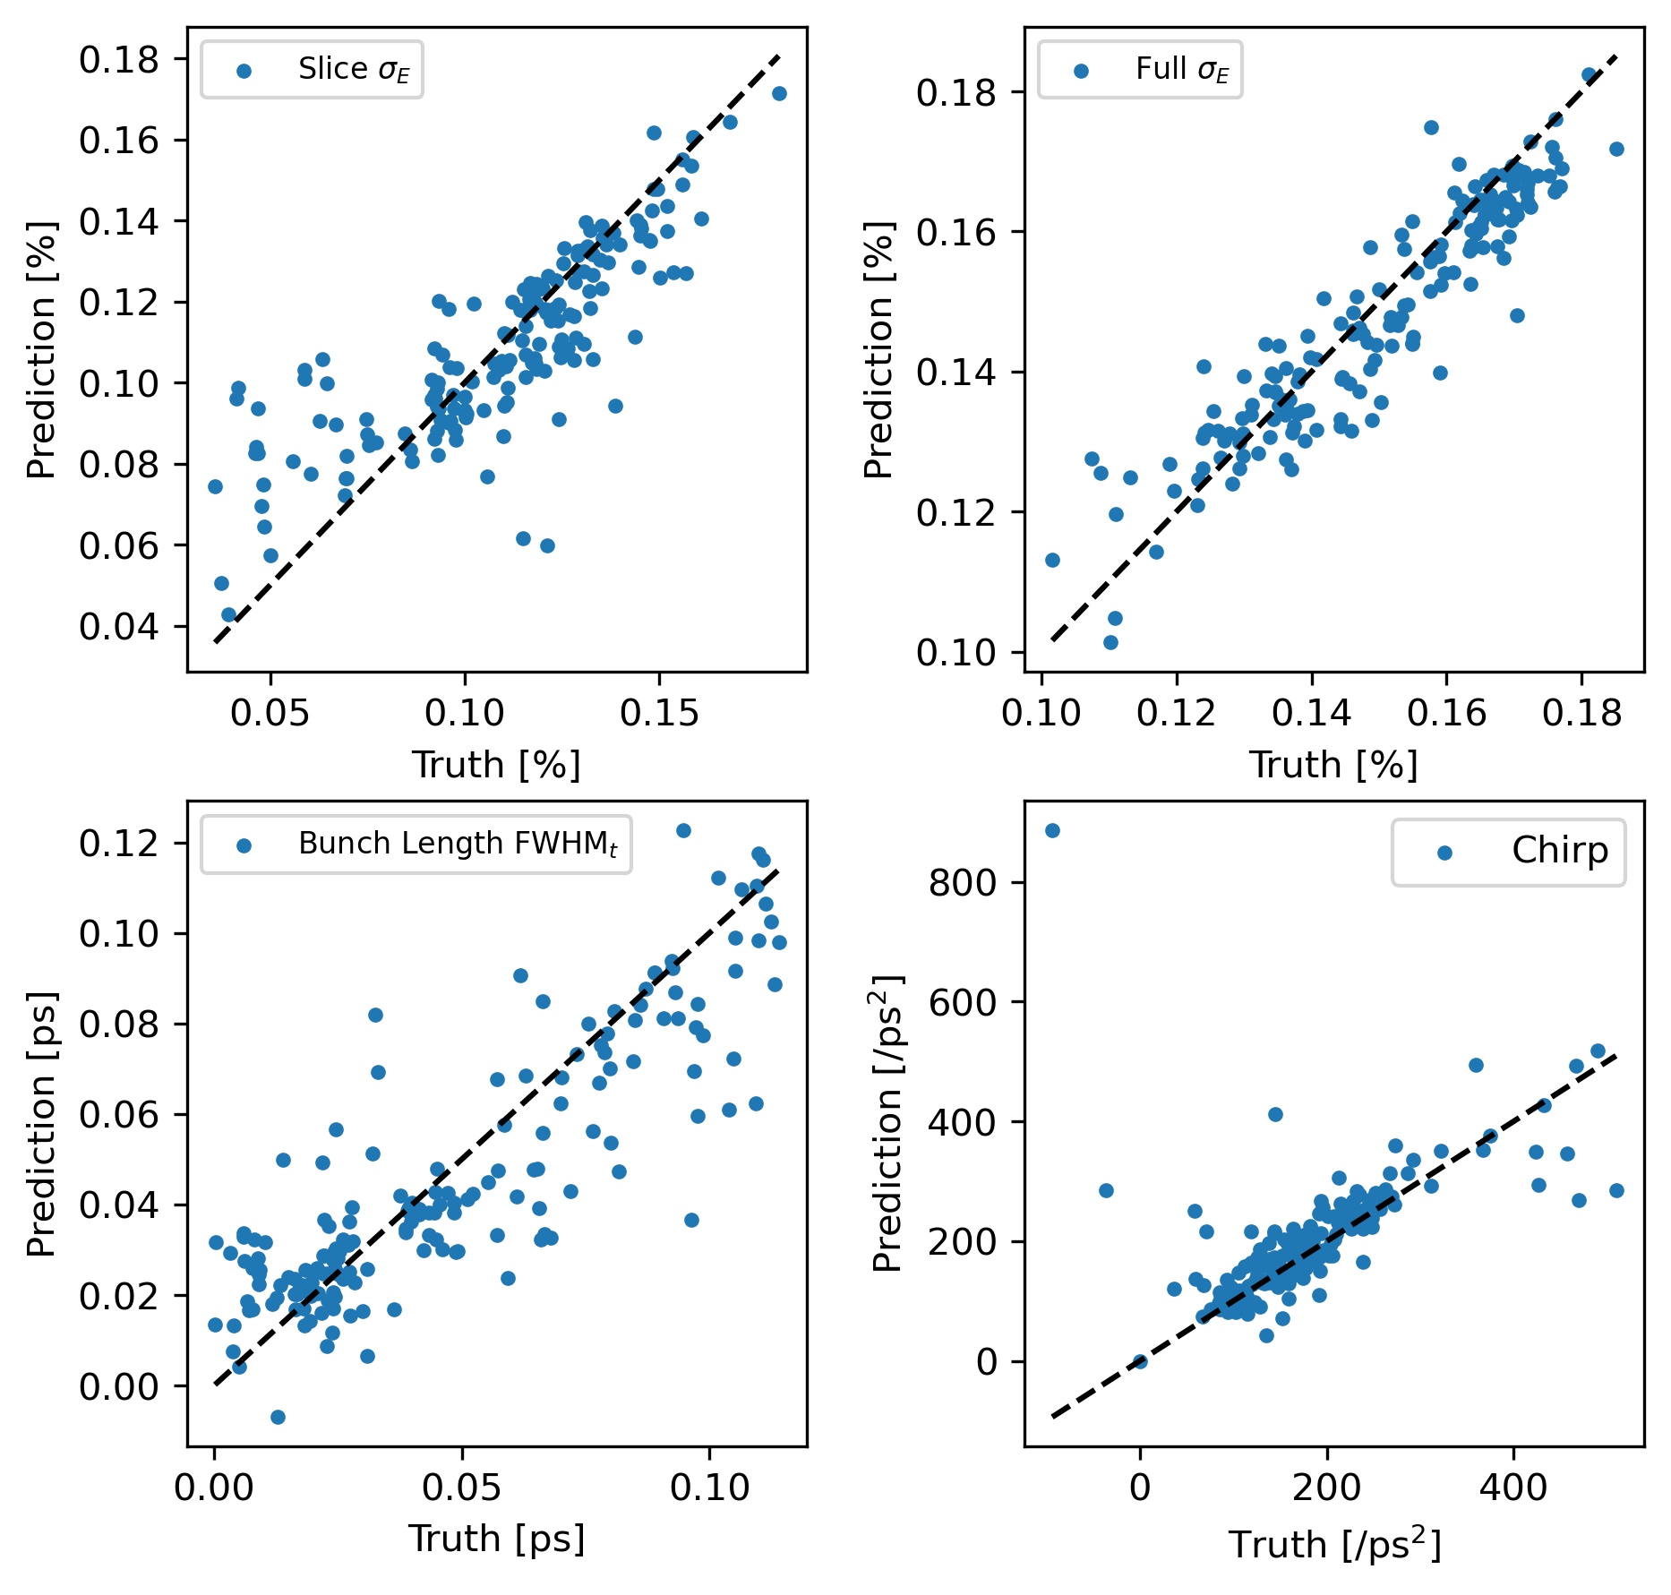
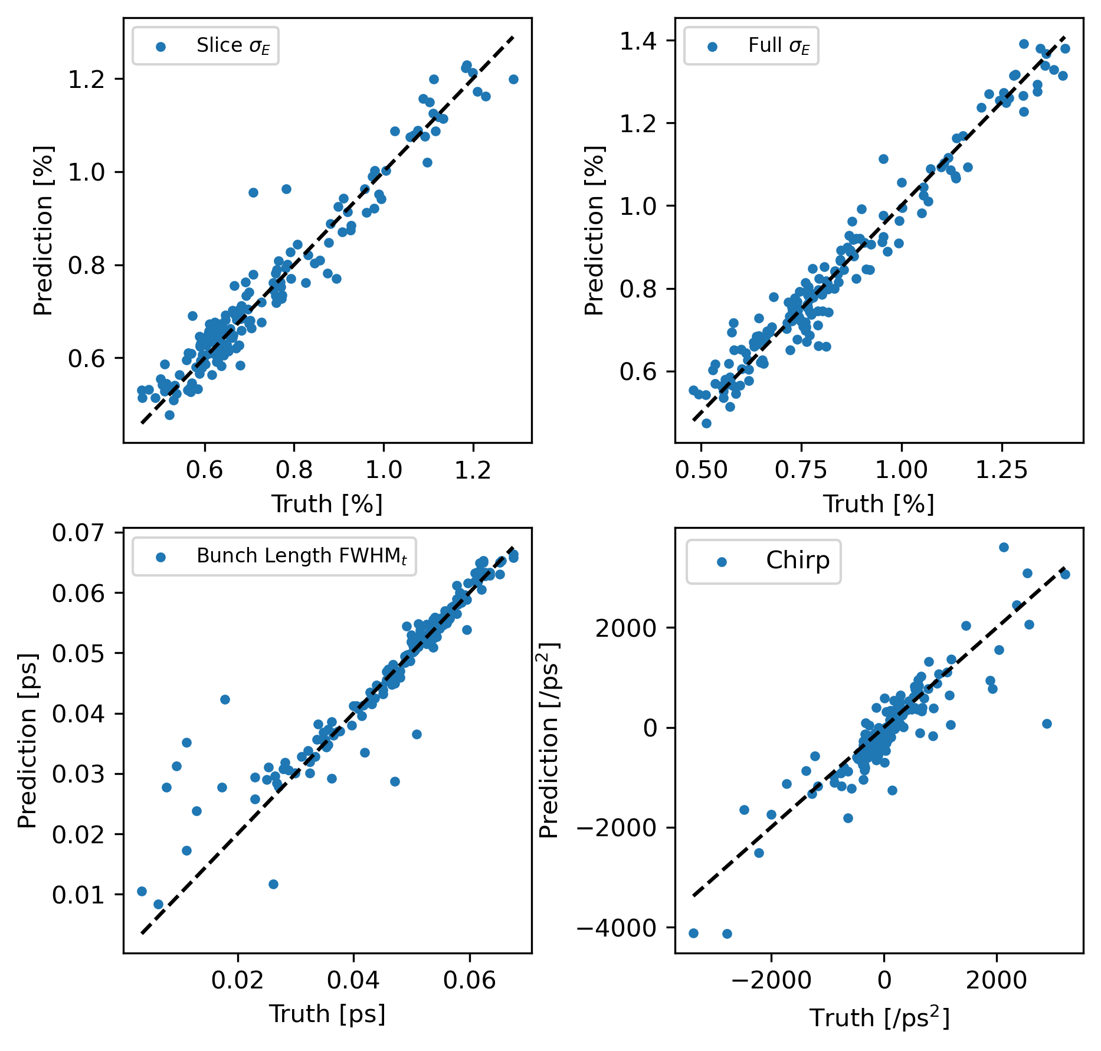
Athos X-band
Aramis C-band

Slide 12
Collection 3 – Jitter Collections with different amount of lasing
Jitter collections of lasing beam while detuning different IDs, 8-3 IDs detuned.
X-band Athos TDS

Slide 13
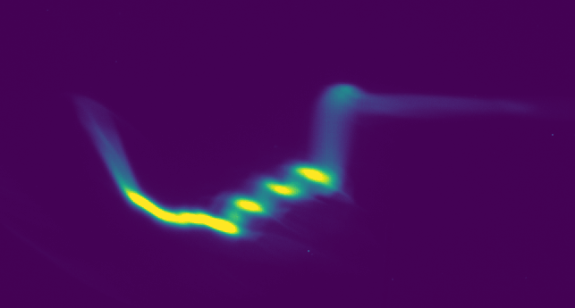
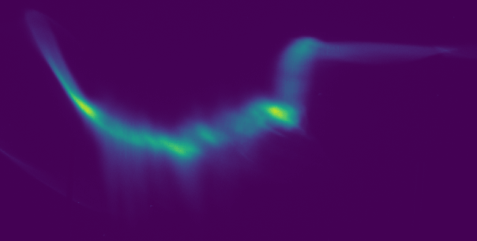
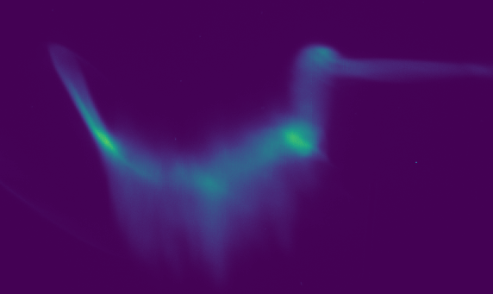
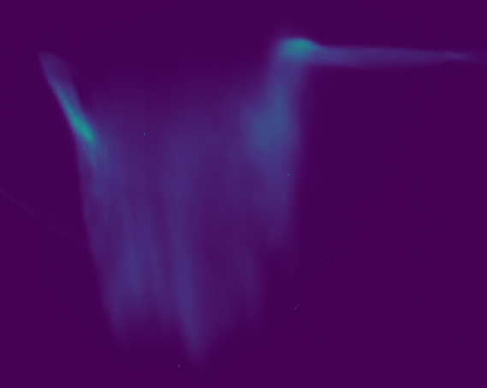
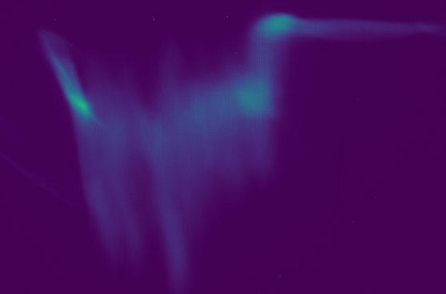
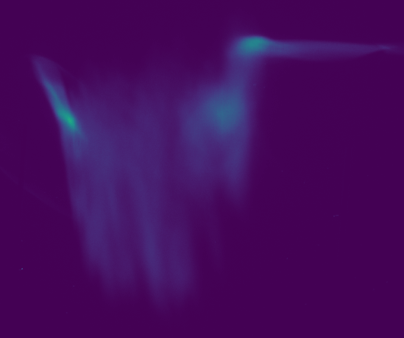
8 IDs Detuned (48)
7 IDs Detuned (28)
6 IDs Detuned (33)
3 IDs Detuned (45)
5 IDs Detuned (37)
4 IDs Detuned (41)

Slide 14
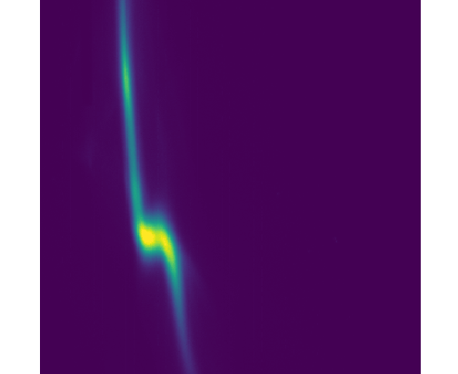
Collection 4 – Parallel Dechirper and X-band Collections
X-band Athos TDS
SCANS:
Biggest part of the data, 800 setpoints per combination
Sergey’s idea: Use Dechirper data when scanning the same inj and l01 phase to reconstruct the C-band data from earlier
Dechirper
SCAN: Injector phase, X-band amplitude and Linac 1 Phase

Slide 15
Collection 5 – X-band Collections with RF scans while lasing
X-band Athos TDS
SCANS:
Repeated all combinations from X-band/dechirper collection, so I have lasing ON/OFF for the X-band in all combinations.
SCAN: Injector phase, X-band amplitude and Linac 1 Phase

Slide 16

Thank you!
Acknowledgments:
Data acquisition software: A. Gobbo (image pipelines) and S. Augustin (BSCache)
Participation in measurement shift: C. Kittel and P. Dijkstal

