Slide 1
Echo-enabled harmonics generation (EEHG) beamtime
SwissFEL Progress Meeting
Wenxiang Hu on behalf on the HERO team
01/04/2025

Slide 2
Outline
Introduction
Overview of the beamtime
Optimization of EEHG
Results
  Measured spectra
  Scanning relative timing
  Scanning EEHG parameters
Summary
Outlook

Slide 3
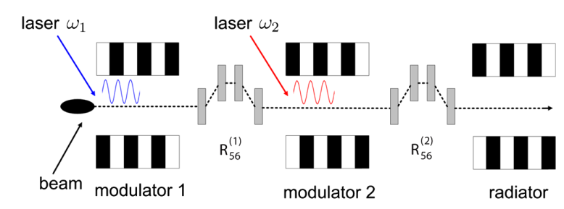
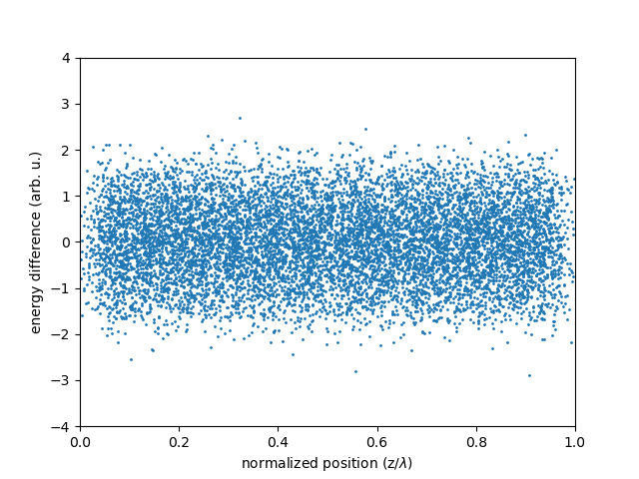
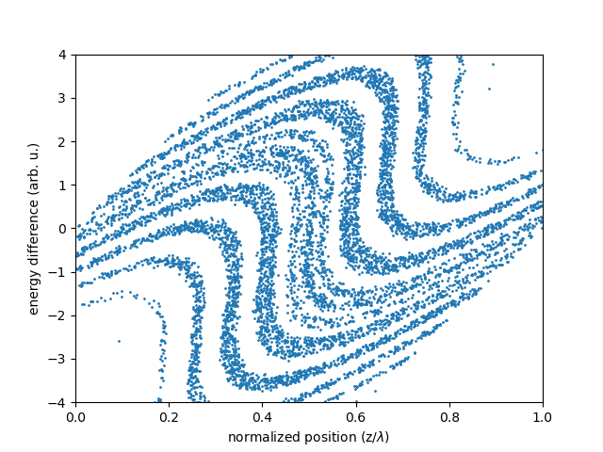
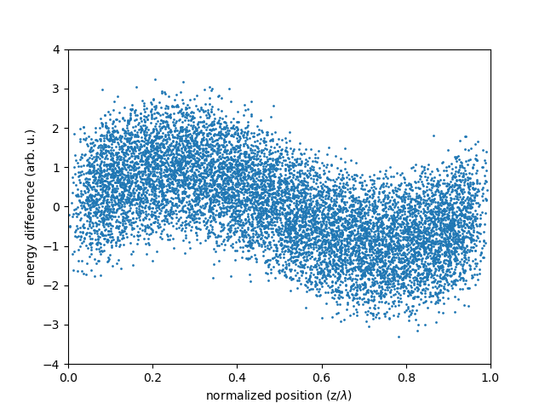
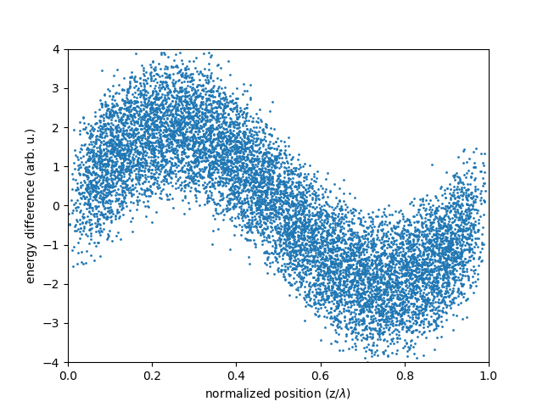
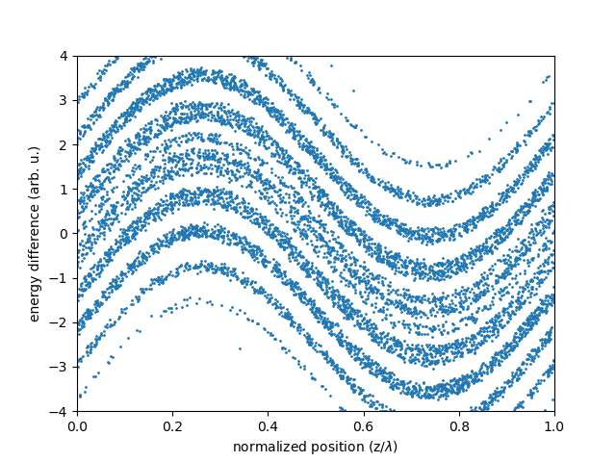
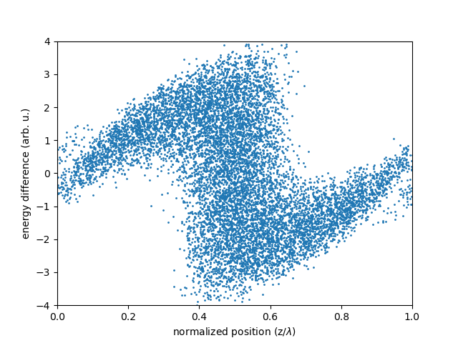
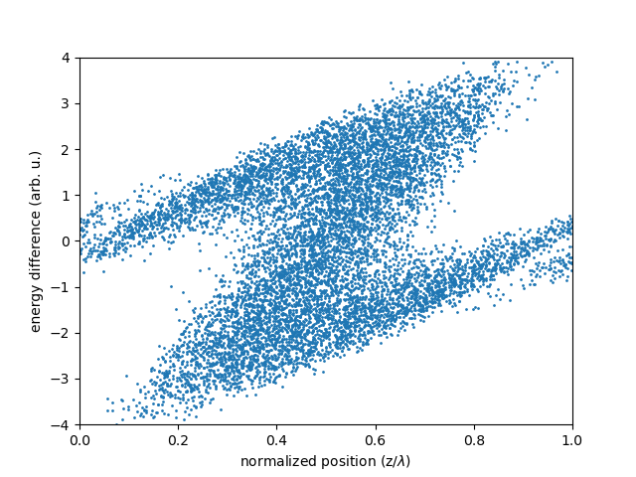
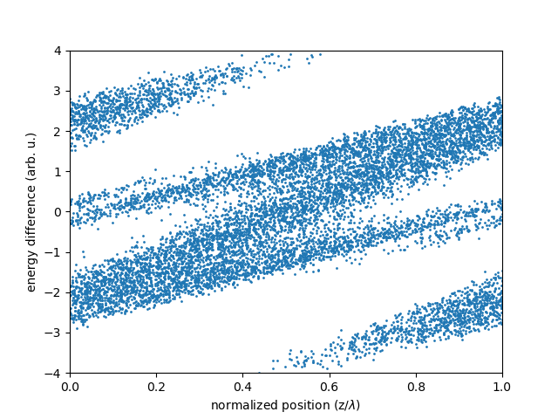
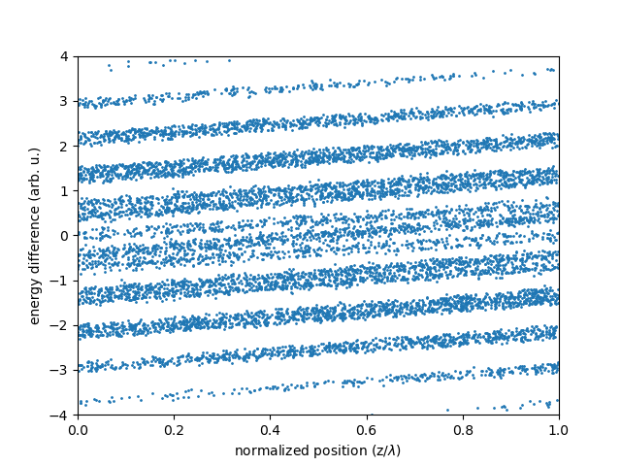
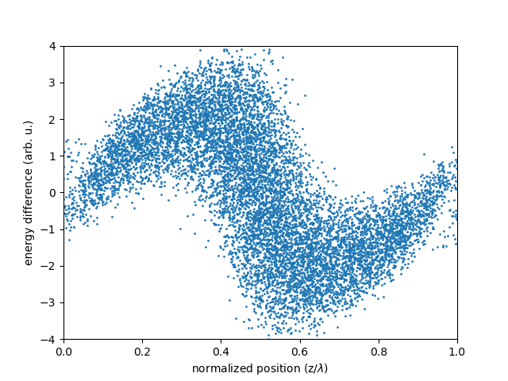
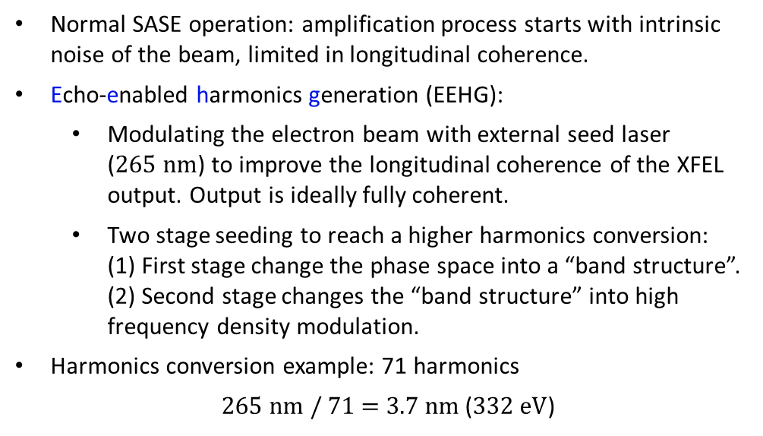
Introduction: general idea of EEHG
Normal SASE operation: amplification process starts with intrinsic noise of the beam, limited in longitudinal coherence.
Echo-enabled harmonics generation (EEHG):
  Modulating the electron beam with external seed laser ($265 nm$) to improve the longitudinal coherence of the XFEL output. Output is ideally fully coherent.
  Two stage seeding to reach a higher harmonics conversion:
  (1) First stage change the phase space into a “band structure”.
  (2) Second stage changes the “band structure” into high frequency density modulation.
Harmonics conversion example: 71 harmonics
$265 nm$ / 71 = $3.7 nm$ ($332 eV$)
D. Xiang and G. Stupakov, Phys. Rev. ST Accel. Beams, 12:030702 (2009)
Electron beam phase space (z, E)
Mod 1
Chicane 2
Chicane 1
Mod 2

Slide 4

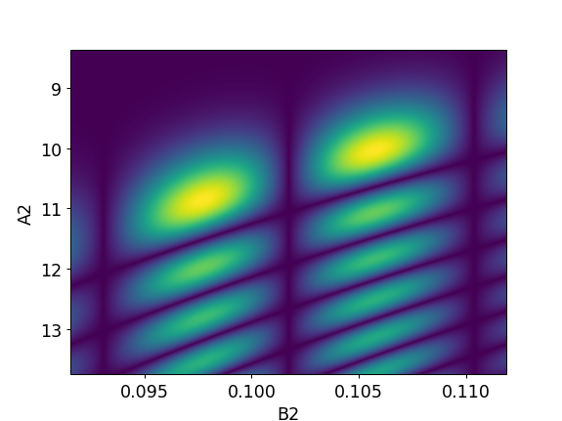
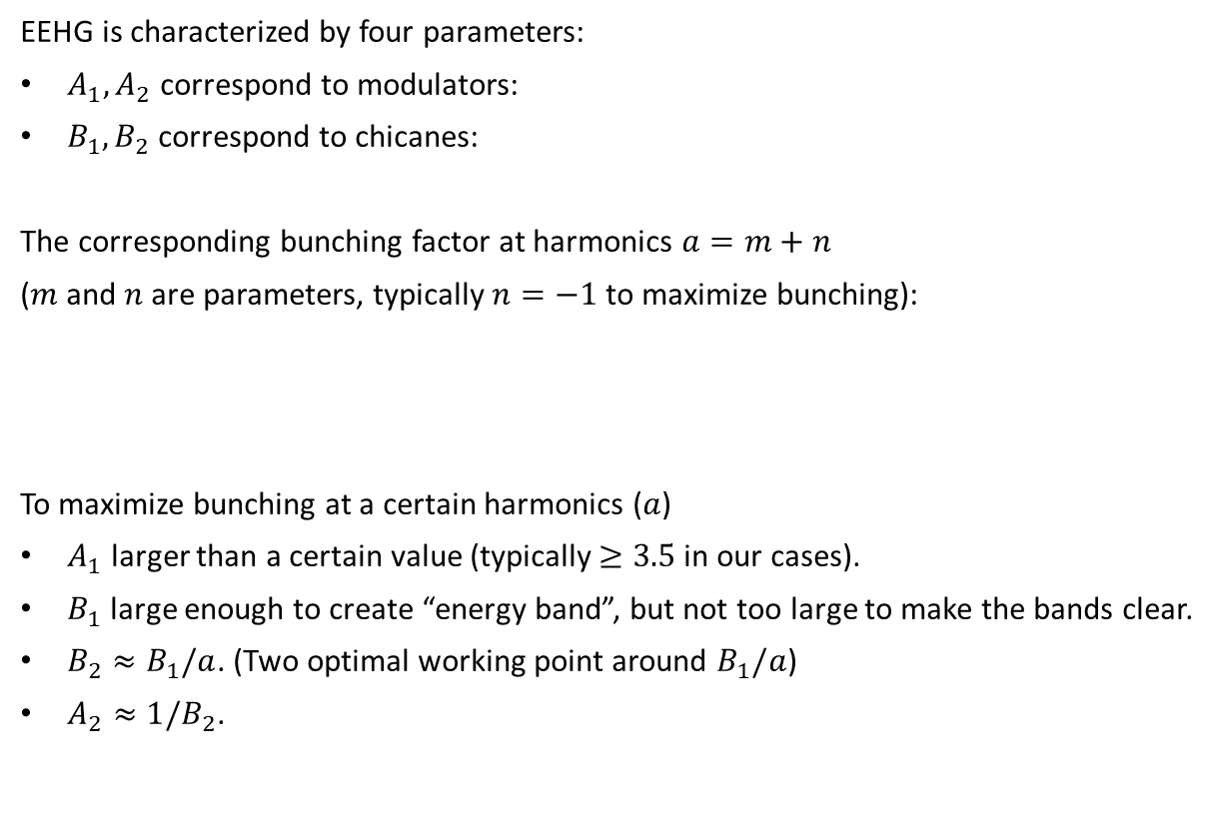
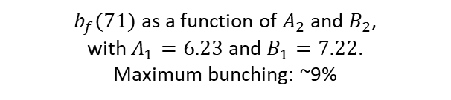
Introduction: analytical expressions for EEHG
EEHG is characterized by four parameters:
$A_{1}, A_{2}$ correspond to modulators:
$B_{1}, B_{2}$ correspond to chicanes:
The corresponding bunching factor at harmonics $a=m+n$
($m$ and $n$ are parameters, typically $n=−1$ to maximize bunching):
To maximize bunching at a certain harmonics ($a$)
$A_{1}$ larger than a certain value (typically $≥3.5$ in our cases).
$B_{1}$ large enough to create “energy band”, but not too large to make the bands clear.
$B_{2}≈B_{1}/a$. (Two optimal working point around $B_{1}/a$)
$A_{2}≈1/B_{2}$.
$b_{f}(71)$ as a function of $A_{2}$ and $B_{2}$,
with $A_{1}=6.23$ and $B_{1}=7.22$.
Maximum bunching: ~9%

Slide 5
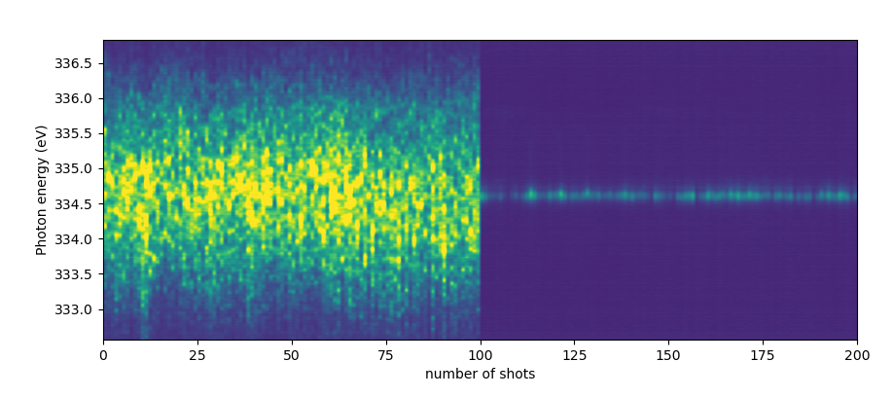


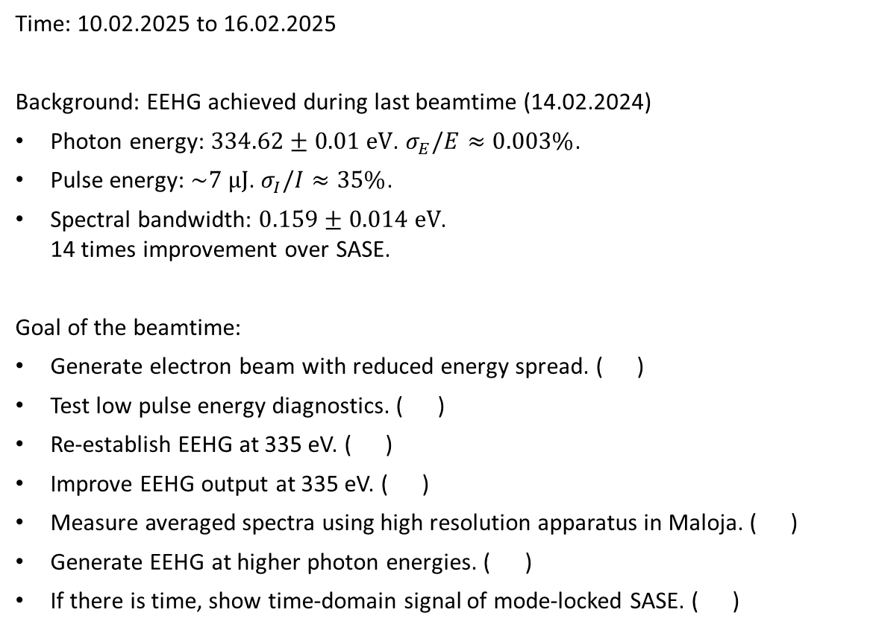
Overview of the beamtime
Time: 10.02.2025 to 16.02.2025
Background: EEHG achieved during last beamtime (14.02.2024)
Photon energy: $334.62±0.01 eV$. $σ_{E}/E≈0.003\%$.
Pulse energy: $\sim 7 μJ$. $σ_{I}/I≈35\%$.
Spectral bandwidth: $0.159±0.014 eV$.
14 times improvement over SASE.
Goal of the beamtime:
Generate electron beam with reduced energy spread. ( )
Test low pulse energy diagnostics. ( )
Re-establish EEHG at 335 eV. ( )
Improve EEHG output at 335 eV. ( )
Measure averaged spectra using high resolution apparatus in Maloja. ( )
Generate EEHG at higher photon energies. ( )
If there is time, show time-domain signal of mode-locked SASE. ( )
Previous results
SASE
EEHG

Slide 6
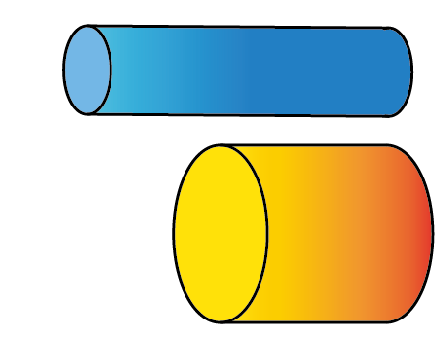
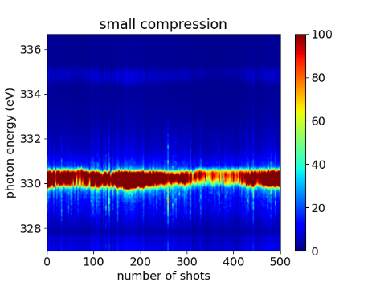
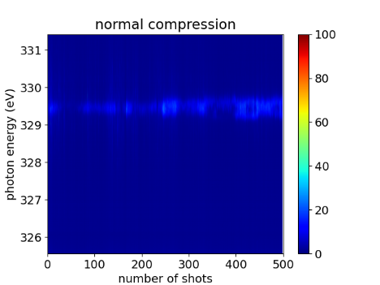
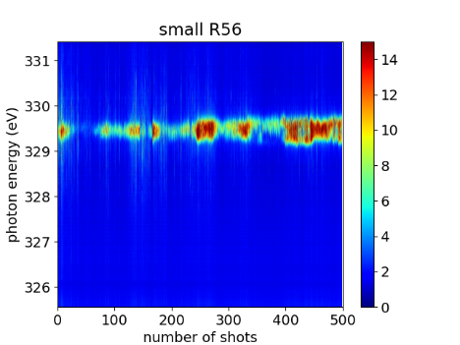
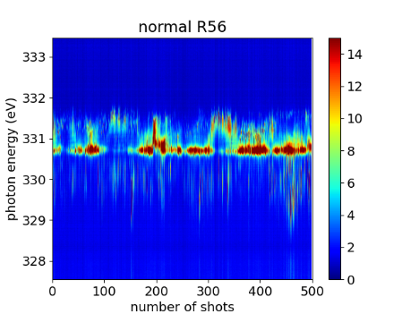
Optimization of EEHG
Switching to alternative injector configuration to reduce the intrinsic energy spread.
  In general the concept works, reducing the intrinsic energy spread to
  108 keV, half of what was previously measured.
  Beam mismatch, loss issue, and the micro-bunching instability cause an unstable EEHG signal.
Optimization of the beam compression
  Lower compression seems to be better as it helps to provide a more flat beam longitudinal phase space.
Optimization of the seed chicane strength
  Lower chicane strength (B factor) seems to help with reduced chicane non-linear effects and broader spacing between the adjacent “energy bands”.
Normal operation
New operation
Smaller compression V.S. similar compression as previous
Smaller chicane strength V.S. similar chicane strength as previous

Slide 7
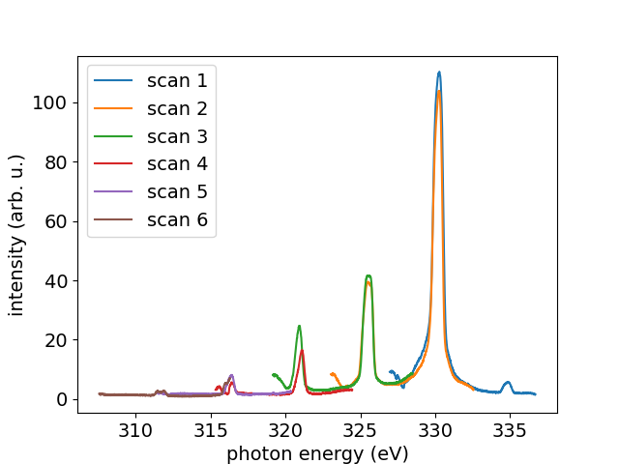
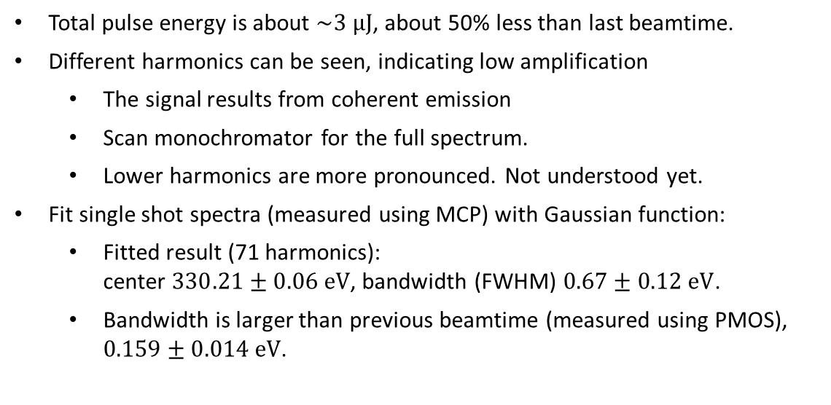
Measured EEHG spectra
Total pulse energy is about $\sim 3 μJ$, about 50% less than last beamtime.
Different harmonics can be seen, indicating low amplification
  The signal results from coherent emission
  Scan monochromator for the full spectrum.
  Lower harmonics are more pronounced. Not understood yet.
Fit single shot spectra (measured using MCP) with Gaussian function:
  Fitted result (71 harmonics):
  center $330.21±0.06 eV$, bandwidth (FWHM) $0.67±0.12 eV$.
  Bandwidth is larger than previous beamtime (measured using PMOS), $0.159±0.014 eV$.
Low compression case: scans

Slide 8
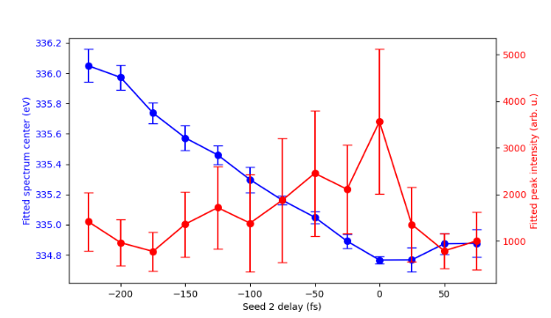
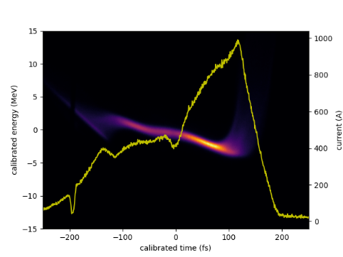
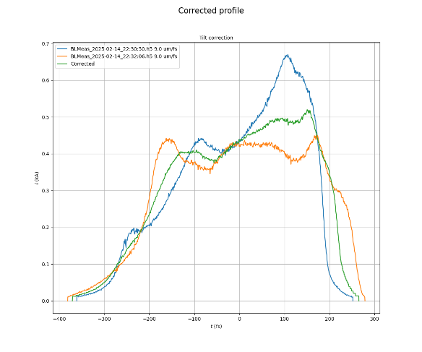
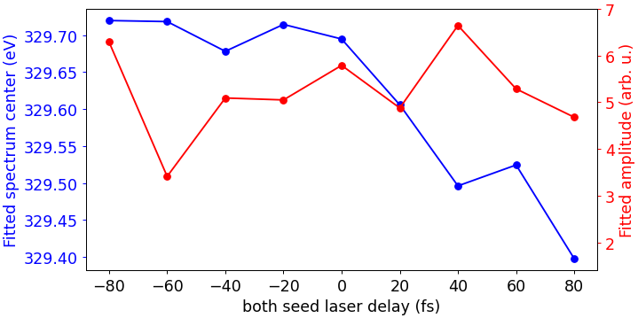
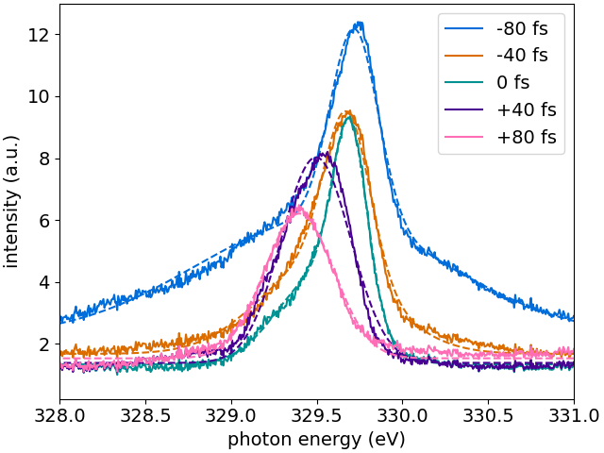
Scanning relative timing
Idea
Changing the timing delay of both seed lasers
from -80 fs to +80 fs to overlap laser with different parts of the electron beam.
Scan the “lasing region” along the beam.
Conclusion
Change in central wavelength: indicating linear chirp is changing along the beam (second order chirp).
The second order chirp is smaller than last beamtime.
Last beamtime: fit result & current profile by TDS
This beamtime: fit result & current profile by TDS
Averaged spectrum

Slide 9
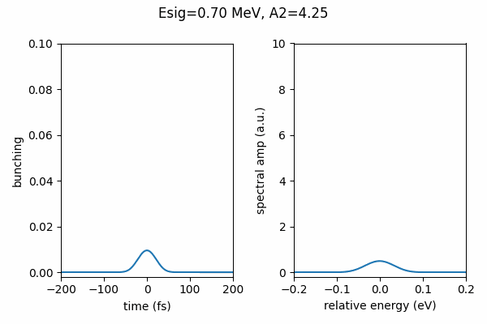
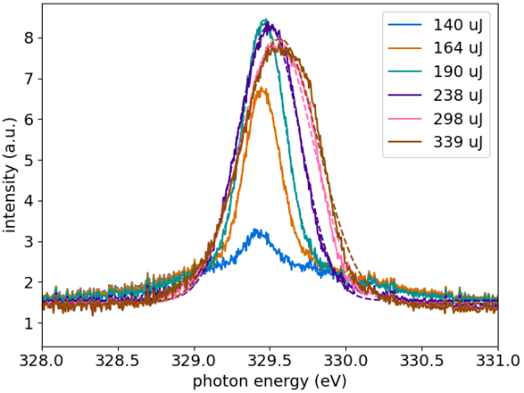
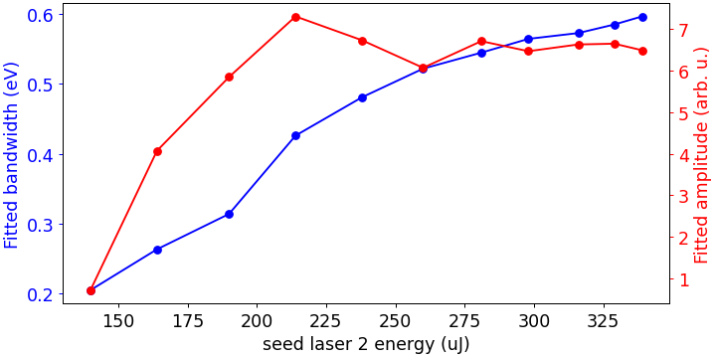
Scanning A2
Analytical results
(utilizing aforementioned 1D formulas)
Idea
Changing A2 would first increase the bunching of the central part, and then cause the center to over-bunch.
Creates sidebands, under limited resolution, would observe an increase of BW.
Conclusion
Qualitatively consistent with the expectation.
Averaged spectrum
Fitted results
Optimum

Slide 10
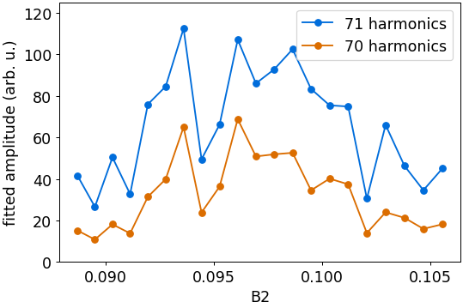
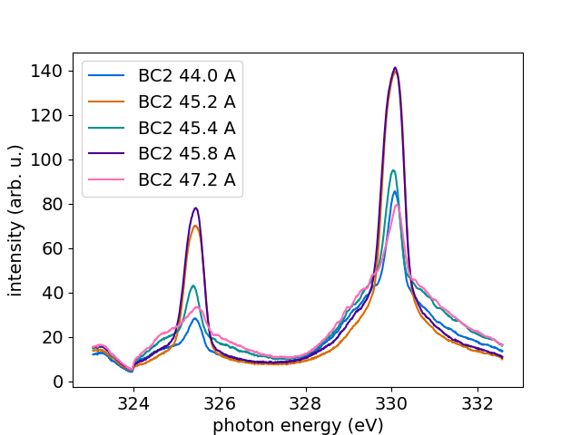

Scanning B2
Idea
From the 1D expression for bunching, expecting two “islands”, with two optimal working points.
Conclusion
Two islands show up, which is qualitatively consistent with the expectation.
“Right island” is wider.
The center of two islands is slightly smaller than expected, possibly due to the long undulator line we enabled.
Averaged spectrum
Analytical results with $A_{1}=6.23$ and $B_{1}=7.22$
(estimated using experimental condition)

Slide 11
Summary: experiment
We are able to find EEHG signal at ~71 harmonics:
  Both seed lasers perform similarly, and their performance is comparable to previous beamtime.
We are unable to optimize the output:
  The new injector configuration, though reducing energy spread by 50%, has mismatch, beam loss and MBI issues. Potentially, these effects prevent a stable EEHG setup.
  With a similar machine configuration as last time, the pulse energy is about 50% smaller while the bandwidth is about 3 times larger compared with previous results.
  As the beam quality doesn’t seem to be worse, further investigation is needed.
  We do not find signal at higher harmonics.
We study the optimized parameters for EEHG under current settings and perform a few scans for characterization.
  (1) EEHG characteristics are qualitatively consistent with expectation.

Slide 12
Outlook
Simulation:
  Start-to-end electron phase space simulation for most flat phase space.
  EEHG seeding simulation considering various degrading effects.
For next beamtime:
  Going to lower harmonics (for example, 200 eV) by lowering beam energy
  Using fewer undulators (4 modules).
  Optimizing beam transport, especially closing the dispersion after switchyard.
  Lowering the charge for lower energy spread and more flat phase space.
  Horn cutting to reduce space charge effect.
  Possibly select the seeded part on the beam.
Long tern:
  Different upgrades for a lower energy spread.
  Optimize compression to minimize phase space distortion (e.g. horn cutting).
  Understanding the potential MBI issue and how to mitigate it.
  Tuneable seed 2 laser pulse duration for pulse duration / bandwidth tunability.

Slide 13
Acknowledgements
  Beam Dynamics
    Sven Reiche, Eduard Prat, Philipp Dijkstal
  Laser
    Alexandre Trisorio, Andreas Dax, Carlo Vicario, Martin Huppert, Yunpei Deng, Stefan Neppl
  Diagnostics
    Christopher Arrell, Rolf Follath
  Maloja
    Andre Al Haddad, Kirsten Schnorr, Antoine Sarracini
  Instrumentation
    Rasmus Ischebeck, Pavle Juranic
  We acknowledge support from all technical groups for the EEHG and ML-SASE projects. Thanks for your effort and help!

