Slide 1
Web Applications Support @ GFA
RF section requirements
Roger Kalt KR84
For Meeting “CAS front-end software strategy” 20250325

Slide 2
Contents
Web applications
  SwissFEL RF fault events system
  RF Pikett list (nice display)
  Elektroschema platform
Request to GFA
Wishes for collaboration
References

Slide 3
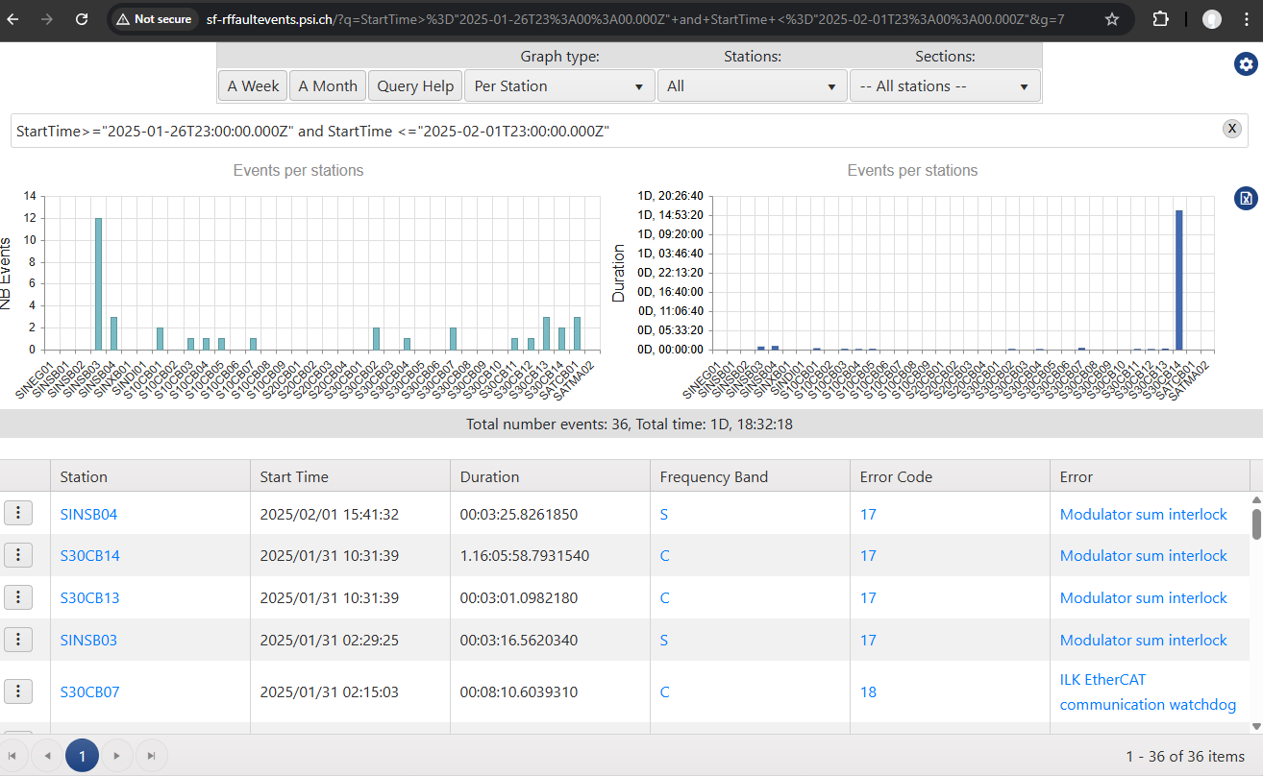
1. Web-Apps: SF RF Fault Events http://sf-rffaultevents.psi.ch
Is operation relevant for RF: Need to get easily the statistics and faults of SF RF systems.
Was originally created by Controls/S. Ebner.
Then in 2019 summer student @RF but technically guided by Controls/D. Lauk for iteration.
requirements
Then in 2021 A. Bertrand helped to migrate the GUI-part (now .NET)
Now RH7->RH9 transition to be done, needs also changes in the daemons talking to the archiver systems (missing knowledge on this, who can do it?

Slide 4
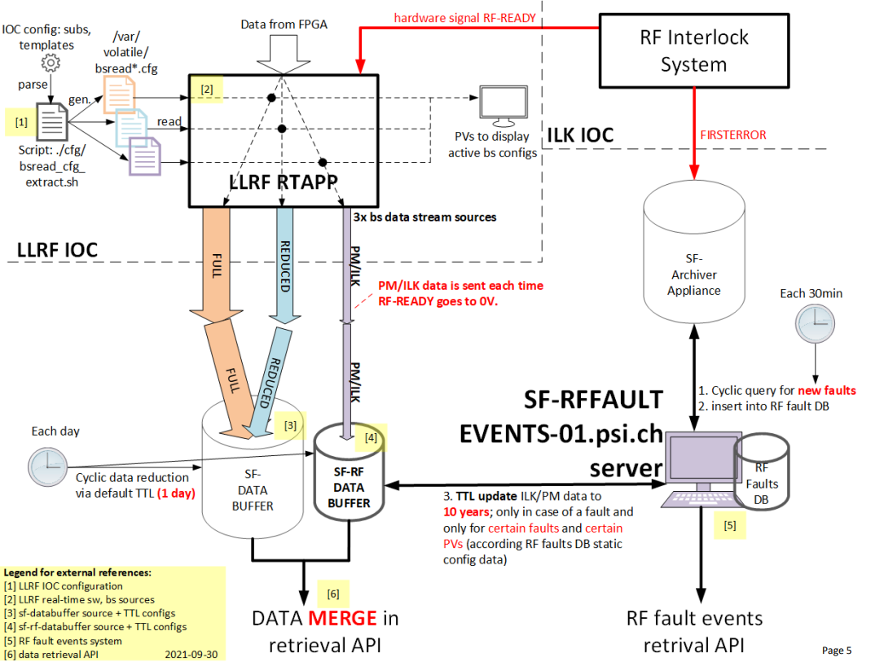
1. Web-Apps: SF RF Fault Events – big picture

Slide 5
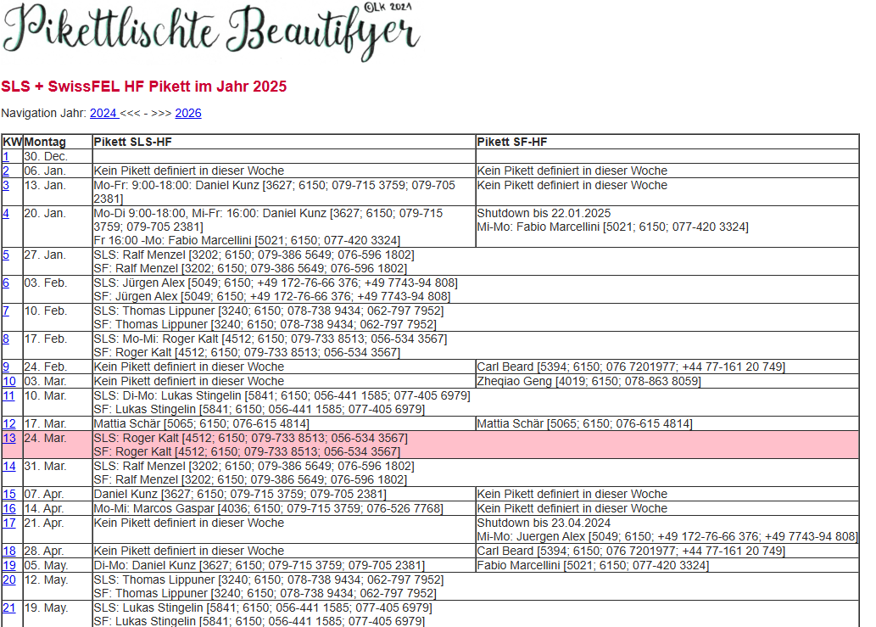
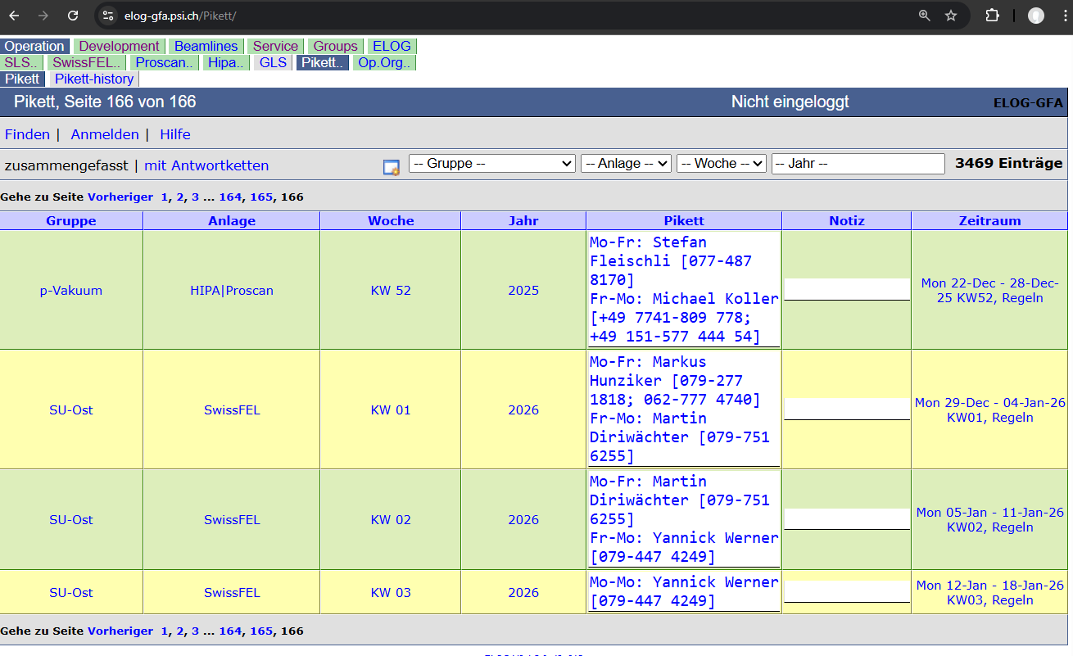
1. Web-Apps: RF Pikett https://rf.intranet.psi.ch/pikettlischte-beautifier/pikettlischte-beautifier_slssfrf.php
ELOG Pikett list
AFS www hosted PHP translator scripts.
Sources in git

Slide 6
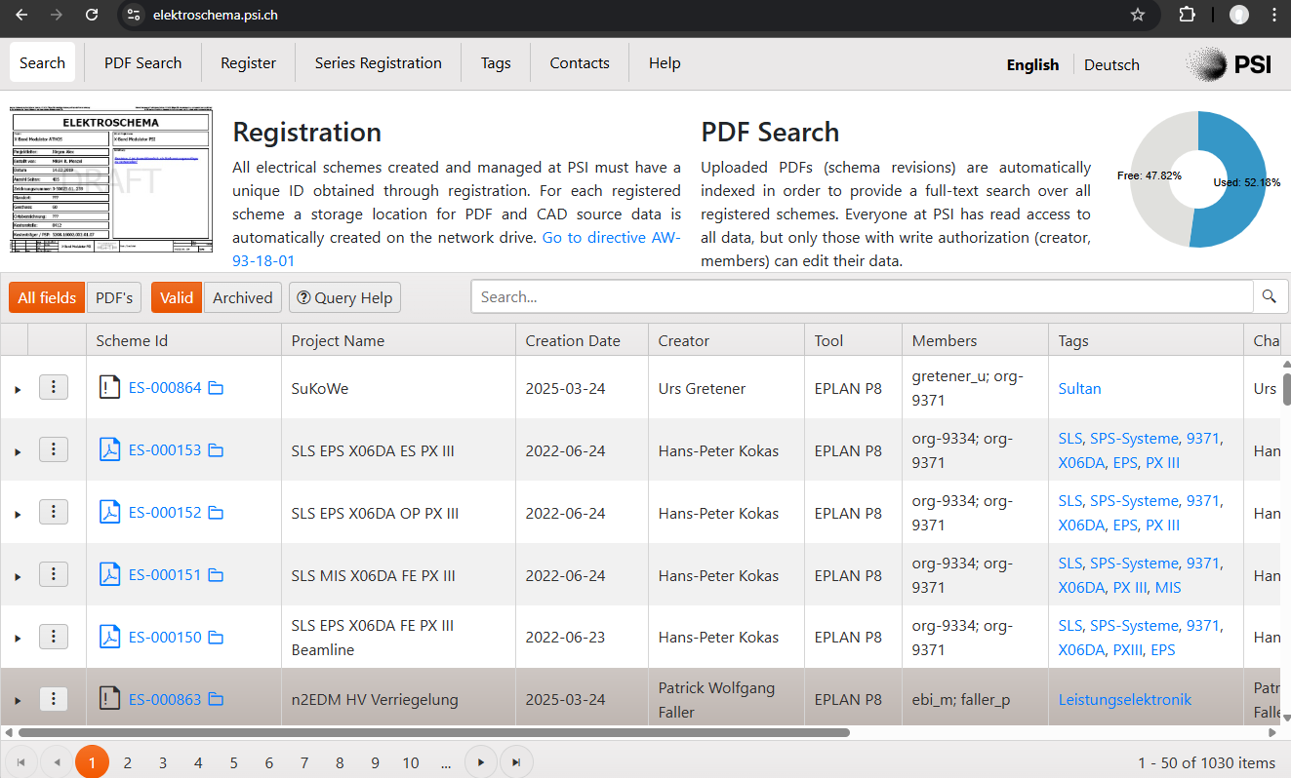
1. Web-Apps: Elektroschema Platform: https://elektroschema.psi.ch + AW 93 18 01
Was created 2021 on my initiative by M. Müller (NUM) + A. Bertrand (AIT) and supported my LOG/AIE (M. Jörg).
AW 93 18 01 was adapted to the new platform.
Based on same technologies as used for Inventory + ecad.psi.ch
Used as successor of old planarchiv.psi.ch, because 3DXpericence does not fulfill the requirements.
Link to intro @ RF section

Slide 7
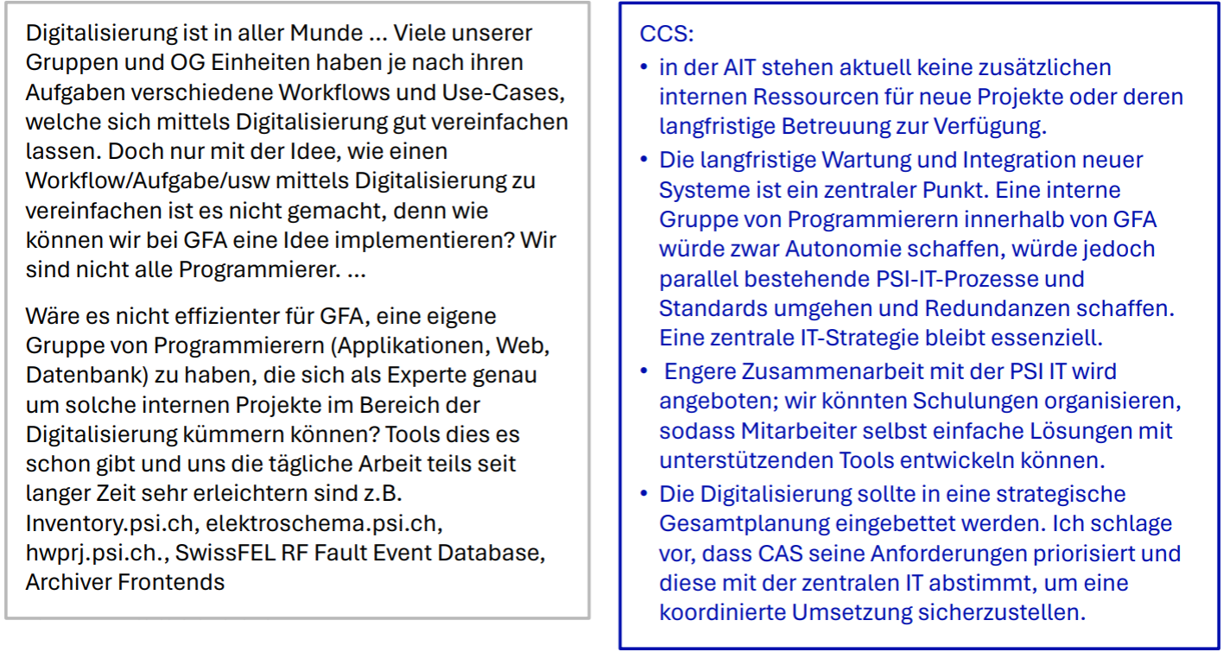
2. Request to GFA
Question KR84 to GFA Fragerunde Answer March 2025
KR84 comments:
Mir scheint, als hätten wir nicht die richtigen Profile am PSI für unsere Aufgaben.
Bestehende IT Prozess funktionieren schlecht.
Was ist denn die zentrale IT Strategie? Sind darin unsere eher kleinen aber speziellen Web-Applikationen abgedeckt? Vermutung ist nein.
!?!?!
Die Zentrale IT hat keine eigenen Programmierer die nötig wären für die Umsetzung.
Hat das GFA Mgmt die Frage überhaupt verstanden?

Slide 8
3. Wishes for collaboration
The role of RF is «customer that provides requirements».
So RF needs external expert groups that…
Implement
Maintain
… our web applications.

Slide 9
4. References
https://indico.psi.ch/event/13741/ : Meeting 2022-11-24 RF-Controls on
«Web applications: Consulting, Development, Maintenance and Operation»

