Slide 1
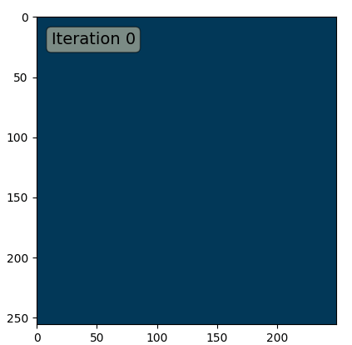
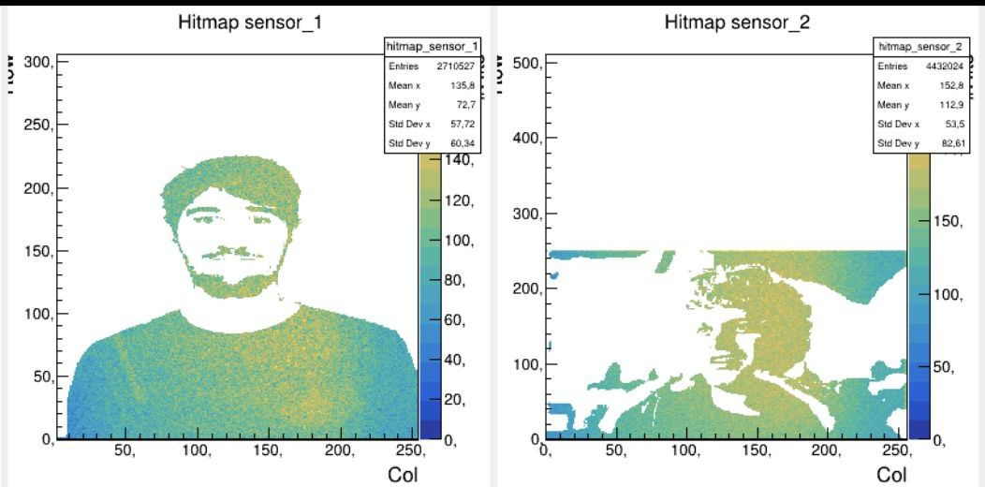
Vertex Calibration + Pixel Tuning
Mu3e collaboration meeting
Zurich
Thomas Senger

Slide 2
Calibration
IV scan
VDAC power consumption
Signal transmission
BLPix vs VNOutPix (Eficiency and Stability)
VPTimerDel & VNTimerDel

Slide 3
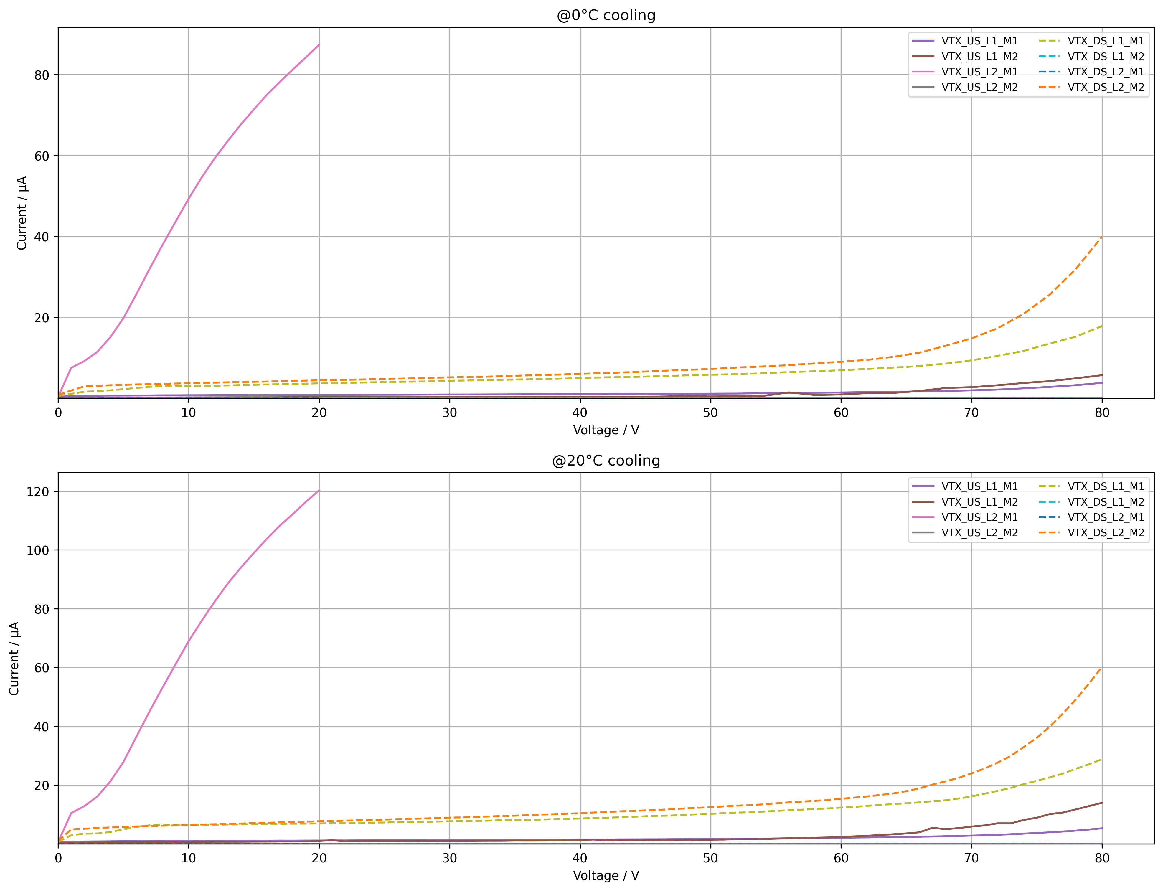
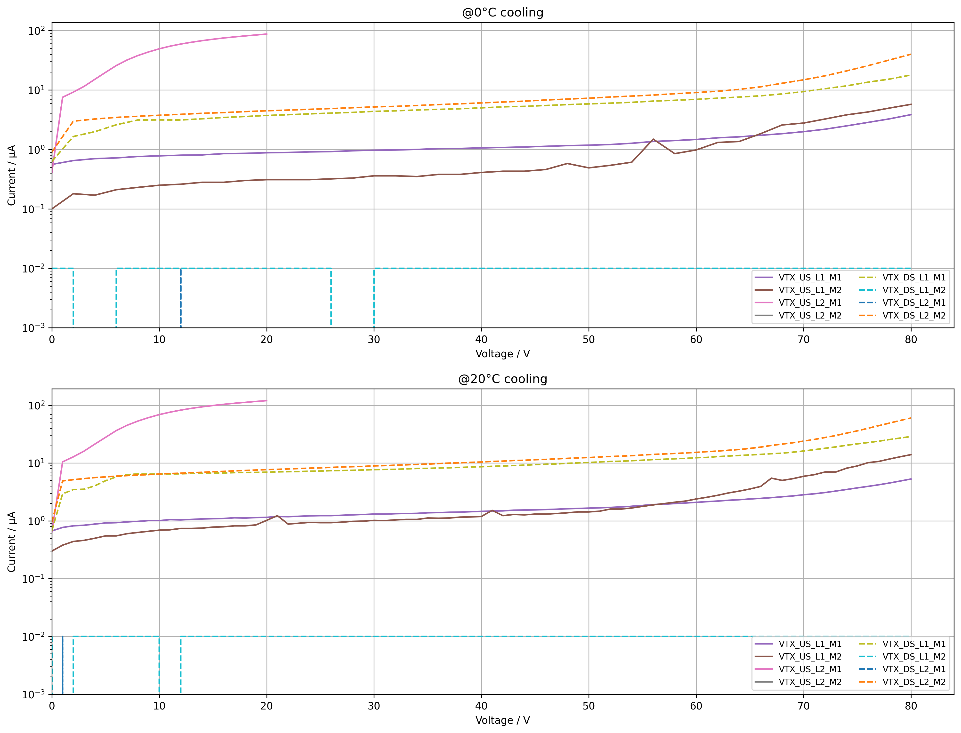
IV Scan
IV curves performed after extraction
  5 partitions are working
  2 have no current, one in HV compliance
Factor of ~1.5 difference in HV current at 0°C vs 20°C
Temp Diode difference max 9°C

Slide 4
IV Scan
IV curves performed after extraction
  5 partitions are working
  2 have no current, one in HV compliance
Factor of ~1.5 difference in HV current at 0°C vs 20°C
Temp Diode difference max 9°C

Slide 5
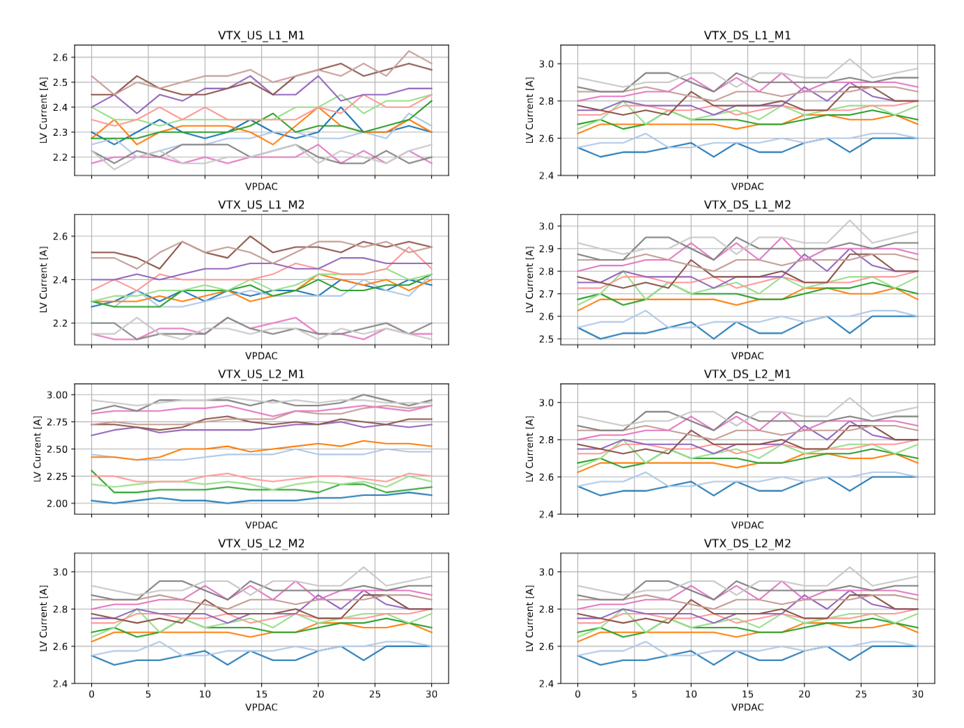
DAC Power Consumption
VPDAC
Each line represents one Mupix sensor
Would expect 2mA per DAC
Observe more or less flat distribution
Resolution of DCDC boards to low to see differences

Slide 6
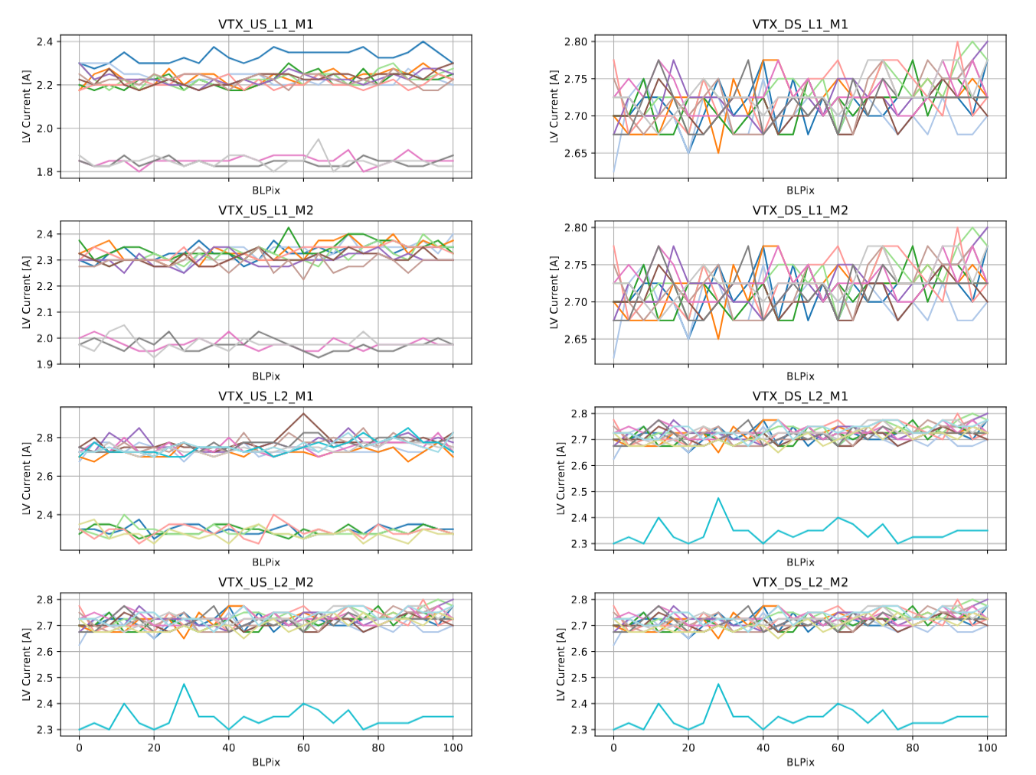
DAC Power Consumption
BLPix
Each line represents one Mupix sensor
Would expect in total 80mA increase per chip
Observe more or less flat distribution
Resolution of DCDC boards to low to see differences

Slide 7
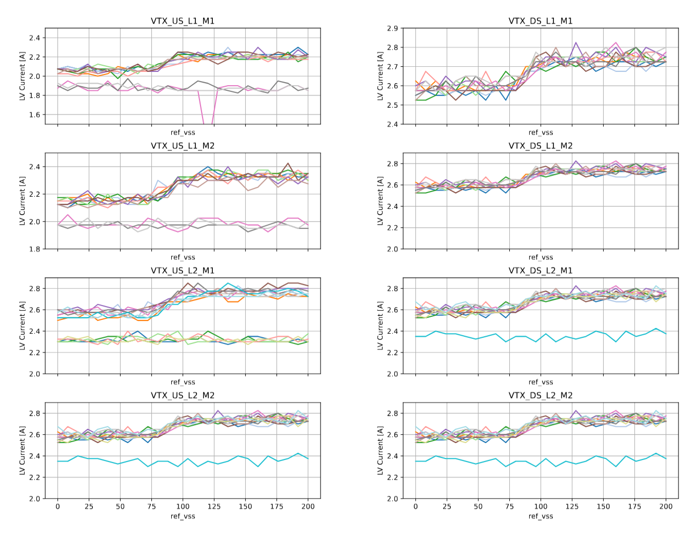
DAC Power Consumption ref_vss
Each line represents one Mupix sensor
Expect total increase per chip O(150mA)
Data is compatible with QC data
Operation at 169 → in plateau region

Slide 8
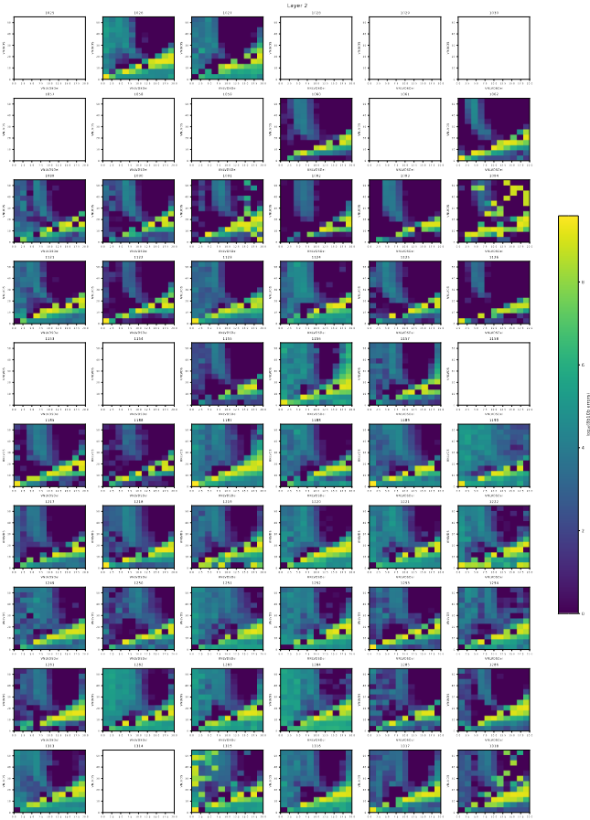
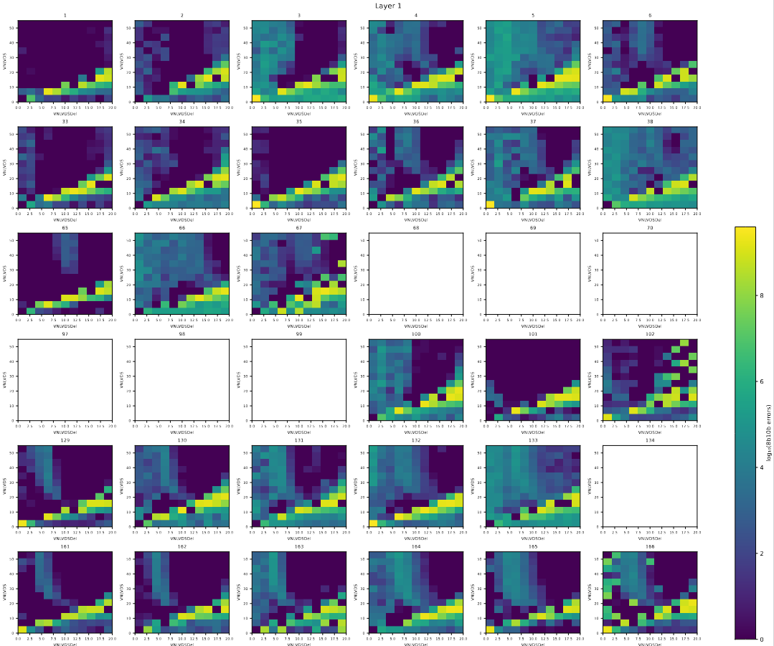
Signal transmission scan
8b10b errors

Slide 9
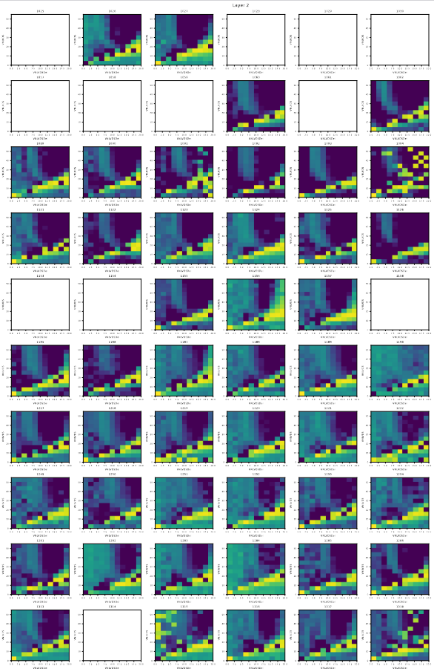
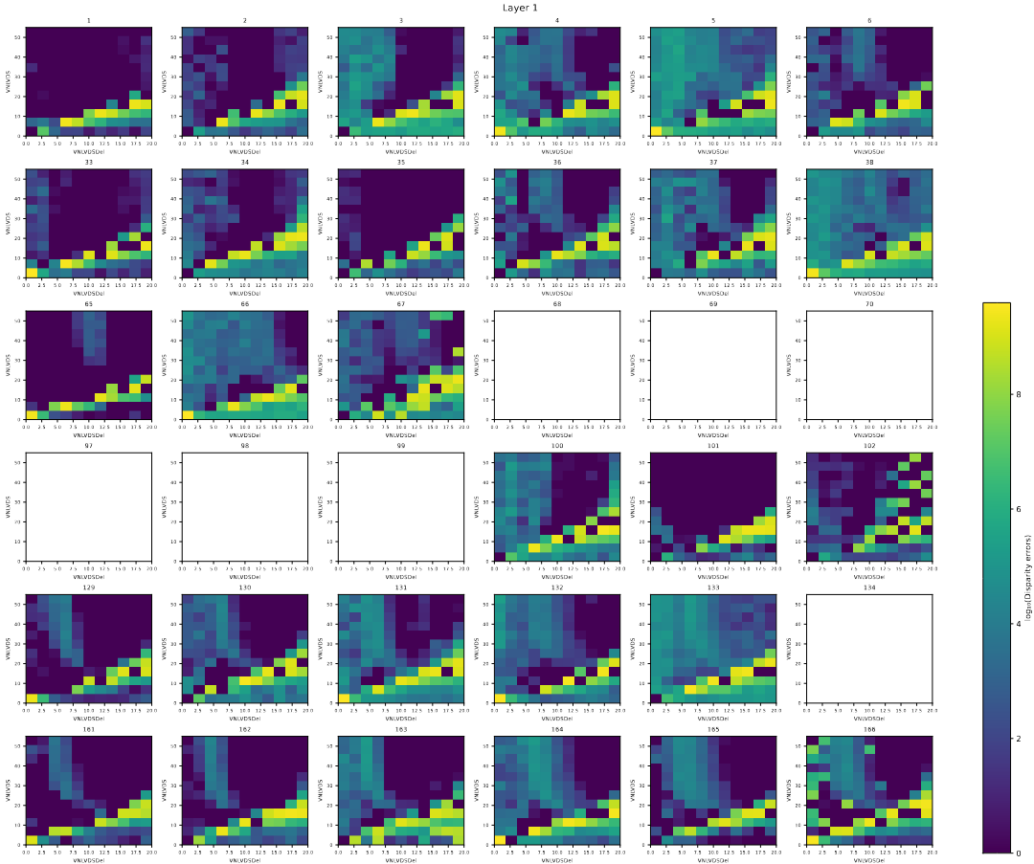
Signal transmission scan disparity errors

Slide 10
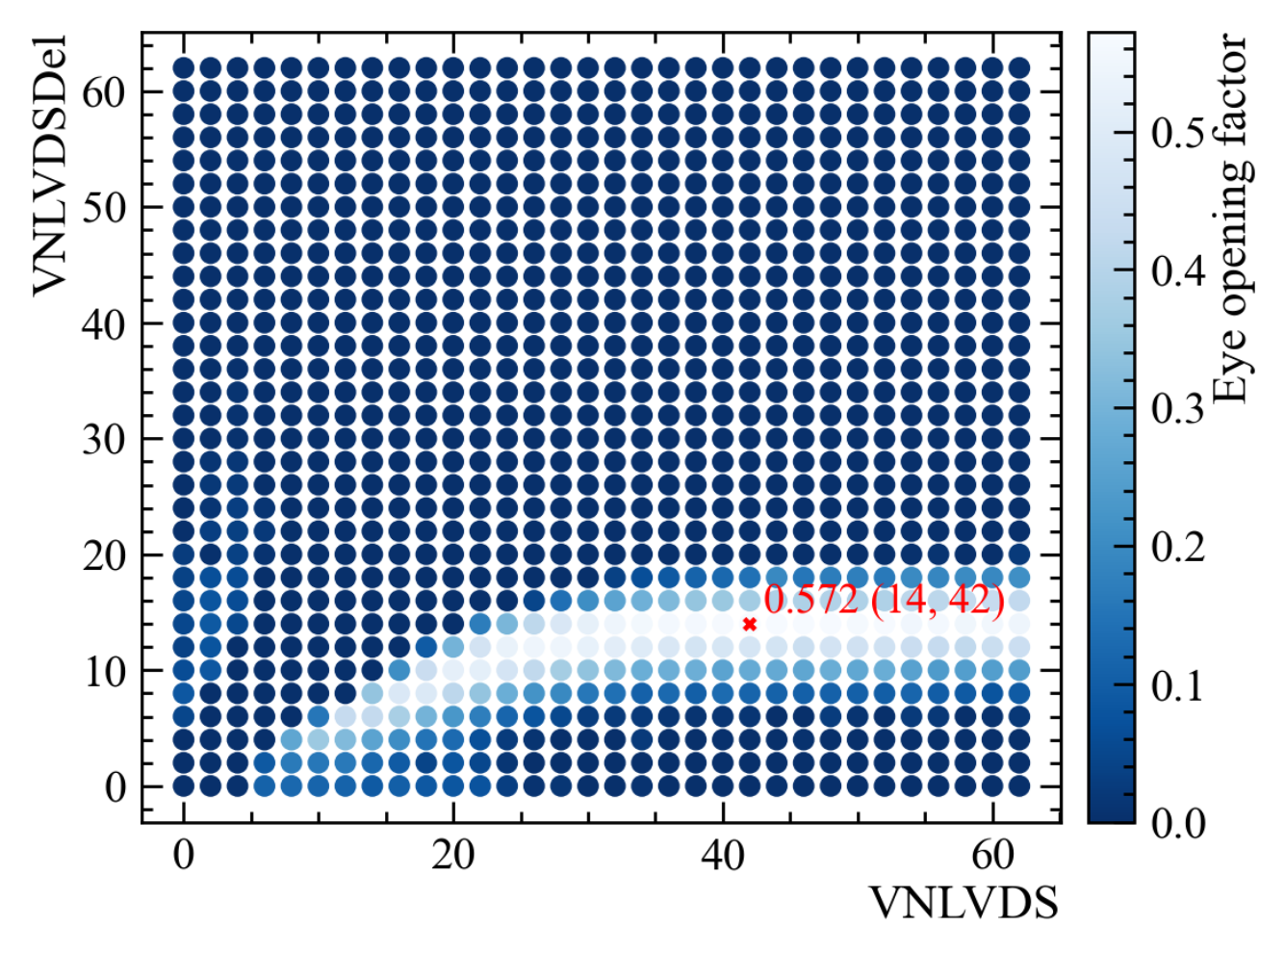
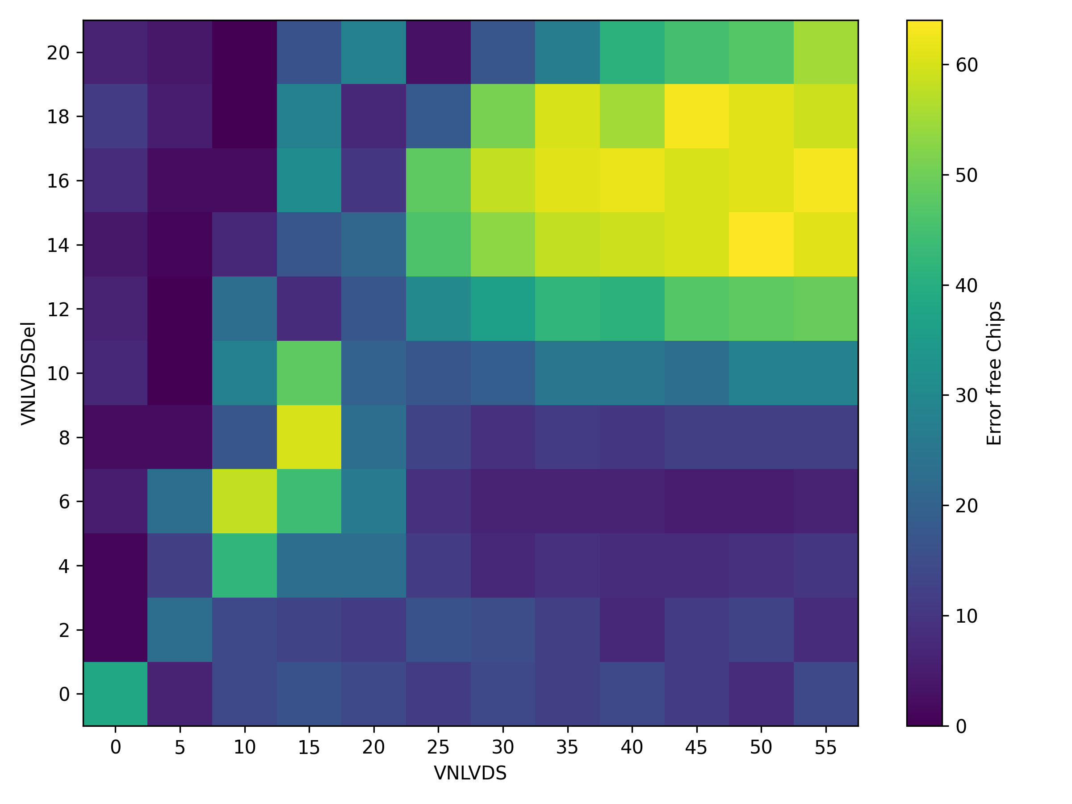
Signal transmission scan optimal settings
Eye diagramm measurement at UZH
Results of the Vertex Detector

Slide 11
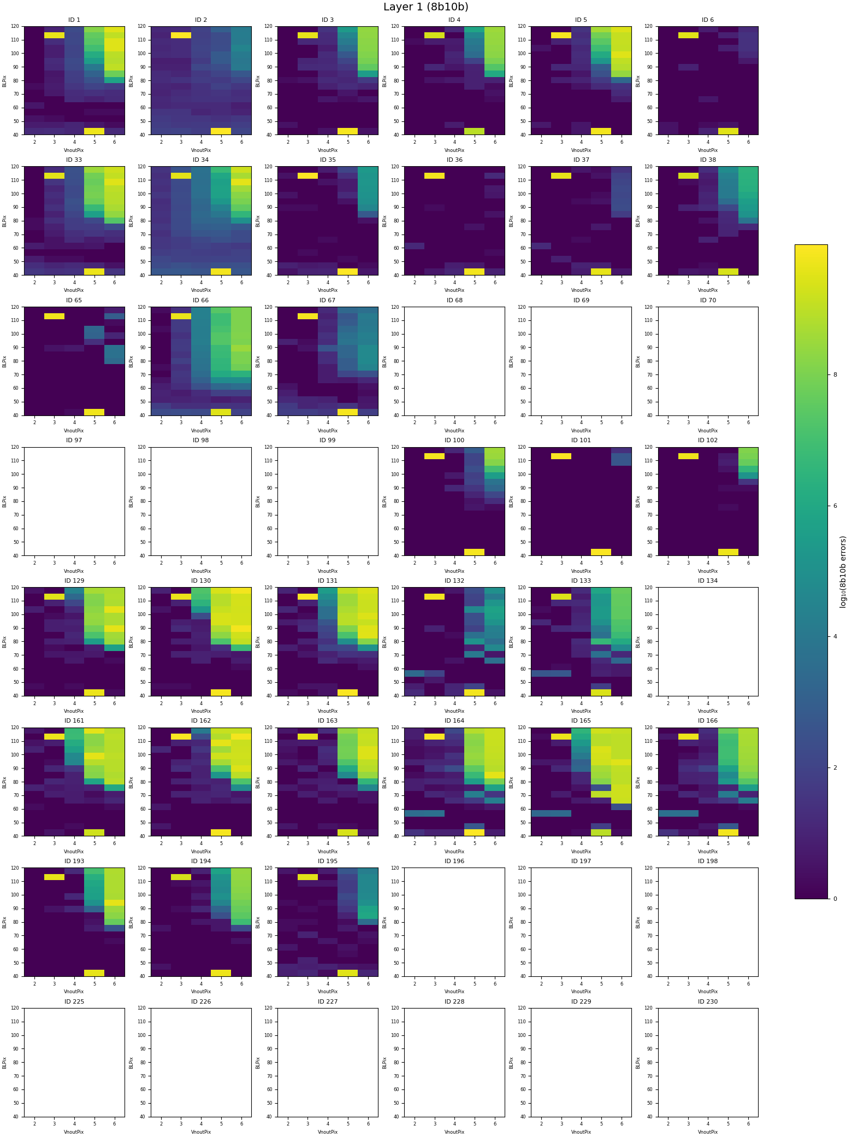
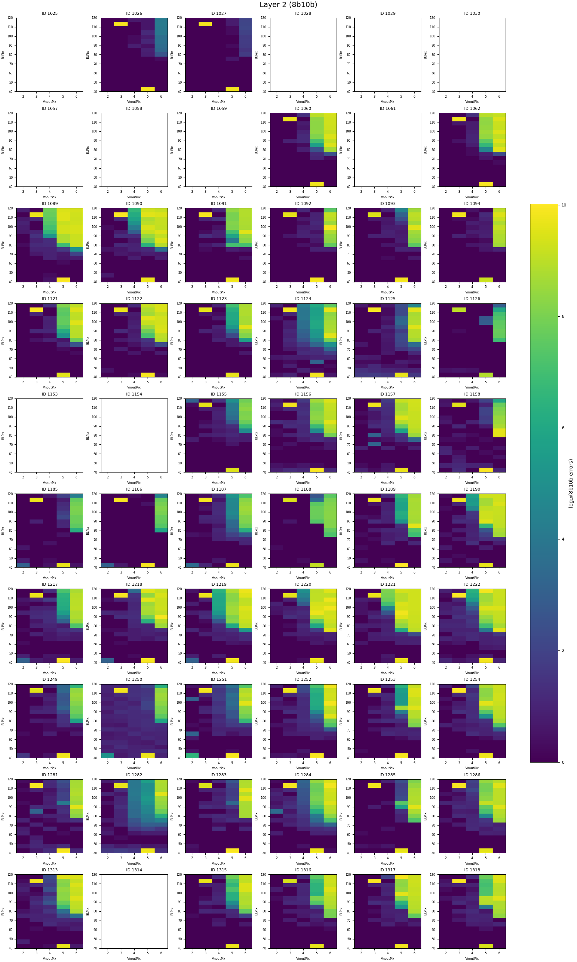
BLPix vs VNOutPix
8b10b errors

Slide 12
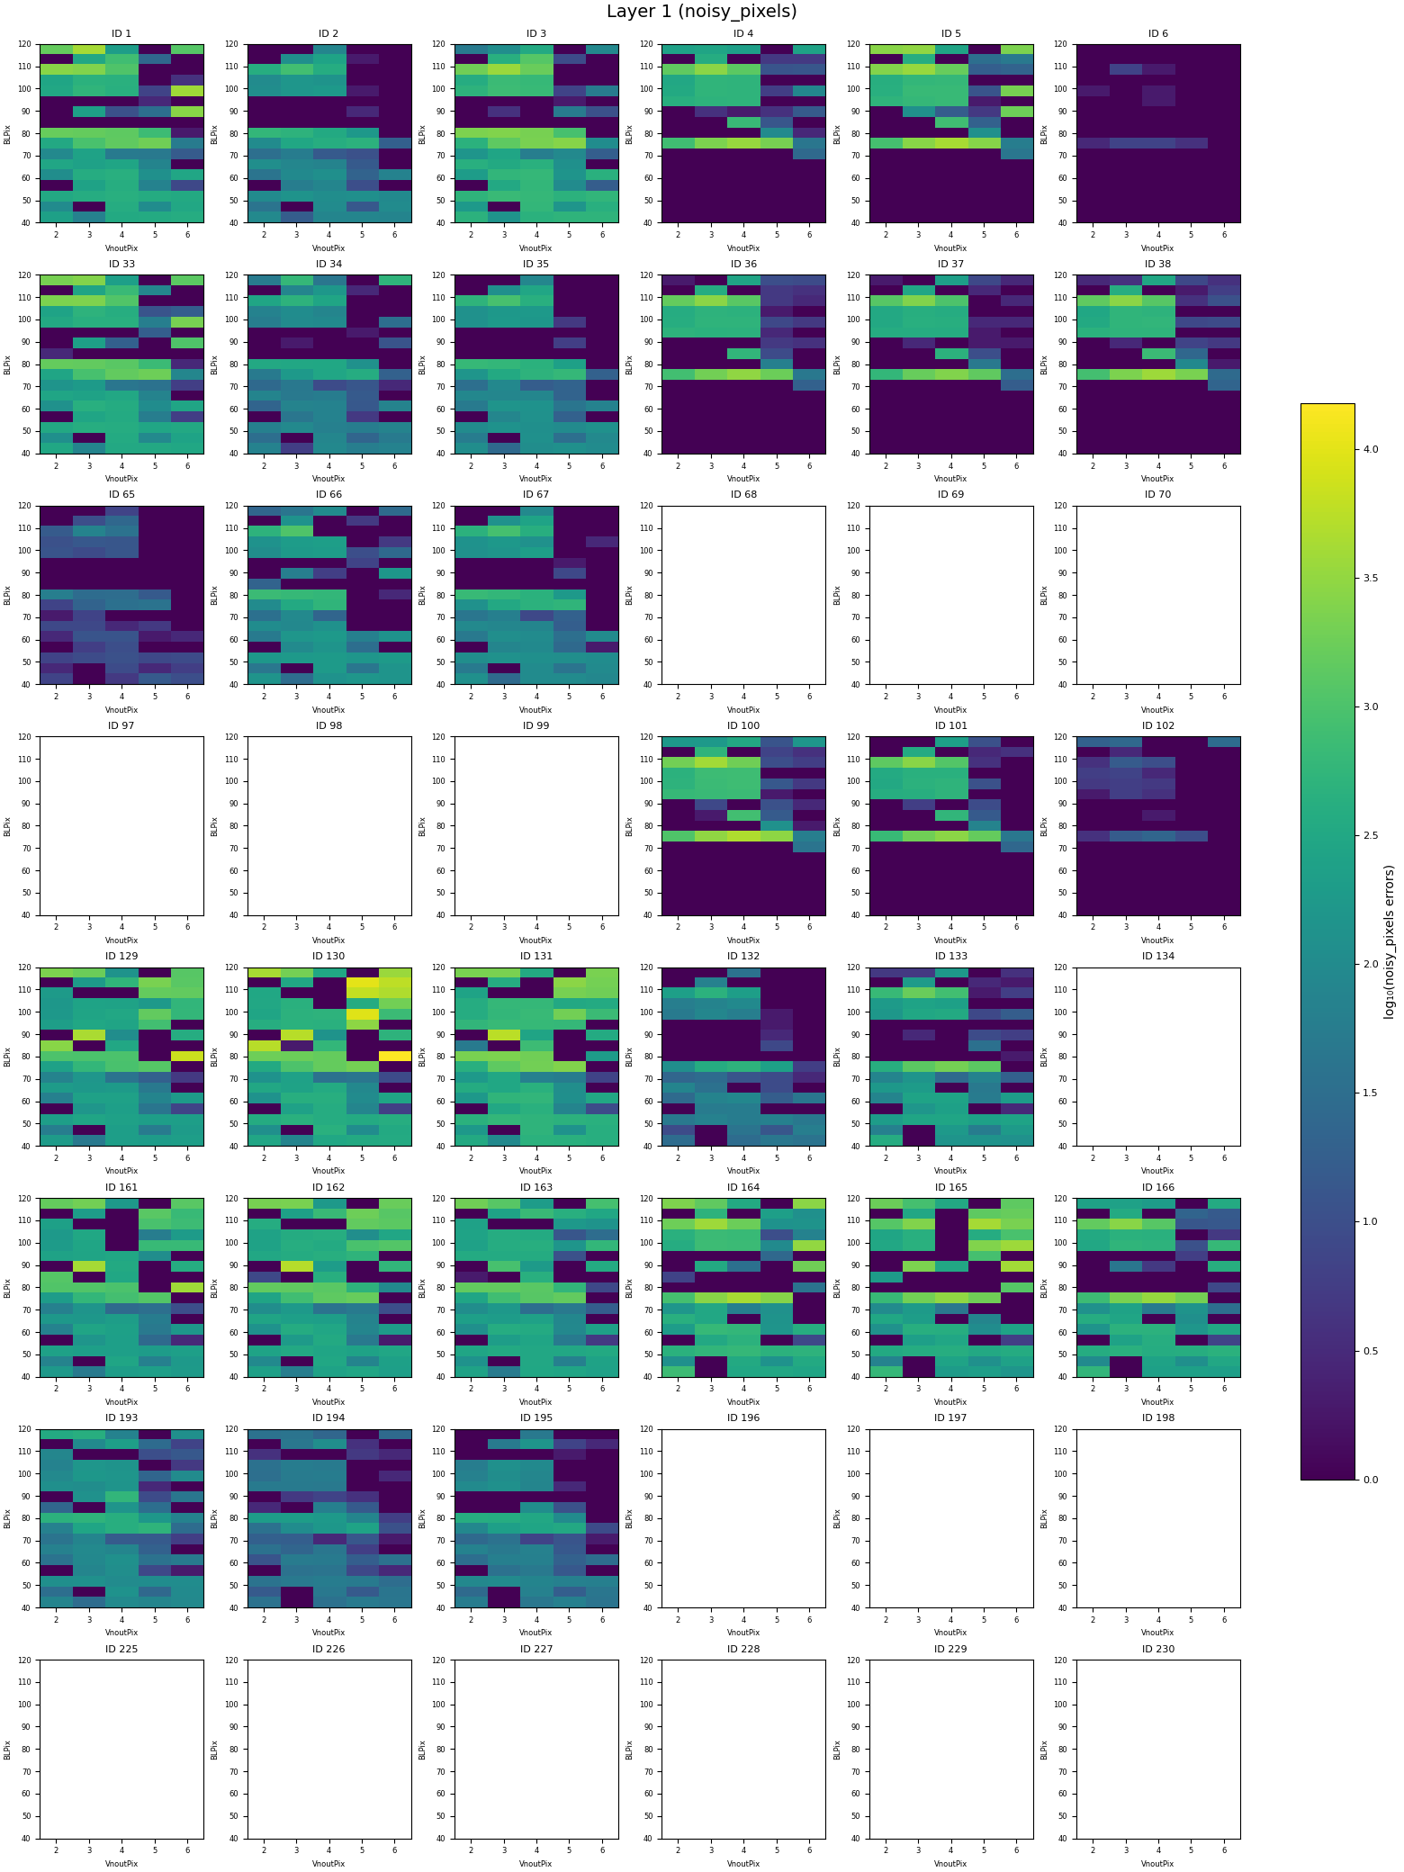
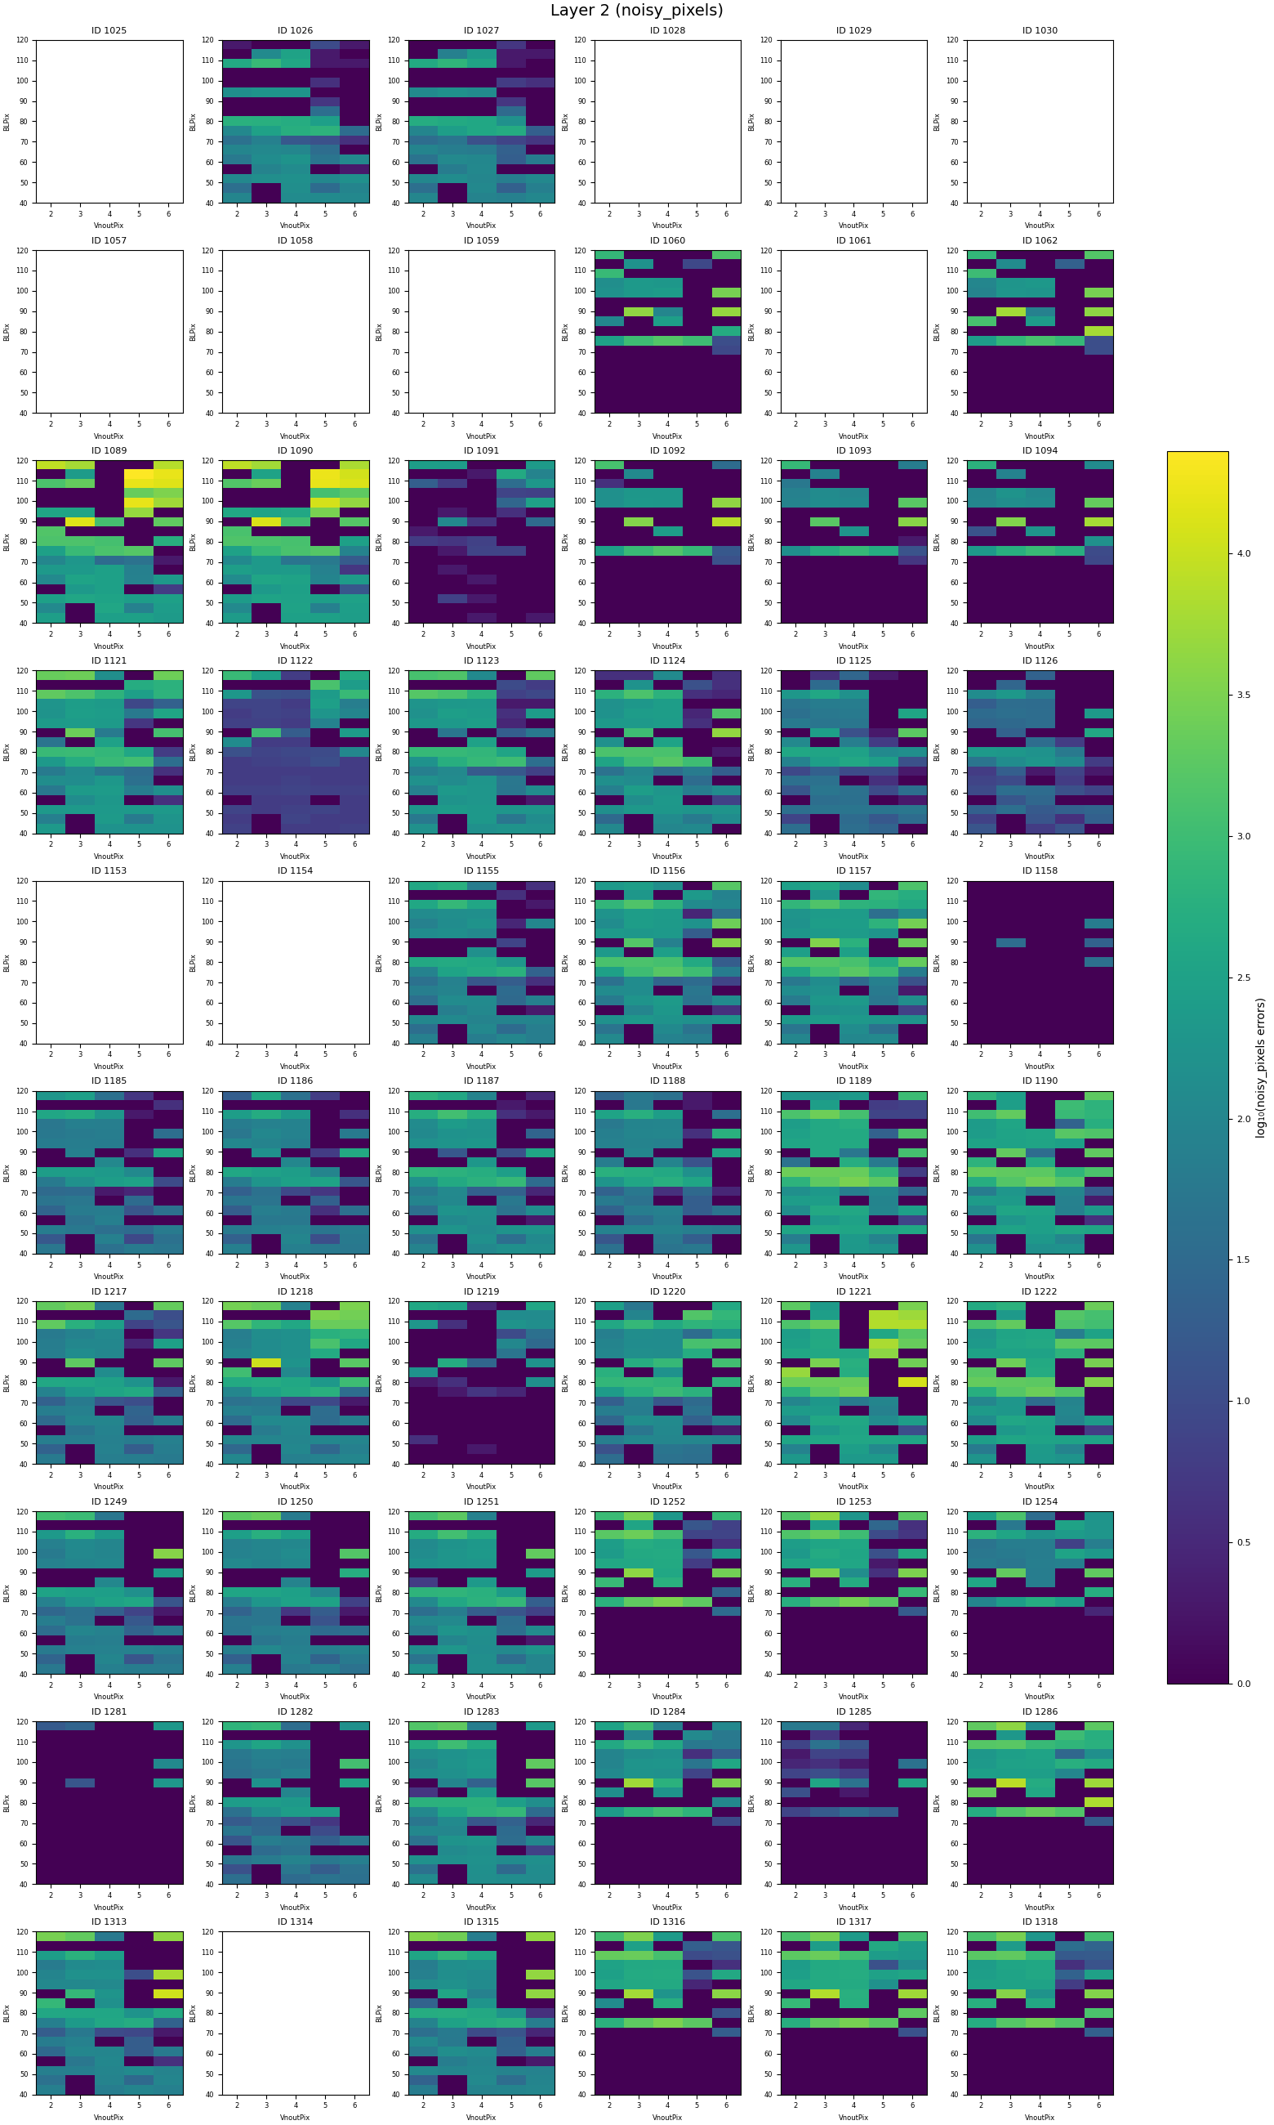
BLPix vs VNOutPix
Active pixels

Slide 13
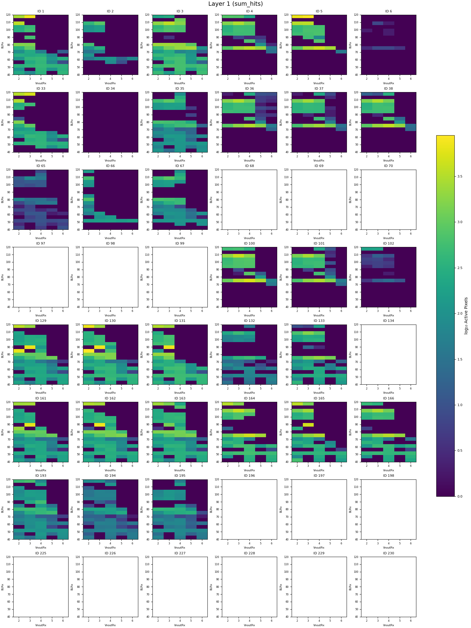
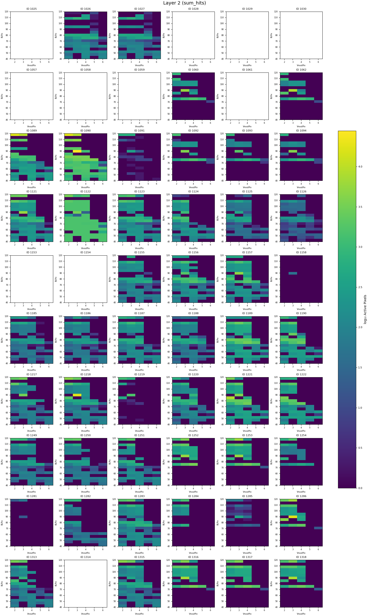
BLPix vs VNOutPix
Active pixels (with 8b10b error exclusion)

Slide 14
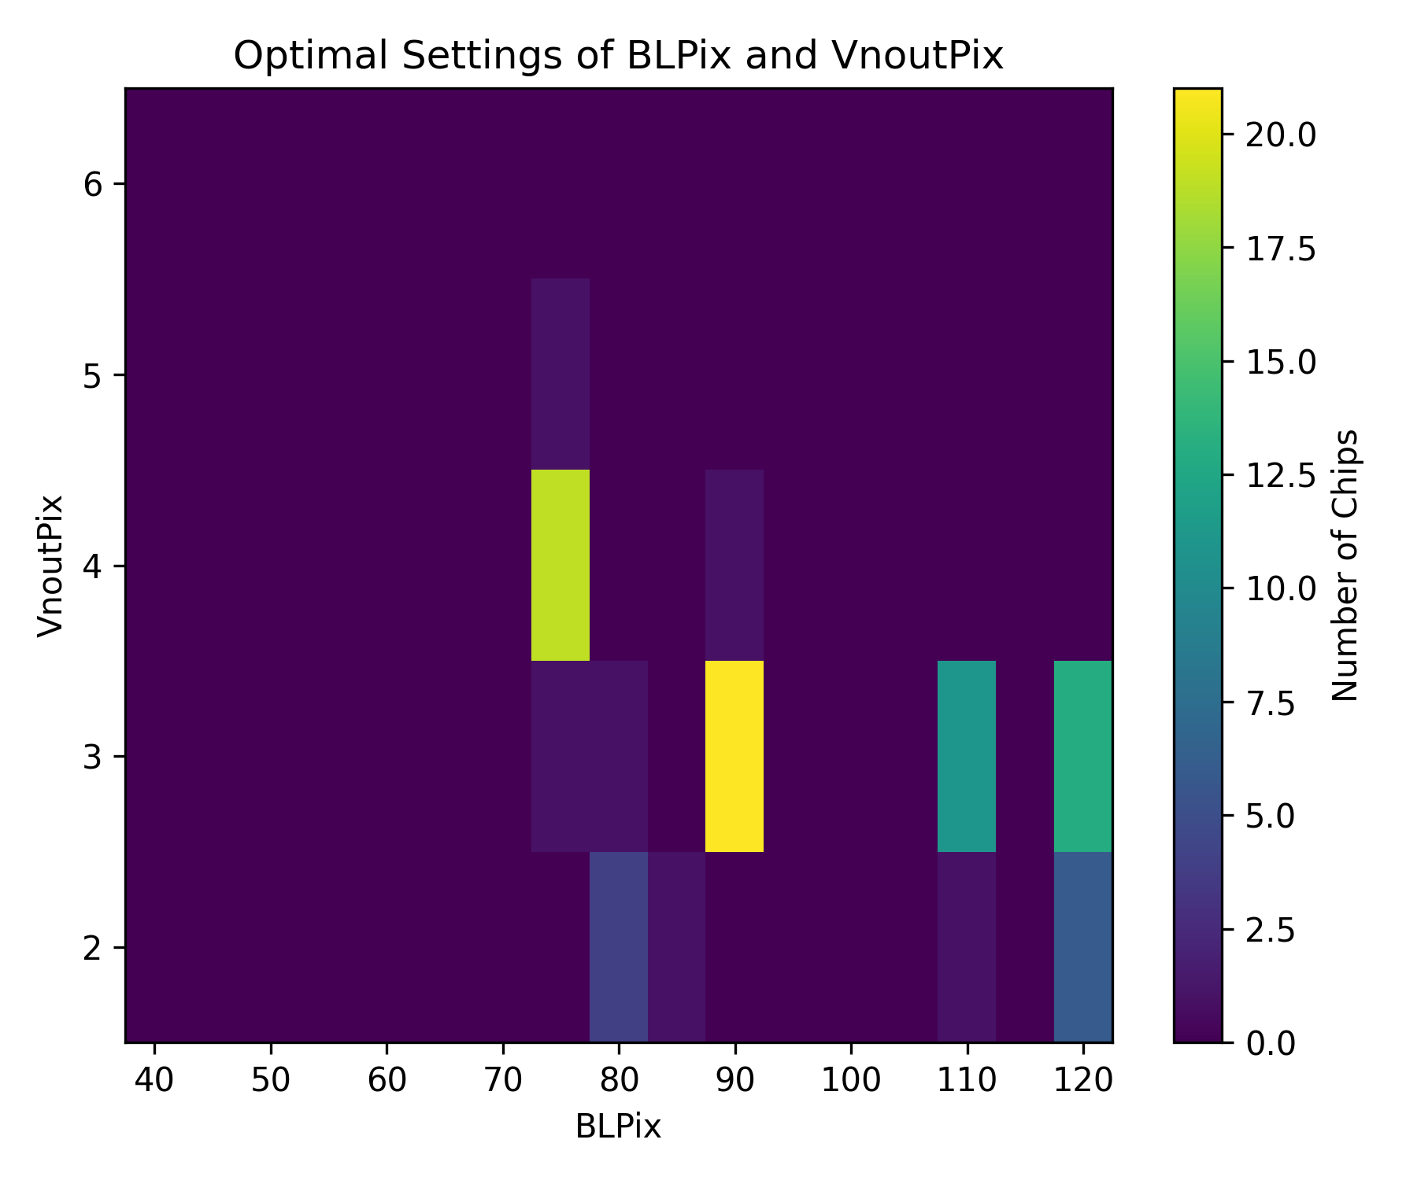
Optimal Parameters
Default settings:
  VNOutPix=5
  BLPix=80
Optimal settings found at
  No 8b10b errors
  Most active pixels

Slide 15
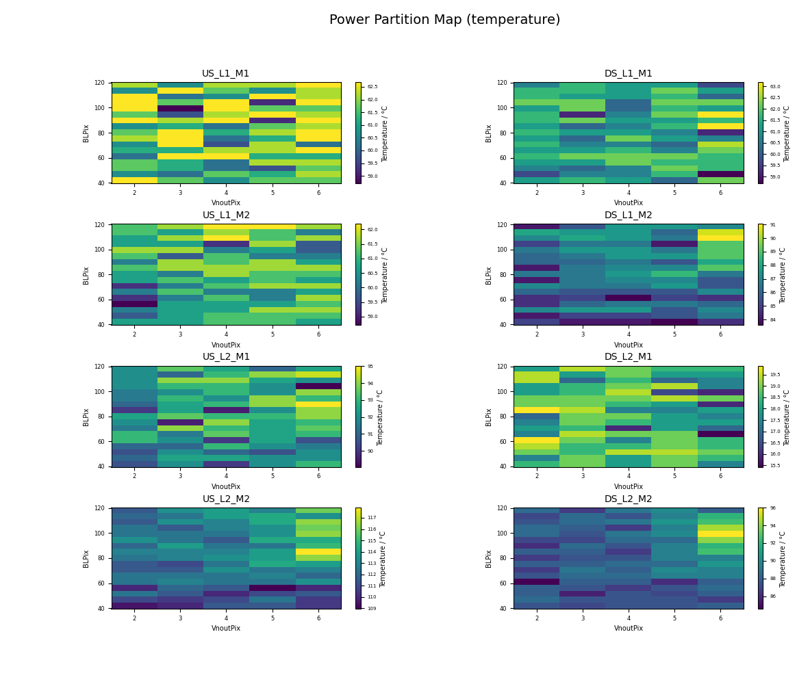
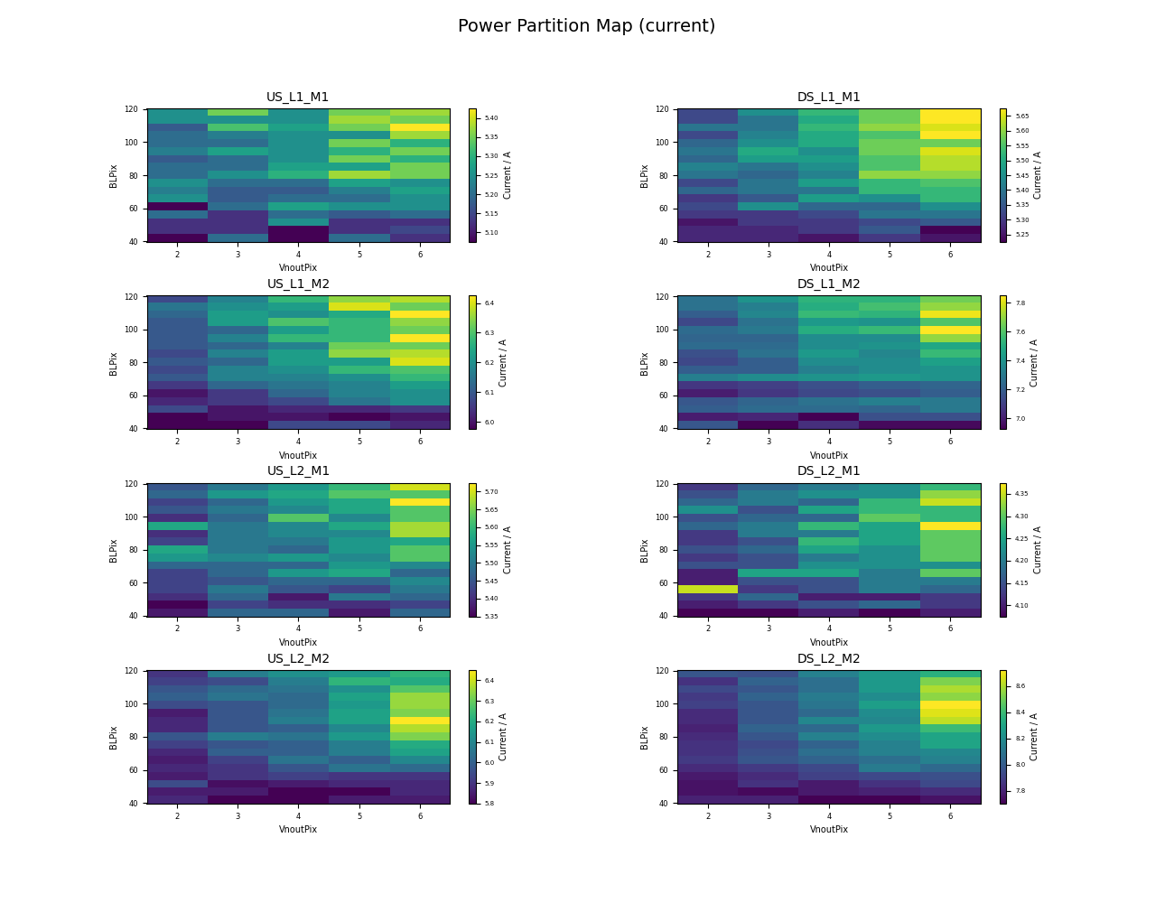
BLPix vs VNOutPix
Current consumption + Temperature

Slide 16
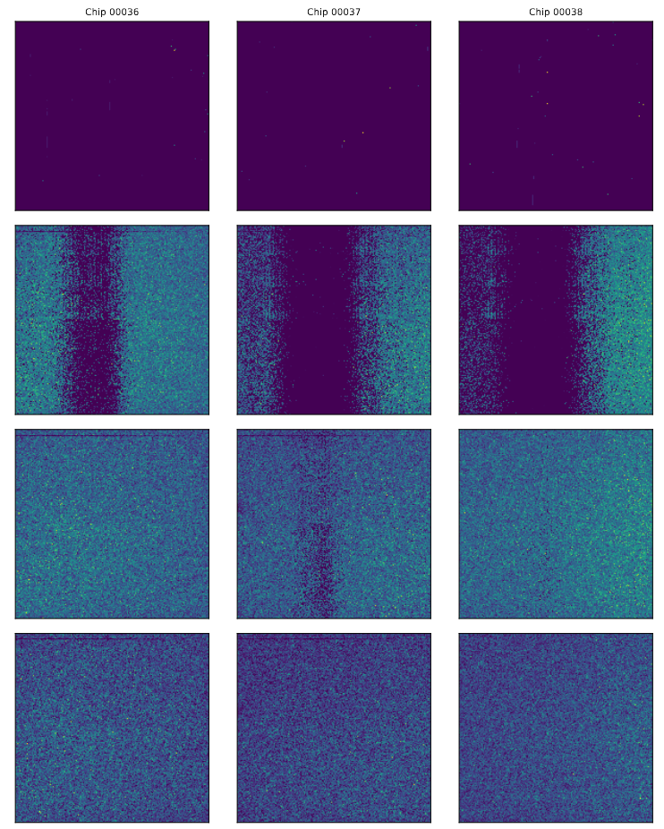
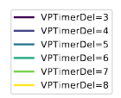
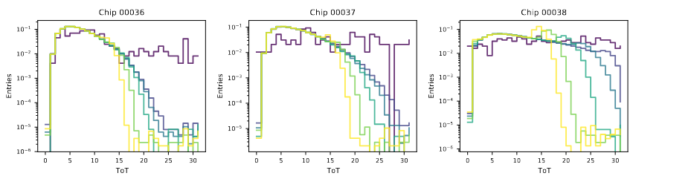
VPTimerDel
Three chips as example
Want to use full ToT range → can be controlled through VPTimerDel
Default Value was 10 before the beamtime
  Ckdivend2 put 15→31
Low VPTimerDel → full ToT spectrum
  Too low: Voltage drop visible, pixels are not readout
  (Current Interpretation)
Set cut to ToT=30 + full hitmap

Slide 17
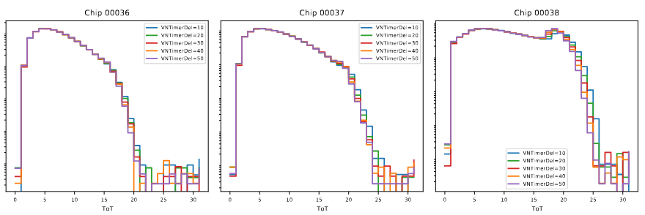
VNTimerDel
Three chips as example
No difference in ToT for different VNTimerDel

Slide 18
Tuning

Slide 19
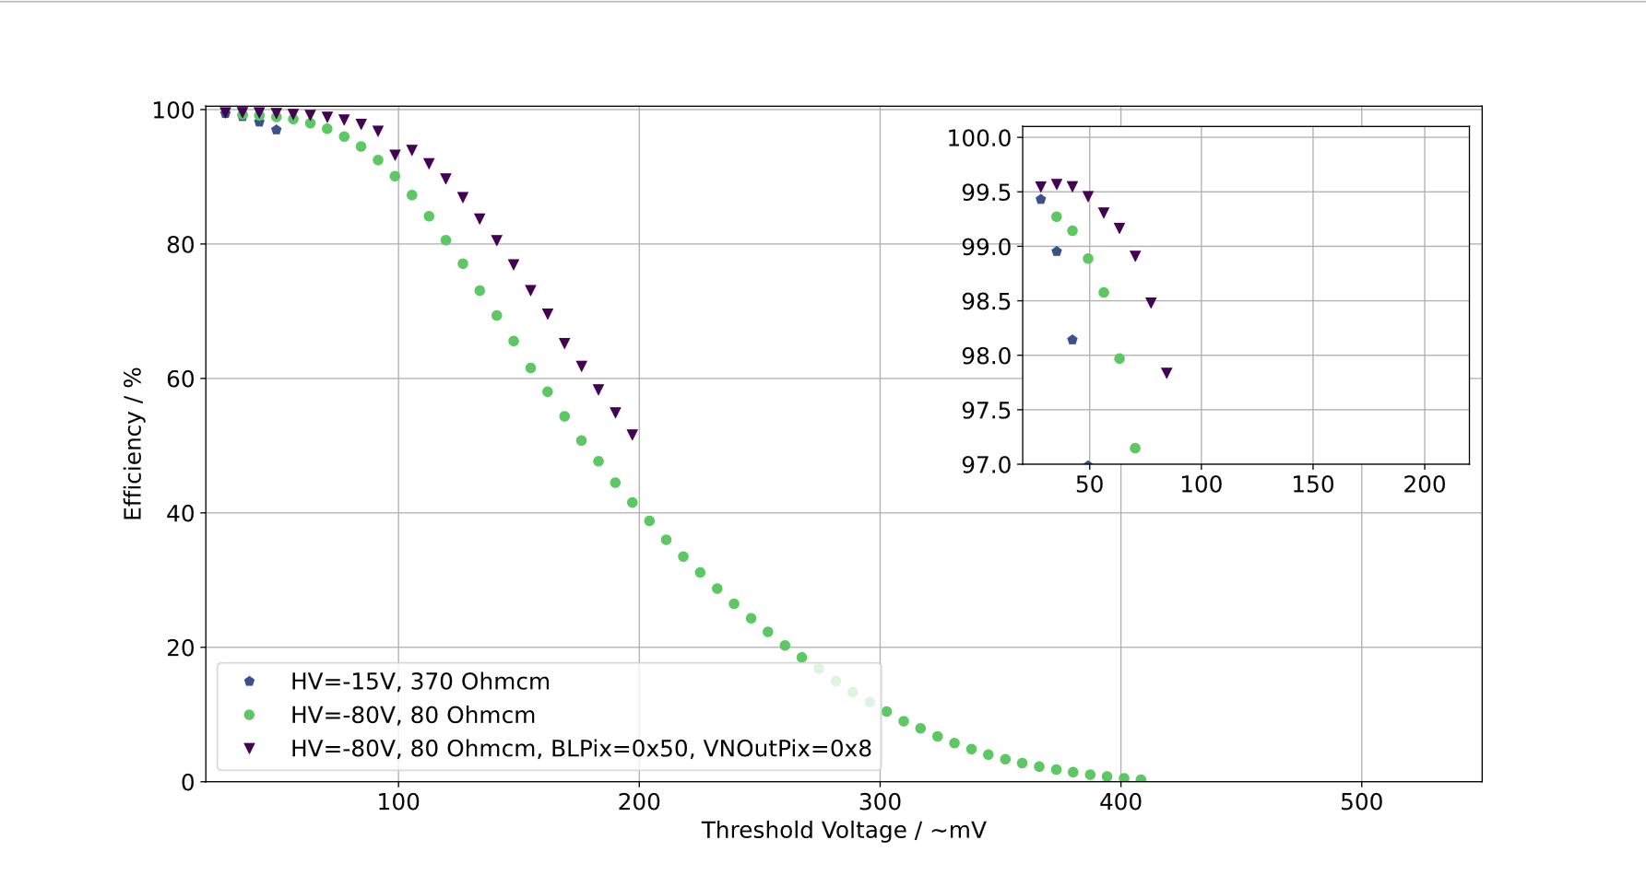
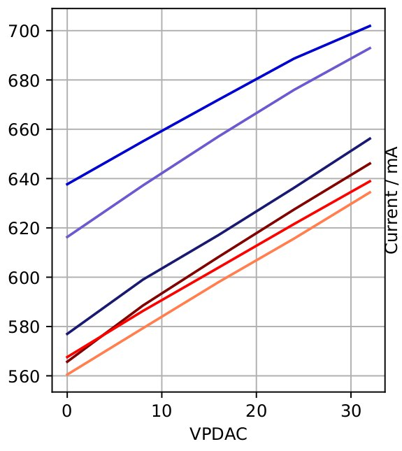
Reminder: VPDAC & TDAC
Small threshold plateau region of high efficiency
Goal is low threshold operation
  Noise at the edges is dominant
  Chips get unstable at low threshold
VPDAC determines the tuning current range
increases power consumption of the chip
8 TDAC bits
  0_1masking_3ThLow_3ThHigh
$ThHigh_{eff} = ThHigh +α⋅ VPDAC⋅ TDAC$

Slide 20
Reminder: VPDAC & TDAC
Small threshold plateau region of high efficiency
Goal is low threshold operation
  Noise at the edges is dominant
  Chips get unstable at low threshold
VPDAC determines the tuning current range
increases power consumption of the chip
8 TDAC bits
  0_1masking_3ThLow_3ThHigh
$ThHigh_{eff} = ThHigh +α⋅ VPDAC⋅ TDAC$
Has to be determined

Slide 21
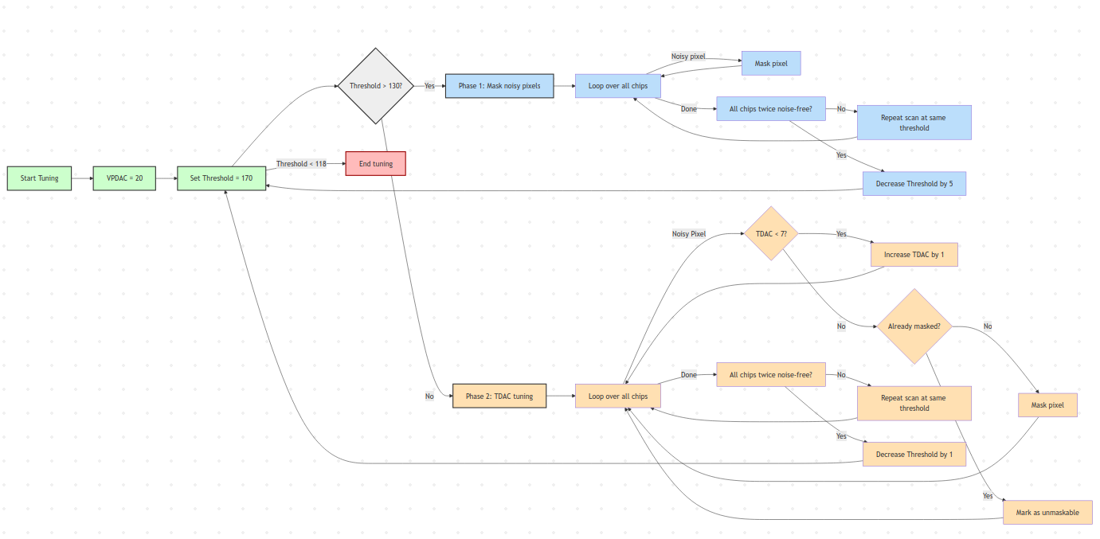
Algorithm: Brute force tuning

Slide 22
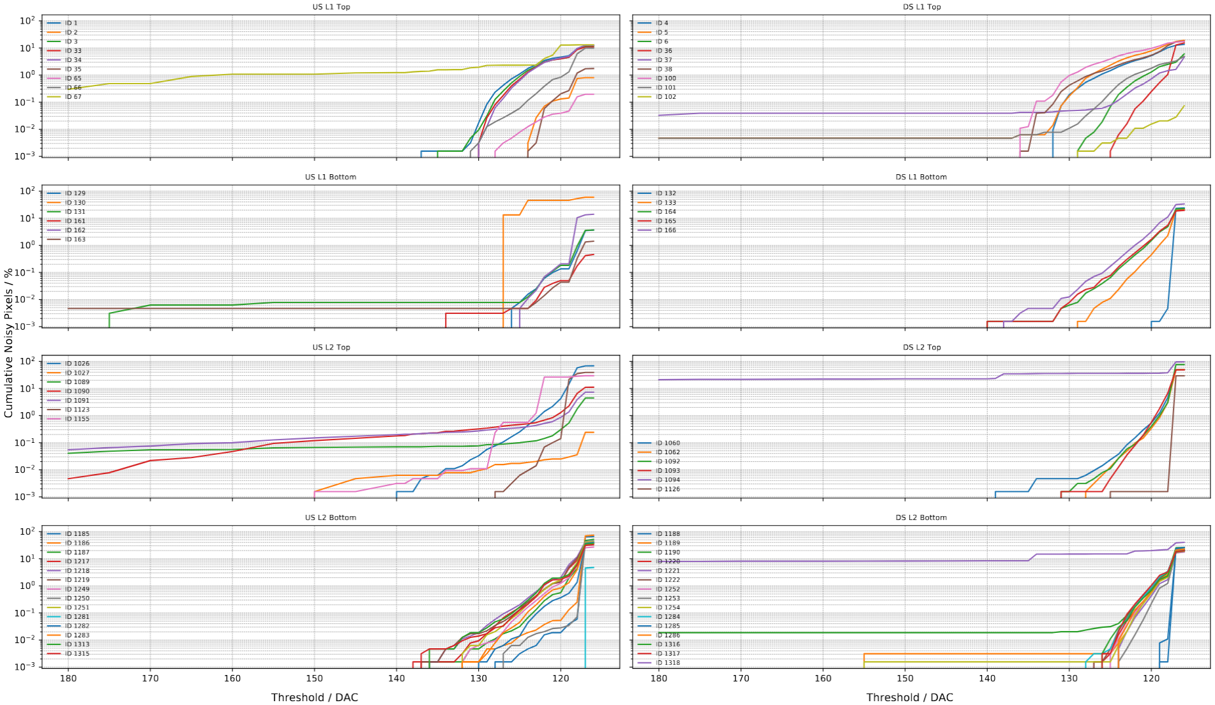
Noise scan

Slide 23
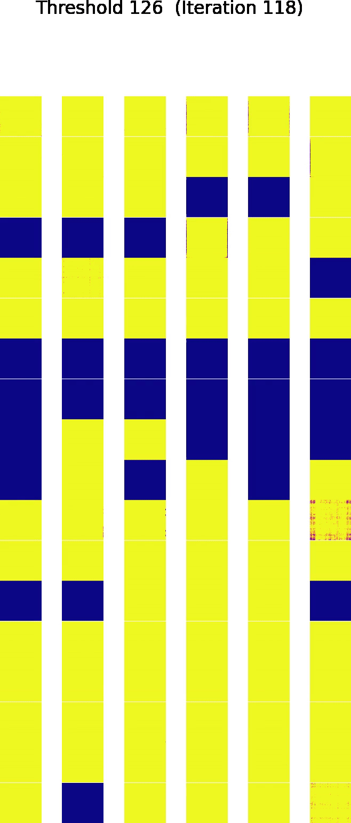
Noise scan
Noise only appears below ThHigh=130
  Was 160 in QC stand
Only shown here from ThHigh = 126
Noise first visible at the edges
Chips seem to behave similar on same ladder
8b10b flooded on certain chips at low threshold
At 117 metal structures are visible
  Also visible during QC

Slide 24
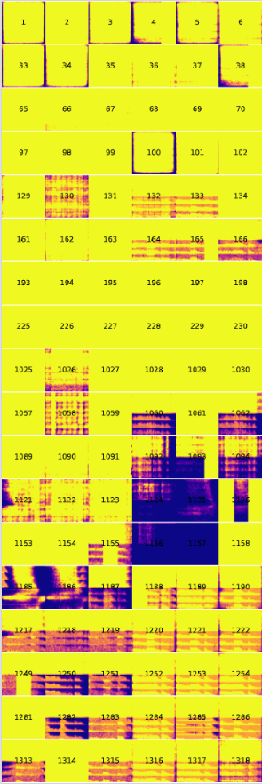
Noise scan
Noise only appears below ThHigh=130
  Was 160 in QC stand
Only shown here from ThHigh = 126
Noise first visible at the edges
Chips seem to behave similar on same ladder
8b10b flooded on certain chips at low threshold
At 117 metal structures are visible
  Also visible during QC

Slide 25
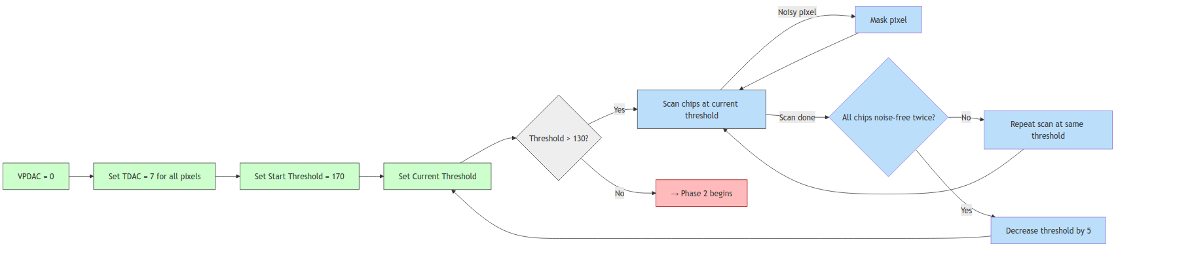
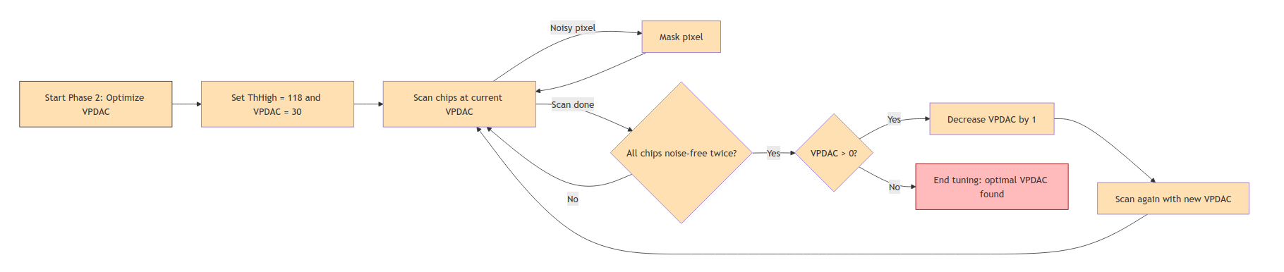
Find Optimal VPDAC

Slide 26
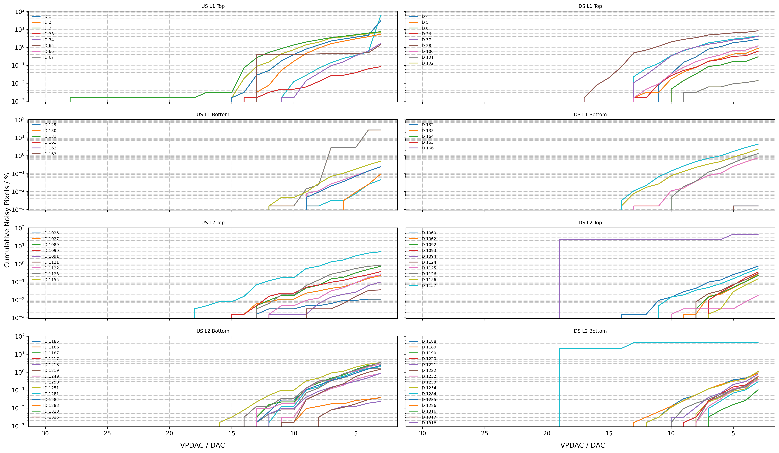
VPDAC scan

Slide 27
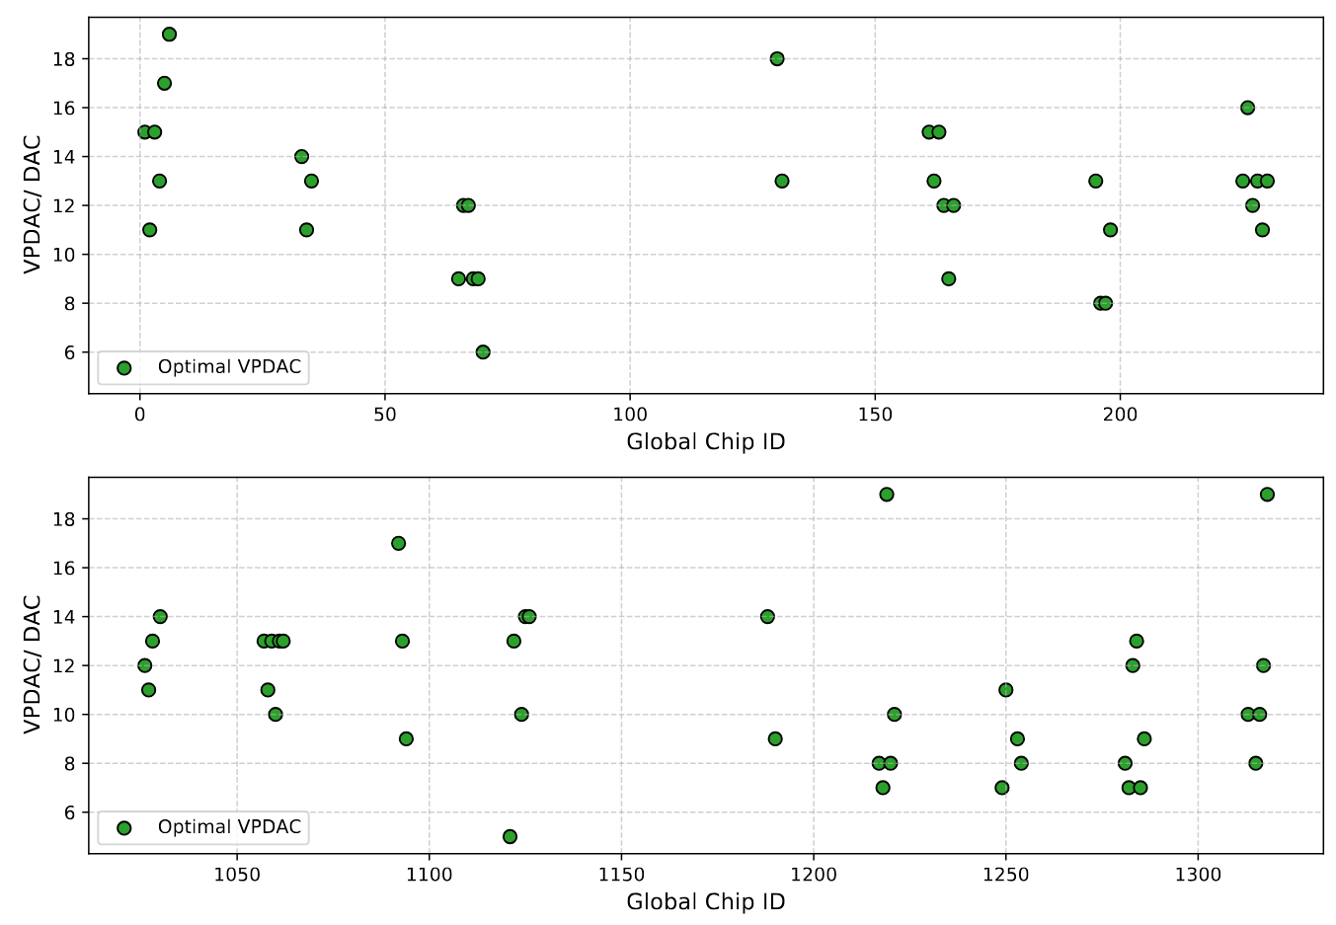
Optimal VPDAC values

Slide 28
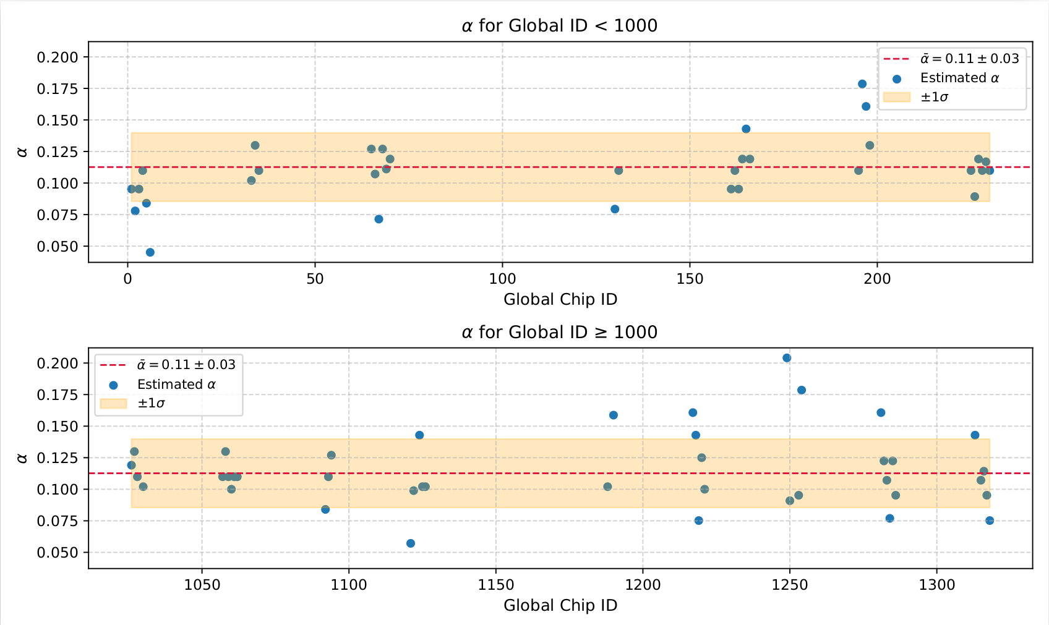
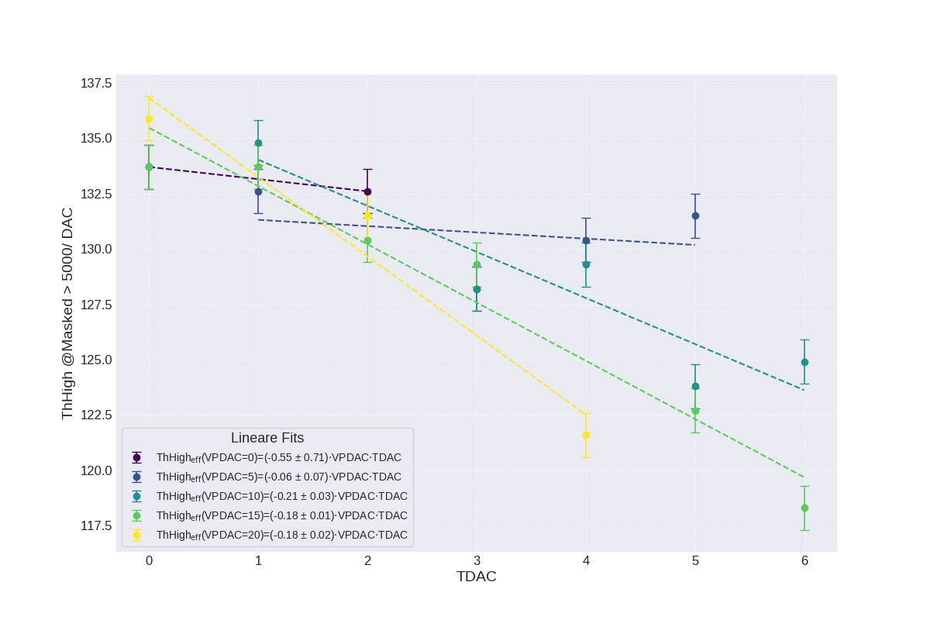
Alpha estimation
Only rough alpha estimation
  comparison of noise scan and optimal VPDAC estimation
Need to mask edges and perform noise scans at different TDAC values at fixed VPDAC
  As shown in Wengen
TDAC writing takes currently too long
  50ms per writing
  Does not work for 10ms
  Can this be solved?

Slide 29
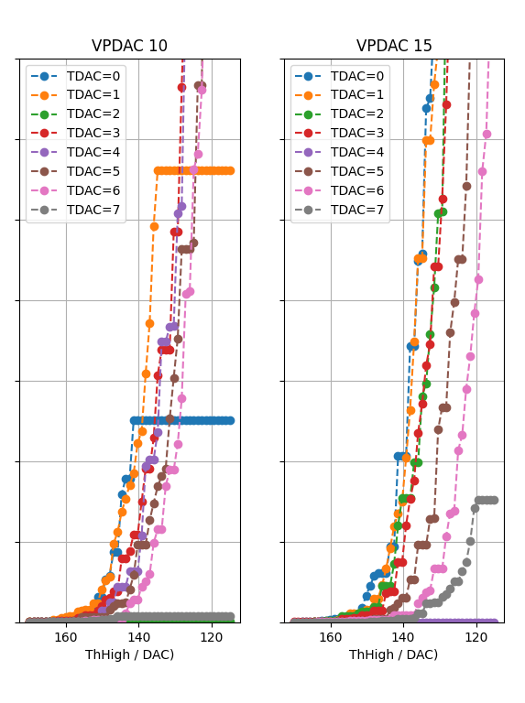
Alpha estimation
Only rough alpha estimation
  comparison of noise scan and optimal VPDAC estimation
Need to mask edges and perform noise scans at different TDAC values at fixed VPDAC
  As shown in Wengen
TDAC writing takes currently too long
  50ms per writing
  Does not work for 10ms
  Can this be solved?

Slide 30
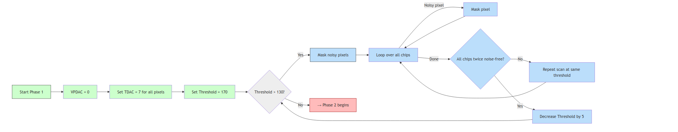
Algorithm: Not so Brute force tuning
Part 1

Slide 31
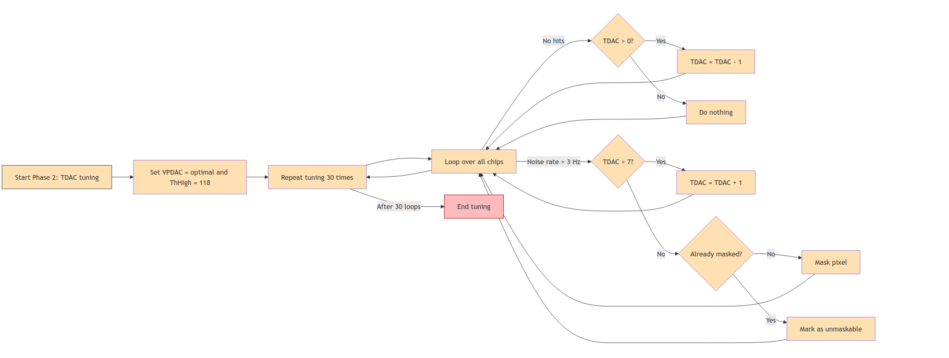
Algorithm: Not so Brute force tuning
Part 2

Slide 32
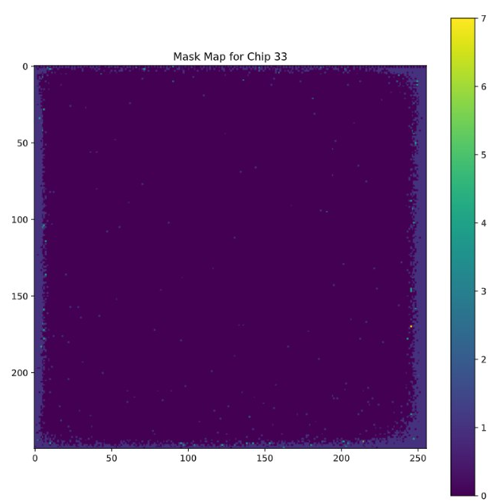
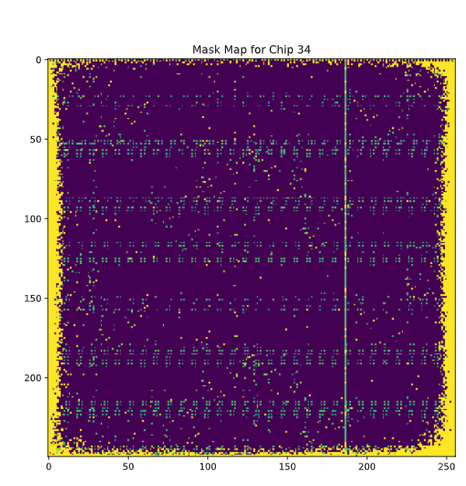
Next steps and open questions
Perform noise scan at different VPDAC values at different TDAC values with masked edges
  Determine alpha per chip – are there chip to chip differences
Perform full tuning with optimal TDAC/VPDAC values
How to not be influenced by 8b10b errors
  More steps seem not to help
What is our goal threshold
  Do we also tune the metal layers (ThHigh=117)
Reduce time of TDAC writing (currently >90s)

Slide 33
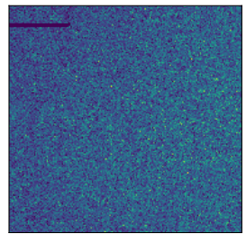
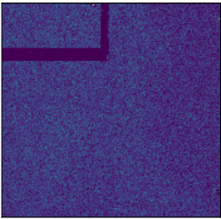
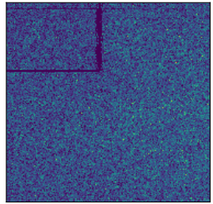
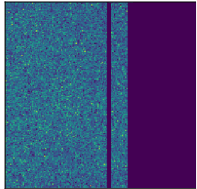
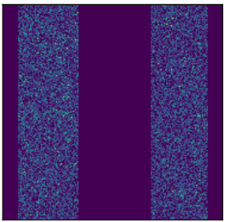
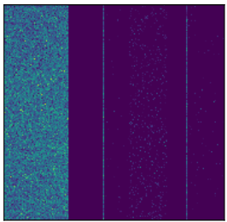
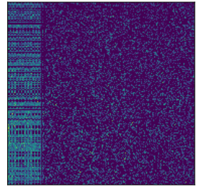

Weird Mupix structures

Slide 34





Weird Mupix structures
QC

