Slide 1
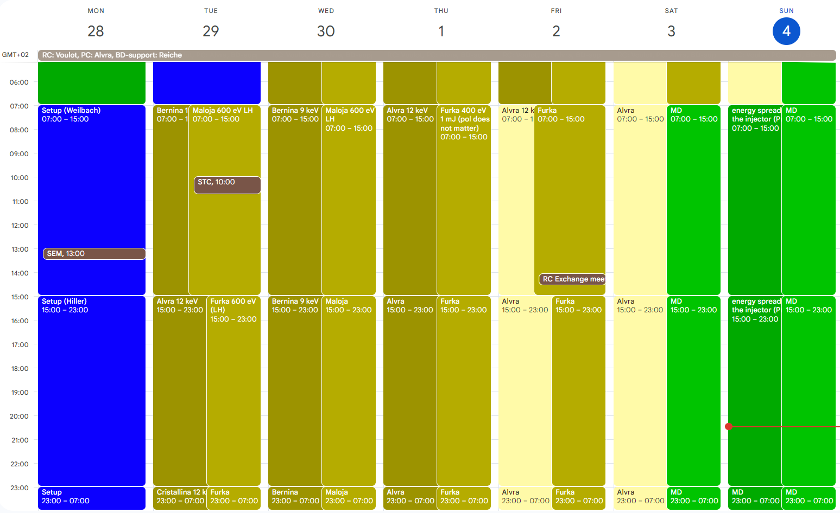
Beam ready –day on Tuesday
Aramis: Bernina 9 keV, Alvra 12 keV, MD on Sunday
Athos: Maloja 600 eV LH, Furka 400 eV LH, MD Sat-Sun (Sat was unused)

Slide 2
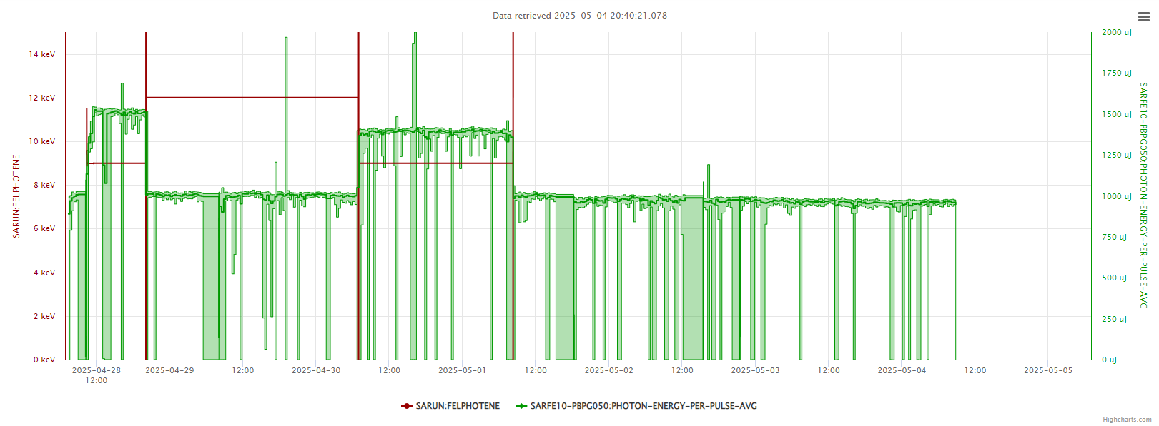
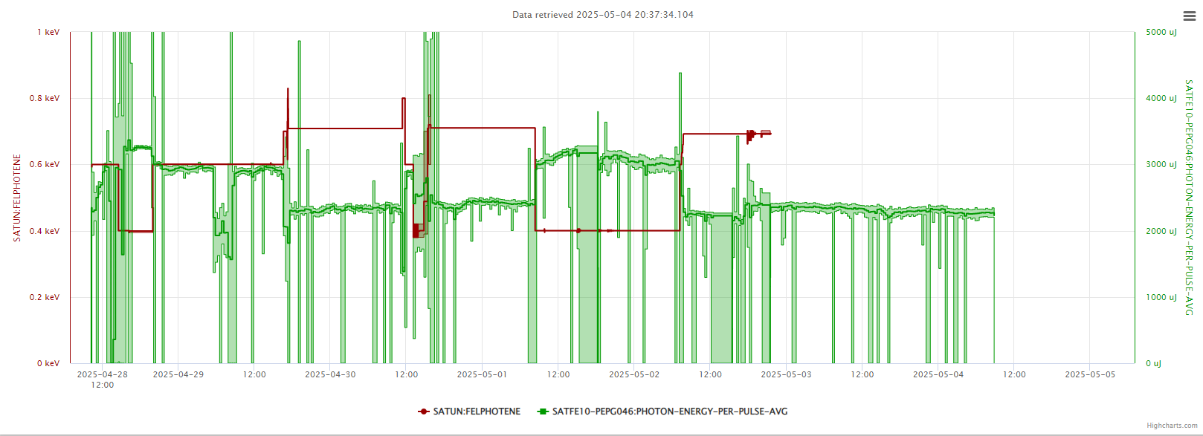
Alcor LAM
S20CB04
T&S failure
SINSB02

Slide 3
Technical issues
Tuesday: LAM alarm Alcor, apparently problem on a VME crate (3h)
Thursday: S20CB04 Solenoid Power Supply replaced (3h)
Friday: Timing and Synch failure, broken module of OMO1 was replaced with one from OMO2 which was fixed later (3h)
Friday 20:30: SINSB02 trip, local reset by piquet (1h)

