Slide 1
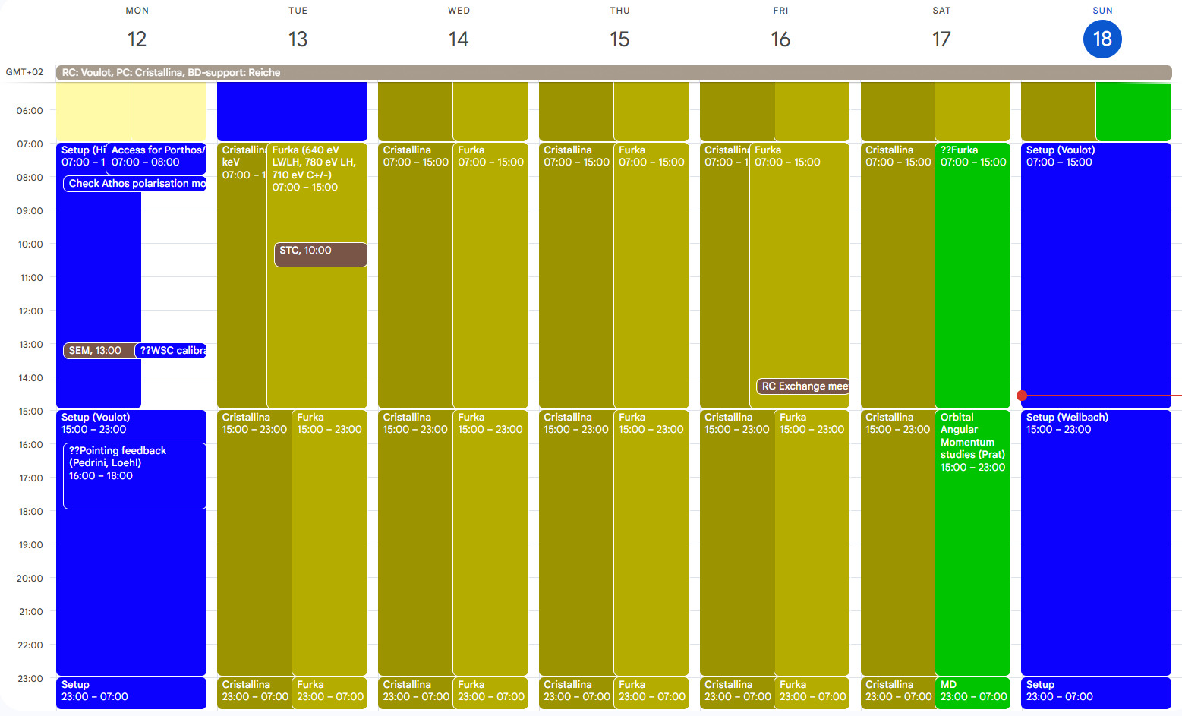
Aramis: Cristallina 8.36 keV (short pulse), set-up on Sunday
Athos: Furka 640 eV LV/LH, 780 eV LH, 710 eV C+/-, Sat MD, set-up on Sunday

Slide 2
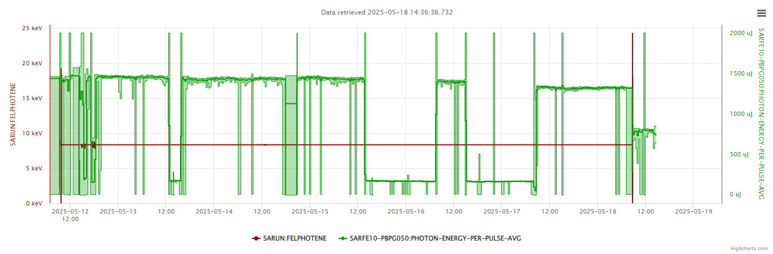
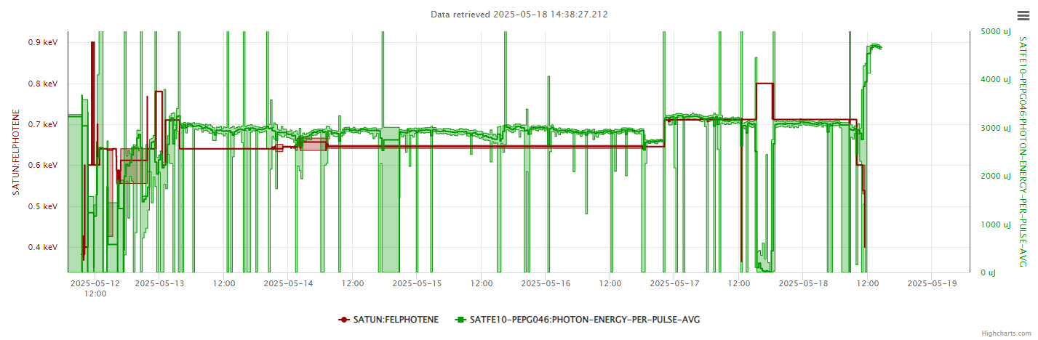
setup
S10CB08
setup
Short pulse
Short pulse
Short pulse
setup
MD
setup
S10CB08

Slide 3
Technical issues
Downtime
Wednesday: S10CB08 (3h)
Friday: BLM settings abruptly changed, causing losses and downtime (30 min)
Other issues
FEL pointing feedback was used for Cristallina. The procedure is confusing (server + setpoints + feedback panel) -> could be automatized.

