Slide 1
SwissFEL RC report, week 21, G.L. Orlandi

Slide 2
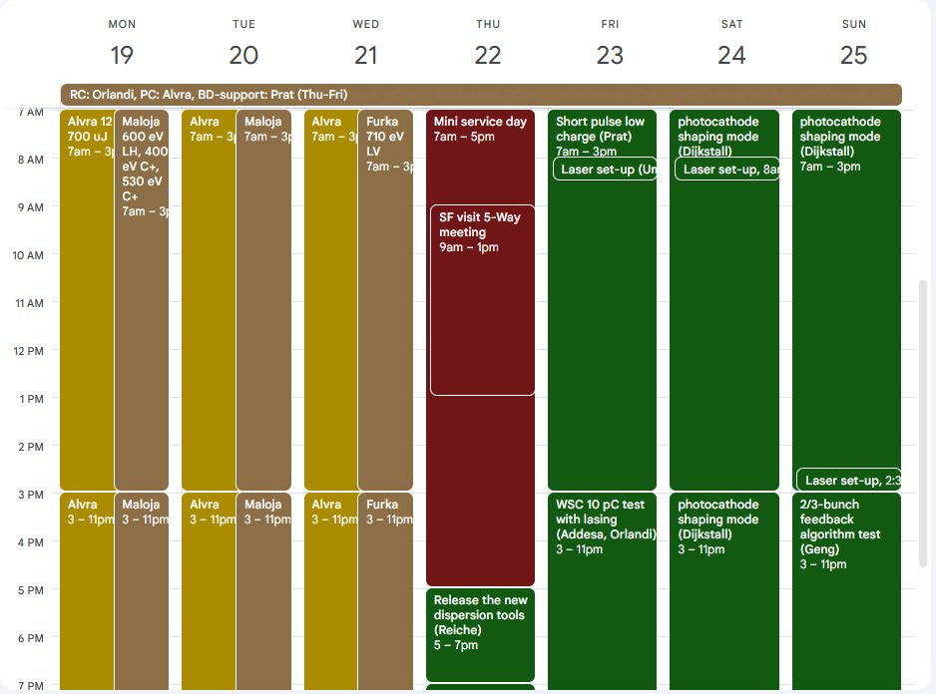
Users’ plan for week 21
Aramis (Mon-Wed):
  Alvra 12 keV, >700uJ
Athos (Mon-Wed):
  Maloja 600 keV LH, 400 & 530 eV C+
  Furka 710 eV LV (Wed)
MD shift (Thu-Sun):
  New dispersion tools (S.Reiche)
  Software test (P. Dijkstal)
  Short-pulse low-charge (E.Prat)
  Wire-scanner measurements (Addesa, Orlandi)
  Photocathode shaping (P. Dijkstal)
  Bunch feedback algorithm test (Z.Geng)

Slide 3
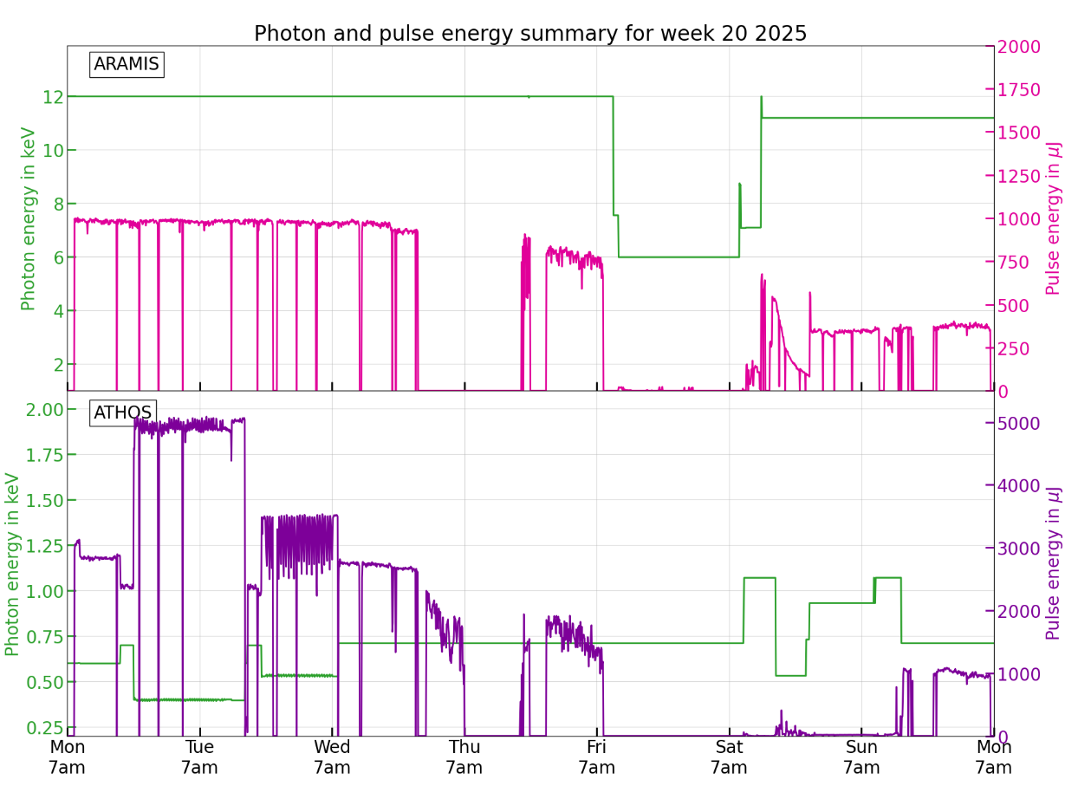
Alcor amplifier pump diode failure
End of users’ operations

Slide 4
Issues
Mon 19.05.2025
03:30-08:30. S30CB03 RF Power station failure, malfunctioning of a Switch Unit. RF picket intervention
Tue 20.05.2025
15:30. a photon energy change for Maloja, SATUN06-10 didn’t reach the desired K value. Problem solved by the CR
20:20-21:00. Vacuum problem in LINAC1, S10CB01 in stand-by. Vacuum pump set back into operations
Wed 21.05.2025
09:30. ICT S10DI01-DICT025, frozen IOC got rebooted
Thu 22.05.2025
20:30- 01:00. Alcor LAM signal lost, no way to recover it. Interruption of machine operations in Aramis. The morning after the Laser group found out the problem: Alcor amplifier pump diode somehow stopped working around 1030 pm on May 21
19:00. S30CB14 RF station not on-beam. RF group fixed the problem
Fri 23.05. 2025
15:30. DRPS0301 detector disabled because of a communication issue. Device to be replaced on Monday morning during a tunnel access.

