Slide 1
Requests for week of 26.04.2025-01.05.2025
Requests at week’s begin:
Aramis:
  Cristallina 11 keV low jitter
Athos:
  Furka 710eV, 850 eV LV/LH
  RC: Pavle Juranic, PC: Furka, BD: Philipp Dijkstal

Slide 2
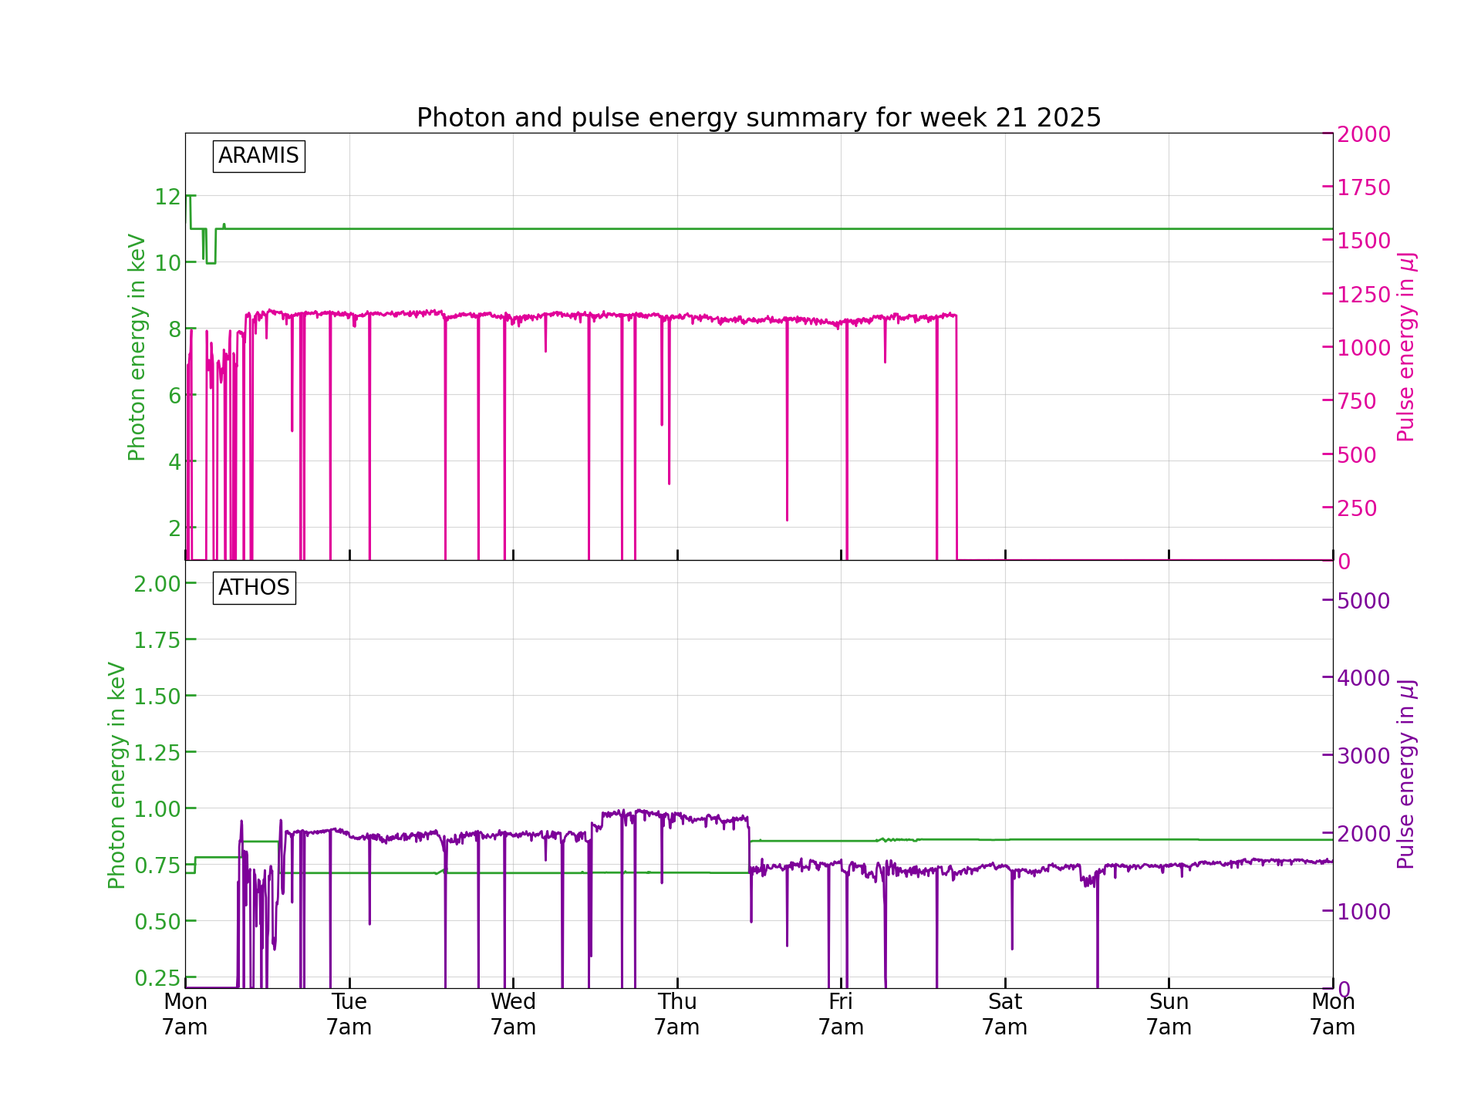
Performance
FEL performance did well on Athos the whole week except for a minor issues with stability for a few hours on Thursday in Athos.
A forepump in the front end Aramis failed on Friday night, causing the closing of the front-end shutter there, resulting in no light in Aramis for the weekend. Stable performance until then.

Slide 3
Down time
30.05.2025 a forepump in the front end of Aramis failed on Friday night, causing no beam to go to the Aramis branch. Pikett was called, but it is a front-end pump, which has no Pikett service—repair on Monday.

Slide 4
Degraded performance
26.05.2025 and a few times noted before, the motion of the undulators to set the K values in Athos sometimes freezes, requiring the restart of the IOC to get it working again. Causes a bit of degraded performance for about ten minutes.
29.05.2025 UV delay was not set properly for the Athos beamline causing oscillations in photon energy, fixed after about ten minutes. Beam was stable afterwards.

Slide 5
Plan for next week
RC: Marco Boll, BD: Dijkstal
Aramis:
  Cristallina the whole week,
  12 keV >500 uJ
  - pulse length measured (standard)
Athos:
  Maloja the whole week
  Photon energy 680 (Priority)/ 540/ 400 eV
  Polarization: Linear Horizontal
  Pulse energy at full pulse length >2mJ
  Pulse length: option to tilt the bunch and have ~10 fs (FWHM) pulse

Slide 6
Special thanks to
Tobias for jumping in on a holiday to fix the UV delay issue.
The operators and pikett.

