Slide 1
SF RC Report 2025 Week 26
Nicole Hiller
N. Hiller
PSI 30.6.2025

Slide 2
Week 11 Mon 23.6. – Mon 30.6.
Cristallina
  Tue-Thur: MX: 12 keV
  Thur-Mon: Q: 11.8 & 10.2 keV
Maloja
  620 eV LH, 400 eV C+/LV, 530 eV C+/LV
Sunday: Start of EEHG MD in Athos
Many thanks to all the expert groups to bring/keep the machine up!

Slide 3
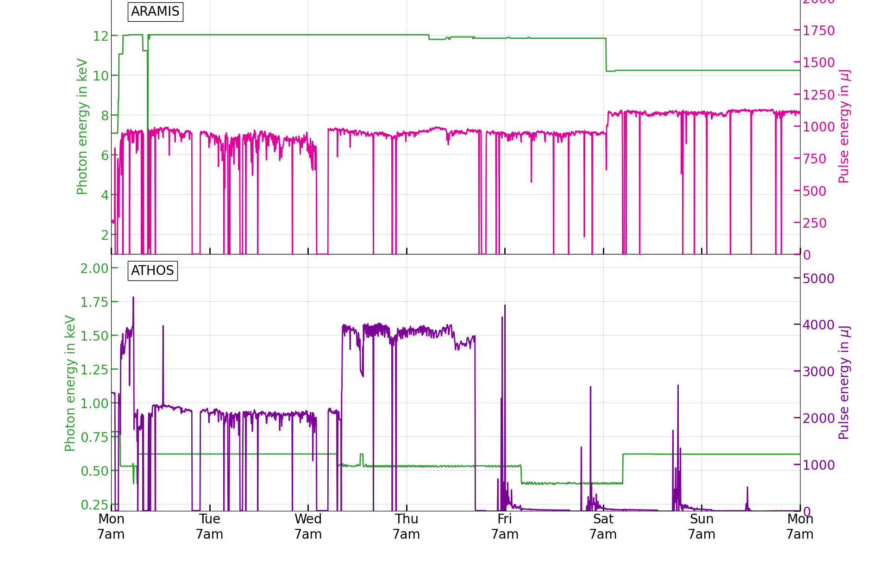
Issues during the week
SINXB01 instabilities
By Tue morning strong instabilities made photon delivery very bumpy
  One issue with the Alcor LAM motor -> resolved by the laser group
  Bigger issue came from SINXB01: Finally on Wed around lunch, the issue was found: multiplier box (used for upconversion of 3 GHz timing signal to 9 and 12 GHz for LLRF) was exchanged Elog:RF/7058
Thur-Fri Night: Vacuum issue at Athos gas detector (pre-pump broke) -> vacuum pikett managed to restore vacuum in frontend, but gas flow had to stay off -> no gas detector reading
Athos vacuum issue
at gas detector -> no signal

Slide 4
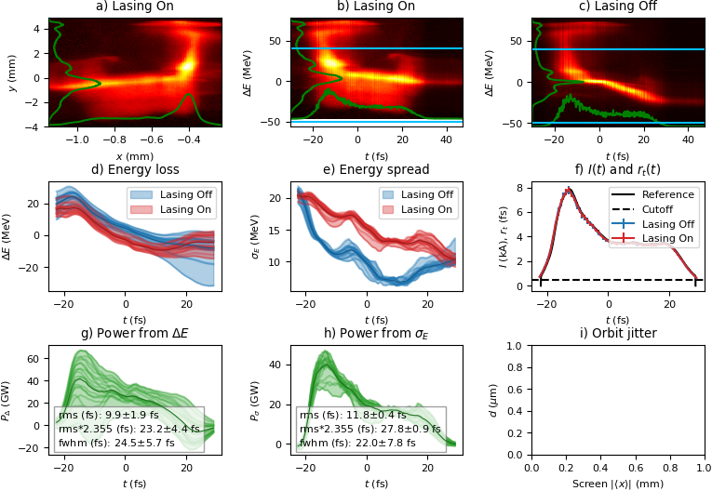
FEL Power Profiles in Aramis
https://elog-gfa.psi.ch/SwissFEL+commissioning+data/63215

