Slide 1
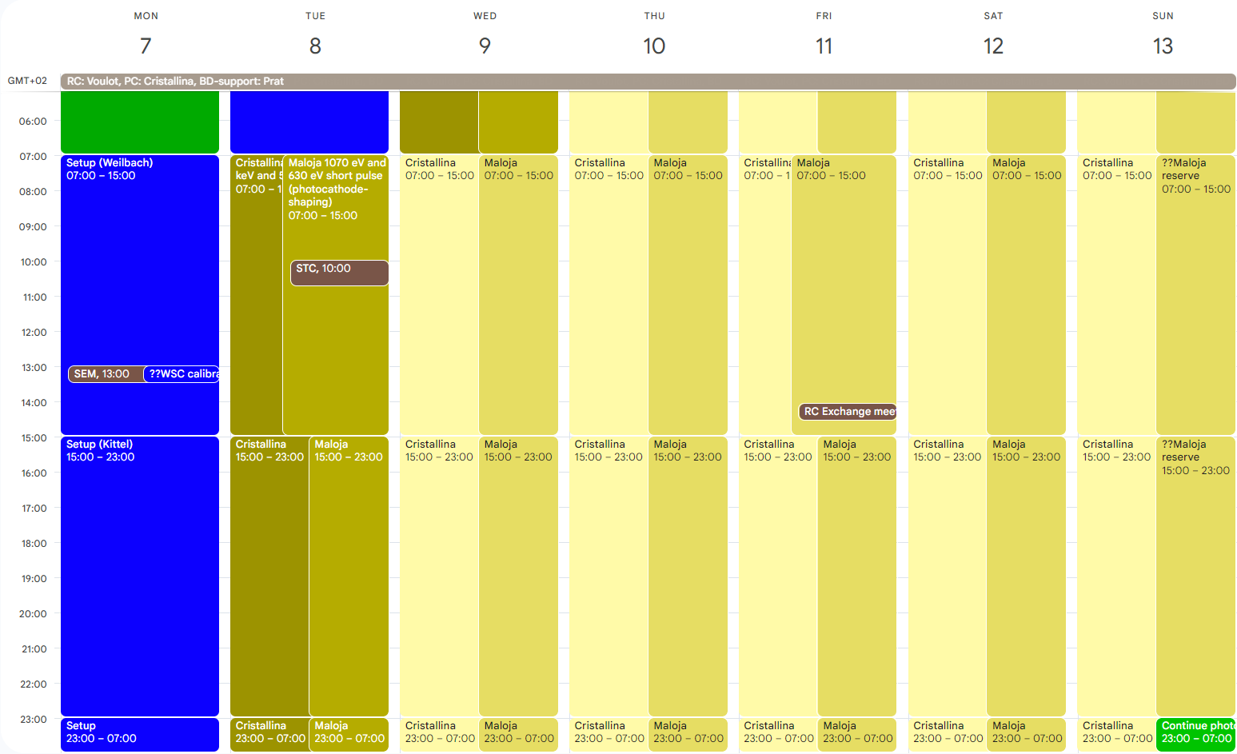
Aramis: Cristallina 11.8 keV and 5.7 keV (standard/short pulse)
Athos: Maloja 1070 eV and 630 eV short pulse (photocathode-shaping), Sunday: Maloja extension + MD

Slide 2
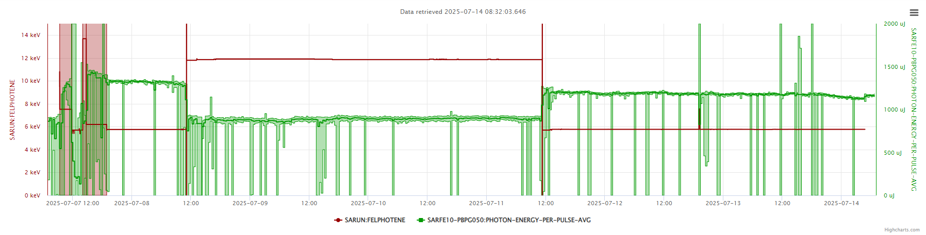
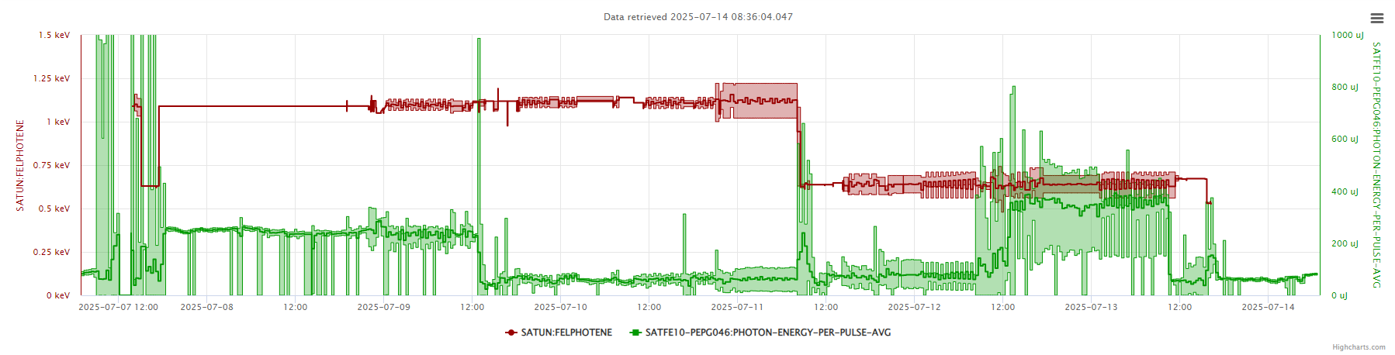
setup
setup
0.63 keV very short?
15-18 fs
Very short/6 fs?
1.1 keV 15 fs
1.1 keV 6 fs/very short?

Slide 3
Technical issues
Downtime
Tuesday: Cooling station SINEG01, SINSB01, SINSB02 (1h)
Other issues
Noisy BLMs, several units add to be disabled
SATBD02-DSCR050 needs the focusing positions updated
Some difficulties with compression feedbacks, maybe due to the special operation mode

