Slide 1
SwissFELplus and Porthos: RF considerations
Injector and linac upgrades, 3-bunch operation
Paolo Craievich and Zheqiao Geng
SwissFELplus machine kick-off meeting, 13 May 2025

Slide 2
Requests for RF systems
3-bunch operation covered by Z. Geng
Increase of the Linac Energy
C-band TDSs will be relocated downstream of the Aramis undulator. However, a question remains: should we use a C-band or an X-band TDS?
For the energy upgrade, there are two main options under consideration:
  Increase the energy in Linac 3.
  Install a dedicated 1 GeV linac for Porthos, which would require an additional klystron gallery.
  Best solution (?) to enable independent operation of Aramis and Athos is to increase the energy in the existing linacs and add a dedicated linac in the Porthos transfer line.
Injector upgrade
BC1 has to be moved upstream. New RF stations are already planned in EMI22+, and FERMI-type RF structures are currently under development.
For 3-bunch operation, RF pulse compression cannot be used. Some solutions are under discussion, with the constraint that the beam energy at BC1 must exceed 300 MeV.
Regarding a potential new electron source, two options are being considered: a C-band TW gun or the existing SwissFEL RF gun with a chirping RF cavity. The goal is to achieve a 2-3x increase in peak current.

Slide 3
Courtesy of Sven Reiche
additonal RF stations
X-band?
technical gallery?
1 additonal RF stations
Min beam energy 2.9 GeV
BC1 energy >300MeV
± 480 MeV
2 additonal C-band RF stations
OR
2 additonal C-band RF stations
2 rf stations to be moved after BC1 or instead of BC2
next slide
+ 480 MeV

Slide 4
Linac Energy upgrade (from 2021) – end of linac 3
C-TDS to be moved after Aramis undulator
S30CB13 to be moved in Athos
S30CB13
S30CB14
(TDSs)
S30CB15
S30CB16
Linac 3 end
3 X-band modules
to be checked if there is space for the RF station in S30CB16
Energy upgrade:
+ 120 MeV
gradient 60 MV/m
2029-2032
S30CB13
XB13
XB14
XB15
S30CB16
200 MeV x 3 (from EuPraxia) but an optimization of the energy gain vs space is needed, 12 over 16 m used!
Energy upgrade:
+ 960 MeV
(+ building and infrastructures)
Extension klystron gallery: Length 40 m, width 9 m, height 4m
Linac 3 builiding extension
4 C-band modules in the transfer line
>2033
S30CB15
S30CB16
First phase: 1 C-band module (Athos), 3+1+1 +1 X-band RF stations + 4 S-band RF station at injector
Second phase: up to 4x C-band RF modules to be installed in Porthos TL

Slide 5
Injector upgrade concept - motivation
Reliability: replacement of the klystron modulators
  Ongoing EMI22+ program with in-house manufactured modulators
  Increase modulator reliability
  Decrease pulse-to-pulse phase and amplitude jitter
  First modulator being assembled for the Pcubed experiment
Performance: move the bunch compressor closer to the electron gun
  minimize the energy spread growth generated by the intra-beam scattering​.
  This is a serious limiting factor for the seeding schemes as under development in Athos, but it is also a potentially limiting the performance of the hard-X ray FEL (Aramis & Porthos)
Courtesy of Marco Pedrozzi – 12.03.2025

Slide 6
Injector upgrade - concept
Heilige Liste 10.5.4-Final (design and optimization undergoing)​
Courtesy of Marco Pedrozzi – 12.03.2025

Slide 7
Injector upgrade - schedule indications (1)
Replacement modulators in technical gallery OSFA ⇒ EMI22+ program
  SINEG & SINSB01-03 modulators:
  Functionality test of modulators must first be performed in WLHA ⇒ minimizing unexpected issues during implementation and commissioning in OSFA.
  Implementation in OSFA: minimum requirement 6 weeks for two modulators, i.e. 12 weeks if done in two steps.
  Eventually the modulator exchange can be carried out prior to beam-line works in bunker
  SINXB01
  The new SINXB modulator can be implemented at any time in the SINSB05 slot and connected to the X-Band structures during a normal shutdown. Expected an amelioration of the shot-to-shot phase-amplitude stability ⇒ peak current stability @ FEL-undulator
Require careful verification
Courtesy of Marco Pedrozzi – 12.03.2025

Slide 8
Injector upgrade - schedule indications (2)
Modification of the beamline in the bunker
  Plan a unique long shutdown (LSD)
    Anticipating where possible cabling during the normal shutdowns preceding the LSD
    Anticipating where possible the floor marking of new component positions (but the bulk will be done during LSD)
    Components available when starting the LSD ⇒ required support from AIK (construction & production)
    With good preparation and available manpower required 3 to 4 months
  RF conditioning of the high gradient S-Band module will require at least 1 month.
  Recommissioning of SwissFEL for FEL operation: 1 months?
  Overall, we should realistically consider a dark period of about 6 months
  LSD starting May 2028? Combine with klystron modulator exchange?
Require careful verification
Courtesy of Marco Pedrozzi – 12.03.2025

Slide 9
Highlight of 3-Bunch OP Requirements
  The bunches have a separation of 21 ns, with preferred assignments: Bunch1→ Aramis, Bunch2 →Athos, Bunch3 → Porthos.
  LLRF will only consider the following operational conditions:
    All three bunches have the same charge.
    Aramis and Porthos have the same nominal bunch length.
    Aramis and Porthos are equally accelerated up to 7 GeV.
  Relative beam energy requirements:
    The 3 bunches should have the same energy at LH and BC1.
    Bunch1 and Bunch3 should have the same energy at BC2 and the end of Linac3.
    Bunch2 energy can be different up to ~100 MeV than Bunch1/3 at the Switchyard.
  The relative ACC phases for different bunches should be tunable (tuning range not specified but will be estimated for the selected tuning knobs).

Slide 10
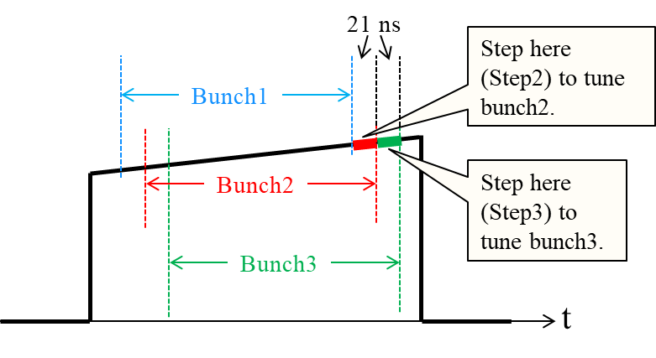
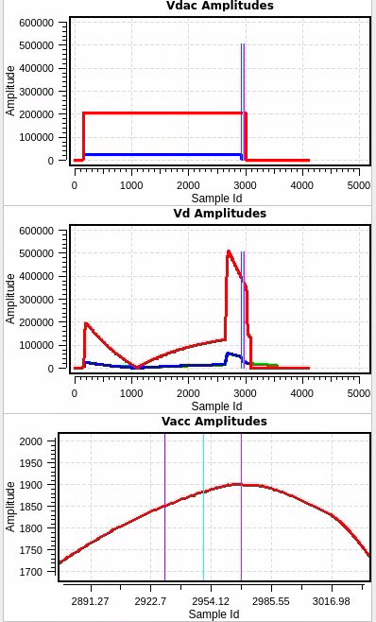
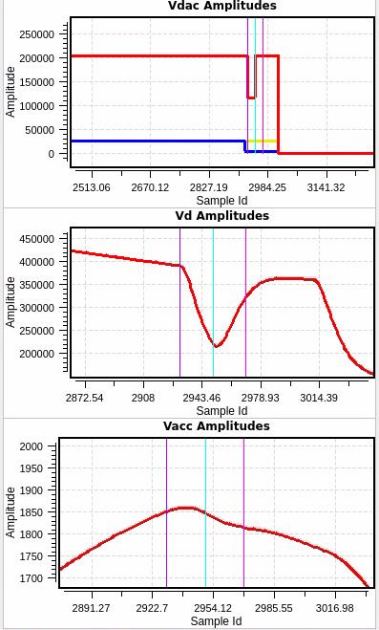
LLRF Tuning Knobs for 3-Bunch Operation
  Amplitude and phase slopes of the RF pulse (Gun, S-band, X-band):
    Pre-set the relative energy gain and ACC phase for the 3 bunches.
  RF pulse delay (C-band)
    Pre-set the relative energy gain for the 3 bunches.
  RF pulse steps (all stations):
    Fine tune the relative ACC voltage and phase for the 3 bunches.
Tuning ranges of a 21 ns step:
 | ACC Voltage Range | ACC Phase Range (deg)
Gun | ± 1 % | ±0.8°
S-band | ± 1 % | ±0.7°
X-band | ± 14.3 % | ±10°
C-band | ± 1.4 % | ±1°
For the case with Bunch1 -> Aramis, Bunch2 -> Athos, Bunch3 -> Porthos, we only need to tune the Bunch3 and Bunch1 to be equal at BC2 and leave Bunch2 to be compensated by the “Tuning XB” before AT-BC. Therefore, we have a 42 ns step to tune Bunch3, with a tuning range of ±3 % in ACC voltage and ±3° in ACC phase.

Slide 11
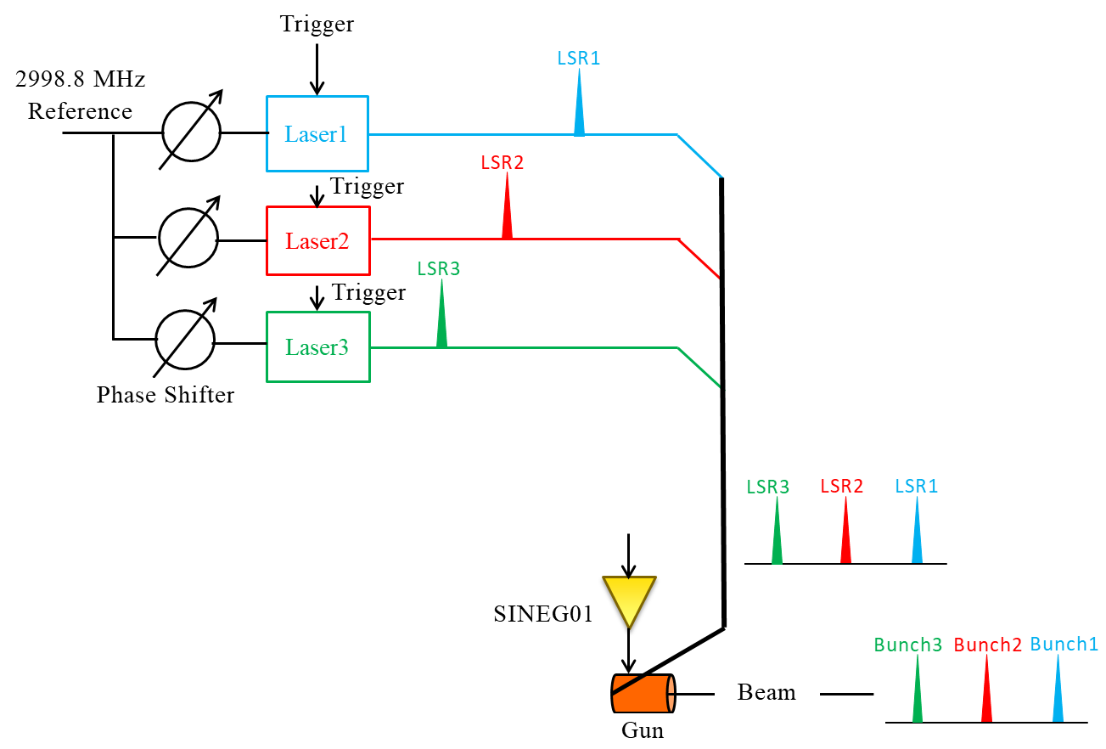
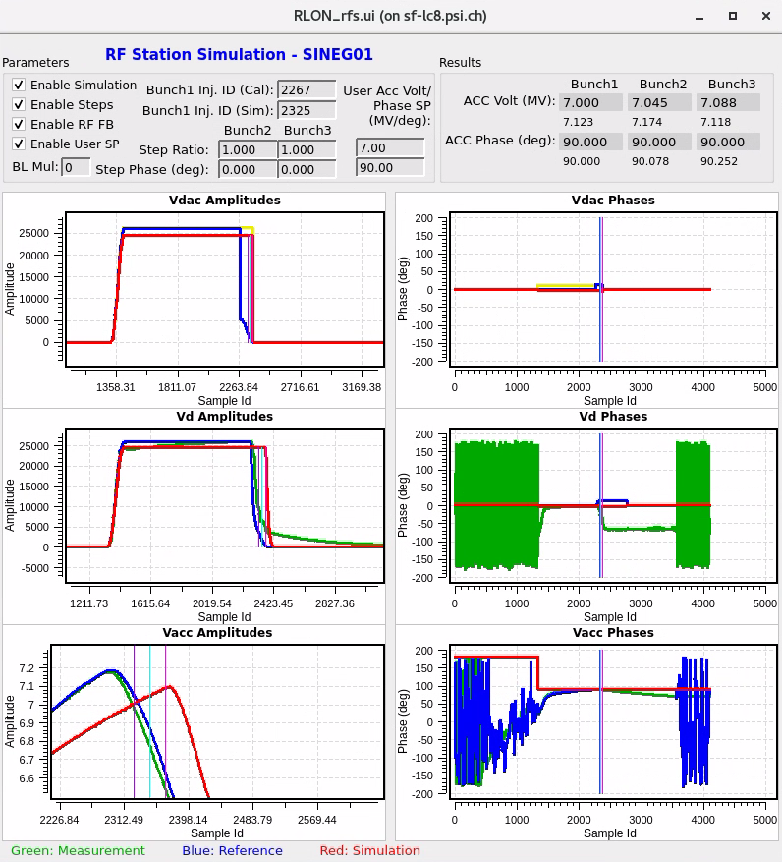
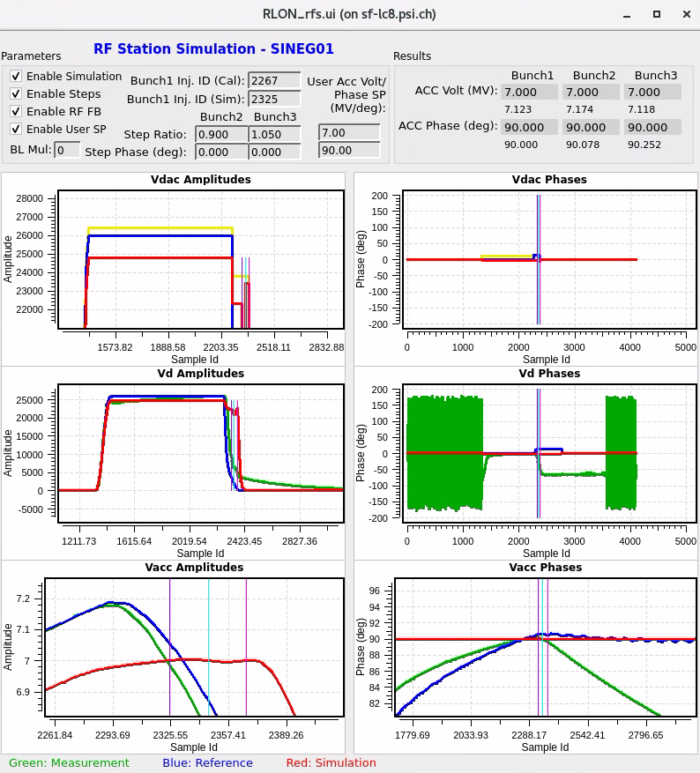
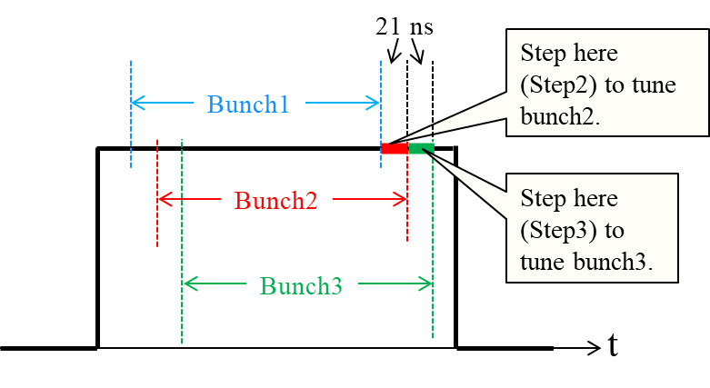
RF Gun Setup and Control
Setup
    Introduce a separate step in the RF pulse before the bunches are generated to produce a flattop (or a slope to compensate for the long-range wakefields) on the Gun voltage pulse.
    Optimize Bunch1 (e.g., for min. energy spread) by Gun RF scanning.
    Place 3 lasers to Bunch1 time one by one (each time only one laser working), optimize the laser settings (e.g., delay) to achieve the same parameters as Bunch1 (e.g., energy, energy spread, or LH BAM) – this step synchronizes all lasers.
    Switch on laser2 at its nominal time, and tune Step2 to optimize the Bunch2 param. (e.g., LH BAM).
    Switch on laser3 at its nominal time, and tune Step3 to optimize the Bunch3 param. (e.g., LH BAM).
    Switch on all three lasers, adjust the delays of laser2 and laser3 to optimize the FEL lasing.
    If necessary, repeat step 1~6 with different flattop slopes.
Beam-based Feedback
    No beam-based feedback acts on the Gun RF.
Requests
    Needs longer RF pulse.
    Gun RF station operates at linear region (with at least
    10 % headroom in acc. voltage).
    3 lasers can be assigned to any bunch’s time.
    LH BAM can measure the relative arrival time of
    different bunches.
Bunch1: Aramis
Bunch2: Porthos
Bunch3: Athos
Definitions of “Step2” and “Step3”
Initial RF pulse and 3bunch acc.
3bunch acc. setup with slopes and steps

Slide 12
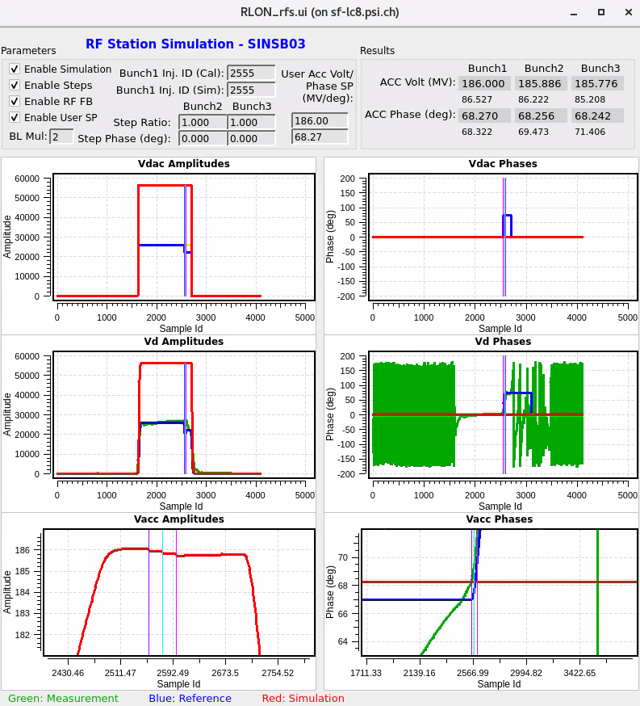
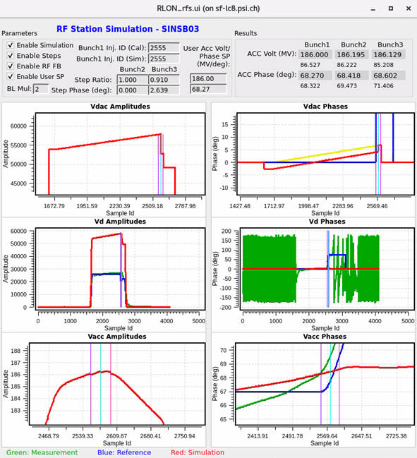


SINSB01/02 (03/04) Setup and Control
Setup
    Optimize Bunch1 with the amplitude and phase of the entire RF pulse.
    Apply RF feedbacks and LH energy feedback for Bunch1.
    Adjust the amplitude and phase slopes of the RF pulse so that Bunch2 reaches the same parameters (e.g., LH energy) as Bunch1. During this process, the feedbacks keep the Bunch1 parameters unchanged. This adjustment can be done with optimizations (e.g., Powell’s method, grid search, etc.) or feedbacks.
    Adjust the Step3 for Bunch3 to reach the desired parameters (e.g., LH energy).
Beam-based Feedback
    Bunch1: LH energy feedback by adjusting the entire RF pulse.
    Bunch2: LH energy feedback by adjusting the amplitude
    and phase slopes.
    Bunch3: LH energy feedback by adjusting the Step3.
Requests
    Needs longer RF pulse.
    Flat RF pulse should be possible (no BOC).
    RF stations operate at linear region (with
    at least 10 % headroom in acc. voltage).
The control of SINSB03/04 follow the same procedure, except for the beam parameters referring to BC1 energy and compression instead of LH energy.
SINSB03/04 should be able to produce a flat RF pulse, therefore, no BOC possible!
Initial RF pulse and 3bunch acc.
3bunch acc. setup with slopes and steps
Initial beam parameters at BC1
Final beam parameters at BC1

Slide 13
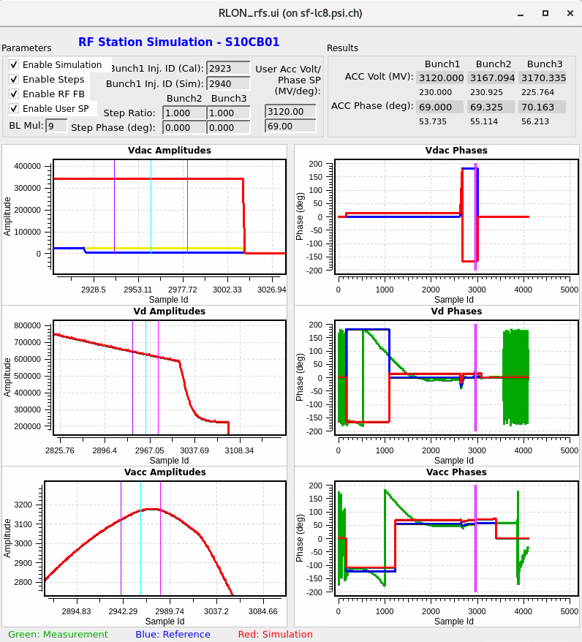
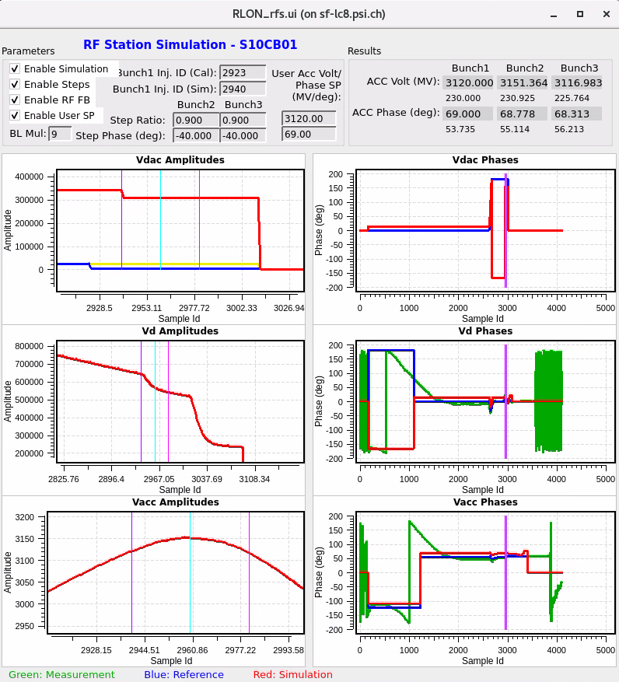
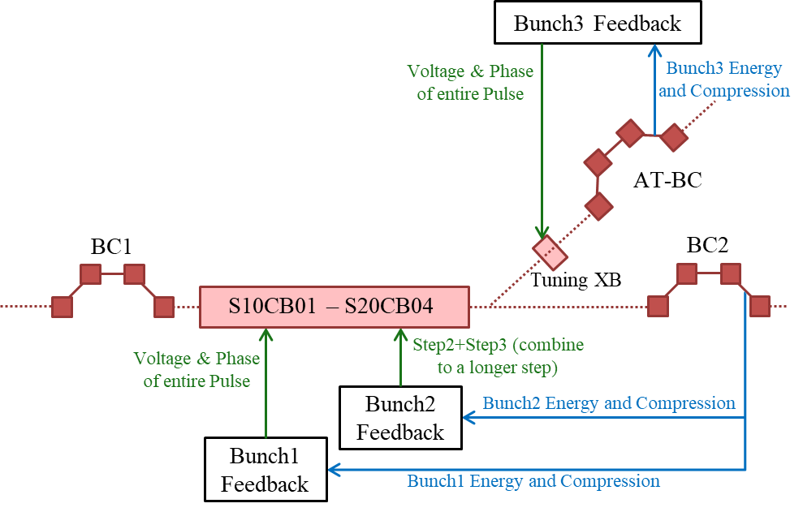


Linac1 Setup and Control
Beam-based Feedback
    Bunch1: BC2 energy and compression FB by acting on the entire pulse of Linac1 stations.
    Bunch2: BC2 energy and compression FB by acting on the Step2+Step3 (combined to be a 42ns step) of Linac1 stations.
    Bunch3: AT-BC energy and compression FB by acting on the Tuning XB station.
1. Initial RF pulse waveforms and beam parameters
  Delay optimized to let Bunch3 with larger energy than Bunch1 (give headroom for step tuning)
  Bunch1 ACC volt reduction ~57 MV, energy reduction ~53 MeV compared to single-bunch case with peak acceleration
2. Equalize Bunch3 and Bunch1 with Step2+Step3
(with same settings to emulate a 42ns step)
  Bunch2 energy is ~37 MeV higher
When tuning the Bunch3 phase by ±1° with the 42ns step while keeping the Bunch3 energy unchanged, the ACC voltage of Bunch2 changes by ~10MV peak-to-peak, and its ACC phase changes by ~0.5 deg peak-to-peak, resulting in an energy change of ~0.3 MeV. This is within the 1 % acceptance (~30 MeV) of the switchyard. Therefore, with this bunch assignment case, we can tune Bunch3 (for Porthos) with the longer (42ns) step and leave the effects on Bunch2 compensated by the “Tuning XB”.

Slide 14
Preliminary Conclusions and Outlook for LLRF
  Preliminary Conclusions:
  It is very likely to be feasible to control and tune three bunches for the new machine layout.
  The bunch assignment (Bunch1 -> Armas, Bunch2 -> Athos, Bunch3 -> Porthos) is preferred considering the easy solution of resonant kicker and larger tuning range for C-band RF stations.
  Injector RF stations should be able to produce a flat RF pulse, therefore, no RF pulse compressors installed.
  The AT-BC scheme relaxes the control of C-band stations, allowing different beam energy for Athos at the switchyard.
  Outlook:
  Test the tuning methods and feedback algorithms with SwissFEL 2-Bunch operation.
  Further study of 3-Bunch operation methods with simulation for the new machine layout.
  Upgrade the existing 2-Bunch operation software based on the progress.

