Slide 1
Recent MIDAS developments
MIDAS Workshop
Stefan Ritt
TRIUMF, Vancouver, CA, 22 September 2025

Slide 2
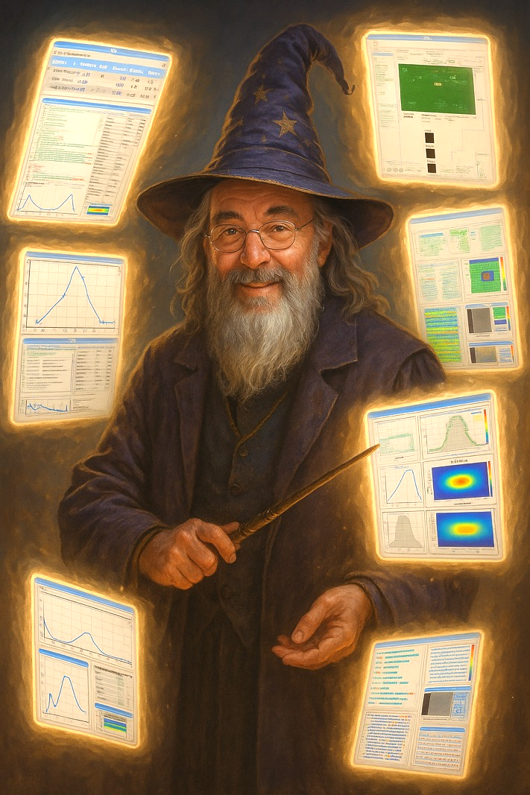
Agenda
Improvements to odbxx API
mdev device driver concept
New equipment pages
Sequencer improvements
Alarm notifications
Custom page improvements (SVG, Mplot, Example Gallery)
One more thing

Slide 3
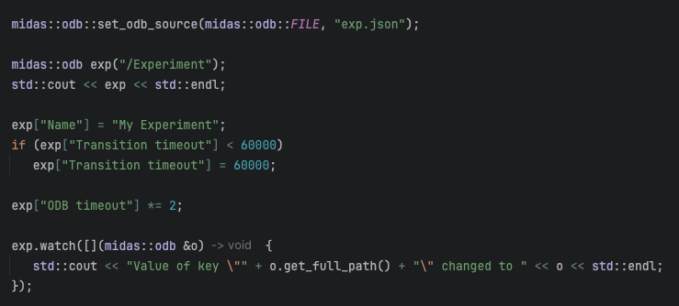
odbxx API improvements
odbxx API used very successful since last workshop
New switch to access ODB from files or buffers: set_odb_source(STRING, “{ … }”); set_odb_source(FILE, “odb.json”);
Suitable to read ODB dumps from .mid files, JSON or XML files
User code does not need to be changed
Only read operation allowed
Optimized transfer of large ODB trees server → XML tree → Network → frontend → midas::odb object
Implemented 64-bit values
Many small bug fixes

Slide 4
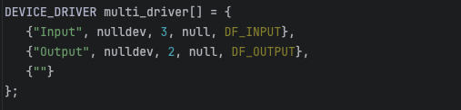
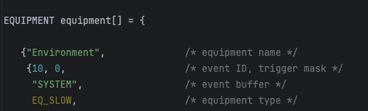
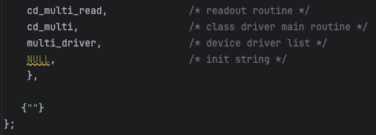
Slow control architectures
Idea: we do not want one front-end program for each device
Some experiments have 100s of devices
Many devices can be logically grouped (like HV boxes)
A slow control architecture should give an easy way to write a FE without specific knowledge of the underlying communication

Slide 5
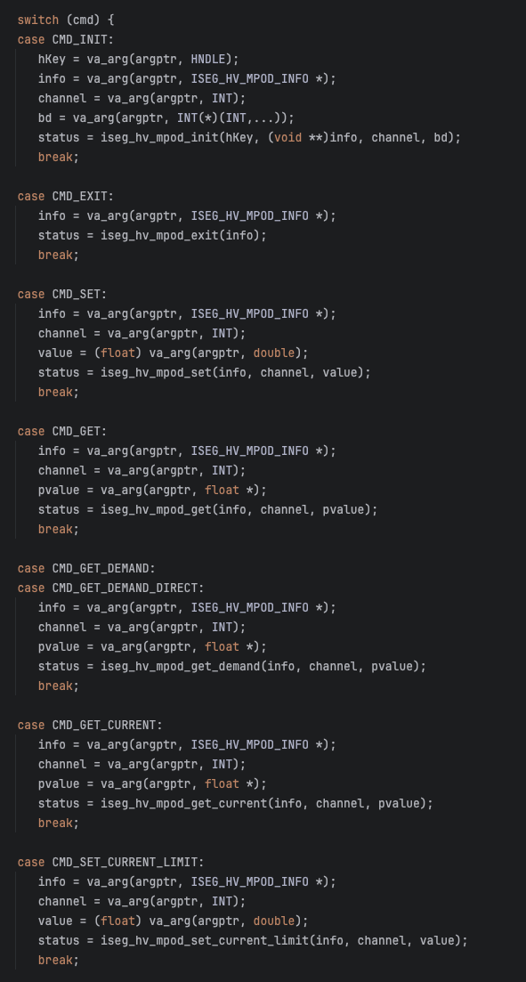
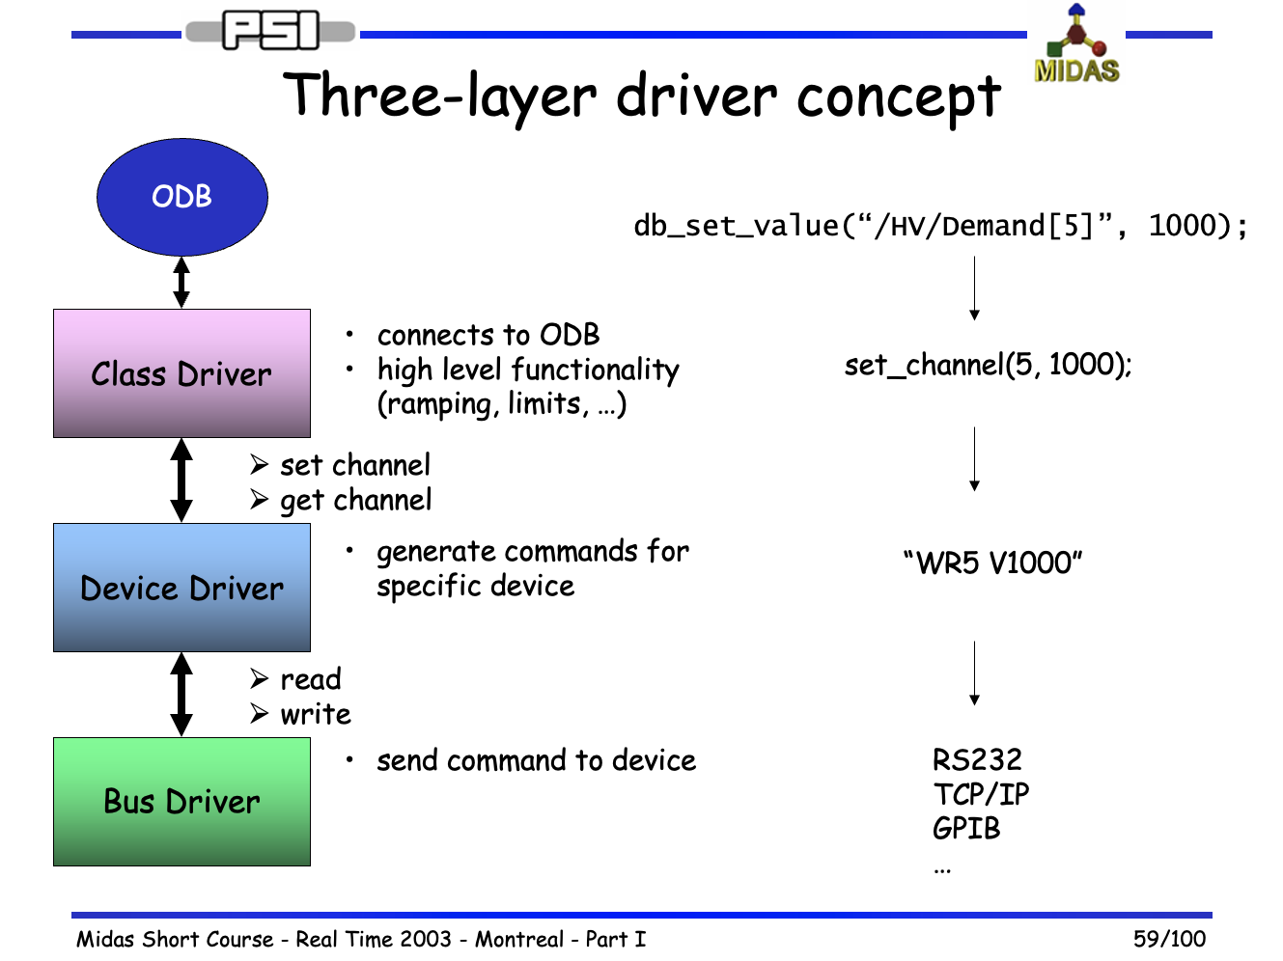
Old Slow Control Architecture

Slide 6
mdev front-end architecture
Generic “mdev” base class
Links to ODB /Equipment/<name> tree
Manages Event ID, readout period etc.
Implement read_event() for periodic event generation
Implement odb_setup(), init(), loop() and exit() functions (pure virtual)
Simple front-end programming std::vector<mdev *> mdev_table; auto device = new mdev_xxx(”HV"); device->add_channels(adress1, type1, …); device->add_channels(adress2, type2, …); . . . mdev_table.push_back(device); mdev::mdev_odb_setup(mdev_table); mdev::mdev_init(mdev_table); install_frontend_loop([](){ mdev::mdev_loop(mdev_table)});
Driver derived from mdev
One object per device

Slide 7
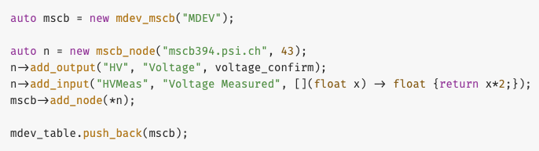
mdev_mscb usage

Slide 8
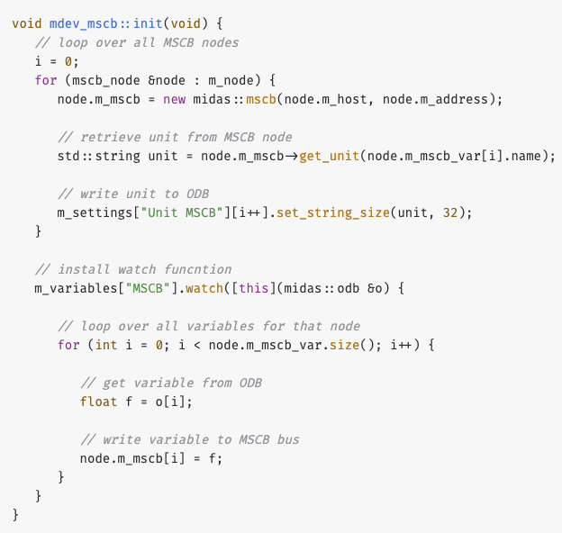
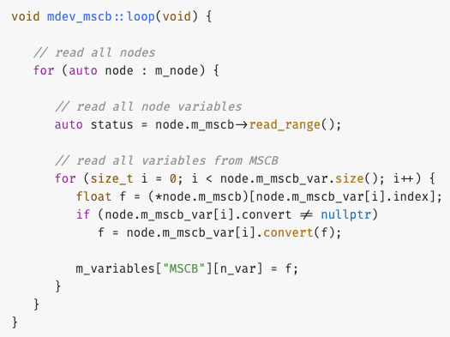
mdev_mscb implementation (simplified)

Slide 9
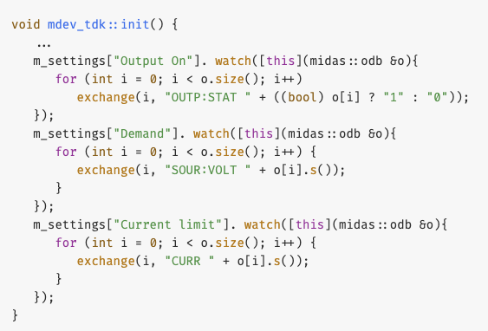
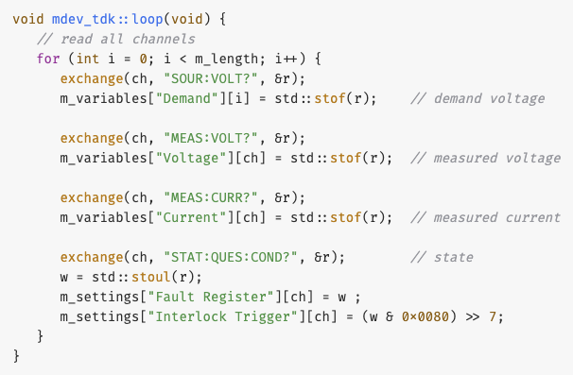
Advantages of mdev architecture
All midas “driver” functionality encapsulated in single object instead of class, device and bus drivers (object still needs to “talk” to device)
New features: conversion function, confirmation function
Any number of attributes per channel possible
Drawback: No multi-threading framework
User can call loop in own thread because ODB is now thread safe

Slide 10
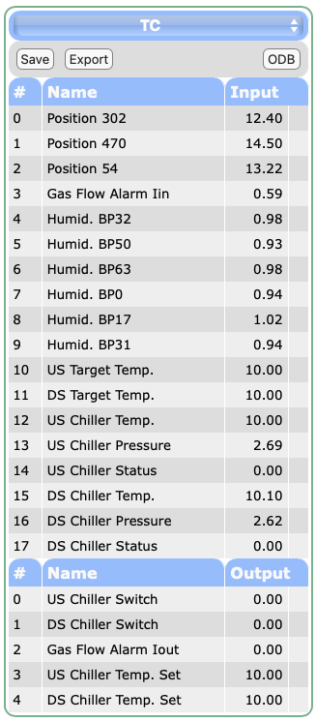
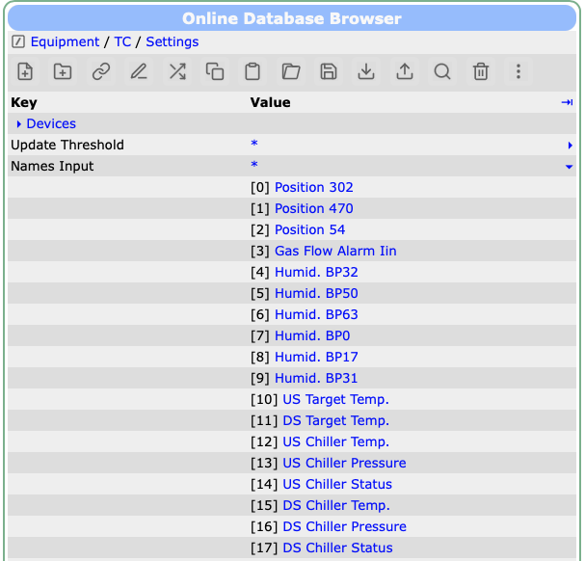
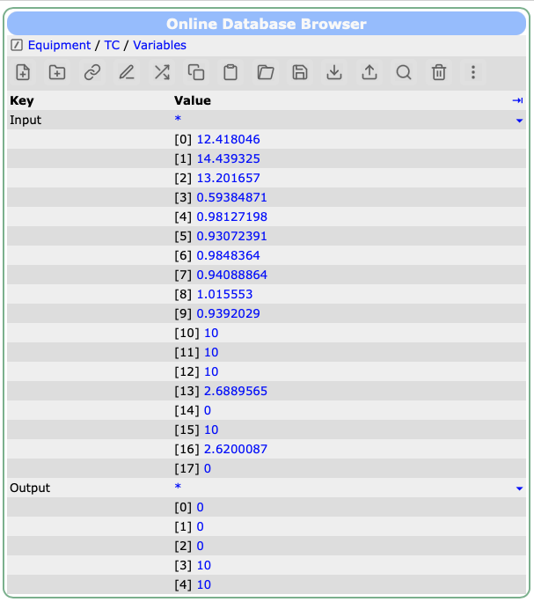
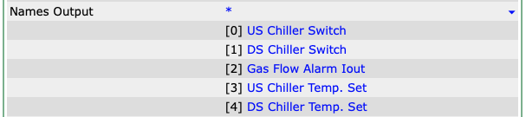
Old Equipment Pages

Slide 11
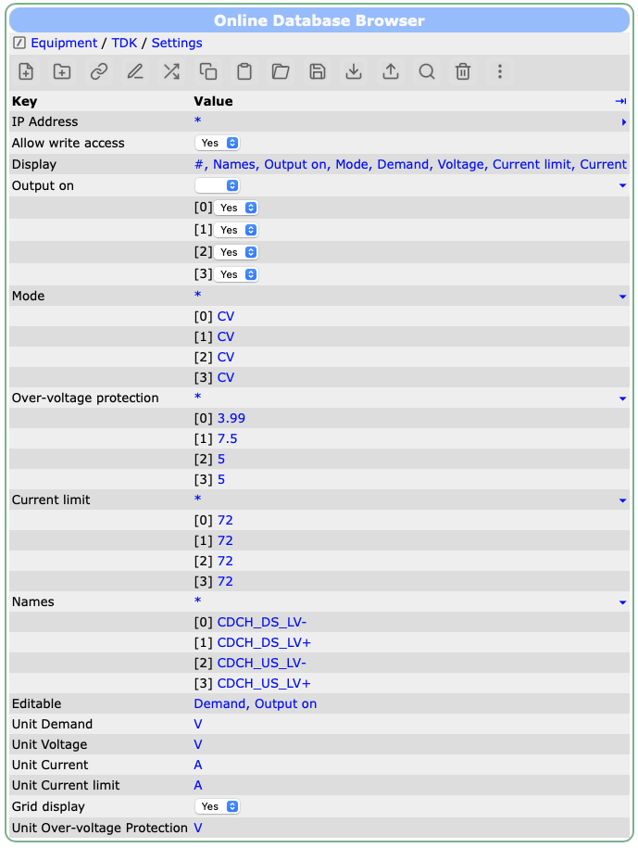
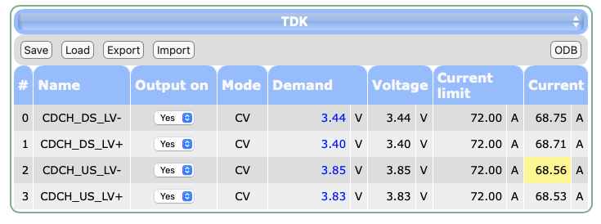
New Equipment Pages
Allow write access: User can change values
Display: Defined which settings and variables to display
Names: Names of “channels”
Editable: Name(s) of editable values
Unit XXX: Unit to display
Grid display: Display several values in one row

Slide 12
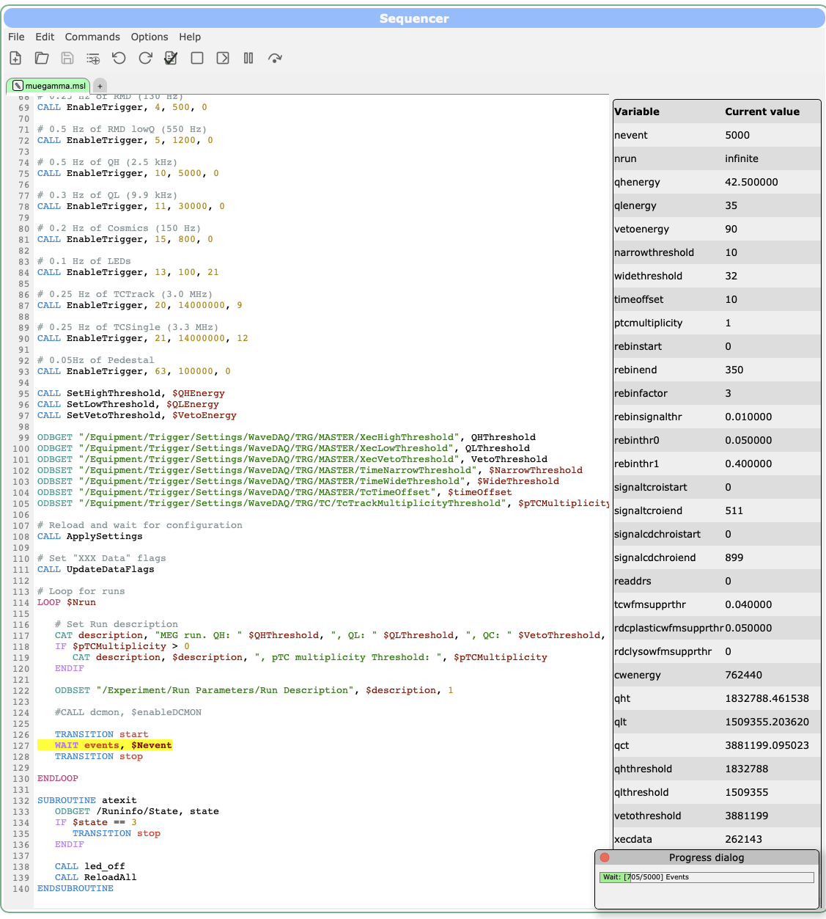
Sequencer Improvements
New sequencer commands
BREAK to exit a loop
ODBLOOKUP “/DIR/Names”, “CH02”, index → retrieve index for an array
ATEXIT subroutine gets called when sequencer gets stopped (automatic or manually)
New UI (many thanks to Zaher Salman)
Load/Save scripts from server ($MIDAS_DIR/userfiles/sequencer)
Syntax highlighting
Variable display
Tabs for multiple files
“Batch queue”

Slide 13
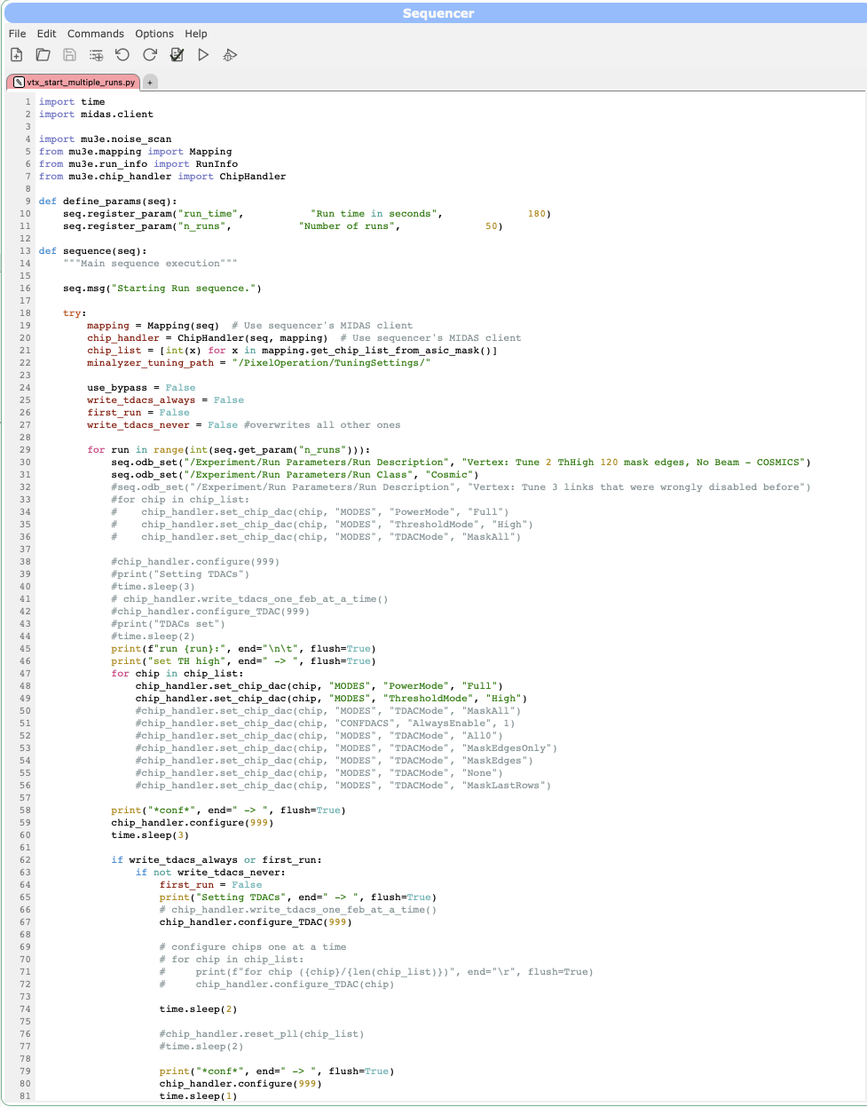
Sequencer limitations
MIDAS Scripting Language (MSL) is easy to learn, but limited
“Can we fit a I-V curve and save the result?”
PySequencer (many thanks to Ben Smith)
Same GUI and functionality as MSL
Full Python language including numpy, …
See detailed talk later by Ben
Already heavily used

Slide 14
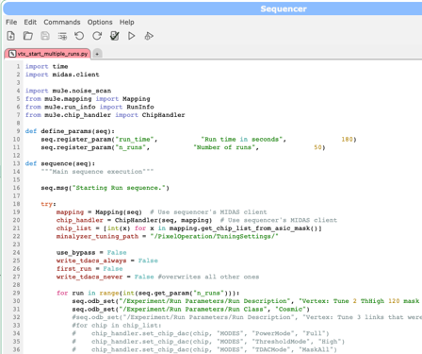
PySeqeuncer Vision
IDE to develop stand-along Python programs
Run Sequencer
Beamline Scans
Detector optimizations e.g. (I-V) curves
Slow Control (replace Labview)

Slide 15
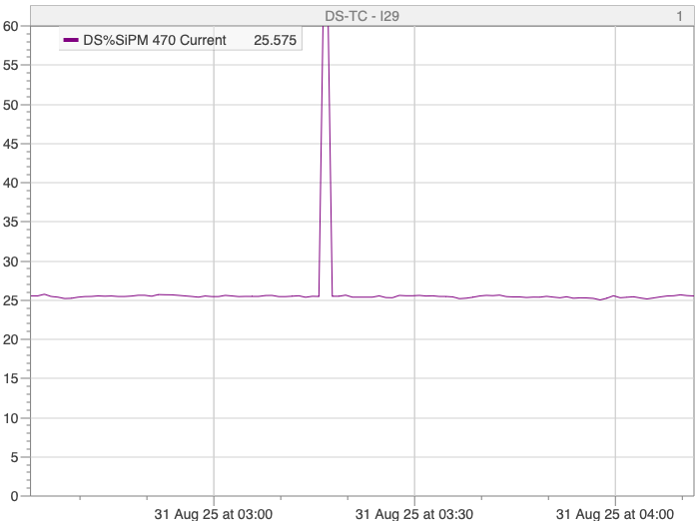
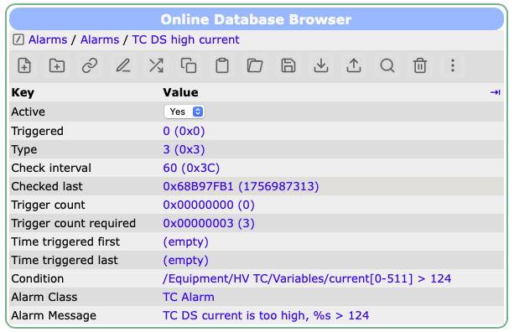
Alarm Improvements
Some slow control channels have “spikes”
Annoying when they trigger an alarm
Usually only 1-2 values above threshold
New setting “Trigger count required” fires trigger only after N consecutive alarm conditions
Alarm condition will be replaced by TinyExpr++ condition (planned, requires C++17): o(“/Equipment/TC/Variables/Curr[0]”)*1000 > 100 && o(“/Runinfo/State”) == 3 on(”/Equipment/TC/Variables/Curr”, “CH3”) > 100

Slide 16
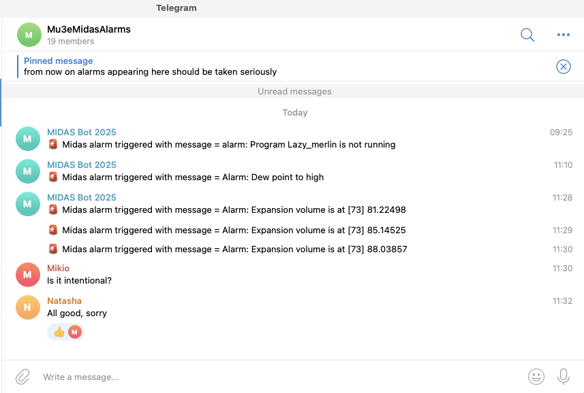
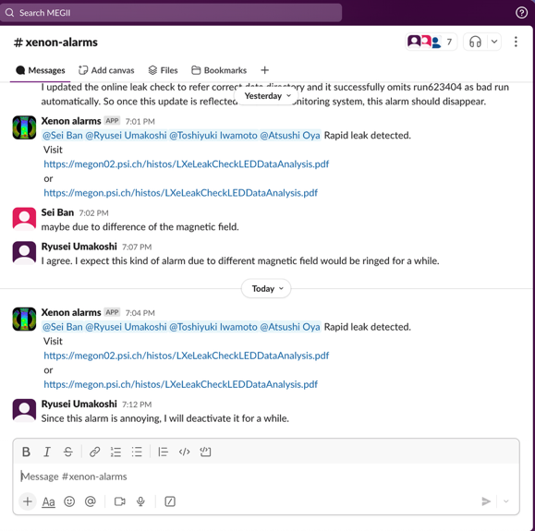
Alarm Notifications
In case an alarm happens, shift crew needs to be notified quickly
You don’t want to get notified when you’re not at the lab
Email not suitable
Shell scripts for Telegram, Mattermost, Slack
Channels can be muted 😉
https://daq00.triumf.ca/MidasWiki/index.php/Alarm_System

Slide 17
Custom Pages

Slide 18
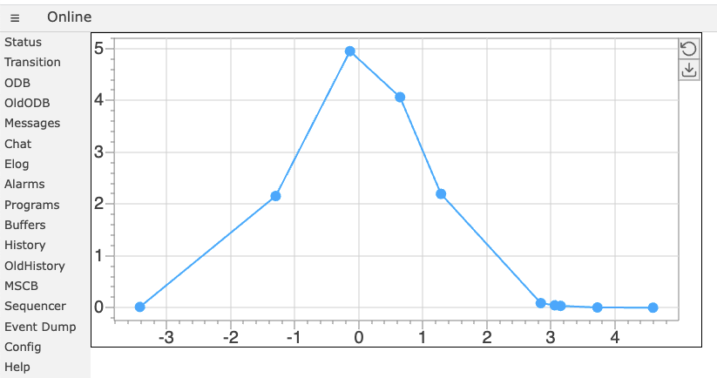
mplot library
History plots are only value over time, but what about X/Y and X/Y/Z (color plots)
mplot JavaScript library https://daq00.triumf.ca/MidasWiki/index.php/Custom_plots_with_mplot
<div class="mplot" style="height: 360px;width: 700px;"
data-odb-path="/Path/To/Data"
data-x="X" data-y="Y">
</div>
Fully interactive
Zoom and pan
Inspect individual values
PNG / CSV download

Slide 19
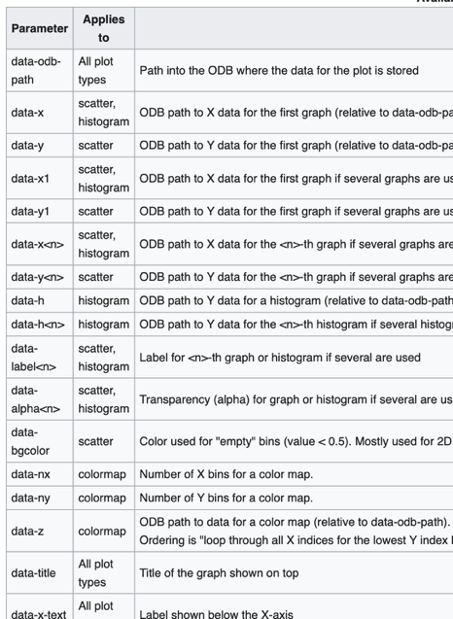
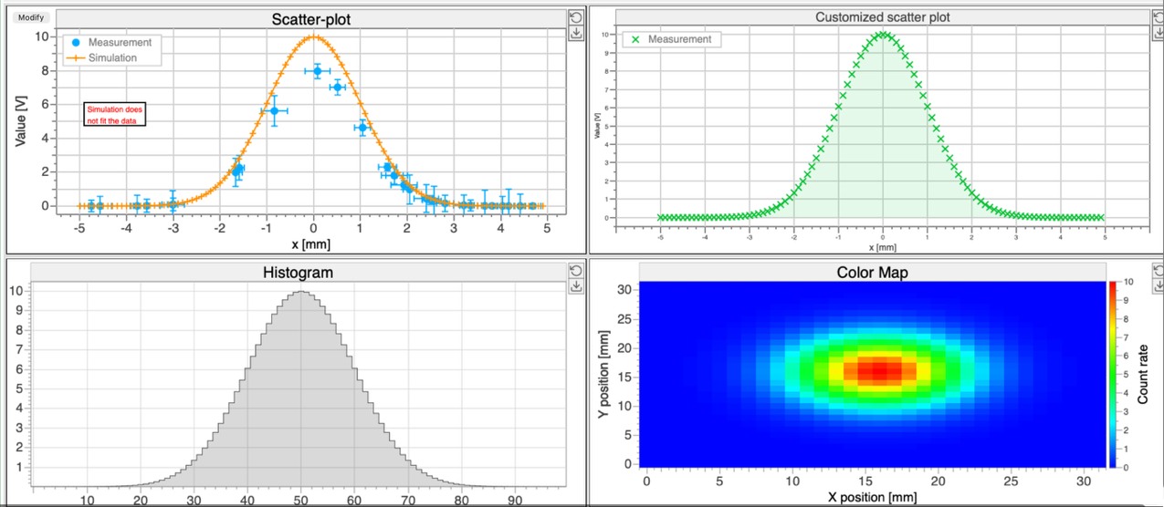
mplot examples
Help → plot_example.html
TBD:
error bars (X & Y)
time X-axis
category X-axis

Slide 20
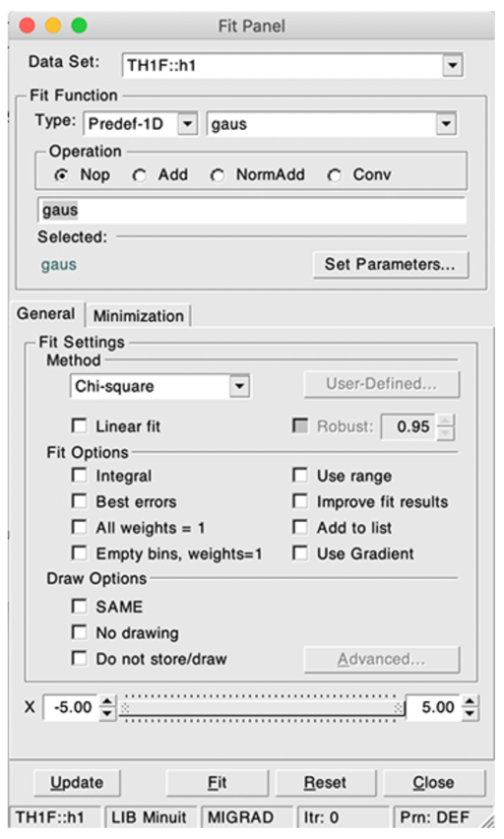
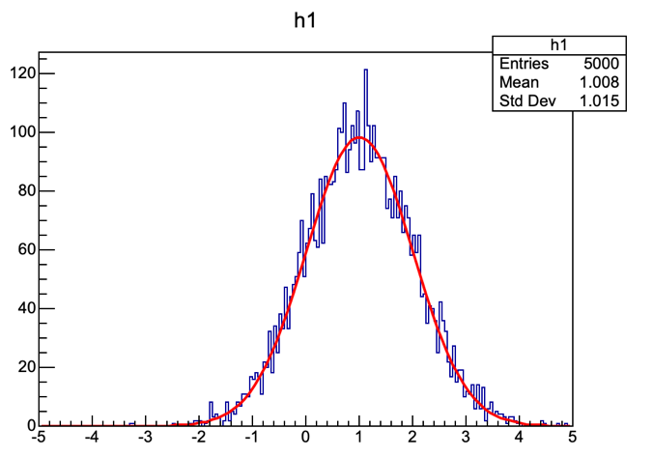
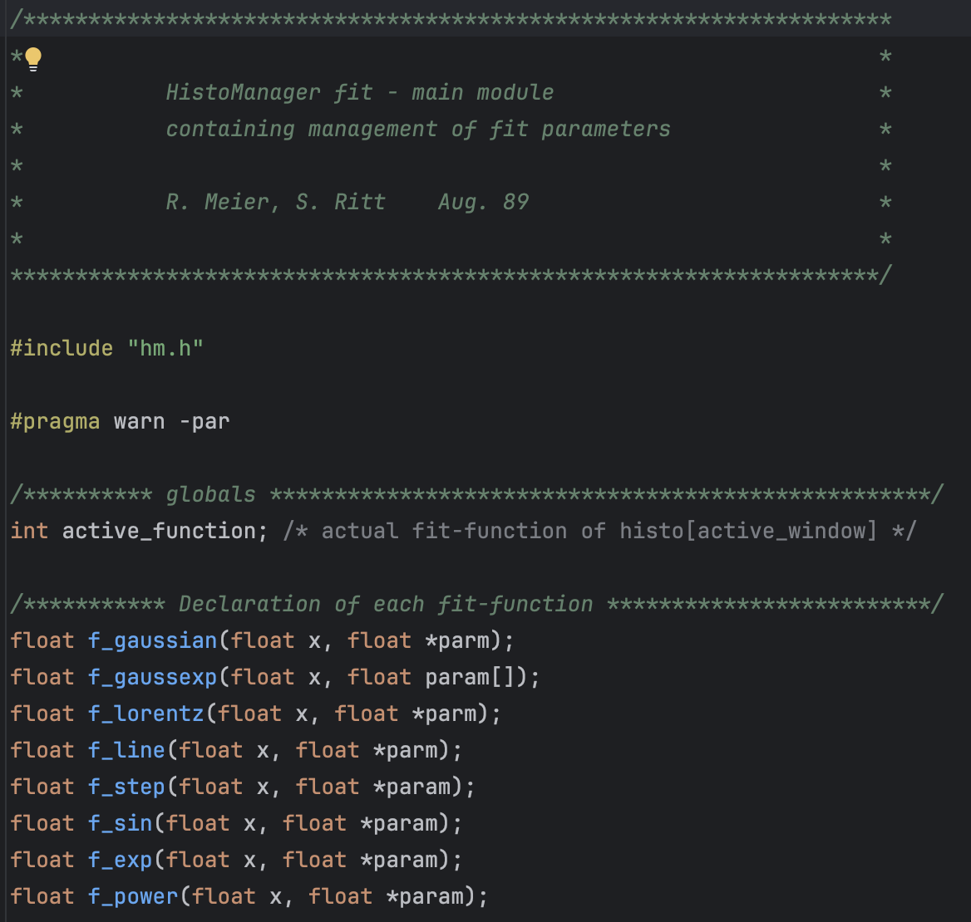
mplot fit similar to JSRoot → TBD

Slide 21
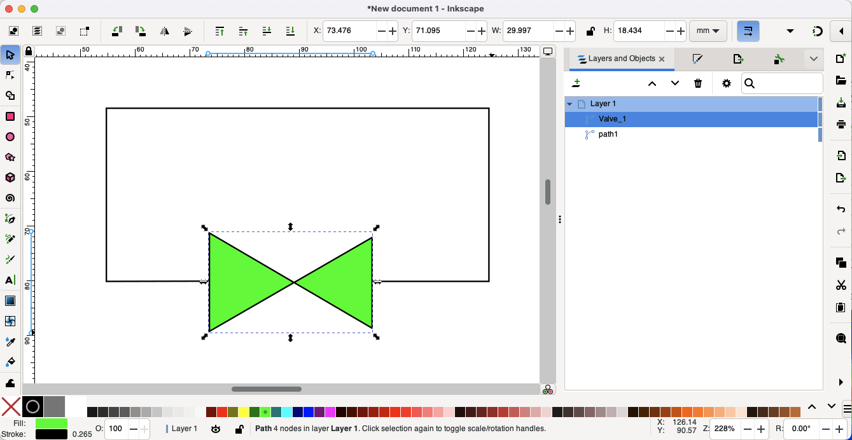
SVG graphics
Use free Inkscape to produce complicated schematics

Slide 22
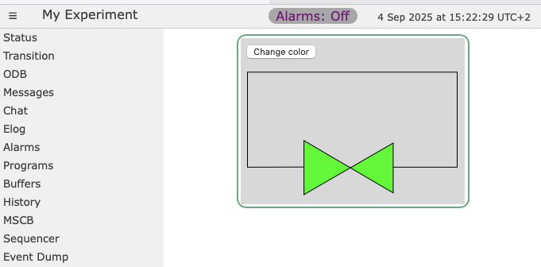
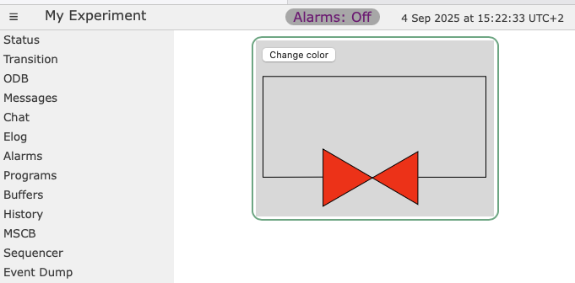
SVG graphics manipulation
<button onclick="change()"> Change color </button><br />
<object id="svgObject" type="image/svg+xml" data="valve.svg" />
<script> function change() { doc = document.getElementById('svgObject').contentDocument; const obj = doc.getElementById('Valve_1'); obj.style.fill = "#FF0000"; }
</script>

Slide 23
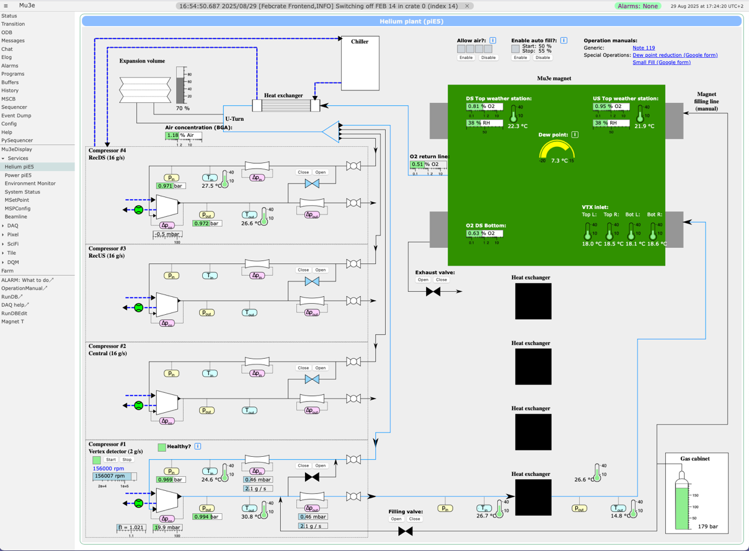
Custom Page Gallery
modbbutton
SVG
modbgauge
modbthermo
modbbox
modbhbar

Slide 24
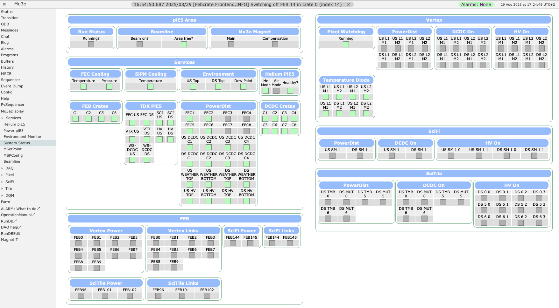
Custom Page Gallery

Slide 25
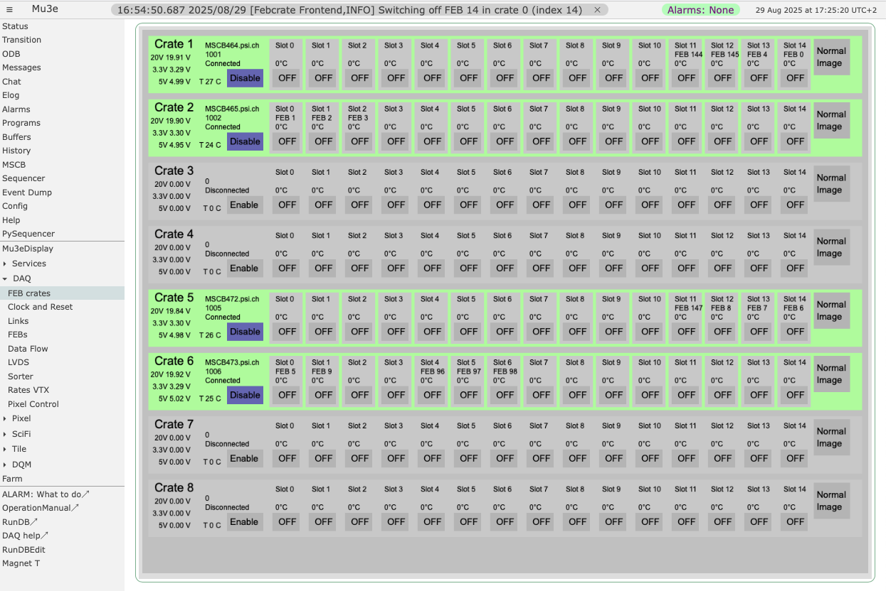
Custom Page Gallery
Style Guide?

Slide 26
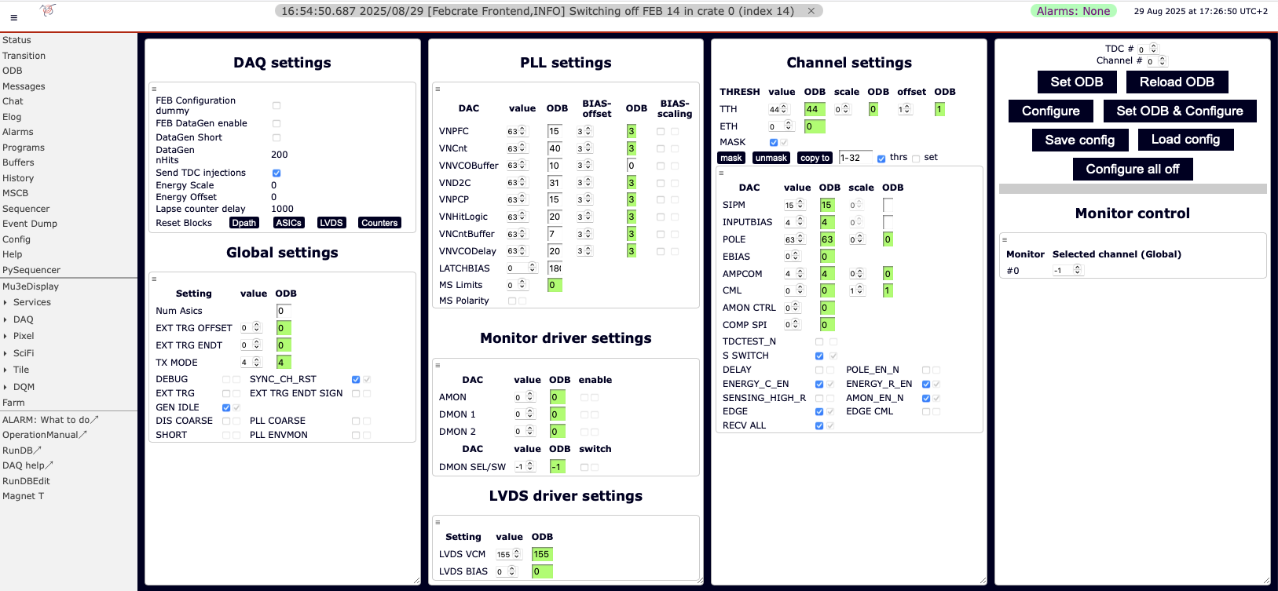
Custom Page Gallery
Style Guide?

Slide 27
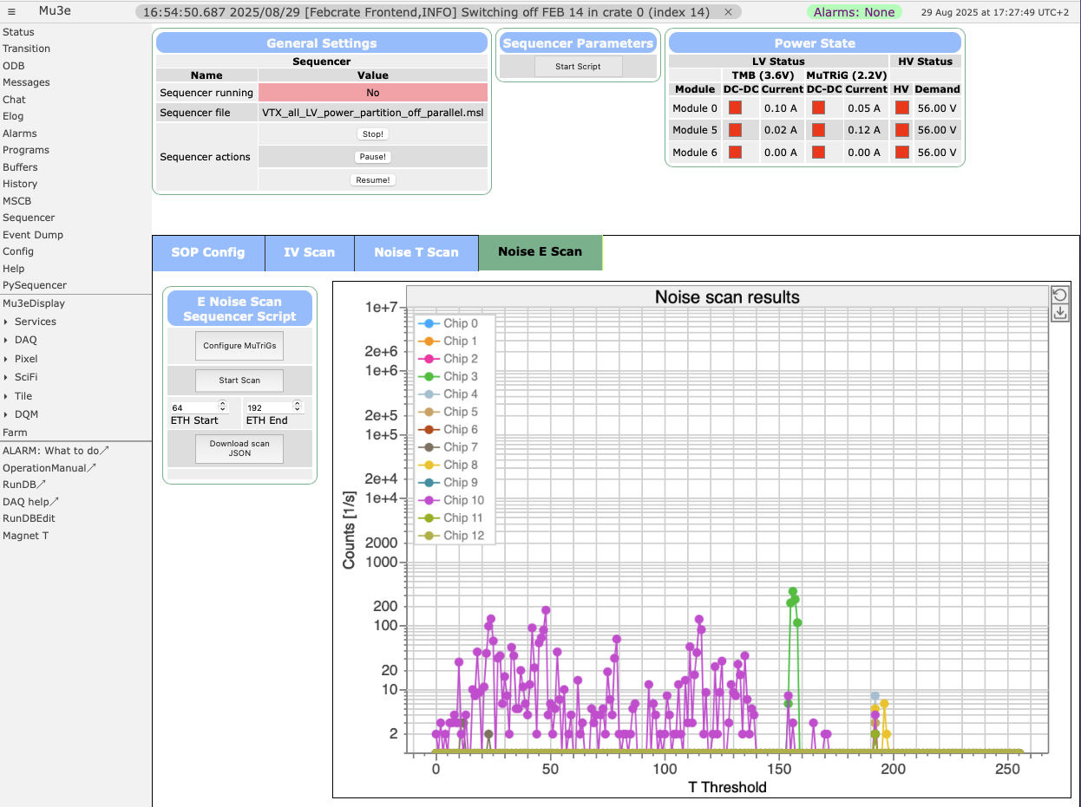
Custom Page Gallery
Noise Scan

Slide 28
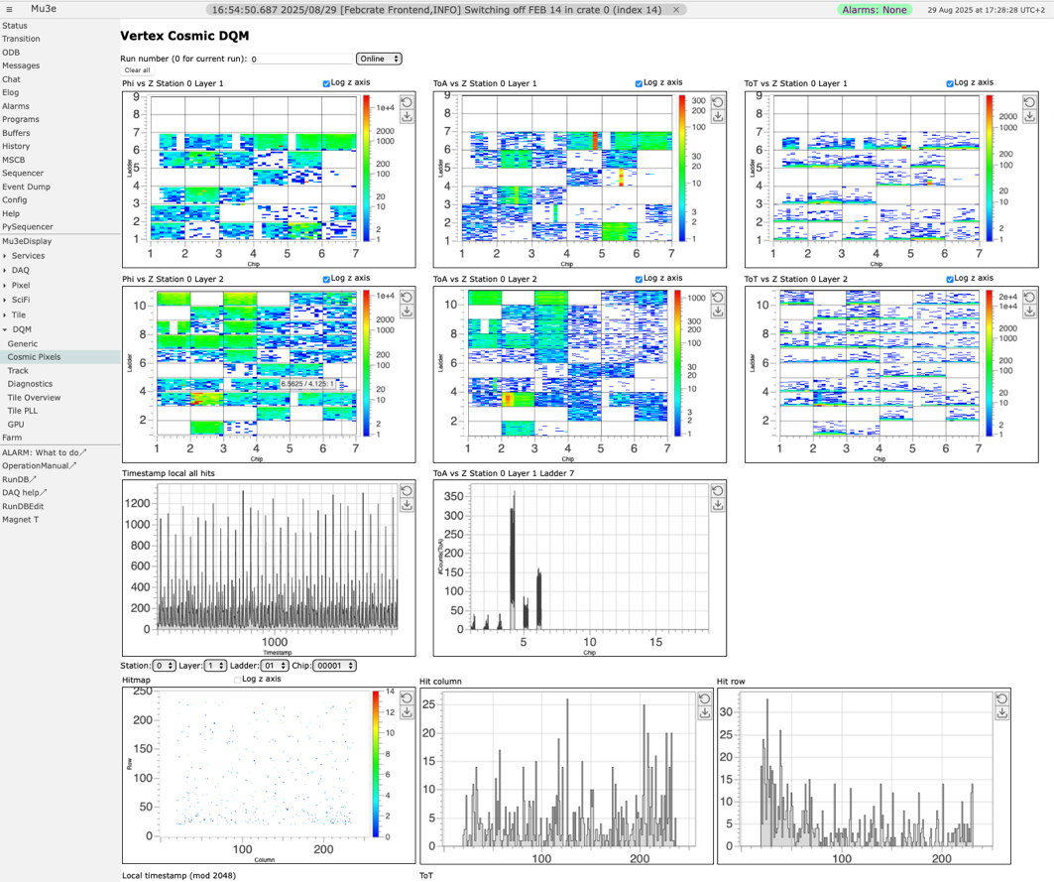
Custom Page Gallery
mplot data-z (colormap)
mplot data-h

Slide 29
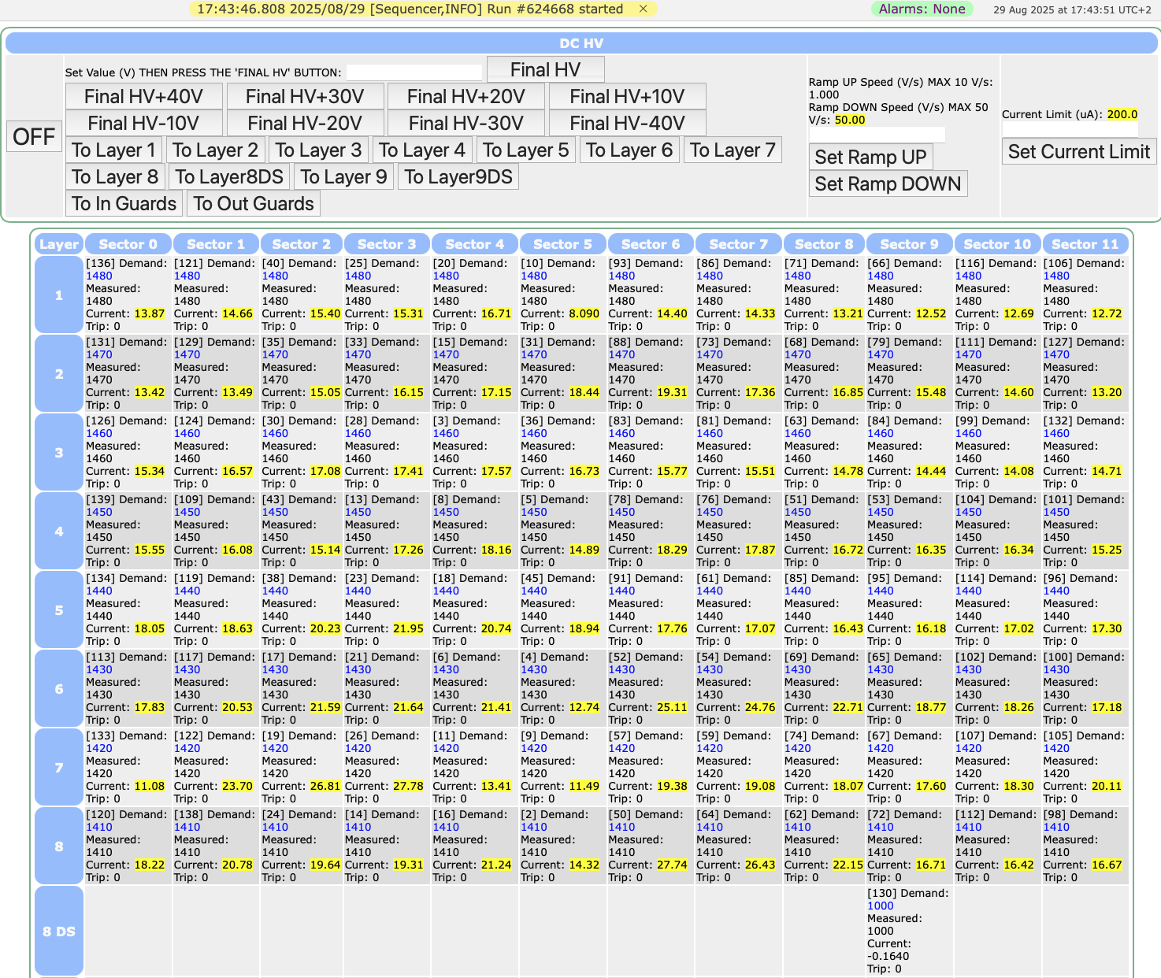
Custom Page Gallery
Bad example!

Slide 30
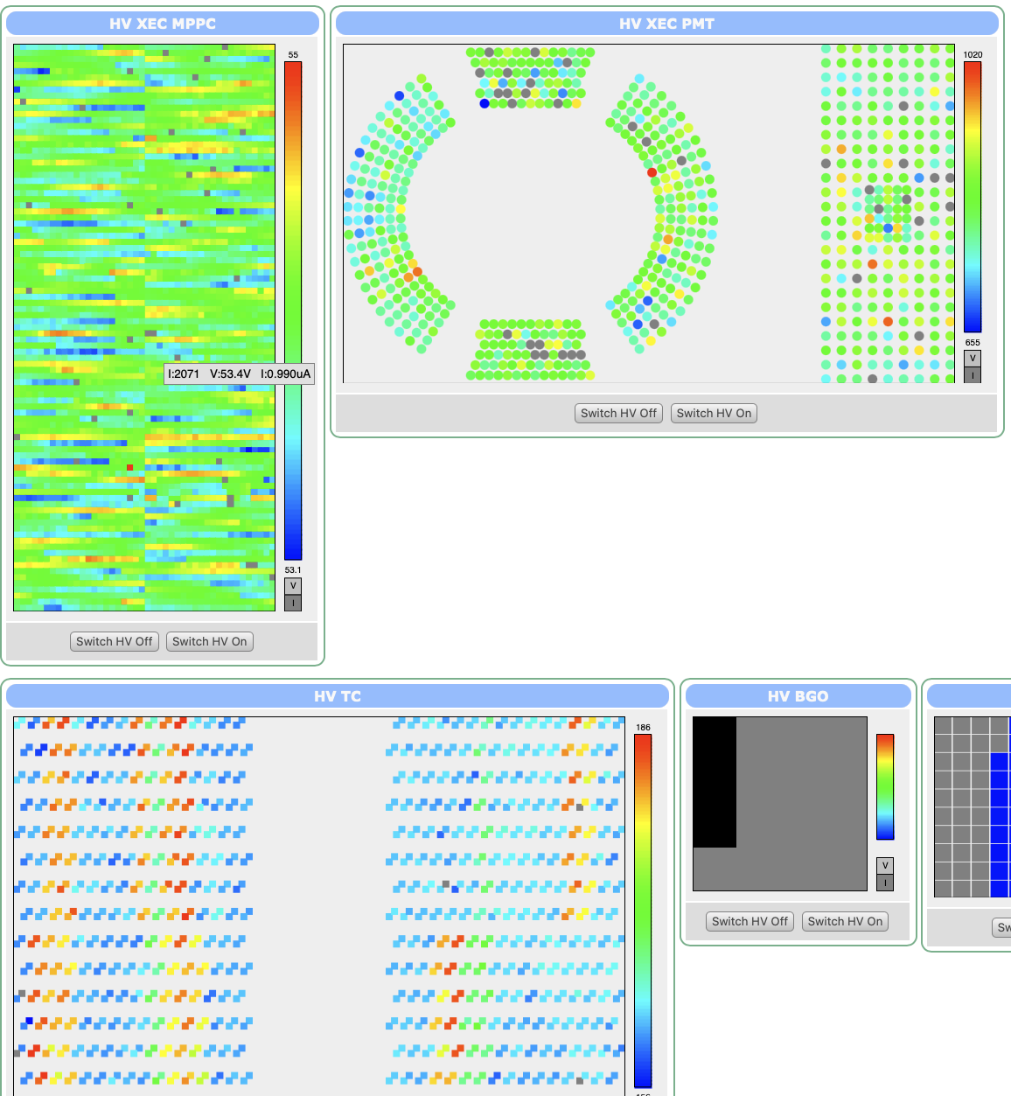
Custom Page Gallery
<canvas> +
mjsonrpc_db_get_values()

Slide 31
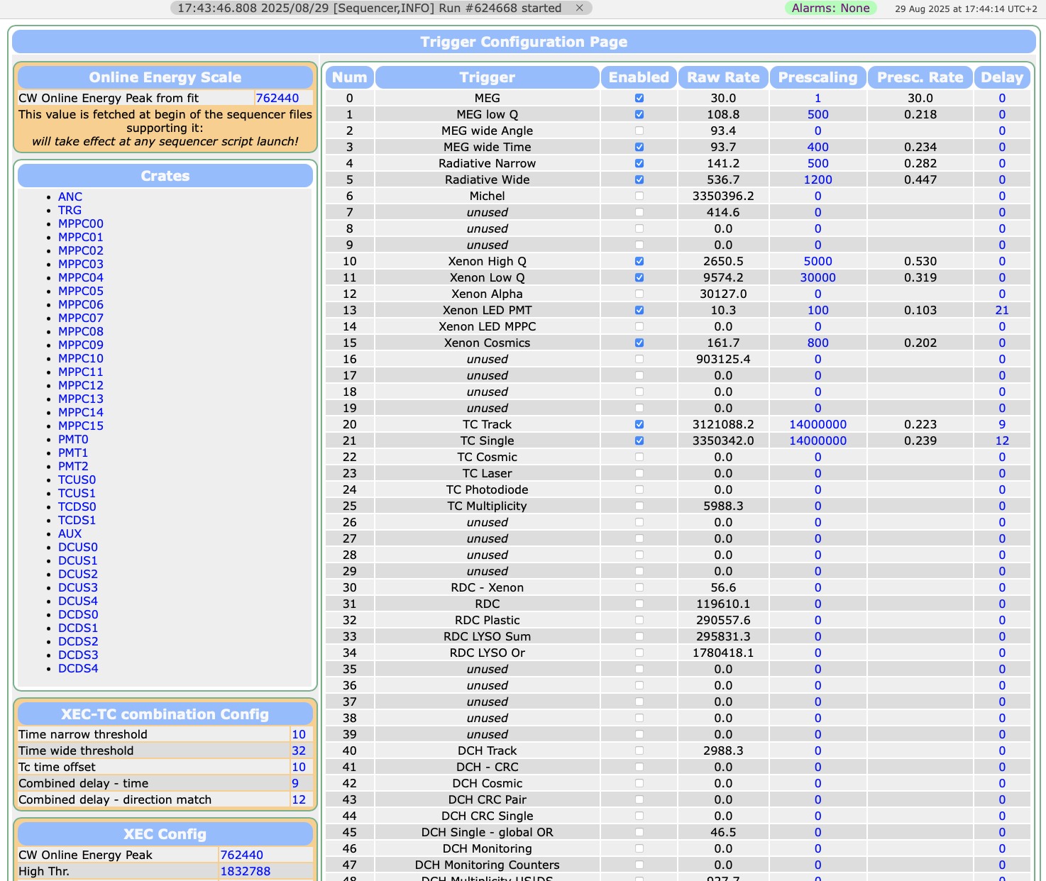
Custom Page Gallery

Slide 32
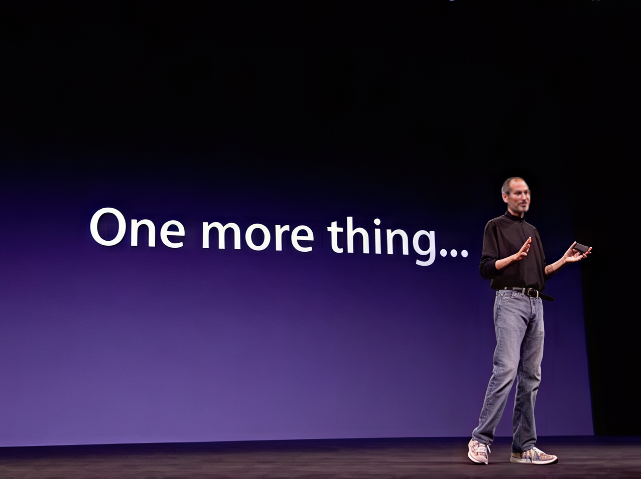

Slide 33



Slide 34
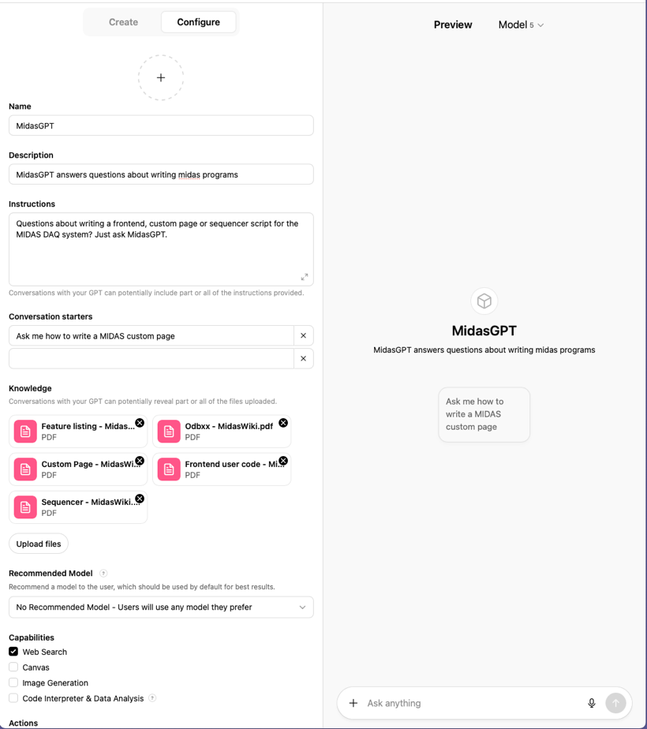

MidasGPT
Standard ChatGPT “knows” midas since it was trained with the public documentation
New midas features are usually not in training set
GPTs allow “special” versions of ChatGPT having PDF files in its context
MidasGPT contains PDF dumps of midas Wiki → https://chatgpt.com/g/g-68b1cce155a48191bb5df1b2919bdaf4-midasgpt

Slide 35
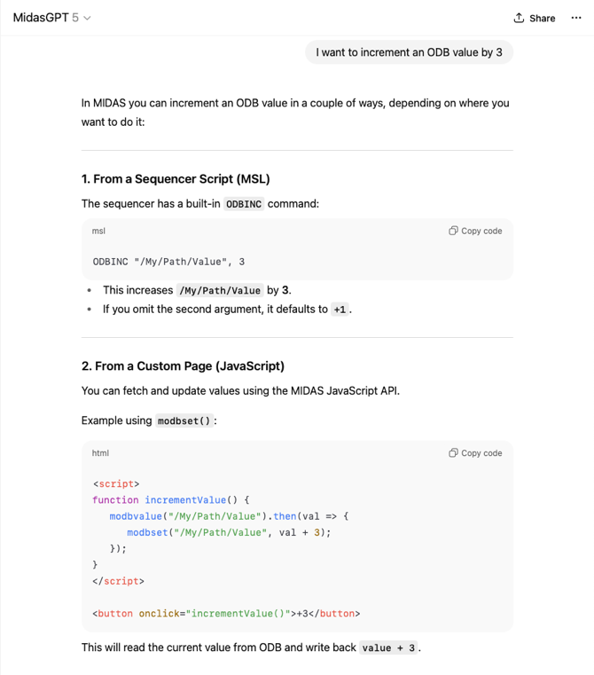
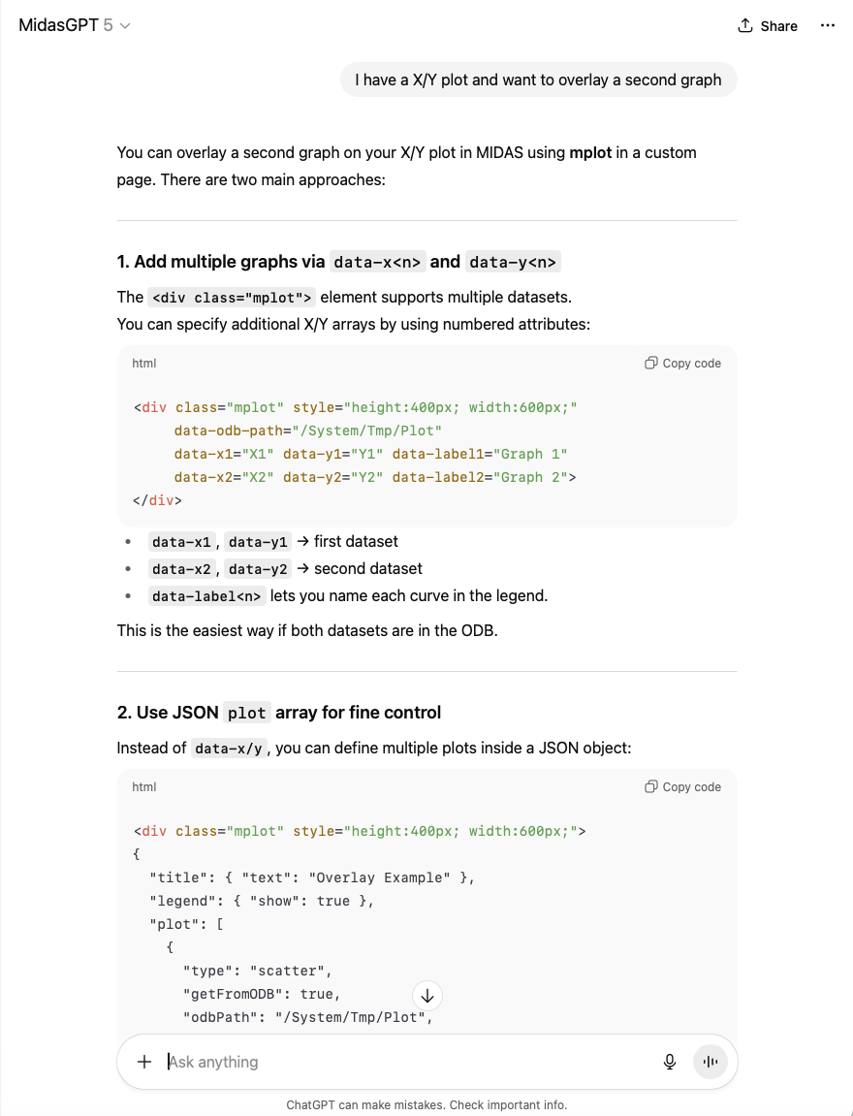
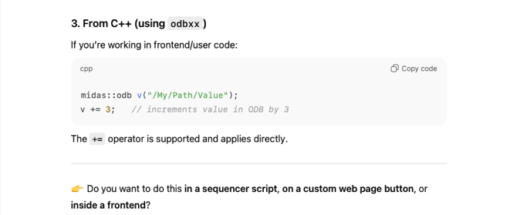

Slide 36
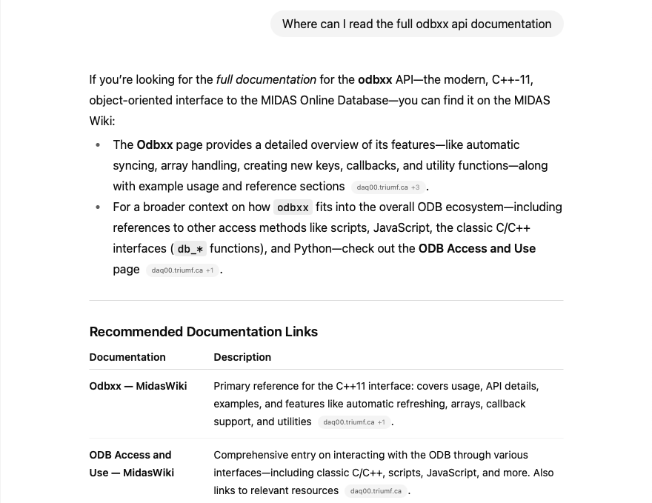
Links back to Midas Wiki

Slide 37
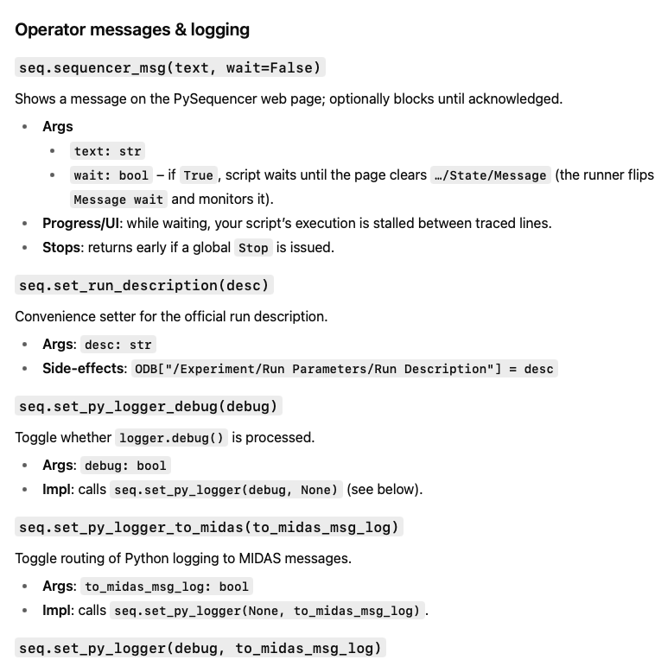

Python Sequencer Documentation upload sequencer.py and ask for API docs

Slide 38


Example MidasGPT generated PySequencer script

Slide 39


Two more things: What’s new?

Slide 40

Two more things : What’s new?

