Slide 1
7904 Update
AWI Dept meeting
Leonardo Sala
05 May 2025

Slide 2
SLS2
Storage:
Started new data storage gradual rollout to Phase I beamlines, including improvement in security (kerberized NFSv4)
Name space and access according to confluence page
Working on user documentation
Compute:
Soon work on procuring compute resources (within new ETHZ server framework contract)
Requirements still unclear, but some numbers from Tomcat to be confirmed by Oliver
Waiting for DAQ specs from Controls
Finalizing work on dynamic compute nodes
Integration of Pilatus at PX
Network:
Infiniband and Ethernet upgrade to 200G

Slide 3
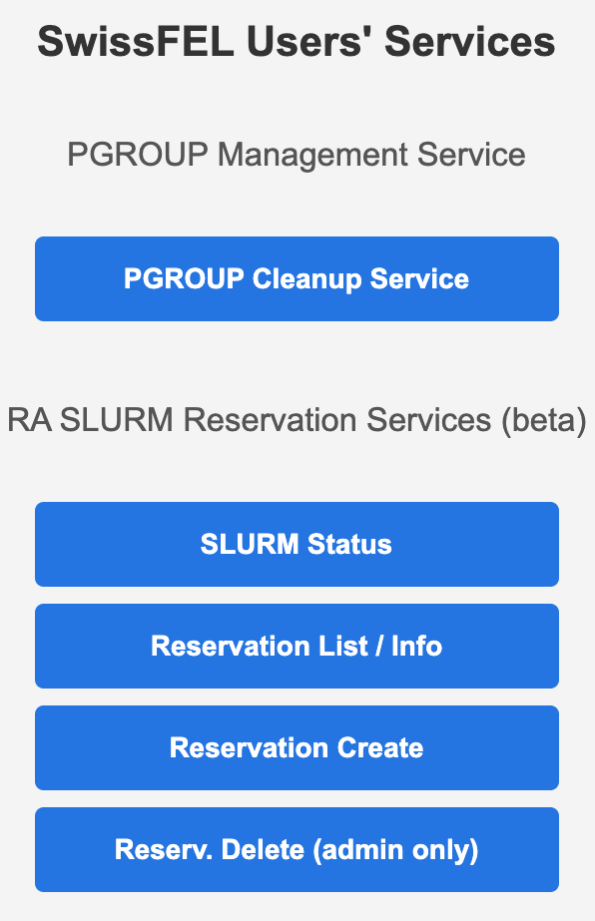
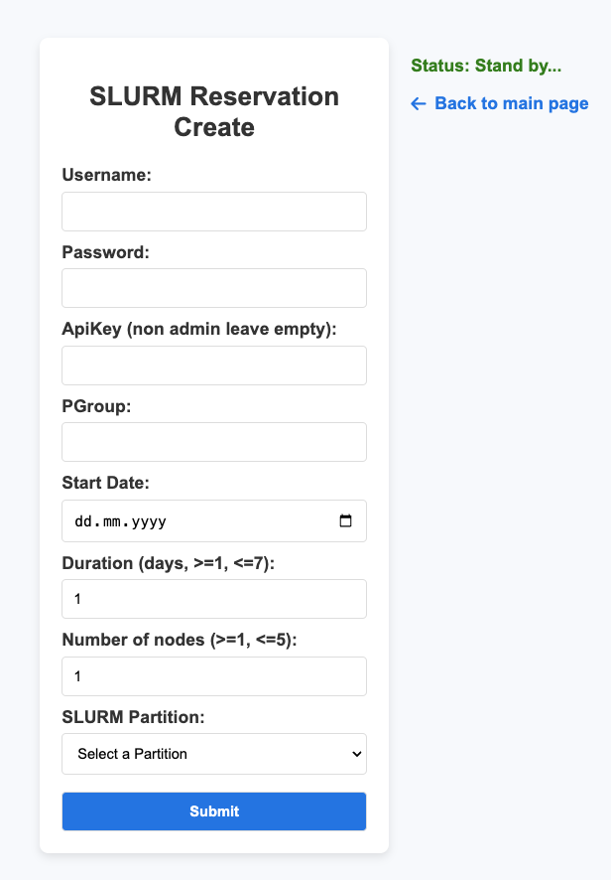
Operations
Storage:
Preparing main storage upgrade in August, tests on Lenovo systems
Ra resource API:
Automatic checks and emails for expired temporary quotas
Self-service for SwissFEL SLURM reservation creation

Slide 4
Varia
Future SwissFEL Storage
  Evaluation of not expensive solution to keep BUFFER @SF, and write experimental data on RA (IB connection SF<->WHGA to be evaluated; already tested Eth connection with good results, ~380 Gbps)
  Identified possible solutions, to be discussed between us and with PSD
Talks
  Talk at "Interactive and Urgent computing" workshop during ISC 25 (June): "A novel approach to dynamic computing using Slurm"
  Talk at IBM Storage Scale user group during ISC 25: "A site update from PSI"

Slide 5
Thanks to everybody!

