Slide 1

Cryogenic pulsating heat pipes for efficient cryocooler-based HTS magnets
Speakers: Quentin Gorit^{1,2}, Cees Maris^{1,2} and Carolin Zoller¹
Co-authors: André Brem¹, Michal Duda¹, Henrique Garcia Rodrigues¹, Jaap Kosse¹, Rebecca Riccioli¹, Stéphane Sanfilippo¹, and Yannik Studer¹
1) Department of Accelerator Technology, Paul Scherrer Institut, 5232 Villigen PSI, Switzerland
2) VDL ETG Technology & Development B.V., De Schakel 22, 5651 GH, Eindhoven, The Netherlands
PSI CAS Seminar, Villigen, 26 June 2025

Slide 2
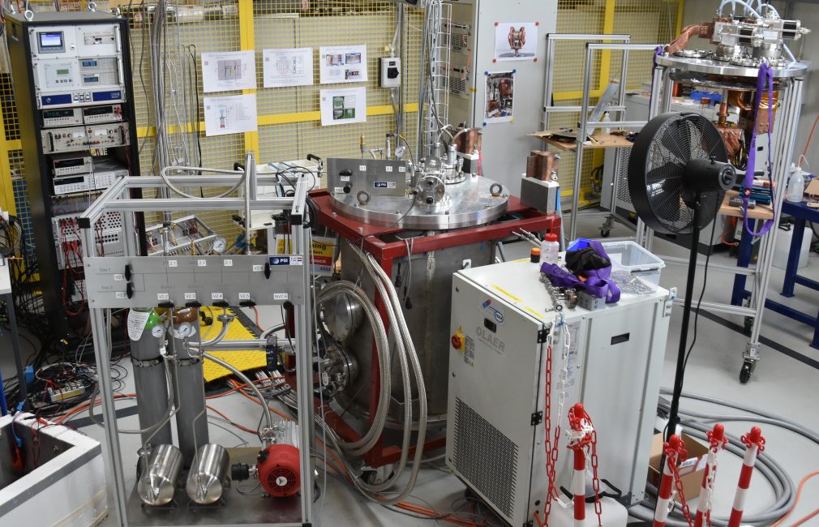

Outline
Context and motivation
Pulsating heat pipes
Experimental set-up
Characterization
Model and visualization
Application
Conclusion and outlook
Cryocooler-based test facility for superconducting magnets and advanced cryogenics
2
PSI CAS Seminar
26.06.2025

Slide 3
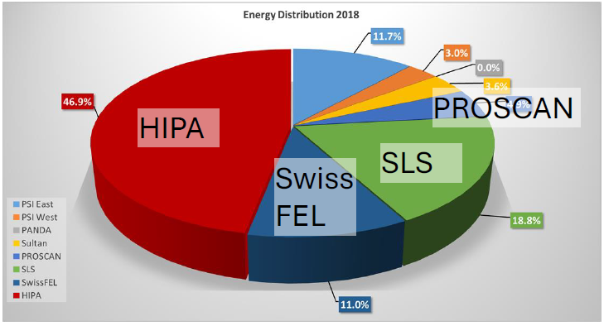
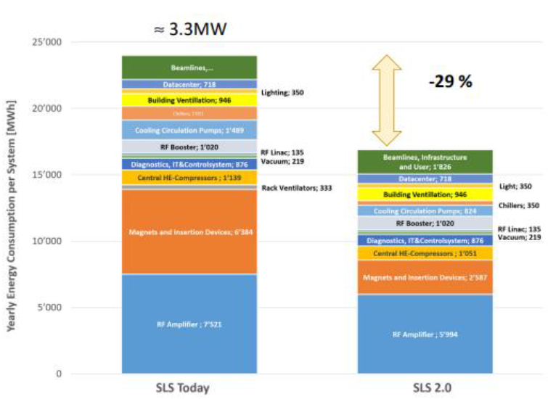

Context: PSI Large Research Facilities
High energy demand of PSI Large Research Facilities
Strong contribution from resistive magnets to power consumption (HIPA 2.6 MW, 26 %)
Aim: magnet performance ↑ energy demand ↓
Example SLS $→$ SLS2:
  Higher performance
  Magnet energy consumption reduced by ~60% using permanent magnets

Slide 4
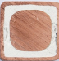
Context: PSI Large Research Facilities
High energy demand of PSI Large Research Facilities
Strong contribution from resistive magnets to power consumption (HIPA 2.6 MW, 26 %)
Aim: magnet performance ↑ energy demand ↓
Example HIPA (IMPACT=HiMB+TATTOOS):
  Higher performance
  HiMB energy consumption increased by factor 6
    70 % of the power comes from special radiation-hard cables
    Permanent magnets not possible due to radiation
    Important to find other solutions in high radiation environment
    Idea to use high temperature superconducting (HTS) magnets
MgO
Cu

Slide 5
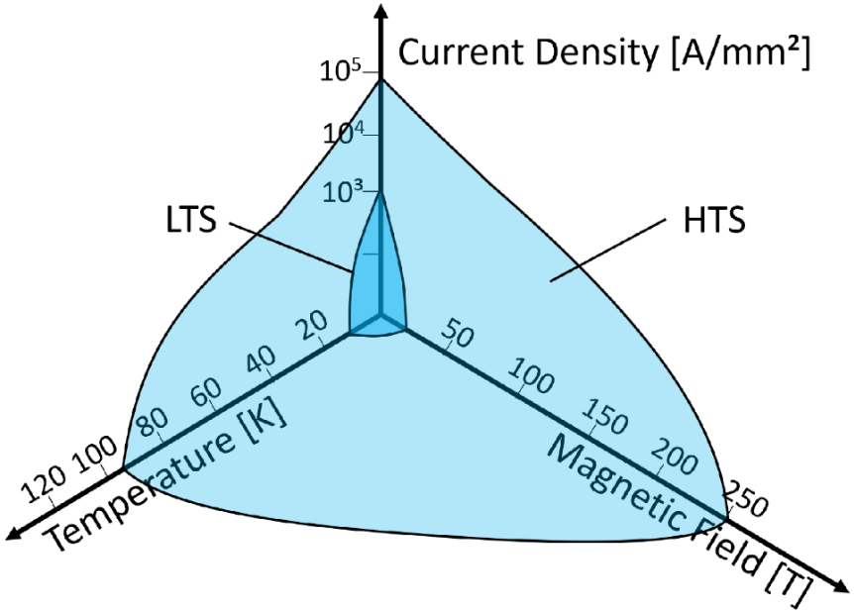
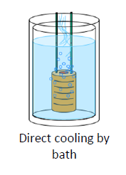
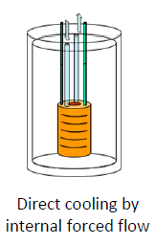
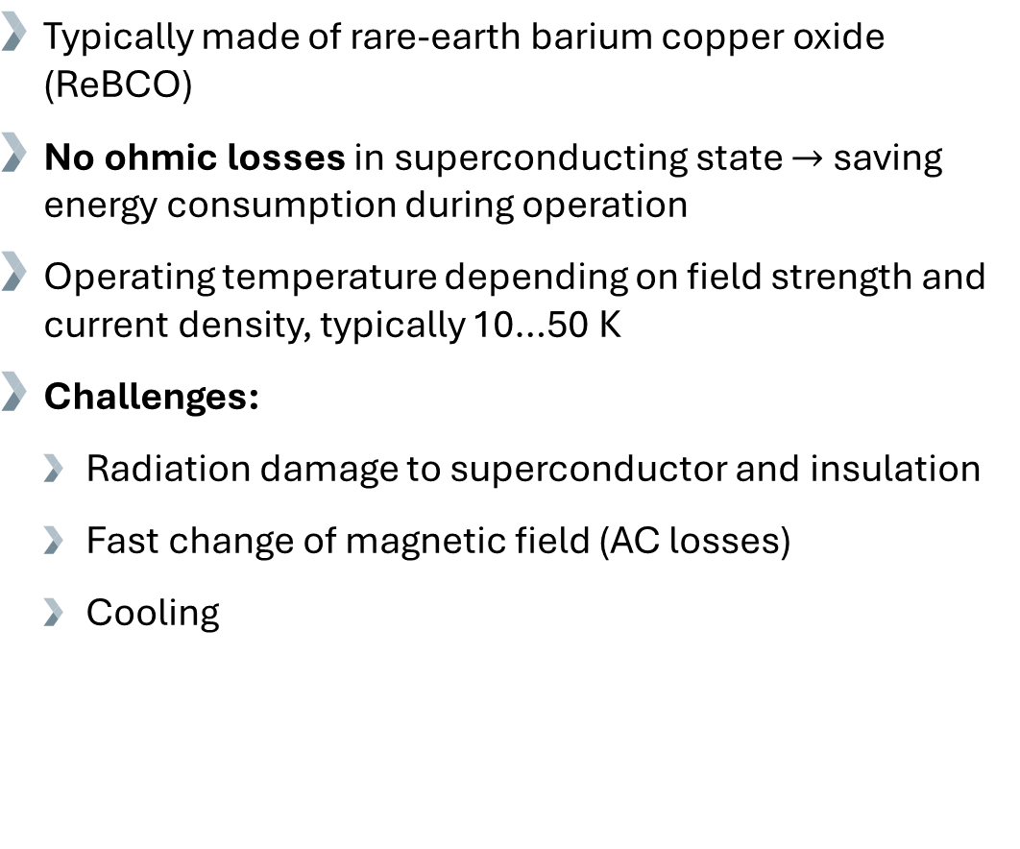
Context: High temperature superconducting (HTS) magnets
Typically made of rare-earth barium copper oxide (ReBCO)
No ohmic losses in superconducting state $→$ saving energy consumption during operation
Operating temperature depending on field strength and current density, typically 10…50 K
Challenges:
  Radiation damage to superconductor and insulation
  Fast change of magnetic field (AC losses)
  Cooling
Liquid bath Forced flow Cryocooler
Cryocooler
  SMILE initiative
Copper bars and braids
Superconducting coil
5
26.06.2025
Courtesy B. Baudouy

Slide 6
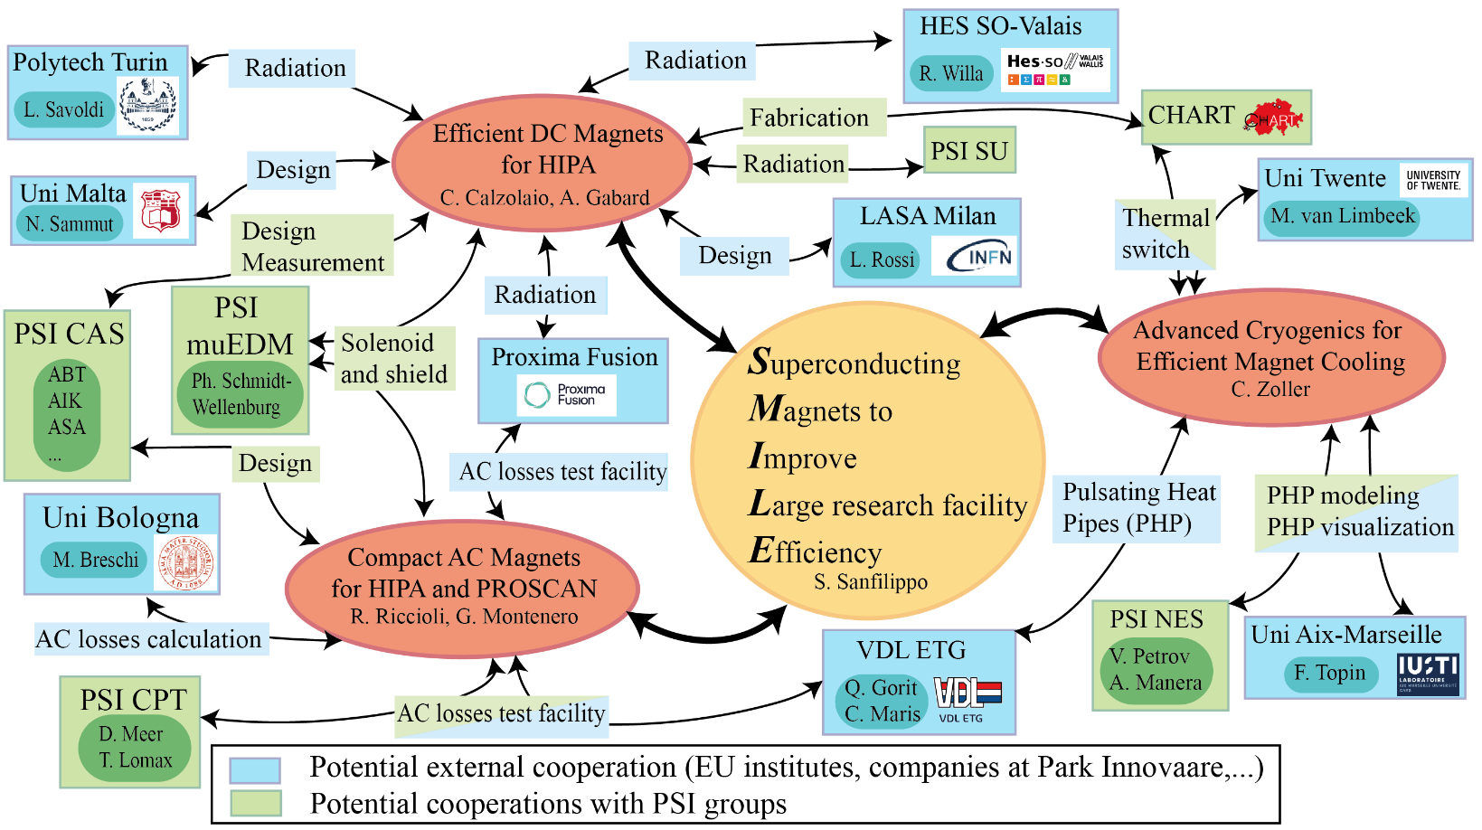
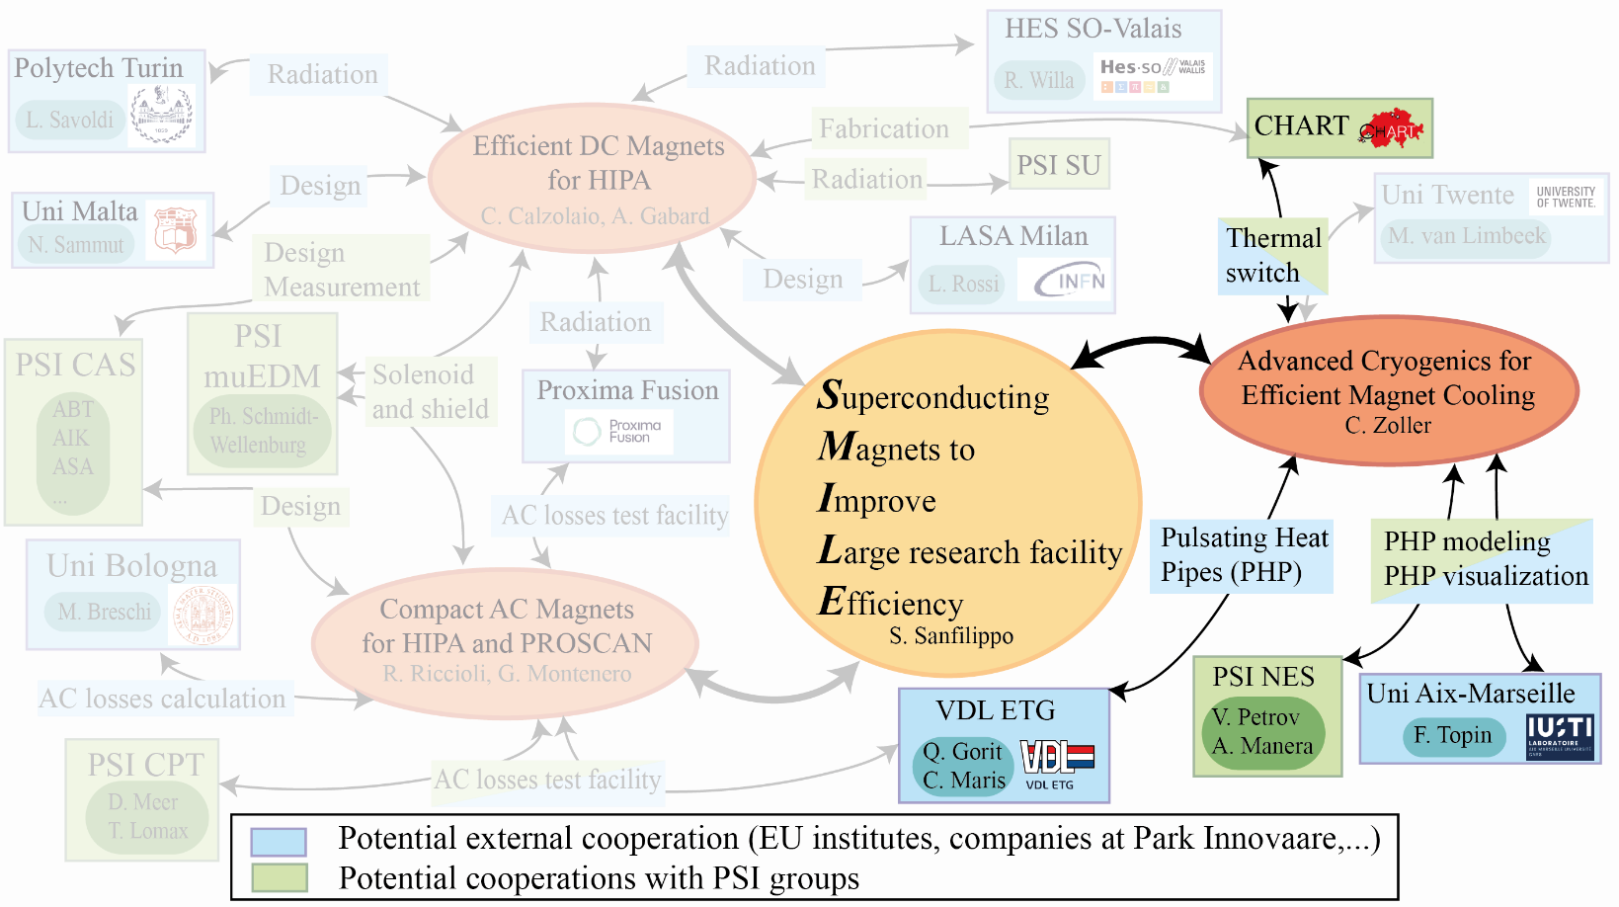
Context: SMILE initiative
Aim of PSI SMILE (Superconducting Magnets to Improve Large Research Facility Efficiency):
  Improve the performance of superconducting AC and DC magnets with/without radiation
  Develop smart cryogenic systems integrated with highly efficient cryocoolers
For Pulsating Heat Pipe (PHP) project, established collaborations with:
  VDL ETG (since 2023): Design and manufacturing, characterization, application
  VDL ETG, PSI NES and IUSTI/Aix-Marseille University (since 2024): Visualization and modelling
6
PSI CAS Seminar
26.06.2025

Slide 7
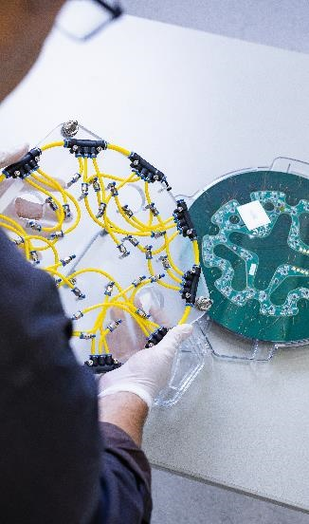
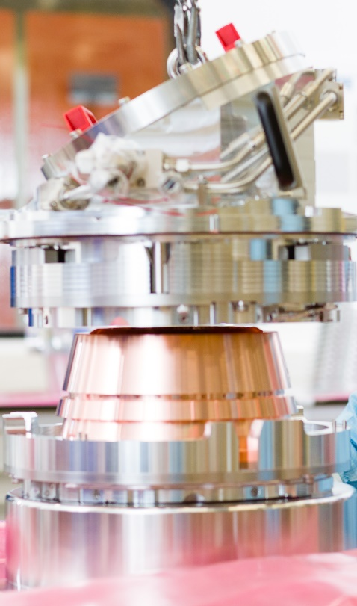
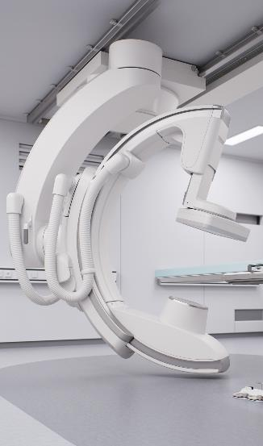
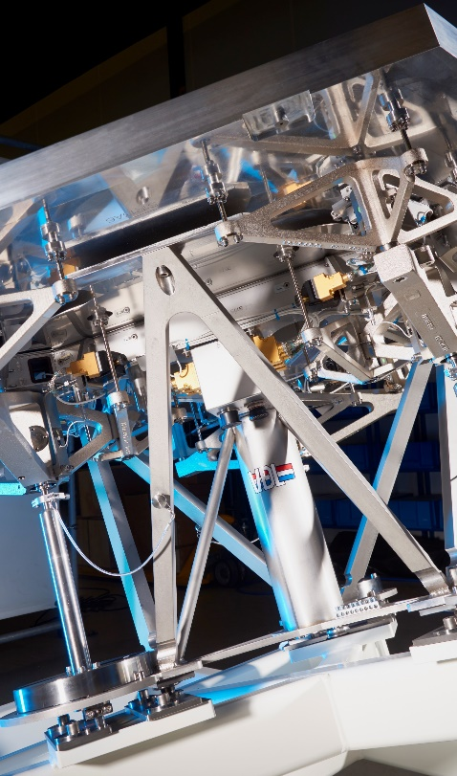
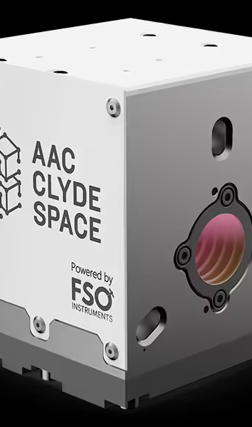
VDL ETG at Park Innovaare
VDL Enabling Technologies Group:
A global development and manufacturing company, in the field of high-tech systems and modules which designs, develops, manufactures, and produces complex components and systems.
Semiconductor Capital Equipment
Analytical Equipment
Medical Equipment
Science & Industry
Space
7
PSI CAS Seminar
26.06.2025

Slide 8
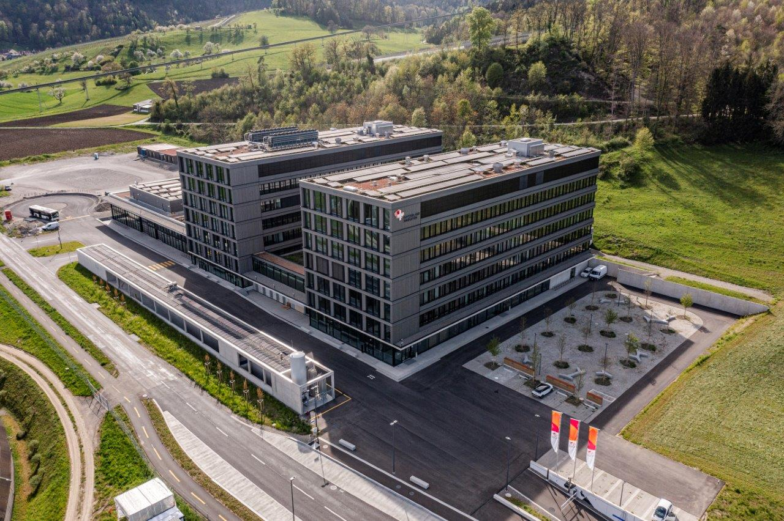

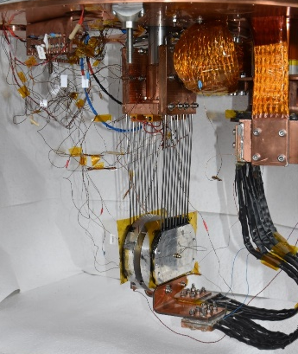
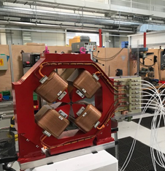
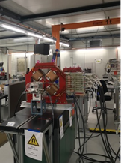
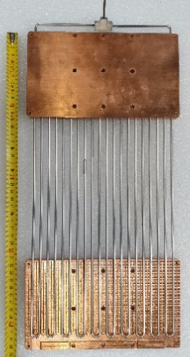
VDL ETG at Park Innovaare
R&D in advanced cryogenics:
Development of pulsating heat pipes (PHP) for an efficient, lightweight, passive, autonomous thermal link and switch operating in no-gravity, high-magnetic-field and high-radiation environments.
R&D in magnetic measurements:
Development of magnetic field measurement methods, for precise and industrial magnetic lens validations
Contact our people at PiA for your project Engineering, Modeling and Manufacturing!
8
PSI CAS Seminar
26.06.2025

Slide 9
Motivation
Trend: Cryocoolers increasingly favored over traditional immersion bath cooling for superconducting (SC) components
Challenge: Transport heat efficiently, with possibility of thermal switch, from SC coil or current leads to cryocooler
State of the art: Copper links (heavy, bulky)
Cryocooler
Copper braids
?
Copper blocks
SC coil
9
26.06.2025

Slide 10
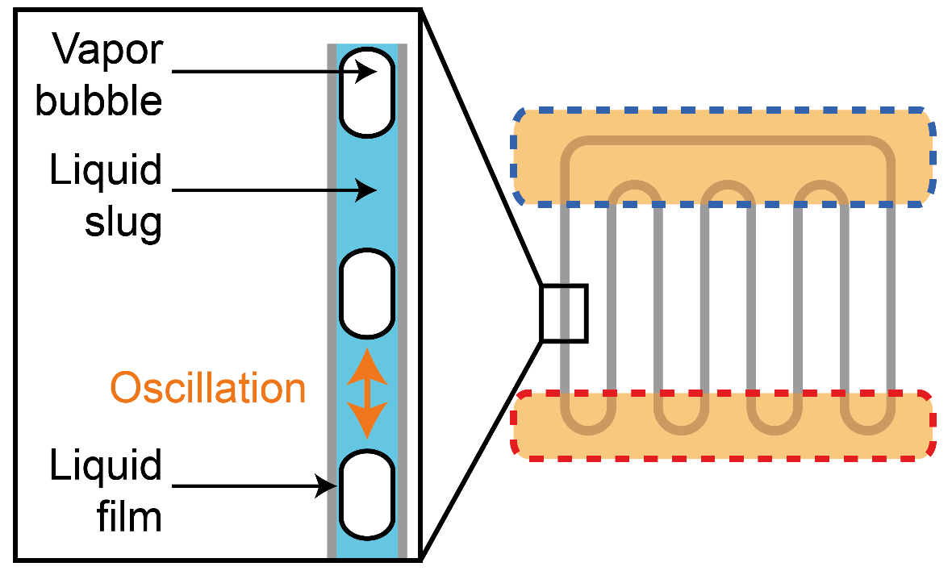
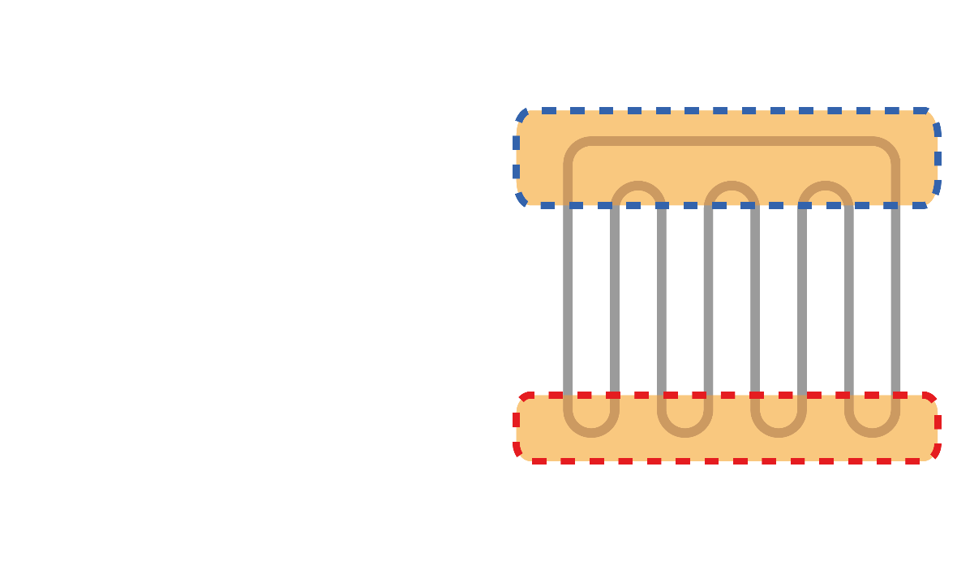
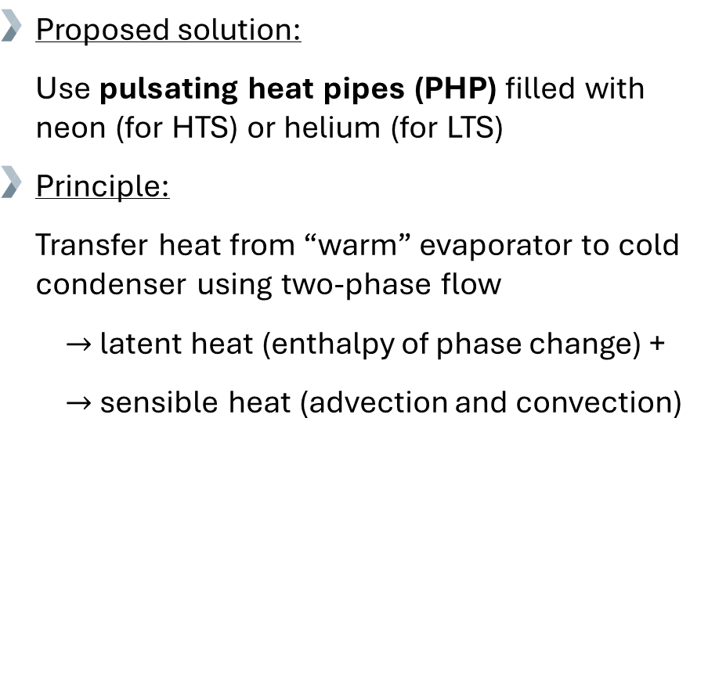
Motivation
Trend: Cryocoolers increasingly favored over traditional immersion bath cooling for superconducting (SC) components
Challenge: Transport heat efficiently, with possibility of thermal switch, from SC coil or current leads to cryocooler
State of the art: Copper links (heavy, bulky)
Cryocooler
Proposed solution:
  Use pulsating heat pipes (PHP) filled with neon (for HTS) or helium (for LTS)
  Principle:
  Transfer heat from “warm” evaporator to cold condenser using two-phase flow
$→$ latent heat (enthalpy of phase change) +
$→$ sensible heat (advection and convection)
PHP
SC coil
10
26.06.2025

Slide 11
Outline
Context and motivation
Pulsating heat pipes
Experimental set-up
Characterization
Model and visualization
Application
Conclusion and outlook
Cryocooler-based test facility for superconducting magnets and advanced cryogenics
11
PSI CAS Seminar
26.06.2025

Slide 12
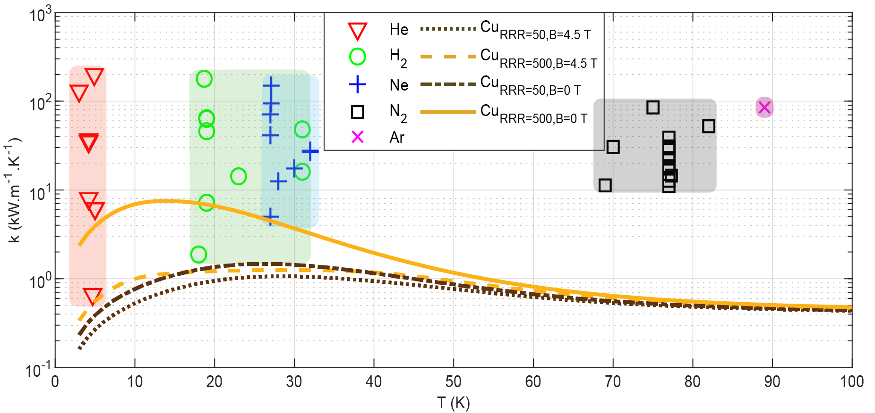
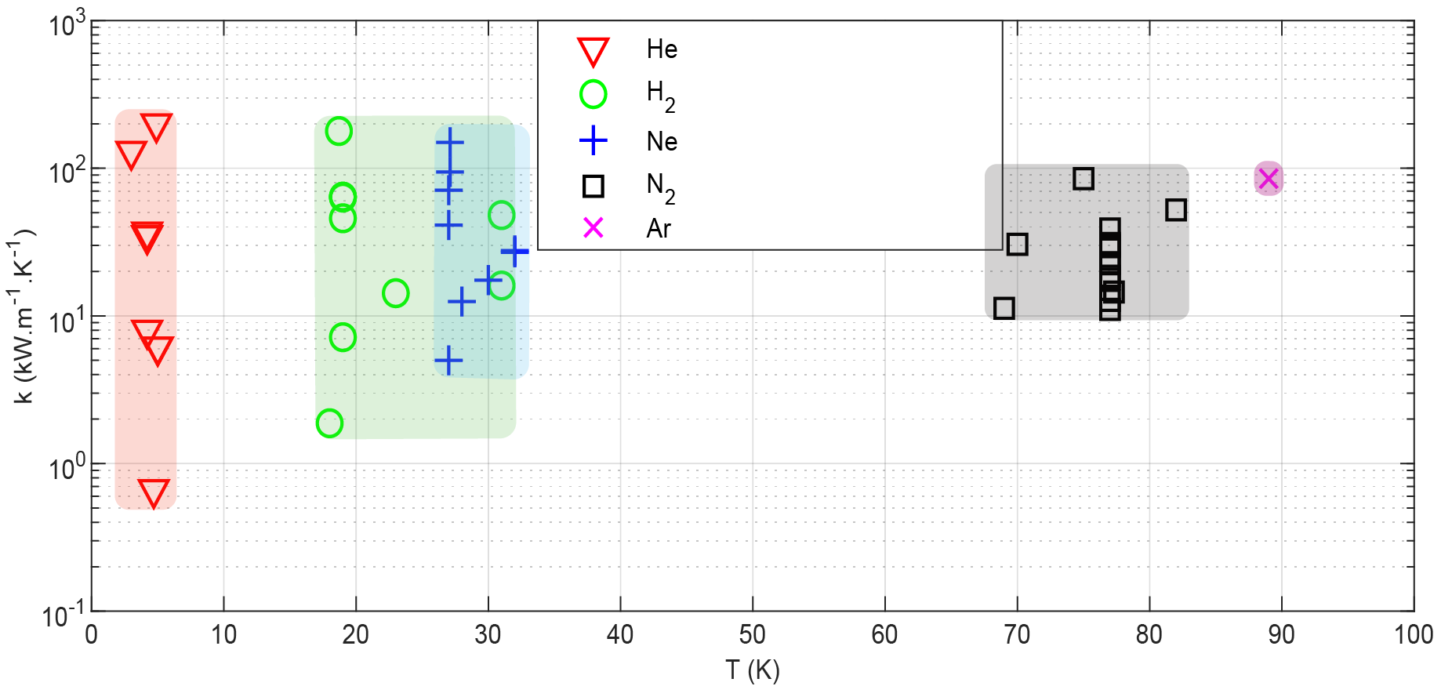



Literature on cryogenic PHPs
PHPs are experimentally studied under cryogenic conditions since 2007: ~50 papers and 2 PhD manuscripts from 8 different working groups (USA, China, Japan, France, India, Switzerland).
$$k_{PHP,Ne}≅150k_{Cu}$$
$$k=\frac{\dot{Q_{e}} L}{ΔT A}$$
Maximum effective thermal conductivity of different PHPs from literature and comparison to copper thermal conductivity against temperature
Q. Gorit, J.C. Maris and C. Zoller, 2025, Experimental characterization of neon pulsating heat pipes for cryocooler-based HTS magnets. Cryogenics.
Several orders of magnitude can be gained on the thermal conductivity of a thermal link by replacing solid copper by PHPs.
Neon is a promising working fluid for cooling HTS since it provides a good balance between PHP and superconductor performances.
12
5th Superconducting Magnets Test Facility Workshop (SMTF 5)
26.06.2025

Slide 13
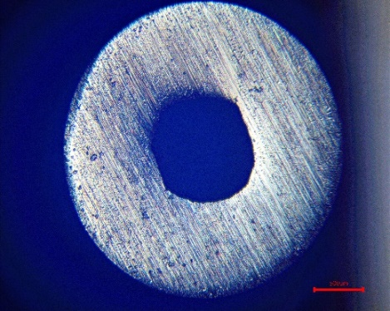

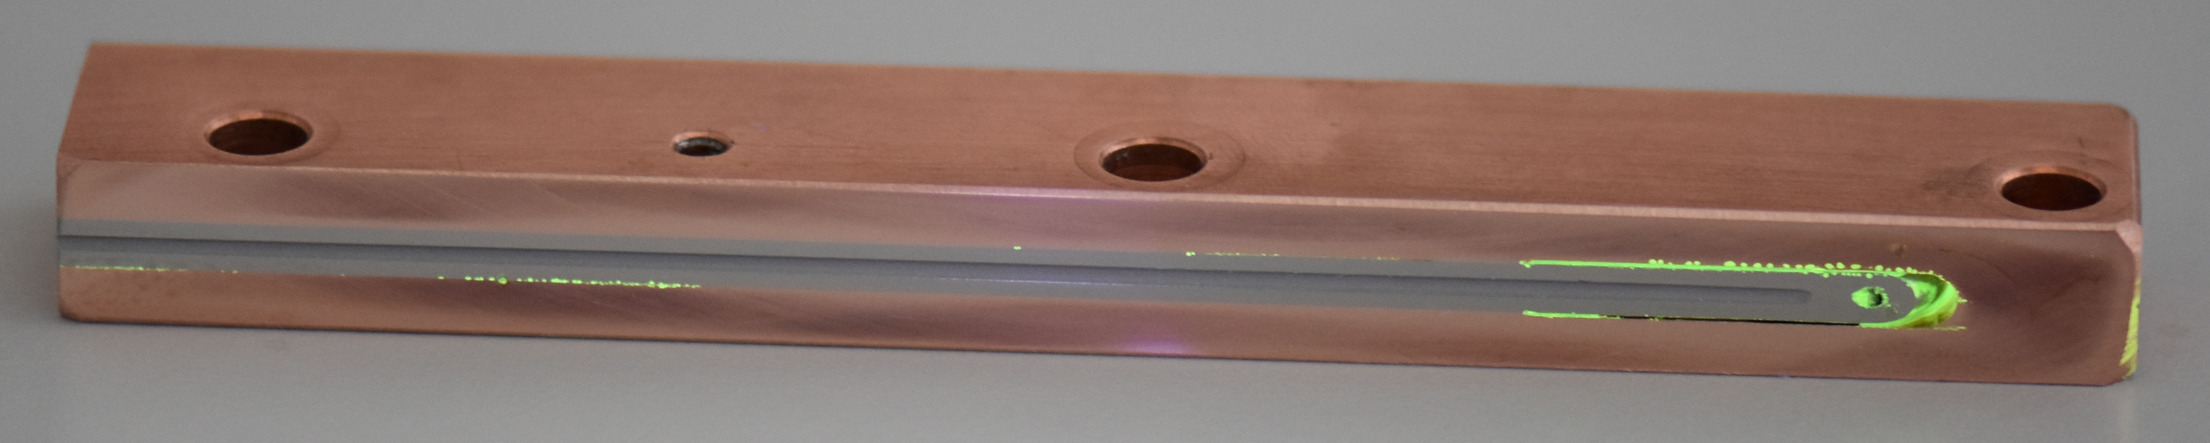

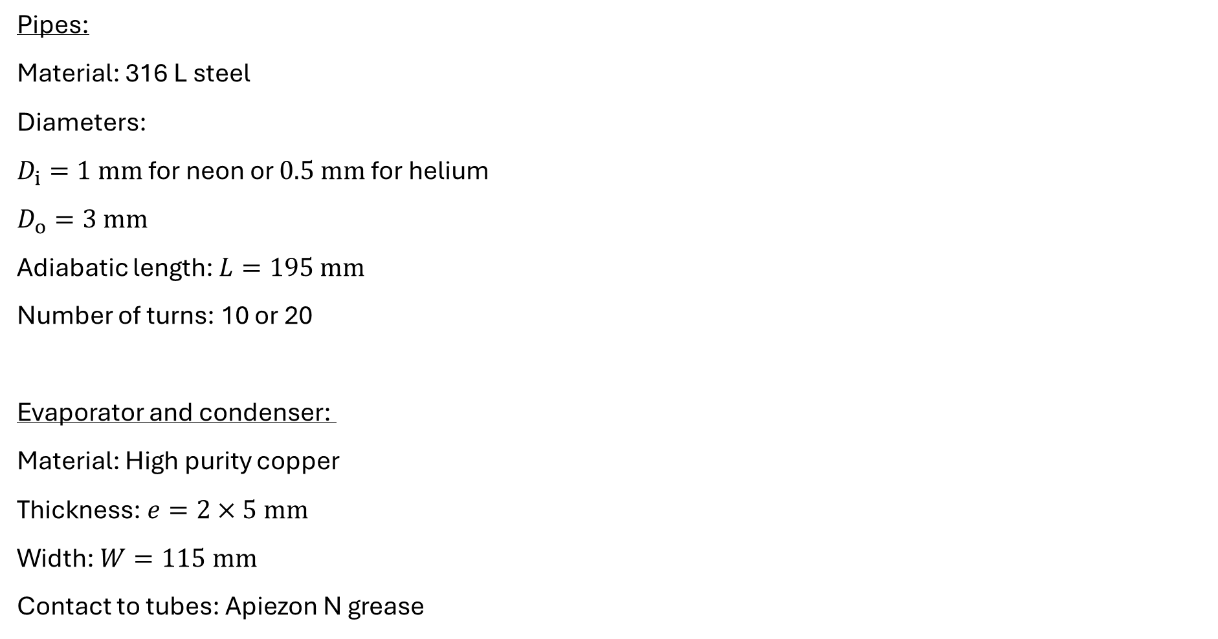

PHP design features
Pipes:
Material: 316 L steel
Diameters:
$D_{i}=\text{1} \text{mm}$for neon or $\text{0.5} \text{mm}$for helium
$D_{o}=3 mm$
Adiabatic length: $L=195 mm$
Number of turns: 10 or 20
Evaporator and condenser:
Material: High purity copper
Thickness: $e=2×5 mm$
Width: $W=115 mm$
Contact to tubes: Apiezon N grease
Condenser
$$500 μm$$
Pipe cross-section, courtesy of A. Brem, PSI
$L$
Brazed connection
Pipes
Evaporator (lower half)
Evaporator cross-section
20-turn PHP
13
PSI CAS Seminar
26.06.2025

Slide 14
Outline
Context and motivation
Pulsating heat pipes
Experimental set-up
Characterization
Model and visualization
Application
Conclusion and outlook
Cryocooler-based test facility for superconducting magnets and advanced cryogenics
14
PSI CAS Seminar
26.06.2025

Slide 15
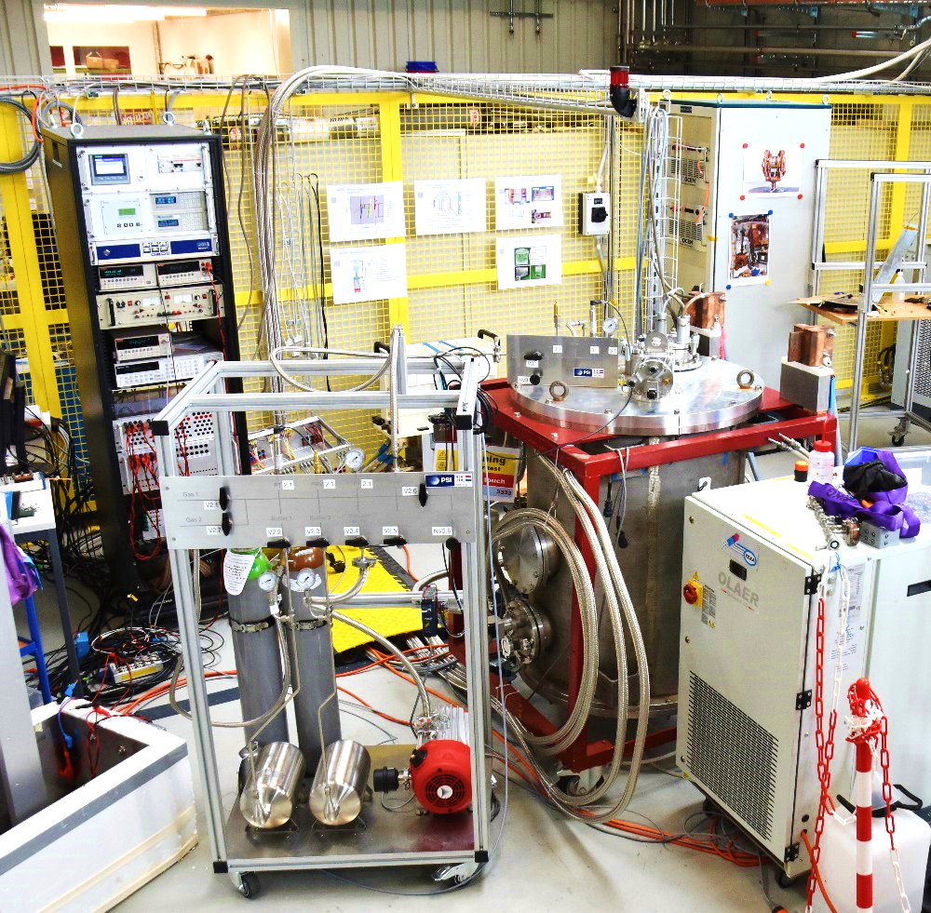
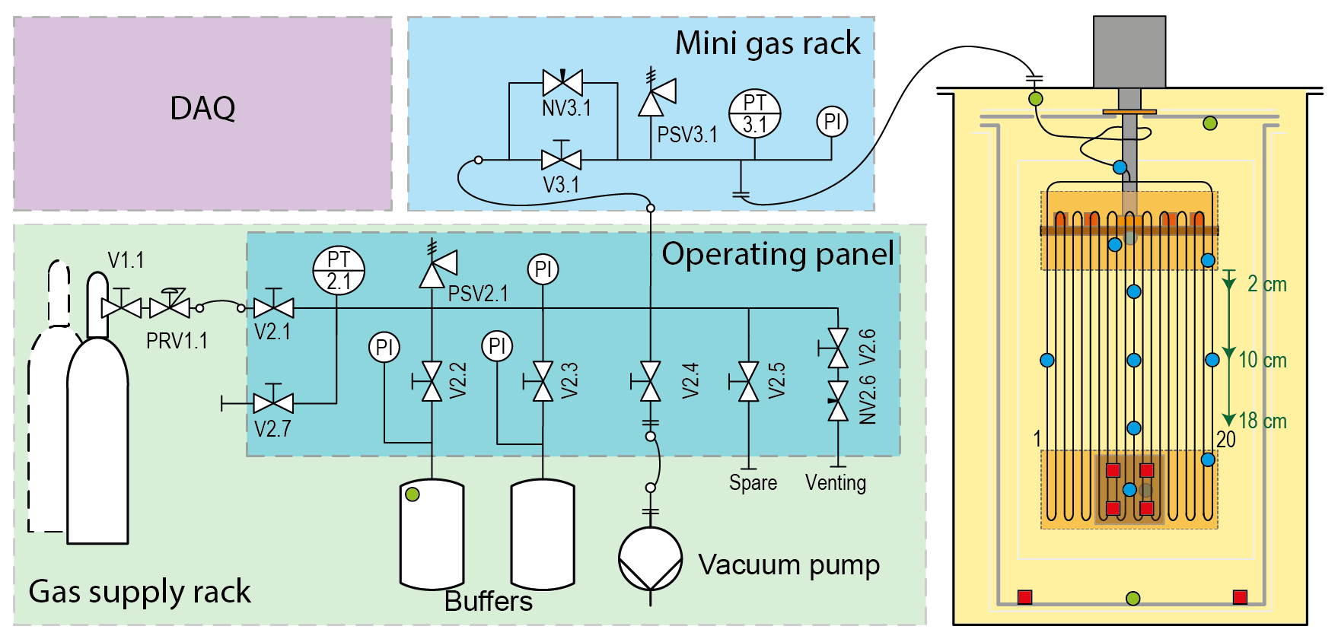
Experimental set-up for PHP characterization
DAQ
Cryocooler RDK-415D
wire feed-
throughs
Mini gas rack
Cryostat
Gas supply rack
15
PSI CAS Seminar
26.06.2025

Slide 16
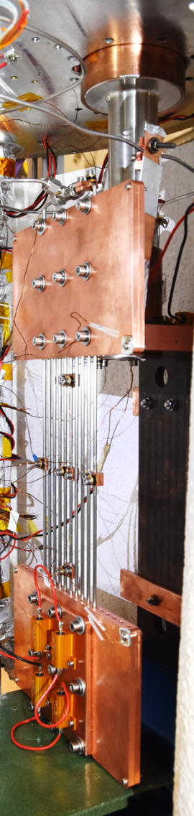
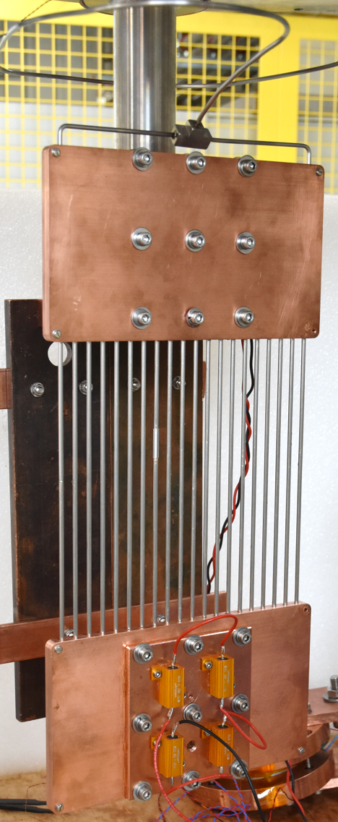
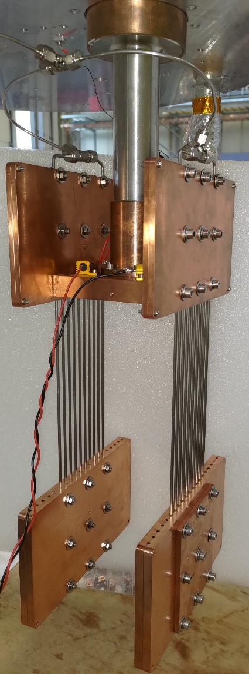
Parametric study on neon PHP
10- turn
20- turn
2 x 10- turn
Three configurations:
10-turn PHP alone
20-turn PHP alone
2 x 10-turn PHP in parallel
Parametric study:
Heat load: 2.0 to 22.8 W
Filling ratio: 15 to 90 %
Condenser temperature: 27 and 30 K
Number of turns: 10 and 20
16
PSI CAS Seminar
26.06.2025
Notes:
Temperature and pressure evolution during 20-tube PHP operation with condenser temperature at 27 K and 55 % of liquid filling ratio

Slide 17
Outline
Context and motivation
Pulsating heat pipes
Experimental set-up
Characterization
Model and visualization
Application
Conclusion and outlook
Cryocooler-based test facility for superconducting magnets and advanced cryogenics
17
PSI CAS Seminar
26.06.2025

Slide 18
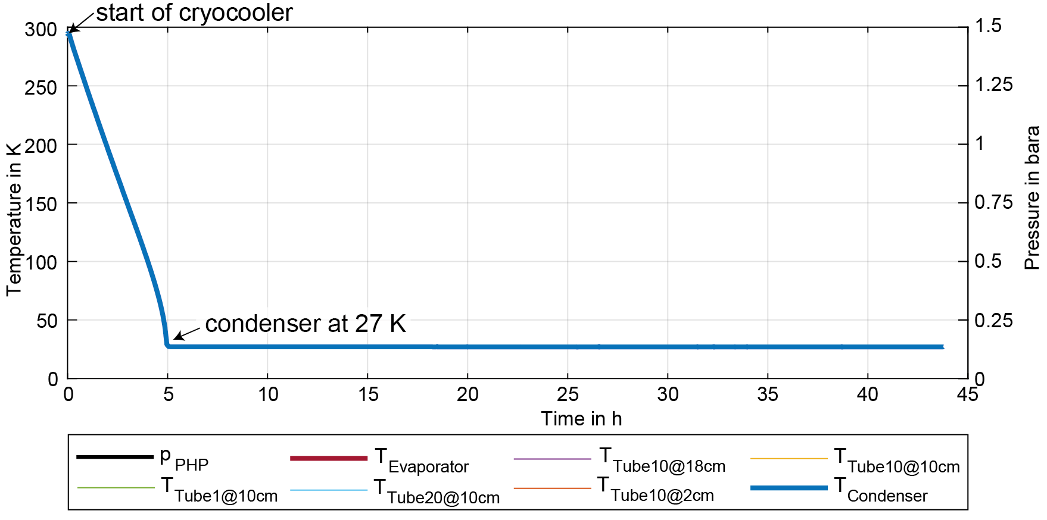
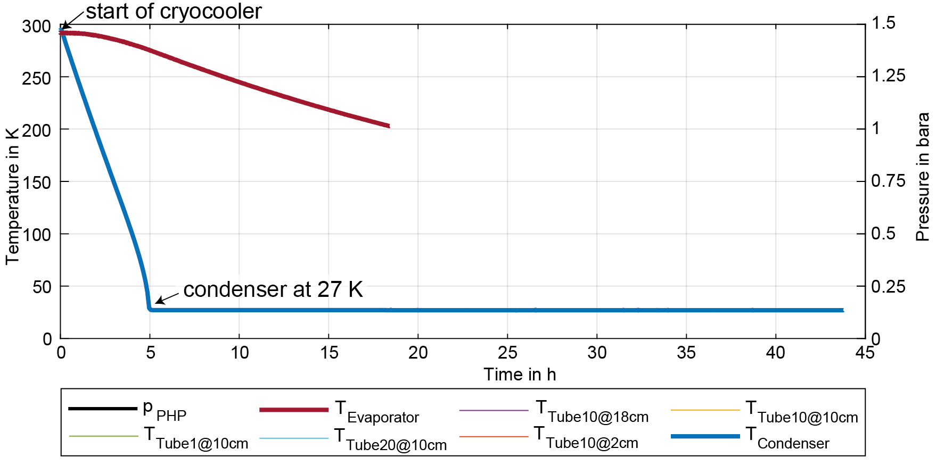
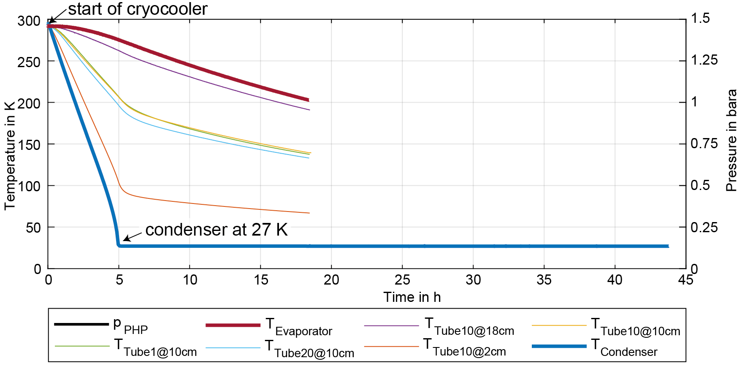
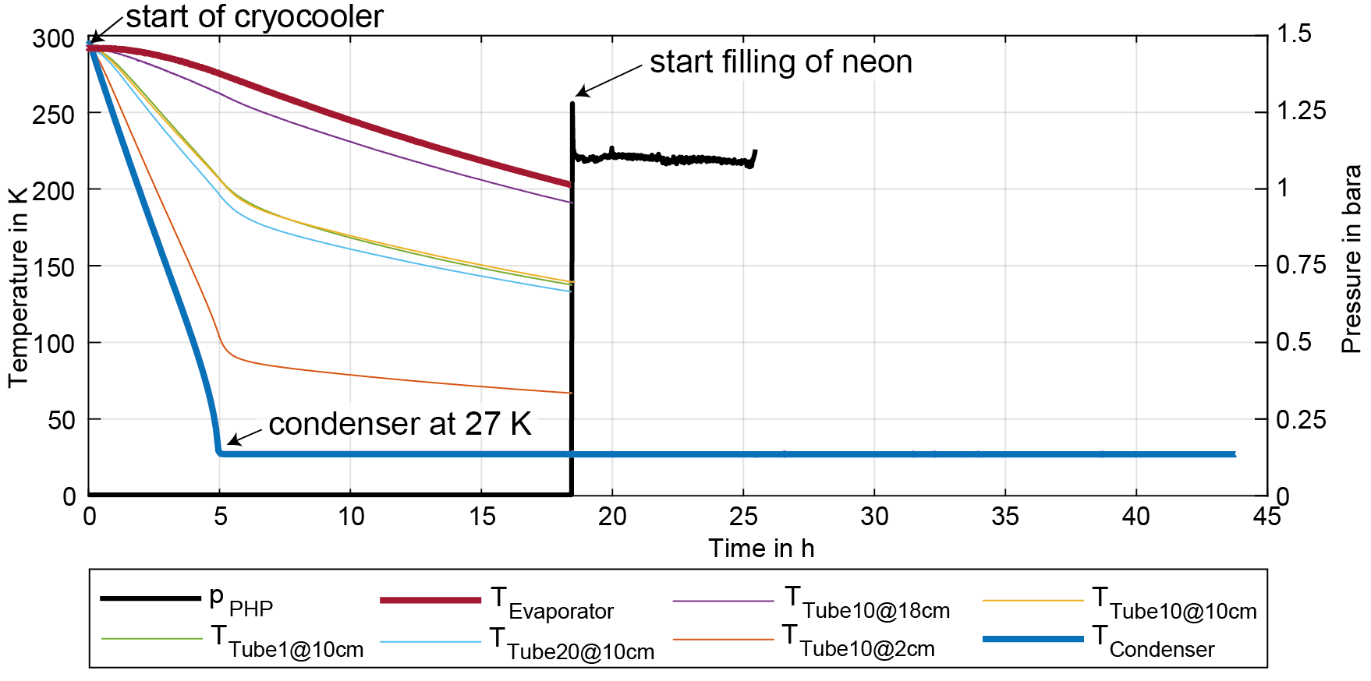
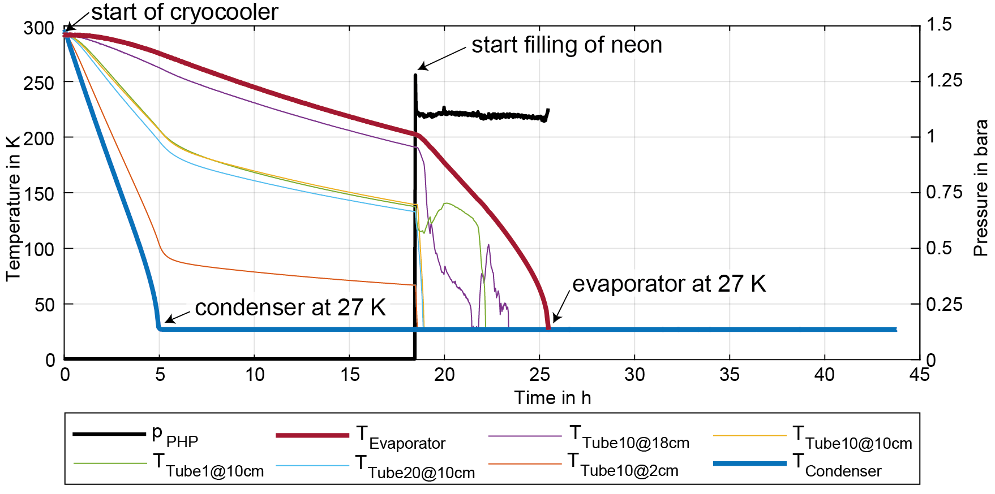
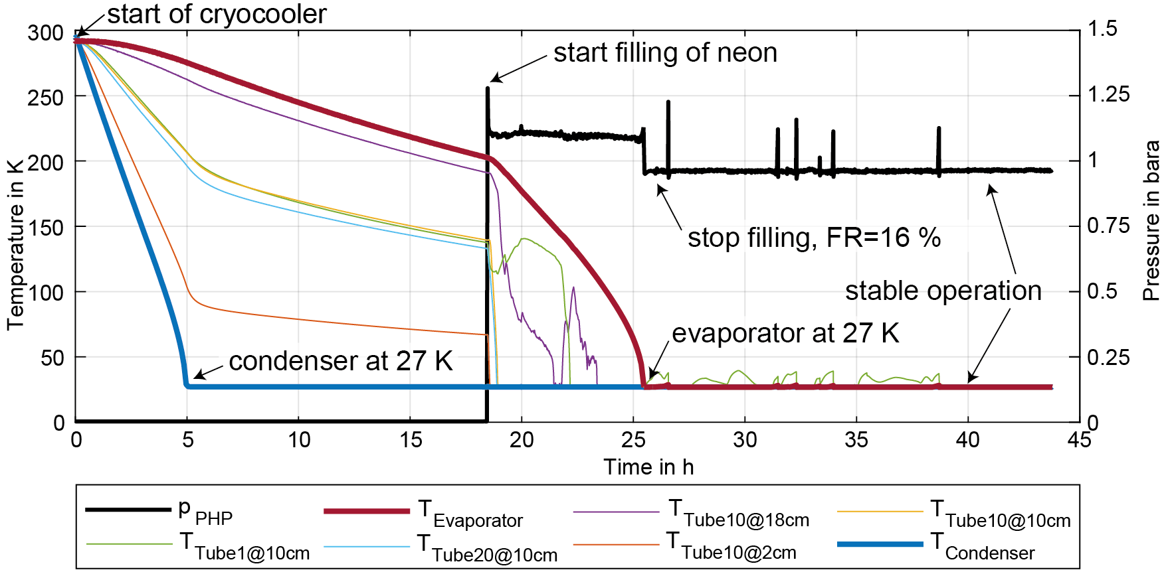
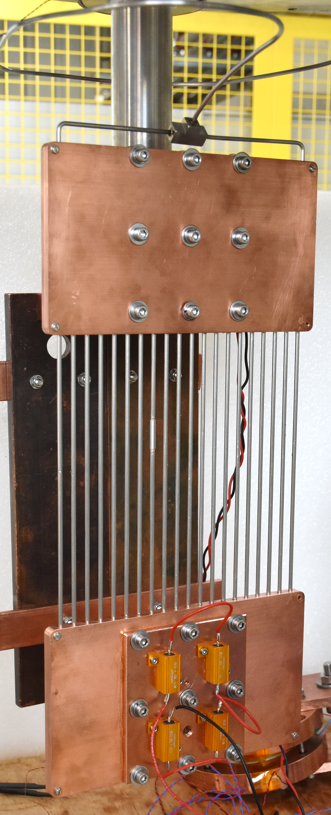
Exemplary cooldown
Condenser
PHP tubes
(adiabatic part)
Evaporator
18
PSI CAS Seminar
26.06.2025
Notes:
Temperature and pressure evolution during cooldown with condenser temperature at 27 K and 16 % of liquid filling ratio

Slide 19
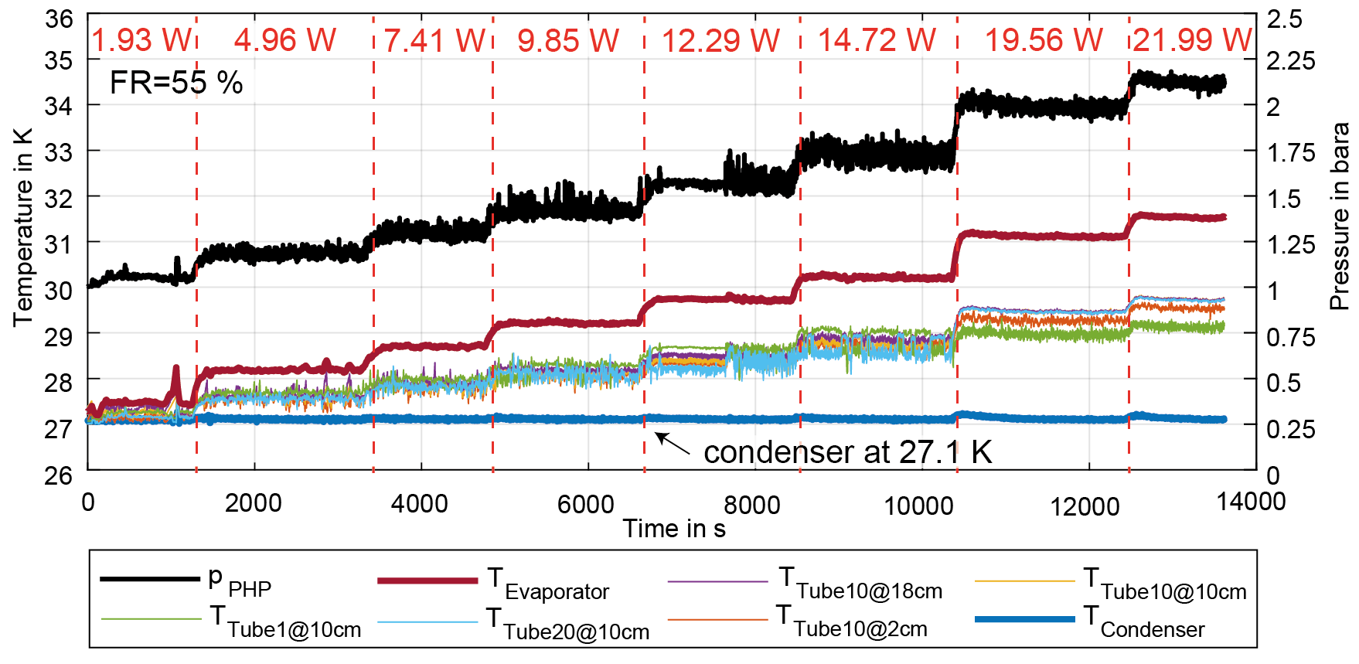
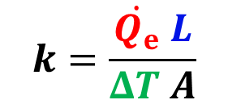

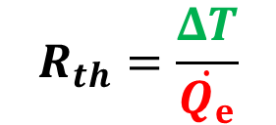


Exemplary characterization
$$\dot{Q_{e}}=$$
Condenser
PHP tubes
(adiabatic part)
$$ΔT$$
$L$
Evaporator
$$k=\frac{\dot{Q_{e}} L}{ΔT A}$$
$$R_{th}=\frac{ΔT}{\dot{Q_{e}}}$$
19
PSI CAS Seminar
26.06.2025
Notes:
Temperature and pressure evolution during 20-tube PHP operation with condenser temperature at 27 K and 55 % of liquid filling ratio

Slide 20
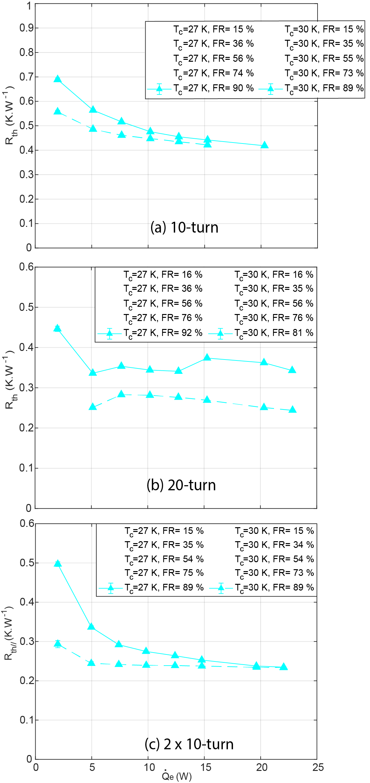
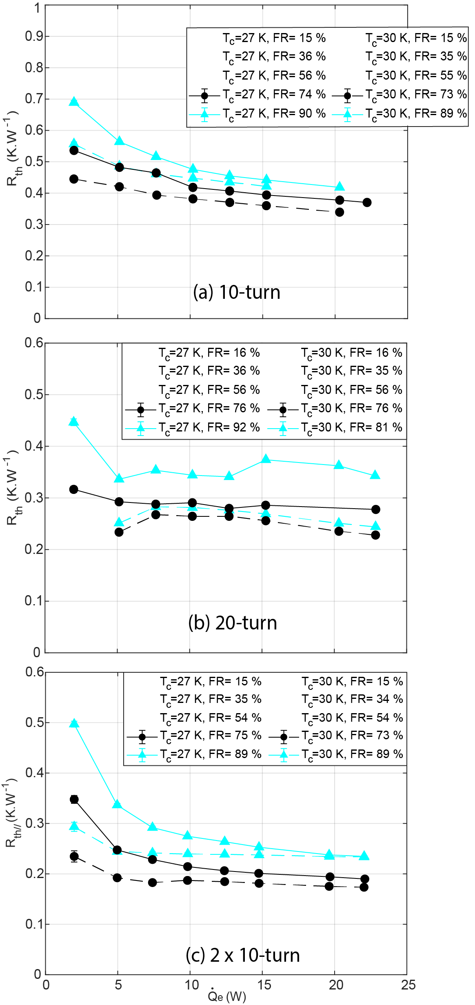
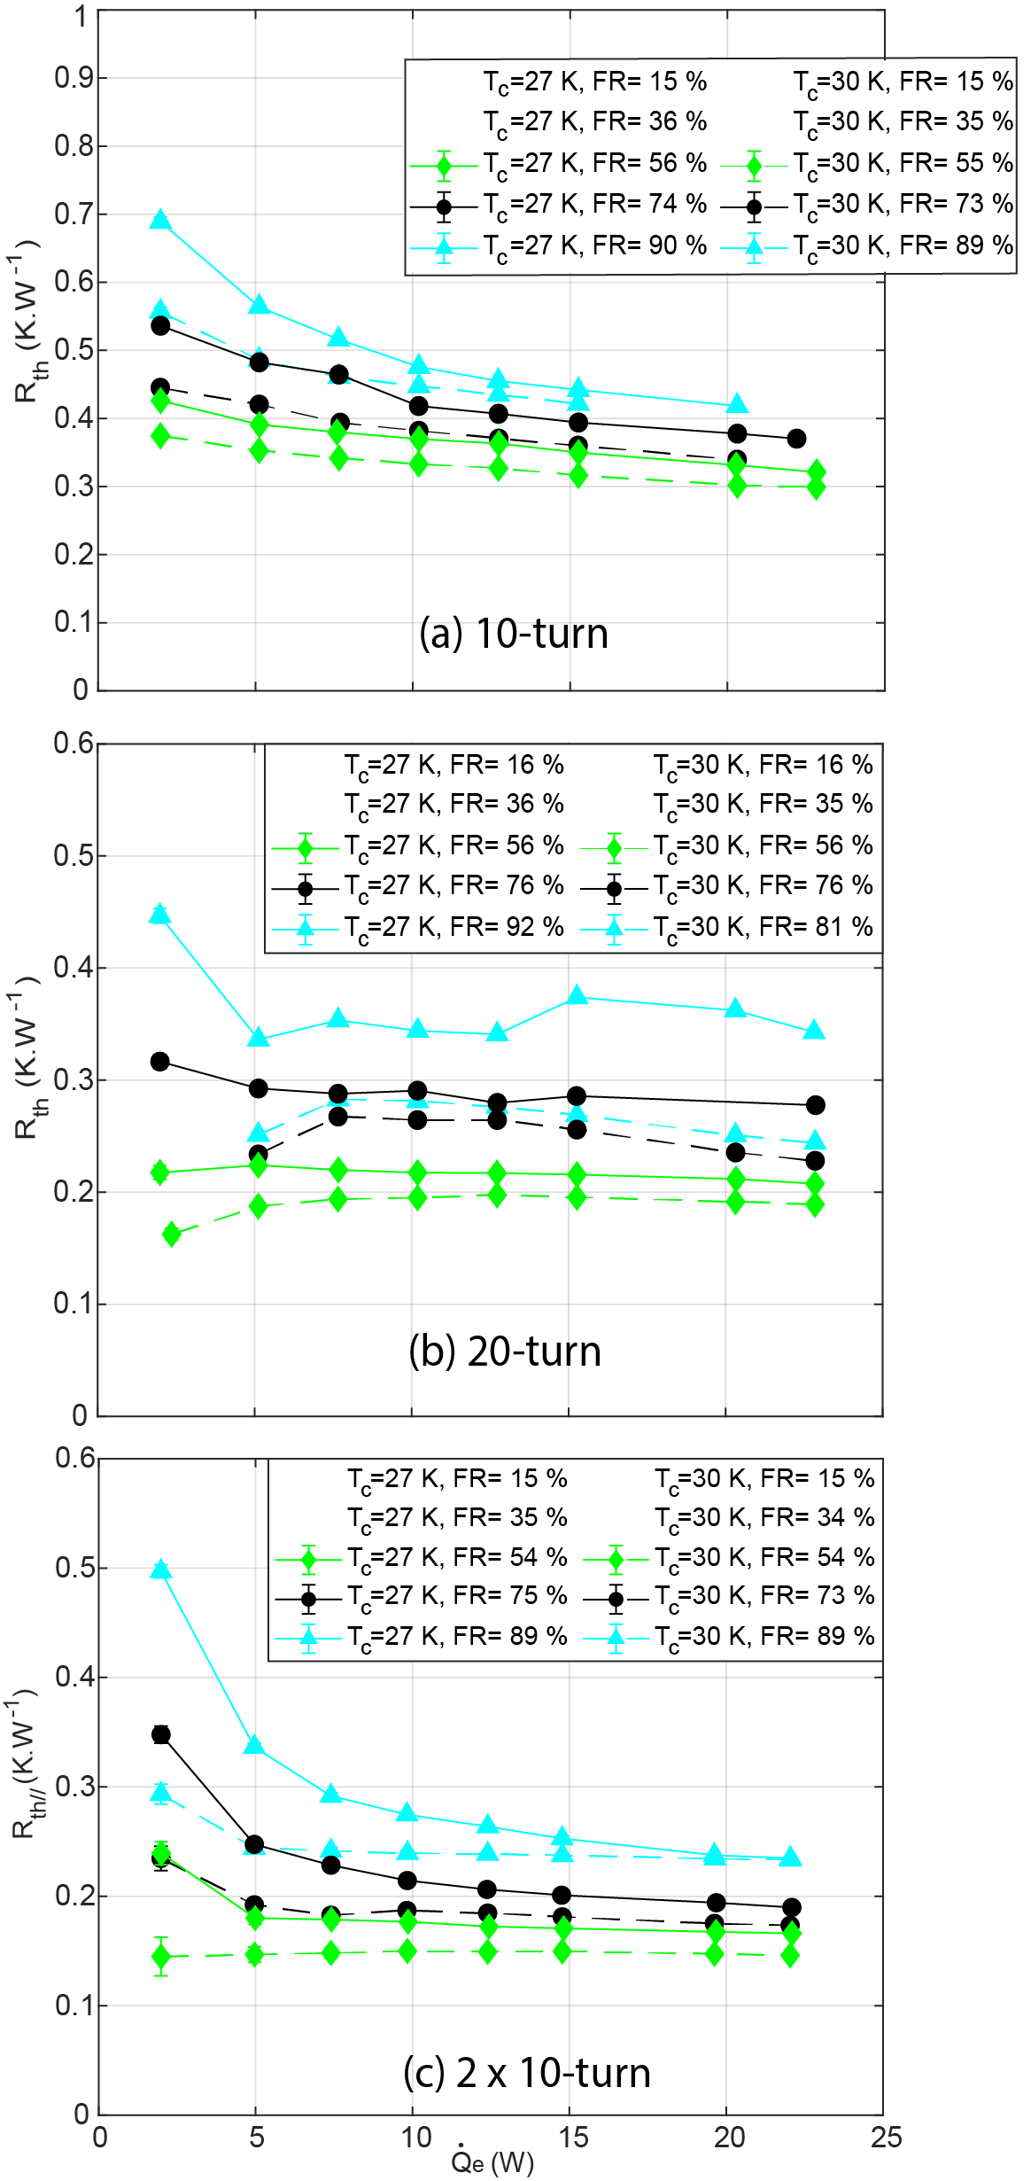
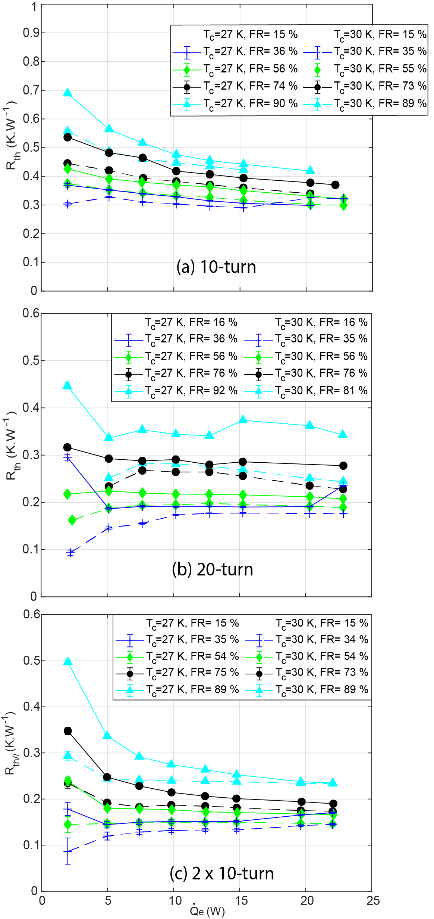
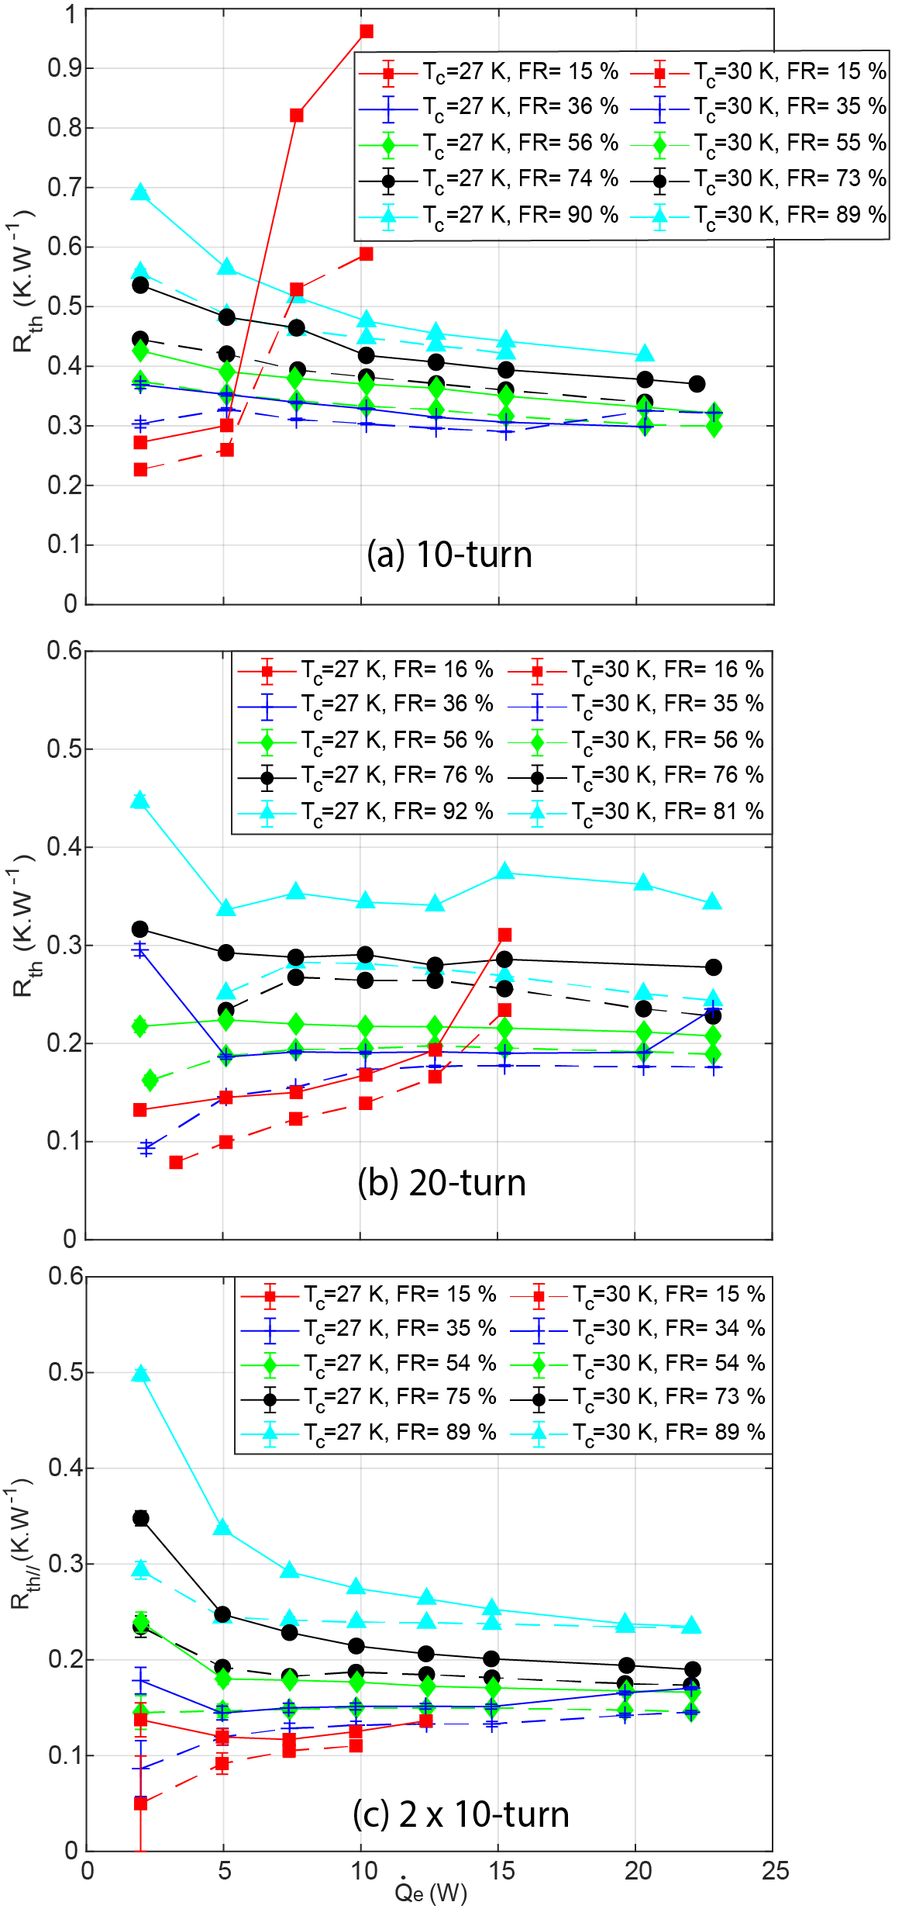
Parametric study results
Thermal resistances
Dry-out
Thermal resistance in function of the heat load at different condenser temperatures and filling ratios for; (a) the 5-turn PHP, (b) the 10-turn PHP and (c) the two 5-turn PHPs in parallel.
Optimum parameters
2x10-turn in parallel, filling ratio of 35 % and condenser temperature of 27 K
These conditions lead to the lowest evaporator temperatures with thermal resistances ranging from 0.15 to 0.29 K.W⁻¹, while no dry-out phenomena occur in the input heat load range tested
20
PSI CAS Seminar
26.06.2025
Notes:
Temperature and pressure evolution during 20-tube PHP operation with condenser temperature at 27 K and 55 % of liquid filling ratio

Slide 21
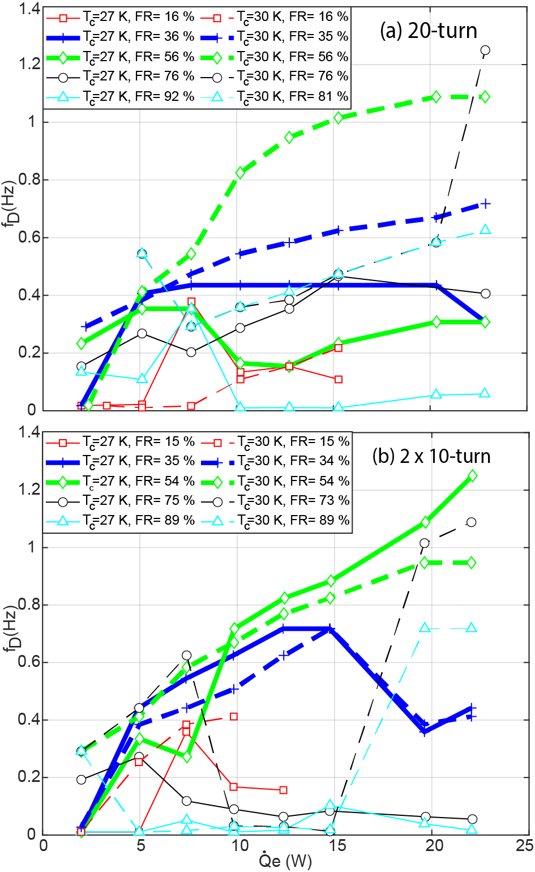

Parametric study results
Frequency analysis
Aim: Determine the dominant frequency of oscillation motion using the pressure signal obtained at each pseudo-steady state.
Method: Calculate the continuous wavelet transform and the wavelet power spectrum of the sample period using Matlab software.
Main result: High dominant frequencies and low thermal resistances measured at 35 and 55 % of filling ratios support the assumption of enhanced sensible heat transfer due to greater fluid movement in these conditions.
Dominant frequency of pressure signal in function of the heat load at different condenser temperatures and filling ratios for; (a) the 10-turn PHP and (b) the two 5-turn PHPs in parallel.
21
26.06.2025
Notes:
Temperature and pressure evolution during 20-tube PHP operation with condenser temperature at 27 K and 55 % of liquid filling ratio

Slide 22








Parametric study results
Correlation
An empirical correlation for the heat transfer is determined using the appropriate dimensionless numbers and 139 experimental data points obtained from the individual characterizations of the 10-and 20-turn PHPs.
$$Ku=\dot{\frac{q}{h_{lv}ρ_{v}{\left(\frac{σg(ρ_{l}−ρ_{v})}{ρ_{v}}\right)}^{0.25}}}$$
where
$$\dot{q}=\dot{\frac{Q_{e}}{2πD_{i}L_{e}n}}$$
The Kutateladze number can be expressed following an exponential relationship:
$$Ku={2.678.10}^{−12}Ka^{1.095}(J{a^{∗})}^{−0.142}Prl^{6.128}Bo^{−7.307}n^{−0.426}$$
where
$$Ka=\frac{ρ_{l}ΔpD_{i}^{3}}{μ_{l}^{2}L_{eff}}$$
$$Ja^{∗}=\frac{ΔT{C_{p}}_{l}FR}{h_{lv}(1−FR)}$$
$$Prl=\frac{{C_{p}}_{l}μ_{l}}{k_{l}}$$
$$Bo=\frac{g\left(ρ_{l}−rho_{v}\right)D_{i}}{σ}$$
The average standard deviation of $Ku$ and $\dot{q} are$ about 10.5 % where 93.5 % of deviations are within $±$30 %. It seems that the correlation can reasonably predict the input heat flux for the different condenser temperatures, filling ratios and turn numbers.
Comparison between the power-law correlation results and those of the experiments.
22
PSI CAS Seminar
26.06.2025
Notes:
Temperature and pressure evolution during 20-tube PHP operation with condenser temperature at 27 K and 55 % of liquid filling ratio

Slide 23
Outline
Context and motivation
Pulsating heat pipes
Experimental set-up
Characterization
Model and visualization
Application
Conclusion and outlook
Cryocooler-based test facility for superconducting magnets and advanced cryogenics
23
PSI CAS Seminar
26.06.2025

Slide 24


Neon PHP modelling
No analytical framework allows to analyze the PHP physics
at cryogenic temperatures
The Volume Of Control (VOF) numerical scheme and the Lee model are used for simulation of the 2D two-phase flow in Ansys Fluent:
PHPs designs are generally based on empirical correlation techniques
Unreliable
Solution for the prediction of their behavior: use numerical models
CryoPHP numerically studied since 2017:
only 12 papers and 1 PhD manuscript on the subject but no publication on neon PHP modelling
Liquid volume fraction in a single turn neon PHP at Tcond=27 K, FR=55 %,$\dot{Q_{e}}$=5 W.
Collaboration with experts from CNRS/IUSTI on two-phase flow CFD modelling
The next step is the model validation by comparing thermal resistances obtained with models and experiments.
24
PSI CAS Seminar
26.06.2025

Slide 25


Neon PHP visualization
Experimental visualization of the two-phase flow in transparent PHP is an important step for improving and validating models.
No publication on visualization of the two-phase flow in transparent neon PHP
Collaboration with experts on two-phase flow visualization from PSI/NES
Obtain the flow characteristics captured using a high-speed camera and a code for image processing to study the:
Evolution of flow patterns (bubbly, slug, churn, annular and mist flows)
Vapor and liquid interfaces (filling ratio)
Liquid film thickness
Fluid motion (velocities, dominant frequencies of oscillation motions)
Relationship between flow and heat transfer
Y. Shi, Visualized investigation of a nitrogen pulsating heat pipe, 2024.
Transparent 10-turn neon PHP
25
PSI CAS Seminar
26.06.2025

Slide 26
Outline
Context and motivation
Pulsating heat pipes
Experimental set-up
Characterization
Model and visualization
Application
Conclusion and outlook
Cryocooler-based test facility for superconducting magnets and advanced cryogenics
26
PSI CAS Seminar
26.06.2025

Slide 27


Experimental set-up for PHP application to non-insulated HTS coil
DAQ
Power supply
Gas supply rack
wires feedthroughs
Mini gas rack
Cryocooler
RDK-418D
Water cooled copper leads
Cryostat
Cryocooler
RDK-500B
27
PSI CAS Seminar
26.06.2025

Slide 28







Exemplary application to non-Insulated HTS coil
Status: Cooling and operating an NI HTS coil using two neon PHP in parallel has been performed.
Current ramps of 1 A/s : I= 0 to 100 A and 100 to 120 A
Current, temperature and thermal resistance measurements:
$\dot{Q_{e}}$= 18.2 W
$\dot{Q_{e}}$= 12.1 W
Condensers
Coil
$$ΔT_{cond,evap}=1.4 K$$
k_{eff}= 156.5 kW.m⁻¹.K⁻¹
k_{Cu,RRR=100}= 2.3 kW.m⁻¹.K⁻¹
Evaporators
Results:
1st test: Heat loads too high
(PHPs operated well, high resistance of aluminum supports, changed for pure copper)
2nd test: Heat loads too low
(PHPs cold but not started-up, no possibility to increase current for safety reasons)
$$\dot{Q_{e}}>{\dot{Q}}_{cryocooler}$$
HTS coil: ReBCO non insulated pancake
Neon PHPs: condenser at 27 K and filling ratio at 35%
$$\dot{Q_{e}}<{\dot{Q}}_{PHP,start−up}$$
28
PSI CAS Seminar
26.06.2025

Slide 29

Experimental set-up for PHP application to insulated HTS coil
DAQ
Power supply
Gas supply rack
wires feedthroughs
Mini gas rack
Cryocooler
RDK-418D
Water cooled copper leads
Cryostat
Cryocooler
RDK-500B
Main differences with insulated coil application:
The coil itself
Powering in AC and not DC mode
Stycast for electrical insulation located between the coil and the cryocooler instead of between the coil and the PHP
PHPs in parallel are operated individually instead of connected to the same external reservoir
29
PSI CAS Seminar
26.06.2025

Slide 30


Exemplary application to insulated HTS coil
Status: first test of cooling and operating an insulated HTS coil using two neon PHP in parallel has been performed.
Condensers
Coil
Evaporators
HTS coil: ReBCO insulated pancake
Cooldown: After charging neon, it takes less than 2 hours to cool the coil from 100 to 27 K
Neon PHPs: condenser at 27 K and filling ratio at 35%
30
PSI CAS Seminar
26.06.2025

Slide 31



Exemplary application to insulated HTS coil
Current ramps of 350 A/s : I= 0 to 500 A during 500 cycles
Condensers
$$ΔT_{cond,coil}=3.8 K$$
Coil
$$ΔT_{cond,evap}=0.8 K$$
Evaporators
HTS coil: ReBCO insulated pancake
Neon PHPs: condenser at 27 K and filling ratio at 35%
31
PSI CAS Seminar
26.06.2025

Slide 32









Exemplary application to insulated HTS coil
Current and magnetic field measurements:
AC losses post-processing:
$$U_{meas}=U_{ind}+U_{res}=\frac{LdI}{dt}+U_{res}$$
Voltage:
Inductance: $L=0.4 mH$measured using slow ramps
Instantaneous dissipated Power:
$${\dot{Q}}_{inst}=U_{res}I$$
Total dissipated energy:
$$E=17700 J$$
Dissipated power per cycle:
${\dot{Q}}_{cycle}=11.3$W
$$E_{cycle}=34 J$$
Dissipated energy per cycle:
Voltages measurements and differentiation:
32
26.06.2025
PSI CAS Seminar

Slide 33














Simplified model for comparison with copper braid
Model description:
Results comparison:
Experiments in post-processing:
Energy equation:
$$ρ_{Cu}C_{Cu}(x,t)\frac{\text{∂}T\left(x,t\right)}{\text{∂}t}=\frac{\text{∂}}{\text{∂}x}(k_{Cu}(x,t)\frac{\text{∂}T(x,t)}{\text{∂}x})$$
Tcond | FR | Imax | dI/dt
27 | 35 | 500 | 200
27 | 35 | 500 | 350
27 | 55 | 500 | 200
27 | 55 | 500 | 350
30 | 35 | 500 | 200
30 | 35 | 500 | 350
30 | 55 | 500 | 200
30 | 55 | 500 | 350
$$ΔT_{cond,coil}=8.3 K$$
Boundary conditions:
$$T(0,t)=T_{cond,exp}(t)$$
$$T(L_{a},t)=T_{coil,calc}(t)$$
$${\left(mC(t)\right)}_{coil}\frac{{\text{∂}T}_{coil,calc}(t)}{dt}={\dot{Q}}_{inst,exp}(t)−k_{Cu}A\frac{\text{∂}T(L_{a},t)}{\text{∂}x}$$
$$ΔT_{cond,coil}=3.8 K$$
Initial conditions:
$$T(x,0)=T_{cond,exp}(0)$$
k_{Cu,RRR=100}= 2.3 kW.m⁻¹.K⁻¹
k_{eff}= 123.8 kW.m⁻¹.K⁻¹
$$T_{coil,calc}(x,0)=T_{cond,exp}(0)$$
Proof of concept:
Heat loads in the range of PHP operation (starting-up to dry-out)
Thermal conductivity of the link increased by a factor 54 compared to a copper braid of the same dimensions
Coil temperature margin increased of 4.5 K compared to a copper braid of the same dimensions
Next experiments:
$$L_{a}$$
Repeat the tests replacing PHPs by copper braids of the same dimensions for experimental validation
$$x$$
Numerical solution:
Explicit Euler method
$$A=n\frac{πd_{o}^{2}}{4}$$
$$m_{coil}$$
33
PSI CAS Seminar
26.06.2025

Slide 34
PHP foreseen applications to accelerator magnets
Applications
Application
High field
High radiation environment
High reliability
Fast ramping
Current leads
Problematics
Influence of magnetic field on evaporation and potential cryocooler damage
Nuclear load and potential cryocooler damage
Cryocooler redundancy
High AC losses
Bulky and heavy
Solutions
Require thermal link working without gravity
Require long length thermal link
Require reliable thermal switches
Require efficient thermal link
Require compact thermal link
Pulsating heat pipe
Main advantages: Passive, efficient, possibility to operate without gravity and to be used as thermal switch.
These can be used to gain on weight, bulk, reliability and electricity consumption.
34
PSI CAS Seminar
26.06.2025

Slide 35
Outline
Context and motivation
Pulsating heat pipes
Experimental set-up
Characterization
Application
Model and visualization
Conclusion and outlook
Cryocooler-based test facility for superconducting magnets and advanced cryogenics
35
PSI CAS Seminar
26.06.2025

Slide 36
Conclusion
Neon and helium PHPs designed and manufactured
Experimental setup dedicated to PHP characterizations and applications built at PSI
Characterization of 3 configurations of neon PHP, leading to optimal parameters definition and correlations to predict their performances
First ever application of neon PHP to cool down and operate non-insulated and insulated HTS coils, leading to a proof of concept for replacing conventional copper braids
First ever CFD model of neon PHP in development for improvement of performance predictions
First ever neon PHP visualization in development for accurate validation of the CFD model
Neon PHP is a very promising candidate for optimizing the cooling of cryocooler-based HTS magnets
36
PSI CAS Seminar
26.06.2025

Slide 37
Outlook for 2025-2027
Characterization:
Parametric study on the effect of internal diameter (helium, neon)
Investigate different orientation and shapes: horizontal orientation, coil shape, L-shape…
Application:
Improve actual design by displacing the electrical insulations of the coil
Use PHP as thermal switches with 2 cryocoolers for redundancy and improved reliability
Cool and operate CORC coil with neon PHP
Cool and operate NbTi coil with helium PHP
Use embedded neon PHP in a high field or high radiation environment superconducting magnet
Model:
Validate the models of 10 and 20-turn Ne PHP with the characterization and visualization results
Extend the model from 2D to 3D
Model the HTS coil with neon PHP and validate with the application results
Model a HTS magnet with embedded PHP in operation and quench
Visualization:
Characterize transparent neon PHP without visualization
Modify test facility for visualization
Perform the visualization campaign
Post-process images
37
PSI CAS Seminar
26.06.2025

Slide 38


Thank you for your interest
We would like to thank:
PSI CAS and VDL ETG for their ongoing commitment
PSI magnet section and CHART team for support
PSI technicians for support in manufacturing, assembly and, vacuum-, volume- and pressure tests
Q. Gorit^{1,2}, C. Zoller¹, J.C. Maris^{1,2}
PSI CAS Seminar, Villigen, 26 May 2025
38

