Slide 1
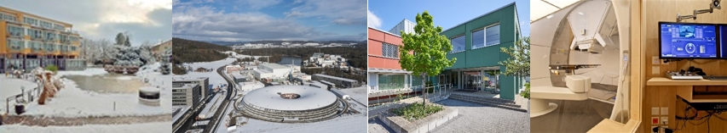
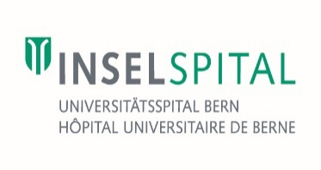


2026
Paul Scherrer Institute PSI Prof. Dr. med. Damien Charles Weber
A short historical overview of Proton Therapy
PSI Winter School

Slide 2
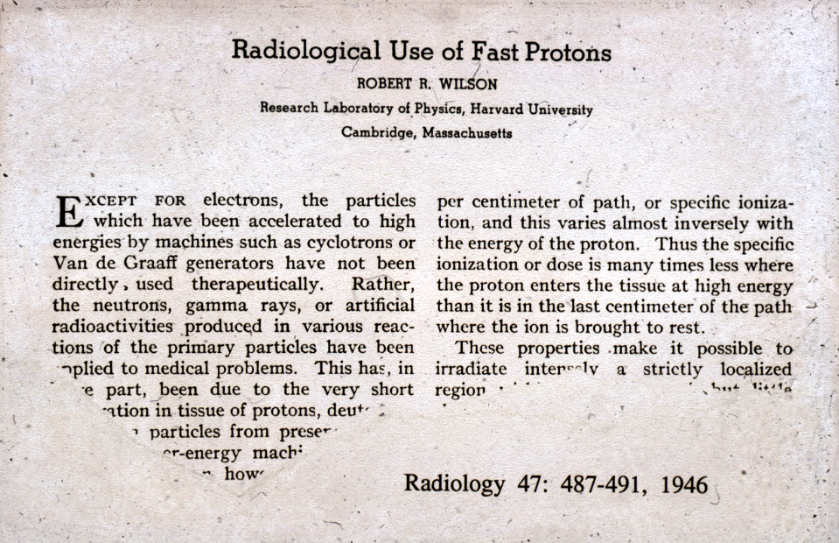
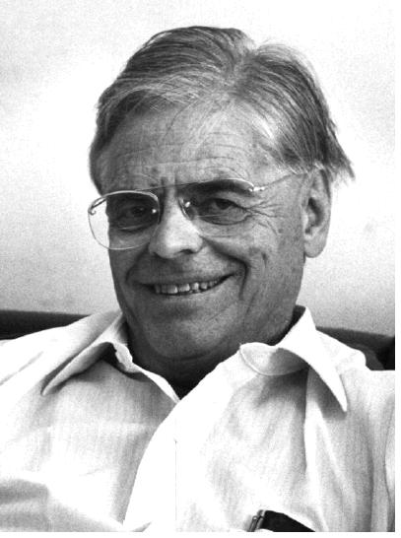
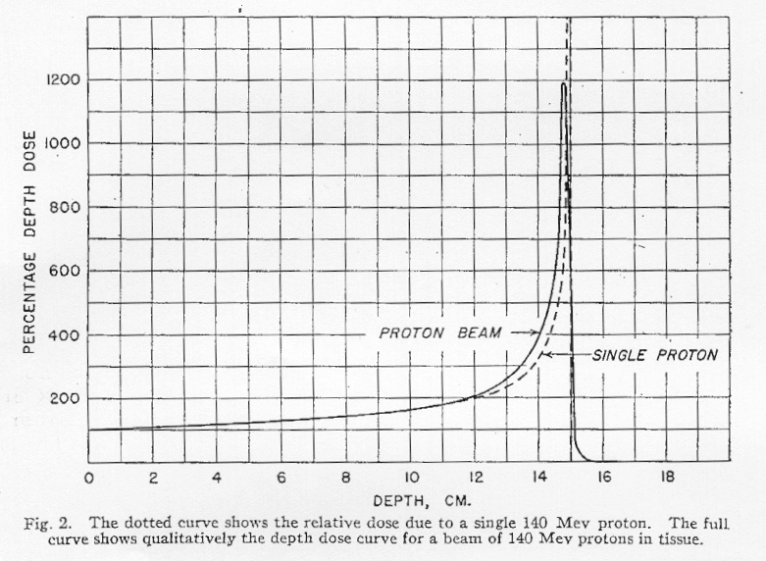
narrow peak (few mm)
DOSE
depth of penetration depends on the proton’s energy
low entrance dose
“no” exit dose
DEPTH (CM)
Notes:
This concept of a “peak” was initially discovered by William Bragg in the early 1900’s and is known as the “Bragg peak.” The Bragg peak, or energy deposition as a function of tissue depth, has potential to deliver higher doses to a target volume while maintaining dose-constraints of nearby critical structures [20]. The potential for increased tumor cell effect while reducing dose to structures at risk is one of the underlying factors in the medical interest of proton therapy.

Slide 3
Clinical Concept and History of Protons
The desire and necessity to focus radiation to target volumes and the physical knowledge about particle beams led Prof. Robert Wilson to write his landmark paper Radiological Use of Fast Protons in 1946
“These properties (of protons, as described before) make it possible to irradiate intensely a strictly localized region within the body, with but little skin dose.”
“One naturally asks what are the advantages of fast protons over high-energy electrons such as those from a betatron. This question can be answered only by medical workers, and the answers will probably be different for different kinds and sizes of tumors.”
Robert Wilson, 1946

Slide 4
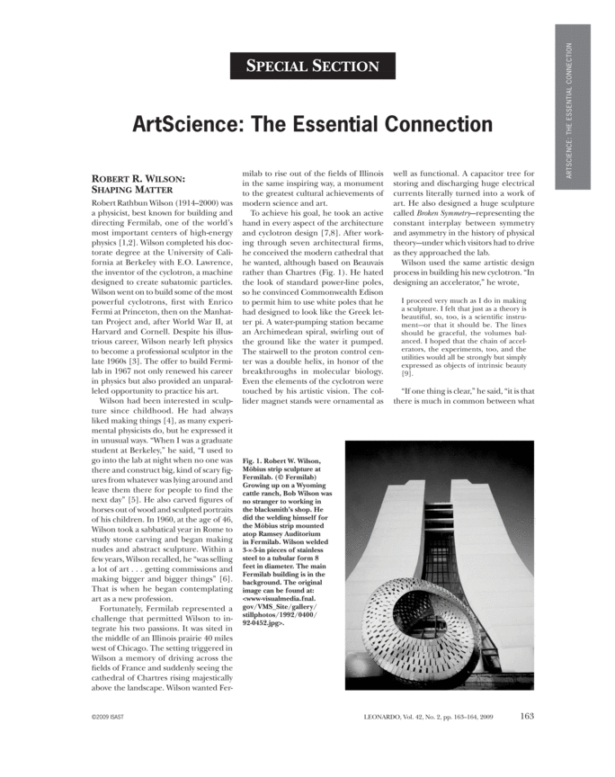
“In designing an accelerator”, Robert R Wilson
I proceed very much as I do in making a sculpture. I felt that just as a theory is beautiful, so, too, is a scientific instrument-or that it should be. The lines should be graceful, the volumes balanced. I hoped that the chain of accelerators, the experiments, too, and the utilities would all be strongly but simply expressed as objects of intrinsic beauty.
Robert R. Wilson. Robert Wilson, physicist, human-rights activist, writer, architect, sculptor, artist, spokesman for science, and founder of Fermilab (and the founder of Proton therapy)
More information:http://www.proton-therapy.org/pr10.htm

Slide 5
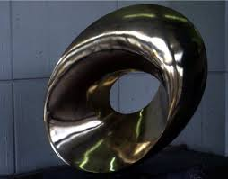
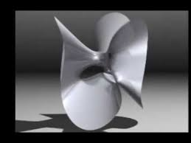
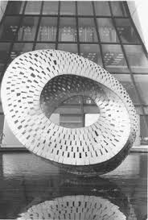

Slide 6

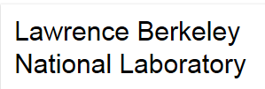
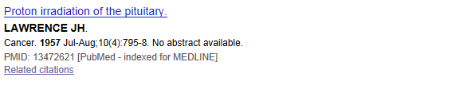
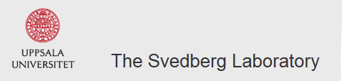
USA: First patient treated by J Lawrence (LBL) and C. Huggins (University of Chicago)
treated 26 breast cancer Patients with 340 Mev Protons 3 fx weekly during 2 weeks.
Targets: pituitary gland
Total dose: 140-300 Gy
In Europe, 1957 was the start of proton therapy at the University of Uppsala, Sweden
(185 MeV synchrocyclotron)

Slide 7
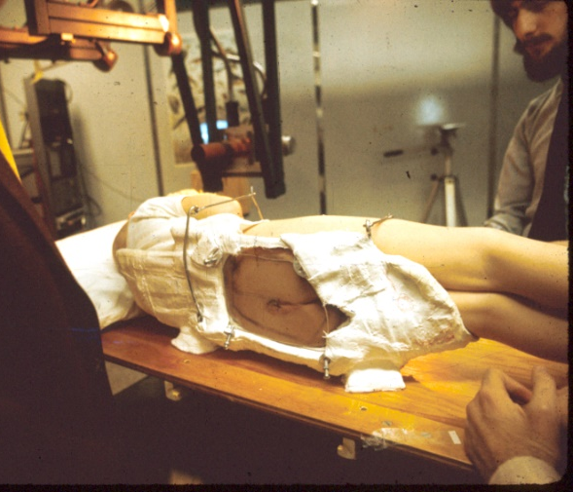
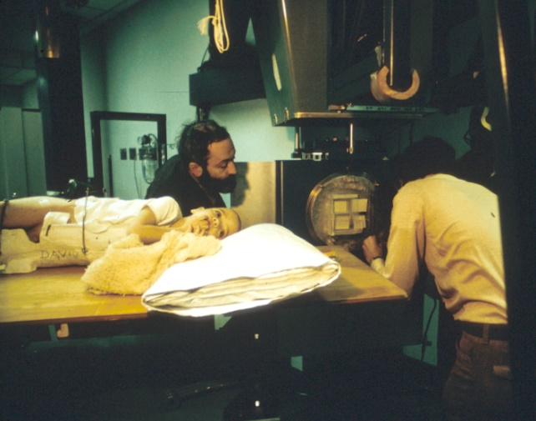
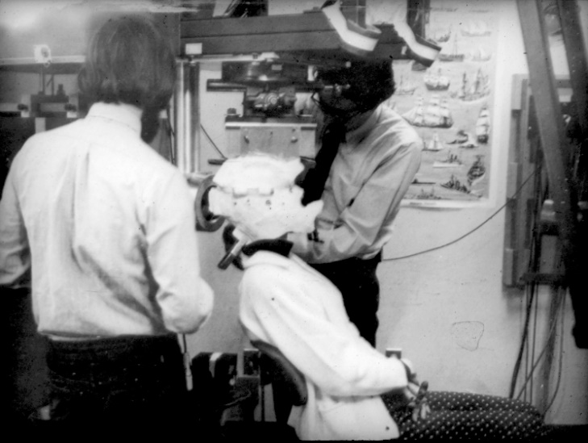
Clinical Concept and History of Protons (1954 – ongoing)
HCL-MGH pioneers of proton radiation therapy
The first large field treatment with protons at the Harvard Cyclotron in 1976, for a pediatric pelvic rhabdo-myosarcoma. The patient died several years later from probably a marginal tumor progression or relapse .
The second large field treatment, for a chondrosarcoma of the base of skull. The patient is alive and active, though diagnosed with local relapse more than 30 years after proton radiation therapy
Slides courtesy of M. Goitein

Slide 8
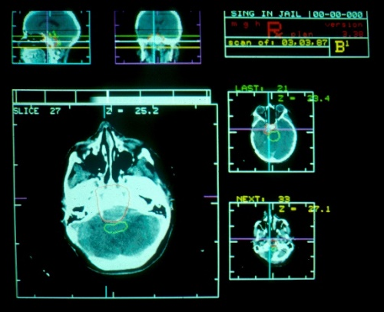
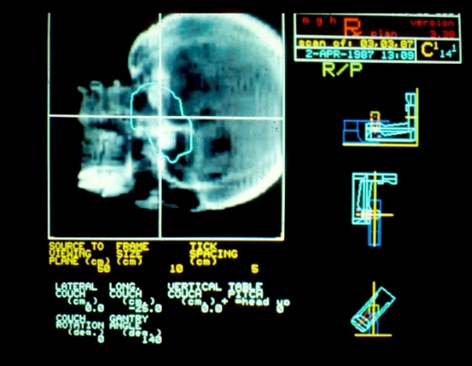
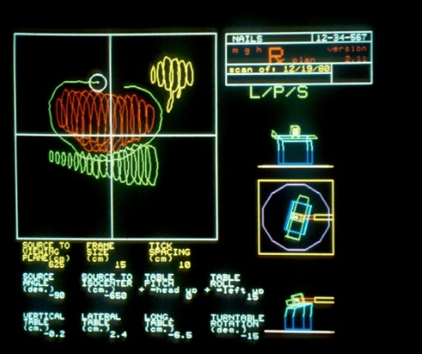
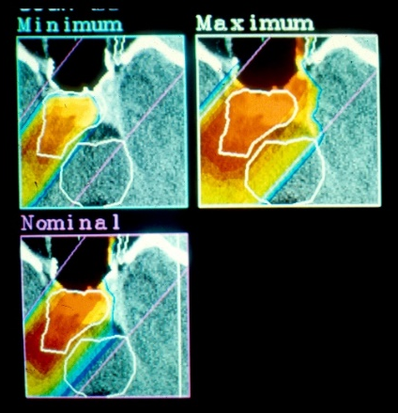
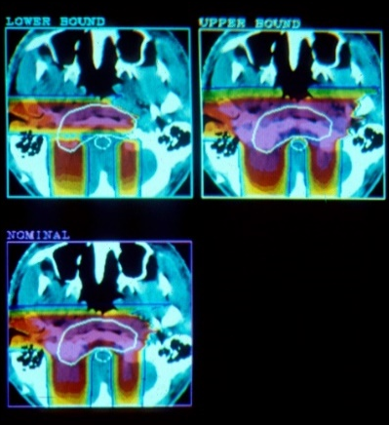
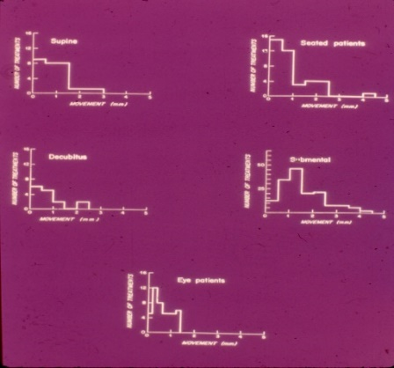
Clinical Concept and History of Protons (1954 – ongoing)
Pioneers of proton radiation therapy
The first 3-d treatment planning program, including DRR and BEV, by M. Goitein
Patients’ position
Number of treatments
Slides courtesy of M. Goitein
Motion (mm)

Slide 9
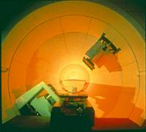
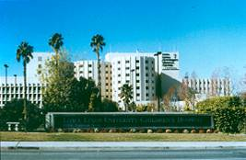
The Era of modern, contemporary Proton Radiation Therapy (PT)
1991 First hospital-based Proton facility at Loma Linda University Medical Center, Loma Linda, CA

Slide 10
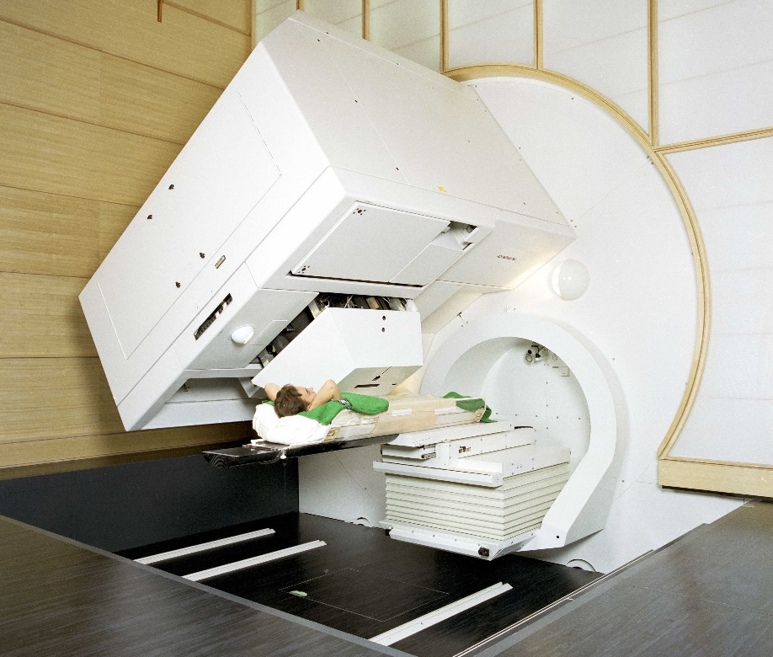
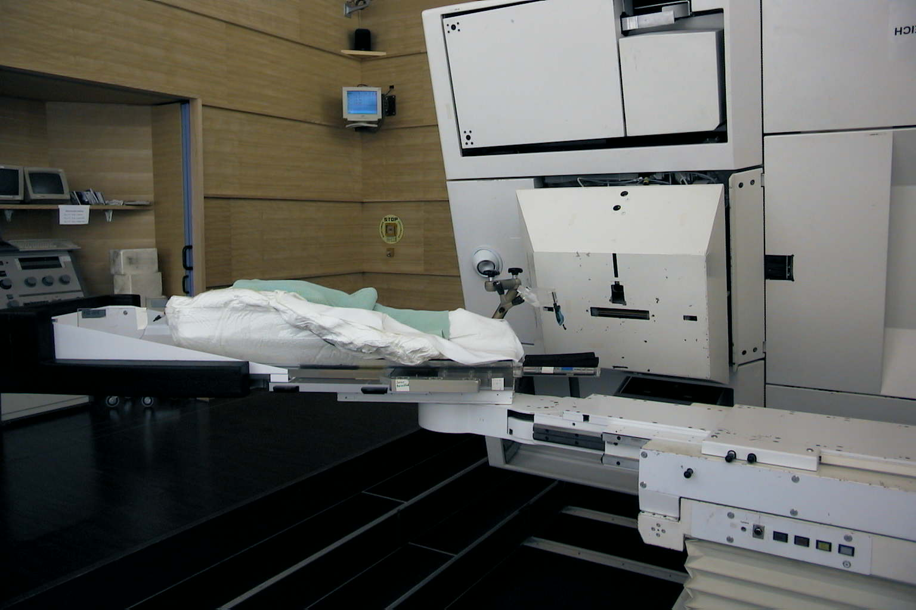
Clinical Concept and History of Protons (1954 – ongoing)
Pioneers of proton radiation therapy
The first compact gantry and the first gantry providing spot scanning technology, a PSI-product, designed by E. Pedroni. 1300 patients treated (December 2018)
α+β rotation for cranial/intracranial and c-spine treatments
α rotation for treatments in the trunk


β rotation

Slide 11
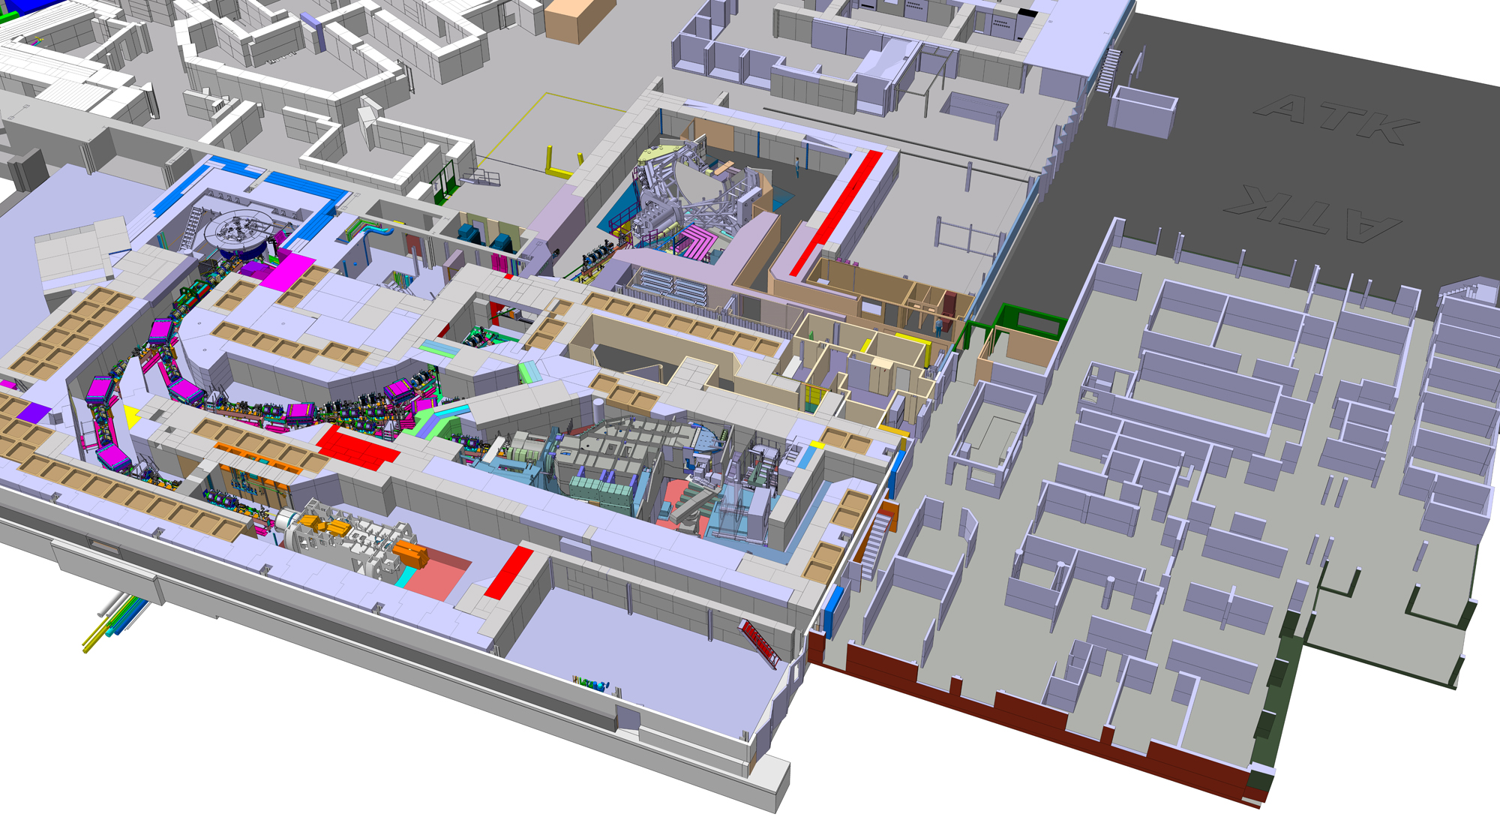
Gantry 1

Slide 12
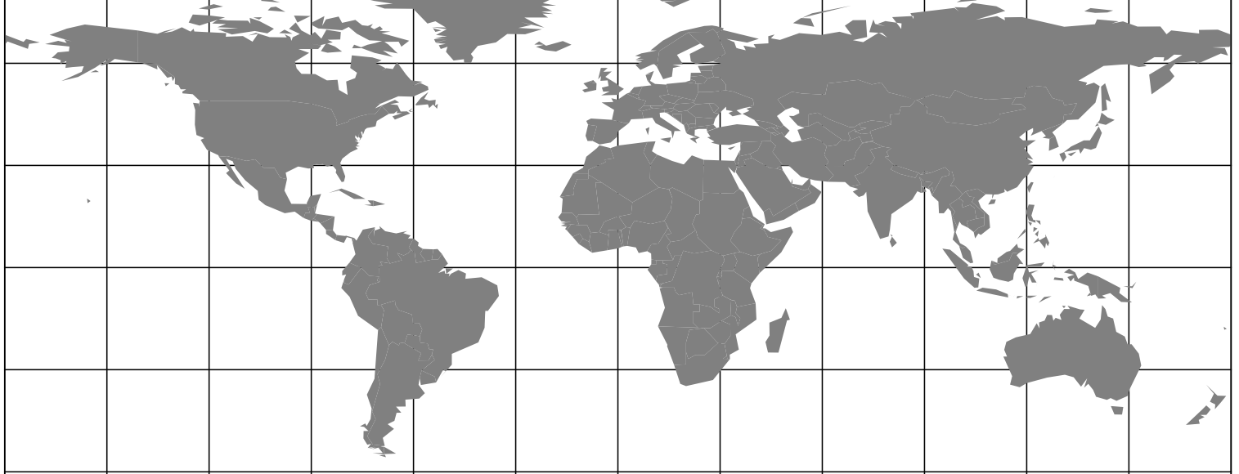
Development of Proton therapy (I)
Spreading of Proton Therapy Technology (1996)
3
Passive Scattering (Pioneered by Loma Linda/FermiLab)
Pencil Beam Scanning (Pioneered by PSI)

Slide 13
Development of Proton therapy (I)
Spreading of Proton Therapy Technology (2010)
3 PBS
Passive Scattering
Pencil Beam Scanning

Slide 14
Development of Proton therapy (I)
Spreading of Proton Therapy Technology (2015)
+++
Passive Scattering
Pencil Beam Scanning

Slide 15
Development of Proton therapy (I)
Spreading of Proton Therapy Technology (2020)
45-50 PBS
Passive Scattering
Pencil Beam Scanning

Slide 16
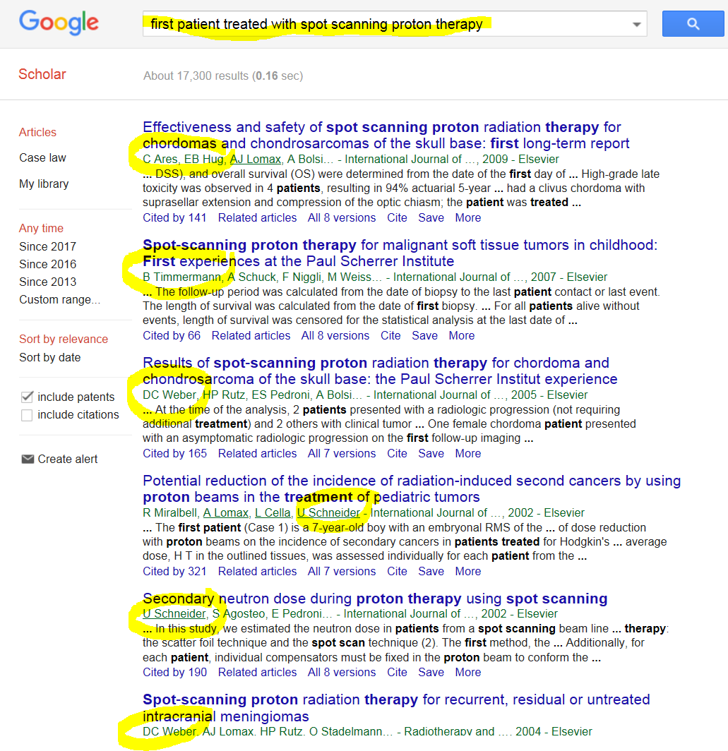

Slide 17
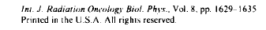
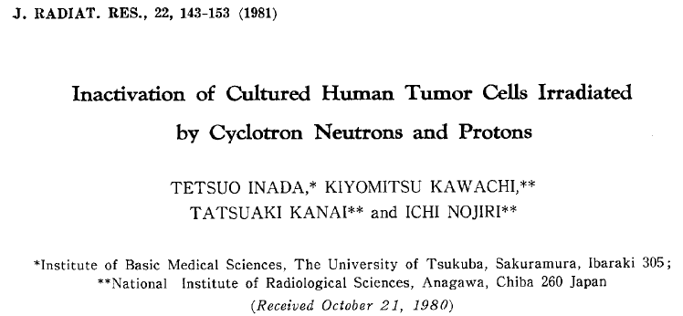
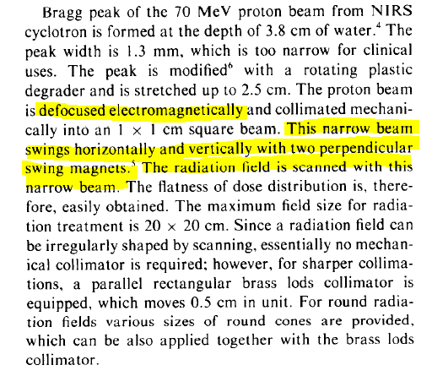
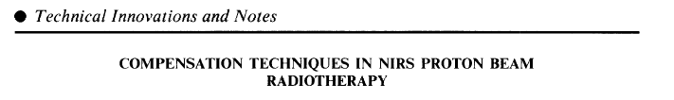
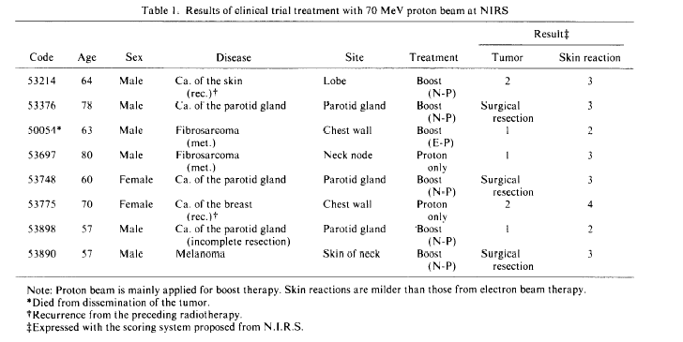
Pencil beam scanning
Kanai T, Kawachi K, Kumamoto Y, et al. Spot scanning system for proton radiotherapy. Med Phys 1980;7:365–369.

Slide 18
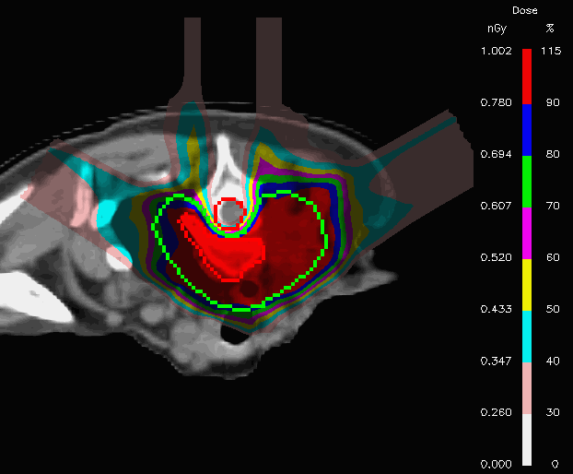
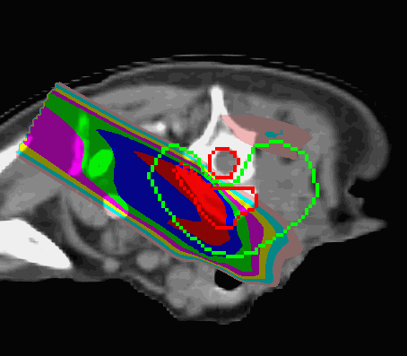
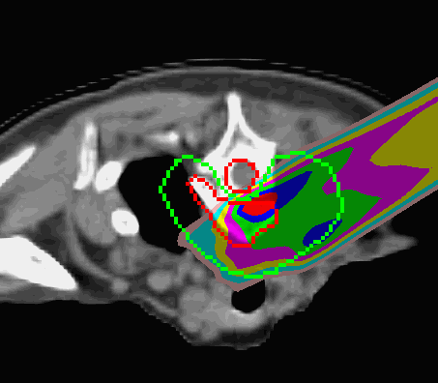
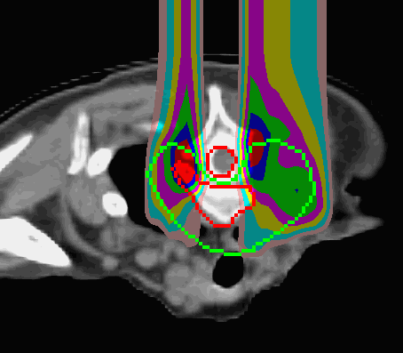
Clinical Concept and History of Protons (1954 – ongoing)
Pioneers of proton radiation therapy
Dynamic beam application, 3-d dose calculation; discrete spot scanning, IMPT at PSI
+
↓
Treatment planning for spot scanning protons and IMPT
+
+
↓
IMPT
IMPT
IMPT
IMPT

Slide 19
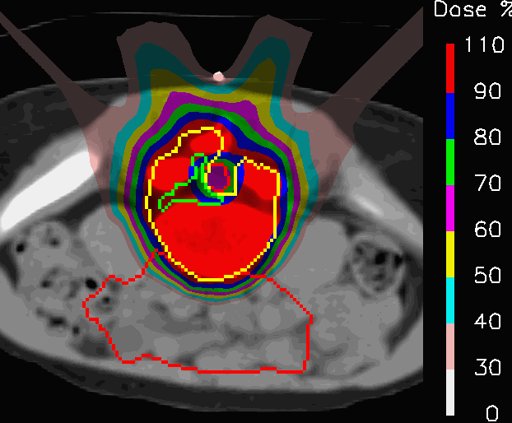
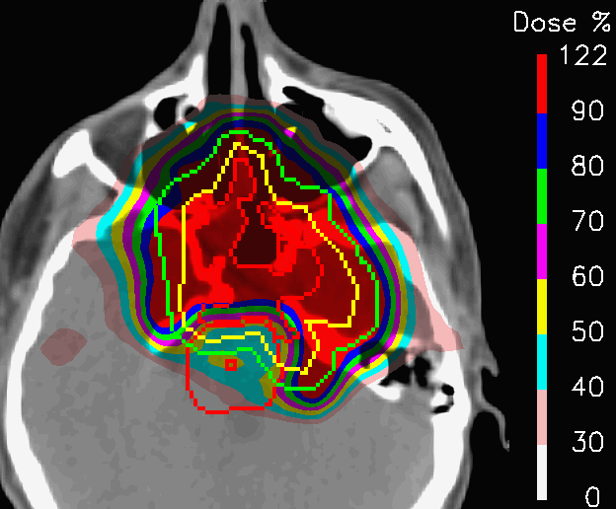
Conformality – Relevance and Limitations
The amount and the geometry of dose reduction in OARs is relevant for the applicable total dose; the dose gradient matters: conformality does not necessarily mean zero dose outside a target or inside an OAR
4 “fields” IMPT
OAR: cauda equina
3 “fields” IMPT
OAR: brainstem & center
Sacral chordoma, 10 year old girl
Skull base chordoma

Slide 20
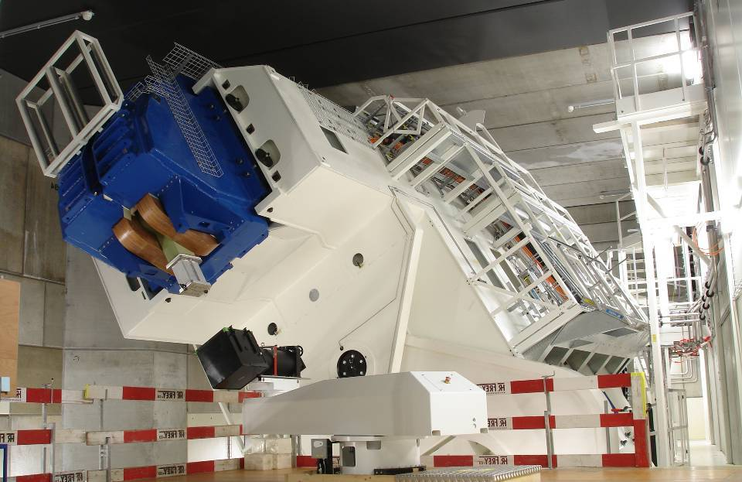
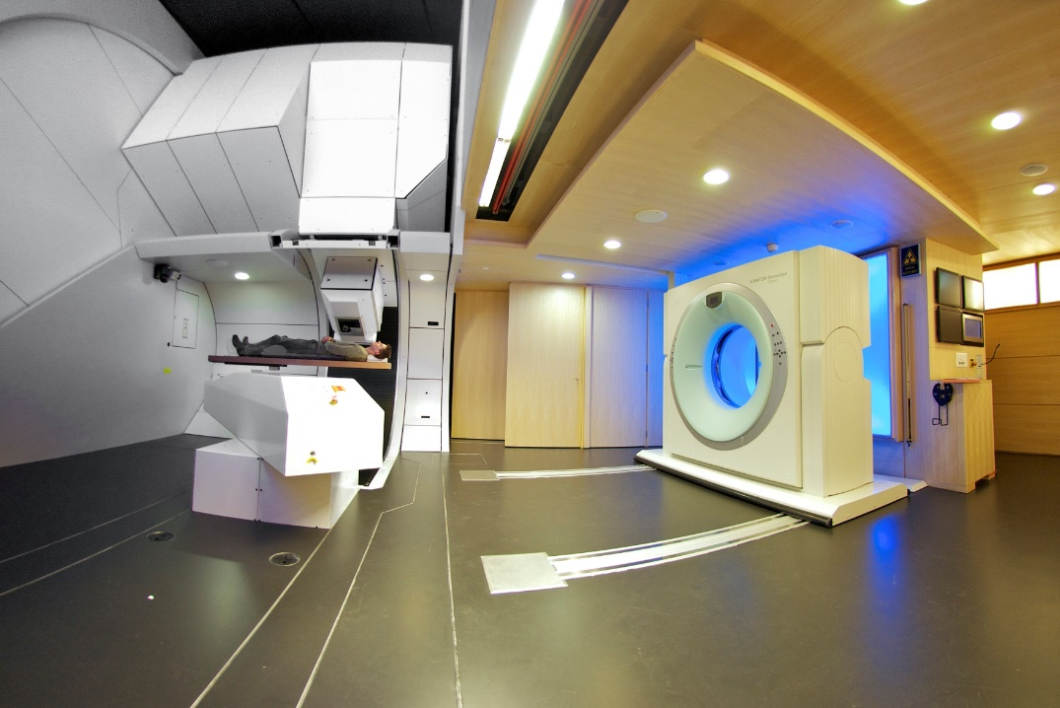
Clinical Concept and History of Protons (1954 – ongoing)
Pioneers of proton radiation therapy
Gantry 2, the 2nd generation of a scanning gantry, providing very fast re-scanning to treat mobile targets – design E. Pedroni for PSI
Gantry 2 under construction
Gantry 2 treatment room with CT on rails

Slide 21
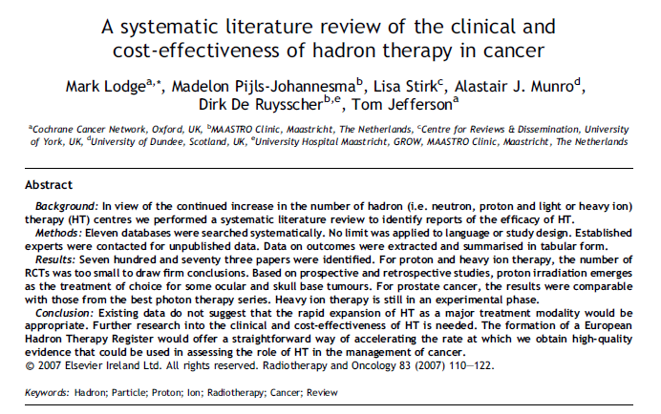
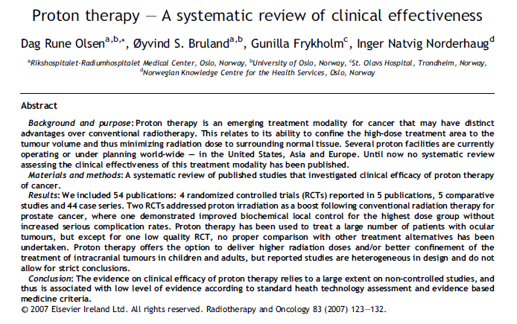

The evidence for clinical efficacy of proton therapy relies to a large extent on non-controlled studies, and is thus associated with a low level of evidence according to standard technology assessment and EBM criteria (RCTs etc)

Slide 22
The CATCH-22 of expensive equipment Expensive technology not readily available in academic centers
Generation of clinical evidence requires access to the new technology
clinical evidence is required to get funding of the heavy investments
Even if trials are performed, the technology is often outdated when the results are mature

Slide 23
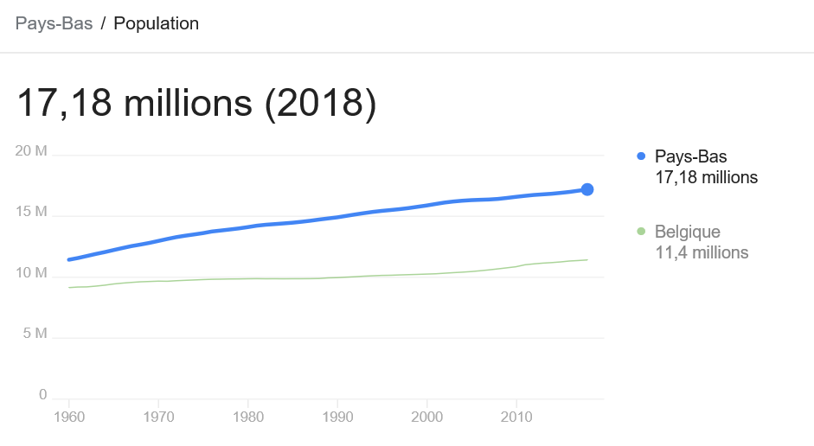
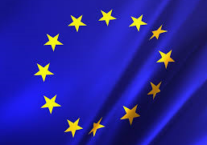
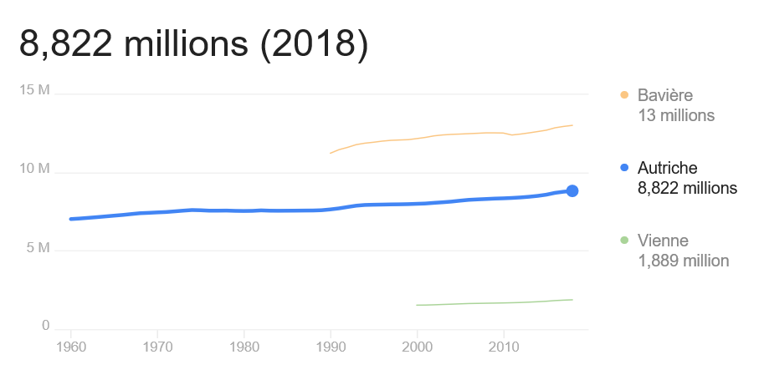
Proton therapy :: Europe

Slide 24
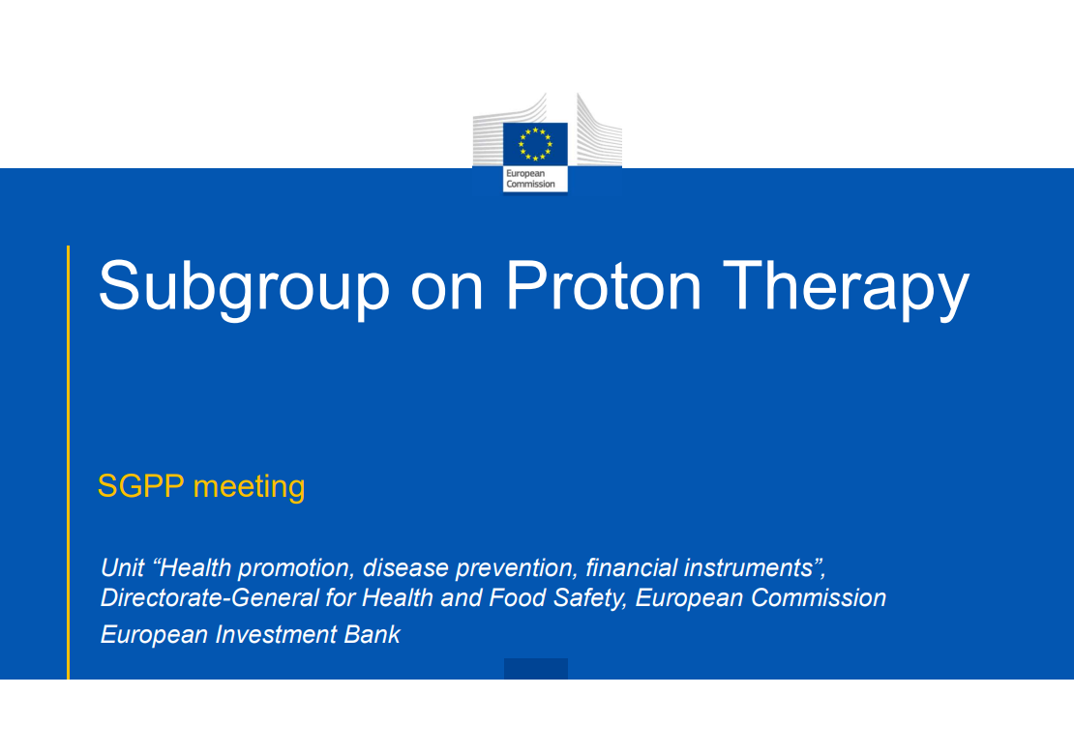

Slide 25
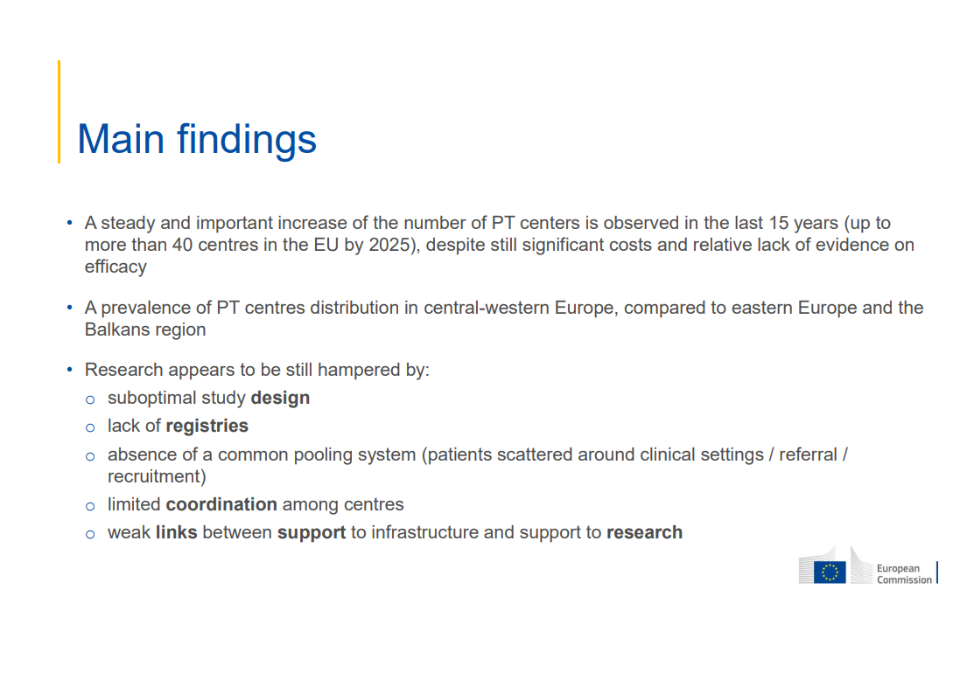

Slide 26
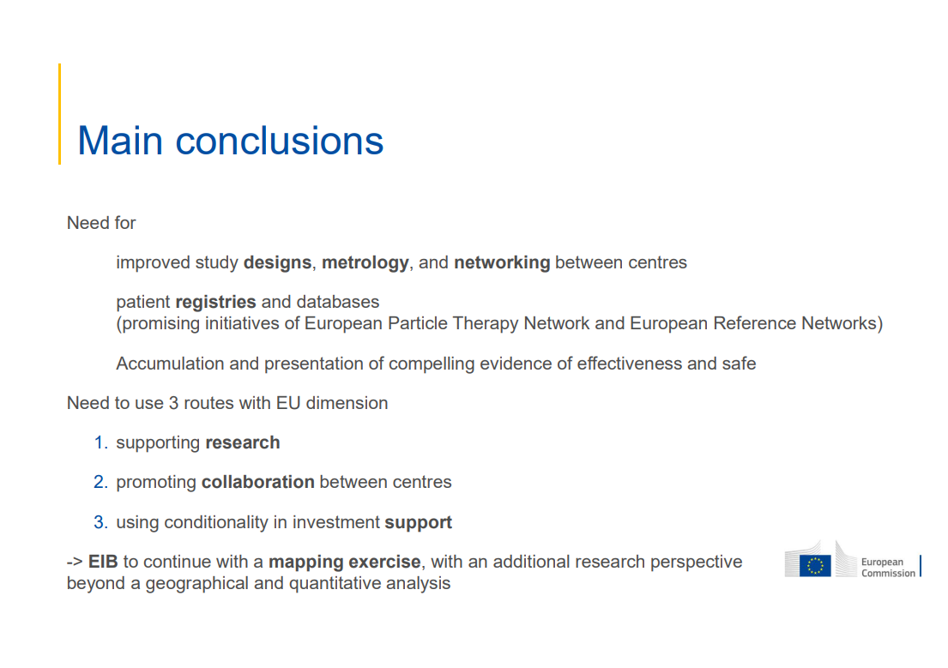

Slide 27
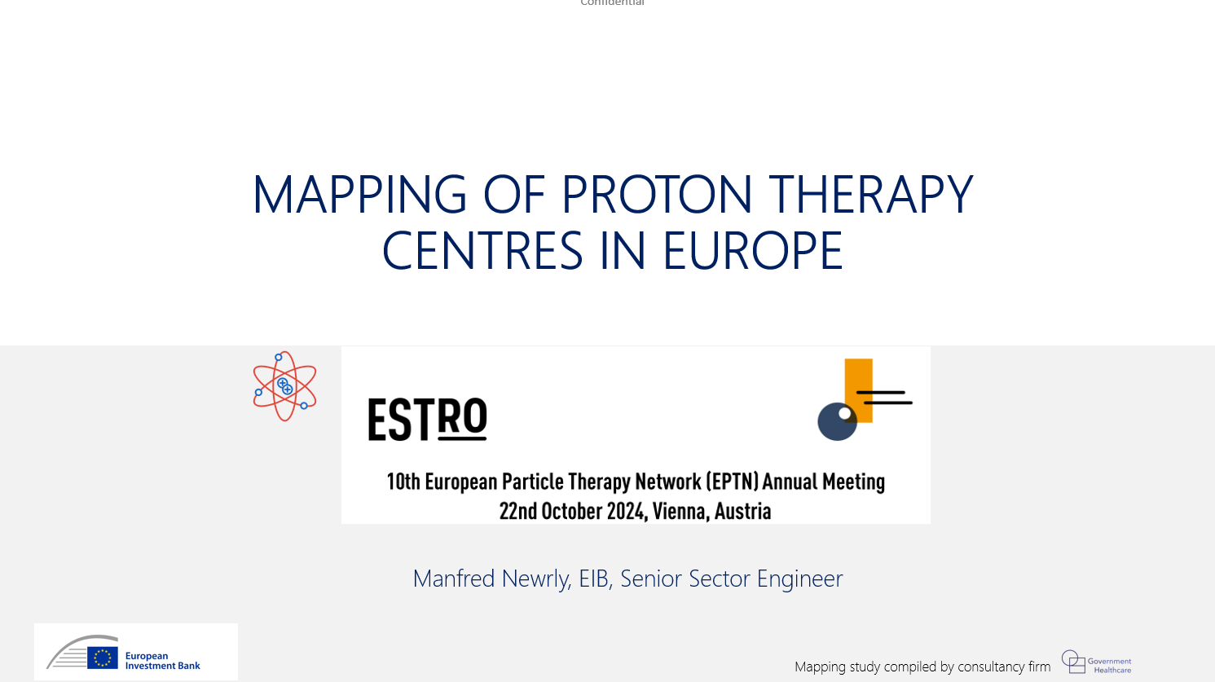


Slide 28


Slide 29


Slide 30




27 Proton Therapy Facilities in Operation in 13 Countries
Legend
MIT, Marburg
WPE, Essen
Countries surveyed in this study
UMC PTC, Groningen
Location of Proton Therapy Facilities in Operation
HollandPTC, Delft
Clatterbridge, Birkenhead
Skandion Clinic, Uppsala
Dansk centre for Partikelterapi, Aarhus
Christie PTC, Manchester
Centres are concentrated in the European Megalopolis (‘Blue Banana’), from Manchester to Northern Italy
HZB – Charité, Berlin
UCLH PTC, London
UPTD, Dresden
Maastro, Maastricht
IFJ PAN, Krakow
PARTICLE PC, Leuven
PTC Czech, Prague
CYCLHAD, Caen
MedAustron, Wiener Neustadt
CPO, Orsay
APSS, Trento
HIT, Heidelberg
CPT, PSI, Villigen
CNAO, Pavia
IEO, Milan
Quironsalud PTC, Madrid
CUN, Madrid
CAL/IMPT, Nice
INFN-LNS, Catania

Slide 31


Countries with an Institutional Indication Protocol tend to have more Indications
Country | Austria | Belgium | Czechia | Denmark | France | Germany | Italy | Netherlands | Poland | Spain | Sweden | Switzerland | United Kingdom
National or Institutional indication protocol | Institutional | National | Institutional | National | National | National | National (Unsure) | National | National (Unsure) | Institutional | National | Institutional | National
Brain and spinal cord tumours (Skull base tumours, meningiomas, low-grade gliomas, etc.)
Pediatric tumours
Eye tumours
Head-neck area tumours (Nasopharynx, paranasal sinuses, salivary glands, tonsils, eye socket, middle and inner ear)
Gastrointestinal tumours (Oesophageal cancer, anal and rectal cancer)
Prostate cancer
Lymphomas
Breast cancers
Lung cancer
Legend:
Validated indication
Validated indication for clinical trials
Model-based indication
This table represents indications at a given time that may have undergone changes.
Notes:
Confirmation that there is no consensus for most cancer types

Slide 32














No Uniform Reimbursement Amounts defined throughout Europe
€20,000 in total
Ca. €60,000 in total (€2k per session)
€12,000-€16,000
€50,000 in total
€30,000 to €140,000
Ca. €35,000 in total
Ca. €15,000 (€500 per session)
€20,000 to €30,000
€10,000 to €50,000
Ca. €28,000
€40,000 in total (€8,000 in advance)
Unknown, full treatment
To be defined
€ per patient
This graph represents insurance policies at a given time that may have undergone changes.

Slide 33


Discrepancy between Actual Patient Number and Potentially Benefitting Patients
Number of patients currently treated
An average of 223 adult patients per proton therapy centre, totalling 4,233 adult patients.
1,810,658 potential radiotherapy patients in Europe (ESTRO-HERO (2016))
Estimates
French National Institute of Cancer: 1,15% of all irradiated cancer patients could benefit from proton therapy
2,3% of all radiotherapy patients could benefit from proton therapy (and all paedriatric patients).
5% of all radiotherapy patients could benefit from proton therapy.
20,823 potential patients
47,489 potential patients
90,533 potential patients
*Tambas, van der Laan, Steenbakkers et al. (Current practice in proton therapy delivery in adult cancer patients across Europe, Radiotherapy and Oncology, Feb. 2022)
All figures are only indicative.

Slide 34
Conclusion
Proton therapy faces challenges…
Costs and Cost-effectiveness
capital expenditures
operational expenditures
Lack of clear and uniform indications
Financial and Logistical constraints regarding reimbursement, distance, etc.
…which can be mitigated by:
Well-established referral and reimbursement systems
Patients’ needs in terms of services and accommodation
Geographical positioning with an important local catchment area
Embedment of centres in medical facilities
Collection of patient data and high-quality randomized controlled trials

Slide 35


Winter School :: PSI 2026

