Slide 1
MuXmeeting 23/05/2025
Marie Deseyn

Slide 2
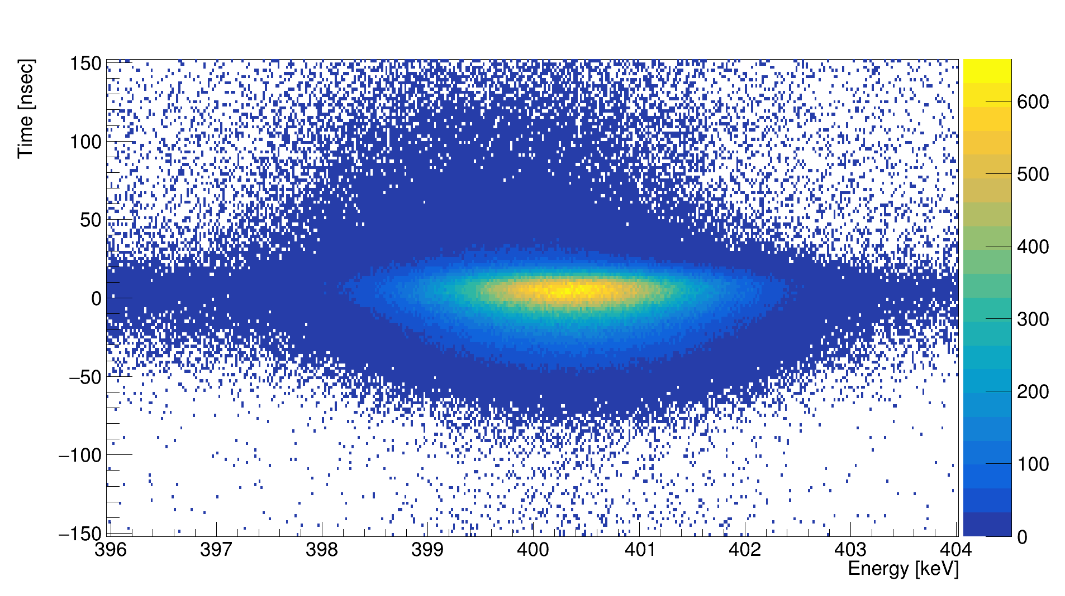
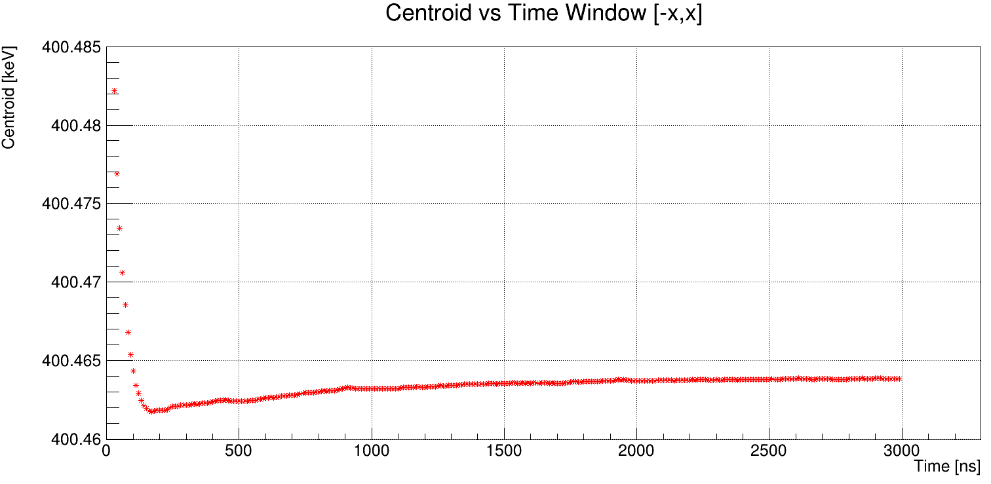
Risetime correction

Slide 3
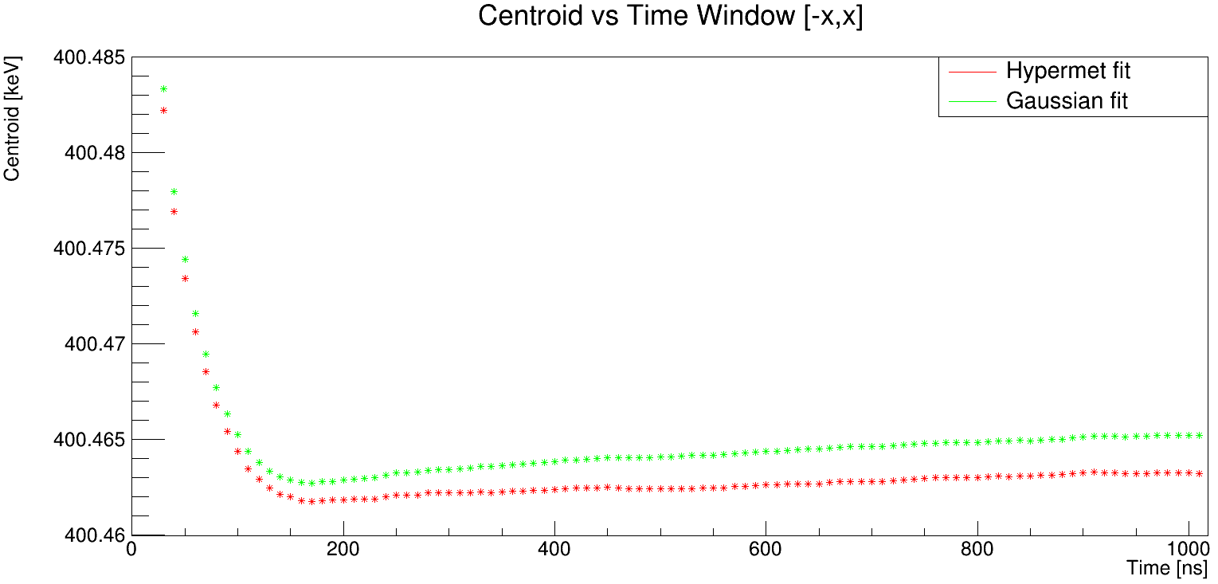
Risetime correction

Slide 4
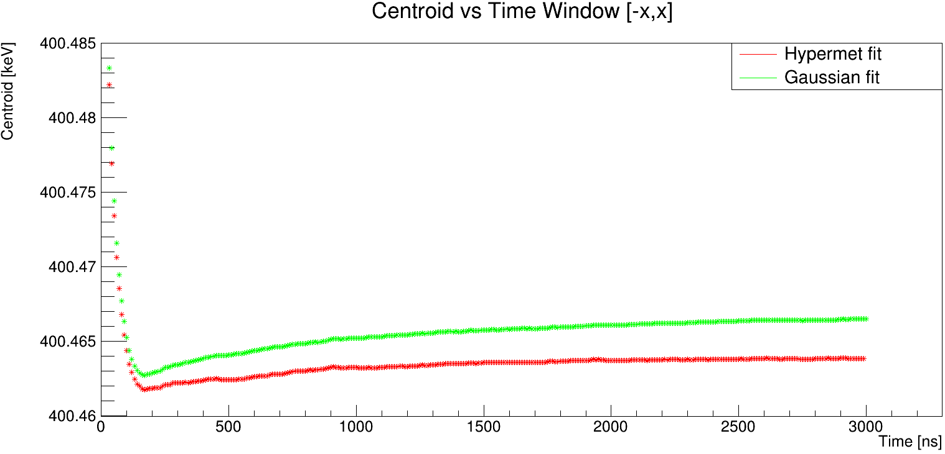
Risetime correction

Slide 5
Overview of the risetime correction
Make the energy vs. risetime graphs
Do the fits for the energy vs. risetime
Apply all the corrections (for all combinations of start and stop fraction)
Test the corrections
Make the fit for the time for this optimal set of parameters
Test the correction

Slide 6
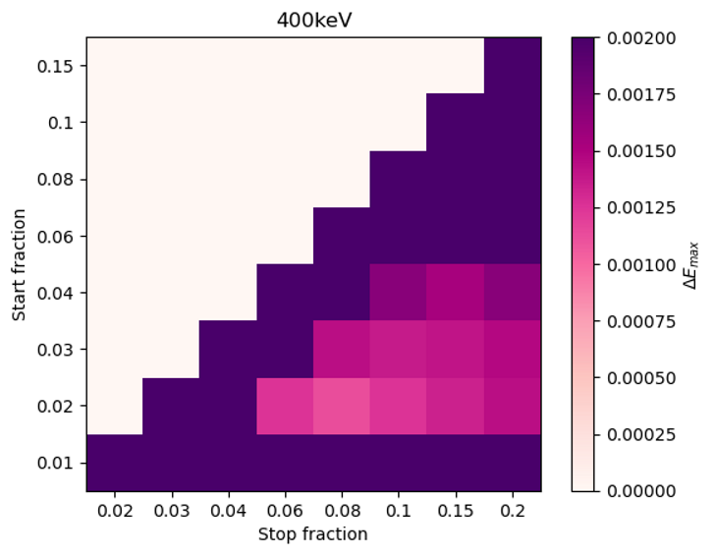
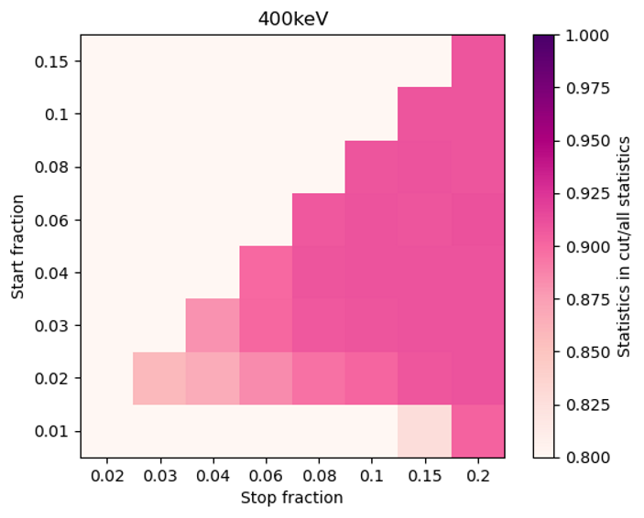
Overview of the risetime correction – Ge06

Slide 7
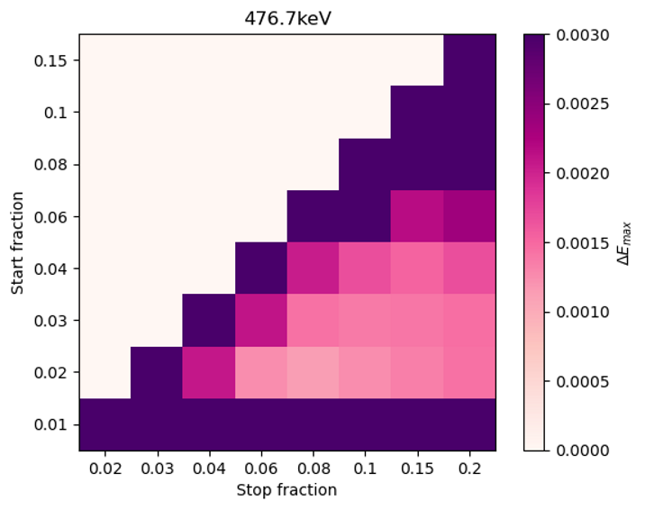
Overview of the risetime correction – Ge06

Slide 8
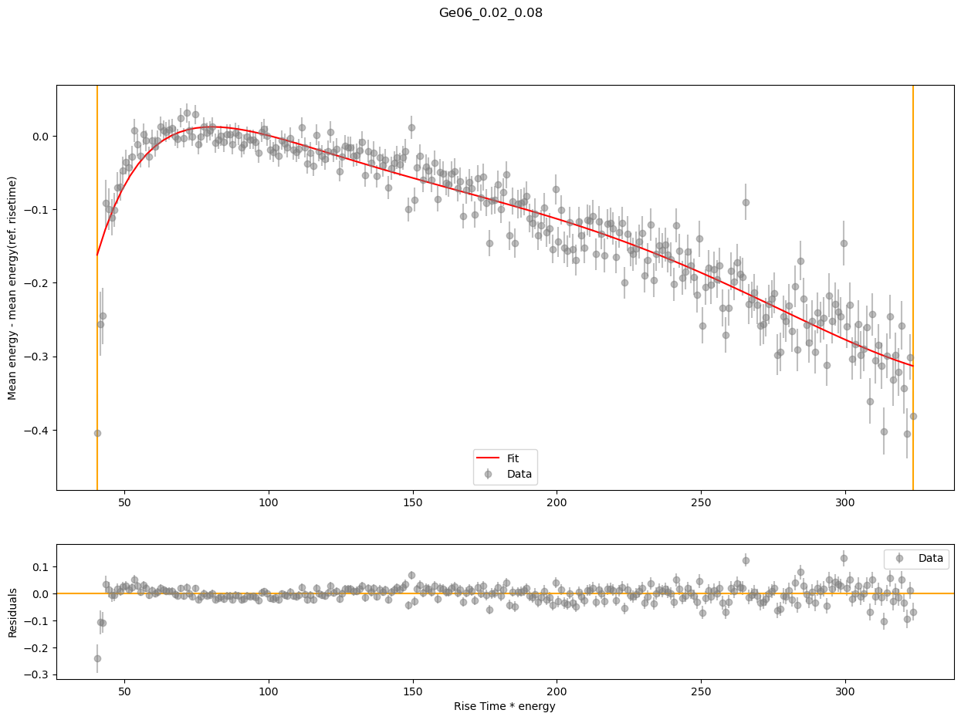
Overview of the risetime correction – Ge06

Slide 9
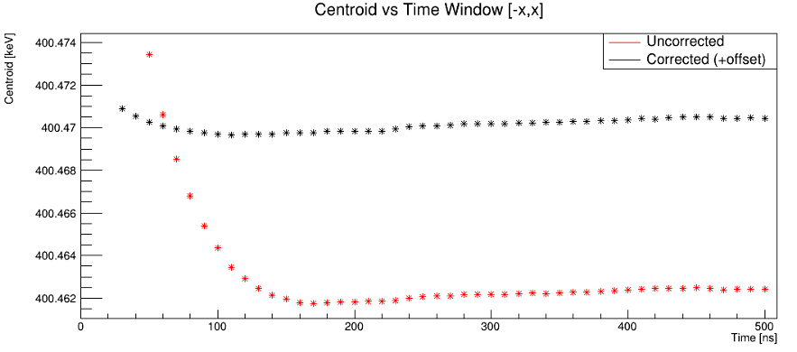
Overview of the risetime correction – Ge06

Slide 10
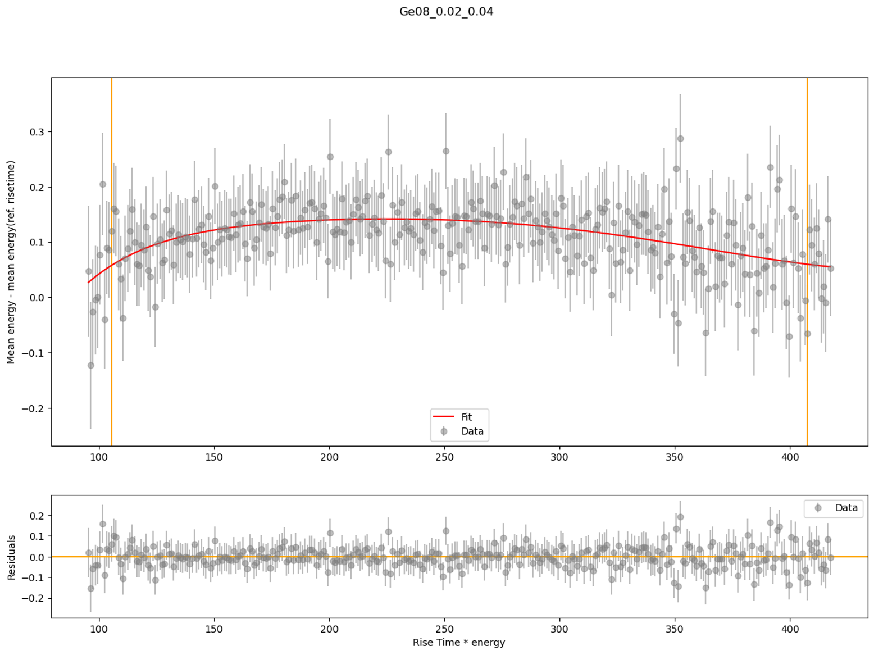
For some of them, fitting a bit further

Slide 11
Det | Lower th | Upper th | 400keV shift No corr [eV] | 400kev shift Corr [eV] | 400keV Statistics kept [-50,50]ns | 400keV Statistics kept [-500,500]ns | 476keV shift No corr [eV] | 476 keV shift Corr [eV] | 476keV Statistics kept [-50,50]ns | 476keV Statistics kept [-500,500]ns
Ge01 | 0.02 | 0.08 | 143.25 | 31.59 | 0.8918 | 0.8757 | 153.93 | 58.35 | 0.9210 | 0.9189
Ge02 | 0.01 | 0.06 | 48.13 | 14.56 | 0.8886 | 0.8995 | 43.73 | 19.01 | 0.8904 | 0.9004
Ge03 | 0.02 | 0.08 | 207.92 | 55.48 | 0.8912 | 0.8746 | 213.35 | 78.67 | 0.9177 | 0.9056
Ge04 | 0.01 | 0.04 | 3.57 | 0.76 | 0.9162 | 0.9108 |  |  | 0.9506 | 0.9437
MB05A | 0.04 | 0.1 | 5.10 | 3.08 | 0.9292 | 0.8985 | 12.21 | 5.31 | 0.9673 | 0.9265
MB05B | 0.08 | 0.1 |  | 2.29
Ge06 | 0.03 | 0.1 | 20.42 | 0.95 | 0.9330 | 0.9246 | 14.65 | 1.59 | 0.9386 | 0.9355
Ge07 | 0.04 | 0.06 | 21.00 | 3.94 | 0.9340 | 0.9036 | 15.69 | 15.08 | 0.9498 | 0.9399
Ge08 | 0.08 | 0.1 | 5.92 | 1.83 | 0.9243 | 0.9163 |  | 4.39 | 0.9382 | 0.9318
Ge09 | 0.04 | 0.15 | 21.61 | 1.25 | 0.9260 | 0.9188 | 20.42 | 6.47 | 0.9379 | 0.9360
Ge10 | 0.03 | 0.15 | 24.14 | 2.23 | 1.0309 | 1.0250 | 15.87 | 1.65 | 1.0484 | 1.0484
Ge11 | 0.03 | 0.1 |  | 1.07 |  |  | 10.2844 | 0.89
Ge12

Slide 12
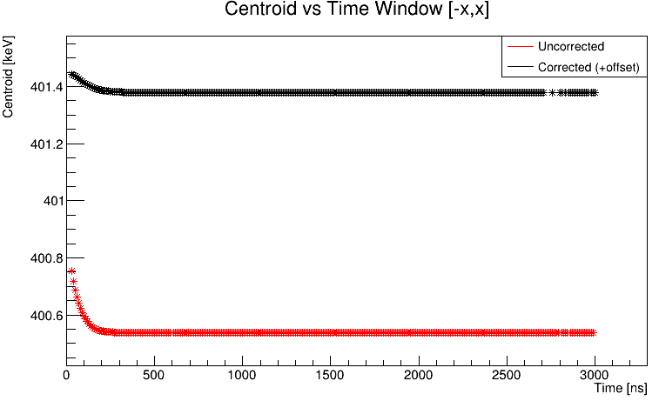
Risetime correction
Ge03

Slide 14
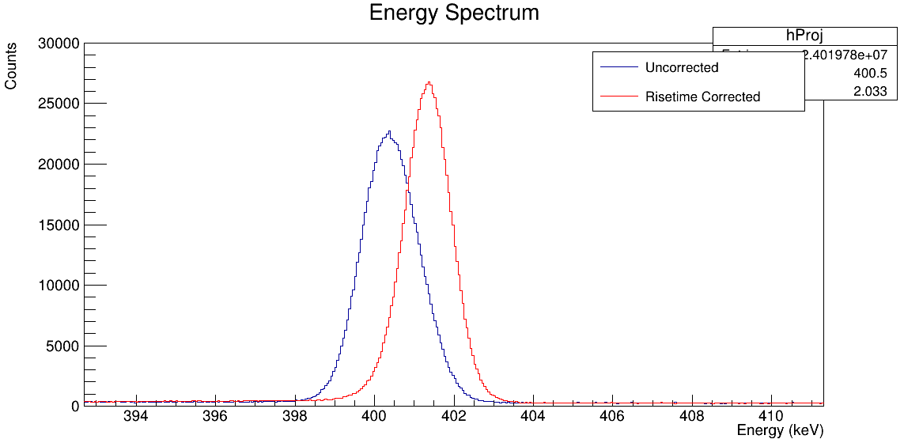
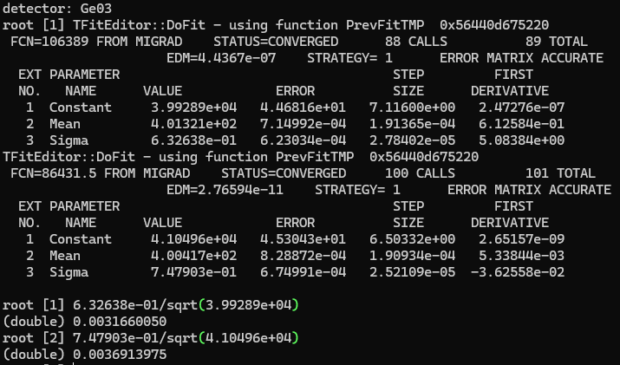
Evaluation of the correction in the calibration spectra – 400keV

Slide 15
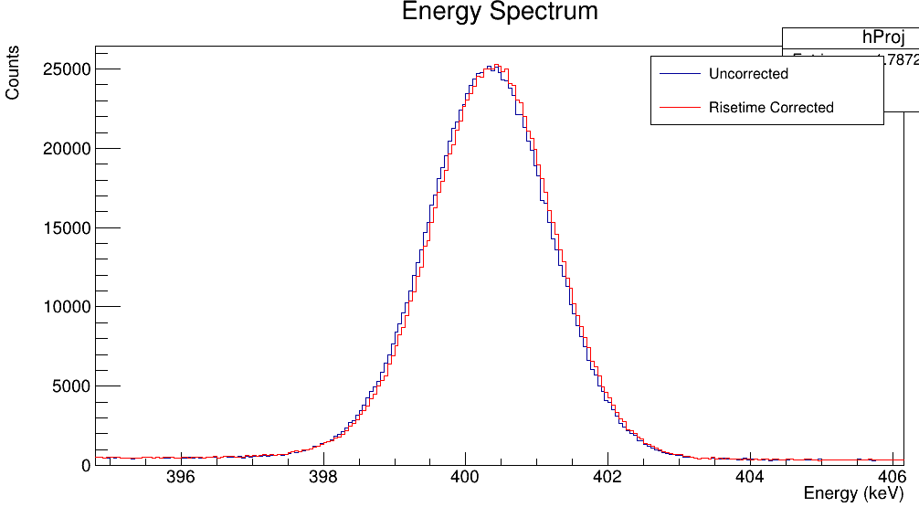
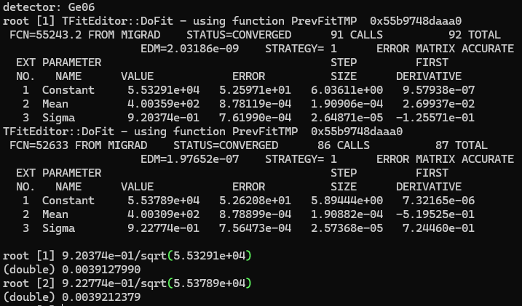
Evaluation of the correction in the calibration spectra – 400keV

Slide 16
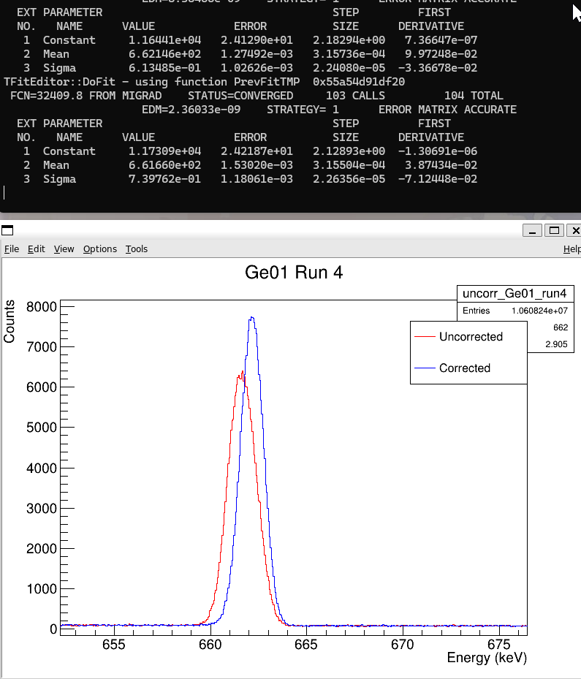

Evaluation of the correction in the calibration spectra – 662keV

Slide 17
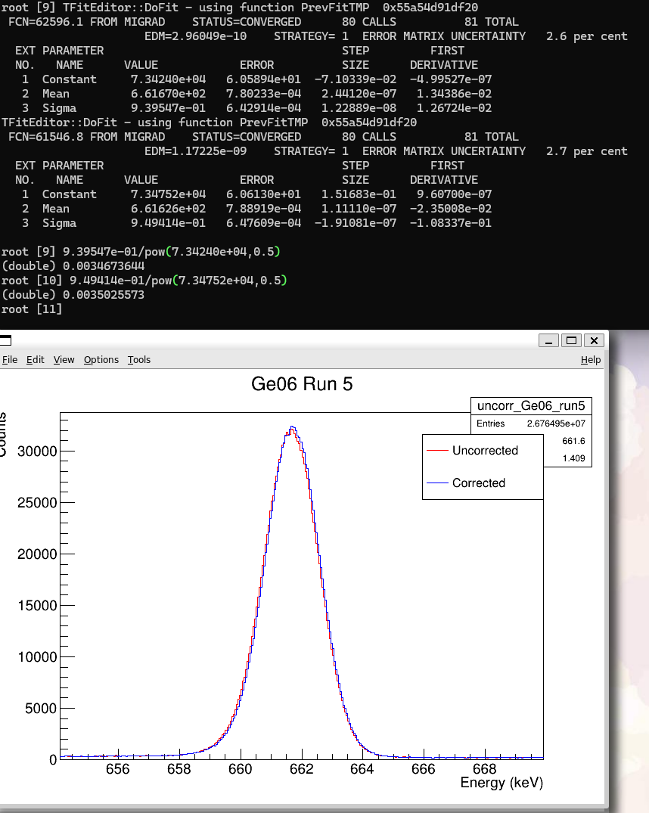
Evaluation of the correction in the calibration spectra – 662keV

Slide 18
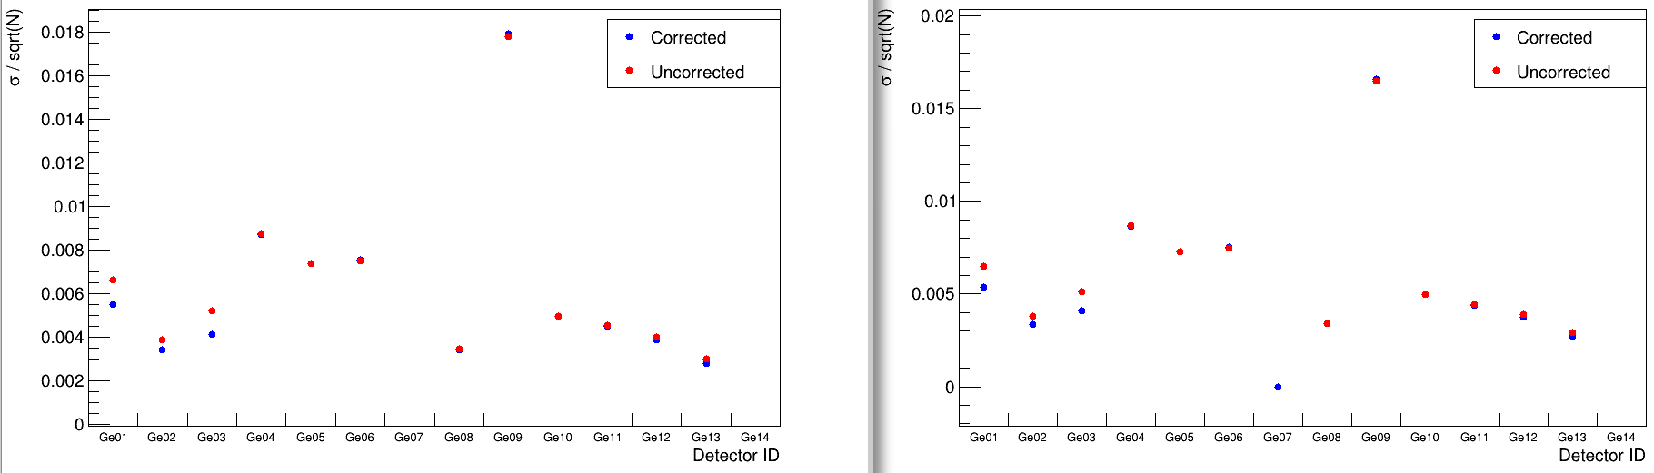
Evaluation of the correction in the calibration spectra
662keV peak

