Slide 1
Update 20/06
Michael Heines

Slide 2
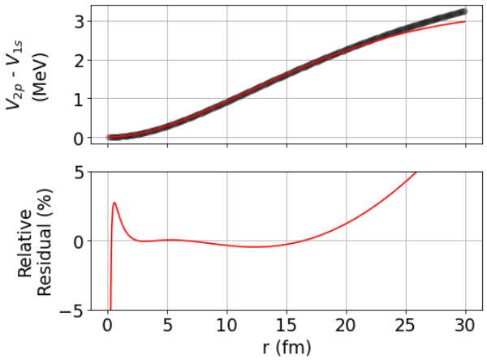
Extracting for K
Fit on Cl potential difference
Konstantin sent me potentials were weird
Turns out some unit conversion issue → Nucleus 5.3e4 too large?
New calculations make sense

Slide 3
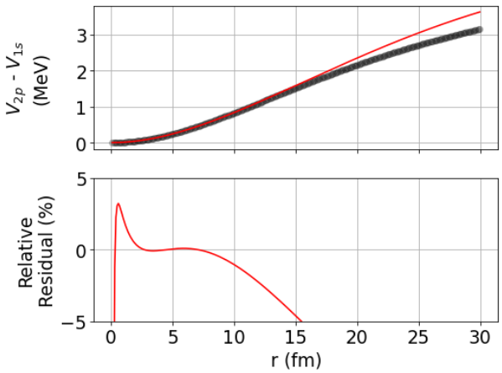

Extracting $k,α$ for ^{39, 40, 41}K
Fit on K potential difference with bad potentials
Konstantin sent me potentials were weird
Turns out some unit conversion issue → Nucleus 5.3e4 too large?
New calculations make sense

Slide 4
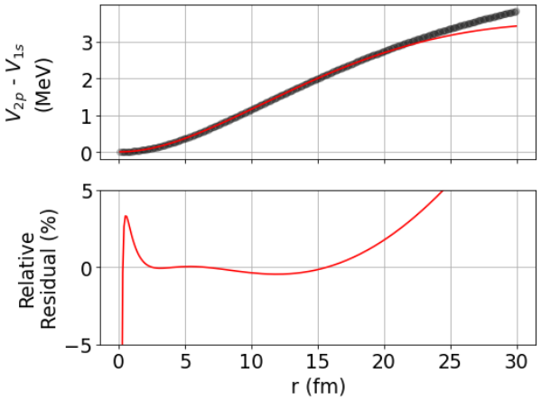
Extracting $k,α$ for ^{39, 40, 41}K
Fit on K potential difference with good potentials
Konstantin sent me potentials were weird
Turns out some unit conversion issue → Nucleus 5.3e4 too large?
New calculations make sense

Slide 5

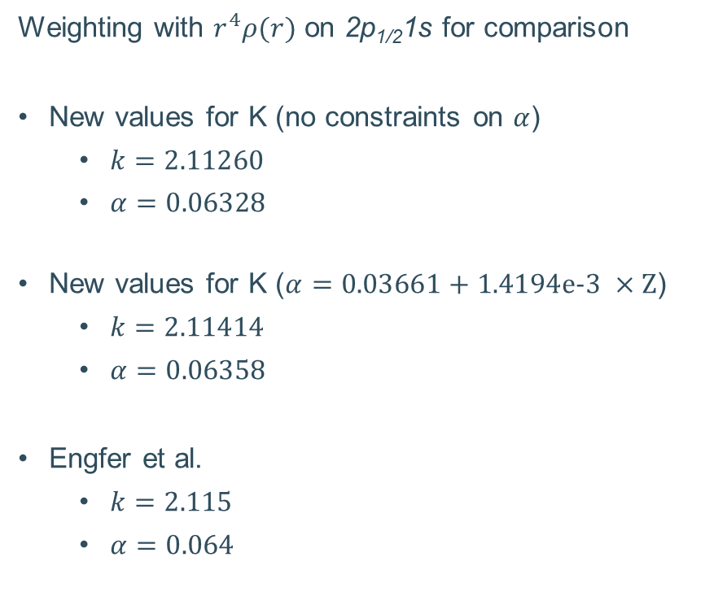
Do the extracted parameters make sense?
YES
Weighting with $r^{2}ρ(r)$
Values for Cl
  $k=2.09410$
  $α=0.05613$
Old values K
  $k=2.08513$
  $α=0.04094$
New values K
  $k=2.10329$
  $α=0.06133$
Weighting with $r^{4}ρ(r)$ on 2p_{1/2}1s for comparison
New values for K (no constraints on $α$)
  $k=2.11260$
  $α=0.06328$
New values for K ($α=\text{0.03661 + 1.4194}\text{e}\text{−3 }×\text{Z}$)
  $k=2.11414$
  $α=0.06358$
Engfer et al.
  $k=2.115$
  $α=0.064$
Notes:
k = 2.1141399 alpha = 0.0635786

Slide 6
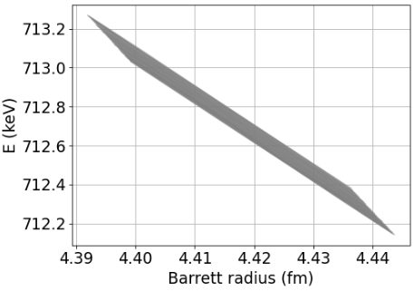
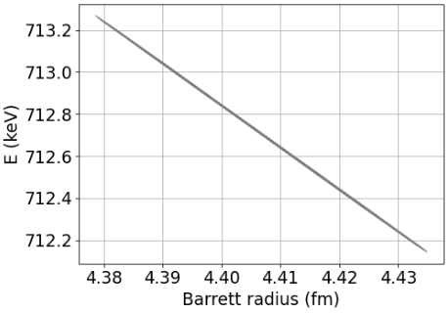


Residual model dependence
Old (bad) values: $±50$ eV
New (good) values: $±1$ eV

Slide 7
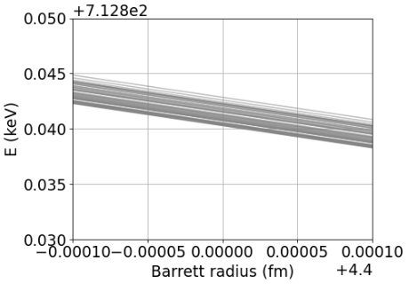
Residual model dependence
Limited by numerical errors of Riemann summing
→ Sufficiently fast, not really an issue
Approximate spread between lines
  1e-2 fm step size → 150 eV
  1e-3 fm step size → 12.5 eV
  1e-4 fm step size → 2.5 eV
  1e-5 fm step size → 1 eV
New (good) values: $±1$ eV

