Slide 1
Update 04/07
Michael Heines

Slide 2
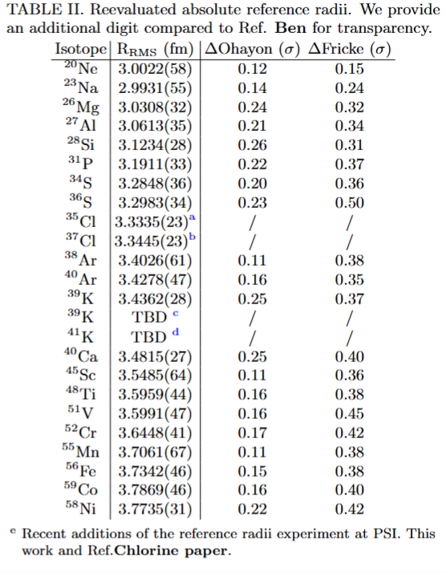
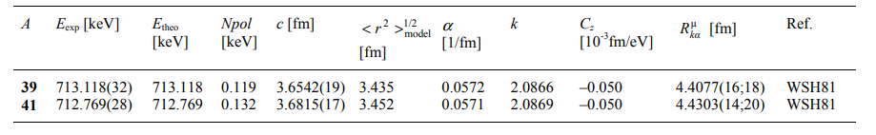
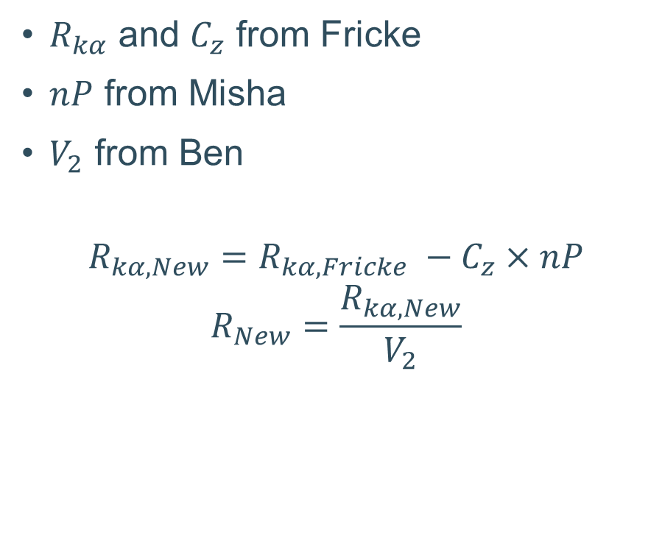
Recalculated references with nP
$R_{kα}$ and $C_{z}$ from Fricke
$nP$ from Misha
$V_{2}$ from Ben
$$R_{kα, New}=R_{kα, Fricke} −C_{z}×nP$$
$$R_{New}=\frac{R_{kα, New}}{V_{2}}$$

Slide 3
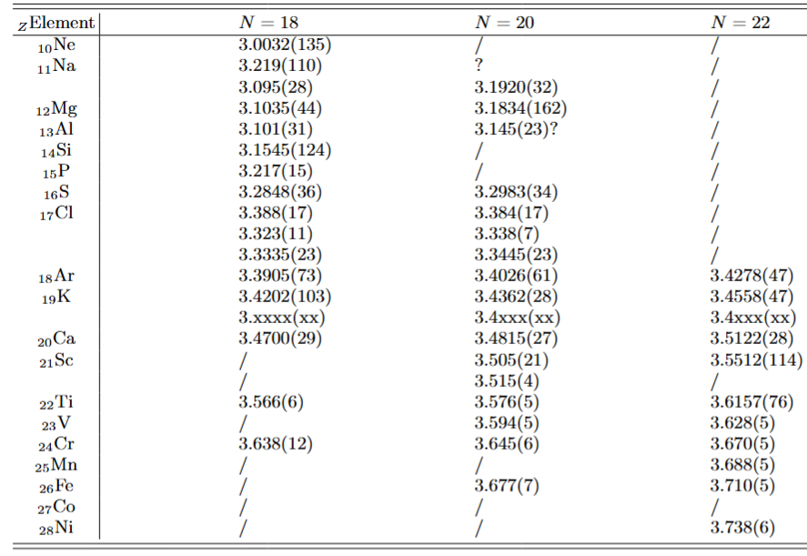

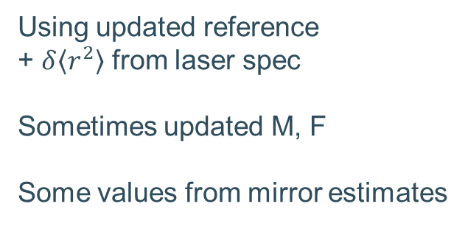
Calculate $R_{abs}$ for complete isotonic chains
Using updated reference
+ $δ\left\langle r^{2}\right\rangle$ from laser spec
Sometimes updated M, F
Some values from mirror estimates
Almost done apart from our updated K

Slide 4
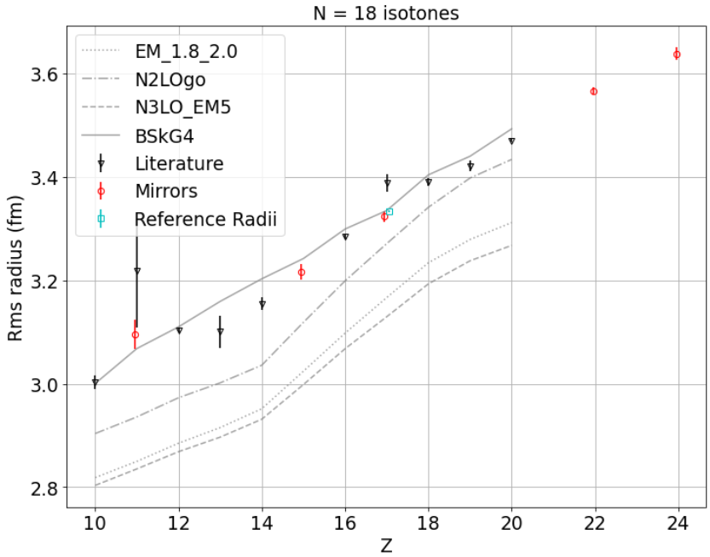
Absolute scale
Main conclusion
  EDF (BSkG) does great for absolute
  Ab initio (others) not too great
To do
  Waiting for a few last theory points
  Implementing BSkG as a band

Slide 5
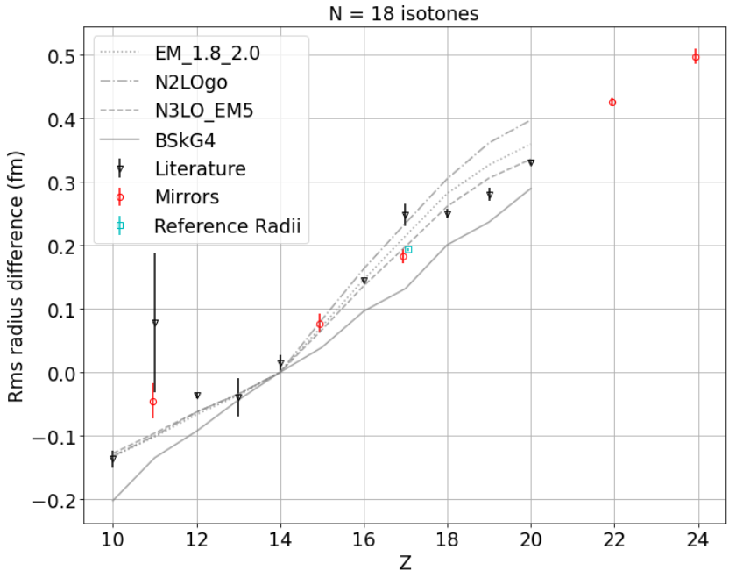
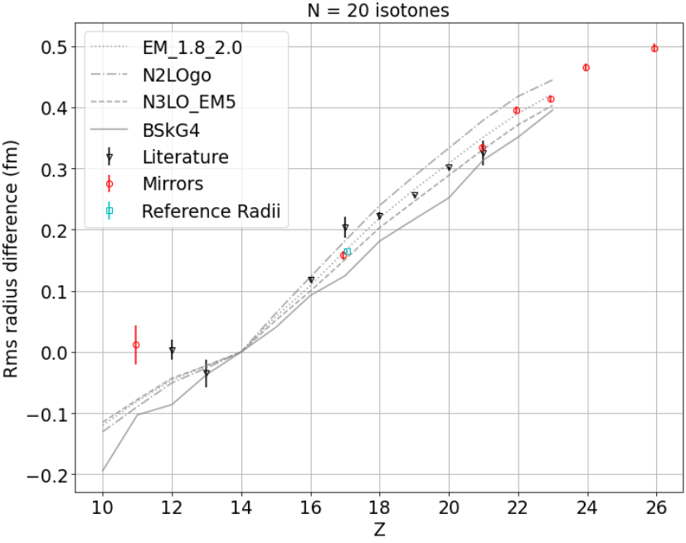
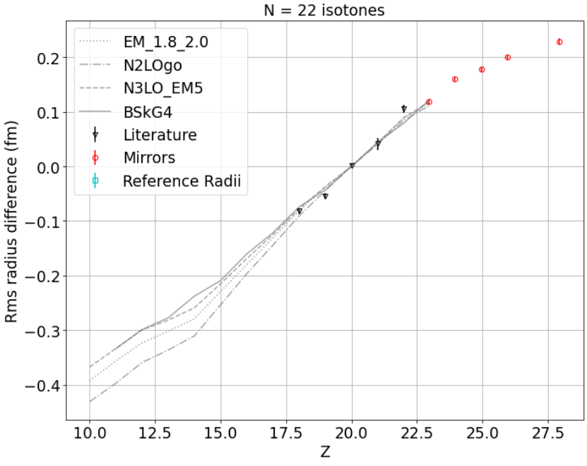
Differential scale
Kink at Z=14: Clear for N=18, indication for N=20
Kink at Z=20: Not clear indication
Flattening towards Z=28

