Slide 1

PhD and Postdoc Association
(PPA) at PSI
Welcome!
Nicola Rizzi :: Head of PPA PR Committee
Chiara Berretta :: Head of PPA Career Committee
Andrea Pappagallo :: Vice-President of PPA
Welcome Day :: July 1st , 2025

Slide 2



Why is PPA important?
PSI is not just a job – it is a community
PhDs and Postdocs
PSI Bodies

Slide 3






PPA Mission
Enable
Support
social life by organizing many different types of events
the community through difficulties at all stages of the PhD
Promote
Represent
scientific exchange among PhDs and Postdocs of different divisions
the interests of PhDs and Postdocs to the PSI administration

Slide 4
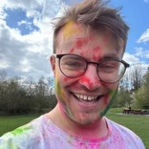
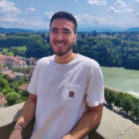
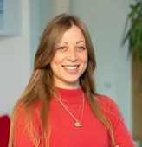
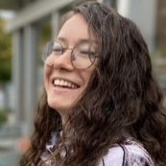
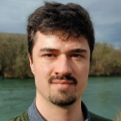
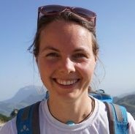
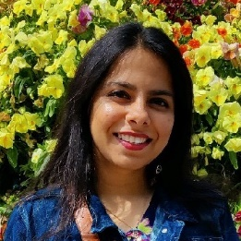
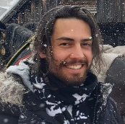
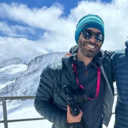






New PPA Board Organigram
ADMINISTRATIVE
President
Peter Seidel
Vice-President
Andrea Pappagallo
Treasurer
Giulia Malvicini
EVENT-ORGANISING COMMITTEES
EXECUTIVE
Career
Committee
Chiara Berretta
Scientific Committee
Flavien Museur
Green
Team
Deborah Walter
Social Committee
Cheshta Chopra
DEICO
Jolan
Tissier
PR
Committee
Nicola
Rizzi

Slide 5
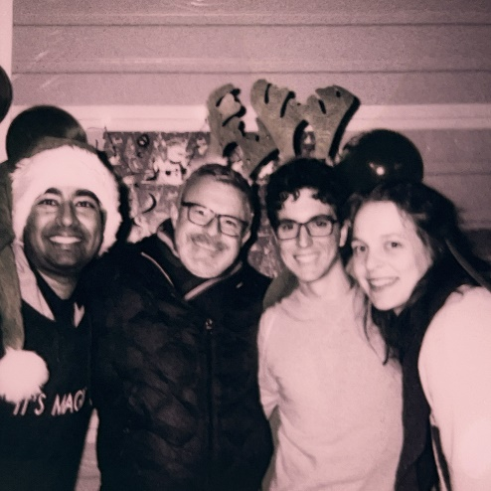
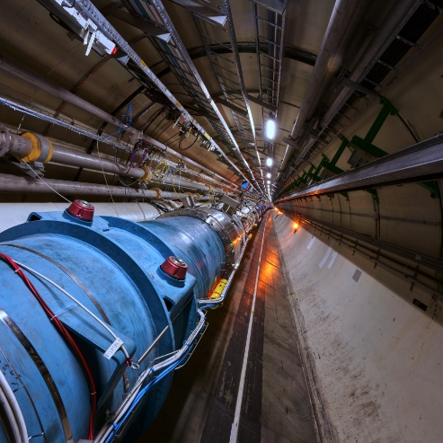
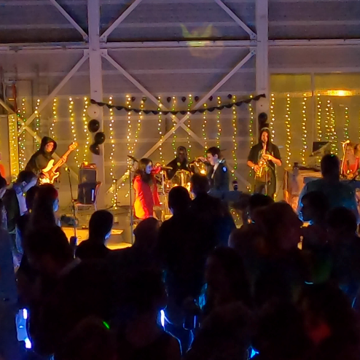
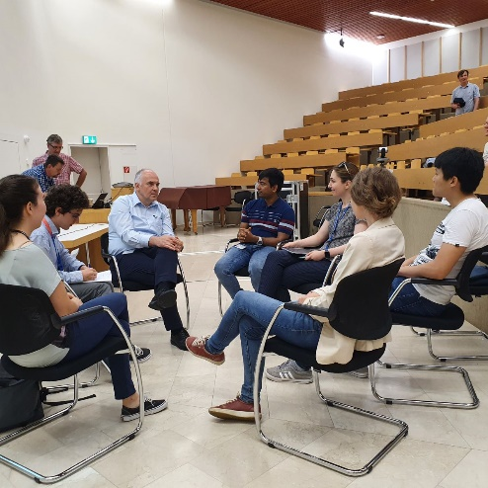
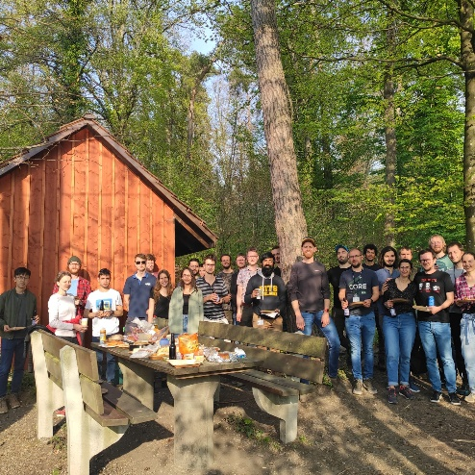
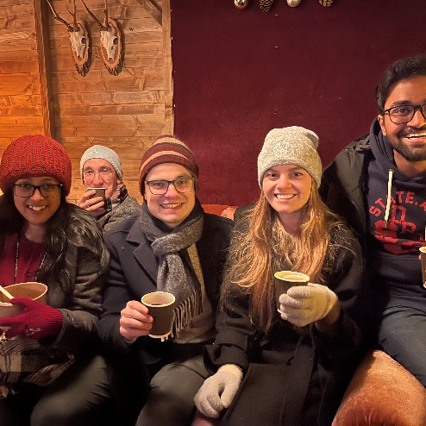
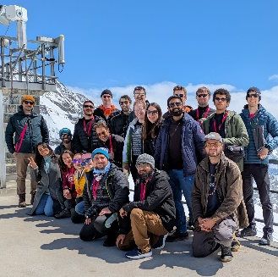
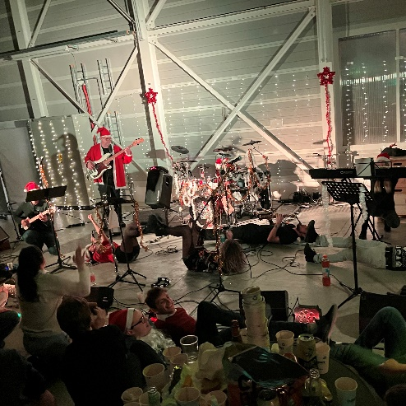
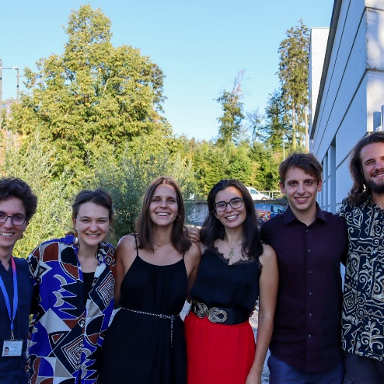
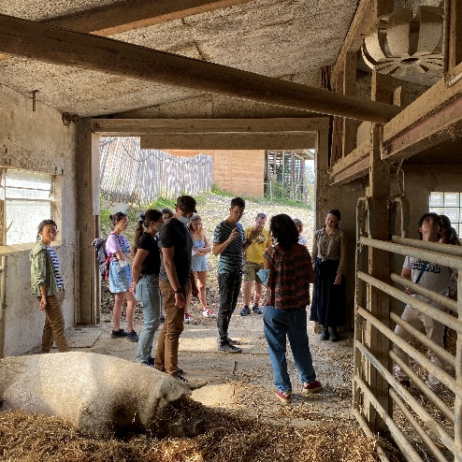
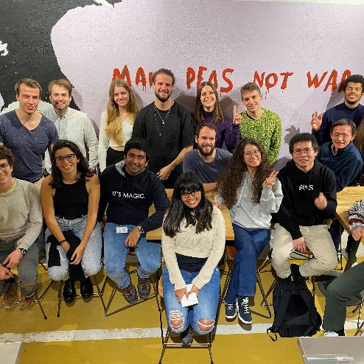
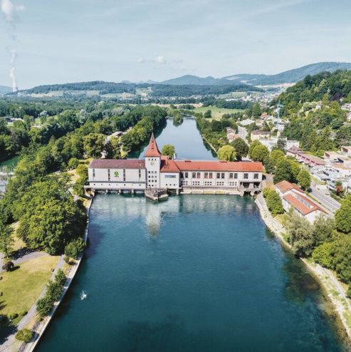
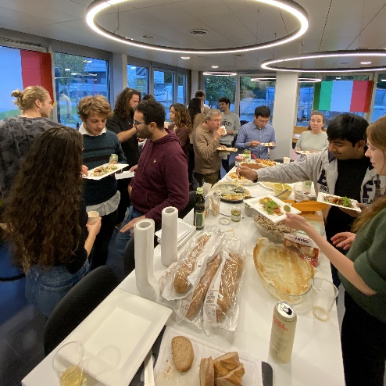
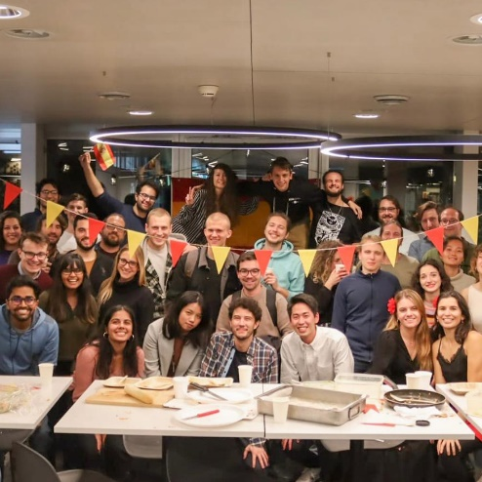
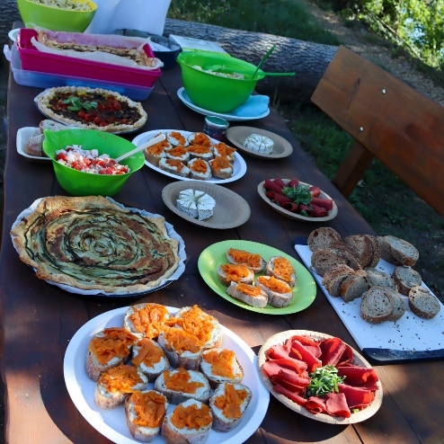
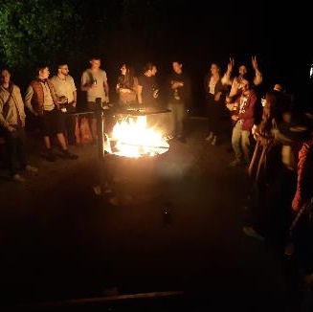
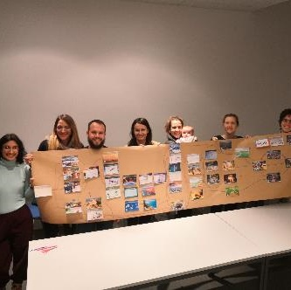
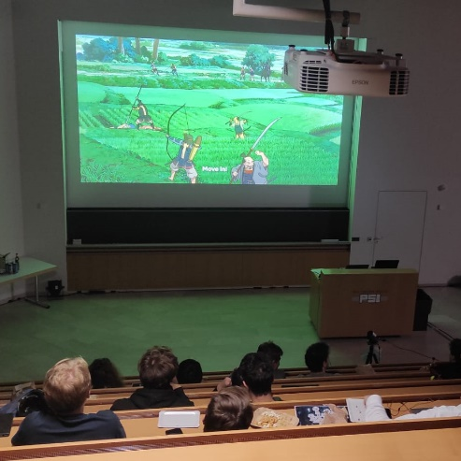
24 events last year, with up to 300 participants at single events

Slide 6

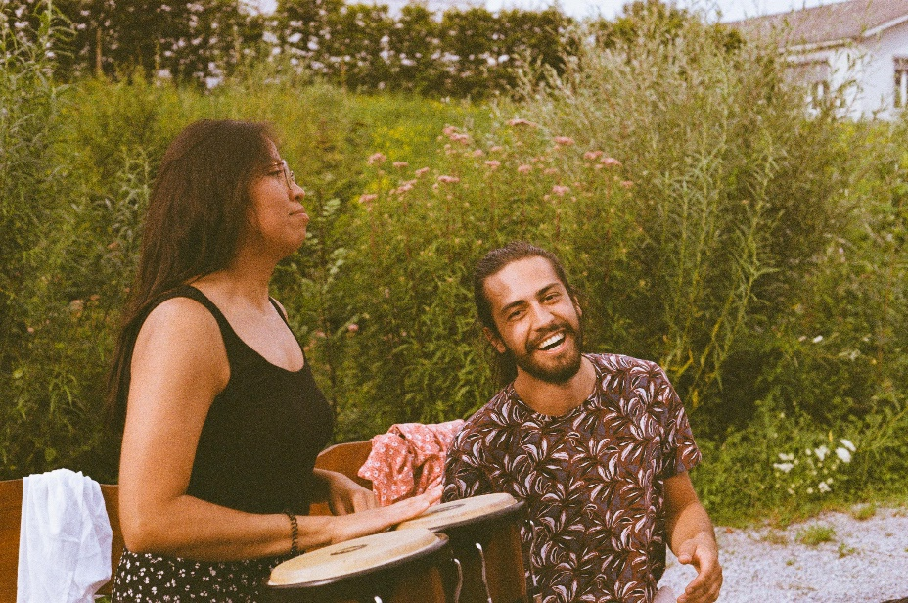
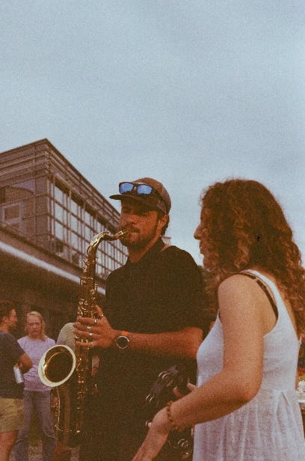
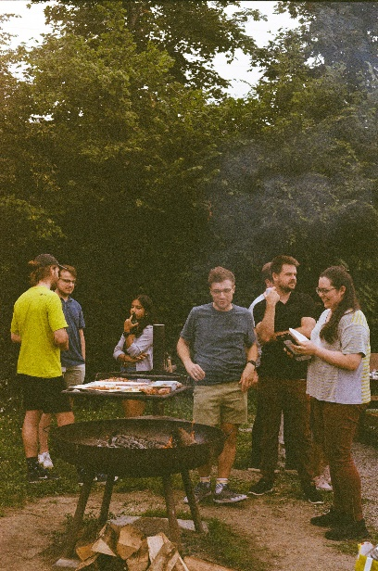
Upcoming this Summer
Jams by the river
PPA and Music Club join forces to cool these warm summer Fridays with good drinks, good food and good music. All for free!
Contact: jolan.tissier@psi.ch
July 18th, 17:30
August 22nd, 17:30
September 19th, 17:30
Sunset Rock vol.4
PSI's most famous summer concert will be back in August, featuring live bands and music festival vibes!
Contact: jolan.tissier@psi.ch
August, TBD

Slide 7
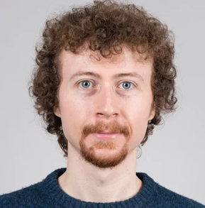
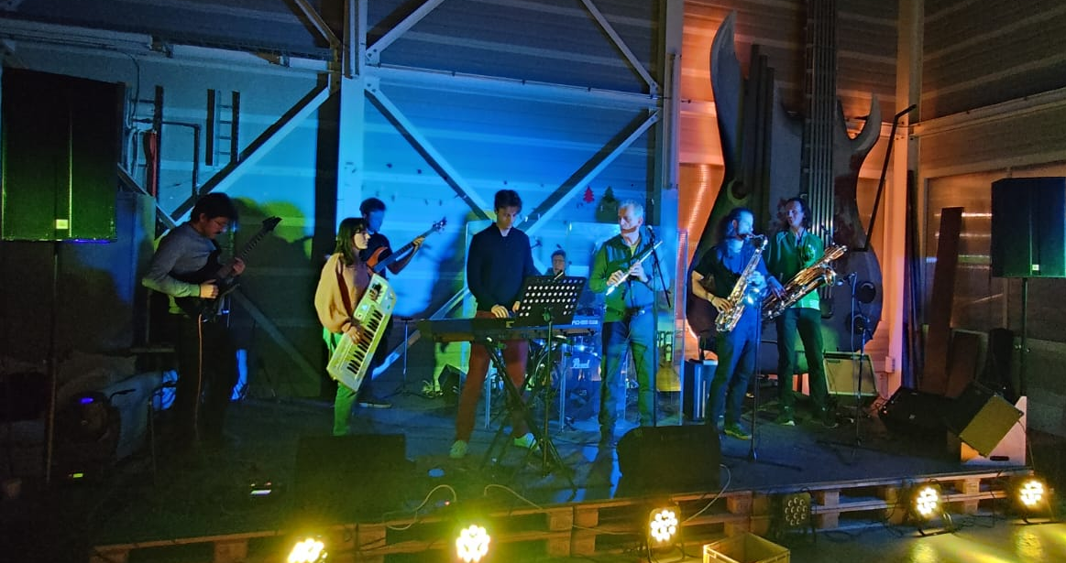
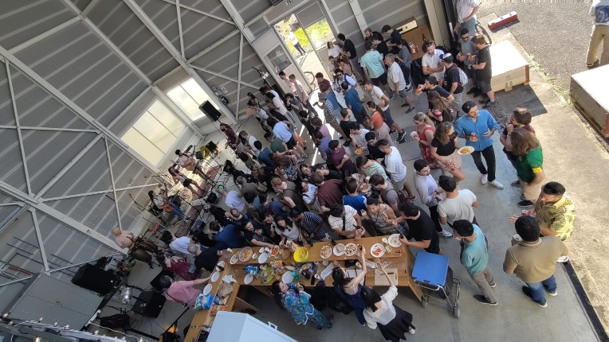
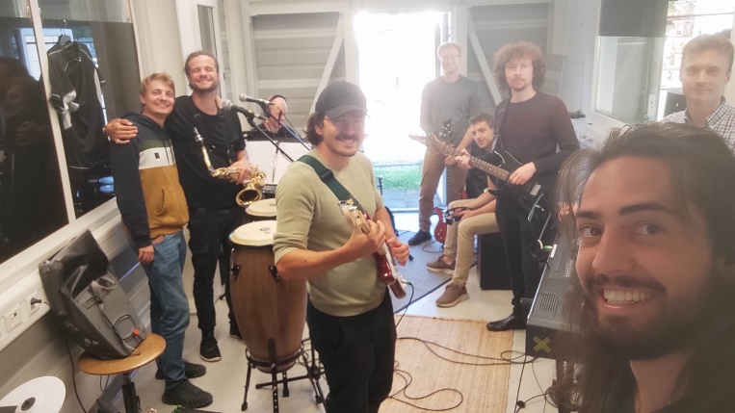
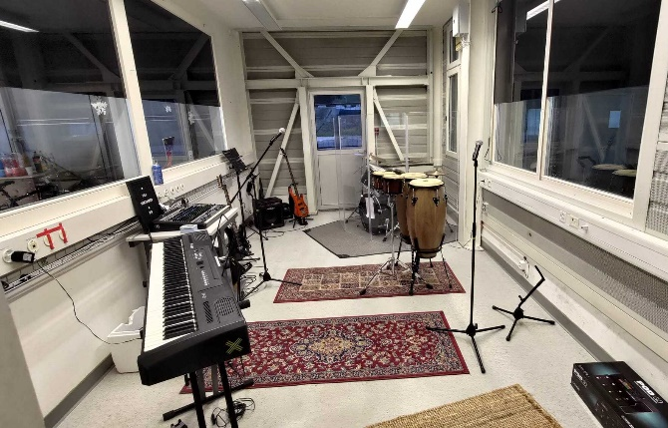
Music Club (not PPA)
  Meet us this Friday and the others!
  → Open Jam ←
  from ~18:00 at WSAE
  Visit our website: https://sportclub-psi.ch/sektionen/musik
  MC president: daniel.haynes@psi.ch
Daniel Haynes
daniel.haynes@psi.ch
Contact

Slide 8
I want to get involved!
  We usually meet on the last week of the month:
  The next meeting will be on
  Tuesday, July 22 at 11:00 AM in WBWB/021
  Visit our website: https://www.psi.ch/en/ppa
  Contact: phdassociation@psi.ch

Slide 9




Welcome to PSI – Join along!
Thank you! ☺ ↓ Get in touch with us ↓
phdassociation@psi.ch
General PSI chat
PPA Community

