Slide 1
EIDO Update
05 May 2025

Slide 2
SLS

Slide 3
BEC
BEC
Streamline the integration of new devices with bespoke Ophyd signals
  PreviewSignal (data stream for visualization)
  ProgressSignal (device / scan progress)
  AsyncSignal (fly scanning updates)
  …
TOMCAT and PX-II will receive first beam on Wednesday

Slide 4
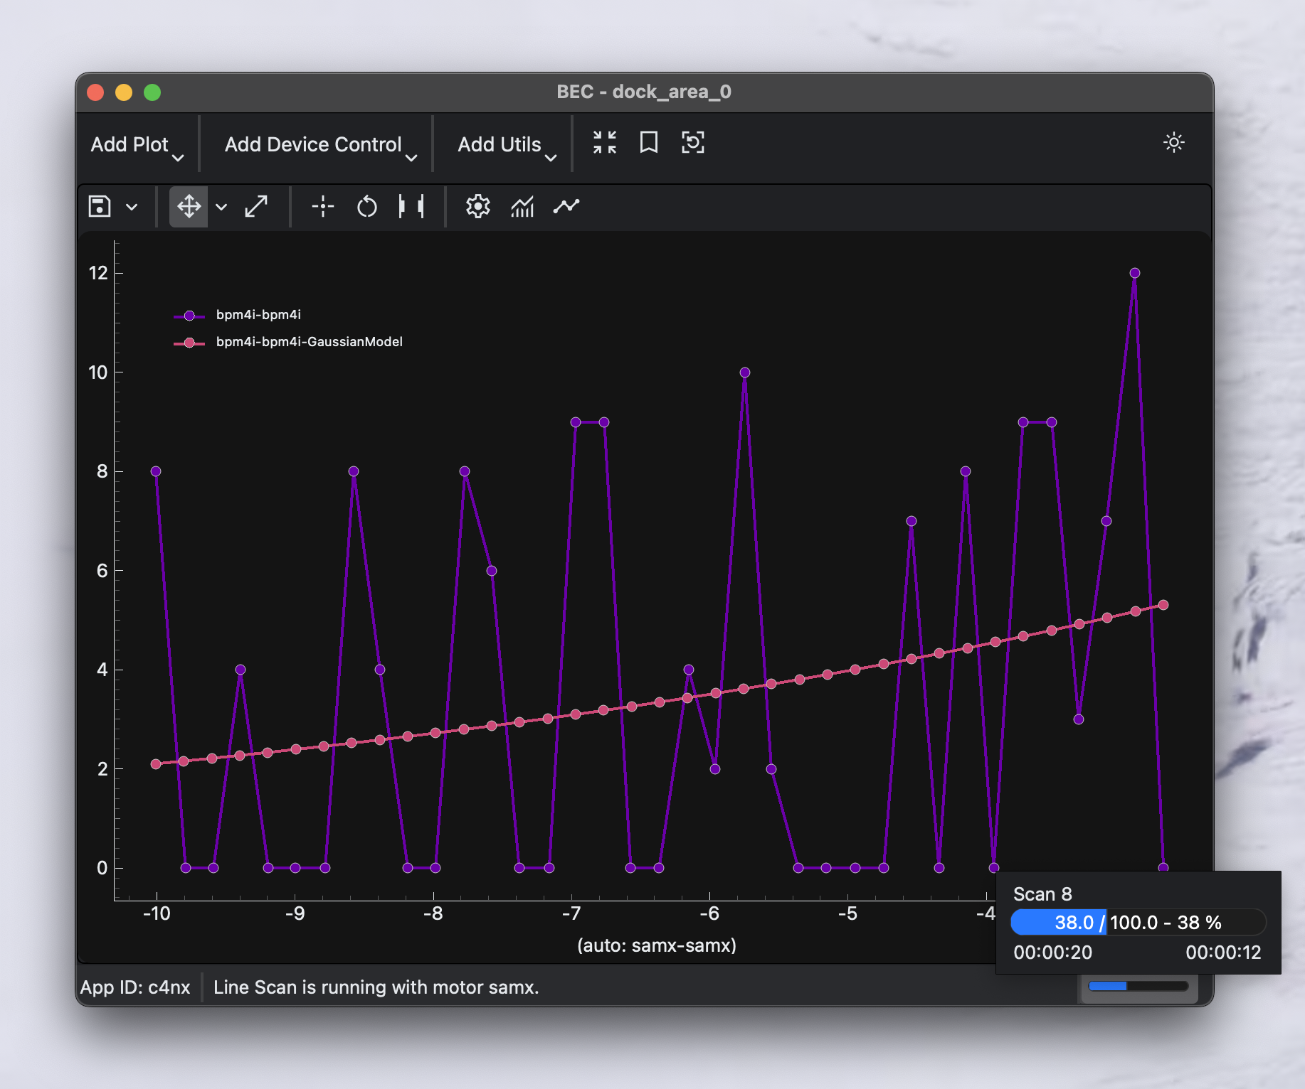
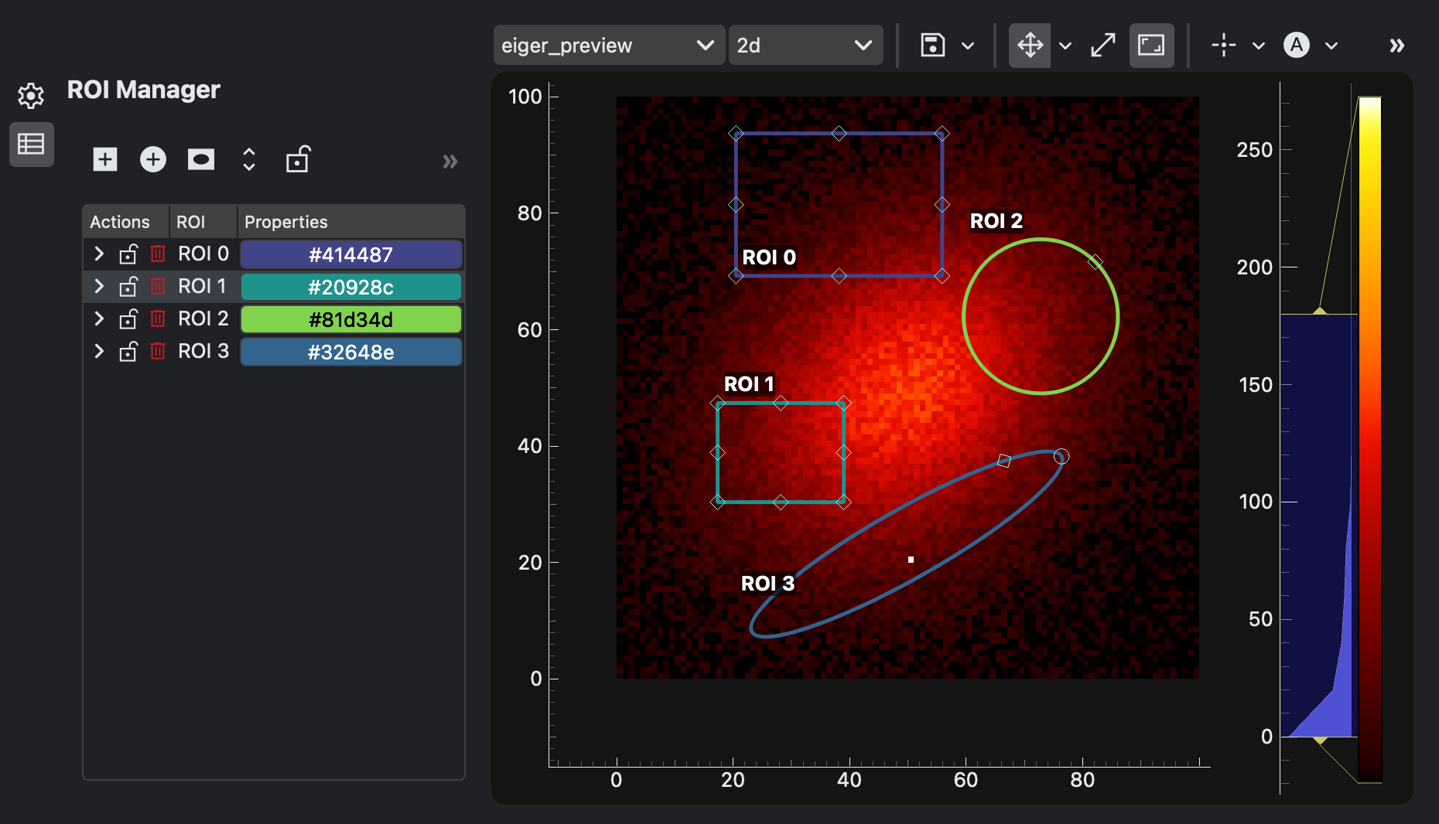
BEC update
BEC Widgets
ROI Manager
Status Bar
  Client Info Message
  Scan Progress

Slide 5
SwissFEL

Slide 6
SwissFEL
General
Incident: full camera picture channel added to epics buffer (meant for, e.g., motor positions)
  Filled the entire memory before eviction triggered → frozen DAQ until hard reboot
  Safeguards added:
    Limited docker container memory → only crash one epics buffer instance
    Check names when adding channels, raise if picture channel
Problems with bitshuffle on multi-core machine
  Solution in preparation with Andrej
Working with Alvise on self-service web app (slurm reservation, pgroup deletion, etc.)
  New UI, backed review
sf-daq migration gitlab → gitea done

Slide 7
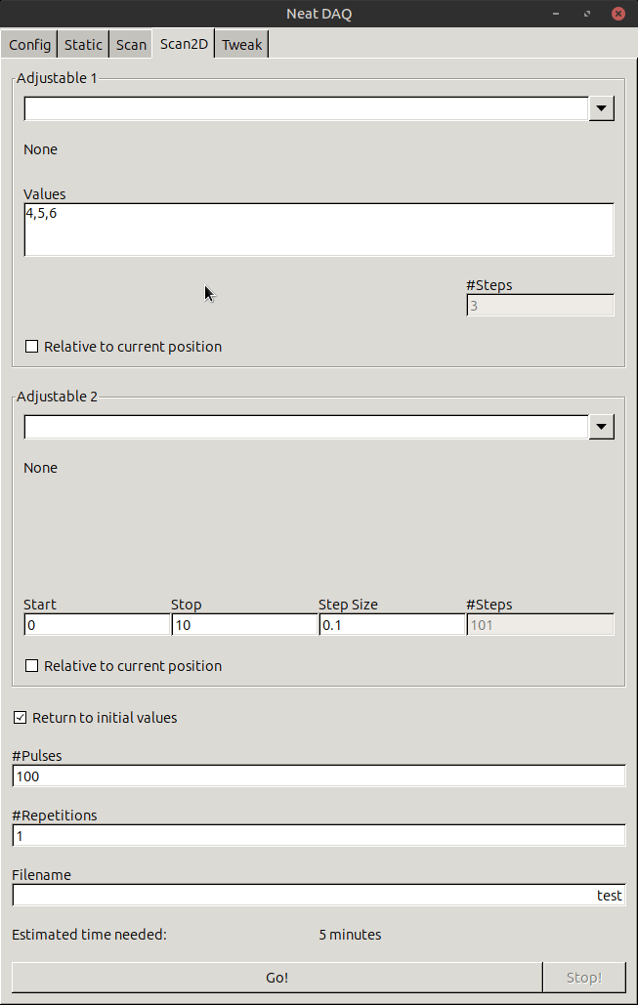
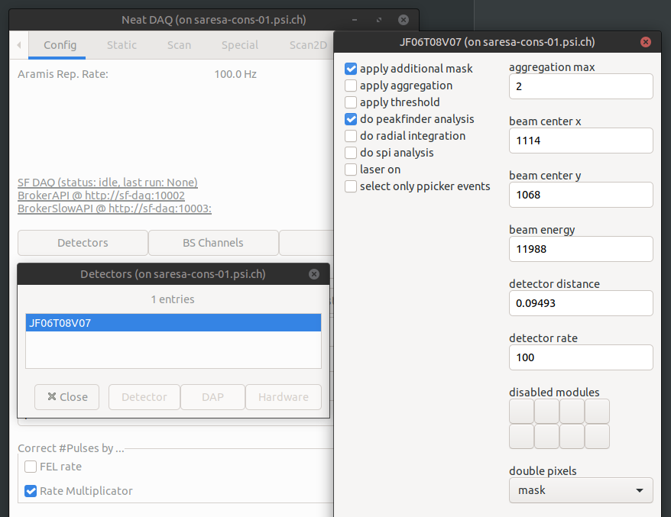
SwissFEL
slic
Python 3.13 compatibility (probably 3.14, if deprecation warnings are considered complete)
New GUI features:
  Adjust ALL Jungfrau settings.
  Switch between Range and Sequence mode for scans.

Slide 8
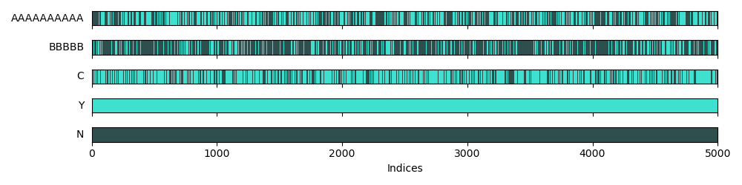
SwissFEL
Jungfrau Utils
New feature: downsampling/projection within specified ROIs
sfdata
New feature: added plot missing pulses (when in a run is data missing):

