Slide 1

Ion extraction studies
IMPACT/TATTOOS
Maryam Mostamand
PSI, 3 July 2025

Slide 2
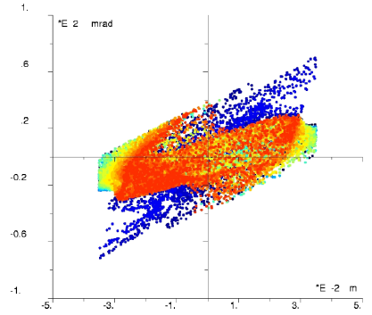
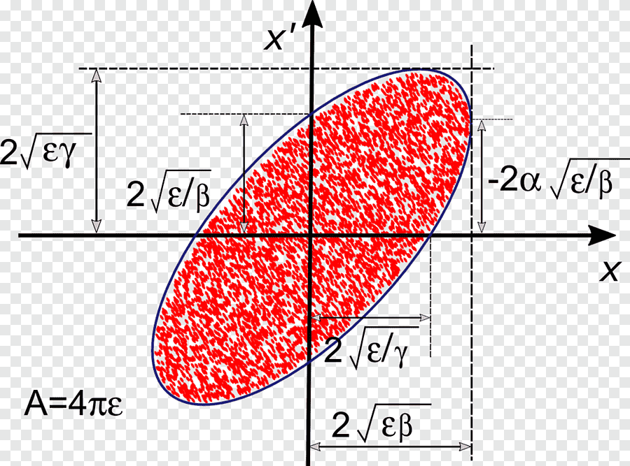
Main Content
Objective:
Beam parameters: Emittance, Energy spread, Beam focusing (COMSOL Simulations)
Previous studies: TRIUMF, ISOLDE
Different electrodes/configurations and their impact on beam parameters
S. Warren’s presentation!

Slide 3
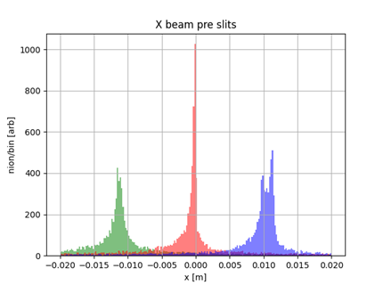
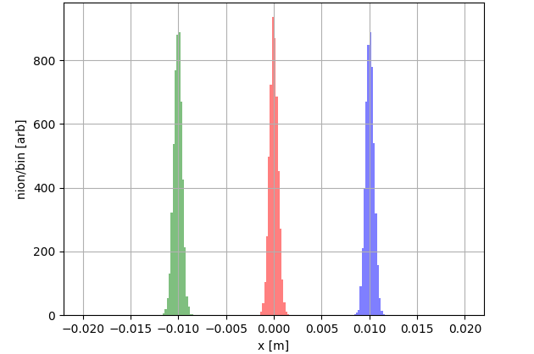
Objective
Ideal
Graphs from S. Warren’s calculations

Slide 4
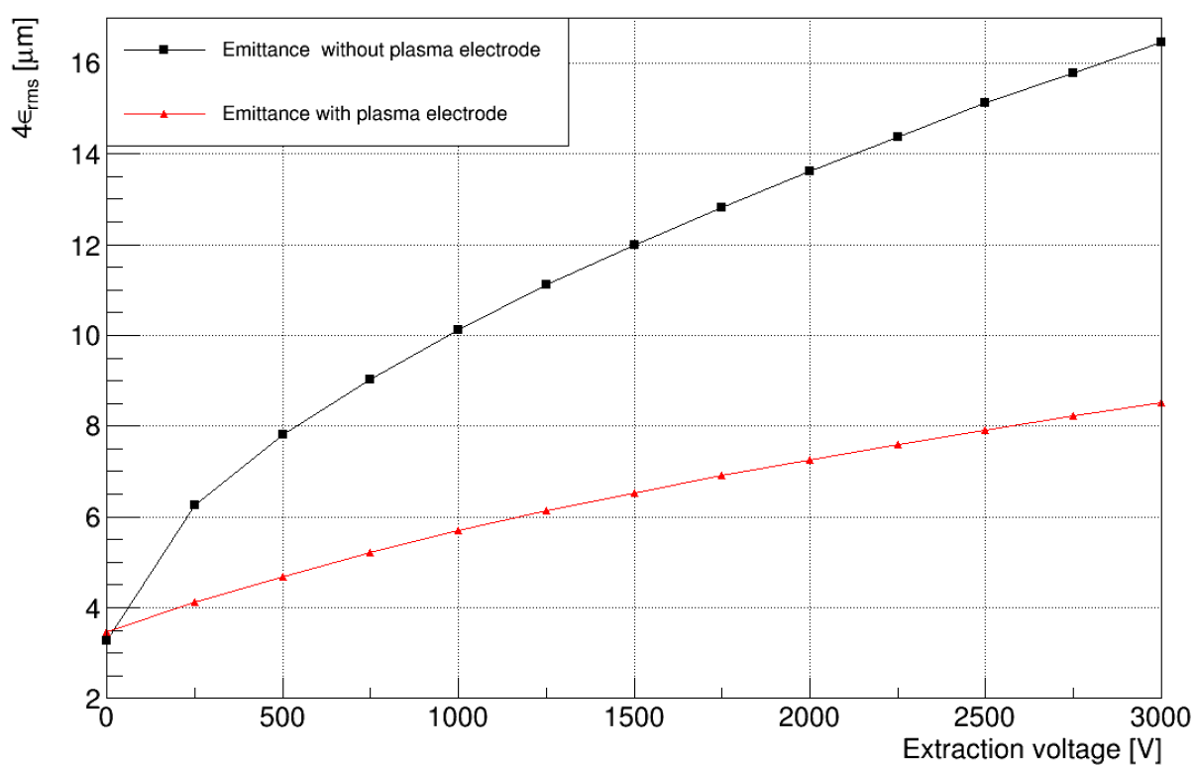
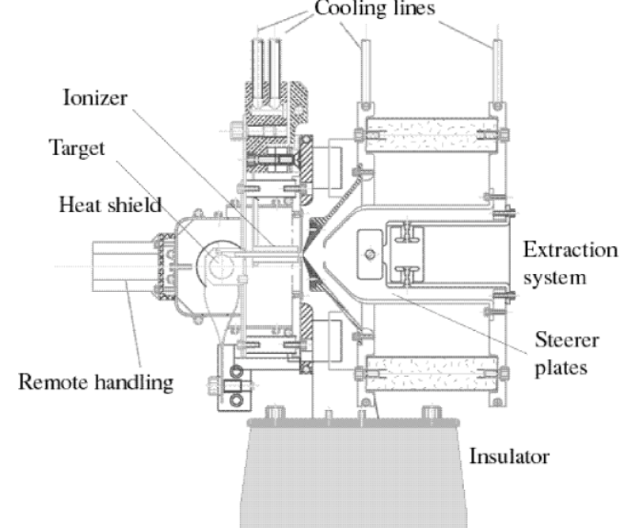
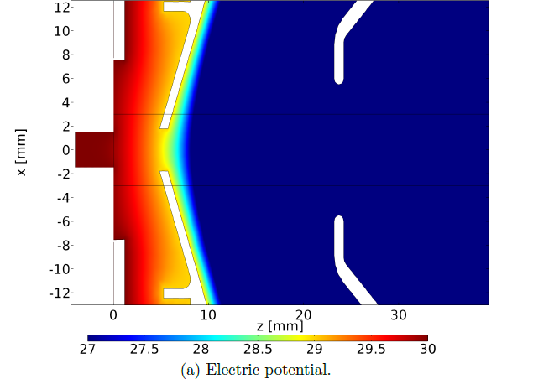
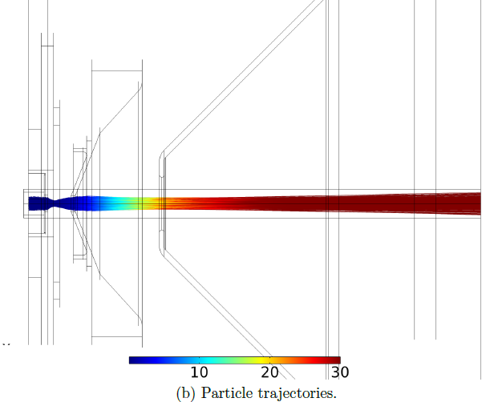
ISAC extraction
F. Maldonado (MS.c thesis at TRIUMF)
Ion source
Plasma electrode
Extraction electrode (lens)
Effect of plasma electrode

Slide 5
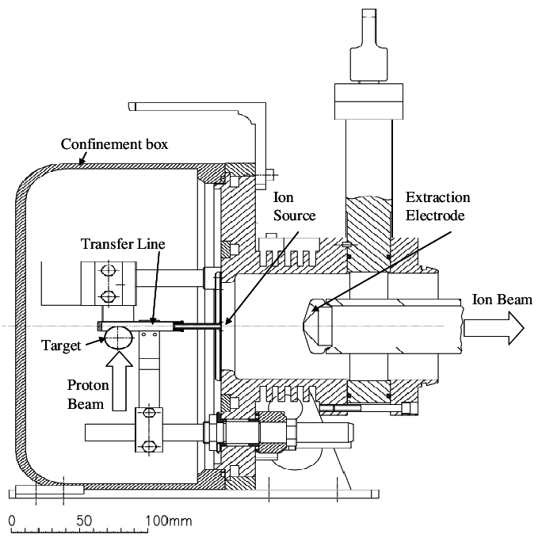
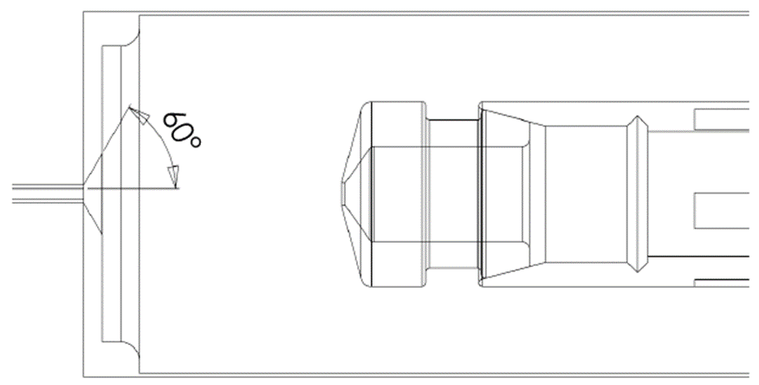
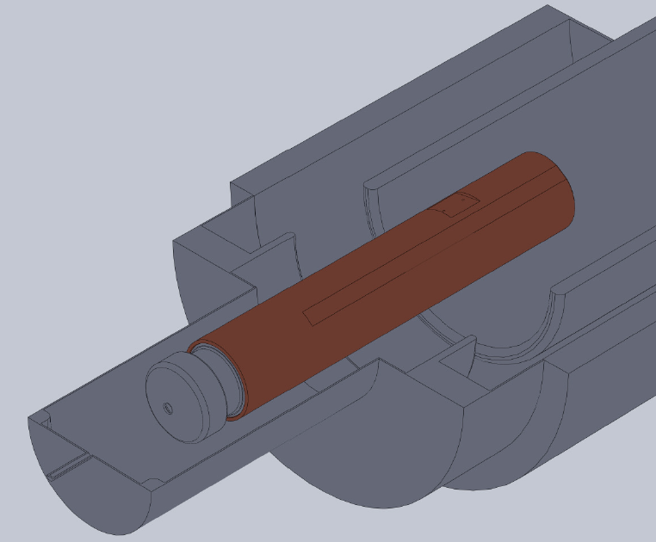
ISOLDE/ARIEL
Pic from F. Maldonado (TRIUMF)

Slide 6
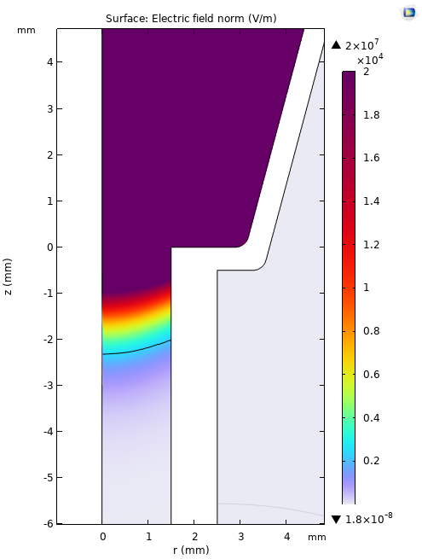
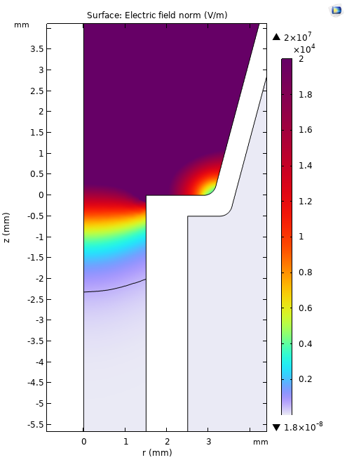
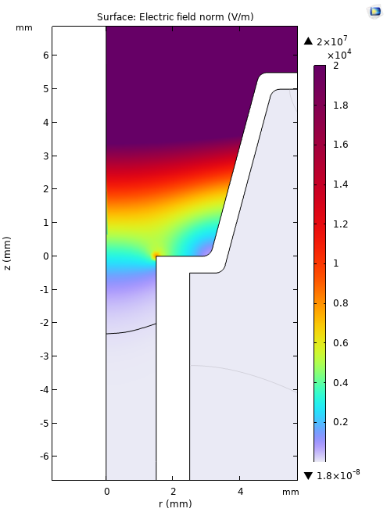
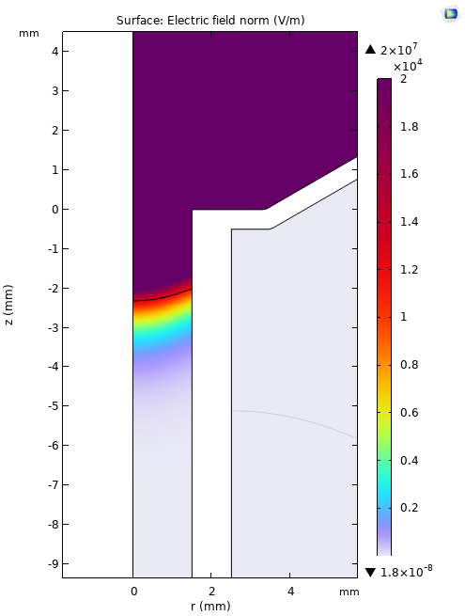
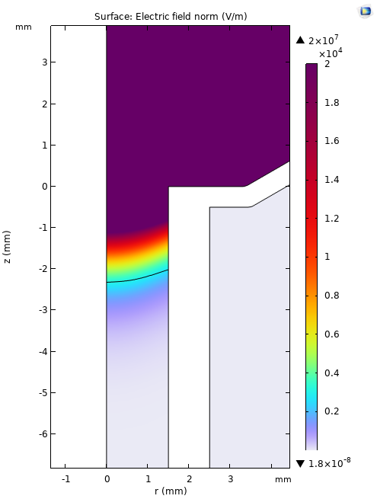
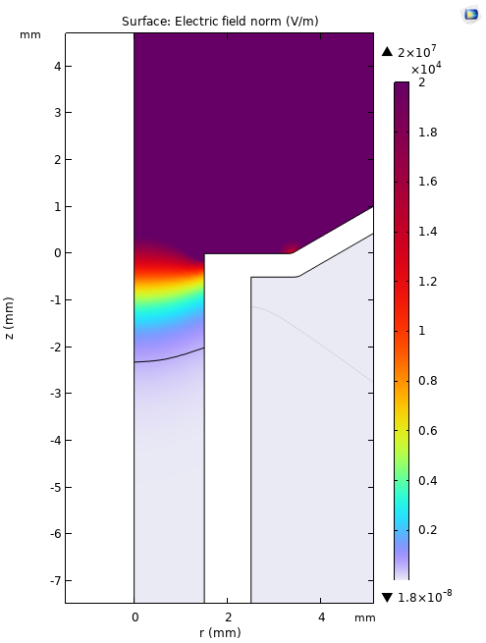
ISOLDE
1st design
Field penetration inside the ionizer tube with different outlet angle.
gap: 30 mm
gap: 60 mm
gap: 100 mm
gap: 30 mm
gap: 60 mm
gap: 100 mm
15°
^{60°}

Slide 7
Simulation assumptions (COMSOL)
Two separate particle trajectories has been calculated for laser ionization and surface ionization.
Laser ionization happens only in the ionizer volume and ions hitting the ionizer wall will disappear and are not included in the computations.
Surface ionization happen only on the surface of the ionizer wall and ions hitting on the wall, reset their energy and bounce back as thermal reemissions.
Ionization efficiency is considered 100%

Slide 8
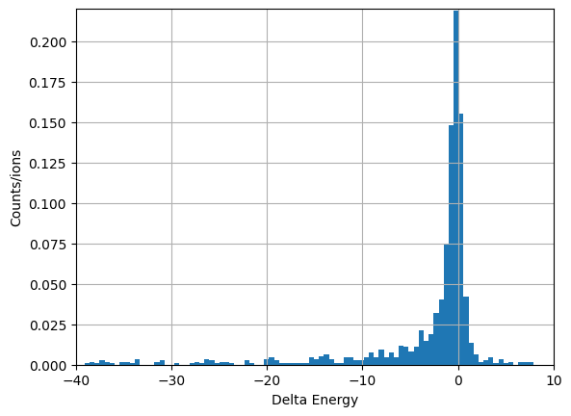
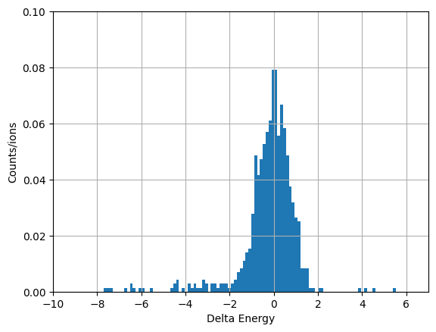
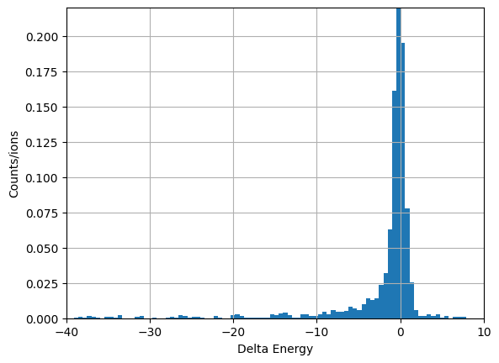
Results from 1st design
Energy spread is too large in this design
The outlet angle is important:
changes the field inside the ionizer
the angle helps with the focusing of the beam while reduces the sensitivity of ground electrode distance with respect to the ionizer
III. Emittance is large
gap: 60 mm
Emittance:
5.6 +/- 0.3 mm-mrad
Emittance:
6.5 +/- 0.5 mm-mrad
Emittance:
6.0 +/- 0.3 mm-mrad
Laser
Surface
Laser + Surface

Slide 9
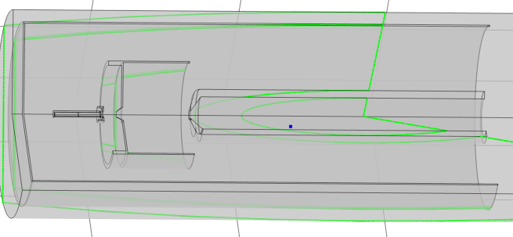
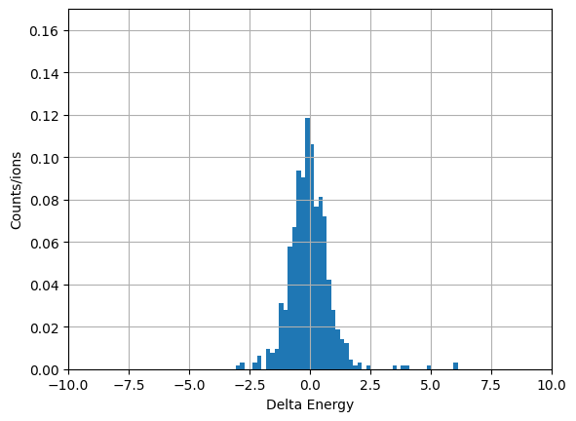
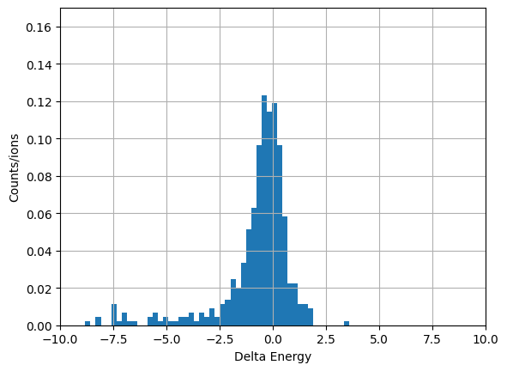
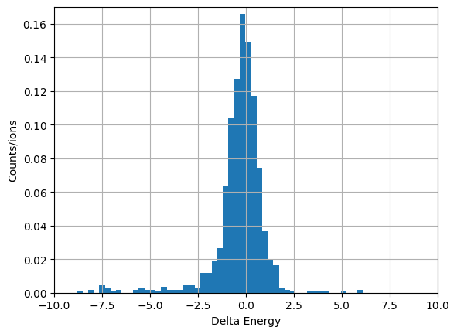
ISAC + ISOLDE
2nd design
4rms: 4 mm.mrad
Surface
Laser
Laser+surface

Slide 10
Conclusions from 2nd design
Changing G electrode distance with fixed lens voltage:
Slight change in energy spread and beam focusing, No change in emittance.
Fixed G electrode with lens voltage variation:
Higher bias voltages result in larger E_spread, Emittance; slight change in beam focusing, however beam will have tails for higher bias voltages. Optimal is between 1-2kV.
Plasma electrode angle variations:
Slight change in beam focusing, smaller angle result in larger emittance and E_spread due to larger field penetration. Optimal is around 60 – 70 degree.

Slide 11
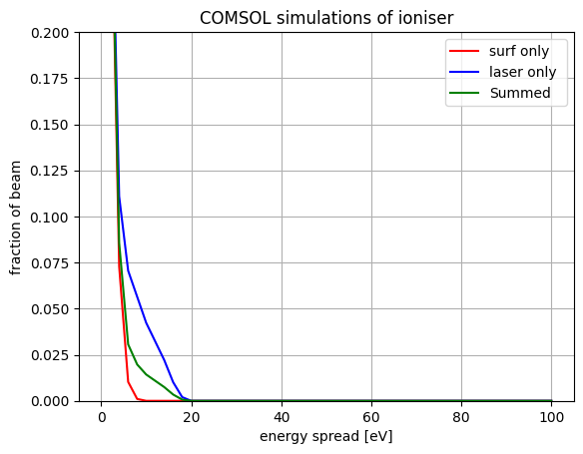
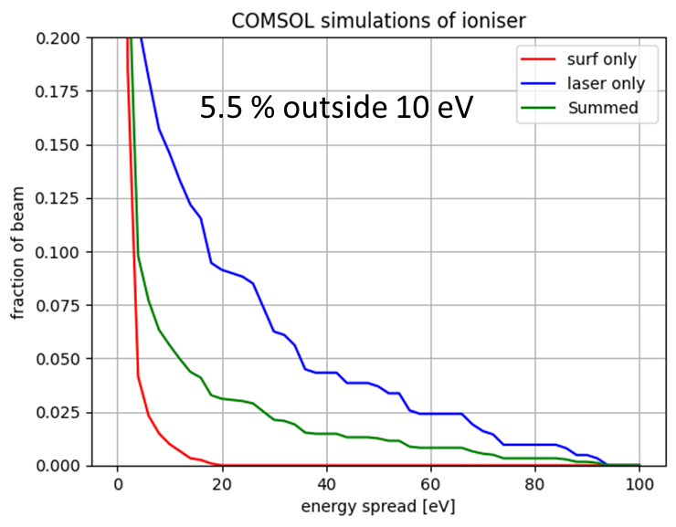
1st and 2nd design comparison
ISAC+ISOLDE
ISOLDE
~1% outside 10 eV

Slide 12
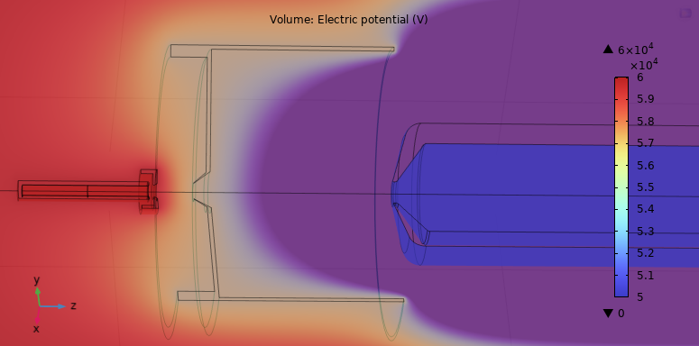
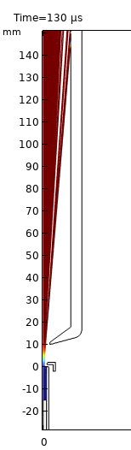
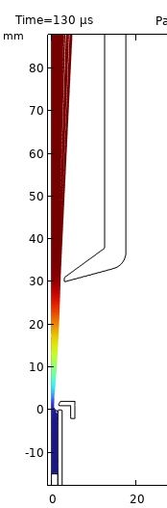
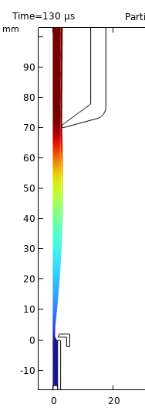
ISAC without lens
3rd design
The point here is the opening of the plasma electrode is as large as the diameter of the ionizer tube (similar to ISAC)!
By increasing distance of G electrode emittance and energy spread becomes smaller (comparable to the 2nd design), while the ion beams is well focused. Optimal is 90 mm.
Note: one must consider at larger distances the field penetration and consequently ion transmission may reduce.

Slide 13
ALL in ALL
Depending on the mechanical design challenges, compromises will be made, and the best option will be chosen for TATTOOS!
Offline tests, complement the simulation studies.

